Slide 1
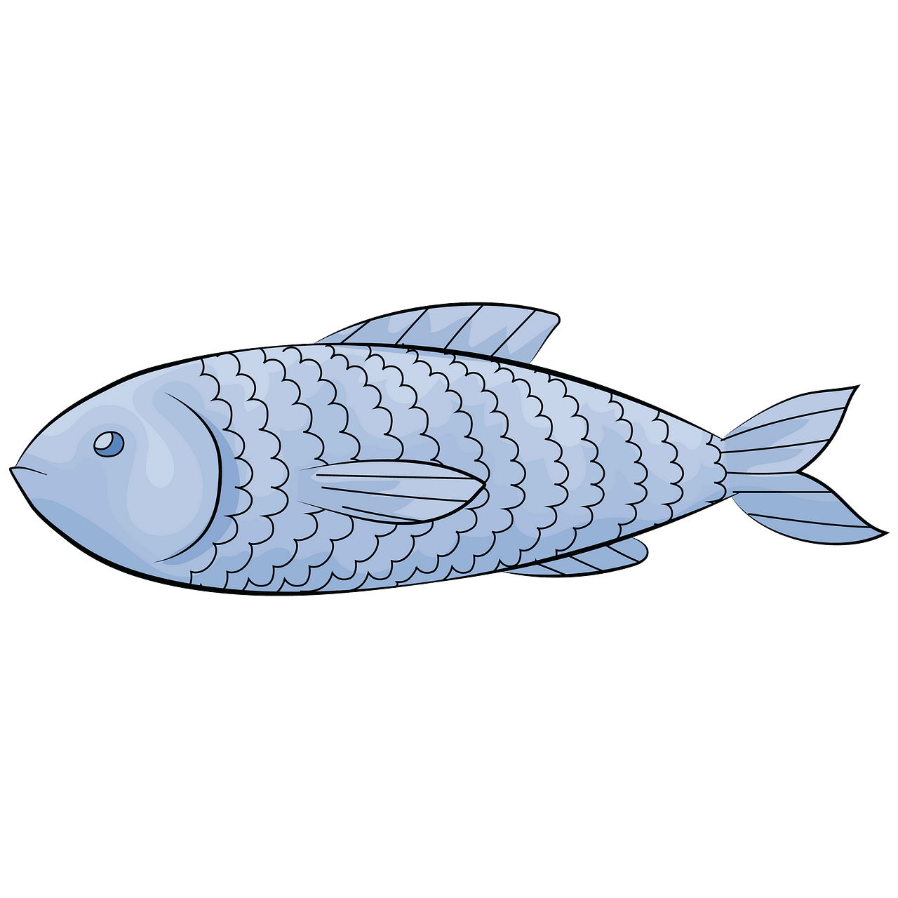
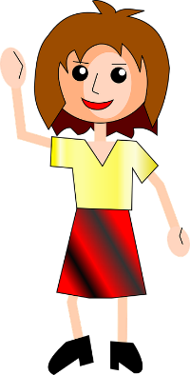
Family and friends 2 - Grade 2 Unit 7 Quiz
Answer the following questions.
1- Match the pictures with the correct words. Number one is done for you.
1-
fish
4-
bread
2-
rice
5-
yogurt
3-
carrots
6-
meat
2- Complete what’s missing. Number one is done for you.
Q1- Do you like yogurt?
A1: Yes, I do.
Q2: Do you like bread?
A2: ____________________
Q3: __________________?
A3: No, I don’t.
Q4 :__________________?
A4: _____________________.
3- Read the following paragraph and tick what Sally likes. Cross what she doesn’t like.
Hi, my name is Sally. I like rice and yogurt. I like carrots too. I don’t like bread or fish.
rice | bread | carrots | fish | yogurt
√

Slide 2
Family and friends 2 - Grade 2 Unit 7 Quiz
Answer the following questions.
1- Match the pictures with the correct words. Number one is done for you.
1-
fish
4-
bread
2-
rice
5-
yogurt
3-
carrots
6-
meat
2- Complete what’s missing. Number one is done for you.
Q1: Do you like yogurt?
A1: Yes, I do.
Q2: Do you like bread?
A2: No, I don’t
Q3: Do you like fish?
A3: No, I don’t.
Q4: Do you like rice ? A4: Yes, I do.
3- Read the following paragraph and tick what Sally likes. Cross what she doesn’t like.
Hi, my name is Sally. I like rice and yogurt. I like carrots too. I don’t like bread or fish.
rice | bread | carrots | fish | yogurt
√ | X | √ | X | √

