Slide 1
Introduction t0 physiology

Slide 2
What is physiology?
It is a branch of biology dealing with :
1-Body functions as a whole.
2- The functions of its individual organs.
3- How these functions interplay to maintain the existence and well being of the body.
N.B
Human physiology based on both animal and plant physiology.
Biology is a branch of science dealing with life and its features.( Bios=life, Logus = branch of science)

Slide 3
Organization Of The Body
-
The cell with its structures:
-represent the structural unit of living body.
-Similar cells are organized together to form :tissues.
-Tissues of complementary functions form :organs.
-Organs of complementary functions form :systems.
-The body: includes group of systems act in a coordinated and integrated manner to maintain existence and well being of individuals.
so
Cells are grouped to form tissues
Tissues are grouped to form organs
Organs acting together form systems

Slide 4
-Life:
Is the mysterious force of binding , coordination and integration of the
functions of different organs and system to maintain existence and well being of individuals.
-Death:
Is irreversible withdrawal of binding, coordination and integration of the functions of different organs and systems.

Slide 5
Under proper conditions:
Organs and systems remain living and still functioning out side the body for variable periods after individual death.
(this is the base of post mortem organ gift).

Slide 6
Properties Of Life
1-Irritability:
-Is the ability to respond to a stimulus ( any change in the environment ).
2-Conductivity:
-Is the ability of the cell to transmit an impulse from a point to another across the cell surface or to another cell.
3-Conractility:
-Is the ability of the cell to change its shape in response to a stimulus.

Slide 7
4-Absorption:
-Is The ability of the cell to transfer fluids and dissolved substances to interior of the cell across the cell membrane to be used for growth, repair and to provide heat or energy.
5-Metabolism:
-Is the ability of the cell to breakdown the absorbed materials for production of energy.
6-Secretion:
-Is the ability of the cell to release materials as hormones and enzymes to be used else where.

Slide 8
7-Excretion:
-Is the ability of the cell to get ride harmful waste products of metabolism
-Through skin →sweat =perspiration.
-Through urinary system → urine = micturition.
-Through respiratory system → co2 = expiration.
-Through digestive system → stools = defecation.
.
8-Respiration:
-is the ability of the cell to combine o2 with food substances → E+Co2+H2o.

Slide 9
9-Growth and reproduction:
- growth is via:
A-Increase the amount of protoplasm.
B-Increase the number of cells.
-Growth starts faster then decreases in adults, and there is
a maximal growth point at which growth stops completely. While reproduction maintains species via production of new individuals by sexual or asexual act.
10-Movement:
-Some cells have the ability to move.

Slide 10
Protoplasmic Constituents
Protein:
Carbohydrates:
Lipids:
Nucleic acids:
Water:
Inorganic materials:

Slide 11
Protein:
-Present either alone or combined with lipids or carbohydrates.
-All enzymes and some hormones as those of pancreas are protein in nature
Carbohydrates:
-Present in form of glucose(Is the main source of energy) and glycogen is the storage form of glucose
-There is carbohydrate protein complexes forming :
some enzymes.
Antibodies.
Intercellular sub that binds cells together.

Slide 12
Lipids:
-Which serve as:
energy source
and form a major components of the membrane system of cells
4) Inorganic materials:
-Including, calcium, potassium, sodium, magnesium, carbonate, chloride, sulfate, phosphate, trace elements( cobalt-zinc-manganese) and small quantities of iron, copper and iodine.
-They maintain the inter and extra-cellular osmotic pressure and needed for different physiological processes AS:

Slide 13
1- Nerve impulse transmission.
2- Contraction of muscles.
3- Activation of enzymes.
4- Rigidity of bones.
5- Oxygen transport.
6- Adhesiveness of cells.
Water:
-Forms about 75% of protoplasm.
-Present either In:
1-Free form: acting as solvent for various metabolic processes.
2-Bound to protein:

Slide 14
6) Nucleic acids:
- Of Which two classes are known
A- Ribonucleic acid: RNA
-Present in the nucleus and cytoplasm.
-Carries information from nucleus to cytoplasm.
-Plays an important role in protein synthesis.
B- Deoxyribonucleic acid:DNA
- Mainly in the nucleus
- Forming the genetic Material.

Slide 15
Organization Of Cells
-All cells are made of protoplasm which consists of cytoplasm and nucleus.
-In the cytoplasm, there is:
1-Living structures called cell organells.
2-Non-living structures called cell inclusions.
-The cytoplasm is surrounded by thin, elastic, semi-permeable membrane containing pores called cell membrane.
-The nucleus, is surrounded by a nuclear membrane and contains the genetic material.

Slide 16
Cytoplasmic Constituents
1- Cell Organells
-Each performs a specific function.
-Their size and concentration vary with type and activity of cells.
-They are essential to life.
-Include the following:
1-Cell membrane.
2-Endoplasmic reticulum.
3-Golgi apparatus.
4-Mitochondria.
5-Lysosomes.
6-peroxisomes
7-Centrioles.
8-Filaments.
9-Microtubules.
2- Cell Inclusions
-They are cell products or metabolites.
-Are not essential to life.
Include the following:
1-Glycogen.
2-Pigment granules.
3-Crystals.
4-Lipid Droplets.
5-Secretory granules.

Slide 17
The Cell Membrane
-Is a thin tri-laminar structure ( consisting of inner and outer dense line separated by light zone) of about 75 angestron in thickness enclosing the cell.
-Structurally,
the cell membrane is a phospho-lipid bilayer.
1-The lipid portion is hydrophobic and directed inward.
2-The phosphate portion is hydrophilic and directed outward.
-The proteins in the cell membrane either:
1-External, coated by poly saccharide matrial.
2-Interinsic, through the thickness of the membrane.

Slide 18
-As a whole it performs the following functions:
1-Protects the protoplasmic mass from any environmental hazards.
2-Contains receptors for chemical messenger which can activate or inhibits certain cellular activities.
3-The cell membrane is selectively permeable and plays an active role in bringing materials into or discharging them out the cell. So it is of importance in
- polarizing the cell membrane
- and it is a deciding factor in the exchange of materials between the protoplasm and the environment.

Slide 19
-Proteins in the cell membrane performs the following functions
1-Keep the integrity of the membrane.
2-Make passive channels for passage of ions and water.
3-Very important for active transport of ions across the membrane.
4-Acts as receptors for binding with hormones or neurotransmitters.
5-Form enzymes to catalyze certain reactions.
-Cholesterol like substances are present in the cell membrane,
Responsible for its toughness.
The solidity of the cell membrane is directly proportionate with cholesterol / phospho-lipid ratio.

Slide 20
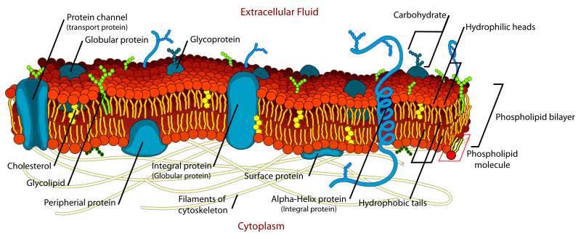
Cell membrane

Slide 21
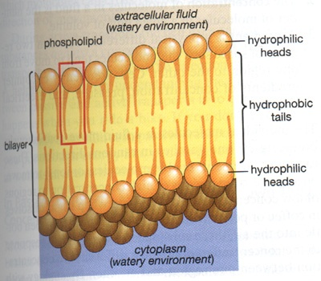
Cell membrane

Slide 22
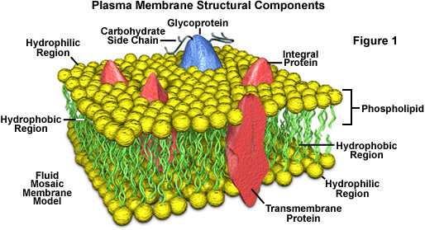

Slide 23
Transport Across The Cell Membrane
Substances pass through the cell membrane by:
1- Passive mechanism:
-Is with no energy consumption .
-Including :
diffusion,
facilitated diffusion
filtration
osmosis
Solvent drag

Slide 24
2-Active mechanism:
- with energy consumption.
3- Special forms of active transport:
-Including :
exo-cytosis
endo-cytosis. Is of two types
a- pinocytosis
b- phagocytosis

Slide 25
Protein Channels In The Cell Membrane
1- Non-gated leak channels:
- Opened all the time for continuous passage of ions.
Smaller in diameter and less in number.
2-Gated channels:
- Closed by protein gates.
- If opened by potential changes, it is voltage gated channels.
- If opened by a substance attached to channel, it is ligand gated.
-Gated channels are:
specific allowing only one type of ions to pass.

Slide 26
Diffusion Through The cell Membrane
-It is
the ability of particles to move from an area of higher concentration to an area of lower concentration till even distribution.
It occurs through
1-Lipid bilayer: 2-Protein channels:
- for small molecules and fat sol. substances. -Formed by intrinsic protein.
- Water passes very rapidly through this layer - For water and water sol.
because its molecules are small and of high substances.
Kinetic energy. - of 5 A in diameter .
- Urea can pass being of small molecules. -Is of two types:
- Na+ ,K+, and glucose cannot pass. A- leak non gated channels.
B-Gated channels.

Slide 27
N.B
*The rate of diffusion across the cell membrane is modified by several factors
some of these factors depend on properties of cell membrane
and other factors depend on the diffusing substances.
*O2, Co2 and fatty acids diffuse easy through the lipid portion of cell membrane
*water sol. Substances as electrolytes tend to diffuse through the membrane pores or carried by active transport.

Slide 28
Transport of electrolytes through the membrane pores is impeded by:
Ionization of electrolytes :
as it forms a water shell which increases their molecular size.
2) Pores may be lined by repellent factors as calcium
(producing + ve charges that repels cations) and proteins.
.

Slide 29
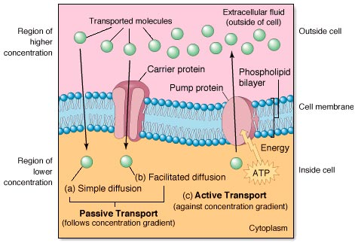

Slide 30
The Facilitated Diffusion
-It is a type of passive transport Because:
No energy is required to drive this system.
The transported substances diffuse down its own concentration gradient.
-It occurs through a carrier system.
-It is for relative impermeable substances as glucose and amino-acids.
AS regards glucose:
- its molecular size= 8.6 A i.e greater than pore diameter.
- Insol. In lipid layer of cell membrane

Slide 31
- It differs from simple diffusion In Being:
Not absolutely directly related to concentration gradient but once the carrier is saturated the maximum rate of diffusion is reached.
The carrier system is only specific to certain substance.
Show competition between substances using the same carrier.
Show inhibition of transport for other substances using the same carrier, if the substance combine strongly and irreversibly with carrier

Slide 32
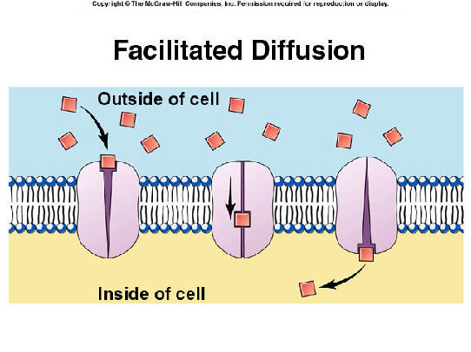

Slide 33
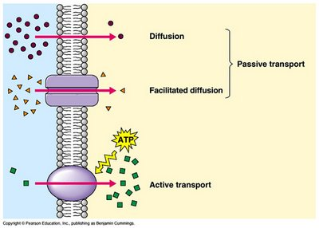

Slide 34
Osmosis
- It is the movement of water (solvent) through a semi-permeable membrane from a solution of lower concentration to a solution of higher concentration .
- During osmosis, water is attracted by osmotic pressure
It is the pressure needed to stop the movement of
solvent into the solution through a semi-permeable membrane.
The magnitude of the pressure developed by osmosis depends on the total number of non-diffusible solute particles on each side of the membrane.
The magnitude of the pressure developed by osmosis depends upon the total number of non-diffusible solute particles on each side of the membrane.

Slide 35
Osmosis :
- is one of the main forces involved in the formation of I.S.F across the capillary via O.P.
- O.P is a force measured by mm.Hg.
-To describe O.P of a solution relative to O.P of Plasma the term tonicity is used where
Iso-tonic solution: is of same o.p as plasma as 0,9 Nacl solution.
Hyper-tonic solution: Of higher o.p than plasma.
Hypo-tonic solution: Of lower o.p than plasma.

Slide 36
Solvent Drag:
-`It is a diffusion of a solute following diffusion of its solvent through the membrane,
i.e the solvent drags the solute after it.
-This mechanism is of little importance in the body.
-This type of transport is seen in:
renal tubules, where re-absorption of large amounts of water drags some urea to be reabsorbed with it.

Slide 37
Filtration
-It is the process of forcing fluid through a membrane or barrier by the hydrostatic pressure.
1-formed by pumping action of the heart.
2-one of the forces involved in the formation of I.S.F and in glomerular filtration .
N.B
-In muscular capillaries = 35 mmHg at arteriolar end and 15 mmHg at venular end.
-In glomerular capillary = 50-70 mmHg.

Slide 38
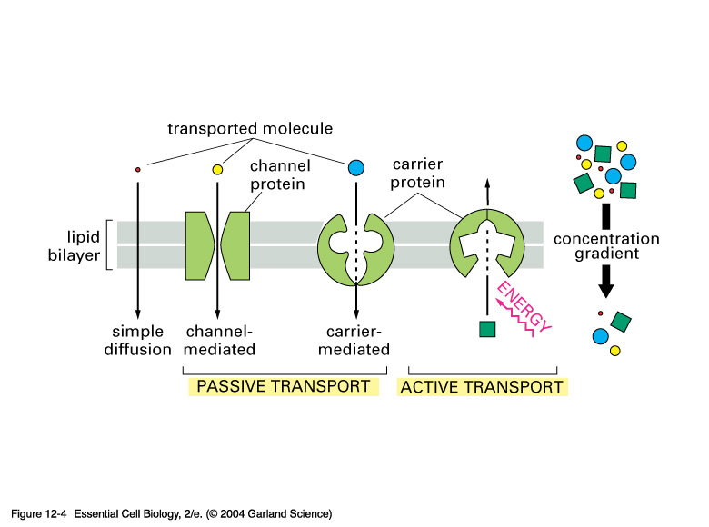

Slide 39
Osmolarity
-Is a concentration measured by osmol or m .osmol.
1 m. osmol = o.oo1 osmol. Or one osml =1000 m.osml
Or it is the concentration of osmotic active particles in a given aqueous solution.
N.B
Body fluid osmolarity =300 m. osmol = Nacl solution 0.9%.
1 Mol = gm M.W of solute. 1 m.Mol = 1/ 1000 Mol.

Slide 40
1 osmol = 1 Mol/ L. Water / No. of free particles.
Example for glucose.
M.W of glucose = 180
- 1 Mol of glucose = 180 gm glucose
1 osmol of glucose = 180 gm glucose/ L water divided by no. of free particles.
- Because glucose does not dissociate in solution
So, 180 gm glucose in 1 L. of water exert one osmol
. Example for Nacl
-M.W of Nacl = 58.5.
- 1 Mol of Na cl = 58.5 gm Na cl.
-- So one osmol of Na cl = 58.5 gm
. Na cl / L. water divided by no. of
-free particles(2) =29.75 gm Na cl /1LWater or 58.5 gm Na cl / 1 L. water
= 2 osmol.

Slide 41
Active Transport
- It is a type of carrier mediated transport occurring against gradient.
-It requires energy either from ATP hydrolysis or from direct oxidative process.
-In which:
the specific transported substance is attached to a receptor part of the carrier.
The carrier is activated to act as ATPase enzyme.

Slide 42
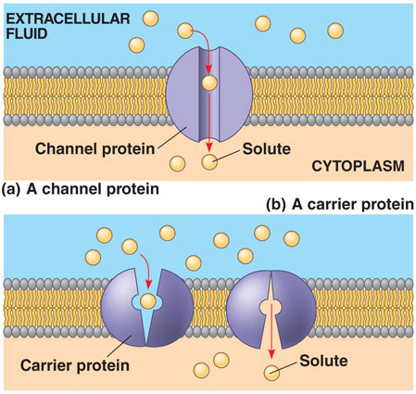

Slide 43
The most common examples of active transport are:
Na+ and K+ pump:
-Is one of the causes of RMP.
-It actively transports Na+ from inside the cell out and K+ from outside the cell in against their concentration gradient.
-Because the carrier is an ATPase activated by attachment to Na+ or K+, It is called Na+/ ATPase.
H+ / K+ pump:
-Occurs in pariatal cells of gastric mucosa.
-It is an important step in Hcl formation.
3) Ca+2 pump in cardiac and skeletal muscles:

Slide 44
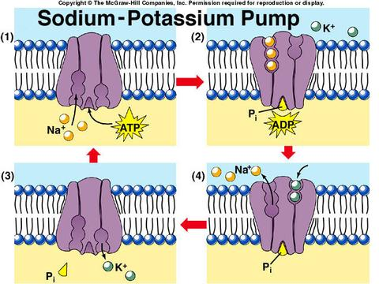

Slide 45
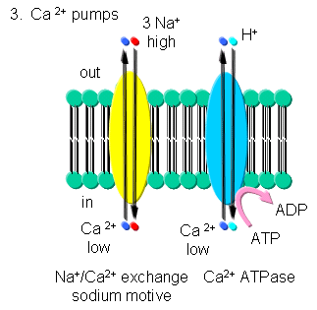

Slide 47
The carrier proteins in the cell membrane are of three types:
Uniport carrier→ in which, the carrier transports one substance in one direction as in ca+2 pump.
Antiport carrier→ in which, the carrier transports two substances in opposite direction as in Na+/K+ pump.
Symport carrier→ in which, the carrier transports two substances in the same direction simultaneously as in sodium and glucose.

Slide 48
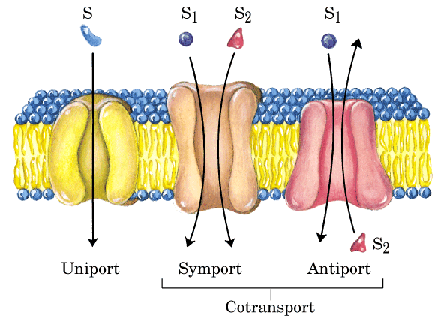
Types of carrier proteins in cell membrane

Slide 49
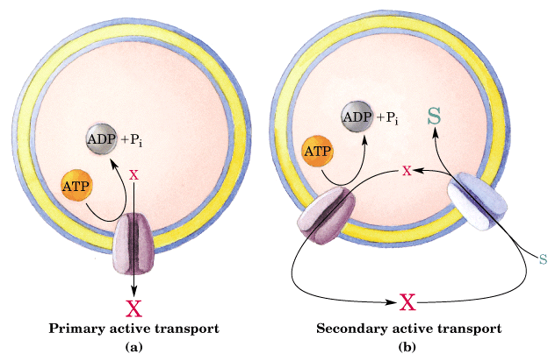

Slide 50
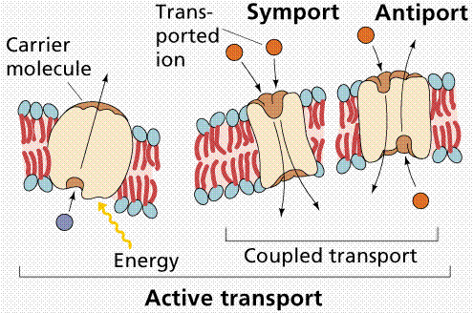

Slide 51
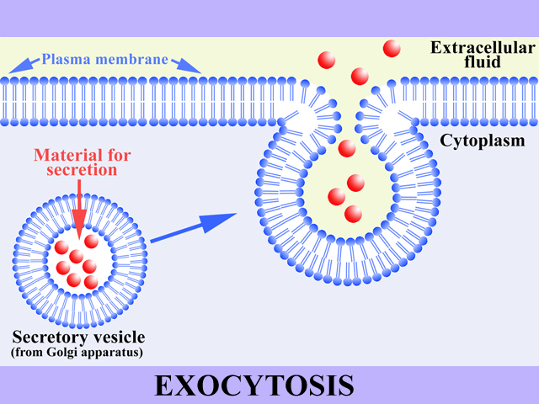

Slide 52
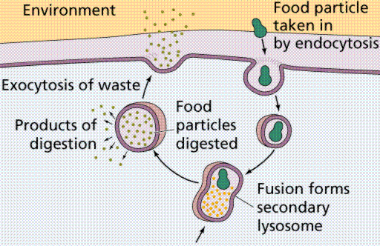
Exocytosis and endocytosis

Slide 53
Endo-cytosis and exo-cytosis
-Are specialized type of active transport which needs energy.
-In which, the carrier involved is a portion of cell membrane itself.
-Through these processes substances can be taken into the cells or expelled put.

Slide 54
In exo-cytosis
There is: expulsion of the contents of Secretory vesicles.
Where:
1- The vesicles fuse with cell membrane
2-Then , there is break-down of the fusion area
By unknown mechanism → letting the vesicle
Content out of the cells.

Slide 55
In endo-cytosis
- It is a process opposite to exo-cytosis
By which: a substance is taken into The cell.
It include two processes:
1) Pino- cytosis.
2) phagocytosis.

Slide 56
Pino-cytosis = cell drinking:
-The substance taken is, large molecule dissolved in solution and not visible
under microscope.
Phago-cytosis = cell eating:
-The material ingested by the cell is in solid form suspended in aqueous medium of extra-cellular fluid and can be seen under the microscope.
Types Of endo-cytosis
1-Constitutive endo-cytosis
Occurs spontaneously with-out any ligand triggering it
2-Receptive-mediated
- It needs a ligand to activate
. Receptors on the cell membraneto start endo-cytosis.

Slide 57
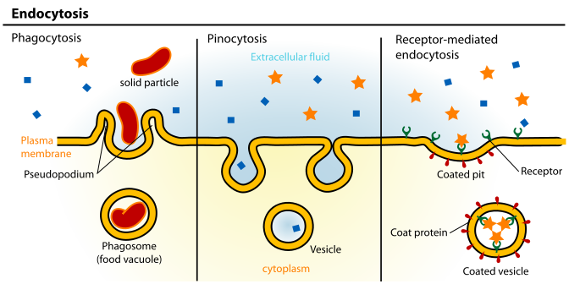

Slide 58
Mechanism of endo-cytosis
The ingested material is adsorbed on the cell surface by electrostatic bond
or chemical attraction to a specific receptors on the cell membrane.
The cell membrane invaginates to form a vacuole in which the substance
is carried into the cytoplasmic matrix.
The vacuole shrinks in size and moves away from the cell membrane which has resolved.
The contents of the vacuole are librated into the cytoplasm by disintegration of the membrane.
Alternatively during phagocytosis, the phagocytic vacuole can fuse with lysosomes to digest vacuolar contents intracellular. This is important
during body defense mechanism against infection .

Slide 59
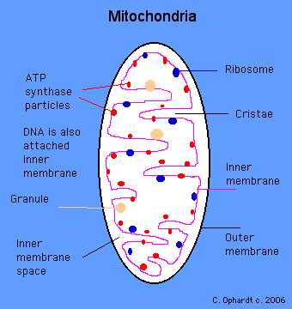
The Mitochondria
- One of cellular organelles that plays a vital role in production of energy required by cells.
-Enclosed by two membranes:
1-outer smooth.
2-Inner folded.

Slide 60
-The folds of inner membrane are called cristae that:
1-Increase the surface area of the membrane.
2-Are a site for phospho-rylated enzymes and enzymes of electron transfer system.
-The inner membrane surrounds an interstitial space in which enzymes
Of krebs cycle are present for final break down of F.A, a.a, and mono-sugars.
which are incorporated into ATP by cytochrome system
-In addition to the enzymes of krebs cycle, inside the mitochondrial matrix
There is:
Enzymes involved in lipid and protein synthesis.
Enzymes for steroid hormone synthesis.
Small particles of ribo-nucleo protein that regulate ionic environmental

Slide 61
Functions Of Mitochondria
- Generally speaking, it is the battery or energy plant of cell required for different cellular activities and storing this energy as ATP.
The last functions are achieved via:
Enzymes of Krebs cycle responsible for final break down of F.A, mono-sugars and some a.a.
Presence of phospho-rylated enzymes.
Enzymes of electron transfer = cytochrome oxidase and reductase
which are very important for cellular respirationand storage of released energy as ATP which diffuses into the cytoplasm.

Slide 62
-Proteins and lipid synthesis ( the enzymes for this process is also present in mitochondrial matrix).
-Steroid hormone synthesis ( the enzymes for this process is also present in
mitochondrial matrix).
-Regulate the ionic environment of mitochondria through the small particles of ribo-nucleo-protein.

Slide 63
Endoplasmic Reticulum E.R
It is a net- work of membranes of two types:
Granular or rough E.R
Agranular or smooth E.R
Granular or rough E.R
Contains numerous particles of ribonucleoprotein
( ribosome) for:
protein synthesis.
and some protein hormone synthesis as parathormone

Slide 64
Agranular or smooth E.R
-Without ribosomes For:
1-Steroid hormone synthesis as cortisol and progesterone in some endocrine cells.
2-Detoxification of drugs in liver cells.
3-Cholesterol and lipid metabolism.
4-In muscles, called Sarcoplasmic reticulum for release and uptake of Ca+2 during
contraction and relaxation of muscles.
N.B
Liver cells have the two types of E.R equally.
Smooth type predominates in cells secreting steroids.
Rough type predominates in protein secreting cells as pancreas.

Slide 65
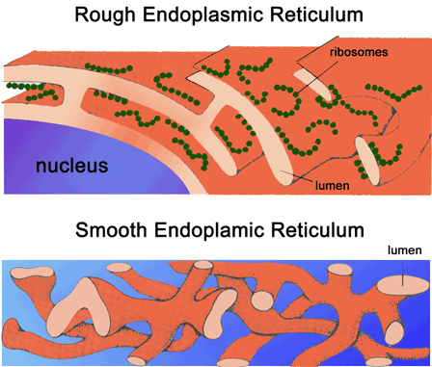

Slide 66
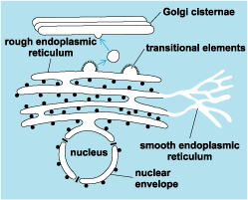

Slide 67
Ribosomes
- Are particles of ribonucleo protein.
- Either free or attached to E.R by threads of ribonucleic acid ( mRNA ) to form polyribosomes.
N.B
Proteins formed by free ribosomes are utilized by the cell itself rather than secreted.
Ribosomes must be assosiated with mRNA before they engage in protein synthesis.

Slide 68
Messenger RNA = mRNA:
-Are threads of ribonucleic acid formed in the nucleus.
-Play an important role in protein synthesis…………………How?
1-It contains coded message that specifies the sequence in which a.a are incorporated into the newly formed protein.
2-mRNA, during protein synthesis enters the cytoplasm to be attached to ribosomes translating the code to put the a.a in the needed order.
3-Finally, ribosomes detach and release the synthesized proteins on reaching the end of mRNA

Slide 69
Lysosomes
-Are a type of cell organelles containing more than 50 acid hydrolase enzymes (active only in acid pH).
-They represents the digestive system of the cell.
-The limiting membrane of the lysosome protects the remainder of the cell from the effect of contained enzymes which if released into the cytoplasm, would
digest or lyses the cell in a process called autolysis which occurs normally during regression of mammary tissues after cessation of lactation.

Slide 70
-The lysosomal activity increases during regression of some tumors.
-If one lysosomal enzyme is congenitally absent, the components which are digested by it will accumulate in the cell causing lysosomal storage disease
( of which more than 25 diseases are known according to deficient enzyme) .
In Gout,
- phagocytosis ingest uric acid crystals and release lysosomal enzymes Which destroy the intercellular structure in and around joints aggrevating its inflammation

Slide 71
Pigment Granules Inside The cells
-Are naturally occurring pigments of specific color in man cells. AS
Melanin
-Present in specific cells called melano-cytes in:
Epidermis of skin where it contributes to skin coloration.
Certain brain cells.
Pigmented epithelium of retina and iris for Vit. A storage necessary for the function of rods and cones.

Slide 72
Hemosidrin
- Golden brown pigment derived from break-down of H.B in R.B.Cs .
-Normally present in phagocytic cells of liver, spleen, and bone marrow.
-Hemosidrin accumulates in tissues when iron absorption increases causing tissues damage and the conditions is known as
hemochromocytosis
Which is characterized by:
Skin pigmentation.
Bronzen diabetes.
Liver cirrhosis and
Gonadal atrophy.
↑ incidence of hepatic cancer

Slide 73
3) Lipofusion
Light brown in color.
Found in many cells particularly In old age.
Some time called wear and tear pigment.
Represents the end products of lysosomal activity

Slide 74
Golgi Complex
- One of cellular organelles that predominates in glandular cells.
-It is located near the nucleus and performs the following functions.
1-Concetration of secretory products.
2-Packing of digestive enzymes to form lysosomes.
3-Formation of glycoproteins.
4-Replacing the lost or worn part of cell membrane.

Slide 75
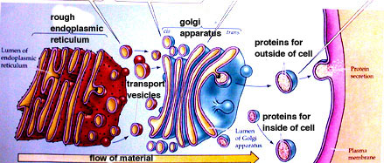

Slide 76
The centrioles
-Minute rods located near the nucleus in specialized region of the cytoplasm called centrosome.
-Two centrioles are present in non-dividing cells, and capable of duplication before cell division.
-Centrioles performs the following functions
1-Development of mitotic spindle, where after duplication of each parent centriole they migrate to the opposite pole of the cell together with daughter centriole.
2-Formation of basal bodies after migration close to the surface of the cell, from which cillium or flagellum may arise.

Slide 77
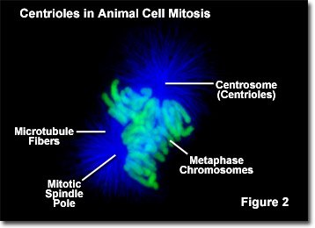

Slide 78
The Nucleus
-Is an essential organelle present in all cells except: R.B.Cs and platelets.
-Each cell has a single nucleus however:
Some liver cells, parietal cells of stomach and cardiac muscle cells
may have two nuclei.
Osteoblasts of bones and skeletal muscle cells may have several nuclei.

Slide 79
-In non-dividing cells, the nucleus is surrounded by a nuclear envelop containing many ribosomes on its outer surface which is highly permeable while its inner membrane is smooth containing pores.
-Inside the nucleus there is,chromatin materials,Nuclear matrix,1 or 2 nuclei
-The chromatin material or chromosomes are giant molecules of DNA inside which genetic information is stored.

Slide 80
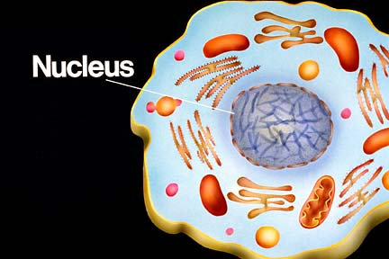

Slide 81
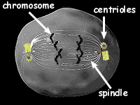
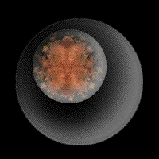

Slide 82
-Gene:
is a part of DNA molecule representing the hereditary unit that can carry and can express the heritable characters.
-The human somatic cells contains 23 pairs of chromosomes 22 of which are somatic called autosomes and 1 pair sex chromosomes.
-During cell division, Pairs of chromosomes become visible.but between cell division, only clumps of chromatin are seen.

Slide 84
The Intercellular Space, Connection And Communication
The Intercellular Space:
-Is a space between cells. Of 250 A wide and filled with interstitial fluid.
Cells are connected with each other by:
Gap junction:
Tight Junction:
Desmosome:

Slide 85
1) Gap junction:
Are channels running across the intercellular space connecting one cell with another.
Allows rapid propagations of ions and other substances between cells without entering the intercellular space.
Also allows rapid propagation of electrical activity from one cell membrane to another being of low electrical resistance .
As those seen in cardiac muscle cells allowing the heart to act as physiological synthetium.

Slide 86
2) Tight Junction:
Is a projecting ridge between the apical margins of near by cells.
Present in the epithelial cells of intestinal mucosa and renal tubules.
Is a strong junction obliterating the intercellular space at its sites.
Hinder passage of ions from one cell to another.
Desmosome:
-Is a thickening of membrane on two opposite cells.
-At it the intercellular space is 300 A.
-Seen in some epithelial cells.
N.B
Both tight junctions and desmosomes hold cells together to make a strong tissues.

Slide 87
Cell Receptors
-The first step for a messenger to act on a target cell is to bind to its specific receptor, activating it .
-The active receptors start a series of reaction to reach the desired effect on such cell.

Slide 88
The receptors are characterized by:
1-Protein or glycoprotein in nature.
2-Present in cell membrane, cytoplasm or nucleus.
3-Are specific i.e each receptor can combine with its specific ligand ( hormone,drug, chemical transmitter ).
4-The receptors may be stimulatory or inhibitory.
5-At rest , the receptors are inactive but when combine with their specific ligands → active form → which starts a series of cellular reaction to stimulate
or inhibit a certain cellular function.

Slide 89
Mal Function Of Receptors
It may result in:
Diabetes mellitus
-where antibodies are formed against insulin receptors blocking the action of insulin.
Myathenia gravis
-Where antibodies are formed against nicotinic receptors in skeletal muscles So,muscle cannot be excited by acetyl choline resulting in its weakness and easy fatigability.

Slide 90
Nephrogenic diabetes insipidus
-In which, ADH of posterior pituitary falls to increase cAMP in the cells of C.D of the kidney → ↓ water re-absorption ↑ the volume of urine.
Hyperthyroidism
-Where , antibodies are formed in the thyroid gland for TSH receptors , these antibodies aggravate not block these receptors → excessive secretion of thyroid hormone.

Slide 91
The Intercellular Communication
-Occurs via chemical messengers or mediators that reach the target cells either:
Directly: from one cell to another through the gap junctions.
Indirectly: where the chemical messenger is released first to ECF then reach the target cells to act via:
Synaptic communication
-Where the nerve impulses release the chemical messenger at the synaptic cleft to act on post synaptic cells.

Slide 92
2- Paracrine communication:
-In which, a cell in a tissue of an organ release a chemical substance called paracrine regulator as histamine, and endothelein that diffuse to ISF then to another tissue in same organ.
3- Endocrine communication:
-The messenger is the hormone released from ductless or endocrine gland →blood → Target organ.
4- Autocrine communication:
occurs when a cell secrete a chemical messenger acting on same cell.

Slide 93
Regulation Of Receptors
-The receptors are subjected for two types of regulation.
Down regulation:
-Occurs when the ligand of the receptors is present in excess,
-In which, the receptor number and its sensitivity decrease.
-As in tolerance to morphine and in insulin dependent diabetes.
Up regulation:
- Occurs when the number of receptors increase due to deficient of its ligand.
- As in denervated hyper sensitivity = ↑ the sensitivity of an organ to a chemical to a chemical transmitter after denervation of that organ.=
الممنوع مرغوب
الذى يزيد عن حده ينقلب لضده

Slide 94
Body Fluids And Electrolytes
-The existence and activity of living being are highly correlated with fluid inside.
-Water is the principle constituent of the body and loss of 1/5 of it is fatal because all biological reactions must be performed in an aqueous medium.
-The importance of body water is due to:
It forms the bulk of cellular protoplasm.
It is a transport media from and to the cells.
In which electrolytes are held in solutions and colloids are held in suspension.
It favors ionization of dissolved salts.
It regulates body temperature.
It gives blood its fluidity.

Slide 95
-Body water is about 60% of body weight, this amount is 5% less in female
due to:
Greater amounts of fats which is relatively water free .
-For the same reason and in both sexes, the amount of body water tends to decrease with age.
-In 70 K.g man about 50 liters of water are present and distributed
as follow:

Slide 96
Total body water
1-Intracellular compartment : 2-Extracellular compartment:
-Represents about 2/3 of T.B.F -It is the internal sea in which
= 35 liters. Our cells exist
- = 1/3 T.B.F =15 liters.
- It is divided into
A-Plasma B-interstitial fluid
-Is a part of E.C.F that present inside B.V
-Part of E.C.F out side the
-About 3.5 liters i.e 25% of E.C.F vascular system bathing
or 5% of body weight. the cells. i.e between cells.
-It represents 75% of E.C.F
=11.5 liters =15% of body
weight.
N.B
The cell membrane separates the intracellular from extra-cellular fluid
The capillary wall separates plasma from I.S.F

Slide 97
The Intra-cellular Mediators
-Also called 2ry messengers, produce the effects of chemical messenger on target cells.
-They includes the following:
1- ↑ mRNA
-Which ↑ intracellular protein → ↑ enzymatic activity → producing the required response.
2- ↑ Ca+2 concentration in the cytoplasm
-Released fro E.R to bind cytoplasmic protein → calcium binding protein complex= calmodulin , which carries out the required effect .

Slide 98
3- ↑ cA.M.P in the cell
-Which activates protein kinase that forms phospho-proteins which carries out the
required effect.
N.B
The action of cAMP is terminated by phosphodiestrase enzyme which converts cAMP to 5-AMP, Such enzyme is inhibited by the action of caffine and thiophylline so they prolong the action of cAMP in the cells.
4- ↑cGMP in the cell

Slide 99
Distribution Of Electrolytes In Different Body Fluids Compartments
-Electrolytes are good conductors for electricity.
-Electrolytes dissociates in solutions into their respective ions.
-Positive charged ions as Na+ and K+ move towards cathode in electric field
so called Kations.
-Negatively charged ions as cL- and HCo3- move towards anode in electric field
so called Anions .

Slide 100
-The composition of ECF and ICF differs ,where:
The chief intracellular kation is K+ balanced by proteins, posphate and sulphate and bicarbonate anions.
The chief extra-cellular kation is Na+ balanced by chloride, bicarbonate and protein (in blood) anions.
This difference is
produced Na+/ K+ pump which actively transport these ions across the cell membrane .
Of importance in maintaining cellular functions.

Slide 101
Comparison
I.C.F E.C.F
1-Cations K+ = 150 m.Eq / L. Na+ = 145 m.Eq /L
Mg+2 = 40 m.Eq / L. K+ = 4.5 m.Eq / L
Na+ = 10 m.Eq / L Ca++ = 5 m.Eq / L
2-Anions Proteins = 60 m.Eq / L CL = 110 m. Eq / L
phosphate = 100 mEq / L HCo3 = 27 m.Eq / L
Sulfate = 20 m.Eq / L
Bicarbonate = !0 m.Eq / l
3-pH 7.2 due to metabolic products. 7.4
4-Osmolarity iso-osmotic = 300 m.osm The same due to free water movement

Slide 102
In-spite of the last differences:
The sum of anions and the sum of Kations must be balanced to maintain electric neutrality.
The ionic composition of two compartments of ECF are identical except in plasma proteins = 7gm %.
It is apparent that ECF
has a higher concentration of Na+, Cl-, HCo3- and glucose
while ICF
has a higher Concentration of K+, Proteins- and phosphates.

Slide 103
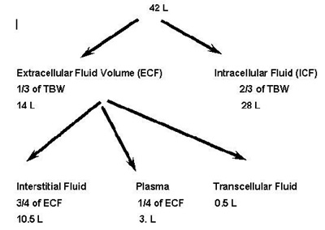
Body water compartments

Slide 104
Homeostasis
Self Control Constant
Means:
Maintaining constant the internal environment of the body.
( is the extra-cellular fluid that surrounds the living cells of body )
i.e
Any change in physical or chemical characteristic of this environment will be corrected to avoid interference with the proper function of the cells.

Slide 105
It includes the following examples:
Keep the pH of body fluid constant = 7.4 = Acid base balance.
Keep glucose concentration constant =90-100 mg % = Glucose homeostasis
Keep blood calcium constant =9-11 mg % =calcium homeostasis.
N.B
Haemo-stasis: = keeping blood volume constant by preventing its loss keeping fluid state of blood.

Slide 106
Regulation of different body functions
At cellular level = Genetic control
-The Gene (DNA) is activated forming a specific molecule of RNA called mRNA
= messenger RNA, this process is termed Transcription.
-mRNA leaves the nucleus to cytoplasm and attached to a ribosome.
-At the ribosome, mRNA with the help of another RNA called tRNA = transfer RNA assemble different a.a in a specific sequence to form the required protein molecule. This process called translation.
-The formed protein may be :
Enzyme → catalyzing certain reaction.
Structural protein → which in combination with lipids form cell membrane or regulatory proteins
Called mRNA
Called tRNA

Slide 107
2) Regulation Of Body Function As a Whole:
- Occurs by two mechanisms ( nervous and hormonal )
1- Nervous Regulation
-It is a rapid mechanism formed of:
1- central part =CNS = Brain + spinal cord
2- Peripheral part = Nerves of the body
Efferent or motor nerves Afferent or sensory nerve
-Carry nerve impulses away from c.n.s - carry nerve impulse towards
To effector organ to produce a response. Cns in a coded form.
- arise from sensory receptors
in skin or deeper structure or viscera and special sense organs.

Slide 108
N.B
-The anatomical unit of CNS is the neuron.
-The physiologic unit of CNS is the reflex arc
( receptors, afferent, center, inter-neuron, synaptic point, efferent and effectors organ ).
-The reflex may be:
1-Monosynaptic
in which the afferent synapse with efferent directly without interneuron.
2-Poly –synaptic
in which the afferent stimulates the efferent via activating
many neuron in –between.

Slide 109
2-Hormonal Regulation
-Concerned with regulation of different metabolic functions of the body via:
Controlling the rate of chemical reactions in the cells.
Controlling transport of substances through the cell membrane.
Controlling cellular metabolism as growth and secretion.
-It represents slow mechanism.
-Carried by the hormones:
- Are chemical substances released from endocrine glands or specialized cells directly into blood in minute amounts to elicit a physiologic response other cells.
- Hormones are physiologic regulator , they slow down or speed up biologic functions according to the body needs.

Slide 110
-According to their chemical nature , classified into:
1-a.a derivative: As catechol-amine and thyroxin.
2- Poly peptide: As posterior pituitary hormones.
3- protein: As pancreatic and anterior pituitary hormones.
4-Steroid hormone: Derived from cholesterol. As gonadal hormones, estrogen and progesterone.
N.B
-All enzymes are protein in nature.
-Enzymes are biologic catalysts.

Slide 111
Energy Liberation And Transfer
-All chemical reactions inside the living cells involve energy exchange.
-The chemical reactions which librates heat is said to be exothermic.
-The chemical reactions which take energy is said to be endothermic.
-Most catabolic reactions release usable energy,
complete oxidation of 180gm of glucose = 1 mol→ 686 k.cal + H2o + Co2 while the same amount of energy is needed to synthesize 180 gm of glucose.
A complex molecule has higher energy content than the simple molecule from which it is built due to release of energy from broken bonds
which may be:

Slide 112
Low energy phosphate compounds: R- ph
represents phosphate group
when released from the rest of molecule 2.3 k cl are released.
AS:
Glucose 1- ph, AMP,
Glucose 6- ph
Fructose diphosphate

Slide 113
High Energy Phosphate Compounds:
- R ph
this bond when removed from the molecule releases 10-12 kcl.
-Of high energy compounds:
ADP contains one low energy and one high energy bonds.
ATP contains one low and two high energy bonds.
Creatine phosphate contains one high energy bond.
-They are important because:
They are the sole source of energy used directly by the cells for:
chemical synthesis,
performing works ( muscular- osmotic-secretory )
and to liberate heat necessary to maintain body temperature.

Slide 114
-Re-synthesis of high energy phosphate compounds as ATP:
Is from Energy librated from break-down process of food .
these compounds are stored and the energy looked up in them to be utilized when required.
N.B
Acyl derivatives of mercaptans
can be considered to be a high energy compound, on hydrolysis gives 8-10 k cl as Acyl derivatives of co- enzyme A.

Slide 115
The Resting Membrane Potential = Trans membrane Potential
Definition:
-Is the electrical potential difference across the plasma membrane of most cells, with inside negative to outside at rest.
-In excitable cells = -70 m.v in nerve cells and -90 m.v in muscle cells.
-In non-excitable cells = -10 m.v in RBCs and -30 m.v in liver cells.
Recording:
-Done by the use of cathode ray oscilloscope when one of its electrode is introduced inside the cells and the other electrode is placed on the outer surface.

Slide 116
N.B
-If the two electrodes are placed on the outer surface of a resting membrane of a nerve or muscle
no difference in potential is recorded because all points on the outer surface are of equal potential.
-Potential difference means:
the difference in total charges of two points or places
-Only in excitable cells and during activity this resting potential shows transient Changes = action potential
is the rapid change in resting membrane potential followed by return to resting one when adequate stimulus is applied to the tissues.

Slide 117
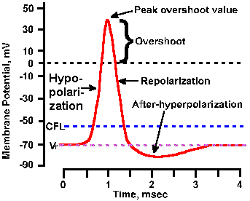

Slide 118
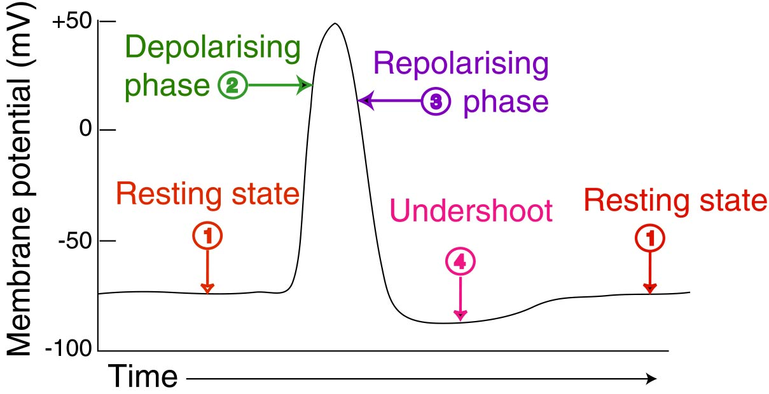

Slide 119
Causes Of R.M.P:
1-Unequal distribution of ions across the plasma membrane, together with the difference in the permeability of cell membrane to these ions. Donnans effect on ions distribution will take place and the membrane will be polarized.
2-Sodium / K pump:
It keeps excess Na+ out and excess K+ in.
Without this pump, Na+ will enter and K+ will leave the cell and the resting membrane
potential will disappear or markedly diminished.
In summary we can say that
- RMP is directly due to the diffusion of Na+ and k+ down their respective electrochemical Gradient and it is indirectly due to Na+/ K+ pump which maintains the gradients.

Slide 120
Donnan Effect:
-Stated that→ In the presence of non-diffusible ions the other diffusible ions distribute themselves on both sides of the membrane and at equilibrium their concentration products on both sides are equal.
The equilibrium Potential:
Idea: -The ions fluxes across the cell membrane ( influx or efflux) occurs along the concentration or electrical gradient.
-These ion fluxes will stop when the force of concentration gradient in one direction equals to the force of electrical gradient in the opposite direction.
-The membrane potential at this point is the equilibrium potential.

Slide 121
Blood flow
-The main function of blood is homeostasis.
-Unidirectional blood flow needs the following:
1-Pump system ( heart and contracted skeletal muscles ). → Creating pressure in arteries→ 120 mmHg in systemic circulation and 25 mmHg in pulmonary circulation.
2-Closed vascular system ( arteries-arterioles-capillaries-venules –veins ).
3-Adequate amount of blood. ( 5 liters )
4- A system for unidirectional blood flow ( valves in heart and big veins ).

Slide 122
-The considerable resistance to blood flow is present mainly in the arterioles and to less extent in capillaries.
-No resistance in large vessels.
-Blood flow (Q ) = pressure gradient pushing blood (P1- P2 ) divided by:
resistance opposing blood flow (R ).
Q = ^{P1-P2}
^{R}

Slide 123
Blood flow is of two types
1-Laminar Blood flow
-Continuous blood flow through a long smooth vessels occurs in layers, the velocity of flow is greater at the center and slowest near the vessel wall.
This is because
the next layer of molecules slips over the previous ( the third over the 2nd and fourth over the 3 rd and so on.
2-Turbulent Blood Flow:
-Blood flow is crosswise forming whorls called eddy currents similar to whirlpools seen in a rapidly flowing river at a point of obstruction.

Slide 124
-Turbulent flow occurs in the following conditions:
1-Increase rate of blood flow.
2-In vessels obstruction.
3-Sharp turn in the vessel.
4-When blood flow over a rough surface as in valvular stenosis.
Turbulent blood flow is measured by Reynold number (Re ) which is:
1-Direct proportional with velocity of blood flow (v).
2-Direct proportional with radius of blood vessel (r ).
3-Indirect proportional with blood viscosity ( n ) divided by its density ( d ).

Slide 125
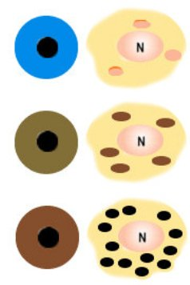
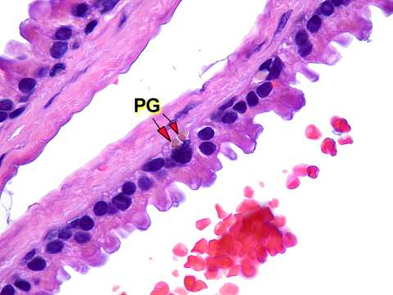
Pigment Granules

Slide 126
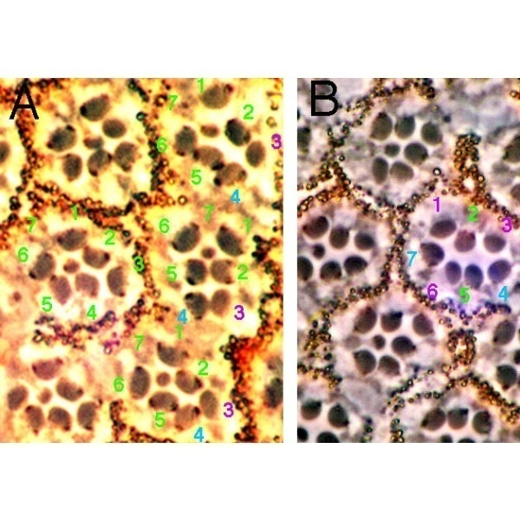
Pigment Granules

Slide 127
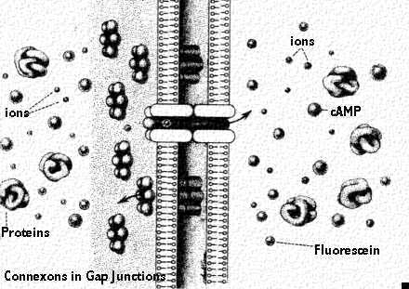
Gap junction

Slide 128
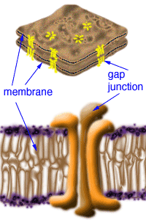
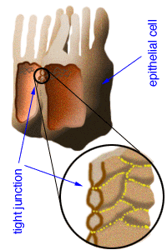

Slide 129
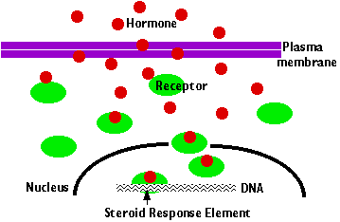

Slide 130
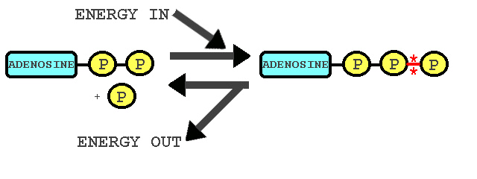

Slide 132
