Slide 1
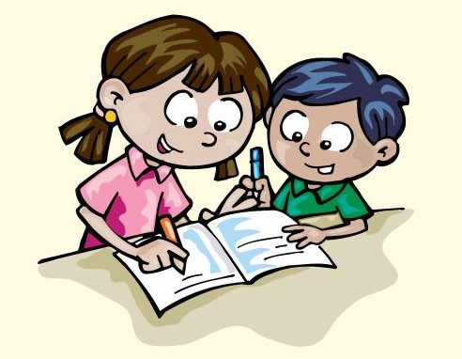
UNIT 7
It’s hot today !
Family and friends 3
Grade 3
Practice + Review

Slide 2
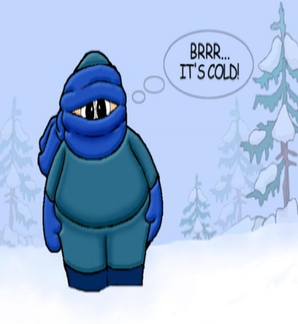
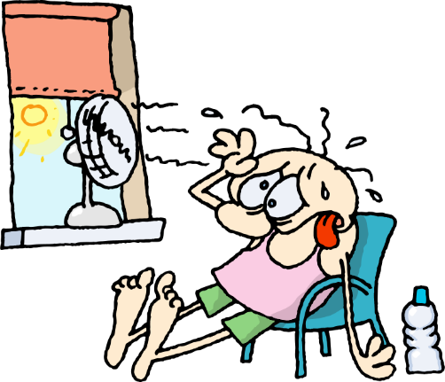
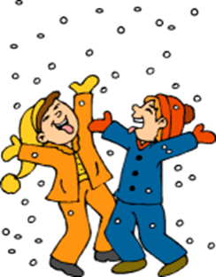
It’s hot today !
7
Lesson One Words
b
c
1 Match
1-It’s raining
2-It’s windy
3-It’s hot
4-It’s cold
5-It’s snowing
6-It’s sunny
a
e
f
d

Slide 3
It’s hot today !
7
Lesson One Words
b
c
1 Match
1-It’s raining
2-It’s windy
3-It’s hot
4-It’s cold
5-It’s snowing
6-It’s sunny
a
c
f
b
e
f
d
a
e
d

Slide 4
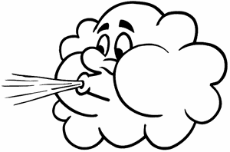
It’s hot today !
2 Now write
It’s cold
It’s

Slide 5
It’s hot today !
2 Now write
It’s cold
It’s hot
It’s snowing
It’s windy
It’s raining
It’s sunny

Slide 6
What’s the weather like?
7
Lesson Two Grammar
1 Order the words
1-
2-
3-
4-
5-
6-
Weather
the
?
what’s
like
hat
Your
on
.
sun
put
hat
Don’t
on
hat
put
your
.
Umbrellas
got
haven’t
we
.
our
door
Close
don’t
the
.
.
The
open
window

Slide 7
What’s the weather like?
7
Lesson Two Grammar
1 Order the words
1-
2-
3-
4-
5-
6-
Weather
the
?
what’s
like
What’s the weather like ?
hat
Your
on
.
sun
put
Put on your sun hat.
hat
Don’t
on
hat
put
your
.
Don’t put on your hat.
Umbrellas
got
haven’t
we
.
our
We haven’t got our umbrellas.
door
Close
don’t
the
.
Don’t close the door.
.
The
open
window
Open the window.

Slide 8
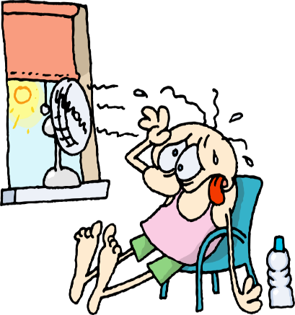
Lesson Two Grammar
7
What’s the weather like?
2 Write
Put on Don’t put on
6
1
2
4
5
3
It’s cold.
Put on your coat and hat.
It’s hot .
………….. Your coat.
It’s raining. …………… your raincoat.
It’s sunny. …………your sun cream.
It’s windy. …………….your hat.
It’s snowing. ……………….your shorts.

Slide 9
Lesson Two Grammar
7
What’s the weather like?
2 Write
Put on Don’t put on
6
1
2
4
5
3
It’s cold.
Put on your coat and hat.
It’s hot .
Don’t put on Your coat.
It’s raining. Put on your raincoat.
It’s sunny. Put on your sun cream.
It’s windy. Don’t put on your hat.
It’s snowing. Don’t put on your shorts.

Slide 10
Lesson Three Words
7
Weather activities
1- Find and cross the weather words. Then write
b | w | i | n | d | y | w | s
r | s | s | n | h | o | t | u
c | o | l | d | n | n | t | n
r | a | i | n | i | n | g | n
s | n | o | w | i | n | g | y
Windy

Slide 11
Lesson Three Words
7
Weather activities
1- Find and cross the weather words. Then write
b | w | i | n | d | y | w | s
r | s | s | n | h | o | t | u
c | o | l | d | n | n | t | n
r | a | i | n | i | n | g | n
s | n | o | w | i | n | g | y
Sunny
Windy
Cold
raining
hot
Snowing

Slide 12
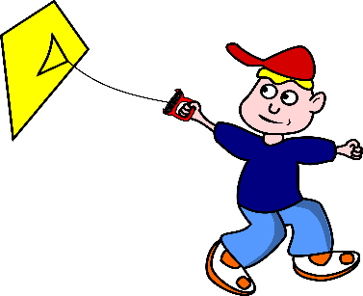
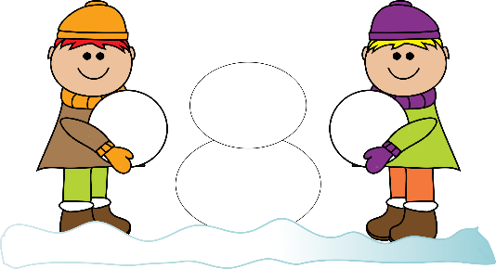
Weather activities
7
Lesson Three Words
2 Look and write.
go outside windy snowing go ice skating sunny fly a kite make a snowman
1-When it’s windy , We ……………………………………………………………..
2-When it’s …………….., we ……………………………….and we …..……………………
3-When it’s ……………, we …………………………………………………………..

Slide 13
Weather activities
7
Lesson Three Words
2 Look and write.
go outside windy snowing go ice skating sunny fly a kite make a snowman
1-When it’s windy, We fly a kite.
2-When it’s snowing, we make a snowman and we go ice skating.
3-When it’s sunny, we go outside.

Slide 14
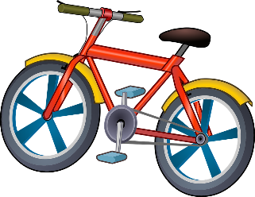
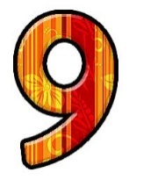
long vowel i +magic e
7
Lesson Four Phonics
1-Order the letters
2-write
Ride your (1)…bike….. .Fly your (2)……..…….
The bike is yellow. The kite is (3)…………………..
White kite, white kite.
Count the children in the (4)……………..…..
Altogether there are (5) ……………………....
Nine in the line. Nine in the line
1-Enil 2-nnei 3-kbie 4-eikt 5-itewh
Line nine bike kite white

Slide 15
long vowel i +magic e
7
Lesson Four Phonics
1-Order the letters
2-write
Ride your (1)…bike….. .Fly your (2)……kite ..…….
The bike is yellow. The kite is (3)……white……………..
White kite, white kite.
Count the children in the (4)……line ………..…..
Altogether there are (5) …nine…………………....
Nine in the line. Nine in the line
1-Enil 2-nnei 3-kbie 4-eikt 5-itewh
Line nine bike kite white
Line nine bike kite white

Slide 16
Skills Time
7
Lesson Five
Reading
1- Read and tick ( √)
 | Sunny | Cold | Raining
1- Put on your coat |  | √
2-Wear your hat
3-Put on your sun cream
4- Put on your raincoat
5-Take your umbrella
6-Wear your sun hat

Slide 17
Skills Time
7
Lesson Five
Reading
1- Read and tick ( √)
 | Sunny | Cold | Raining
1- Put on your coat |  | √
2-Wear your hat |  | √
3-Put on your sun cream | √
4- Put on your raincoat |  |  | √
5-Take your umbrella |  |  | √
6-Wear your sun hat | √

Slide 18
Skills Time
7
Lesson six
Writing
1- Write the words in the correct boxes
verbs
adjectives
wear cold go
ride hungry thirsty
eat sunny drink
wear

Slide 19
Skills Time
7
Lesson six
Writing
1- Write the words in the correct boxes
verbs
adjectives
wear cold go
ride hungry thirsty
eat sunny drink
wear
cold
go
hungry
ride
thirsty
drink
sunny
eat

Slide 20
Skills Time
7
Lesson six
Writing
2- Circle today’s weather .what can you do ? Tick (√ ) or cross (×)
raining windy hot cold snowing sunny
go outside
go outside
Fly a kite
Make a snowman
go ice skating
Wear a coat
Wear a sun hat
take an umbrella
Now write the weather and what can you do in it
Today it’s sunny .I can go outside.
Today it’s ……………… .I can ………………….
Today it’s ……………… .I can ………………….
Today it’s ……………… .I can’t ………………….

Slide 21
Skills Time
7
Lesson six
Writing
2- Circle today’s weather .what can you do ? Tick (√ ) or cross (×)
raining windy hot cold snowing sunny
go outside
Fly a kite
Make a snowman
go ice skating
Wear a coat
Wear a sun hat
take an umbrella
√
- Now write the weather and what can you do in them
Today it’s sunny. I can go outside.
Today it’s raining. I can take an umbrella.
Today it’s windy. I can’t wear a sun hat. I can fly a kit.
Today it’s hot. I can’t go ice skating. I can wear sun hat.
Today it’s cold. I can wear a coat.
Today it’s snowing. I can make a snowman.

Slide 22
7
Review
1 Write

Slide 23
7
Review
1 Write
White
bike
Kite
Line

Slide 24
7
Review
2 What’s the weather like ? Write
Sunday
Monday
Tuesday
On Sunday, it’s ……….. Don’t ……………..your hat.
On Monday, it’s ……….. . Put …… your sun cream.
On Tuesday, it’s ………... Take your …………………...
Wednesday
Thursday
On Wednesday, it’s ………….Stay inside.
On Thursday, it’s ……….. . Put on your …………

Slide 25
7
Review
2 What the weather like ? Write
sunny snowing cold windy raining
Sunday
Monday
Tuesday
On Sunday ,it’s windy. Don’t put on your hat.
On Tuesday, it’s raining . Take your umbrella.
On Monday, it’s sunny. Put on your sun cream.
Wednesday
Thursday
On Thursday, it’s cold. Put on your coat.
On Wednesday, it’s snowing. Stay inside.

