Slide 2
Warm up
What changes will have been made in Saudi Arabia by 2030?
Make Predictions
One-minute paper

Slide 3
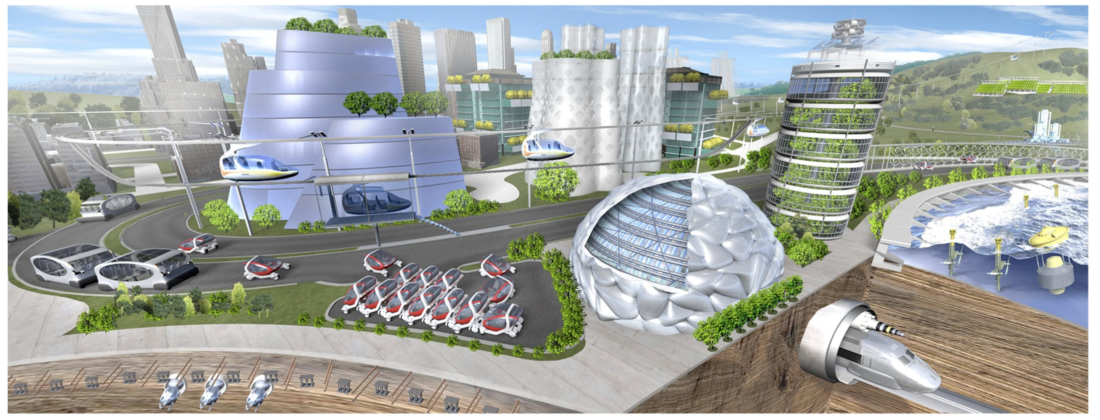
Listen & discuss
Unit 3
What will they think of next ?

Slide 4
Be careful
These are just predictions
because no one knows about future except Allah
قال الله تعالى : ( وعنده مفاتح الغيب لا يعلمها إلا هو ويعلم ما في البر والبحر وما تسقط من ورقة إلا يعلمها ولا حبة في ظلمات الأرض ولا رطب ولا يابس إلا في كتاب مبين ) .

Slide 5
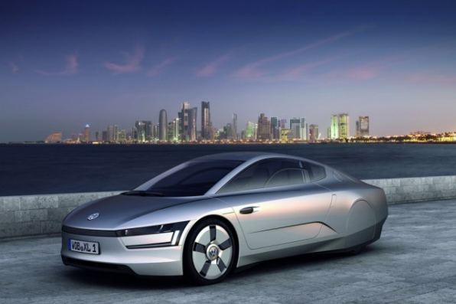
Listen and discuss
Name a discovery or invention that you think people will have 100 years from now.
What do you think the shape of car will be after 100 years?

Slide 6
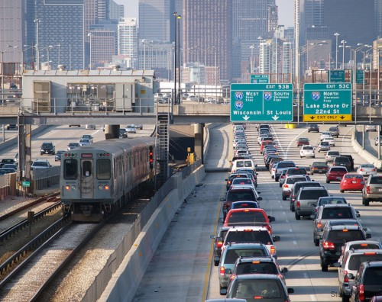
Transportation
Future | Present | Past
Brain storming

Slide 7
School
Future | Present | Past
Brain storming

Slide 8
؟What topics were discussed
Open your book at page: 34 & 35

Slide 9
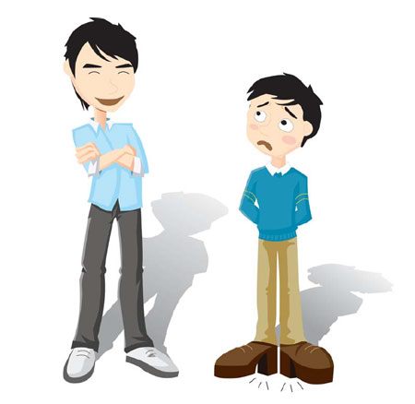
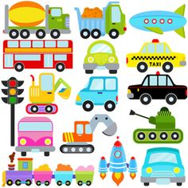
؟What topics were discussed
Scanning
People ?
Language
Transportation

Slide 10
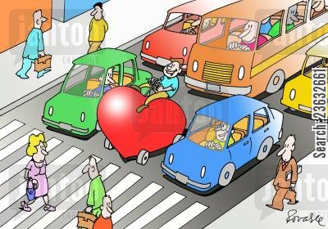
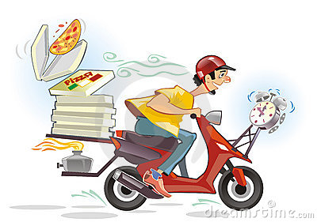
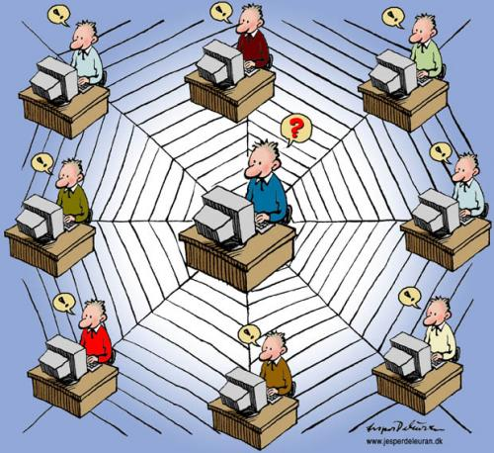
Scanning
traffic
media
Deliveries
Communication

Slide 11
Find your way :
Play a Game
Work sheet

Slide 12
TRUE / NOT TRUE
SQ3RS strategy
What predictions were made about…?
People ?
English Language
Deliveries?
communication?
Transportation& traffic?

Slide 13
Vocabulary

Slide 14
Match the words by using your dictionaries :
Circuits ( ) a- extend a cross
Condensed ( ) b- Shortened
Determined ( ) c- Covering a wide rang or area
Extensive ( ) d-position in an ordered group
Rank( ) e- Path for electrical currents
span ( ) f- Shortened

Slide 15
Write as many prediction about future as you can
Write at least 5 sentences
Hands down strategy

Slide 16
Home Work
Work book
Page 21

