Slide 1
Chapter 7
Kinetic Energy and Work
Notes:
1

Slide 2
7-1 Kinetic Energy
Energy: “Energy is the ability to do work.”
it is required for any sort of motion
Is a scalar quantity assigned to an object or a system of objects
Can be changed from one form to another
Is conserved in a closed system, that is the total amount of energy of all types is always the same
Energy is expressed in JOULES (J)
4.19 J = 1 calorie
Notes:
2

Slide 3
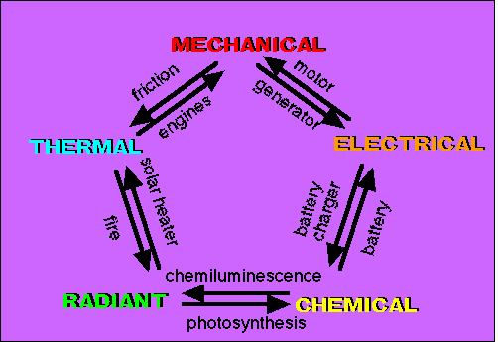
Energy
Energy: “Energy is the ability to do work.”
it is required for any sort of motion
Is a scalar quantity
Can be changed from one form to another
Energy is expressed in JOULES (J)
4.19 J = 1 calorie
Energy is NEVER created or destroyed! can only be STORED or TRANFERRED.
In this chapter we discuss kinetic energy, potential energy, total mechanical energy and work

Slide 4
7-1 Kinetic Energy
Kinetic energy:
“The Kinetic energy of an object is the energy which it possesses due to its motion.”
For an object with v well below the speed of light:
Eq. (7-1)
The unit of kinetic energy is a joule (J)
The faster an object moves, the greater its kinetic energy
Kinetic energy is zero for a stationary object
The kinetic energy of an object is raised four times when its speed raises twice.
Eq. (7-2)
Notes:
4

Slide 5
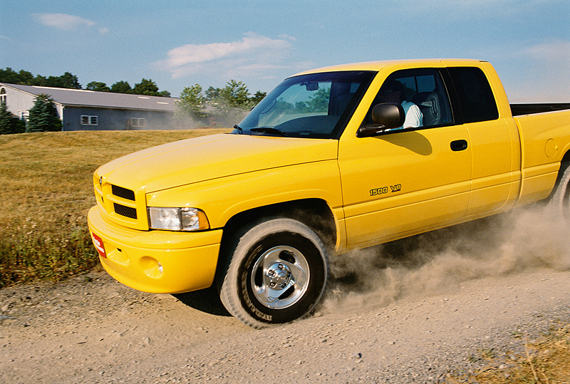
Examples
1- A truck with a mass of 1,500 kg travels at a velocity of 20 m/s.
What is the kinetic energy of the truck?
= ½ x 1,500 x 20²
= 300,000 J = 300 kJ
2- A truck has a mass of 20,000 kg. If its kinetic energy is 2.25 MJ, at what velocity is it traveling?
√
2KE
mass
velocity =
√
2 x 2,250,000
20,000
=
= 15 m/s

Slide 6
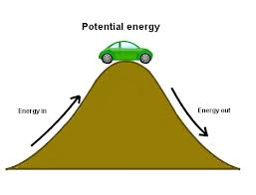
Potential energy
Potential energy : is” the stored energy of position possessed by an object.”
P.E. = mgh
where m is the mass in kilograms, g is the acceleration due to gravity (9.8 m / s² at the surface of the earth) and h is the height in meters. Notice that gravitational potential energy has the same units as kinetic energy, kg m² / s². In fact, all energy has the same units, kg m² / s², and is measured using the unit Joule (J).
Potential Energy is stored energy.
Potential Energy is greater if the position of an object is higher.
Potential energy increases as the mass of an object increases

Slide 7
Example:
1. A cart is loaded with a brick and pulled at constant speed along an inclined plane to the height of a seat-top. If the mass of the loaded cart is 3.0 kg and the height of the seat top is 0.45 meters, then what is the potential energy of the loaded cart at the height of the seat-top?
PE = m*g*h
PE = (3 kg ) * (9.8 m/s/s) * (0.45 m)
PE = 13.2 J

Slide 8
Example

Slide 9
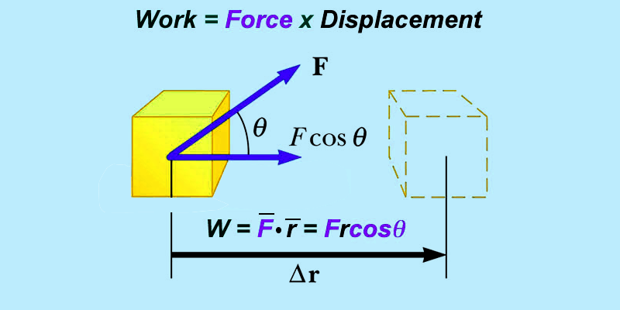
WORK
Work = The Scalar Dot Product between Force and Displacement.
So that means if you apply a force on an object and it covers a displacement you have supplied ENERGY or done WORK on that object.
Who has done the most work?

Slide 10
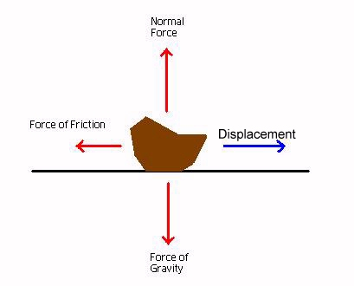
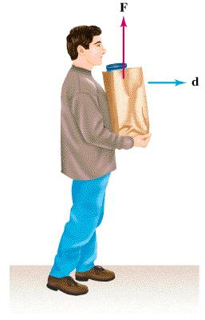
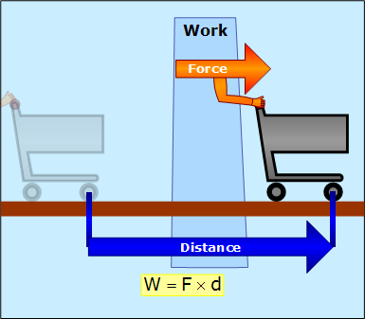
W= Fd cos ɵ
ɵ = 0 , cos 0 = 1
W= Fd POSITIVE
W=Fd cos ɵ
ɵ = 180 , cos 180 = -1
ɵ = 90, cos 90 = 0
W= 0 j
W = - Fd Negative

Slide 11
7-2 Work and Kinetic Energy
Start from force equation and 1-dimensional velocity:
$$W=m{ a}_{x }d$$
Eq. (7-3)
Eq. (7-4)
$$\frac{v^{2}−{vo}^{2} }{2}=a_{x}d$$
Eq. (7-5)
$W=m$( $\frac{v^{2}−{vo}^{2} }{2})$
Rearrange into kinetic energies:
Eq. (7-6)
$$W=∆k$$
Notes:
11

Slide 12
7-2 Work and Kinetic Energy
For two or more forces, the net work is the sum of the works done by all the individual forces
Two methods to calculate net work:
We can find all the works and sum the individual work terms.
We can take the vector sum of forces (F_{net}) and calculate the net work once
Notes:
12

Slide 13
work-kinetic energy theorem
The work-kinetic energy theorem states:
(change in kinetic energy) = (the net work done)
Or we can write it as:
(final KE) = (initial KE) + (net work)
Eq. (7-10)
Eq. (7-11)
Notes:
13

Slide 14
7-2 Work and Kinetic Energy
The work-kinetic energy theorem holds for positive and negative work
Example If the kinetic energy of a particle is initially 5 J:
A net transfer of 2 J to the particle (positive work)
Final KE = 7 J
A net transfer of 2 J from the particle (negative work)
Final KE = 3 J
Notes:
14

Slide 15
7-2 Work and Kinetic Energy
Answer: (a) energy decreases (b) energy remains the same
(c) work is negative for (a), and work is zero for (b)
Notes:
15

Slide 16
work done by the gravitational force
Suppose you lift a mass upward at a constant speed, Δv = 0 & ΔK=0. What does the work equal now?
your APPLIED FORCE equals the WEIGHT of the object you are lifting.
Since you are lifting you are raising the object a certain “y” displacement or height above the ground.
$${\begin{aligned}w=Fh , F=mg \\ W=mgh=P_{E} (Potential Energy) \\ W=mgh−mgh_{0}=∆P_{E}\end{aligned}}^{}$$

Slide 17
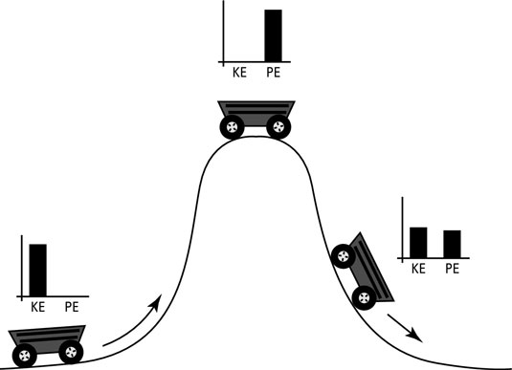
Mechanical energy
mechanical energy is the sum of potential energy and kinetic energy
ME= KE + PE
ME= $\frac{1}{2}mv^{2}$+ mgh
When potential energy increase the kinetic energy will decrease

Slide 18
ENERGY IS CONSERVED
The law of conservation of mechanical energy states: Energy cannot be created or destroyed, only transformed!

Slide 19
A
In Figure A, a pendulum is released from rest at some height above the ground position.
It has only potential energy.
B
In Figure B, a pendulum is still above the ground position, yet it is also moving.
It has BOTH potential energy and kinetic energy.
C
In Figure C, a pendulum is at the ground position and moving with a maximum velocity.
It has only kinetic energy.
D
In Figure D, the pendulum has reached the same height above the ground position as A.
It has only potential energy.

Slide 20
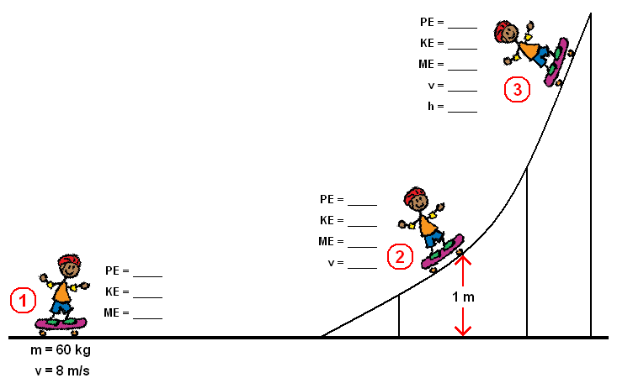
Example
ME=mgh+$\frac{1 }{2}$m$v^{2}$
ME= mgh
=(60)(9.8)h
h = 3.26 m
= (60)(9.8)(1) + (.5)(60)v²
1920= 588 + 30v²
PE= 0
KE=0
= 30v²
44.4 = v²
v = 6.66 m/s
v= 0
ME= 1920J

Slide 21
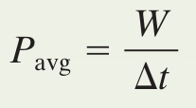
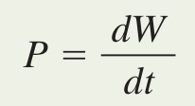
7-6 Power
Power is the time rate at which a force does work
A force does W work in a time Δt; the average power due to the force is:
The instantaneous power at a particular time is:
The SI unit for power is the watt (W): 1 W = 1 J/s
Therefore work-energy can be written as (power) x (time)
Eq. (7-42)
Eq. (7-43)
Notes:
21

Slide 22
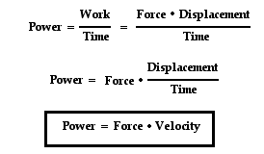
7-6 Power
Example:
Find the power of the man who pushes the box 8m with a force of 15N in a 6seconds.
Solution :
Notes:
22

Slide 23
7 Summary
Kinetic Energy
The energy associated with motion
Work
Energy transferred to or from an object via a force
Can be positive or negative
Eq. (7-1)
Work Done by a Constant Force
The net work is the sum of individual works
Work and Kinetic Energy
Eq. (7-7)
Eq. (7-10)
Eq. (7-8)
Eq. (7-11)
Notes:
23

Slide 24
7 Summary
Power
The rate at which a force does work on an object
Average power:
Instantaneous power:
For a force acting on a moving object:
Eq. (7-42)
Eq. (7-43)
Eq. (7-47)
Eq. (7-48)
Notes:
24

