Slide 1
Copyright © 2012 Pearson Prentice Hall. All rights reserved.

Slide 3
A P P L Y I N G T H E C O N C E P T S
1
What are the cost components for electronic products?
The Production Cost of Mobile Phones
How do indivisible inputs affect production costs?
Indivisible Inputs and the Cost of Fake Killer Whales
What are the sources of scale economies in production?
Scale Economies in Wind Power
What is the cost structure for information goods?
The Average Cost of a Music Video
How does technological innovation affect production cost?
The Falling Cost of Solar Power
2
3
4
5

Slide 4
ECONOMIC COST AND ECONOMIC PROFIT
5.1
● economic profit Total revenue minus economic cost.
economic profit = total revenue – economic cost
● economic cost The opportunity cost of the inputs used in the production process; equal to explicit cost plus implicit cost.
P R I N C I P L E O F O P P O R T U N I T Y C O S T
The opportunity cost of something is what you sacrifice to get it.

Slide 5
ECONOMIC COST AND ECONOMIC PROFIT (cont’d)
5.1
● explicit cost A monetary payment.
● implicit cost An opportunity cost that does not involve a monetary payment.

Slide 6
ECONOMIC COST AND ECONOMIC PROFIT
5.1
economic cost = explicit cost + implicit cost
accounting cost = explicit cost
● accounting cost The explicit costs of production.
● accounting profit Total revenue minus accounting cost.
accounting profit = total revenue − accounting cost

Slide 7
A FIRM WITH A FIXED PRODUCTION FACILITY: SHORT-RUN COSTS
5.2
Production and Marginal Product
● marginal product of labor The change in output from one additional unit of labor.
● diminishing returns As one input increases while the other inputs are held fixed, output increases at a decreasing rate.
P R I N C I P L E O F D I M I N I S H I N G R E T U R N S
Suppose output is produced with two or more inputs, and we increase one input while holding the other input or inputs fixed. Beyond some point—called the point of diminishing returns—output will increase at a decreasing rate.

Slide 8
A FIRM WITH A FIXED PRODUCTION FACILITY: SHORT-RUN COSTS (cont’d)
5.2
Production and Marginal Product
● total-product curve A curve showing the relationship between the quantity of labor and the quantity of output produced, ceteris paribus.

Slide 9
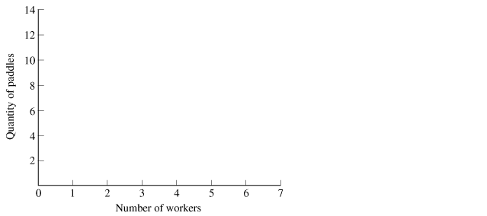
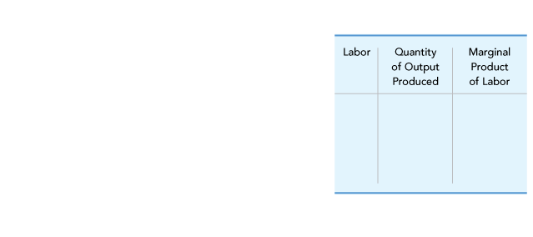
A FIRM WITH A FIXED PRODUCTION FACILITY: SHORT-RUN COSTS (cont’d)
5.2
Production and Marginal Product
FIGURE 5.1 Total-Product Curve
The total-product curve shows the relationship between the quantity of labor and the quantity of output, given a fixed production facility.
For the first two workers, output increases at an increasing rate because of labor specialization.
Diminishing returns occurs for three or more workers, so output increases at a decreasing rate.

Slide 10
A FIRM WITH A FIXED PRODUCTION FACILITY: SHORT-RUN COSTS (cont’d)
5.2
Short-Run Total Cost
● fixed cost (FC) Cost that does not vary with the quantity produced.
● variable cost (VC) Cost that varies with the quantity produced.
● short-run total cost (TC) The total cost of production when at least one input is fixed; equal to fixed cost plus variable cost.
TC = FC + VC

Slide 11
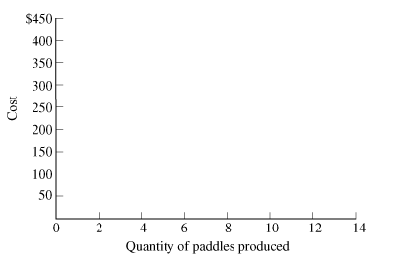
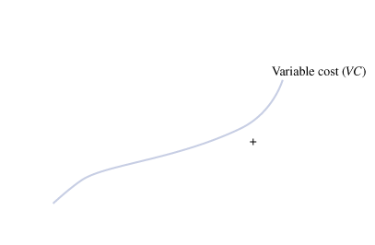
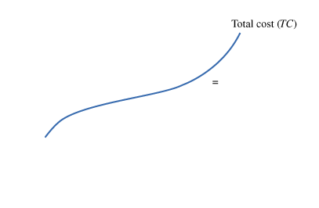
A FIRM WITH A FIXED PRODUCTION FACILITY: SHORT-RUN COSTS (cont’d)
5.2
Short-Run Total Cost
FIGURE 5.2 Short-Run Costs: Fixed Cost, Variable Cost, and Total Cost
The short-run total-cost curve shows the relationship between the quantity of output and production costs, given a fixed production facility. Short-run total cost equals fixed cost (the cost that does not vary with the quantity produced) plus variable cost (the cost that varies with the quantity produced).

Slide 12
A FIRM WITH A FIXED PRODUCTION FACILITY: SHORT-RUN COSTS (cont’d)
5.2
Short-Run Average Costs
● average fixed cost (AFC) Fixed cost divided by the quantity produced.
● average variable cost (AVC) Variable cost divided by the quantity produced.

Slide 13
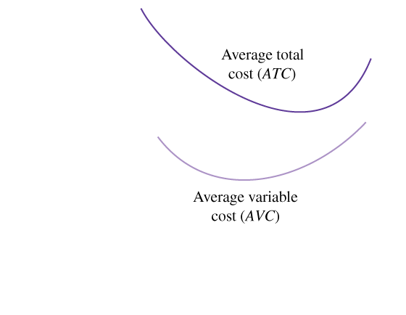
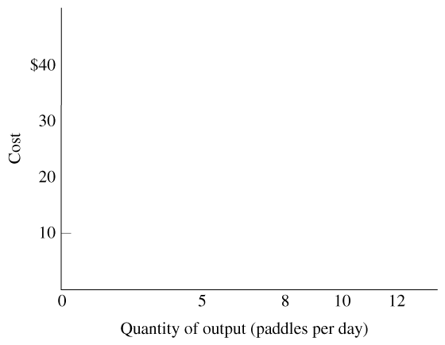
A FIRM WITH A FIXED PRODUCTION FACILITY: SHORT-RUN COSTS (cont’d)
5.2
Short-Run Average Costs
FIGURE 5.3 Short-Run Average Costs
The short-run average-total-cost curve (ATC) is U-shaped.
As the quantity produced increases, fixed costs are spread over more and more units, pushing down the average total cost.
In contrast, as the quantity increases, diminishing returns eventually pulls up the average total cost.
The gap between ATC and AVC is the average fixed cost (AFC).

Slide 14
A FIRM WITH A FIXED PRODUCTION FACILITY: SHORT-RUN COSTS (cont’d)
5.2
Short-Run Average Costs
● short-run average total cost (ATC) Short-run total cost divided by the quantity produced; equal to AFC plus AVC.

Slide 15
A FIRM WITH A FIXED PRODUCTION FACILITY: SHORT-RUN COSTS (cont’d)
5.2
Short-Run Marginal Cost
● short-run marginal cost (MC) The change in short-run total cost resulting from a one-unit increase in output.

Slide 16
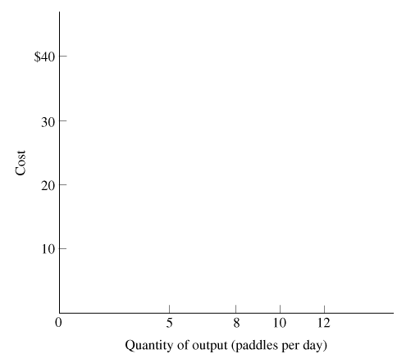
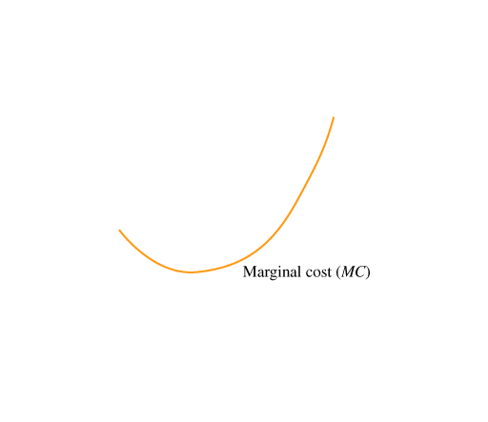
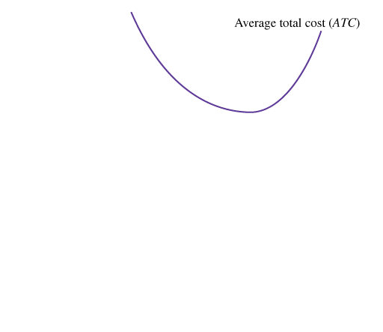
A FIRM WITH A FIXED PRODUCTION FACILITY: SHORT-RUN COSTS (cont’d)
5.2
The Relationship between Marginal Cost and Average Cost
FIGURE 5.4 Short-Run Marginal and Average Cost
The marginal-cost curve (MC) is negatively sloped for small quantities of output, because of the benefits of labor specialization, and positively sloped for large quantities, because of diminishing returns.
The MC curve intersects the average-cost curve (ATC) at the minimum point of the average curve.
At this point ATC is neither falling nor rising.

Slide 17
A FIRM WITH A FIXED PRODUCTION FACILITY: SHORT-RUN COSTS (cont’d)
5.2
The Relationship between Marginal Cost and Average Cost

Slide 18
PRODUCTION AND COST IN THE LONG RUN
5.3
Expansion and Replication
● long-run total cost (LTC) The total cost of production when a firm is perfectly flexible in choosing its inputs.
● long-run average cost (LAC) The long-run cost divided by the quantity produced.

Slide 19
PRODUCTION AND COST IN THE LONG RUN (cont’d)
5.3
Expansion and Replication
● constant returns to scale A situation in which the long-run total cost increases proportionately with output, so average cost is constant.
● long-run marginal cost (LMC) The change in long-run cost resulting from a one-unit increase in output.

Slide 20
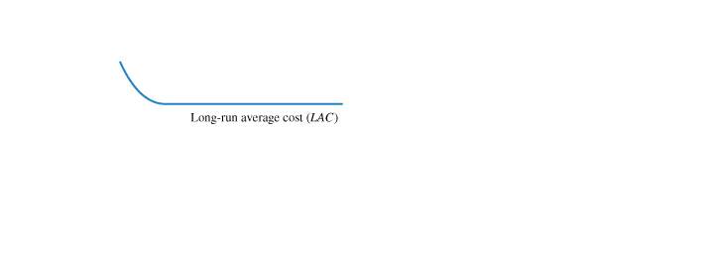
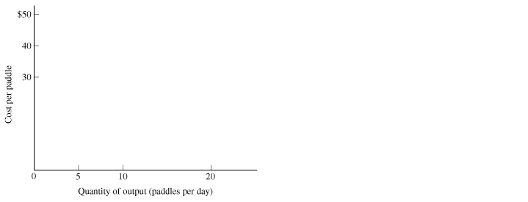
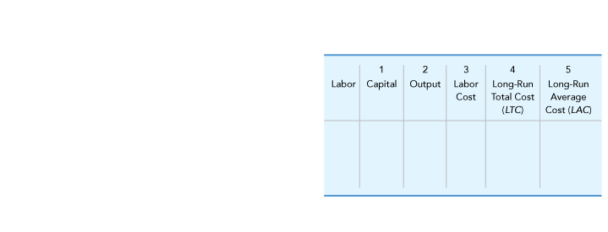
PRODUCTION AND COST IN THE LONG RUN (cont’d)
5.3
Expansion and Replication
FIGURE 5.5 The Long-Run Average-Cost Curve and Scale Economies
The long-run average-cost curve (LAC) is negatively sloped for up to 10 paddles per day, a result of indivisible inputs and the effects of labor specialization.
If the firm replicates the operation that produces 10 paddles per day, the long run average-cost curve will be horizontal beyond 10 paddles per day.

Slide 21
PRODUCTION AND COST IN THE LONG RUN (cont’d)
5.3
Reducing Output with Indivisible Inputs
● indivisible input An input that cannot be scaled down to produce a smaller quantity of output.

Slide 22
PRODUCTION AND COST IN THE LONG RUN (cont’d)
5.3
Scaling Down and Labor Specialization
Labor specialization makes workers more productive because of continuity and repetition.
When we reduce the workforce each worker will become less specialized, performing a wider variety of production tasks.
The loss of specialization will decrease labor productivity, leading to higher average cost.

Slide 23
PRODUCTION AND COST IN THE LONG RUN (cont’d)
5.3
Economies of Scale
● economies of scale A situation in which the long-run average cost of production decreases as output increases.
● minimum efficient scale The output at which scale economies are exhausted.

Slide 24
PRODUCTION AND COST IN THE LONG RUN (cont’d)
5.3
Diseconomies of Scale
● diseconomies of scale A situation in which the long-run average cost of production increases as output increases.

Slide 25
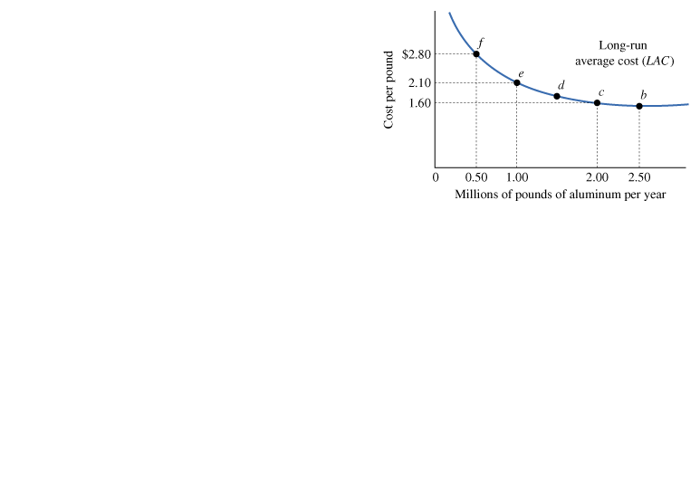
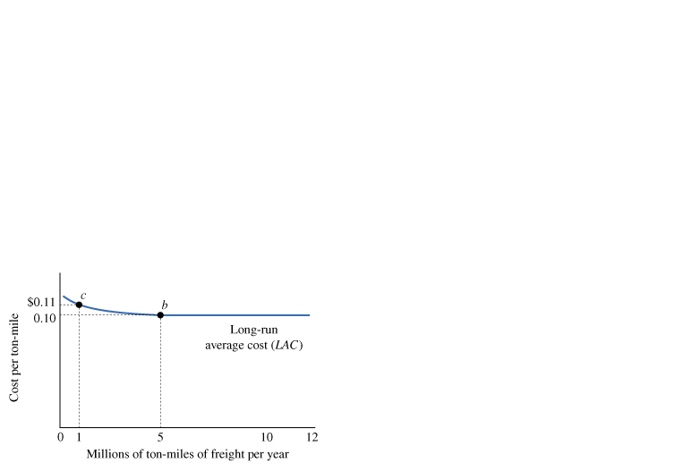
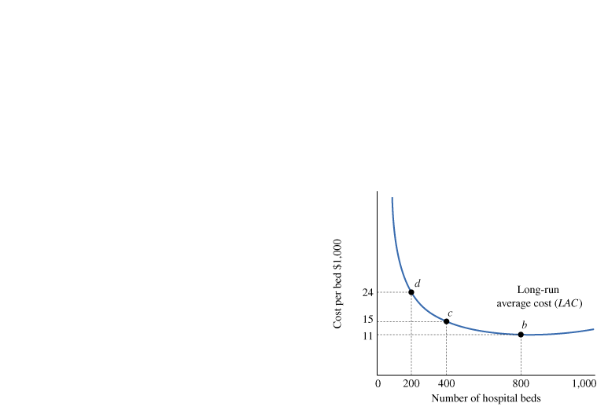
PRODUCTION AND COST IN THE LONG RUN (cont’d)
5.3
Actual Long-Run Average-Cost Curves
 FIGURE 5.6 Actual Long-Run Average-Cost Curves for Aluminum, Truck Freight, and Hospital Services

Slide 26
PRODUCTION AND COST IN THE LONG RUN (cont’d)
5.3
Short-Run versus Long-Run Average Cost
The difference between the short run and long run is a firm’s flexibility in choosing inputs.

Slide 27
APPLICATIONS OF PRODUCTION COST
5.4
A P P L I C A T I O N
1
THE PRODUCTION COST OF MOBILE PHONES
APPLYING THE CONCEPTS #1: What are the cost components for electronic products?
What’s the cost of producing a mobile phone?
Table 5.4 shows the component costs of different mobile phones. The cost of components has fallen in recent years, pulling down the average cost of production.

Slide 28
A P P L I C A T I O N
2
INDIVISIBLE INPUTS AND THE COST OF FAKE KILLER WHALES
APPLYING THE CONCEPTS #2: How do indivisible inputs affect production costs?
Sea lions off the Washington coast eat steelhead and other fish, depleting some species threatened with extinction and decreasing the harvest of the commercial fishing industry. A plastics manufacturer has offered to build a life-sized fiberglass killer whale, mount it on a rail like a roller-coaster, and send the whale diving through the water to scare off the sea lions, whales natural prey.
The first whale would cost about $16,000 (including $11,000 for the mold and $5,000 for labor and materials).
Each additional whale would cost an additional $5,000.
The cost of producing the first fake killer whale is more than three times the cost of producing the second.
In terms of total cost, producing two whales would cost a total of $21,000, while three whales would cost a total of $26,000, and so on.
This little story illustrates the effects of indivisible inputs on the firm’s cost curves. The mold is an indivisible input, because it cannot be scaled down and still produce whales.

Slide 29
A P P L I C A T I O N
3
SCALE ECONOMIES IN WIND POWER
APPLYING THE CONCEPTS #3: What are the sources of scale economies in production?
There are scale economies in the production of electricity from wind because electricity can be generated from turbines of different sizes. Although large wind turbines are more costly than small ones, the higher cost is more than offset by greater generating capacity. The scale economies occur because the cost of purchasing, installing, and maintaining a wind turbine increases less than proportionately with the turbine’s generating capacity. Table 5.5 shows the costs of a small turbine (150-kilowatt capacity) and a large turbine (600-kilowatt capacity), each with an assumed lifetime of 20 years.

Slide 30
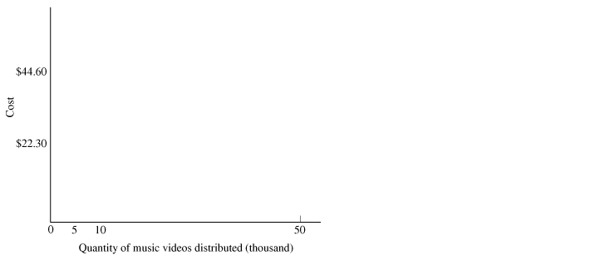
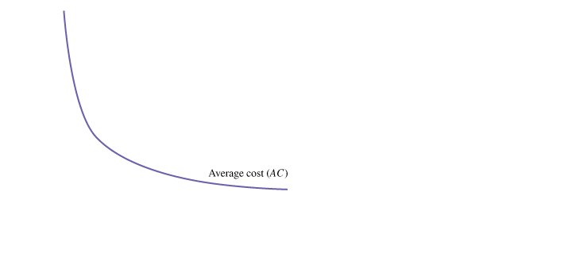
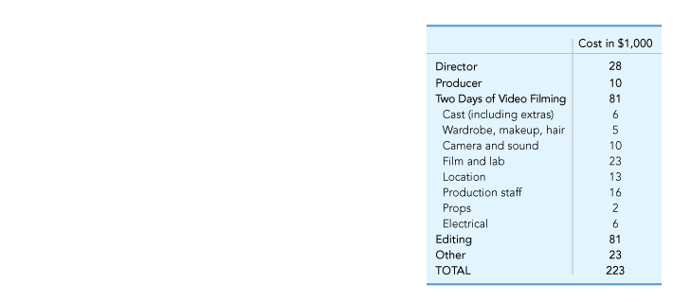
A P P L I C A T I O N
4
THE AVERAGE COST OF A MUSIC VIDEO
APPLYING THE CONCEPTS #4: What is the cost structure for information goods?
FIGURE 5.7 Average-Cost Curve for an Information Good
For an information good such as a music video, the cost of producing the first copy is very high, but the marginal cost of reproduction is relatively low, and for products distributed online, the marginal cost is zero.

Slide 31
A P P L I C A T I O N
5
THE FALLING COST OF SOLAR POWER
APPLYING THE CONCEPTS #5: How does technological innovation affect production cost?
Photovoltaic cells (or solar cells) convert sunlight directly into electricity. In 1980, the capital cost of solar cells was about $20 per watt of electricity generated. Technological innovation reduced the capital cost to less than $5 per watt in 2007.
Even more recent advances focus on reducing the amount of silicon in each solar cell and employing nanotechnology to keep reflected light bouncing around inside the cell until it is eventually absorbed.
These innovations will reduce the capital cost to less than $2 per watt generated, and perhaps as little as $1.35 per watt.
In contrast, the capital cost of a coal-fired power plant is about $1 per watt generated.
The most intriguing innovation of recent years is a sort of hybrid technology. It uses mirrors, but instead of focusing sunlight to boil water, it focuses sunlight on solar cells. Early estimates suggest the cost of this hybrid technology would make solar power competitive with electricity from coal-fired power plants.

Slide 32
SUMMARY

Slide 33
K E Y T E R M S
accounting cost
accounting profit
average fixed cost (AFC)
average variable cost (AVC)
constant returns to scale
diminishing returns
diseconomies of scale
economic cost
economic profit
economies of scale
explicit cost
fixed cost (FC)
implicit cost
indivisible input
long-run average cost (LAC)
long-run marginal cost (LMC)
long-run total cost (LTC)
marginal product of labor
minimum efficient scale
short-run average total cost (ATC)
short-run marginal cost (MC)
short-run total cost (TC)
total-product curve
variable cost (VC)

