Slide 1
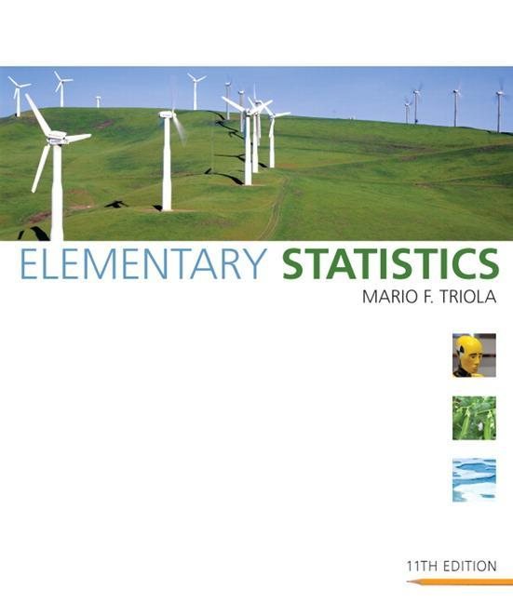
Lecture Slides
Elementary Statistics Eleventh Edition
and the Triola Statistics Series
by Mario F. Triola

Slide 2
Chapter 10 Correlation and Regression
10-1 Review and Preview
10-2 Correlation
10-3 Regression
10-4 Variation and Prediction Intervals
10-5 Multiple Regression
10-6 Modeling

Slide 3
Section 10-1
Review and Preview

Slide 4
Review
In Chapter 9 we presented methods for making inferences from two samples. In Section 9-4 we considered two dependent samples, with each value of one sample somehow paired with a value from the other sample. In Section 9-4 we considered the differences between the paired values, and we illustrated the use of hypothesis tests for claims about the population of differences. We also illustrated the construction of confidence interval estimates of the mean of all such differences. In this chapter we again consider paired sample data, but the objective is fundamentally different from that of Section 9-4.
Notes:
page 517 of Elementary Statistics, 10th Edition

Slide 5
Preview
In this chapter we introduce methods for determining whether a correlation, or association, between two variables exists and whether the correlation is linear. For linear correlations, we can identify an equation that best fits the data and we can use that equation to predict the value of one variable given the value of the other variable. In this chapter, we also present methods for analyzing differences between predicted values and actual values.
Notes:
page 517 of Elementary Statistics, 10th Edition

Slide 6
Preview
In addition, we consider methods for identifying linear equations for correlations among three or more variables. We conclude the chapter with some basic methods for developing a mathematical model that can be used to describe nonlinear correlations between two variables.
Notes:
page 517 of Elementary Statistics, 10th Edition

Slide 7
Section 10-2
Correlation

Slide 8
Key Concept
In part 1 of this section introduces the linear correlation coefficient r, which is a numerical measure of the strength of the relationship between two variables representing quantitative data.
Using paired sample data (sometimes called bivariate data), we find the value of r (usually using technology), then we use that value to conclude that there is (or is not) a linear correlation between the two variables.

Slide 9
Key Concept
In this section we consider only linear relationships, which means that when graphed, the points approximate a straight-line pattern.
In Part 2, we discuss methods of hypothesis testing for correlation.

Slide 10
Part 1: Basic Concepts of Correlation

Slide 11
Definition
A correlation exists between two variables when the values of one are somehow associated with the values of the other in some way.

Slide 12
Definition
The linear correlation coefficient r measures the strength of the linear relationship between the paired quantitative x- and y-values in a sample.
Notes:
page 518 of Elementary Statistics, 10th Edition

Slide 13
Exploring the Data
We can often see a relationship between two variables by constructing a scatterplot.
Figure 10-2 following shows scatterplots with different characteristics.
Notes:
Relate a scatter plot to the algebraic plotting of number pairs (x,y).

Slide 14
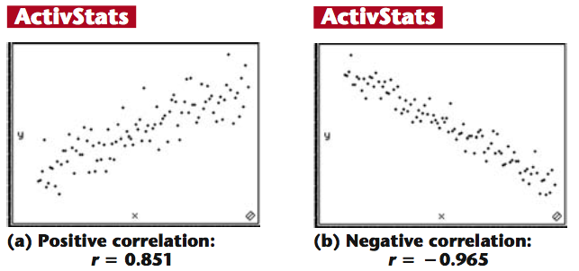
Scatterplots of Paired Data
Figure 10-2
Notes:
Page 519 of Elementary Statistics, 10th Edition

Slide 15
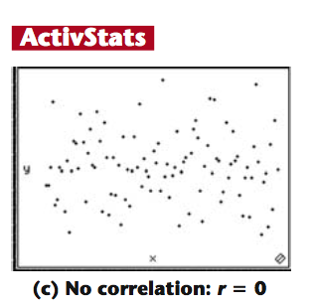
Scatterplots of Paired Data
Figure 10-2
Notes:
Page 519 of Elementary Statistics, 10th Edition

Slide 16
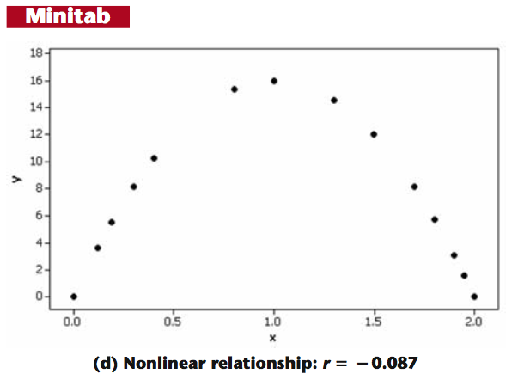
Scatterplots of Paired Data
Figure 10-2
Notes:
Page 519 of Elementary Statistics, 10th Edition

Slide 17
Requirements
1. The sample of paired (x, y) data is a simple random sample of quantitative data.
2. Visual examination of the scatterplot must confirm that the points approximate a straight-line pattern.
3. The outliers must be removed if they are known to be errors. The effects of any other outliers should be considered by calculating r with and without the outliers included.
Notes:
Explain to students the difference between the ‘paired’ data of this chapter and the investigation of two groups of data in Chapter 9.

Slide 18
Notation for the Linear Correlation Coefficient
n = number of pairs of sample data
Σ denotes the addition of the items indicated.
Σx denotes the sum of all x-values.
Σx² indicates that each x-value should be squared and then those squares added.
(Σx)² indicates that the x-values should be added and then the total squared.

Slide 19
Notation for the Linear Correlation Coefficient
Σxy indicates that each x-value should be first multiplied by its corresponding y-value. After obtaining all such products, find their sum.
r = linear correlation coefficient for sample data.
ρ = linear correlation coefficient for population data.

Slide 20
Formula
The linear correlation coefficient r measures the strength of a linear relationship between the paired values in a sample.
nΣxy – (Σx)(Σy)
r =
n(Σx²) – (Σx)² n(Σy²) – (Σy)²
Formula 10-1
Computer software or calculators can compute r

Slide 21
Interpreting r
Using Table A-6: If the absolute value of the computed value of r, denoted |r|, exceeds the value in Table A-6, conclude that there is a linear correlation. Otherwise, there is not sufficient evidence to support the conclusion of a linear correlation.
Using Software: If the computed P-value is less than or equal to the significance level, conclude that there is a linear correlation. Otherwise, there is not sufficient evidence to support the conclusion of a linear correlation.

Slide 22
Caution
Know that the methods of this section apply to a linear correlation. If you conclude that there does not appear to be linear correlation, know that it is possible that there might be some other association that is not linear.

Slide 23
Rounding the Linear
Correlation Coefficient r
Round to three decimal places so that it can be compared to critical values in Table A-6.
Use calculator or computer if possible.
Notes:
Page 521 of Elementary Statistics, 10th Edition

Slide 24
Properties of the Linear Correlation Coefficient r
1. –1 ≤ r ≤ 1
2. if all values of either variable are converted to a different scale, the value of r does not change.
3. The value of r is not affected by the choice of x and y. Interchange all x- and y-values and the value of r will not change.
4. r measures strength of a linear relationship.
5. r is very sensitive to outliers, they can dramatically affect its value.
Notes:
page 524 of Elementary Statistics, 10th Edition
If using a graphics calculator for demonstration, it will be an easy exercise to switch the x and y values to show that the value of r will not change.

Slide 25
Example:
The paired pizza/subway fare costs from Table 10-1 are shown here in Table 10-2. Use computer software with these paired sample values to find the value of the linear correlation coefficient r for the paired sample data.
Requirements are satisfied: simple random sample of quantitative data; Minitab scatterplot approximates a straight line; scatterplot shows no outliers - see next slide
Notes:
page 521 of Elementary Statistics, 10th Edition.

Slide 26
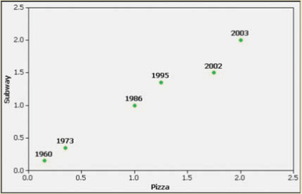
Example:
Using software or a calculator, r is automatically calculated:
Notes:
page 521 of Elementary Statistics, 10th Edition.

Slide 27
Interpreting the Linear Correlation Coefficient r
We can base our interpretation and conclusion about correlation on a P-value obtained from computer software or a critical value from Table A-6.
Notes:
page 524 of Elementary Statistics, 10th Edition
If using a graphics calculator for demonstration, it will be an easy exercise to switch the x and y values to show that the value of r will not change.

Slide 28
Interpreting the Linear Correlation Coefficient r
Using Computer Software to Interpret r:
If the computed P-value is less than or equal to the significance level, conclude that there is a linear correlation.
Otherwise, there is not sufficient evidence to support the conclusion of a linear correlation.
Notes:
page 524 of Elementary Statistics, 10th Edition
If using a graphics calculator for demonstration, it will be an easy exercise to switch the x and y values to show that the value of r will not change.

Slide 29
Interpreting the Linear Correlation Coefficient r
Using Table A-6 to Interpret r:
If |r| exceeds the value in Table A-6, conclude that there is a linear correlation.
Otherwise, there is not sufficient evidence to support the conclusion of a linear correlation.
Notes:
page 524 of Elementary Statistics, 10th Edition
If using a graphics calculator for demonstration, it will be an easy exercise to switch the x and y values to show that the value of r will not change.

Slide 30
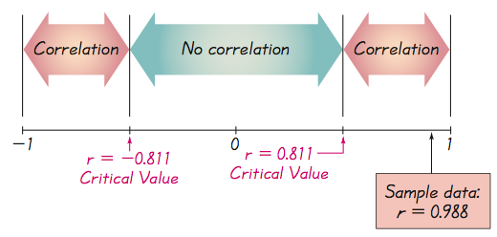
Interpreting the Linear Correlation Coefficient r
Critical Values from Table A-6 and the Computed Value of r
Notes:
page 524 of Elementary Statistics, 10th Edition
If using a graphics calculator for demonstration, it will be an easy exercise to switch the x and y values to show that the value of r will not change.

Slide 31
Example:
Using a 0.05 significance level, interpret the value of r = 0.117 found using the 62 pairs of weights of discarded paper and glass listed in Data Set 22 in Appendix B. When the paired data are used with computer software, the P-value is found to be 0.364. Is there sufficient evidence to support a claim of a linear correlation between the weights of discarded paper and glass?
Notes:
page 524 of Elementary Statistics, 10th Edition

Slide 32
Example:
Requirements are satisfied: simple random sample of quantitative data; scatterplot approximates a straight line; no outliers
Using Software to Interpret r:
The P-value obtained from software is 0.364. Because the P-value is not less than or equal to 0.05, we conclude that there is not sufficient evidence to support a claim of a linear correlation between weights of discarded paper and glass.
Notes:
page 524 of Elementary Statistics, 10th Edition

Slide 33
Example:
Using Table A-6 to Interpret r:
If we refer to Table A-6 with n = 62 pairs of sample data, we obtain the critical value of 0.254 (approximately) for α = 0.05. Because |0.117| does not exceed the value of 0.254 from Table A-6, we conclude that there is not sufficient evidence to support a claim of a linear correlation between weights of discarded paper and glass.
Notes:
page 524 of Elementary Statistics, 10th Edition

Slide 34
Interpreting r: Explained Variation
The value of r² is the proportion of the variation in y that is explained by the linear relationship between x and y.
Notes:
If using a graphics calculator for demonstration, it will be an easy exercise to switch the x and y values to show that the value of r will not change.

Slide 35
Example:
Using the pizza subway fare costs in Table 10-2, we have found that the linear correlation coefficient is r = 0.988. What proportion of the variation in the subway fare can be explained by the variation in the costs of a slice of pizza?
With r = 0.988, we get r² = 0.976.
We conclude that 0.976 (or about 98%) of the variation in the cost of a subway fares can be explained by the linear relationship between the costs of pizza and subway fares. This implies that about 2% of the variation in costs of subway fares cannot be explained by the costs of pizza.
Notes:
page 524 of Elementary Statistics, 10th Edition

Slide 36
Common Errors Involving Correlation
1. Causation: It is wrong to conclude that correlation implies causality.
2. Averages: Averages suppress individual variation and may inflate the correlation coefficient.
3. Linearity: There may be some relationship between x and y even when there is no linear correlation.
Notes:
page 525 of Elementary Statistics, 10th Edition

Slide 37
Caution
Know that correlation does not imply causality.
Notes:
page 525 of Elementary Statistics, 10th Edition

Slide 38
Part 2: Formal Hypothesis Test

Slide 39
Formal Hypothesis Test
We wish to determine whether there is a significant linear correlation between two variables.
Notes:
page 527 of Elementary Statistics, 10th Edition

Slide 40
Hypothesis Test for Correlation Notation
n = number of pairs of sample data
r = linear correlation coefficient for a sample of paired data
ρ = linear correlation coefficient for a population of paired data
Notes:
page 527 of Elementary Statistics, 10th Edition

Slide 41
Hypothesis Test for Correlation Requirements
1. The sample of paired (x, y) data is a simple random sample of quantitative data.
2. Visual examination of the scatterplot must confirm that the points approximate a straight-line pattern.
3. The outliers must be removed if they are known to be errors. The effects of any other outliers should be considered by calculating r with and without the outliers included.
Notes:
page 527 of Elementary Statistics, 10th Edition

Slide 42
Hypothesis Test for Correlation Hypotheses
H₀: ρ = 0 (There is no linear correlation.)
H₁: ρ ≠ 0 (There is a linear correlation.)
Test Statistic: r
Critical Values: Refer to Table A-6
Notes:
page 527 of Elementary Statistics, 10th Edition

Slide 43
Hypothesis Test for Correlation Conclusion
If |r| > critical value from Table A-6, reject H₀ and conclude that there is sufficient evidence to support the claim of a linear correlation.
If |r| ≤ critical value from Table A-6, fail to reject H₀ and conclude that there is not sufficient evidence to support the claim of a linear correlation.
Notes:
page 527 of Elementary Statistics, 10th Edition

Slide 44
Example:
Use the paired pizza subway fare data in Table 10-2 to test the claim that there is a linear correlation between the costs of a slice of pizza and the subway fares. Use a 0.05 significance level.
Requirements are satisfied as in the earlier example.
H₀: ρ = 0 (There is no linear correlation.)
H₁: ρ ≠ 0 (There is a linear correlation.)
Notes:
page 527 of Elementary Statistics, 10th Edition

Slide 45
Example:
The test statistic is r = 0.988 (from an earlier Example). The critical value of r = 0.811 is found in Table A-6 with n = 6 and α = 0.05. Because |0.988| > 0.811, we reject H₀: r = 0. (Rejecting “no linear correlation” indicates that there is a linear correlation.)
We conclude that there is sufficient evidence to support the claim of a linear correlation between costs of a slice of pizza and subway fares.
Notes:
page 527 of Elementary Statistics, 10th Edition

Slide 46
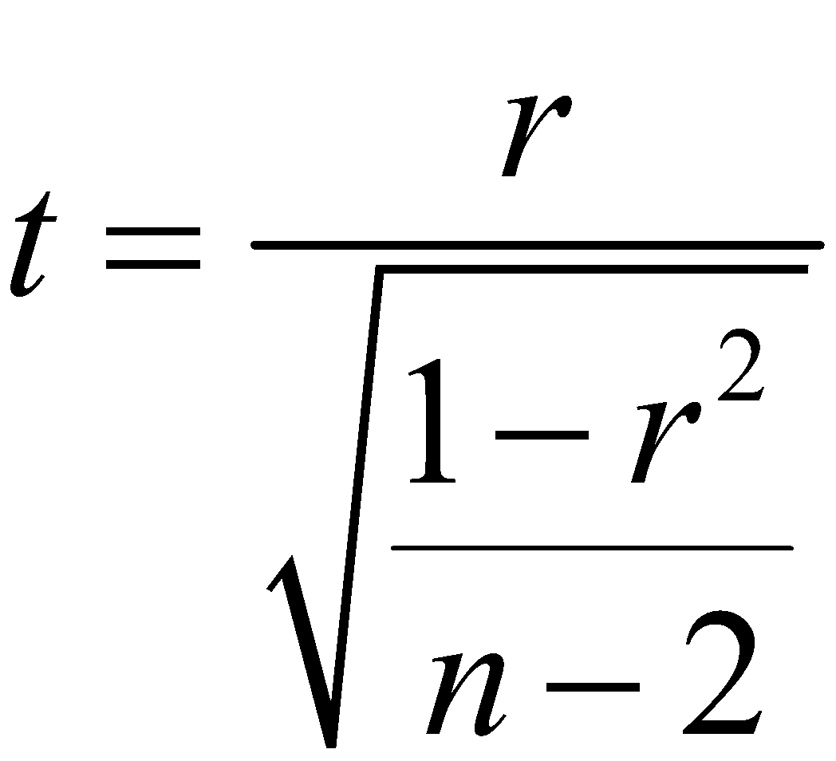
Hypothesis Test for Correlation P-Value from a t Test
H₀: ρ = 0 (There is no linear correlation.)
H₁: ρ ≠ 0 (There is a linear correlation.)
Test Statistic: t
Notes:
page 527 of Elementary Statistics, 10th Edition

Slide 47
Hypothesis Test for Correlation Conclusion
P-value: Use computer software or use Table A-3 with n – 2 degrees of freedom to find the P-value corresponding to the test statistic t.
If the P-value is less than or equal to the significance level, reject H₀ and conclude that there is sufficient evidence to support the claim of a linear correlation.
If the P-value is greater than the significance level, fail to reject H₀ and conclude that there is not sufficient evidence to support the claim of a linear correlation.
Notes:
page 527 of Elementary Statistics, 10th Edition

Slide 48
Example:
Use the paired pizza subway fare data in Table 10-2 and use the P-value method to test the claim that there is a linear correlation between the costs of a slice of pizza and the subway fares. Use a 0.05 significance level.
Requirements are satisfied as in the earlier example.
H₀: ρ = 0 (There is no linear correlation.)
H₁: ρ ≠ 0 (There is a linear correlation.)
Notes:
page 527 of Elementary Statistics, 10th Edition

Slide 49
Example:
The linear correlation coefficient is r = 0.988 (from an earlier Example) and n = 6 (six pairs of data), so the test statistic is
With df = 4, Table A-6 yields a P-value that is less than 0.01.
Computer software generates a test statistic of t = 12.692 and P-value of 0.00022.
Notes:
page 527 of Elementary Statistics, 10th Edition

Slide 50
Example:
Using either method, the P-value is less than the significance level of 0.05 so we reject H₀: ρ = 0.
We conclude that there is sufficient evidence to support the claim of a linear correlation between costs of a slice of pizza and subway fares.

Slide 51
One-Tailed Tests
One-tailed tests can occur with a claim of a positive linear correlation or a claim of a negative linear correlation. In such cases, the hypotheses will be as shown here.
For these one-tailed tests, the P-value method can be used as in earlier chapters.

Slide 52
Recap
In this section, we have discussed:
Correlation.
The linear correlation coefficient r.
Requirements, notation and formula for r.
Interpreting r.
Formal hypothesis testing.

Slide 53
Section 10-3
Regression

Slide 54
Key Concept
In part 1 of this section we find the equation of the straight line that best fits the paired sample data. That equation algebraically describes the relationship between two variables.
The best-fitting straight line is called a regression line and its equation is called the regression equation.
In part 2, we discuss marginal change, influential points, and residual plots as tools for analyzing correlation and regression results.

Slide 55
Part 1: Basic Concepts of Regression

Slide 56
Regression
The regression equation expresses a relationship between x (called the explanatory variable, predictor variable or independent variable), and y (called the response variable or dependent variable).
^
The typical equation of a straight line y = mx + b is expressed in the form y = b₀ + b₁x, where b₀ is the y-intercept and b₁ is the slope.
^

Slide 57
Definitions
Regression Equation
Given a collection of paired data, the regression equation
^
y = b₀ + b₁x
algebraically describes the relationship between the two variables.
Regression Line
The graph of the regression equation is called the regression line (or line of best fit, or least squares line).

Slide 58
Notation for Regression Equation
Population
Parameter
Sample
Statistic
y-intercept of regression equation
Slope of regression equation
Equation of the regression line
β₀ b₀
β₁ b₁
y = β₀ + β₁ x y = b₀ + b₁x
^

Slide 59
Requirements
1. The sample of paired (x, y) data is a random sample of quantitative data.
2. Visual examination of the scatterplot shows that the points approximate a straight-line pattern.
3. Any outliers must be removed if they are known to be errors. Consider the effects of any outliers that are not known errors.

Slide 60
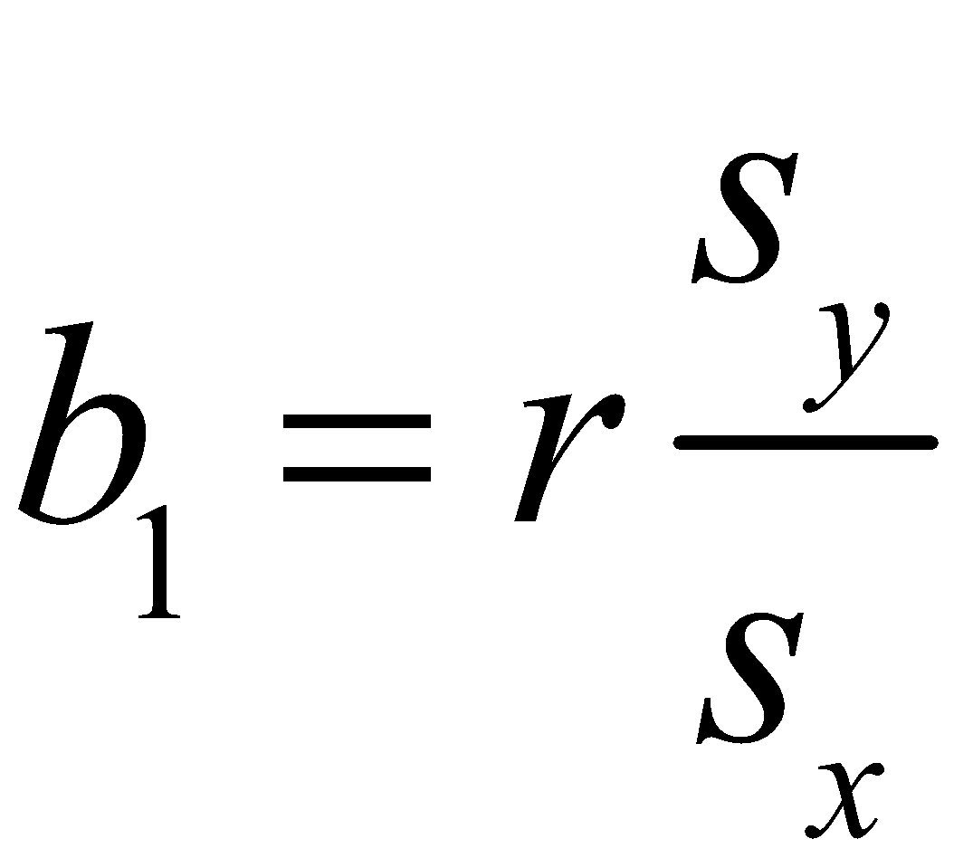
Formulas for b₀ and b₁
Formula 10-3
(slope)
(y-intercept)
Formula 10-4
calculators or computers can compute these values

Slide 61
The regression line fits the sample points best.
Special Property

Slide 62
Rounding the y-intercept b₀ and the Slope b₁
Round to three significant digits.
If you use the formulas 10-3 and 10-4, do not round intermediate values.
Notes:
page 543 of Elementary Statistics, 10th Edition

Slide 63
Example:
Refer to the sample data given in Table 10-1 in the Chapter Problem. Use technology to find the equation of the regression line in which the explanatory variable (or x variable) is the cost of a slice of pizza and the response variable (or y variable) is the corresponding cost of a subway fare.
Notes:
page 543 of Elementary Statistics, 10th Edition.

Slide 64
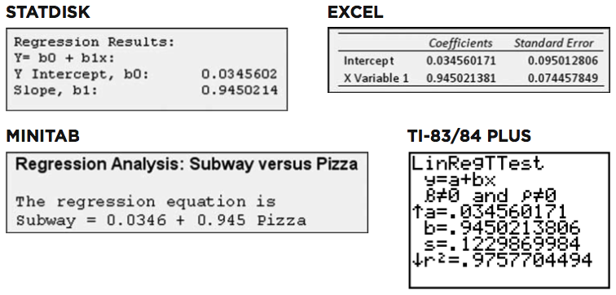
Example:
Requirements are satisfied: simple random sample; scatterplot approximates a straight line; no outliers
Here are results from four different technologies technologies
Notes:
page 543 of Elementary Statistics, 10th Edition.

Slide 65
Example:
All of these technologies show that the regression equation can be expressed as y = 0.0346 +0.945x, where y is the predicted cost of a subway fare and x is the cost of a slice of pizza.
We should know that the regression equation is an estimate of the true regression equation. This estimate is based on one particular set of sample data, but another sample drawn from the same population would probably lead to a slightly different equation.
^
^
Notes:
page 543 of Elementary Statistics, 10th Edition.

Slide 66
Example:
Graph the regression equation (from the preceding Example) on the scatterplot of the pizza/subway fare data and examine the graph to subjectively determine how well the regression line fits the data.
On the next slide is the Minitab display of the scatterplot with the graph of the regression line included. We can see that the regression line fits the data quite well.
Notes:
page 543 of Elementary Statistics, 10th Edition.

Slide 67
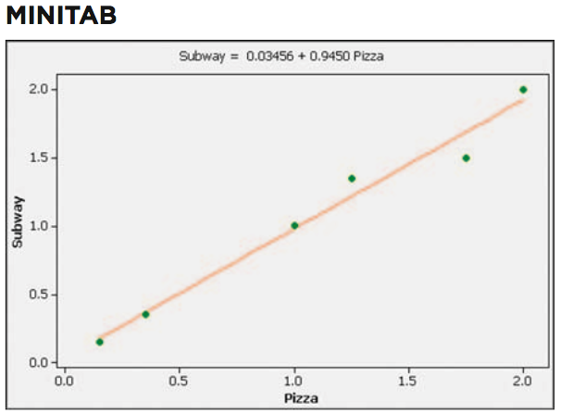
Example:
Notes:
page 543 of Elementary Statistics, 10th Edition.

Slide 68
Using the Regression Equation for Predictions
1. Use the regression equation for predictions only if the graph of the regression line on the scatterplot confirms that the regression line fits the points reasonably well.
2. Use the regression equation for predictions only if the linear correlation coefficient r indicates that there is a linear correlation between the two variables (as described in Section 10-2).

Slide 69
Using the Regression Equation for Predictions
3. Use the regression line for predictions only if the data do not go much beyond the scope of the available sample data. (Predicting too far beyond the scope of the available sample data is called extrapolation, and it could result in bad predictions.)
4. If the regression equation does not appear to be useful for making predictions, the best predicted value of a variable is its point estimate, which is its sample mean.

Slide 70
Strategy for Predicting Values of Y
Notes:
page 546 of Elementary Statistics, 10th Edition

Slide 71
Using the Regression Equation for Predictions
If the regression equation is not a good model, the best predicted value of y is simply y, the mean of the y values.
Remember, this strategy applies to linear patterns of points in a scatterplot.
If the scatterplot shows a pattern that is not a straight-line pattern, other methods apply, as described in Section 10-6.
^

Slide 72
Part 2: Beyond the Basics of Regression

Slide 73
Definitions
In working with two variables related by a regression equation, the marginal change in a variable is the amount that it changes when the other variable changes by exactly one unit. The slope b₁ in the regression equation represents the marginal change in y that occurs when x changes by one unit.
Notes:
The slope b₁ in the regression equation represents the marginal change in y that occurs when x changes by one unit.

Slide 74
Definitions
In a scatterplot, an outlier is a point lying far away from the other data points.
Paired sample data may include one or more influential points, which are points that strongly affect the graph of the regression line.

Slide 75
Example:
Consider the pizza subway fare data from the Chapter Problem. The scatterplot located to the left on the next slide shows the regression line. If we include this additional pair of data: x = 2.00,y = –20.00 (pizza is still $2.00 per slice, but the subway fare is $–20.00 which means that people are paid $20 to ride the subway), this additional point would be an influential point because the graph of the regression line would change considerably, as shown by the regression line located to the right.
Notes:
page 547 – 548 of Elementary Statistics, 10th Edition
The slope b₁ in the regression equation represents the marginal change in y that occurs when x changes by one unit.

Slide 76
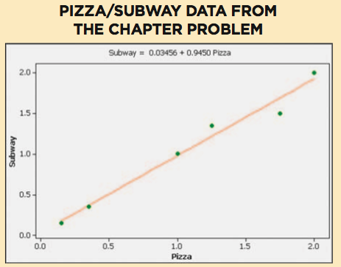
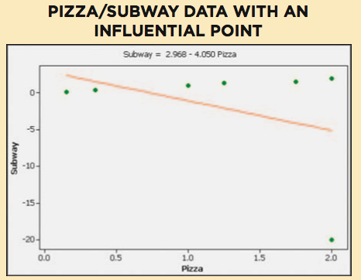
Example:
Notes:
page 547 – 548 of Elementary Statistics, 10th Edition
The slope b₁ in the regression equation represents the marginal change in y that occurs when x changes by one unit.

Slide 77
Example:
Compare the two graphs and you will see clearly that the addition of that one pair of values has a very dramatic effect on the regression line, so that additional point is an influential point. The additional point is also an outlier because it is far from the other points.
Notes:
The slope b₁ in the regression equation represents the marginal change in y that occurs when x changes by one unit.

Slide 78
Definition
For a pair of sample x and y values, the residual is the difference between the observed sample value of y and the y-value that is predicted by using the regression equation. That is,
^
residual = observed y – predicted y = y – y

Slide 79
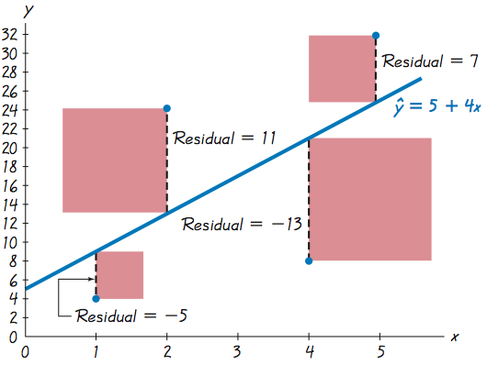
Residuals

Slide 80
Definitions
A straight line satisfies the least-squares property if the sum of the squares of the residuals is the smallest sum possible.
Notes:
page 549 - 550 of Elementary Statistics, 10th Edition

Slide 81
Definitions
A residual plot is a scatterplot of the (x, y) values after each of the y-coordinate values has been replaced by the residual value y – y (where y denotes the predicted value of y). That is, a residual plot is a graph of the points (x, y – y).
^
^
^
Notes:
page 549 - 550 of Elementary Statistics, 10th Edition

Slide 82
Residual Plot Analysis
When analyzing a residual plot, look for a pattern in the way the points are configured, and use these criteria:
The residual plot should not have an obvious pattern that is not a straight-line pattern.
The residual plot should not become thicker (or thinner) when viewed from left to right.

Slide 83
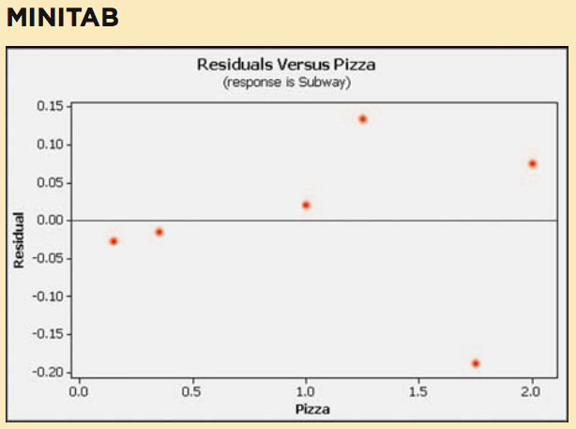
Residuals Plot - Pizza/Subway

Slide 84
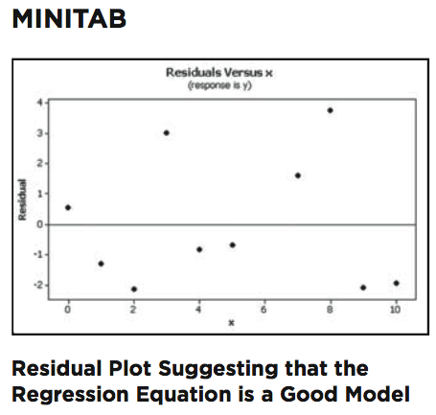
Residual Plots

Slide 85
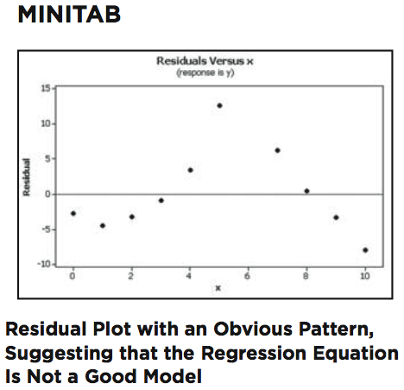
Residual Plots

Slide 86
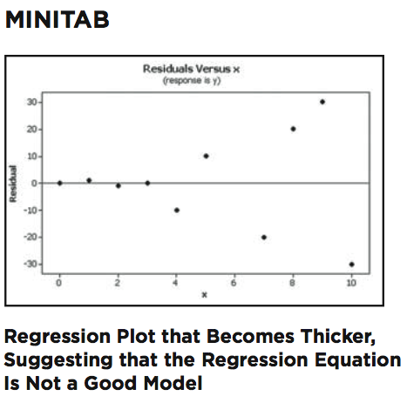
Residual Plots

Slide 87
Complete Regression Analysis
1. Construct a scatterplot and verify that the pattern of the points is approximately a straight-line pattern without outliers. (If there are outliers, consider their effects by comparing results that include the outliers to results that exclude the outliers.)
2. Construct a residual plot and verify that there is no pattern (other than a straight-line pattern) and also verify that the residual plot does not become thicker (or thinner).

Slide 88
Complete Regression Analysis
3. Use a histogram and/or normal quantile plot to confirm that the values of the residuals have a distribution that is approximately normal.
4. Consider any effects of a pattern over time.

Slide 89
Recap
In this section we have discussed:
The basic concepts of regression.
Rounding rules.
Using the regression equation for predictions.
Interpreting the regression equation.
Outliers
Residuals and least-squares.
Residual plots.

Slide 90
Section 10-4
Variation and Prediction Intervals

Slide 91
Key Concept
In this section we present a method for constructing a prediction interval, which is an interval estimate of a predicted value of y.

Slide 92
Definition
Assume that we have a collection of paired data containing the sample point (x, y), that y is the predicted value of y (obtained by using the regression equation), and that the mean of the sample y-values is y.
^

Slide 93
Definition
The total deviation of (x, y) is the vertical distance y – y, which is the distance between the point (x, y) and the horizontal line passing through the sample mean y.

Slide 94
Definition
The explained deviation is the vertical distance y – y, which is the distance between the predicted y-value and the horizontal line passing through the sample mean y.
^

Slide 95
Definition
The unexplained deviation is the vertical distance y – y, which is the vertical distance between the point (x, y) and the regression line. (The distance y – y is also called a residual, as defined in Section 10-3.)
^
^

Slide 96
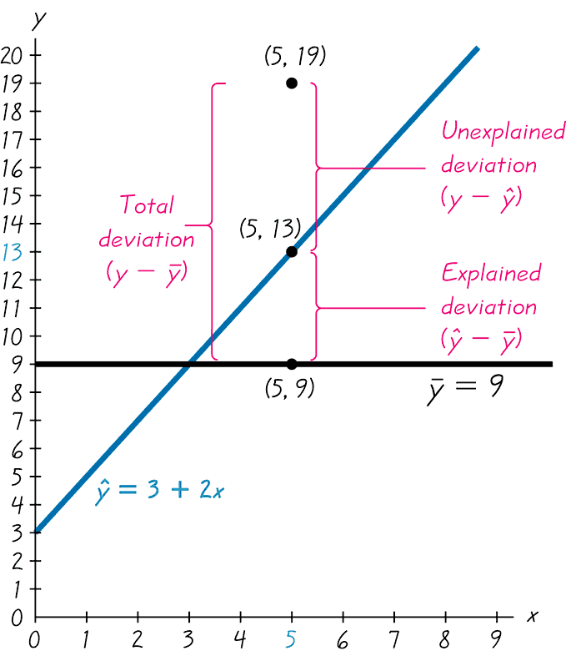
Figure 10-7
Unexplained, Explained, and Total Deviation

Slide 97
Relationships
(total deviation) = (explained deviation) + (unexplained deviation)
^
^
(y - y) = (y - y) + (y - y)
(total variation) = (explained variation) + (unexplained variation)
Σ (y - y) ² = Σ (y - y) ² + Σ (y - y) ²
^
^
Formula 10-5

Slide 98
Definition
Coefficient of determination
is the amount of the variation in y that
is explained by the regression line.
r² =
explained variation.
total variation
The value of r² is the proportion of the variation in y that is explained by the linear relationship between x and y.
Notes:
page 559 of Elementary Statistics, 10th Edition

Slide 99
Definition
A prediction interval, is an interval estimate of a predicted value of y.

Slide 100
Definition
The standard error of estimate, denoted by s_{e} is a measure of the differences (or distances) between the observed sample y-values and the predicted values y that are obtained using the regression equation.
^

Slide 101
Standard Error of Estimate
Σ (y – y)²
^
s_{e} =
n – 2
or
Σ y² – b₀ Σ y – b₁ Σ xy
s_{e} =
n – 2
Formula 10-6

Slide 102
Example:
Use Formula 10-6 to find the standard error of estimate s_{e} for the paired pizza/subway fare data listed in Table 10-1in the Chapter Problem.
n = 6
Σy² = 9.2175
Σy = 6.35
Σxy = 9.4575
b₀ = 0.034560171
b₁ = 0.94502138
s_{e} =
Σ y² - b₀ Σ y - b₁ Σ xy
n - 2
s_{e} =
9.2175 – (0.034560171)(6.35) – (0.94502138)(9.4575)
6 – 2
s_{e} = 0.12298700 = 0.123
Notes:
page 561 of Elementary Statistics, 10th Edition.

Slide 103
Prediction Interval for an Individual y
^
^
y - E < y < y + E
where
n(x₀ – x)²
1
1 + +
E = t_{α/2} s_{e}
n
n(Σx²)
– (Σx)²
x₀ represents the given value of x t_{α/2} has n – 2 degrees of freedom

Slide 104
Example:
For the paired pizza/subway fare costs from the Chapter Problem, we have found that for a pizza cost of $2.25, the best predicted cost of a subway fare is $2.16. Construct a 95% prediction interval for the cost of a subway fare, given that a slice of pizza costs $2.25 (so that x = 2.25).
n(x₀ – x)²
E = t_{α/2} s_{e}
1 + 1
+
n
n(Σx²) – (Σx)²
E = (2.776)(0.12298700)
6(2.25 – 1.0833333)²
1 + 1
+
6
6(9.77) – (6.50)²
E = (2.776)(0.12298700)(1.2905606) = 0.441
Notes:
page 562 of Elementary Statistics, 10th Edition.

Slide 105
Example:
Construct the confidence interval.
^
^
y – E < y < y + E
2.16 – 0.441 < y < 2.16 + 0.441
1.72 < y < 2.60
Notes:
page 562 of Elementary Statistics, 10th Edition.

Slide 106
Recap
In this section we have discussed:
Explained and unexplained variation.
Coefficient of determination.
Standard error estimate.
Prediction intervals.

Slide 107
Section 10-5
Multiple Regression

Slide 108
Key Concept
This section presents a method for analyzing a linear relationship involving more than two variables.
We focus on three key elements:
The multiple regression equation.
The values of the adjusted R².
The P-value.

Slide 109
Part 1: Basic Concepts of a Multiple Regression Equation

Slide 110
Definition
A multiple regression equation expresses a linear relationship between a response variable y and two or more predictor variables (x₁, x₂, x₃ . . . , x_{k})
The general form of the multiple regression equation obtained from sample data is
^
y = b₀ + b₁x₁ + b₂x₂ + . . . + b_{k}x_{k}.

Slide 111
y = b₀ + b₁ x₁+ b₂ x₂+ b₃ x₃ +. . .+ b_{k} x_{k} (General form of the multiple regression equation)
Notation
^
n = sample size
k = number of predictor variables
y = predicted value of y
x₁, x₂, x₃ . . . , x_{k} are the predictor variables
^

Slide 112
Notation - cont
ß₀, ß₁, ß₂, . . . , ß_{k} are the parameters for the multiple regression equation y = ß₀ + ß₁x₁+ ß₂x₂+…+ ß_{k}x_{k}
b₀, b₁, b₂, . . . , b_{k} are the sample estimates of the parameters ß₀, ß₁, ß₂, . . . , ß_{k}

Slide 113
Technology Use a statistical software package such as
STATDISK
Minitab
Excel
TI-83/84
Notes:
The computations of this section will require a statistical software package.

Slide 114
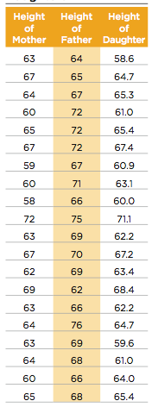
Example:
Table 10-6 includes a random sample of heights of mothers, fathers, and their daughters (based on data from the National Health and Nutrition Examination). Find the multiple regression equation in which the response (y) variable is the height of a daughter and the predictor (x) variables are the height of the mother and height of the father.

Slide 115
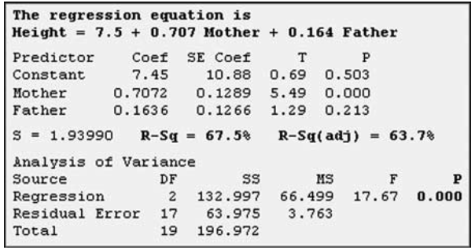
Example:
The Minitab results are shown here:

Slide 116
Example:
From the display, we see that the multiple regression equation is
Height = 7.5 + 7.07Mother + 0.164Father
Using our notation presented earlier in this section, we could write this equation as
y = 7.5 + 0.707x₁ + 0.164x₂
where y is the predicted height of a daughter, x₁ is the height of the mother, and x₂ is the height of the father.
^
^

Slide 117
Definition
The multiple coefficient of determination R² is a measure of how well the multiple regression equation fits the sample data.
The adjusted coefficient of determination is the multiple coefficient of determination R² modified to account for the number of variables and the sample size.

Slide 118
Adjusted Coefficient of Determination
(n – 1)
Adjusted R² = 1 –
(1– R²)
[n – (k + 1)]
where n = sample size
k = number of predictor (x) variables
Formula 10-7

Slide 119
P-Value
The P-value is a measure of the overall significance of the multiple regression equation. Like the adjusted R², this P-value is a good measure of how well the equation fits the sample data.

Slide 120
P-Value
The displayed Minitab P-value of 0.000 (rounded to three decimal places) is small, indicating that the multiple regression equation has good overall significance and is usable for predictions. That is, it makes sense to predict heights of daughters based on heights of mothers and fathers. The value of 0.000 results from a test of the null hypothesis that β₁ = β₂ = 0. Rejection of β₁ = β₂ = 0 implies that at least one of β₁ and β₂ is not 0, indicating that this regression equation is effective in predicting heights of daughters.

Slide 121
Finding the Best Multiple Regression Equation
1. Use common sense and practical considerations to include or exclude variables.
2. Consider the P-value. Select an equation having overall significance, as determined by the P-value found in the computer display.

Slide 122
Finding the Best Multiple Regression Equation
3. Consider equations with high values of adjusted R² and try to include only a few variables.
If an additional predictor variable is included, the value of adjusted R² does not increase by a substantial amount.
For a given number of predictor (x) variables, select the equation with the largest value of adjusted R².
In weeding out predictor (x) variables that don’t have much of an effect on the response (y) variable, it might be helpful to find the linear correlation coefficient r for each of the paired variables being considered.

Slide 123
Part 2: Dummy Variables and Logistic Equations

Slide 124
Dummy Variable
Many applications involve a dichotomous variable which has only two possible discrete values (such as male/female, dead/alive, etc.). A common procedure is to represent the two possible discrete values by 0 and 1, where 0 represents “failure” and 1 represents success.
A dichotomous variable with the two values 0 and 1 is called a dummy variable.

Slide 125
Logistic Regression
We can use the methods of this section if the dummy variable is the predictor variable.
If the dummy variable is the response variable we need to use a method known as logistic regression.
As the name implies logistic regression involves the use of natural logarithms. This text book does not include detailed procedures for using logistic regression.

Slide 126
Recap
In this section we have discussed:
The multiple regression equation.
Adjusted R².
Finding the best multiple regression equation.
Dummy variables and logistic regression.

Slide 127
Section 10-6
Modeling

Slide 128
Key Concept
This section introduces some basic concepts of developing a mathematical model, which is a function that “fits” or describes real-world data.
Unlike Section 10-3, we will not be restricted to a model that must be linear.

Slide 129
TI-83/84 Plus Generic Models
Linear: y = a + bx
Quadratic: y = ax² + bx + c
Logarithmic: y = a + b ln x
Exponential: y = ab^{x}
Power: y = ax^{b}

Slide 130
The slides that follow illustrate the graphs of some common models displayed on a TI-83/84 Plus Calculator

Slide 131
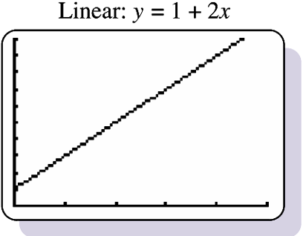

Slide 132
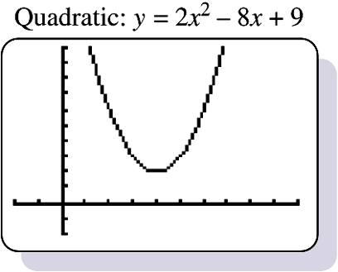

Slide 133
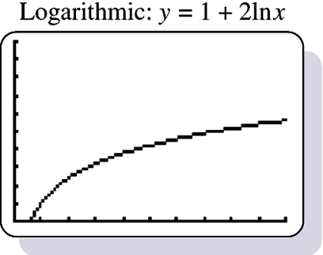

Slide 134
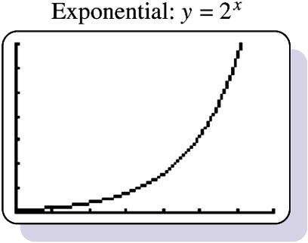

Slide 135
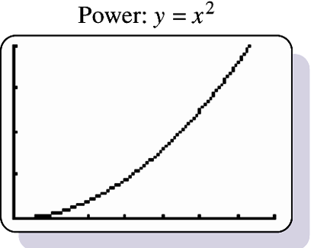

Slide 136
Development of a Good Mathematical Model
Look for a Pattern in the Graph: Examine the graph of the plotted points and compare the basic pattern to the known generic graphs of a linear function.
Find and Compare Values of R²: Select functions that result in larger values of R², because such larger values correspond to functions that better fit the observed points.
Think: Use common sense. Don’t use a model that leads to predicted values known to be totally unrealistic.

Slide 137
Important Point
“The best choice (of a model) depends on the set of data being analyzed and requires an exercise in judgment, not just computation.”

Slide 138
Recap
In this section we have discussed:
The concept of mathematical modeling.
Graphs from a TI-83/84 Plus calculator.
Rules for developing a good mathematical model.

