Slide 1
The description of the Plane Curvilinear Motion by the Polar Coordinates
Lecture VI
Polar coordinates

Slide 2
Plane Curvilinear Motion – Polar Coordinates
Here, the curvilinear motions measurements are made by the radial distance (r) from a fixed pole and by an angular measurement (θ) to the radial line.
The x-axis is used as a reference line for the measurement of θ.
e_{r} & e_{θ} are the unit vectors in r-direction and θ-direction, respectively.

Slide 3
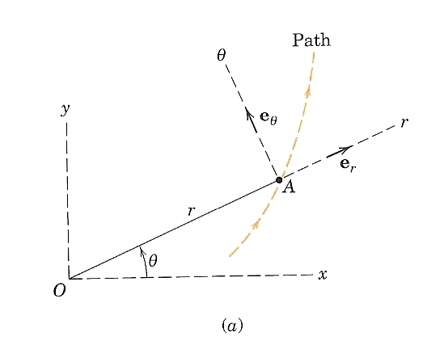
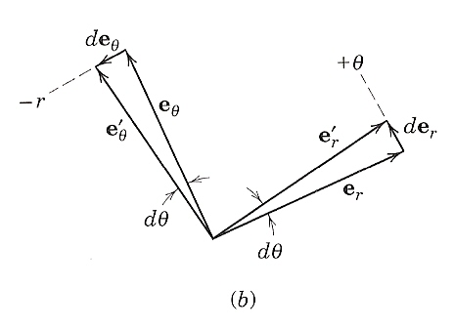
Polar Coordinates – Position & Velocity
The position vector of the particle:
Note: from (b), de_{r} is in the positive θ-direction and de_{θ} in the negative r-direction
The velocity is:
?
(after dt)
(after dt)

Slide 4
Polar Coordinates – Velocity (Cont.)
Thus, the velocity is:
Its magnitude is:
Due to the rate at which the vector stretches
Due to rotation of r

Slide 5
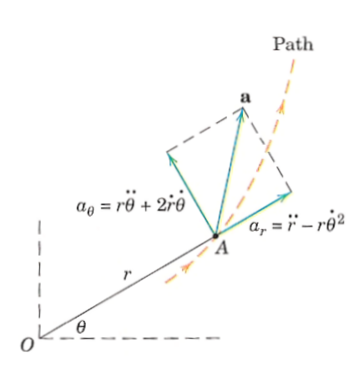
Polar Coordinates - Acceleration
Rearranging,
Its magnitude is:
Centripetal acceleration
Coriolis acceleration

Slide 6
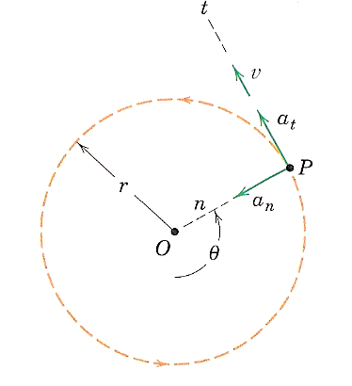
Polar Coordinates – Circular Motion
For a circular path: r = constant
Note: The positive r-direction is in the negative n-direction, i.e. a_{r} = - a_{n}

Slide 7
Polar Coordinates Exercises

Slide 8
Exercise # 1
As the hydraulic cylinder rotates around O, the exposed length l of the piston rod is controlled by the action of oil pressure in the cylinder. If the cylinder rotates at the constant rate θ˙= 60 deg/s and l is decreasing at the constant rate of 150 mm/s, calculate the magnitudes of the velocity v and acceleration a of end B when l = 125 mm.

Slide 9
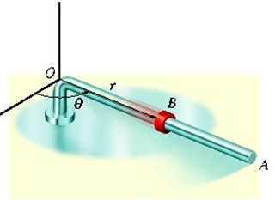
Exercise # 2
The rob OA is rotating in the horizontal plane such that θ = (t³) rad. At the same time, the collar B is sliding outwards along OA so that r = (100t²)mm. If in both cases, t is in seconds, determine the velocity and acceleration of the collar when t = 1s.

Slide 10
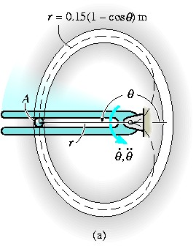
Exercise # 3
Due to the rotation of the forked rod, ball A travels across the slotted path, a portion of which is in the shape of a cardioids, r = 0.15(1 – cos θ)m where θ is in radians. If the ball’s velocity is v = 1.2m/s and its acceleration is 9m/s² at instant θ = 180°, determine the angular velocity and angular acceleration of the fork.

Slide 11
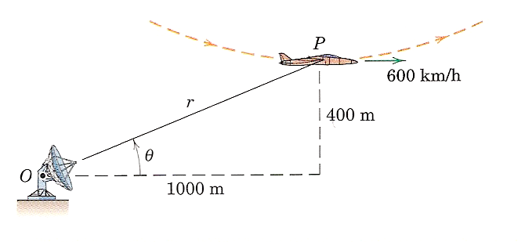
Exercise # 4
At the bottom of a loop in the vertical (r-θ) plane at an altitude of 400 m, the airplane P has a horizontal velocity of 600 km/h and no horizontal acceleration. The radius of curvature of the loop is 1200 m. For the radar tracking at O, determine the recorded values of r˙ , r¨, θ˙, and θ ¨.

Slide 12
Approach to Space Curvilinear Motion
Rectangular Coordinates (x, y, z)
Cylindrical Coordinates (r, θ, z)

Slide 13
Approach to Space Curvilinear Motion
Spherical Coordinates (r, θ, φ)

Slide 14
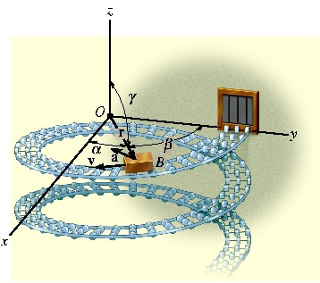
Approach to Space Curvilinear Motion (Exercise)
The motion of box B is defined by the position vector r = {0.5sin(2t)i + 0.5cos(2t)j – 0.2tk} m, where t is in seconds and the arguments for sine and cosine are in radians (π rad = 180°). Determine the location of box when t = 0.75 s and the magnitude of its velocity and acceleration at his instant.

Slide 15
Approach to Space Curvilinear Motion (Exercise)
The box slides down the helical ramp which is defined by r = 0.5 m, θ = (0.5t³) rad, and
z = (2 – 0.2t²) m, where t is in seconds. Determine the magnitudes of the velocity and acceleration of the box at the instant θ = 2π rad.

Slide 16
Approach to Space Curvilinear Motion (Exercise)
The base structure of the fire truck ladder rotates about a vertical axis through O with a constant angular velocity Ω = 10 deg/s. At the same time, the ladder unit OB elevates at a constant rate ϕ˙ = 7 deg/s, and section AB of the ladder extends from within section OA at the constant rate of 0.5 m/s. At the instant under consideration, ϕ = 30°, OA = 9 m, and AB = 6 m. Determine the magnitudes of the velocity and acceleration of the end B of the ladder.

