Slide 1
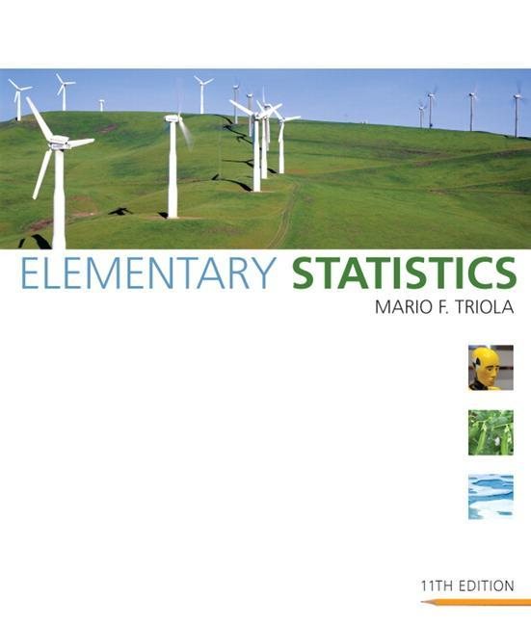
Lecture Slides
Elementary Statistics Eleventh Edition
and the Triola Statistics Series
by Mario F. Triola

Slide 2
Chapter 5 Probability Distributions
5-1 Review and Preview
5-2 Random Variables
5-3 Binomial Probability Distributions
5-4 Mean, Variance and Standard Deviation for the Binomial Distribution
5-5 Poisson Probability Distributions

Slide 3
Section 5-1
Review and Preview

Slide 4
Review and Preview
This chapter combines the methods of descriptive statistics presented in Chapter 2 and 3 and those of probability presented in Chapter 4 to describe and analyze
probability distributions.
Probability Distributions describe what will probably happen instead of what actually did happen, and they are often given in the format of a graph, table, or formula.
Notes:
Emphasize the combination of the methods in Chapter 3 (descriptive statistics) with the methods in Chapter 4 (probability).
Chapter 3 one would conduct an actual experiment and find and observe the mean, standard deviation, variance, etc. and construct a frequency table or histogram
Chapter 4 finds the probability of each possible outcome
Chapter 5 presents the possible outcomes along with the relative frequencies we expect
Page 200 of Elementary Statistics, 10th Edition

Slide 5
Preview
In order to fully understand probability distributions, we must first understand the concept of a random variable, and be able to distinguish between discrete and continuous random variables. In this chapter we focus on discrete probability distributions. In particular, we discuss binomial and Poisson probability distributions.
Notes:
Emphasize the combination of the methods in Chapter 3 (descriptive statistics) with the methods in Chapter 4 (probability).
Chapter 3 one would conduct an actual experiment and find and observe the mean, standard deviation, variance, etc. and construct a frequency table or histogram
Chapter 4 finds the probability of each possible outcome
Chapter 5 presents the possible outcomes along with the relative frequencies we expect
Page 200 of Elementary Statistics, 10th Edition

Slide 6
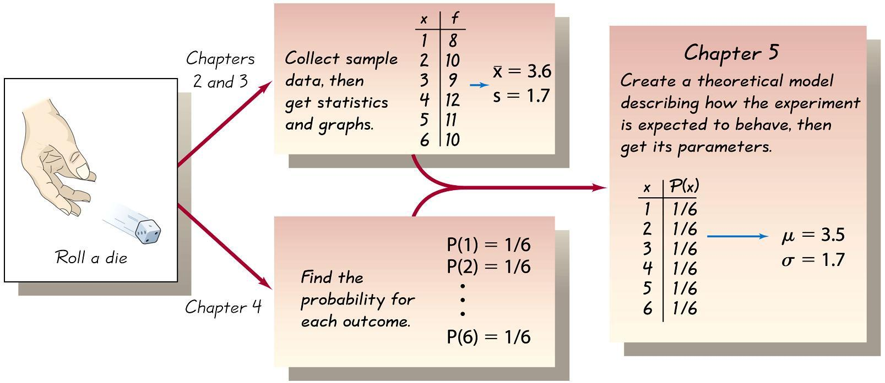
Combining Descriptive Methods
and Probabilities
In this chapter we will construct probability distributions by presenting possible outcomes along with the relative frequencies we expect.
Notes:
page 200 of Elementary Statistics, 10th Edition

Slide 7
Section 5-2
Random Variables

Slide 8
Key Concept
This section introduces the important concept of a probability distribution, which gives the probability for each value of a variable that is determined by chance.
Give consideration to distinguishing between outcomes that are likely to occur by chance and outcomes that are “unusual” in the sense they are not likely to occur by chance.

Slide 9
Key Concept
The concept of random variables and how they relate to probability distributions
Distinguish between discrete random variables and continuous random variables
Develop formulas for finding the mean, variance, and standard deviation for a probability distribution
Determine whether outcomes are likely to occur by chance or they are unusual (in the sense that they are not likely to occur by chance)

Slide 10
Random Variable Probability Distribution
Random variable a variable (typically represented by x) that has a single numerical value, determined by chance, for each outcome of a procedure
Probability distribution a description that gives the probability for each value of the random variable; often expressed in the format of a graph, table, or formula
Notes:
page 201 of Elementary Statistics, 10th Edition

Slide 11
Discrete and Continuous Random Variables
Discrete random variable either a finite number of values or countable number of values, where “countable” refers to the fact that there might be infinitely many values, but they result from a counting process
Continuous random variable infinitely many values, and those values can be associated with measurements on a continuous scale without gaps or interruptions
Notes:
This chapter deals exclusively with discrete random variables - experiments where the data observed is a ‘countable’ value. Give examples.
Following chapters will deal with continuous random variables.
Page 201 of Elementary Statistics, 10th Edition

Slide 12
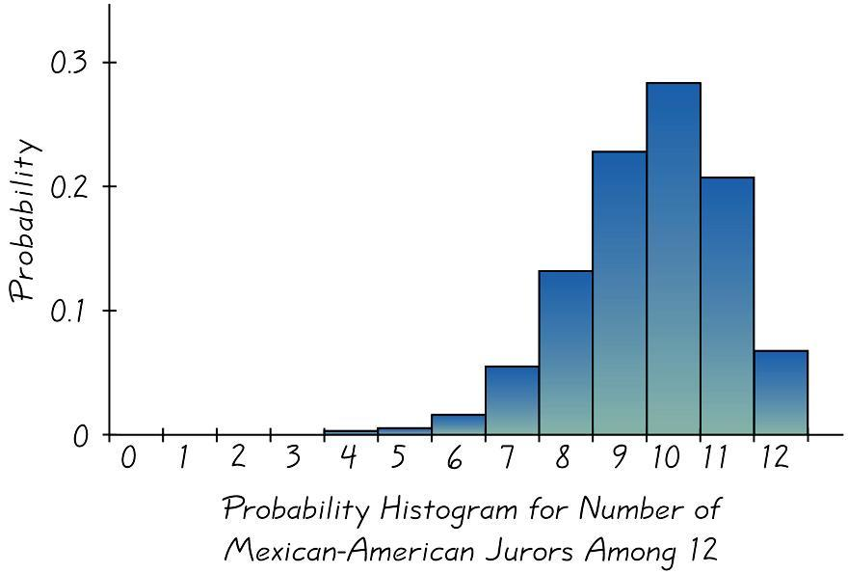
Graphs
The probability histogram is very similar to a relative frequency histogram, but the vertical scale shows probabilities.
Notes:
page 202 of Elementary Statistics, 10th Edition
Probability Histograms relate nicely to Relative Frequency Histograms of Chapter 2, but the vertical scale shows probabilities instead of relative frequencies based on actual sample results
Observe that the probabilities of each random variable is also the same as the AREA of the rectangle representing the random variable. This fact will be important when we need to find probabilities of continuous random variables - Chapter 6.

Slide 13
Requirements for Probability Distribution
Σ
P(x) = 1
where x assumes all possible values.
0 ≤ P(x) ≤ 1
for every individual value of x.
Notes:
Page 203 of Elementary Statistics, 10th Edition

Slide 14
Mean, Variance and
Standard Deviation of a
Probability Distribution
µ = Σ [x • P(x)] Mean
σ² = Σ [(x – µ)² • P(x)] Variance
σ² = Σ [x² • P(x)] – µ ² Variance (shortcut)
σ = Σ [x ² • P(x)] – µ ² Standard Deviation
Notes:
In Chapter 3, we found the mean, standard deviation,variance, and shape of the distribution for actual observed experiments.
The probability distribution and histogram can provide the same type information.
These formulas will apply to ANY type of probability distribution as long as you have have all the P(x) values for the random variables in the distribution.
In section 4 of this chapter, there will be special EASIER formulas for the special binomial distribution.
The TI-83 and TI-83 Plus calculators can find the mean, standard deviation, and variance in the same way that one finds those values for a frequency table.
With the TI-82, TI-81, and TI-85 calculators, one would have to multiply all decimal values in the P(x) column by the same factor so that there were no decimals and proceed as usual.
Page 204 of Elementary Statistics, 10th Edition

Slide 15
Roundoff Rule for µ, σ, and σ²
Round results by carrying one more decimal place than the number of decimal places used for the random variable x.
If the values of x are integers, round µ, σ, and σ ² to one decimal place.
Notes:
If the rounding results in a value that looks as if the mean is ‘all’ or none’ (when, in fact, this is not true), then leave as many decimal places as necessary to correctly reflect the true mean.
Page 205 of Elementary Statistics, 10th Edition

Slide 16
Identifying Unusual Results
Range Rule of Thumb
According to the range rule of thumb, most values should lie within 2 standard deviations of the mean.
We can therefore identify “unusual” values by determining if they lie outside these limits:
Maximum usual value = μ + 2σ
Minimum usual value = μ – 2σ
Notes:
Page 205-206 of Elementary Statistics, 10th Edition

Slide 17
Identifying Unusual Results
Probabilities
Rare Event Rule for Inferential Statistics
If, under a given assumption (such as the assumption that a coin is fair), the probability of a particular observed event (such as 992 heads in 1000 tosses of a coin) is extremely small, we conclude that the assumption is probably not correct.
Notes:
The discussion of this topic in the text includes some difficult concepts, but it also includes an extremely important approach used often in statistics.
Page 207-208 of Elementary Statistics, 10th Edition

Slide 18
Identifying Unusual Results
Probabilities
Using Probabilities to Determine When Results Are Unusual
Unusually high: x successes among n trials is an unusually high number of successes if P(x or more) ≤ 0.05.
Unusually low: x successes among n trials is an unusually low number of successes if P(x or fewer) ≤ 0.05.
Notes:
The discussion of this topic in the text includes some difficult concepts, but it also includes an extremely important approach used often in statistics.
Page 207-208 of Elementary Statistics, 10th Edition

Slide 19
Expected Value
The expected value of a discrete random variable is denoted by E, and it represents the mean value of the outcomes. It is obtained by finding the value of Σ [x • P(x)].
E = Σ [x • P(x)]
Notes:
Also called expectation or mathematical expectation
Plays a very important role in decision theory
page 208 of Elementary Statistics, 10th Edition

Slide 20
Recap
In this section we have discussed:
Combining methods of descriptive statistics with probability.
Random variables and probability distributions.
Probability histograms.
Requirements for a probability distribution.
Mean, variance and standard deviation of a probability distribution.
Identifying unusual results.
Expected value.

Slide 21
Section 5-3
Binomial Probability Distributions

Slide 22
Key Concept
This section presents a basic definition of a binomial distribution along with notation, and methods for finding probability values.
Binomial probability distributions allow us to deal with circumstances in which the outcomes belong to two relevant categories such as acceptable/defective or survived/died.

Slide 23
Binomial Probability Distribution
A binomial probability distribution results from a procedure that meets all the following requirements:
1. The procedure has a fixed number of trials.
2. The trials must be independent. (The outcome of any individual trial doesn’t affect the probabilities in the other trials.)
3. Each trial must have all outcomes classified into two categories (commonly referred to as success and failure).
4. The probability of a success remains the same in all trials.
Notes:
Binomial probability distributions are important because they allow us to deal with circumstances in which the outcomes belong to TWO categories, such as pass/fall, acceptable/defective, etc.
page 214 of Elementary Statistics, 10th Edition

Slide 24
Notation for Binomial Probability Distributions
S and F (success and failure) denote the two possible categories of all outcomes; p and q will denote the probabilities of S and F, respectively, so
P(S) = p (p = probability of success)
P(F) = 1 – p = q (q = probability of failure)
Notes:
The word success is arbitrary and does not necessarily represent something GOOD. If you are trying to find the probability of deaths from hang-gliding, the ‘success’ probability is that of dying from hang-gliding.
Remind students to carefully look at the probability (percentage or rate) provided and whether it matches the probability desired in the question. It might be necessary to determine the complement of the given probability to establish the ‘p’ value of the problem.
Page 214 of Elementary Statistics, 10th Edition.

Slide 25
Notation (continued)
n denotes the fixed number of trials.
x denotes a specific number of successes in n trials, so x can be any whole number between 0 and n, inclusive.
p denotes the probability of success in one of the n trials.
q denotes the probability of failure in one of the n trials.
P(x) denotes the probability of getting exactly x successes among the n trials.
Notes:
Page 214 of Elementary Statistics, 10th Edition.

Slide 26
Important Hints
Be sure that x and p both refer to the same category being called a success.
When sampling without replacement, consider events to be independent if n < 0.05N.
Notes:
Page 214-215 of Elementary Statistics, 10th Edition.

Slide 27
Methods for Finding
Probabilities
We will now discuss three methods for finding the probabilities corresponding to the random variable x in a binomial distribution.
Notes:
Page 216 of Elementary Statistics, 10th Edition.

Slide 28
Method 1: Using the Binomial
Probability Formula
n !
P(x) = • p^{x} • q^{n-x}
(n – x )!x!
for x = 0, 1, 2, . . ., n
where
n = number of trials
x = number of successes among n trials
p = probability of success in any one trial
q = probability of failure in any one trial (q = 1 – p)
Notes:
page 216 of Elementary Statistics, 10th Edition

Slide 29
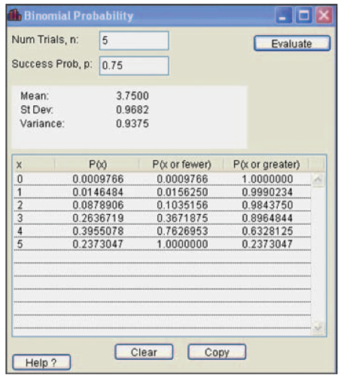
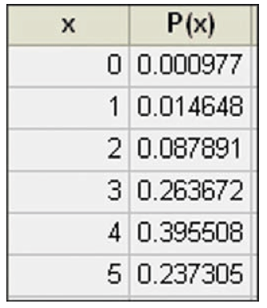
Method 2: Using Technology
STATDISK, Minitab, Excel, SPSS, SAS and the TI-83/84 Plus calculator can be used to find binomial probabilities.
STATDISK
MINITAB
Notes:
Page 218 of Elementary Statistics, 10th Edition.

Slide 30
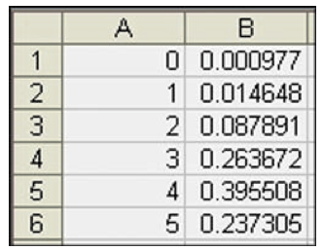
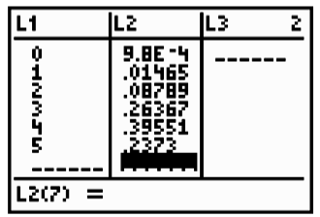
Method 2: Using Technology
STATDISK, Minitab, Excel and the TI-83 Plus calculator can all be used to find binomial probabilities.
EXCEL
TI-83 PLUS Calculator
Notes:
Page 218 of Elementary Statistics, 10th Edition.

Slide 31
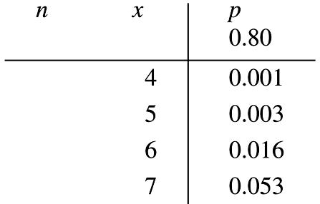
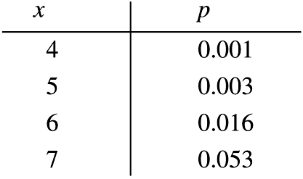
Method 3: Using
Table A-1 in Appendix A
Part of Table A-1 is shown below. With n = 12 and p = 0.80 in the binomial distribution, the probabilities of 4, 5, 6, and 7 successes are 0.001, 0.003, 0.016, and 0.053 respectively.
Notes:
Page 217 of Elementary Statistics, 10th Edition.

Slide 32
Strategy for Finding Binomial Probabilities
Use computer software or a TI-83 Plus calculator if available.
If neither software nor the TI-83 Plus calculator is available, use Table A-1, if possible.
If neither software nor the TI-83 Plus calculator is available and the probabilities can’t be found using Table A-1, use the binomial probability formula.
Notes:
Page 219 of Elementary Statistics, 10th Edition

Slide 33
Rationale for the Binomial Probability Formula
n !
P(x) = • p^{x} • q^{n-x}
(n – x )!x!
The number of
outcomes with exactly x successes among n trials
Notes:
The ‘counting’ factor of the formula counts the number of ways the x successes and (n-x) failures can be arranged - i.e.. the number of arrangements (Review section 4-7, page 181).
Discussion is on page 219 of Elementary Statistics, 10th Edition.

Slide 34
Binomial Probability Formula
n !
P(x) = • p^{x} • q^{n-x}
(n – x )!x!
Number of
outcomes with exactly x successes among n trials
The probability of x successes among n trials for any one particular order
Notes:
The remaining two factors of the formula will compute the probability of any one arrangement of successes and failures. This probability will be the same no matter what the arrangement is.
The three factors multiplied together give the correct probability of ‘x’ successes.

Slide 35
Recap
In this section we have discussed:
The definition of the binomial probability distribution.
Notation.
Important hints.
Three computational methods.
Rationale for the formula.

Slide 36
Section 5-4
Mean, Variance, and Standard Deviation for the Binomial Distribution

Slide 37
Key Concept
In this section we consider important characteristics of a binomial distribution including center, variation and distribution. That is, given a particular binomial probability distribution we can find its mean, variance and standard deviation.
A strong emphasis is placed on interpreting and understanding those values.

Slide 38
For Any Discrete Probability Distribution: Formulas
Mean µ = Σ[x • P(x)]
Variance σ ² = [Σ x² • P(x) ] – µ²
Std. Dev σ = [Σ x² • P(x) ] – µ²
Notes:
These formulas were introduced in section 5-2, pages 204-205.
These formulas will produce the mean, standard deviation, and variance for any probability distribution. The difficult part of these formulas is that one must have all the P(x) values for the random variables in the distribution.

Slide 39
Binomial Distribution: Formulas
Mean µ = n • p
Variance σ ² = n • p • q
Std. Dev. σ = n • p • q
Where
n = number of fixed trials
p = probability of success in one of the n trials
q = probability of failure in one of the n trials
Notes:
The obvious advantage to the formulas for the mean, standard deviation, and variance of a binomial distribution is that you do not need the values in the distribution table. You need only the n, p, and q values.
A common error students tend to make is to forget to take the square root of (n)(p)(q) to find the standard deviation, especially if they used L1 and L2 lists in a graphical calculator to find the standard deviation with non-binomial distributions. The square root is built into the programming of the calculator and students do not have to remember it. These formulas do require the student to remember to take the square root of the three factors.
Page 225 of Elementary Statistics, 10th Edition

Slide 40
Interpretation of Results
It is especially important to interpret results. The range rule of thumb suggests that values are unusual if they lie outside of these limits:
Maximum usual values = µ + 2 σ
Minimum usual values = µ – 2 σ
Notes:
Page 225 of Elementary Statistics, 10th Edition.

Slide 41
Recap
In this section we have discussed:
Mean, variance and standard deviation formulas for any discrete probability distribution.
Mean, variance and standard deviation formulas for the binomial probability distribution.
Interpreting results.

Slide 42
Section 5-5
Poisson Probability Distributions

Slide 43
Key Concept
The Poisson distribution is another discrete probability distribution which is important because it is often used for describing the behavior of rare events (with small probabilities).

Slide 44
Poisson Distribution
The Poisson distribution is a discrete probability distribution that applies to occurrences of some event over a specified interval. The random variable x is the number of occurrences of the event in an interval. The interval can be time, distance, area, volume, or some similar unit.
Formula
µ ^{x} • e ^{–µ}
P(x) = where e ≈ 2.71828
x!
Notes:
Some discussion of the what the value of ‘e’ represents might be necessary.
A minimal scientific calculator with factorial key is required for this formula. Most instructors will want students to use the calculator representation of ‘e’, rather than the rounded version of ‘e’, which might provide a very slightly different final answer.
Page 230 of Elementary Statistics, 10th Edition.

Slide 45
Requirements of the Poisson Distribution
The random variable x is the number of occurrences of an event over some interval.
The occurrences must be random.
The occurrences must be independent of each other.
The occurrences must be uniformly distributed over the interval being used.
Parameters
The mean is µ.
The standard deviation is σ = µ .
Notes:
Page 231 of Elementary Statistics, 10th Edition.

Slide 46
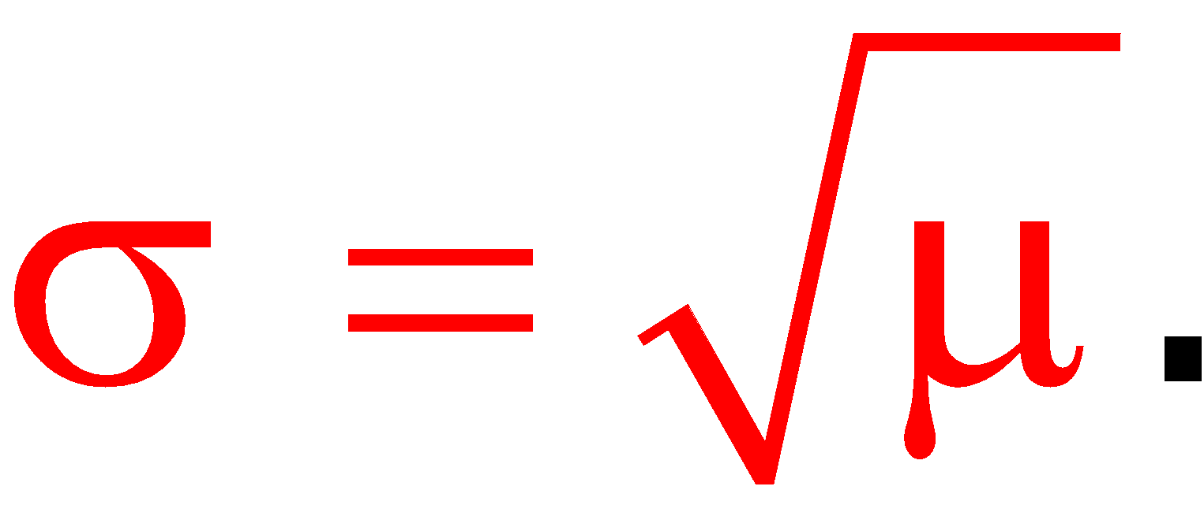
Parameters of the Poisson Distribution
The mean is µ.
The standard deviation is
Notes:
Page 231 of Elementary Statistics, 10th Edition.

Slide 47
Difference from a
Binomial Distribution
The Poisson distribution differs from the binomial distribution in these fundamental ways:
The binomial distribution is affected by the sample size n and the probability p, whereas the Poisson distribution is affected only by the mean μ.
In a binomial distribution the possible values of the random variable x are 0, 1, . . . n, but a Poisson distribution has possible x values of 0, 1, 2, . . . , with no upper limit.
Notes:
Page 231 of Elementary Statistics, 10th Edition.

Slide 48
Poisson as an Approximation to the Binomial Distribution
The Poisson distribution is sometimes used to approximate the binomial distribution when n is large and p is small.
Rule of Thumb
n ≥ 100
np ≤ 10
Notes:
If n is large (greater than or equal to 100) and np is less than or equal to 10, then the Poisson distribution can be used to approximate the binomial distribution.
Page 232 of Elementary Statistics, 10th Edition.

Slide 49
Poisson as an Approximation to the Binomial Distribution - μ
If both of the following requirements are met,
n ≥ 100
np ≤ 10
then use the following formula to calculate µ,
Value for μ μ = n • p
Notes:
Page 232 of Elementary Statistics, 10th Edition.

Slide 50
Recap
In this section we have discussed:
Definition of the Poisson distribution.
Requirements for the Poisson distribution.
Difference between a Poisson distribution and a binomial distribution.
Poisson approximation to the binomial.

