Slide 1
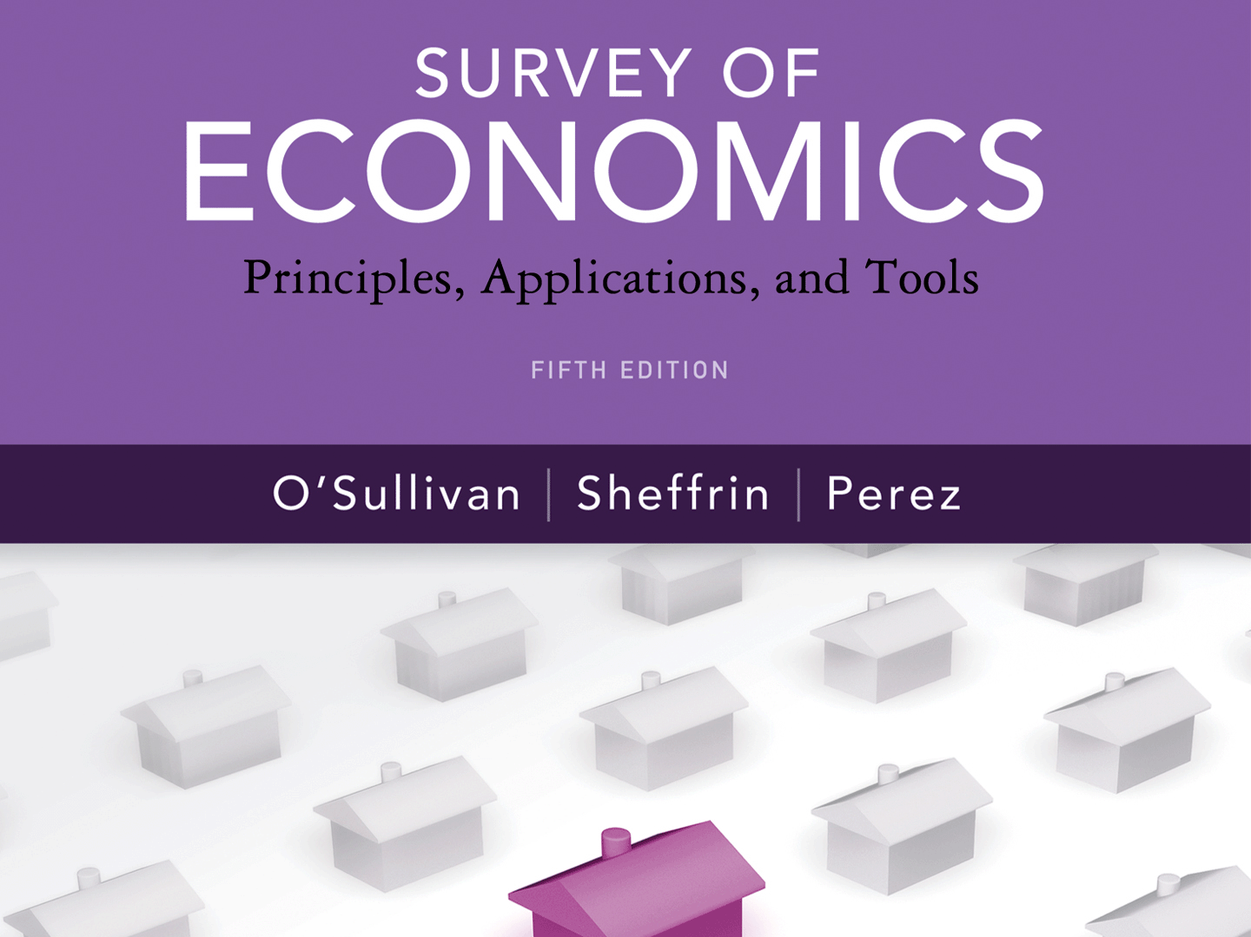
Copyright © 2012 Pearson Prentice Hall. All rights reserved.

Slide 3
A P P L Y I N G T H E C O N C E P T S
1
What is the opportunity cost of running a business?
Don’t Forget the Costs of Time and Invested Funds
How do people think at the margin?
Why Not Walk up an Escalator?
What is the rationale for specialization and exchange?
Jasper Johns and House Painting
Do farmers experience diminishing returns?
Fertilizer and Crop Yields
How does inflation affect the real minimum wage?
The Declining Real Minimum Wage
How does inflation affect lenders and borrowers?
Repaying Student Loans
2
3
4
5
6

Slide 4
THE PRINCIPLE OF OPPORTUNITY COST
2.1
P R I N C I P L E O F O P P O R T U N I T Y C O S T
The opportunity cost of something is what you sacrifice to get it.
● opportunity cost What you sacrifice to get something.
The Cost of College
Opportunity cost of money spent on tuition and books $ 40,000
Opportunity cost of college time (four years working for $20,000 per year) 80,000
Economic cost or total opportunity cost $120,000

Slide 5
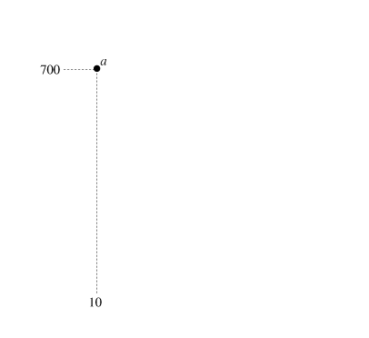
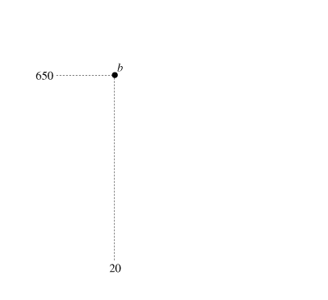
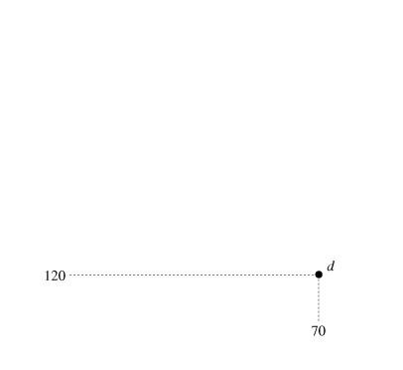
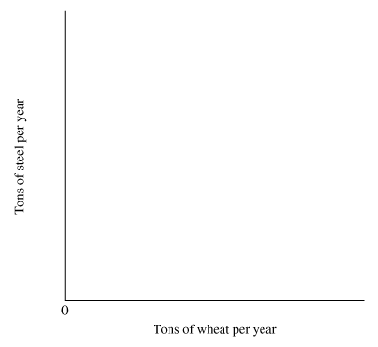
THE PRINCIPLE OF OPPORTUNITY COST (cont’d)
2.1
Opportunity Cost and the Production Possibilities Curve
● production possibilities curve
A curve that shows the possible combinations of products that an economy can produce, given that its productive resources are fully employed and efficiently used.
► FIGURE 2.1 Scarcity and the Production Possibilities Curve
The production possibilities curve illustrates the principle of opportunity cost for an entire economy.
An economy has a fixed amount of resources. If these resources are fully employed, an increase in the production of wheat comes at the expense of steel.

Slide 6
A P P L I C A T I O N
1
DON’T FORGET THE COSTS OF TIME AND INVESTED FUNDS
APPLYING THE CONCEPTS #1: What is the opportunity cost of running a business?
Betty makes a unique product—decorative bottle-cap pins. What is the annual cost of her business?
▪ She uses machines and tools that have a current market value of $10,000.
▪ The annual cost of her raw materials (bottle caps, paint, pins) is $2,000.
▪ She could be earning $30,000 in another job.
• Opportunity cost of funds invested. Betty could have invested the $10,000 in a bank account at 8 percent. The annual cost of her capital (machines and tools) is the $800 she could have earned during the year.
• Opportunity cost of her time. The opportunity cost of Betty’s time is the $30,000 salary she sacrifices by being her own boss.
Adding the $800 cost of funds and the $30,000 cost of her time to the $2,000 materials cost, we find Betty’s cost of doing business is $32,800 per year.

Slide 7
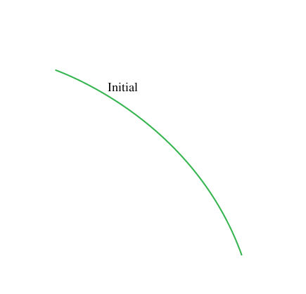
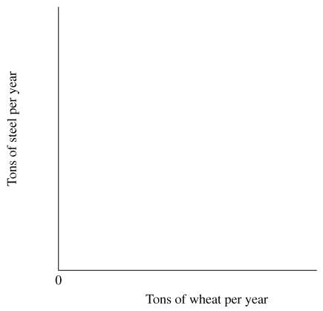
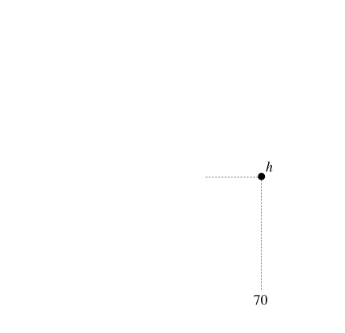
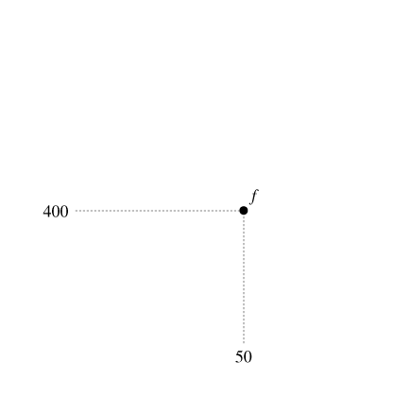
THE PRINCIPLE OF OPPORTUNITY COST (cont’d)
2.1
► FIGURE 2.2 Shifting the Production Possibilities Curve
An increase in the quantity of resources or technological innovation in an economy shifts the production possibilities curve outward.
Starting from point f, a nation could produce more steel (point g), more wheat (point h), or more of both goods (points between g and h).

Slide 8
2.2
THE MARGINAL PRINCIPLE
● marginal benefit The additional benefit resulting from a small increase in some activity.
● marginal cost The additional cost resulting from a small increase in some activity.
M A R G I N A L P R I N C I P L E
Increase the level of an activity as long as its marginal benefit exceeds its marginal cost. Choose the level at which the marginal benefit equals the marginal cost.

Slide 9
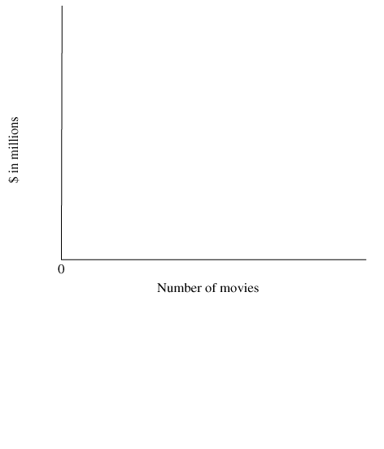
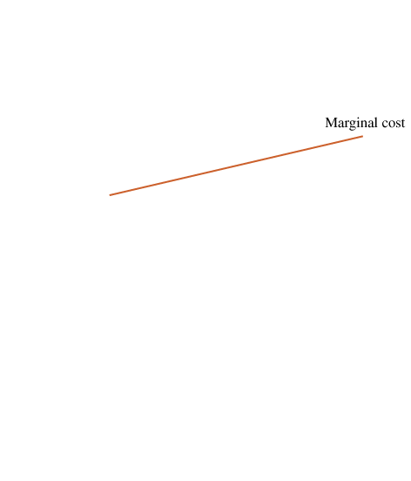
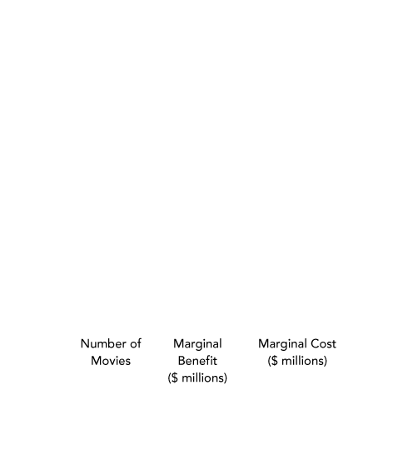
2.2
THE MARGINAL PRINCIPLE (cont’d)
How Many Movie Sequels?
► FIGURE 2.3 The Marginal Principle and Movie Sequels
The marginal benefit of movies in a series decreases because revenue falls off with each additional movie, while the marginal cost increases because actors demand higher salaries.
The marginal benefit exceeds the marginal cost for the first two movies, so it is sensible to produce two, but not three, movies.

Slide 10
2.2
THE MARGINAL PRINCIPLE (cont’d)
Renting College Facilities
Because many colleges include costs that aren’t affected by the use of a facility, they overestimate the actual cost of renting out their facilities, missing opportunities to serve student groups and make some money at the same time.
Automobile Emissions Standards
Using the marginal principle, the government should make the emissions standard stricter as long as the marginal benefit (savings in health-care costs and work time lost) exceeds the marginal cost (the cost of additional equipment and extra fuel used).

Slide 11
A P P L I C A T I O N
2
WHY NOT WALK UP AN ESCALATOR?
APPLYING THE CONCEPTS #2: How do people think at the margin?
Why do people walk up stairs, but do not walk up escalators?
▪ On stairs, if you stand still you get nowhere
▪ On an escalator, you can stand and get there slower or walk and get there faster
▪ The cost of walking is the same either way. We can use the Marginal Principle to
determine if it makes sense to walk up the escalator.
▪ Suppose you are on the way to listen to a free concert, and you would be willing to
pay $10 for the ticket.
▪ There is a long staircase and you would pay up to $3 to avoid it. Walking the
staircase is therefore worth $7, $10 - $3.
▪ The next week there is the same opportunity, but with an escalator.
▪ You can stand and get the $10 value or Walk up the escalator and arrive sooner, but
with a $3 walking cost.
The marginal principle would say walk up the escalator if the extra music you hear is worth the $3 extra cost incurred.

Slide 12
Driving Speed and Safety
Consider the decision about how fast to drive on a highway. The marginal benefit of going one mile per hour faster is the travel time you’ll save. On the cost side, an increase in speed increases your chances of colliding with another car, and also increases the severity of injuries suffered in a collision. A rational person will pick the speed at which the marginal benefit of speed equals the marginal cost.
In the 1960s and 1970s, the federal government required automakers to include a number of safety features, including seat belts and collapsible steering columns. These new regulations had two puzzling effects. Although deaths from automobile collisions decreased, the reduction was much lower than expected. In addition, more bicyclists were hit by cars and injured or killed.

Slide 13
Driving Speed and Safety (cont’d)
We can use the marginal principle to explain why seat belts and other safety features made bicycling more hazardous. The mandated safety features decreased the marginal cost of speed: People who wear seat belts suffer less severe injuries in a collision, so every additional unit of speed is less costly. Drivers felt more secure because they were better insulated from harm in the event of a collision, and so they drove faster. As a result, the number of collisions between cars and bicycles increased, meaning that safer environment for drivers led to a more hazardous environment for bicyclists.

Slide 14
THE PRINCIPLE OF VOLUNTARY EXCHANGE
2.3
P R I N C I P L E O F V O L U N T A R Y E X C H A N G E
A voluntary exchange between two people makes both people better off.
Here are some examples.
▪ If you voluntarily exchange money for a college education, you must expect you’ll be better off with a college education. The college voluntarily provides an education in exchange for your money, so the college must be better off, too.
▪ If you have a job, you voluntarily exchange your time for money, and your employer exchanges money for your labor services. Both you and your employer are better off as a result.

Slide 15
THE PRINCIPLE OF VOLUNTARY EXCHANGE (cont’d)
2.3
Exchange and Markets
Adam Smith stressed the importance of voluntary exchange as a distinctly human trait. He noticed
a propensity in human nature . . . to truck, barter, and exchange one thing for another . . . It is common to all men, and to be found in no other . . . animals . . . Nobody ever saw a dog make a fair and deliberate exchange of one bone for another with another dog.

Slide 16
A P P L I C A T I O N
3
JASPER JOHNS AND HOUSEPAINTING
APPLYING THE CONCEPTS #3: What is the rationale for specialization and exchange?
Jasper Johns’ painting False Start sold for $80 million. He is among the top earning artist.
He could use his considerable paining skills to paint his own house.
▪ If his time as an artist is worth $5,000 a day, then his opportunity
cost of painting his house in one day is that same $5,000.
▪ Suppose a professional housepainter would take ten days and
charge $150 a day.
▪ Although Mr. Johns is more productive, he could earn $5,000 for
his day of work and pay someone else $1,500 for ten days of work
and be $3,500 better off.
People are better off specializing in what they do best and the buying goods and services from someone else.

Slide 17
THE PRINCIPLE OF DIMINISHING RETURNS
2.4
P R I N C I P L E O F D I M I N I S H I N G R E T U R N S
Suppose output is produced with two or more inputs, and we increase one input while holding the other input or inputs fixed. Beyond some point—called the point of diminishing returns—output will increase at a decreasing rate.
Diminishing Returns from Sharing a Production Facility
When we add a worker to the facility, each worker becomes less productive because he or she works with a smaller piece of the facility:
More workers share the same machinery, equipment, and factory space. As we pack more and more workers into the factory, total output increases, but at a decreasing rate.
It’s important to emphasize that diminishing returns occurs because one of the inputs to the production process is fixed.
When a firm can vary all its inputs, including the size of the production facility, the principle of diminishing returns is not relevant.

Slide 18
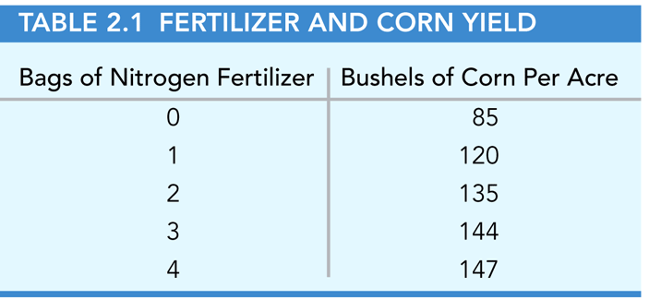
A P P L I C A T I O N
4
FERTILIZER AND CROP YIELDS
APPLYING THE CONCEPTS #4: Do farmers experience diminishing returns?
The notion of diminishing returns applies to all inputs to the production process. For example, one of the inputs in the production of corn is nitrogen fertilizer. Suppose a farmer has a fixed amount of land (an acre) and must decide how much fertilizer to apply.
Table 2.1 shows the relationship between the amount of fertilizer and the corn output. The farmer experienced diminishing returns because the other inputs to the production process are fixed.
Notes:
*

Slide 19
2.5
THE REAL-NOMINAL PRINCIPLE
R E A L - N O M I N A L P R I N C I P L E
What matters to people is the real value of money or income—its purchasing power—not its “face” value.
● nominal value The face value of an amount of money.
● real value The value of an amount of money in terms of what it can buy.

Slide 20
A P P L I C A T I O N
5
THE DECLINING REAL MINIMUM WAGE
APPLYING THE CONCEPTS #5: How does inflation affect the real minimum wage?
Between 1974 and 2007, the federal minimum wage increased from $2.00 to $5.85.
Was the typical minimum-wage worker better or worse off in 2007?
We can apply the real-nominal principle to see what’s happened over time to the real value of the federal minimum wage.
Because prices increased faster than the nominal wage, the real value of the minimum wage actually decreased over this period.

Slide 21
A P P L I C A T I O N
6
REPAYING STUDENT LOANS
APPLYING THE CONCEPTS #6: How does inflation affect lenders and borrowers?
Suppose you finish college with $20,000 in student loans and start a job that pays a salary of $40,000 in the first year. In 10 years, you must repay your college loans. Which would you prefer, stable prices, rising prices, or falling prices?
▪ In this case, your nominal salary in 10 years is $40,000, and the real cost of
repaying your loan is the half year of work you must do to earn the $20,000 you
owe.
▪ However, if all prices double over the 10-year period, your nominal salary will
double to $80,000, and, it will take you only a quarter of a year to earn $20,000 to
repay the loan.
▪ In other words, a general increase in prices lowers the real cost of your loan.

Slide 22
KEY TERMS
marginal benefit
marginal cost
nominal value
opportunity cost
production possibilities curve
real value

