Slide 1


Slide 2
Chapter 4 Objectives
Understand the basic properties of electric charge.
Differentiate between conductors and insulators.
Explain the meaning of Coulomb's law.
Calculate electric force using Coulomb’s law.
Compare electric force with gravitational force.
Calculate electric field.
Draw and interpret electric field lines
Distinguish between electrical potential energy, electric potential, and potential difference.
Solve problems involving electrical energy and potential difference.
Use Ohm’s law to solve electric flow problems.

Slide 3
Chapter 4 Objectives
Analyze circuits with loads in series and parallel.
Find current, voltage, and resistance in simple circuits.
Find electric power.
Calculate electric power.

Slide 4
Electricity
Electricity is the name given to a wide range of electrical phenomena, such as
  lightning.
  spark when we strike a match.
  what holds atoms together.
Electrostatics; the study of electric charge at rest
-- Electrostatics involves electric charges,
  the forces between them,
  the aura that surrounds them, and
  their behavior in materials.

Slide 5
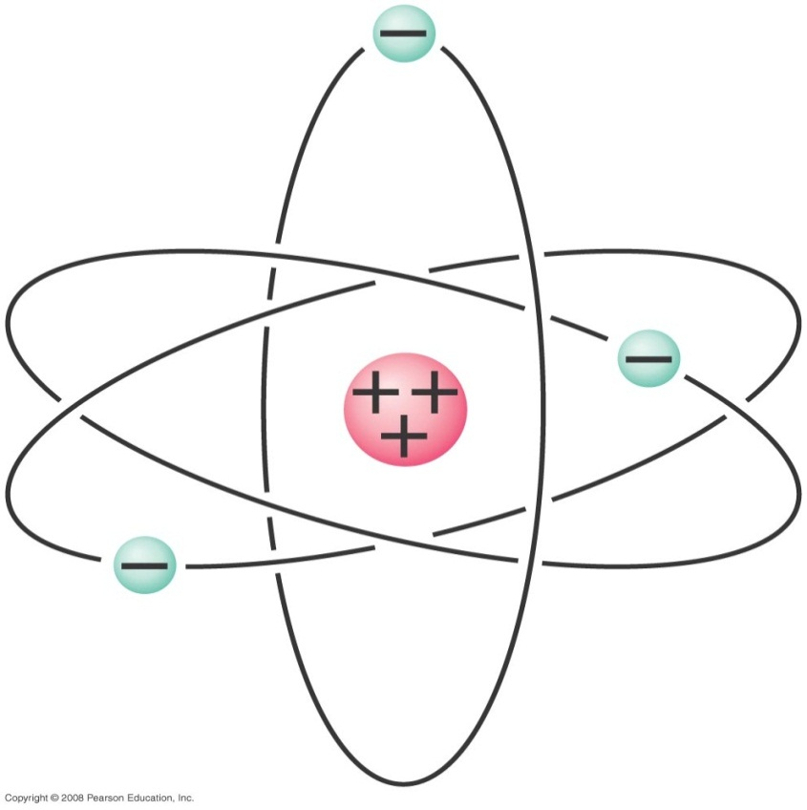
Electric Force and Charges
Fundamental facts about atoms
Every atom is composed of a positively charged nucleus surrounded by negatively charged electrons.
Atom:
Nucleus (small, massive, positive charge)
Electron cloud (large, very low density, negative charge)

Slide 6
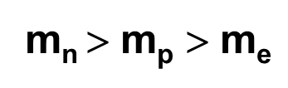
Electric Force and Charges
Fundamental facts about atoms
Each of the electrons in any atom has the same quantity of negative charge and the same mass.
Protons and neutrons compose the nucleus. Protons are about 1800 times more massive than electrons, but each one carries an amount of positive charge equal to the negative charge of electrons. Neutrons have slightly more mass than protons and have no net charge.
Atoms usually have as many electrons as protons, so the atom has zero net charge.

Slide 7
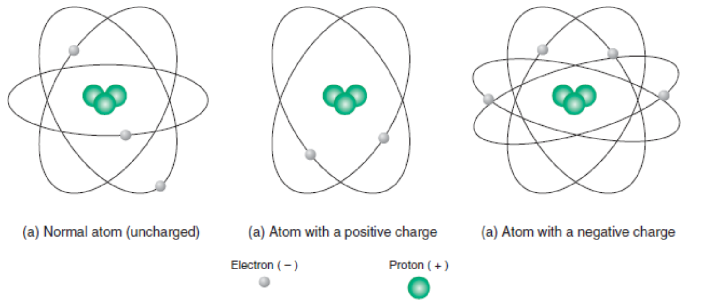
Electric Force and Charges
Electrons in an atom
Innermost—attracted very strongly to oppositely charged atomic nucleus
Outermost—attracted loosely and can be easily dislodged
Ion
Positive ion—atom losing one or more electrons has positive net charge.
Negative ion—atom gaining one or more electrons has negative net charge.

Slide 8

Objects can be charged by rubbing
Conservation of charge
In any charging process,
no electrons are created
or destroyed. Electrons
are simply transferred from
one material to another.

Slide 9
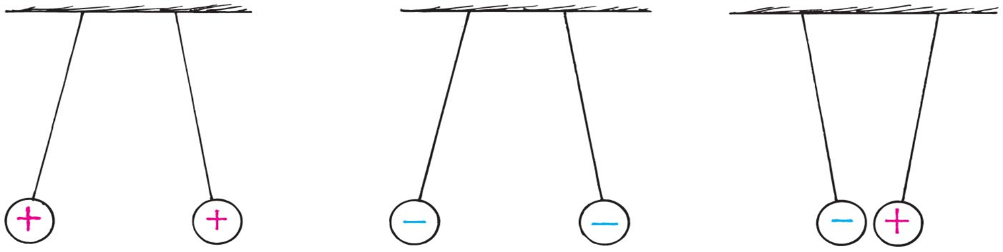
Properties of Electric Charge
There are two kinds of electric charge
  positive and negative.
  like charges repel
  unlike charges attract
Electric charge is conserved.
  Positive electric charges are called protons.
  Neutral electric charges are called neutrons.
  Negative electric charges are called electrons.

Slide 10
Properties of Electric Charge
Chapter 16
Electric charge is quantized. That is, when an object is charged, its charge is always a multiple of a fundamental unit of charge.
q = ne
Charge is measured in coulombs (C).
The fundamental unit of charge, e, is the magnitude of the charge of a single electron or proton.
  e = 1.602 176 x 10^{–19} C

Slide 11
Electric Force and Charges
Examples:
  When rubbing a comb through your hair, electrons transfer from your hair to the comb. Your hair has a deficiency of electrons (positively charged).
  When rubbing a glass rod with silk, electrons transfer from the rod onto the silk and the rod becomes positively charged.
Check Point

Slide 12
Coulomb’s Law
Two charges near one another exert a force on one another called the electric force.
Relationship among electrical force, charge, and distance discovered by Charles Coulomb in the 18th century
For a pair of charged objects (q₁ and q₂) that are much smaller than the distance (r) between them, Coulomb’s law states that
The force between two point charges q₁ and q₂ is directly proportional to the product of their magnitudes and inversely proportional to the square of the distance separating them, r.

Slide 13
Coulomb’s Law(continued)
In equation form:
If the charges are alike in sign, the force is repelling; if the charges are not alike, the force is attractive.
  Positive Force => repulsion
  Negative Force => attraction
Underlies the bonding forces between molecules

Slide 14
Differences between electric and gravitational forces
1. Electric force can be attractive or repulsive, but gravitational force is always attractive
2. Electric force is stronger than gravitational force

Slide 15
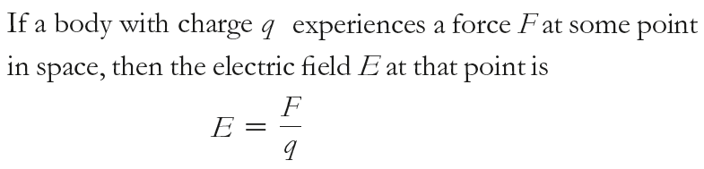
Electric Field
Electric field
Space surrounding an electric charge (an energetic aura)
Describes electric force
Around a charged particle obeys inverse-square law
Force per unit charge (unit: N/C)
The force on an object of charge q in an electric field is given by:
F = q E

Slide 16
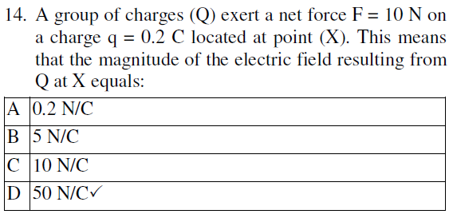

Electric Field
Electric field depends on charge and distance. An electric field exists in the region around a charged object.
Electric Field Due to a Point Charge Q
$E=\frac{F}{q}=k \frac{Q}{r^{2}}$

Slide 17
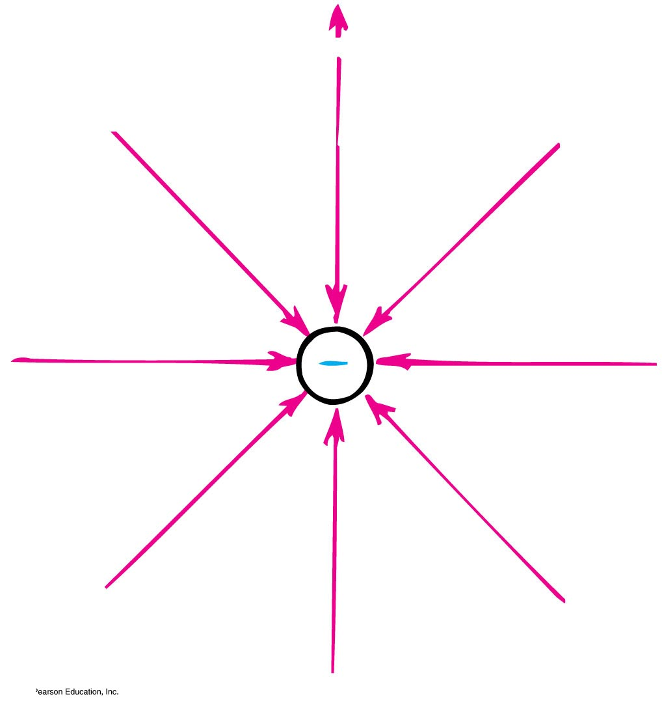
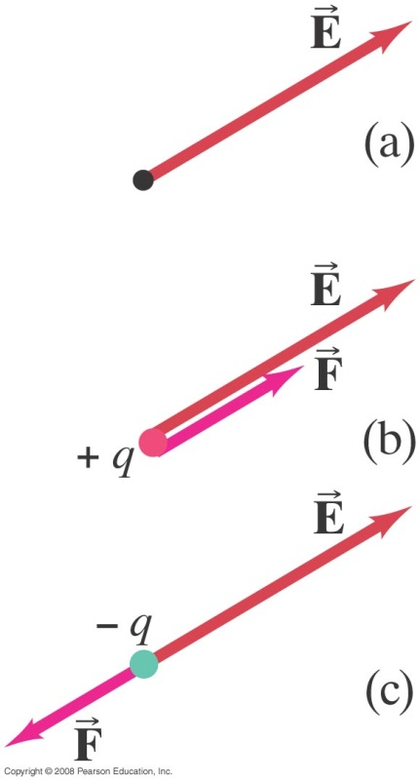
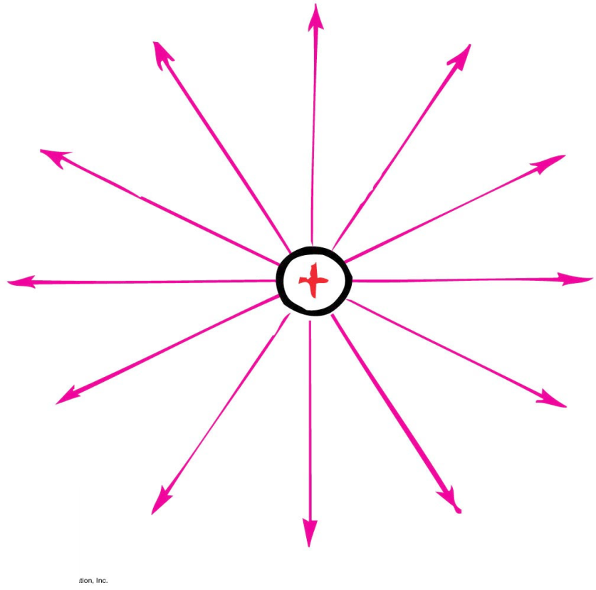
Electric Field
Electric field direction
Same direction as the force on a small positive test charge
Opposite direction to the force on an electron

Slide 18
Electric-field representations about a negative charge.
(a) A vector representation.
(b) A lines-of-force representation.

Slide 19
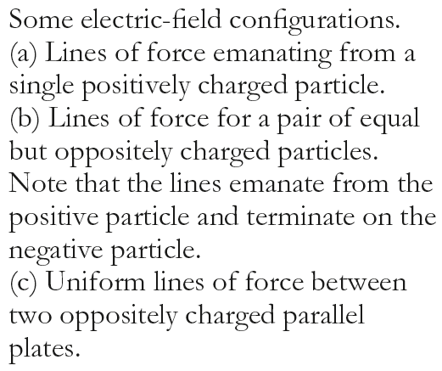
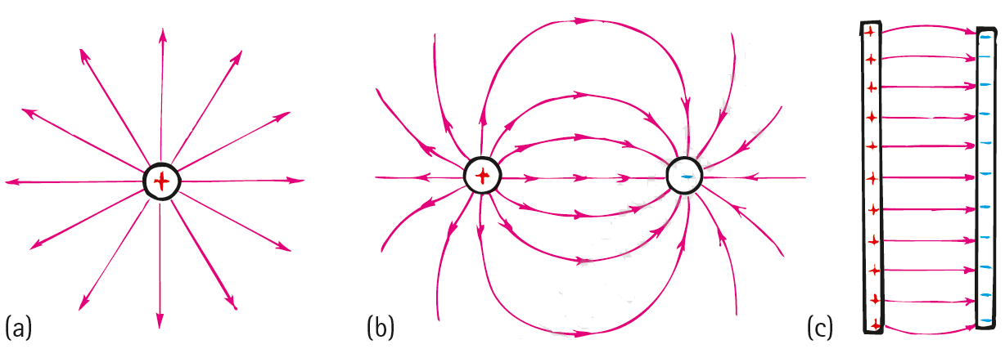


Slide 20
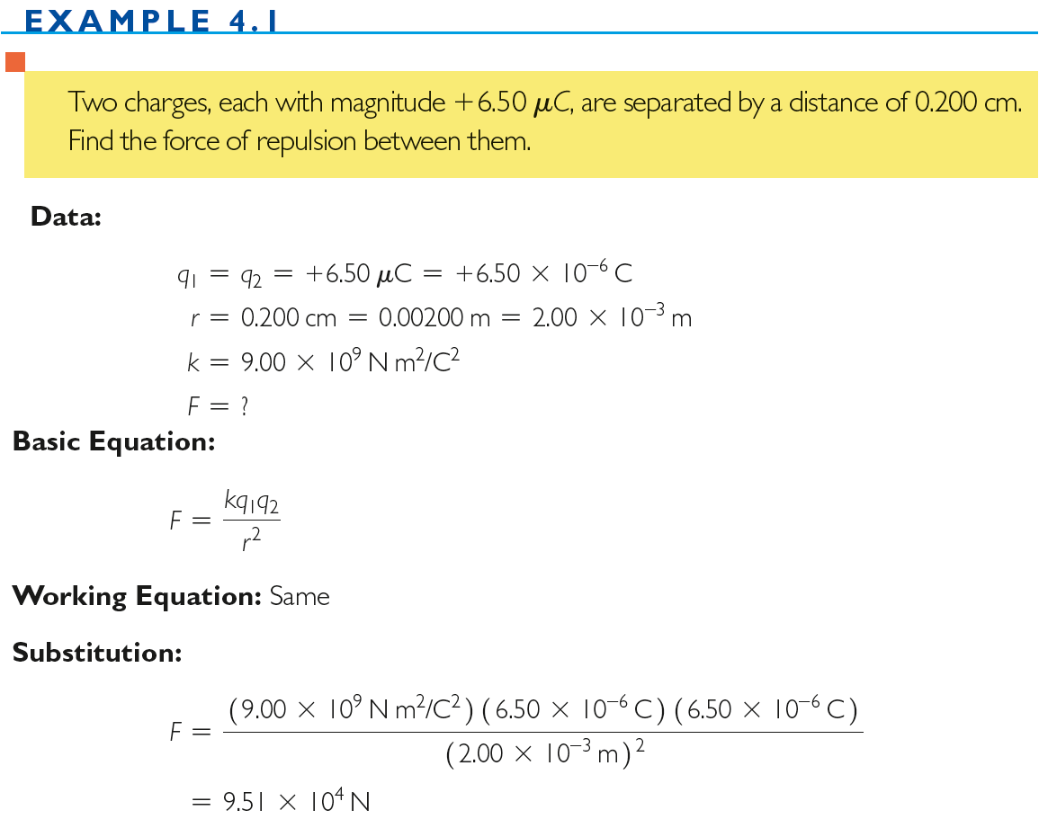

Slide 21
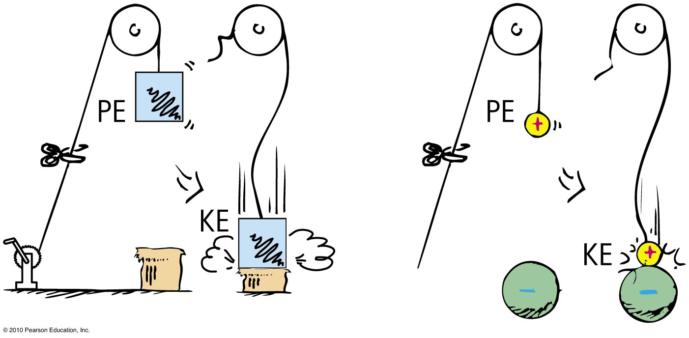
Electric Potential
Electric potential energy (unit: Joule (J))
Energy possessed by a charged particle due to its location in an electric field.
Work is required to push a charged particle against the electric field of a charged body.
Notes:
pəˈzest

Slide 22
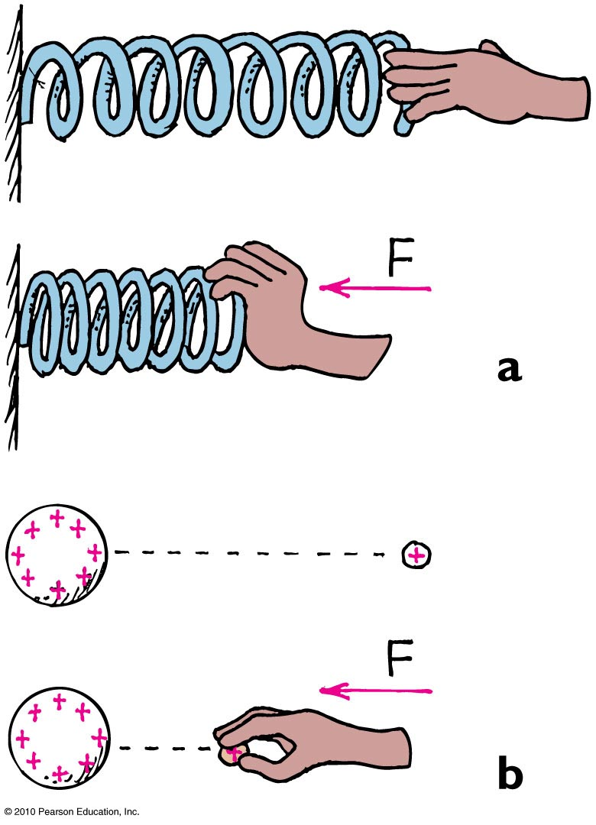
Electric Potential
(a) The spring has more elastic PE when compressed.
(b) The small charge similarly has more PE when pushed closer to the charged sphere. In both cases, the increased PE is the result of work input.

Slide 23
Electric Potential
Electric potential (voltage)
Electric potential energy per unit charge.
May be called voltage—potential energy per charge
In equation form:
electric potential energy
Electric potential =
charge
Unit of measurement: volt,
1 volt =
1 joule
1 coulomb

Slide 24
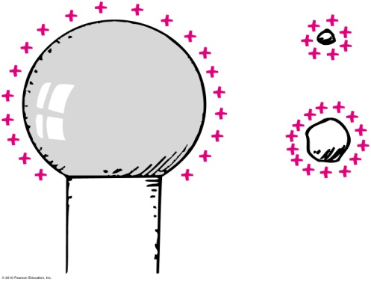
Electric Potential
Electric potential (voltage)
Example:
  Twice the charge in same location has twice the electric potential energy but the same electric potential.
  3 times the charge in same location has 3 times the electric potential energy; U; but the same electric potential (2 U/2 q =
  3 U/3 q = V)

Slide 25
Electric potential energy is measured in joules. Electric potential, on the other hand (electric potential energy per charge), is measured
Electric Potential
CHECK YOUR ANSWER
A. in volts.
in watts.
in amperes.
also in joules.
Notes:
A. in volts.

Slide 26
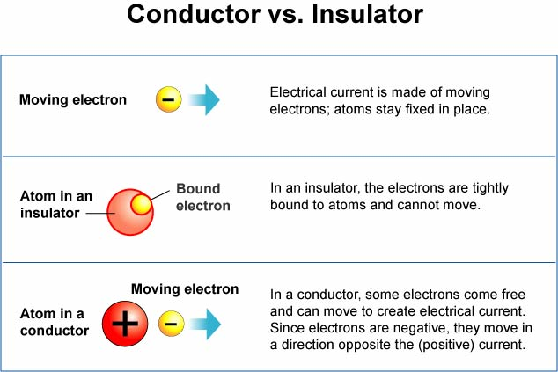
An electrical conductor is a material in which charges can move freely.
An electrical insulator is a material in which charges cannot move freely.
Notes:
kənˈdʌk.tər - ˈɪn.sjʊ.leɪ.tər

Slide 27
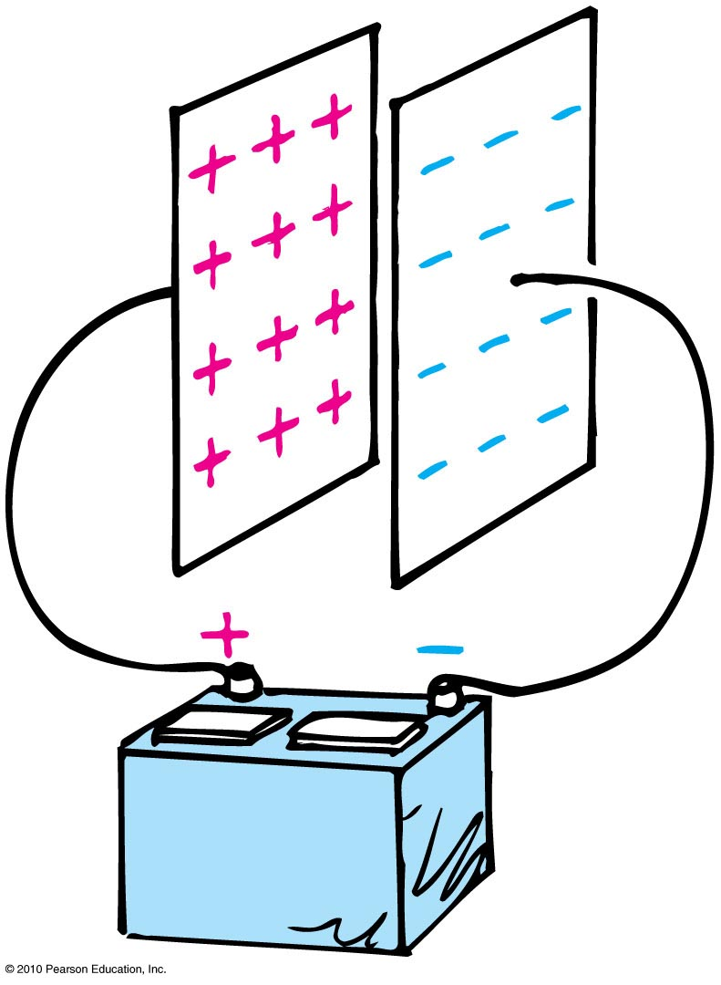
Electric Energy Storage
Electrical energy can be stored in a common device called a capacitor.
The simplest capacitor is a pair of conducting plates separated by a small distance, but not touching each other.
When the plates are connected to a charging device, such as the battery, electrons are transferred from one plate to the other.

Slide 28
Electric Energy Storage
This occurs as the positive battery terminal pulls electrons from the plate connected to it.
These electrons, in effect, are pumped through the battery and through the negative terminal to the opposite plate.
The capacitor plates then have equal and opposite charges:
  The positive plate connected to the positive battery terminal, and
  The negative plate connected to the negative terminal.

Slide 29
Electric Energy Storage
The charging process is complete when the potential difference between the plates equals the potential difference between the battery terminals—the battery voltage.
The greater the battery voltage, and the larger and closer the plates, the greater the charge that can be stored.
The energy stored in a capacitor comes from the work required to charge it.

Slide 30
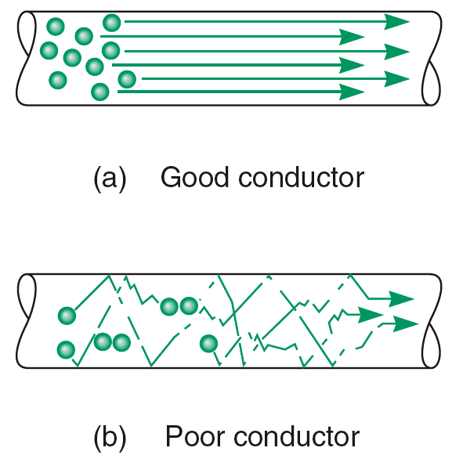
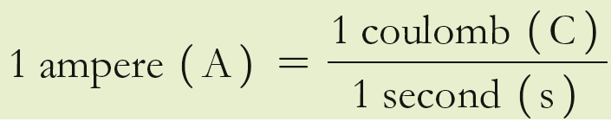

Electric Current
Rate of electric flow
Or
Electric Current is the rate of flow of charge.
Measured in ampere (1 coulomb of charge per second).
Charge flows through a circuit; voltage is established across a circuit.
$$I= \frac{Q}{t}$$
Notes:
Speed of electrons (drift speed) through a wire is slow because of continuous bumping of electrons in wire.

Slide 31


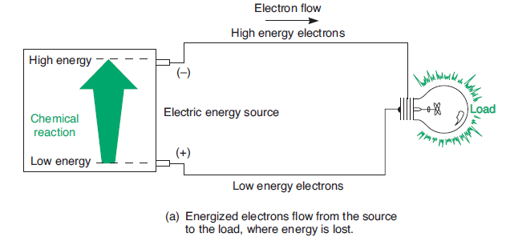
The potential difference between two points in an electric field is the work done per unit of charge as the charge is moved between two points. That is,
In sources, the raising of the potential energy of electrons that results in a potential difference across a source is called emf (E).
In circuits, the lowering of the potential difference across a load is called voltage drop.

Slide 32
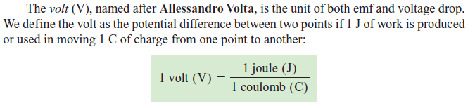

Slide 33

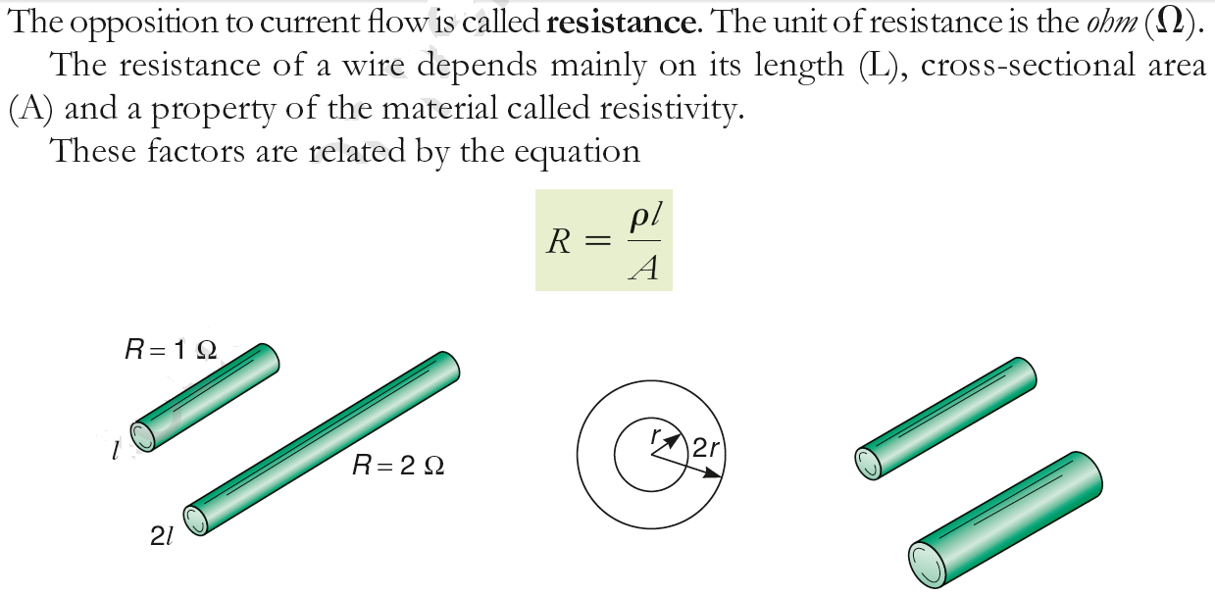

Slide 34
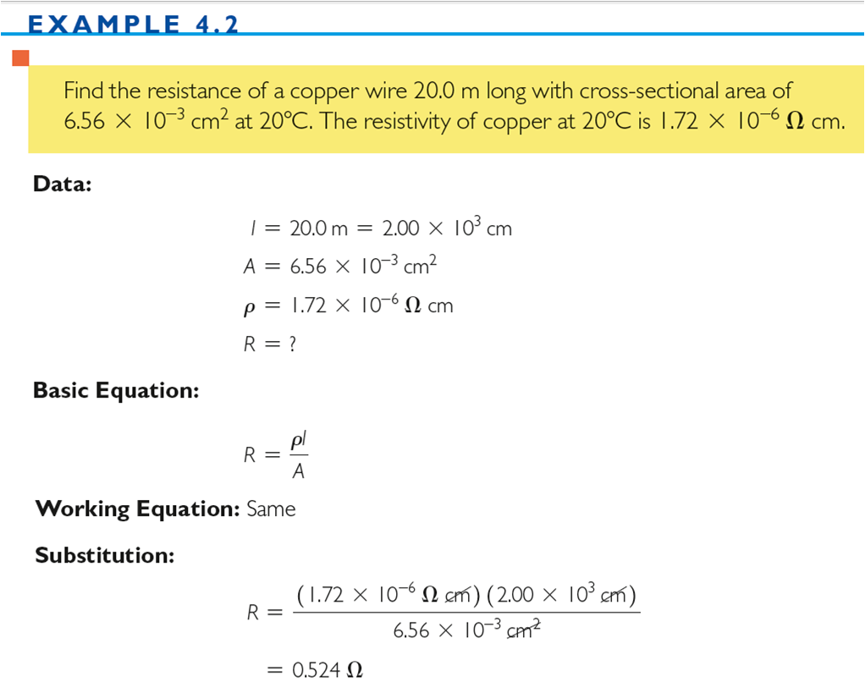

Slide 35
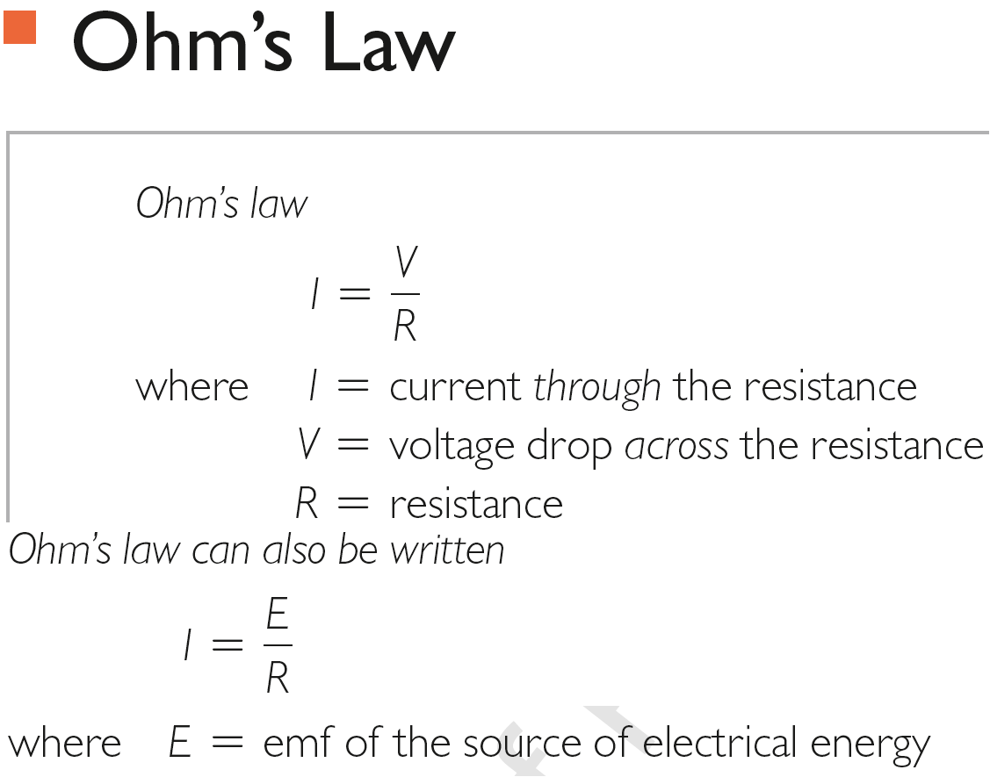

Slide 36
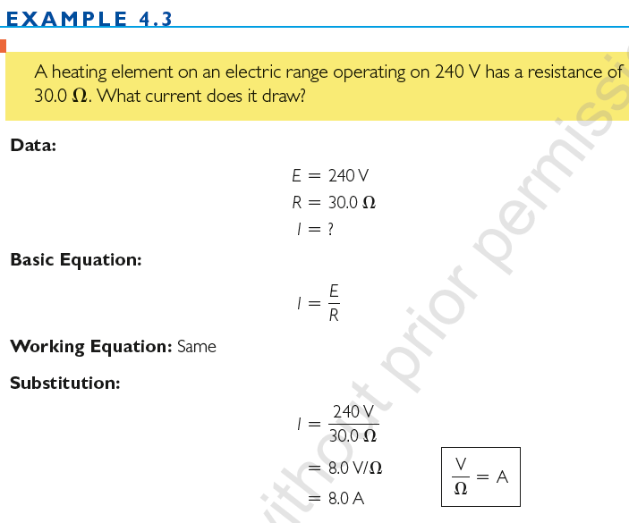

Slide 37

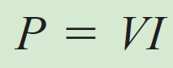
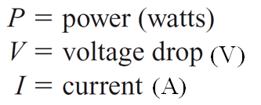
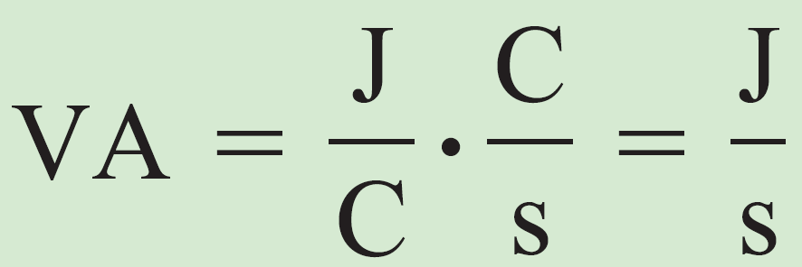

The rate of consuming energy is called power.
Or; electric power is the rate at which electrical energy is converted into another form.
Unit = Watt (W)
1 watt = (1 ampere) × (1 volt)
Since the watt is a relatively small unit, the kilowatt ( 1 kW = 1000 W) is commonly used in industry.
Notes:
Electric power is the rate at which electrical energy is converted into another form

Slide 38
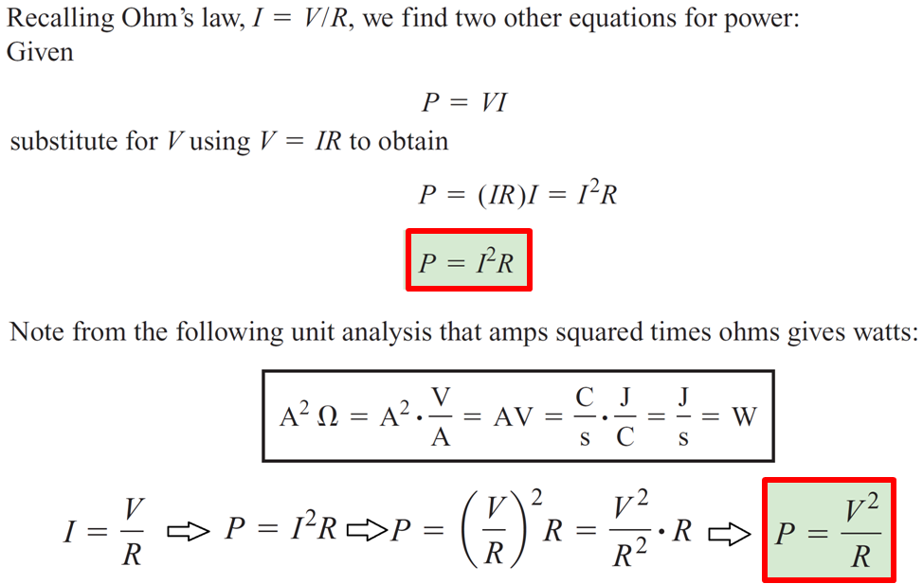

Slide 39
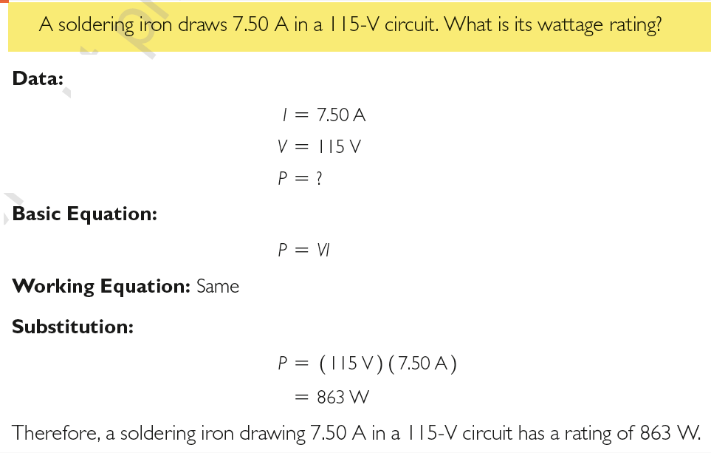
EXAMPLE

Slide 40
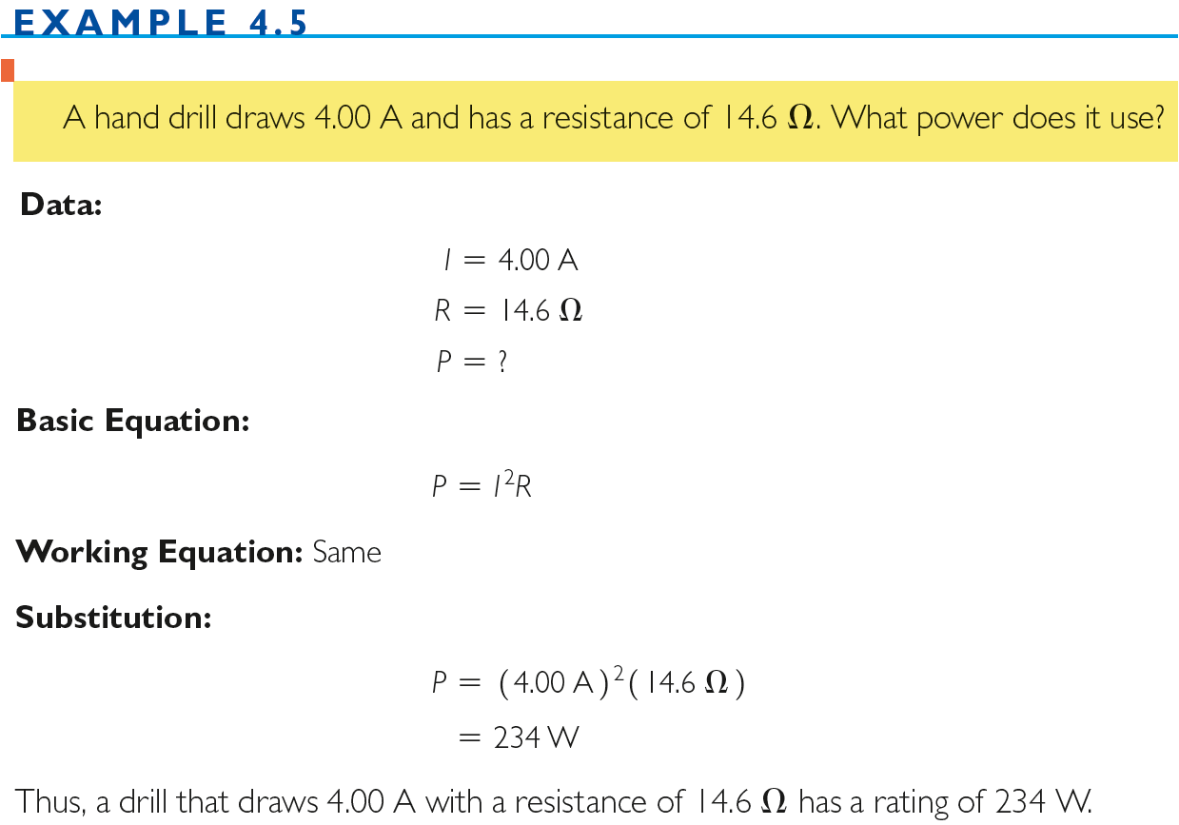

Slide 41
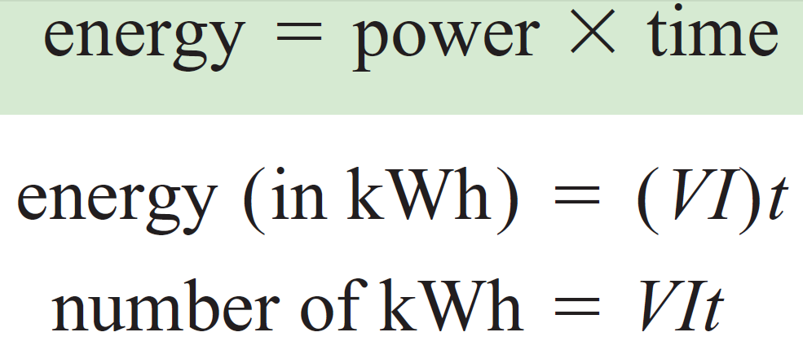
V (in volts), I (in Amperes), and t (in hours.)

Slide 42
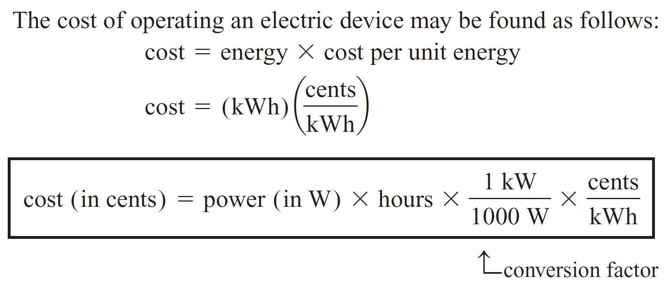
Halala (h) in KSA

Slide 43
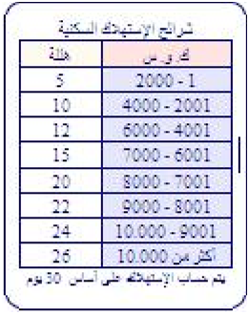
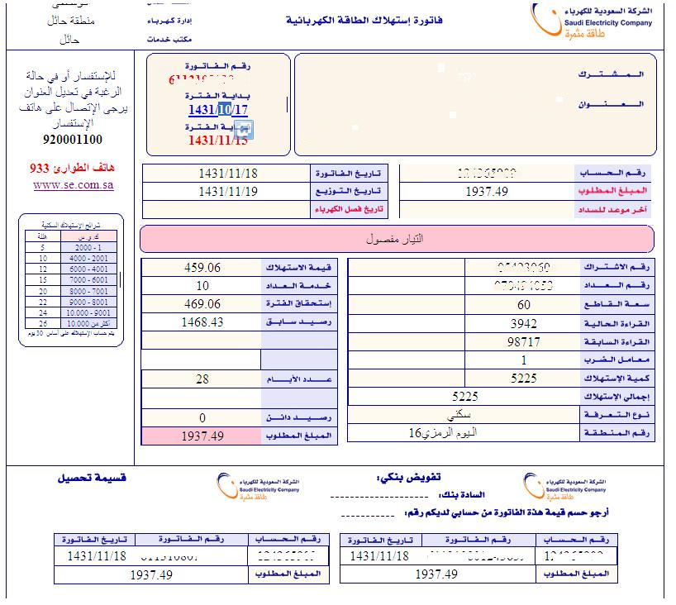
Example:
1500 kW.h ⇒ 1500 kW.h × 0.05 RS / kWh = 75 RS

Slide 44
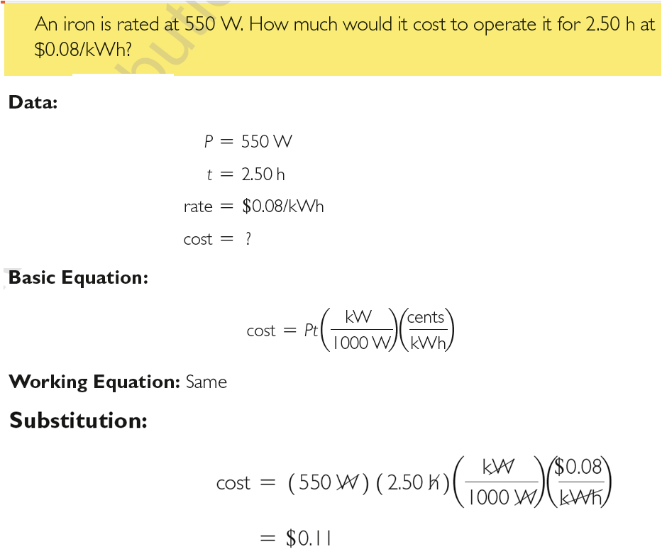

Slide 45
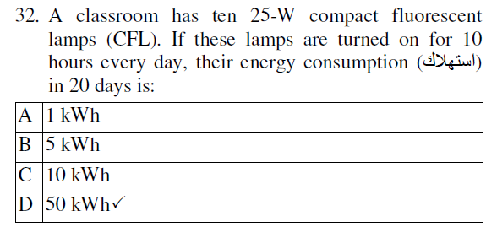

Slide 46

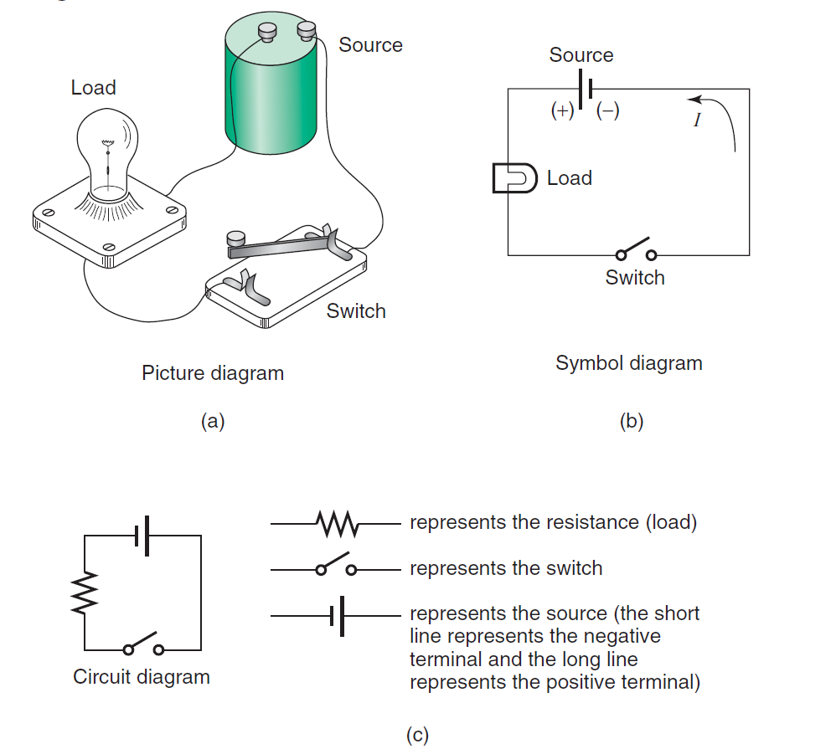

Slide 47
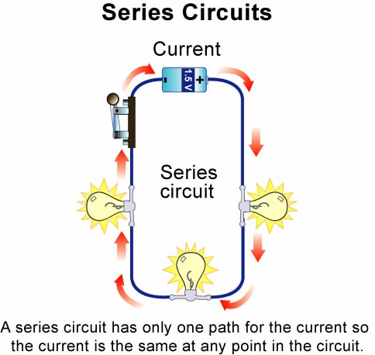

Slide 48
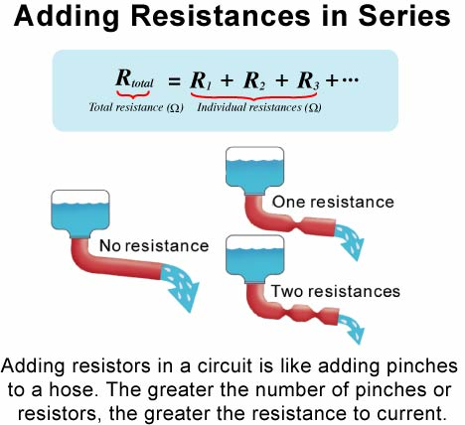

Slide 49
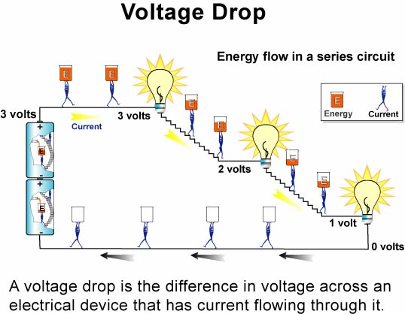

Slide 50

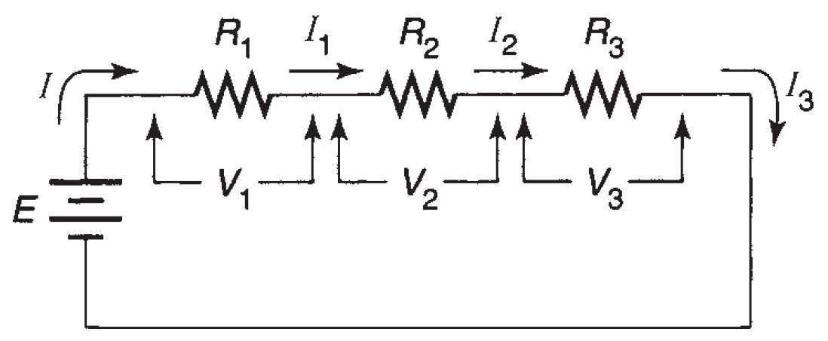
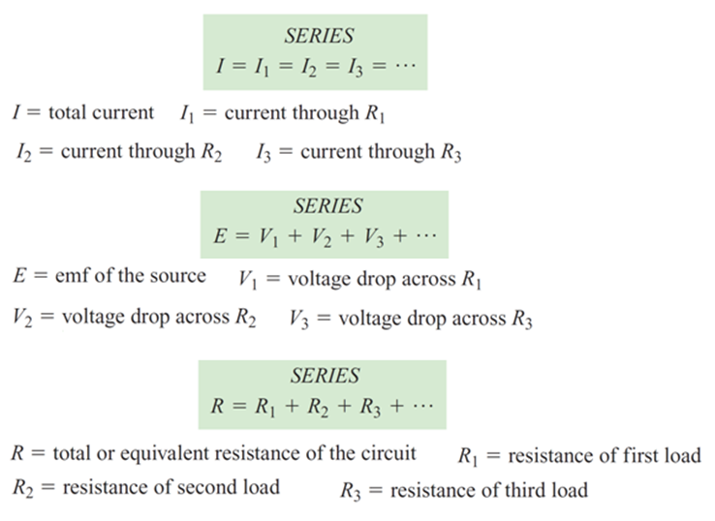
An electric circuit with only one path for the current to flow is called a series circuit.

Slide 51
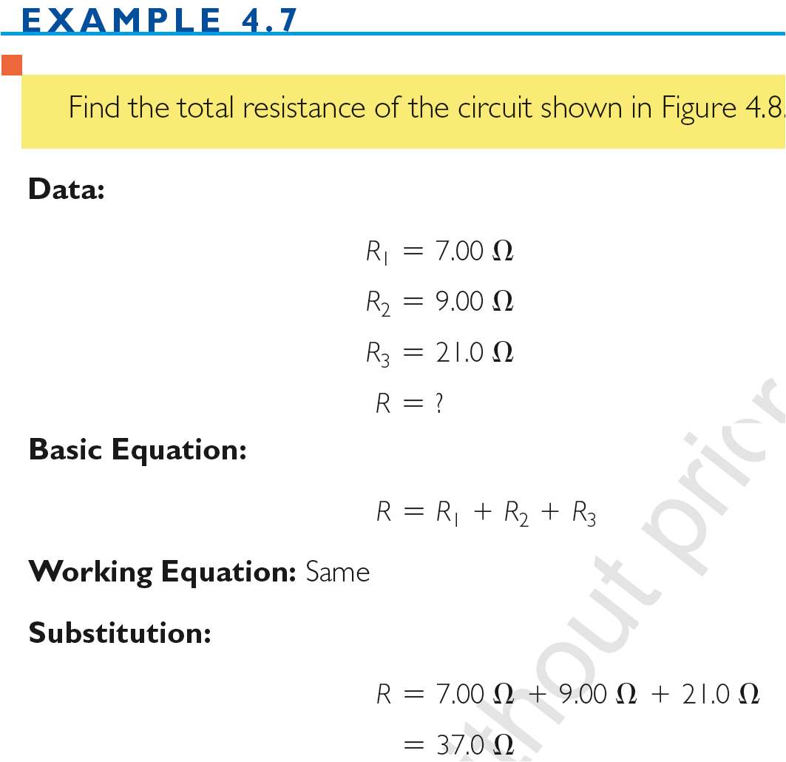
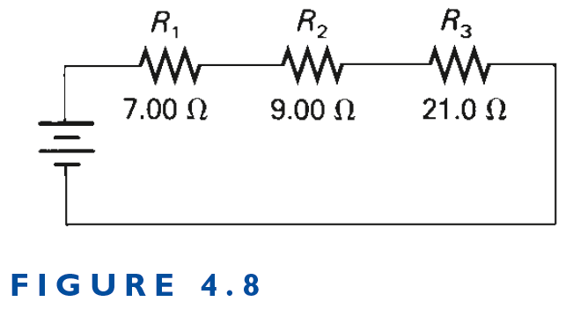

Slide 52
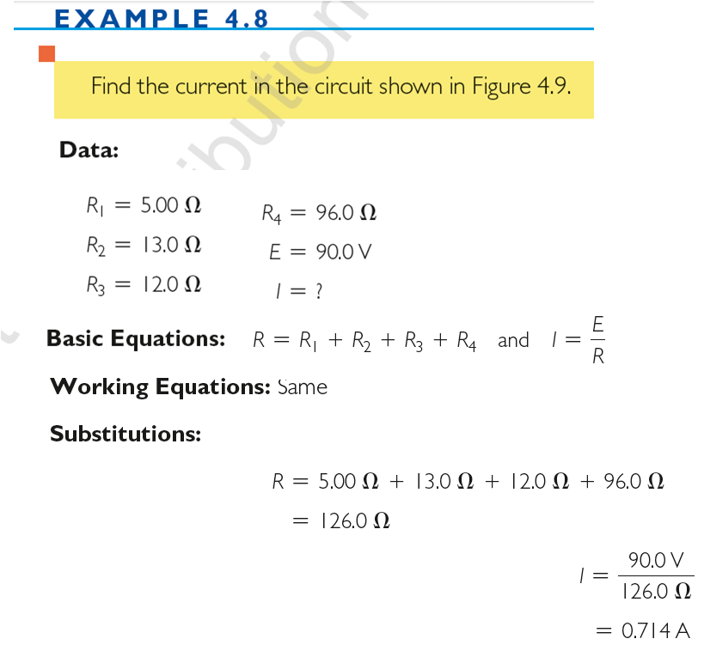
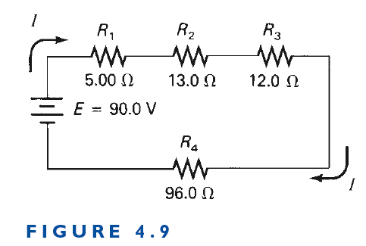

Slide 53
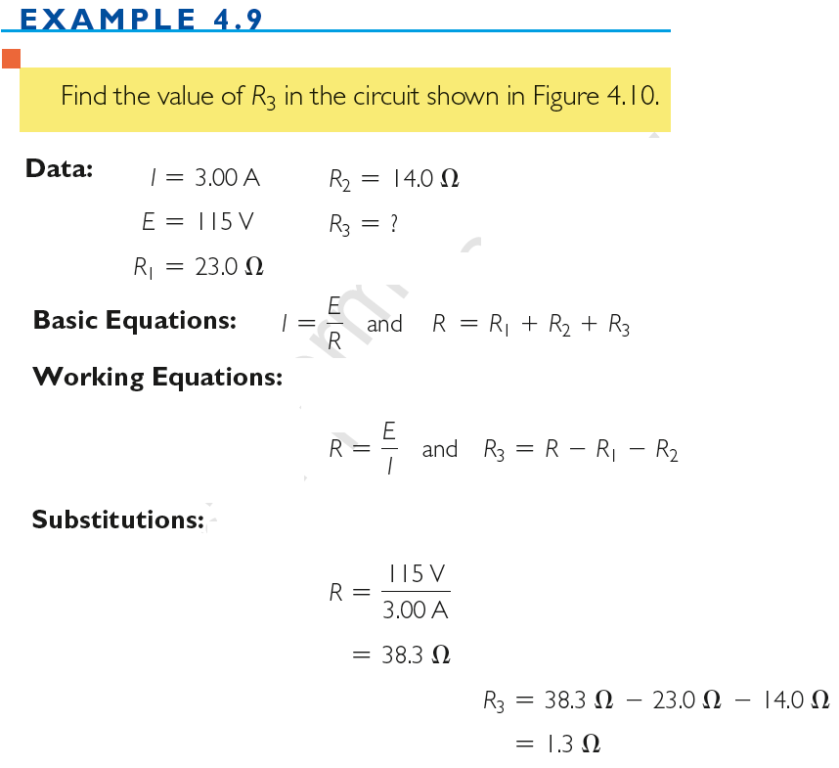


Slide 54



Slide 55


An electric circuit with more than one path for the current to flow is called a parallel circuit.

Slide 56










Slide 57

If the parallel combination of resistances is replaced by a single resistance with the resistance R, the same current flows in the circuit.

Slide 58


Slide 59


Slide 60


EXAMPLE

Slide 61


Slide 62



