Slide 1
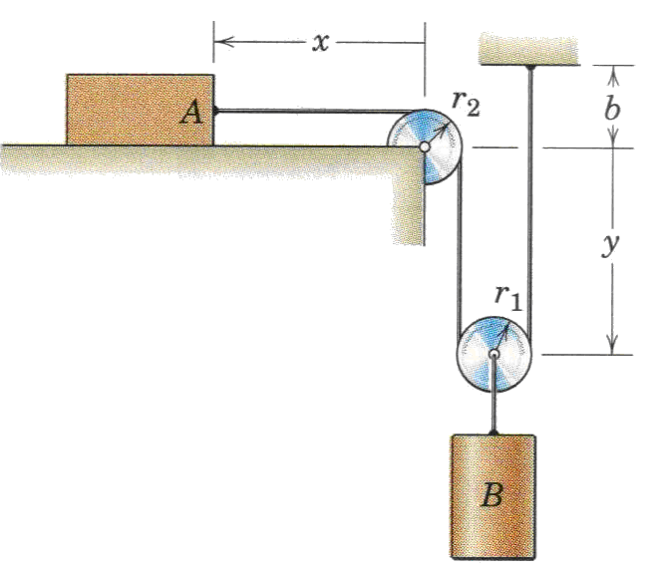
Dependent or constrained Motion
Lecture III

Slide 2
Dependent or constrained Motion
Here, motions of more than one particle are interrelated because of the constraints imposed by the interconnecting members.
In such problems, it is necessary to account for these constraints in order to determine the respective motions of the particles.

Slide 3
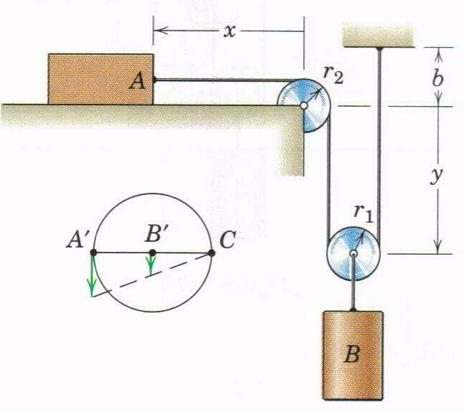
Dependent or constrained Motion(Cont.)
+
Datum
+
One Degree of Freedom System
Notes:
Horizontal motion of A is twice the vertical motion of B.
The motion of B is the same as that of the center of its pulley, so we establish position coordinates x and y measured from a convenient fixed datum.
The system is one degree of freedom, since only one variable, either x or y, is needed to specify the positions of all parts of the system.
L, r₁, r₂, and b are constants
Differentiating once and twice gives:

Slide 4
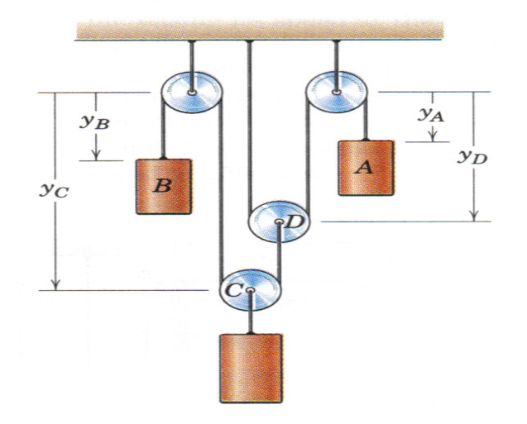
Dependent or constrained Motion(Cont.)
Datum
Datum
+
+
+
+
Two Degree of Freedom System
Note:
The positions of the lower pulley C depend on the separate specifications of the two coordinates y_{A} & y_{B}.
It is impossible for the signs of all three terms to be +ve simultaneously.
Differentiating once gives:
Differentiating once gives:
Eliminating the terms in gives:

Slide 5
Dependent or constrained Motion
Exercises

Slide 6
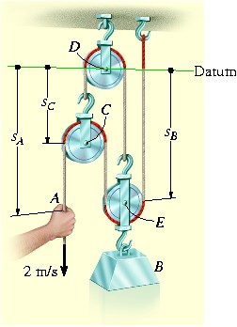
Exercise # 1
Determine the speed with which block B rises if the end of the cord at A is pulled down with a speed of 2m/s.

Slide 7
Exercise # 2
The crate is being lifted up the inclined plane using the motor M and the rope and pulley arrangement shown. Determine the speed at which the cable must be taken up by the motor in order to move the crate up the plane with a constant speed of 1.2 m/s.

Slide 8
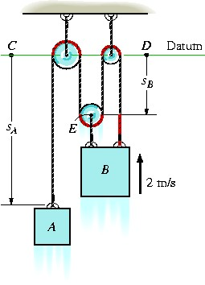
Exercise # 3
Determine the speed of block A if block B has an upward speed of 2 m/s.

Slide 9
Exercise # 4
The power winches on the industrial scaffold enable it to be raised or lowered. For rotation in the senses indicated, the scaffold is being raised. If each drum has a diameter of 200 mm and turns at the rate of 40 rev/min. determine the upward velocity v of the scaffold.

Slide 10
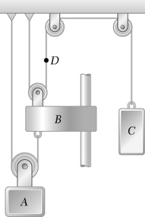
Exercise # 5
Block C starts from rest and moves down with a constant acceleration. Knowing that after block A has moved 0.5 m its velocity is 0.2 m/s, determine (a) the accelerations of A and C, (b) the velocity and the change in position of block B after 2 s.

Slide 11
Exercise # 6
The crate C is being lifted by moving the roller at A downward with a constant speed of v = 2 m/s along the guide. Determine the velocity and acceleration of the crate at the instant s = 1 m. When the roller is at B, the crate rests on the ground. Neglect the size of the pulley in the calculation. Hint: Relate the coordinates x_{C} and x_{A} using the problem geometry, then take the first and second time derivatives.

