Slide 1
3D Printing Techniques
Extrusion-Based Systems

Slide 2
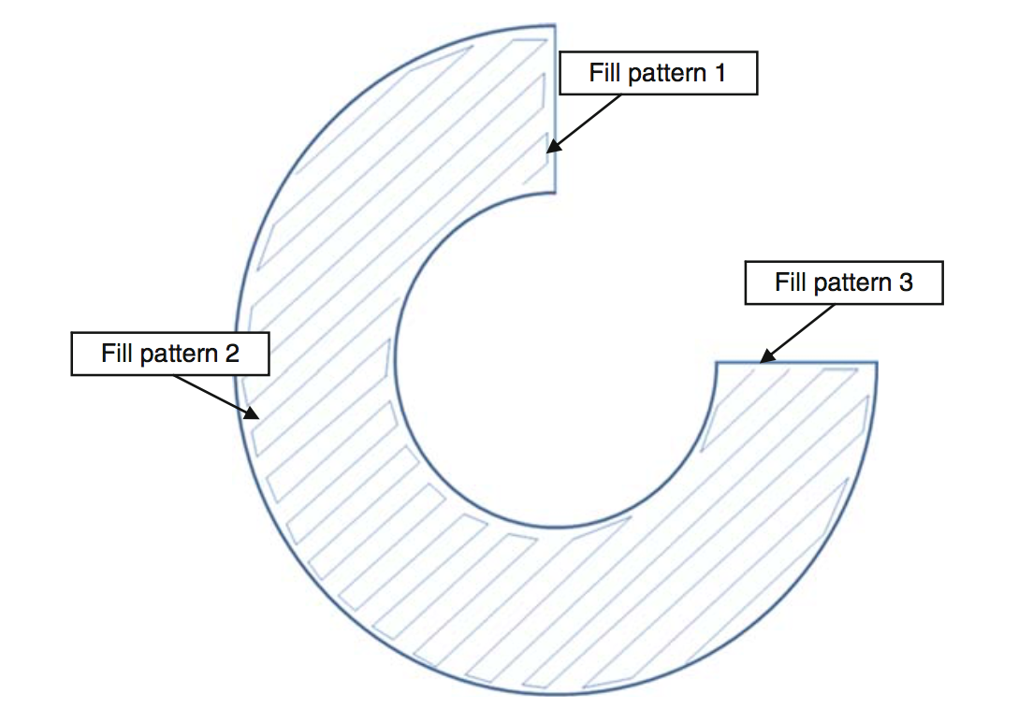
Basic Principles Positional Control
The extrusion head is typically carried on a plotting system that allows movement in the horizontal plane.
This plotting must be coordinated with the extrusion rate to ensure smooth and consistent deposition.
This would involve two orthogonally mounted linear drive mechanisms like belt drives or lead-screws.
cheaper systems often make use of belts driven by stepper motors, higher cost systems typically use servo drives with lead- screw technology.
A common followed strategy is to 3D print the outline of the part to be built using a slower plotting speed to ensure that material flow is maintained at a constant rate.

Slide 3
Basic Principles Positional Control
The internal fill pattern can be built more rapidly since the outline represents the external features of the part that corresponds to geometric precision
Choose at least 10%infill,more than 30% are not necessary.
Interior Fill Percentage = determines the interior solidity.
Internal Fill Pattern = determines the infill geometries. The recommended geometries are Grid (fast) and Honeycomb (solid).
For strong prints, choose Grid, Solid Honeycomb or Triangular.
For prints that don’t have to be strong use Fast Honeycomb or Rectilinear to get a faster print.
For flexible print choose wiggle.

Slide 4
Basic Principles Bonding
For heat-based systems there must be sufficient residual heat energy to activate the surfaces of the adjacent regions, causing bonding.
Gel-based systems must contain residual solvent or wetting agent in the extruded filament to ensure the new material will bond to the adjacent regions that have already been deposited.
If there is insufficient energy, the regions may adhere, but there would be a distinct boundary between new and previously deposited material.
This can represent a fracture surface where the materials can be easily separated.
Too much energy may cause the previously deposited material to flow, which in turn may result in a poorly defined part.

Slide 5
Basic Principles Support Generation
All AM systems must have a means for supporting free-standing and disconnected features and for keeping all features of a part in place during the fabrication process.
Supports in such systems take two general forms:
– Similar material supports
– Secondary material supports
If an extrusion-based system is built in the simplest possible way then it will have only one extruder, and If it has only one then supports must be made using the same material as the part.
The most effective way is to fabricate them in a different material.
The variation in material properties can be used effectively, so that supports are easily distinguishable from part material, either:
Visually (using a different color material).
Mechanically (using a weaker material for the supports).
Chemically (using a material that can be removed using a solvent without affecting the part material).
To do this, the extrusion-based equipment should have a second extruder.

Slide 6
Plotting and Path Control
It can be seen that precise control of extrusion is a complex trade-off, dependent on a significant number of parameters, including:
Input pressure: This variable is changed regularly during a build, since changing the input pressure (or force applied to the material) results in a corresponding output flow rate change.
Temperature: Maintaining a constant temperature within the melt inside the chamber is important, and small fluctuations are inevitable and will cause changes in the flow characteristics.
Nozzle diameter: This is constant for a particular build, but many extrusion- based systems do allow for interchangeable nozzles that can be used to offset speed against precision.
Material characteristics: viscosity information that would help in understanding the material flow through the nozzle.
Gravity and other factors.
Temperature build up within the part: All parts will start to cool down as soon as the material has been extruded.

Slide 7
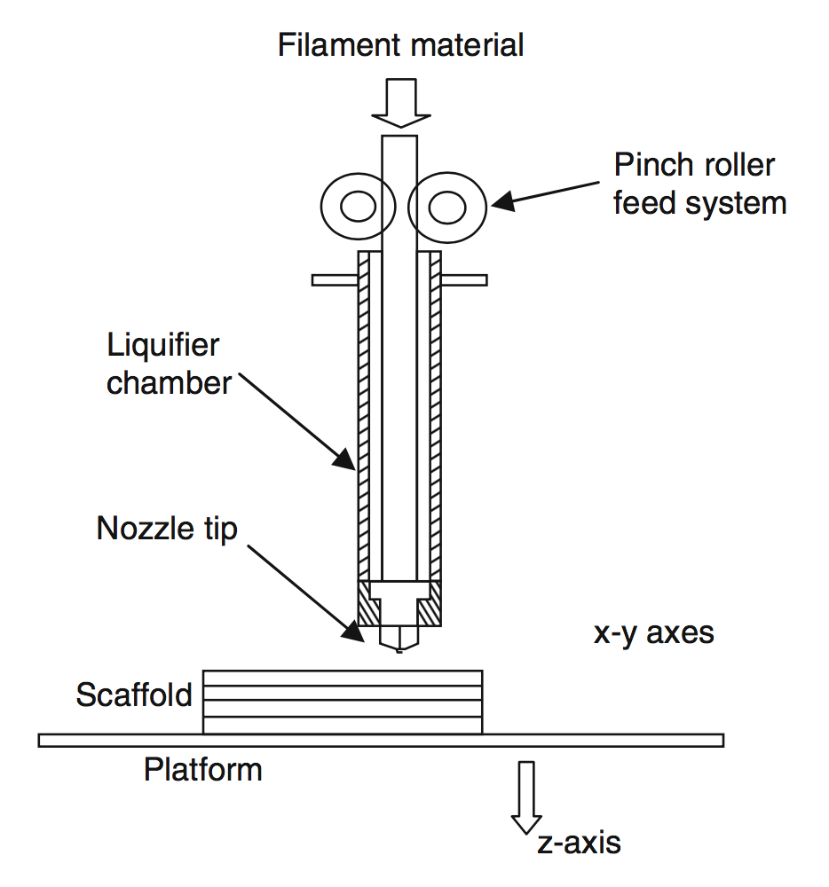
Fused Deposition Modeling (FDM)
By far the most common extrusion-based AM technology is Fused Deposition Modeling (FDM), produced and developed by Stratasys, USA.
The initial FDM patent was awarded to Stratasys founder Scott Crump in 1992 .
FDM uses a heating chamber to liquefy polymer that is fed into the system as a filament.
The filament is pushed into the chamber by a tractor wheel arrangement and it is this pushing that generates the extrusion pressure.
The major strength of FDM is in the range of materials and the effective mechanical properties of resulting parts made using this technology.
Parts made using FDM are amongst the strongest for any polymer-based additive manufacturing process.
The main drawback to using this technology is the build speed.

Slide 8
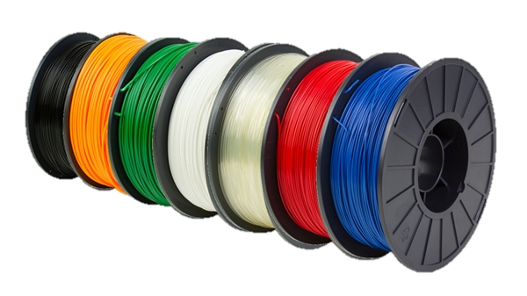
Materials
FDM works best with polymers that are amorphous in nature rather than the highly crystalline polymers that are more suitable for PBF processes.

Slide 9
Bioextrusion
Extrusion-based technology has a large variety of materials that can be processed.
If a material can be presented in a liquid form that can quickly solidify, then it is suitable to this process.
Bioextrusion is the process of creating biocompatible and/or biodegradable components that are used to generate frameworks, commonly referred to as “scaffolds,” that play host to animal cells for the formation of tissue (tissue engineering).
Such scaffolds should be porous, with micro-pores that allow cell adhesion and macro-pores that provide space for cells to grow.

Slide 10
Other Systems Contour Crafting
A major innovative twist on the extrusion-based approach can be found in the Contour Crafting technology developed by Prof. B. Khoshnevis and his team at the University of Southern California.
This research team has developed a method to smooth the surface with a scraping tool.
This is similar to how artisans shape clay pottery and/or concrete using trowels.
the team is in fact developing technology that can produce full-sized buildings using a mixture of the Contour Crafting process and robotic assembly.

Slide 11
Construction Industry (Contour Crafting)
Developed by Behrokh Khoshnevis

Slide 12
Syringe-based 3D printer

Slide 13
Food industry

Slide 14
Food industry

Slide 15
Food industry

Slide 16
Construction Industry
Material reduction | 30%
Labor reduction | 50%

