Slide 1
3. Equation of continuity, Bernoulli’s Equation
3.1- Introduction
An understanding of the physics of fluid flow is vital to an understanding of biological systems as diverse as the human circulatory system and the distribution of nutrients in plant In this chapter we will introduce the physical foundations of fluid flow in the absence of viscosity. Now, we will Definitions of some keys
Incompressible fluid: The fluid has a constant density throughout.
Viscosity: The resistance of a fluid to flow.

Slide 2
laminar flow: A situation in which h layers of fluid slide smoothly past each other. Laminar flow is characteristic of lower fluid velocities.
Turbulent flow: Nonlaminar flow. The flow is irregular and complex, with mixing and eddies. This occurs at higher velocities or where there are objects in the flow producing large changes in velocity.
Streamlines: A family of curved lines that are tangential to the velocity vector of the flow (i.e. always in the same direction as the flow). They provide a kind of snapshot of flow throughout the fluid at an instant of time.

Slide 3
3.2-The Equation of Continuity
Volume Flow Rate

Slide 4
3.3-Continuity of Flow
Under certain conditions, when the fluid is incompressible and there is no fluid gained or lost, the volume flow rate is constant along a pipe or channel.

Slide 5
Example 14.1 Continuity of the flow
A water pipe carries 1000 L of water past a certain point every minute.
(a) If the speed of the water in this pipe is 2 ms⁻¹, what is the radius of the pipe?
(b) The radius of the pipe narrows by 10% as it passes from one suburb to another. What is the velocity of the water in the pipe now?
(c) The pipe then splits up into two pipes, each of which of has an area equal to the area of the pipe just before it splits. What is the speed of the water in each pipe now?

Slide 7
3.4-Bernoulli’s Equation Bernoulli’s Principle and
Incompressible Fluid Flow
Bernoulli's principle states that: When
viscosity can be neglected, an increase in fluid velocity is accompanied by a decrease in pressure and/or a decrease in gravitational potential energy (see Figure 14.4).
This equation relates together pressure, speed and elevation for the case of an incompressible fluid. This will be valid for most liquids, and for gases when no expansion or compression is happening. In addition, if the fluid flow is laminar, steady (i.e., independent of time), and we can ignore the effects of friction, then we have Bernoulli's equation:

Slide 10
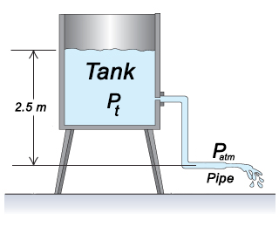

Slide 11
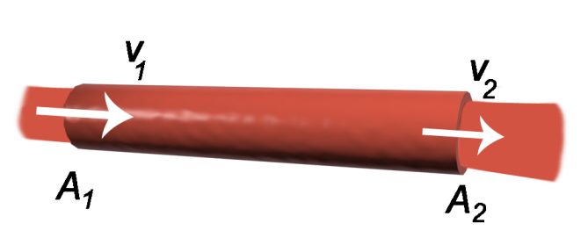
Solution
Since the height is constant we could write
$${P_{2}−P}_{1}=\frac{1}{2}ρ{v_{1}^{}}^{2}−\frac{1}{2}ρ{v_{2}^{}}^{2}$$
$$∆P=\frac{1}{2}ρ\left({{{v_{1}^{}}^{2}−v}_{2}^{}}^{2}\right)$$
$$∆P=\frac{1}{2}×1060×\left({v_{1}^{}}^{2}−0.69{v_{1}^{}}^{2}\right)$$
$$∆P=530×\left(0.31×3^{2}\right)$$
$$∆P=1.48×{10}^{3} Pa$$
$$v_{2}A_{2}=v_{1}A_{1}$$
$$v_{2}=v_{1}\frac{A_{1}}{A_{2}}$$
We have$A_{2}=1.2A_{1}$
$$v_{2}=v_{1}\frac{A_{1}}{{1.2A}_{1}}$$
$$v_{2}={0.83v}_{1}$$
$${v_{2}}^{2}=0.69{{ v}_{1}}^{2}$$

Slide 12
4. Viscosity (Poiseuille’s Law),Turbulence.

Slide 13
4.1 Introduction
In the last we ignored friction within the fluid, and between the fluid and the material it was flowing past. Ignoring this friction is not a valid assumption in many cases.
When blood or other fluids are injected into a person's vein. they need to go through a narrow-diameter needle, providing a large amount of friction and resistance to fluid flow. Work needs to be done against this friction, and there needs to be a force creating a pressure difference between the two ends of the needle to keep the fluid moving.
The fluid viscosity also influences how readily the flow ceases to be smooth and laminar. In this chapter we will see how friction affects fluids by investigating fluid viscosity and turbulence.

Slide 14
4.2-Poiseuille’s Law

Slide 15
Important observation
F ∝ R⁴ (neither R³, R² nor R). Hence F is very sensitive to the radius of the vein.
The formation of cholesterol on the walls of the arteries greatly decreases the flow rate of blood. So the heart has to work harder to compensate. At times of stress, when an increased flow rate is required, there can be a breakdown.
In the respiratory system any constriction of the narrow tubes leading to the alveoli decreases the flow rate and makes breathing much more difficult (asthma).

Slide 16
Example 4.1

Slide 17
4.3-fluid flow
So far, we have been concerned only with laminar flow (1, see the figure), where the fluid flows in smooth layers without mixing.
Turbulent flow (2, see the figure) occurs when the velocity of a fluid is increased, the flow becomes more complex, with mixing between layers and eddies, where the flow is in a different direction to the net fluid flow (see Figure 15.3).
The speed at which the flow becomes turbulent depends on the viscosity of the fluid, the density of the fluid and the dimensions and shape of the pipe it is flowing through.
Ideal (Not Existed Naturally)
1. Laminar
2. Turbulent

Slide 18
Laminar Flow
When blood flows through a long smooth vessel it flows in straight lines, with each layer of blood remaining the same distance from the walls of the vessel.
When laminar (streamline) flow occurs the different layers flow at different rates creating a parabolic profile.
The parabolic profile arises because the fluid molecules touching the walls barely move because of adherence to the vessel wall. The next layer slips over these, the third layer slips over the second and so on.

Slide 19
Turbulent flow
The flow may become turbulent when:
the rate of blood flow becomes too great,
it passes by an obstruction in a vessel,
it makes a sharp turn,
or when it passes over a rough surface.
Turbulent flow means that the blood flows crosswise in the vessel as well as along the vessel causes eddy currents. When eddy currents are present, the blood flows with much greater resistance than when the flow is streamline.

Slide 20
4.4- Blood Viscosity
Blood is a heterogeneous mixture, not a simple liquid, as the blood cells are physically separate from the plasma. As a result of this, its behavior is more complicated. Its viscosity is not constant. strokes.
The viscosity of blood ≠ zero.
The blood layers have different velocities where
the flaw may be laminar (streamline) or
turbulent.
⬥ Poiseuille equation is applied in that case.

Slide 21
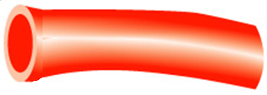
4.5 - flow resistance of blood
Δp
This is another form of Poiseuille law

Slide 22
Important observation
Again the resistance is very sensitive to the radius of the blood vessel. Therefore, most of the flow resistances and hence pressure drops occur in the smaller arteries.

Slide 23
◆
Example 4.2
A large artery in a dog has an inner radius of 4×10⁻³ m. Blood flows through the artery at the rate of 1 cm³s⁻¹=10⁻⁶ m³s⁻¹. Find (a) the average of the blood, (b) the pressure drop in a 0.1-m long segment of the artery.
The viscosity of blood = η_{b} = 2.084×10⁻³ Pa.s (37ºC),
Solution
0.1 m
(a) $A_{circle}=πr^{2}$ and $F=Av$ ,then $v=\frac{F}{A}=\frac{F}{πr^{2}}$
R= 4×10⁻³m
F=10⁻⁶m³s⁻¹
(b)

Slide 24
Thank You
Any Questions?

