Slide 1
Kinematics of Particles
Lecture II

Slide 2
Subjects Covered in Kinematics of Particles
Rectilinear motion
Curvilinear motion
  Rectangular coords
  n-t coords
  Polar coords
Relative motion
Constrained motion

Slide 3
Introduction
Kinematics: Branch of dynamics that describes the motion of bodies without reference to the forces which either cause the motion or are generated as a result of the motion.
Applications: The design of cams, gears, linkages, and other machines elements to control or produce certain desired motion, and the calculation of flight trajectories for aircraft, rockets, etc.
Particle: As per mentioned, a particle is a body whose physical dimensions are so small compared with the radius of curvature of its path, e.g. an aircraft and its flight path.
Studying the Motion: Studying the motion of a body includes studying its displacement from one location to another, its velocity, and its acceleration.

Slide 4
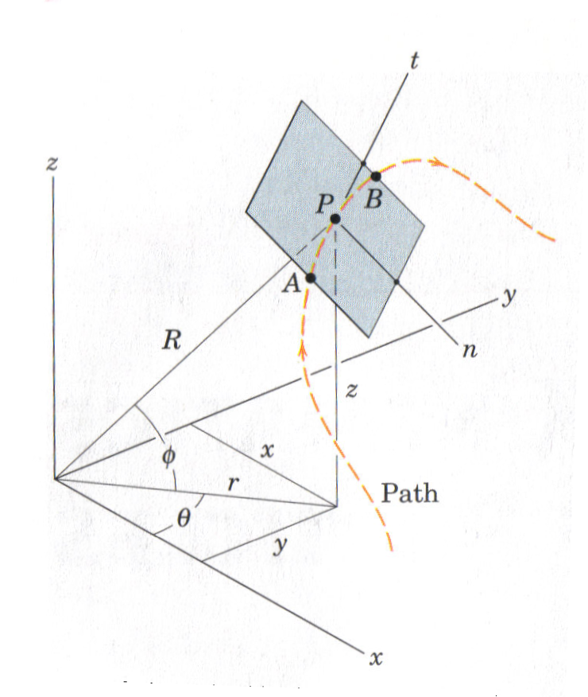
Introduction (Cont.)
Choice of Coordinates: The position of a particle P at any time t can be described by specifying its rectangular coordinates (x, y, z), its cylindrical coordinates (r, θ, z), or its spherical coordinates (R, θ, ϕ). The motion of P can also be described by measurements along the tangent (t) and normal (n) to a curved path. These two are path variables since they move with the particle on the path. The motion of a body described by fixed reference axes known as absolute motion, while the motion described by a moving reference axes known as relative motion.

Slide 5
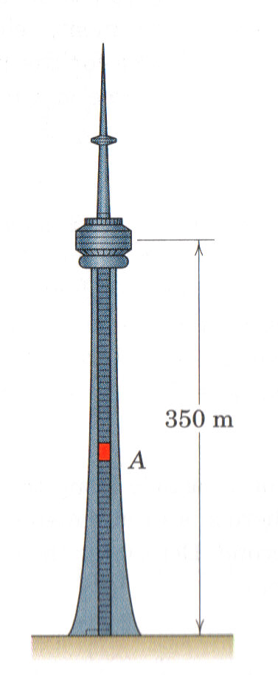
Rectilinear Motion
Studying the motion of a particle moving in a straight line (1-D)
s
Displacement
1
2
-S
+S
Displacement is defined to be the change in position of an object. (vector)
Distance traveled is the total length of the path traveled between two positions. (scalar)
Initial Position
Final Position

Slide 6
Rectilinear Motion - Velocity
Velocity: describes how position changes
Average velocity (v_{av}):
Instantaneous velocity (v): as Δt approaches
zero in the limit, which is or
Note: the velocity is positive or negative depending on the displacement
Velocity vs. Speed
Velocity is vector
Speed is scalar
(1)

Slide 7
Rectilinear Motion – Acceleration
Acceleration: describes how velocity changes
Average acceleration (a_{av}):
Instantaneous acceleration (a): as Δt
approaches zero in the limit, which is or
Note: the acceleration is positive (acceleration) or negative (deceleration) depending whether the velocity is increasing or decreasing
, Δv
-S
v1
v2
+S
Initial Velocity
Final Velocity
or
(2)

Slide 8
Rectilinear Motion – Acceleration (Cont.)
Velocity & acceleration: are vector quantities, as we will see in the study of curvilinear motion; however, since in rectilinear motion, the particle is moving in straight line path, the sense of direction is described by plus or minus sign.
To obtain differential equation relating displacement, velocity, and acceleration: dt has to be eliminated from equation (2) (using Chain rule)
Equations (1), (2), and (3): known as the differential equations for the rectilinear motion.
or
(3)

Slide 9
Rectilinear Motion – Graphical Interpretation
The net displacement of a particle during interval Δt:
The net change in velocity of a particle during interval Δt:
When the acceleration is a function of the position coordinates S:
or
or
or

Slide 10
Rectilinear Motion – Problems Classifications
Rectilinear Motion
(Problems Classifications)
Given s(t)
Required v(t) and/or a(t)
Given a
a (t)
Required v(t) and/or s(t)
a (v)
Required v(t) or v(s) and/or s(t)
a (s)
Required v(s) and/or s(t)
a = constant
Given v
v (t)
Required s(t) and/or a(t)
v = constant
or

Slide 11
Exercises

Slide 12
Exercise # 1
The position coordinate of a particle which is confined to move along a straight line is given by s = 2t³ - 24t + 6, where s is measured in meters from a convenient origin and t is in seconds. Determine (a) the time required for the particle to reach a velocity of 72 m/s from its initial condition at t = 0, (b) the acceleration of the particle when v = 30 m/s, and (c) the net displacement of the particle during the interval from t = 1 s to t = 4 s.

Slide 13
Exercise # 2
A particle starts from s = 0 and travels along a straight line with a velocity v = (t² - 4t + 3) m/s, where t is in seconds. Construct the s – t, v – t, and a - t graphs for the time interval 0 ≤ t ≤ 4 s.

Slide 14
Exercise # 3
A truck travels 220 m in 10 s while being decelerated at a constant
rate of 0.6 m/s². Determine (a) its initial velocity, (b) its final velocity, (c) the distance traveled during the first 1.5 s.

Slide 15
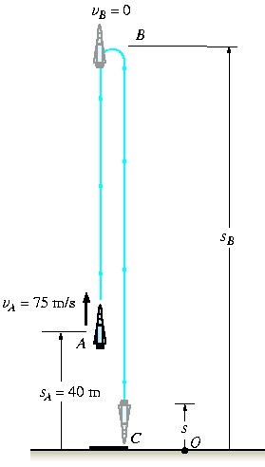
Exercise # 4
A rocket travel upward at 75m/s. When it is 40m from the ground, the engine fails. Determine max height s_{B} reached by the rocket and its speed just before it hits the ground.

Slide 16
Exercise # 5
When two cars A and B are next to one another, and they are traveling in the same direction with speeds of 15 and 20 m/s, respectively. If car B maintains its constant speed of 20 m/s, while car A begins to decelerate at a constant rate of 1 m/s², determine the distance d between the cars at the instant car A stops.

Slide 17
Exercise # 6
A sprinter in a 100-m race accelerates uniformly for the first 35 m and then runs with constant velocity. If the sprinter’s time for the first 35 m is 5.4 s, determine (a) his acceleration, (b) his final velocity, (c) his time for the race.

Slide 18
Exercise # 7
The v - t graph of a car while traveling along a road is shown. Draw the s - t and a - t graphs for the car motion.

Slide 19
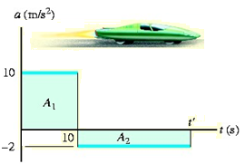
Exercise # 8
A test car starts from rest and travels along a straight track such that it accelerates at a constant rate for 10 s and then decelerates at a constant rate. Draw the v-t and s-t graphs and determine the time t’ needed to stop the car. How far has the car traveled?

Slide 20
Exercise # 9
The a–s graph for a jeep traveling along a straight road is given for the first 300 m of its motion. Construct the v–s graph. At s = 0, v =0.

Slide 21
Exercise # 10
When a train is traveling along a straight track at 2 m/s, it begins to accelerate at a = (60 v⁻⁴) m/s², where v is in m/s. Determine its velocity v and the position 3 s after the acceleration.

