Slide 1
Unit 4 helloes , helpers & heroes
Lesson 2
Have you bought the flowers yet ?

Slide 2
A – 5 letters
ankle

Slide 3
C – 7 letters
collect

Slide 4
G – 5 letters
2 parts
get on ( a bus )

Slide 5
i – 3 letters
icy

Slide 6
P – 7 letters
2 parts
put away

Slide 7
S – 6 letters
switch on / off

Slide 8
W – 9 letters
2 parts
washing up

Slide 9
New words
Ankle
Collect
get on ( a bus )
Icy
put away
switch on / off
washing up

Slide 10
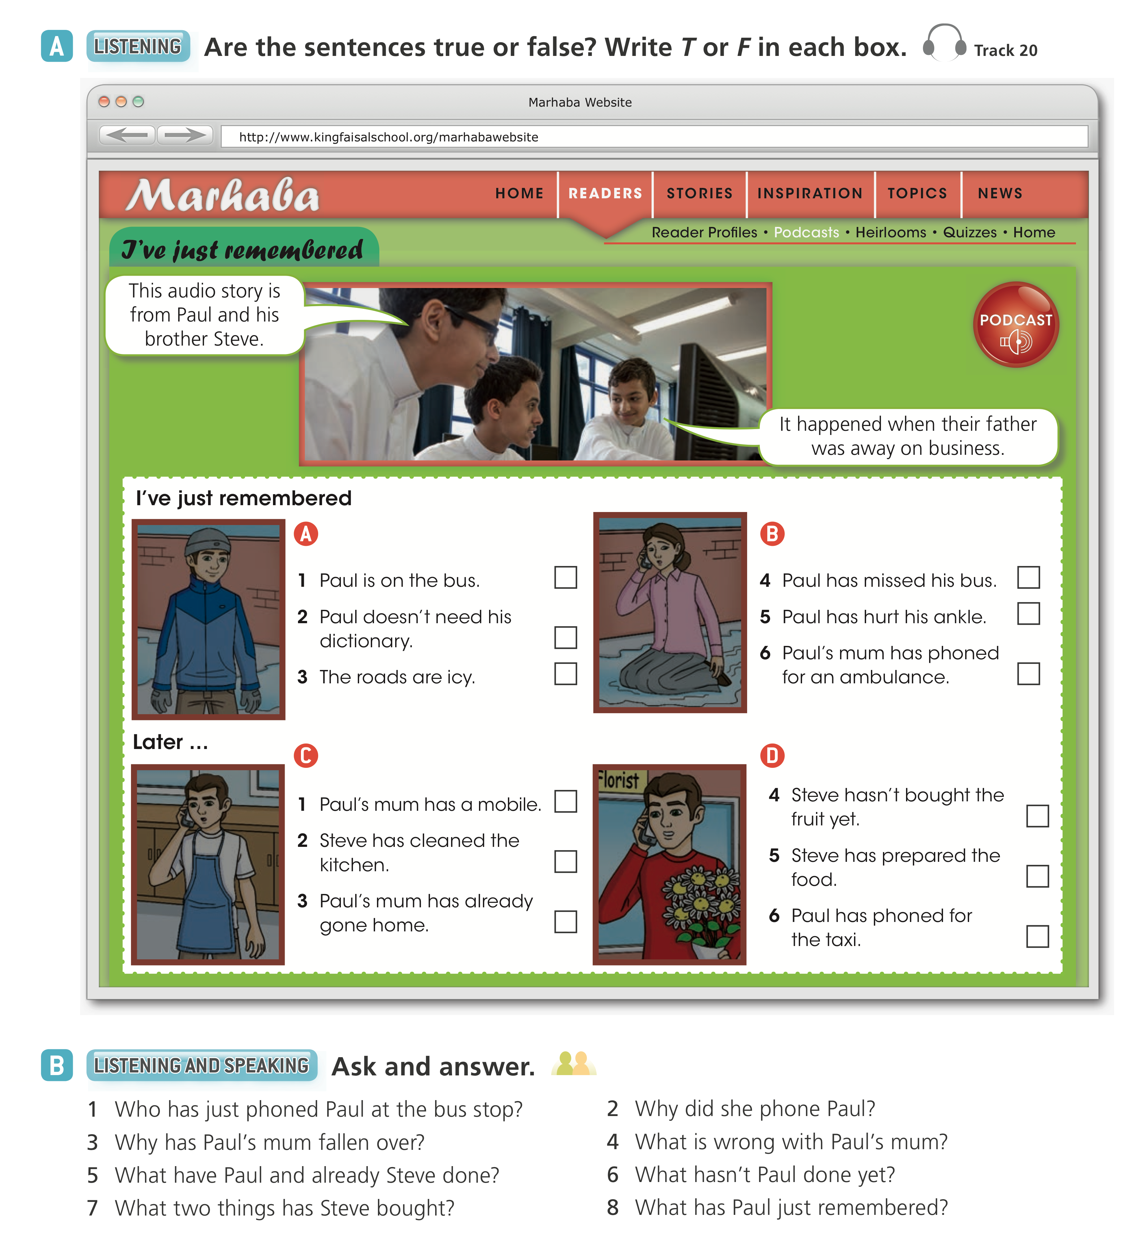
F
T
F
F
T
T
T
F
F
T
F
F

Slide 11
1 Paul’s mum has (just) phoned Paul.
4 She’s hurt her ankle.
2 Because Paul has forgotten his dictionary.
3 Because the water from the rain has frozen.
5 They have done the things on their mother’s list.
6 He hasn’t ordered a taxi.
8 He hasn’t phoned for a taxi.
7 Fruit and flowers.

Slide 13
1 They have already checked the work.
2 Steve has already bought flowers.
3 I have already been to Jeddah.
4 Paul has already got on the bus to school.
5 Julie has already written the/her article.
6 Adnan and Sami have already tidied the/their office.

Slide 14
2 Has Steve put away his books yet? No, Steve hasn’t put away his books yet.
3 Have you done your homework yet? No, I haven’t done my homework yet.
4 Have Yazeed and Adel just left the room? Yes, Yazeed and Adel have just left the room.
5 Have Dalal and Lena studied Italian yet? No, Dalal and Lena haven’t studied Italian yet.
6 Has Paul’s mum switched on her mobile yet? No, Paul’s mum hasn’t switched on her mobile yet.

Slide 15
3 Julie is tired and hungry now, but will phone later.
1 Dalal
2 Julie

