Slide 1
Chapter 9 GAS EXCHANGE & CIRCULATION

Slide 2
0
MECHANISMS OF GAS EXCHANGE
Respiration
Taking up O₂ and giving up CO₂
2
Copyright © 2009 Pearson Education, Inc.

Slide 3
MECHANISMS OF GAS EXCHANGE
0
Three phases of gas exchange
Breathing
Transport of oxygen and carbon dioxide in blood
Body tissues take up oxygen and release carbon dioxide in the process of Cellular respiration
Cellular respiration (Glucose + O₂ → CO₂ + H₂O) requires a continuous supply of oxygen and the disposal of carbon dioxide
3

Slide 4
Animals exchange O₂ and CO₂ across respiratory surfaces Respiratory Surface = the site of gas exchange
0
Respiratory surfaces must be thin and moist for diffusion of O₂ and CO₂
Earthworms and other animals use their skin for gas exchange
Most animals have specialized body parts that promote gas exchange called Respiratory Surface = the site of gas exchange include:
Skin in Sponges, jellies and flatworms rely on the skin as their only respiratory surface
Gills in fish and amphibians
Tracheal systems in arthropods
Lungs in tetrapods that live on land such as, amphibians, reptiles, birds and mammals
4

Slide 5
Lungs
0
Tetrapods seem to have evolved in shallow water
The first tetrapods on land diverged into three major lineages
Amphibians use small lungs and their body surfaces
Nonbird reptiles have lower metabolic rates and simpler lungs
Birds and mammals have higher metabolic rates and more complex lungs
5
Copyright © 2009 Pearson Education, Inc.

Slide 6
In the human respiratory system, branching tubes convey air to lungs located in the chest cavity
0
In mammals, air is inhaled through the nostrils into the nasal cavity
Air is filtered by hairs and mucus surfaces
Air is warmed and moisturized
Air is sampled for odors
6
Copyright © 2009 Pearson Education, Inc.

Slide 7
In the human respiratory system, branching tubes convey air to lungs located in the chest cavity
0
From the nasal cavity, air next passes
To the pharynx
Then larynx, past the vocal cords
Into the trachea (held open by cartilage crescent rings)
Into the paired bronchi
Into bronchioles
Finally to the alveoli, grapelike clusters of air sacs, where gas exchange occurs
7
Copyright © 2009 Pearson Education, Inc.

Slide 8
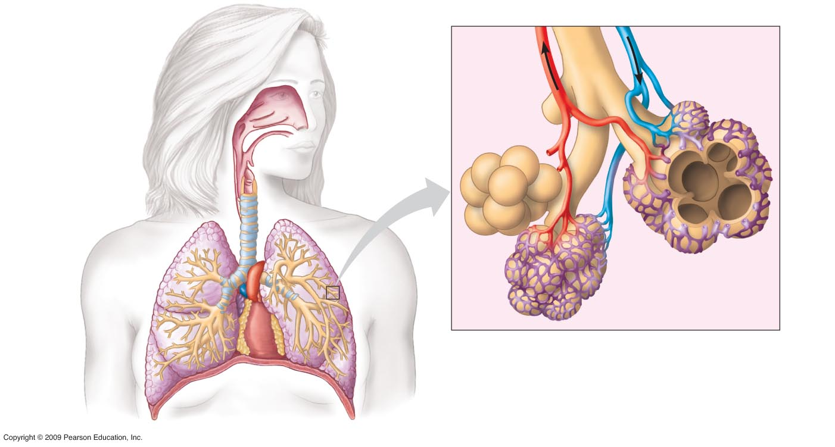
Oxygen-rich
blood
Oxygen-poor
blood
Pharynx
Nasal
cavity
Bronchiole
(Esophagus)
Larynx
Left lung
Alveoli
Trachea
Right lung
Bronchus
Blood
Capillaries
Bronchiole
(Heart)
Diaphragm
The anatomy of the human respiratory system (left)
and details of the structure of alveoli (right)
8

Slide 9
How alveoli are adapted for gas exchange ?
0
Alveoli are well adapted for gas exchange
Are surrounded by capillaries
Have huge surface area (100 m² in humans)
In alveoli
O₂ diffuses into the blood
CO₂ diffuses out of the blood
9
Copyright © 2009 Pearson Education, Inc.

Slide 10
Mechanics of Breathing
0
Breathing is the alternate inhalation and exhalation of air (ventilation)
1) Inhalation occurs when
The rib cage expands (muscles between ribs contract and rib cage rises)
The diaphragm moves downward
The volume of the chest cavity increases, lowering the air pressure around lungs.
Air rushes into lungs to equalize the pressure difference
10
Copyright © 2009 Pearson Education, Inc.

Slide 11
22.8 Negative pressure breathing ventilates our lungs
0
2) Exhalation occurs when
The rib cage contracts
The diaphragm moves upward
The pressure around the lungs increases
And air is forced out of the respiratory tract
11
Copyright © 2009 Pearson Education, Inc.

Slide 12
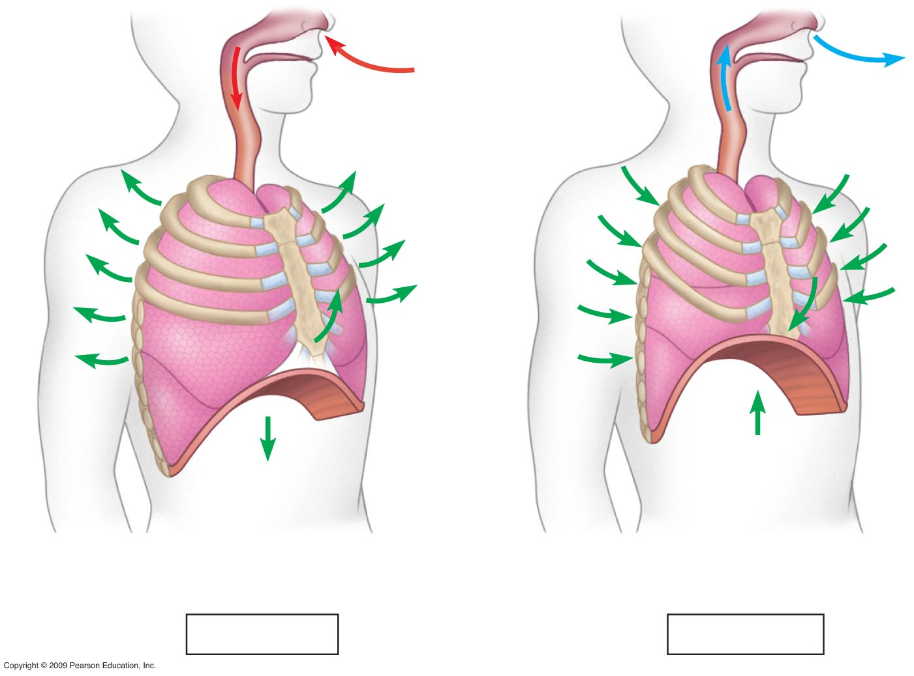
Rib cage
expands as
rib muscles
contract
Rib cage gets
smaller as
rib muscles
relax
Air
inhaled
Air
exhaled
Lung
Diaphragm
Diaphragm contracts
(moves down)
Diaphragm relaxes
(moves up)
Inhalation
Exhalation
Negative pressure breathing draws air into the lungs
12

Slide 13
Breathing is automatically controlled
0
Breathing is usually under automatic control.
It is controlled by two centers at the base of the brain the pons and medulla oblongata
Breathing control centers in the brain sense and respond to CO₂ levels in the blood
A decrease in blood pH increases the rate and depth of breathing
Aorta and carotid arteries have O₂ sensors which signal the brain to increase breathing
13
Copyright © 2009 Pearson Education, Inc.

Slide 14
0
TRANSPORT OF GASES IN THE HUMAN BODY
14
Copyright © 2009 Pearson Education, Inc.

Slide 15
Blood transports of respiratory gases
0
In the lungs, blood picks up O₂ and drops off CO₂
In the body tissues, blood drops off O₂ and picks up CO₂
The heart pumps blood to two regions
The right side pumps oxygen-poor blood to the lungs
The left side pumps oxygen-rich blood to the body
15
Copyright © 2009 Pearson Education, Inc.

Slide 16
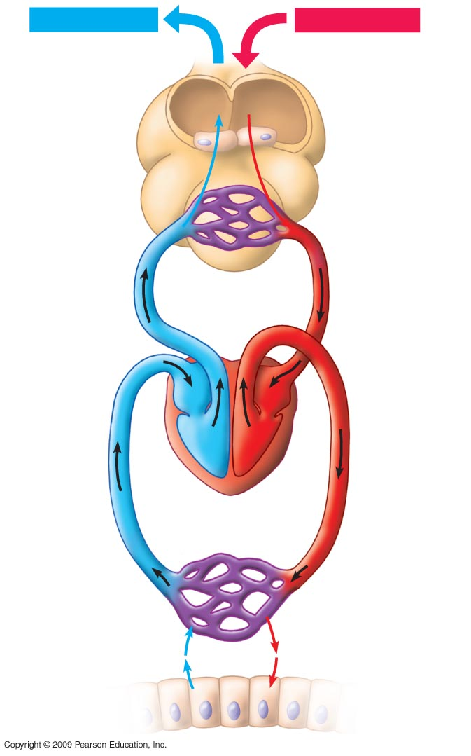
Coordination of circulation and gas exchange
Exhaled air
Inhaled air
Air spaces
Alveolar
epithelial
cells
CO₂
O₂
CO₂
O₂
Alveolar
capillaries
CO₂-rich,
O₂-poor
blood
O₂-rich,
CO₂-poor
blood
Gas transport and exchange in the body.
Tissue
capillaries
Heart
CO₂
O₂
Interstitial
fluid
Tissue cells
throughout
body
CO₂
O₂
16
Notes:
Figure 22.10 Gas transport and exchange in the body.

Slide 17
Blood transport of gases
0
Gases move from areas of higher concentration to areas of lower concentration
Gas exchange between alveoli and blood
Gases in the alveoli have more O₂ and less CO₂ than gases in the blood
O₂ moves from the alveoli of the lungs into the blood
CO₂ moves from the blood into the alveoli of the lungs
Gas exchange between blood and tissues
The tissues have more CO₂ and less O₂ than in the blood
CO₂ moves from the tissues into the blood
O₂ moves from the blood into the tissues
17
Copyright © 2009 Pearson Education, Inc.

Slide 18
Blood transport of gases
1. Once the oxygen reaches the body cells, it is taken up by the mitochondria.
2. The mitochondria use oxygen to breakdown glucose into ATP. This is called cellular respiration
Oxygen transport
Oxygen is not very soluble in water (blood)
Oxygen transport and delivery are enhanced by binding of O₂ to respiratory pigments (hemoglobin in vertebrates )
Binding is reversible
18

Slide 19
Respiratory pigments
0
Most animals transport O₂ bound to proteins called respiratory pigments
1) Copper-containing pigment (hemocyanin)
in Mollusca and Arthropods
2) Iron-containing pigment (hemoglobin)
in almost all vertebrates and many invertebrates transports oxygen, buffers blood, and transports CO₂
19
Copyright © 2009 Pearson Education, Inc.

Slide 20
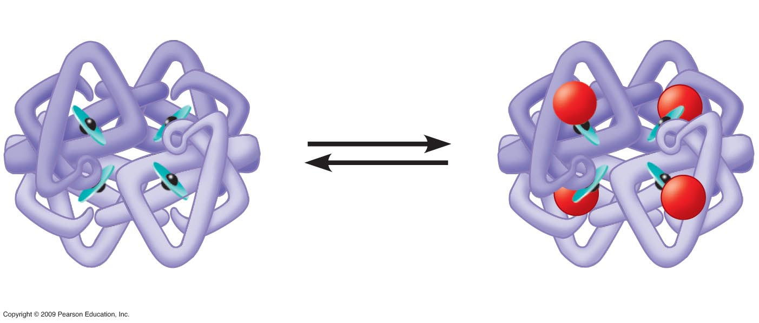
Iron atom
Heme group
O₂ loaded
in lungs
O₂
O₂ unloaded
in tissues
O₂
Polypeptide chain
Hemoglobin loading and unloading of O₂
20
Notes:
Figure 22.11 Hemoglobin loading and unloading of O₂.

Slide 21
Carbon dioxide transport
0
Most CO₂ in the blood is transported as bicarbonate ions in the plasma
21
Copyright © 2009 Pearson Education, Inc.

Slide 22
Circulation
22

Slide 23
3 Major Parts of the Circulatory system
Circulatory system in most animals consists of Blood, Heart and Blood vessels
Blood Vessels - networks of hollow tubes that transport blood throughout the entire body.
Heart – pumps blood through body
Blood – carries oxygen, food, & waste ..etc through body.
23

Slide 24
Circulatory systems facilitate exchange with all body tissues
MECHANISMS OF INTERNAL TRANSPORT
An internal transport system assists diffusion by moving materials between
Surfaces of the body
Internal tissues
0
All cells need
Nutrients
Gas exchange
Removal of wastes
24
Copyright © 2009 Pearson Education, Inc.

Slide 25
Four-chambered hearts: Two atria and two ventricles
0
Four-chambered hearts Two atria and two ventricles
Two circuits that do not mix
Right side pumps blood from body to lungs
Left side pumps blood from lungs to body
Oxygen rich blood is completely separated from oxygen poor blood
No mixing → much more efficient gas transport
Birds, mammals and crocodilians have four-chambered hearts
Needed in endothermic animals
25
Copyright © 2009 Pearson Education, Inc.

Slide 26
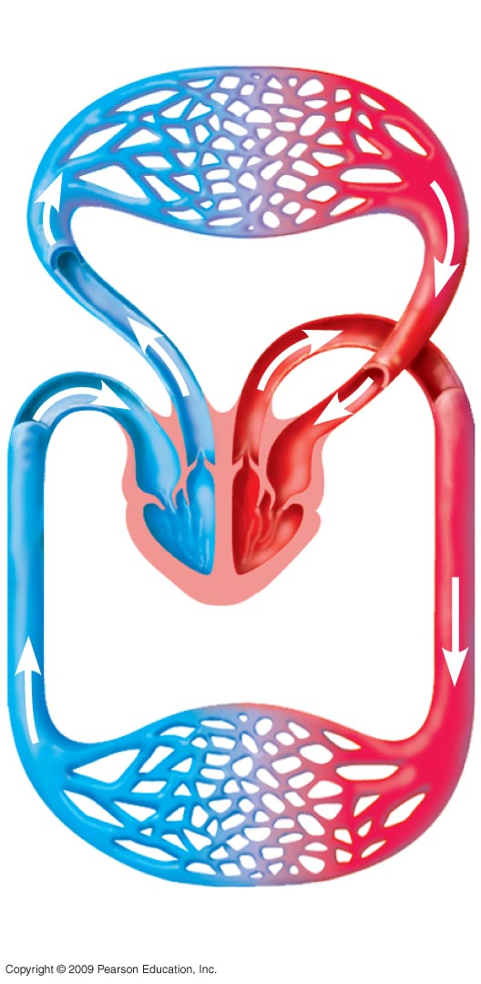
Lung capillaries
Pulmonary
circuit
The double circulation and four-chambered heart of a bird or mammal
A
A
V
V
Right
Left
Systemic circuit
Systemic capillaries
26

Slide 27
0
THE HUMAN CARDIOVASCULAR SYSTEM
27
Copyright © 2009 Pearson Education, Inc.

Slide 28
The human cardiovascular system illustrates the double circulation of mammals
0
Blood flow through the double circulatory system of humans
The mammalian heart consists of
Two thin-walled atria that move blood to ventricles
Thick-walled ventricles that Pump blood to lungs and all other body regions
28

Slide 29
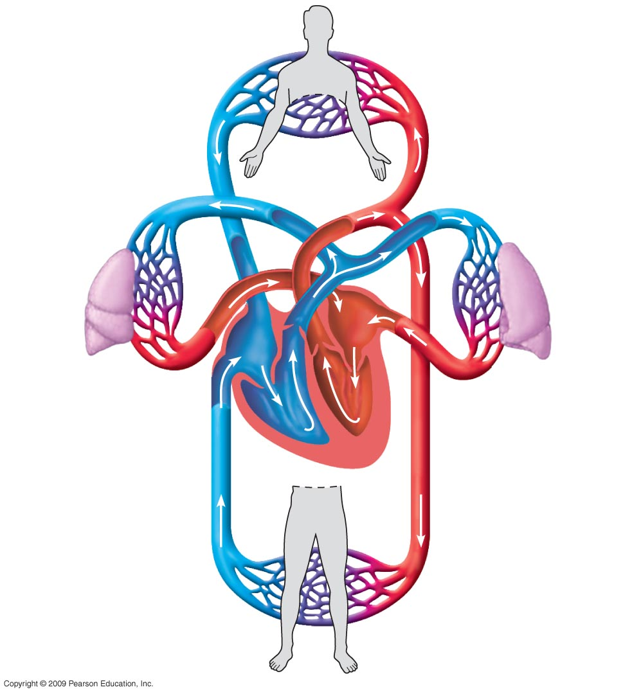
Superior
vena cava
8
Capillaries of
head, chest, and
arms
Pulmonary
artery
Pulmonary
artery
Capillaries
of right lung
9
Aorta
Capillaries
of left lung
2
7
2
3
3
4
5
10
4
Pulmonary
vein
Pulmonary
vein
1
6
Right atrium
9
Left atrium
Right ventricle
Left ventricle
Inferior
vena cava
Aorta
Capillaries of
abdominal region
and legs
8
Blood flow through the double circulation of the human cardiovascular system
29

Slide 30
The structure of blood vessels fits their functions
0
Arteries and veins
Arteries have thicker walls than veins
Arteries are under more pressure than veins
Veins have one-way valves that restrict backward flow and force blood back to right heart atrium
30
Copyright © 2009 Pearson Education, Inc.

Slide 31
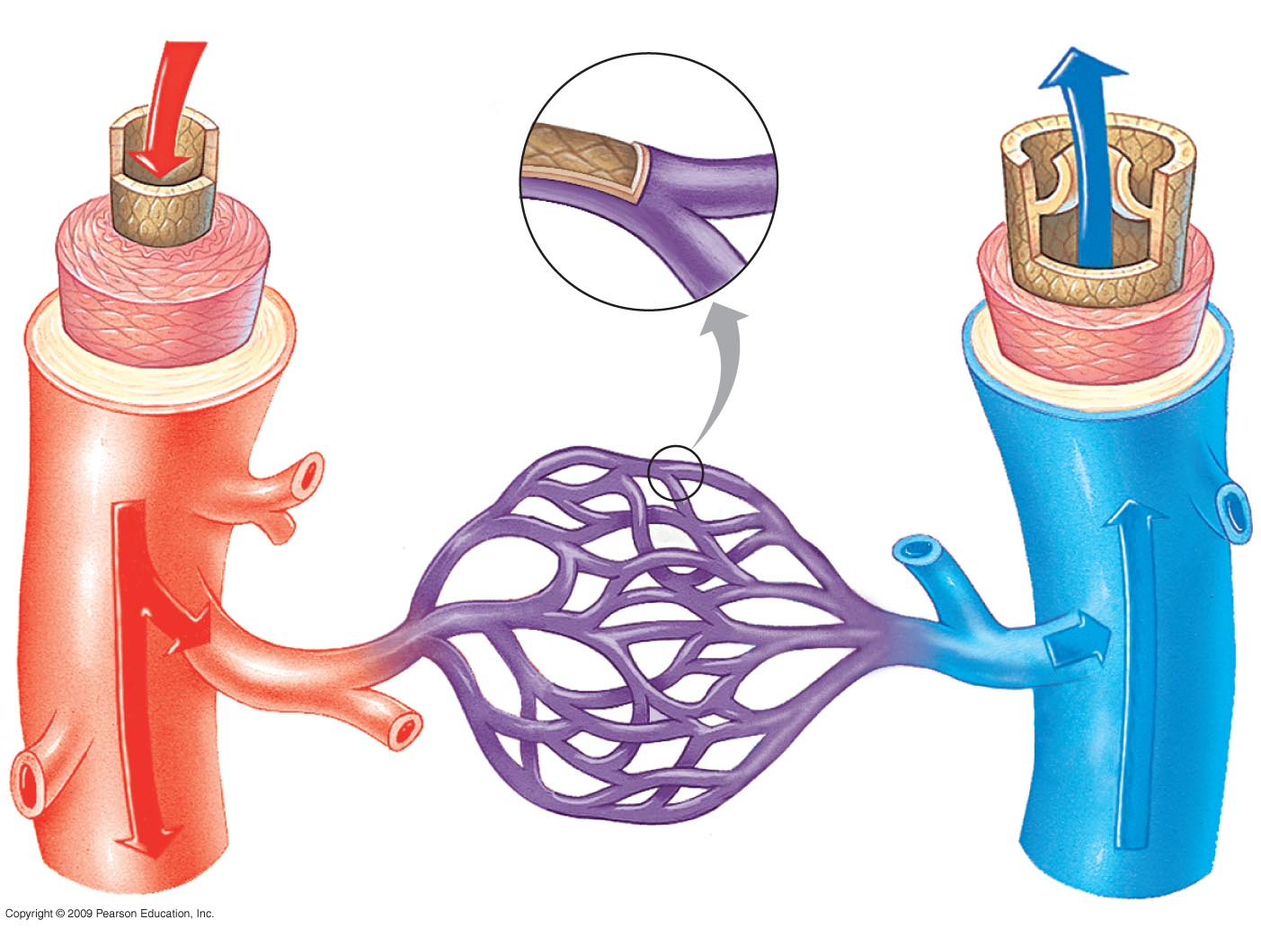
Capillary
Epithelium
Basal lamina
Valve
Epithelium
Epithelium
Smooth
Muscle
Smooth
Muscle
Connective
Tissue
Connective
Tissue
Artery
Vein
Arteriole
Venule
Structural relationships of blood vessels
31

Slide 32
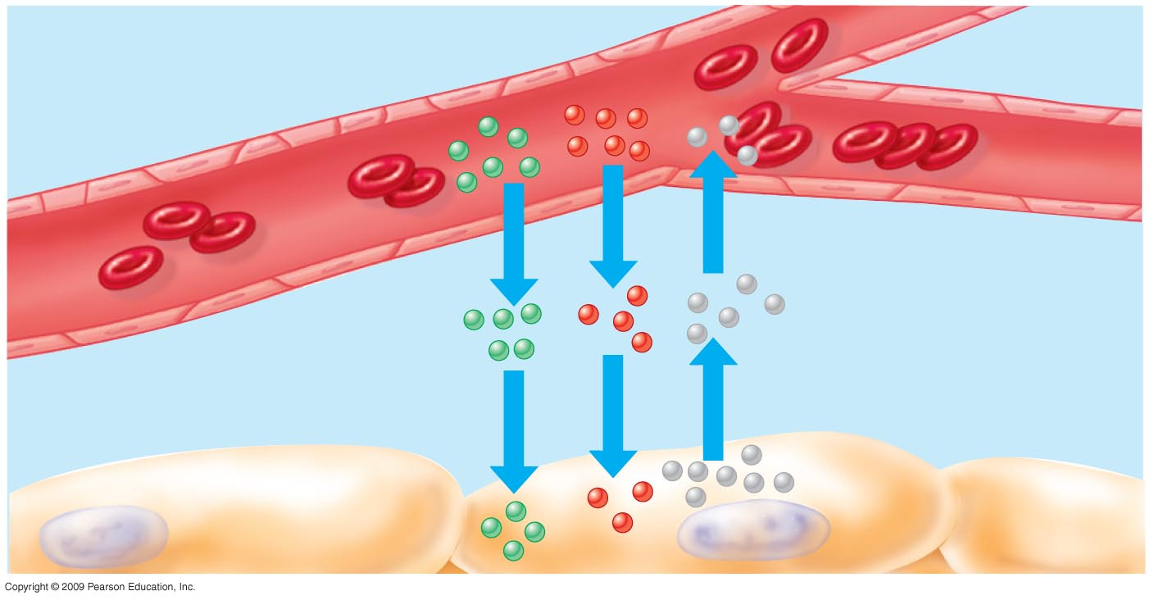
Capillaries are the exchange surface
0
Capillaries
Thin walls: a single layer of epithelial cells
Narrow: blood cells flow in a single file
Increase surface area for gas and fluid exchange
Gas exchange and other transfers occur in the capillary beds
Endocytosis → exocytosis across membrane. Diffusion based on electrochemical gradients
Capillary
Diffusion between blood and tissue cells
Diffusion of
Molecules
Interstitial
Fluid
Tissue cell
32
Copyright © 2009 Pearson Education, Inc.

Slide 33
The heart contracts and relaxes rhythmically
0
Cardiac output: Amount of blood/minute pumped into systemic circuit
Heart rate: Number of beats/minute
Heart valves: Prevent the backflow of blood
Heart murmur: A defect in one or more heart valves
33
Copyright © 2009 Pearson Education, Inc.

Slide 34
The pacemaker sets the tempo of the heartbeat
0
The pacemaker (SA node)
Sets the rate of heart contractions
Generates electrical signals in atria
The AV node
Relays these signals to the ventricles
34
Copyright © 2009 Pearson Education, Inc.

Slide 35
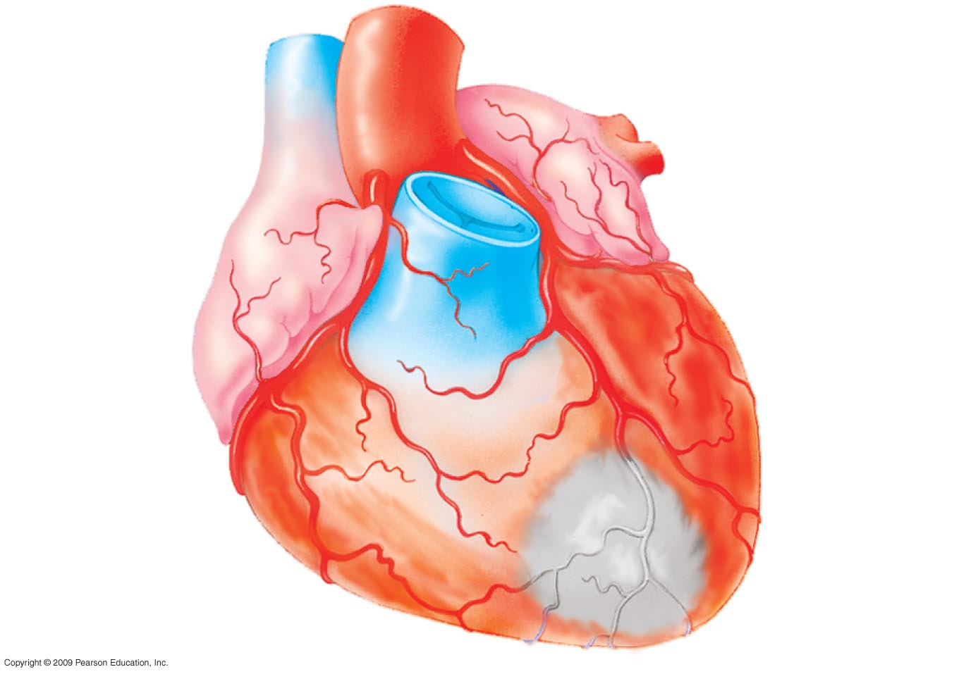
CONNECTION: What is a heart attack
0
A heart attack is damage to cardiac muscle typically from a blocked coronary artery
Stroke Death of brain tissue from blocked arteries in the head
Superiorvena cava
Aorta
Pulmonary
Artery
Left
coronary
Artery
Right
coronary
Artery
Blockage
Dead muscle tissue
Blockage of a coronary artery, resulting in a heart attack
35
Copyright © 2009 Pearson Education, Inc.

Slide 36
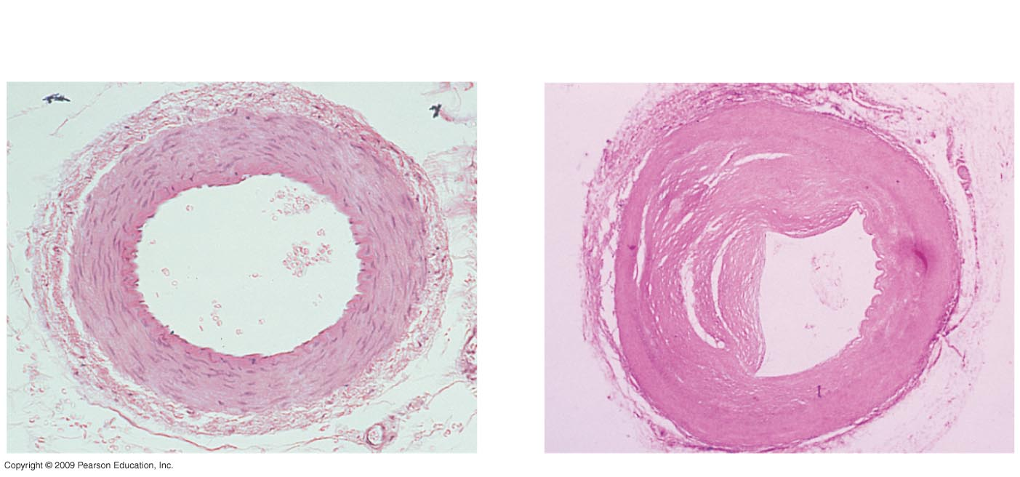
CONNECTION: What is a heart attack?
Atherosclerosis
Plaques develop inside inner walls of blood vessels
Plaques narrow blood vessels
Blood flow is reduced
Atherosclerosis: an artery partially
closed by plaque
A normal artery
Epithelium
Plaque
Smooth Muscle
ConnectiveTissue
36

Slide 37
Blood pressure and velocity reflect the structure and arrangement of blood vessels
0
Blood pressure: The force blood exerts on vessel walls
Depends on cardiac output and resistance of vessels
Decreases as blood moves away from heart
Highest in arteries & lowest in veins
It is measured as
Systolic pressure: caused by ventricular contraction
Diastolic pressure: low pressure between contractions
37
Copyright © 2009 Pearson Education, Inc.

Slide 38
BLOOD STRUCTURE AND FUNCTION
0
Blood consists of:
Cellular elements (red and white blood cells and platelets) suspended in plasma.
Plasma which is about 90% water and contains
Various inorganic ions
Proteins, nutrients
Wastes, gases
Hormones
38
Copyright © 2009 Pearson Education, Inc.

Slide 39
Blood Cellular Elements
0
Red blood cells (erythrocytes)
Transport O₂ bound to hemoglobin
White blood cells (leukocytes)
Function inside and outside the circulatory system
Fight infections and cancer
Platelets: Small fragments of cells promote clotting
39
Copyright © 2009 Pearson Education, Inc.

Slide 40
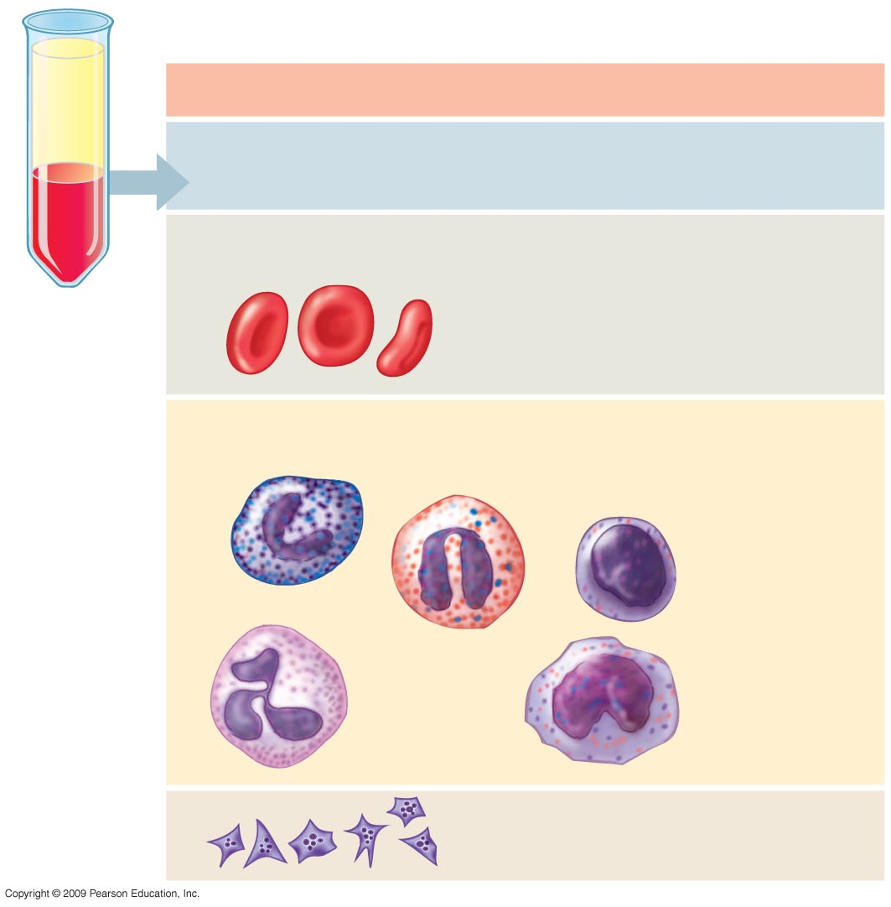
Cellular elements (45%)
Centrifuged
blood
Sample
Cell type
Number العدد
per µL (mm³) of blood
Functions
Erythrocytes
(red blood cells)
Transport of
oxygen (and
carbon dioxide)
5–6 million
Leukocytes
(white blood cells)
5,000–10,000
Defense and
Immunity
Lymphocyte
Basophil
Eosinophil
Neutrophil
Monocyte
Platelets
250,000–
400,000
Blood clotting
40

Slide 41
CONNECTION: Too few or too many red blood cells can be unhealthy
0
Anemia
Abnormally low amounts of hemoglobin or red blood cells
Causes fatigue due to lack of oxygen in tissues
Erythropoietin hormone (EPO) Regulates red blood cell production
Some athletes artificially increase red blood cell production by injecting erythropoietin which can lead to Clotting , Stroke, Heart failure, Death
41
Copyright © 2009 Pearson Education, Inc.

Slide 42
The Clotting Process Blood clots plug leaks when blood vessels are injured
0
When a blood vessel is damaged
Platelets help trigger the conversion of fibrinogen (plasma protein) → fibrin (fiber) which makes knit that forms a clot and plugs the leak
The blood-clotting process
Platelets adhere to exposed connective tissue
Platelets form a plug
A fibrin clot traps blood cells
42
Copyright © 2009 Pearson Education, Inc.

Slide 43
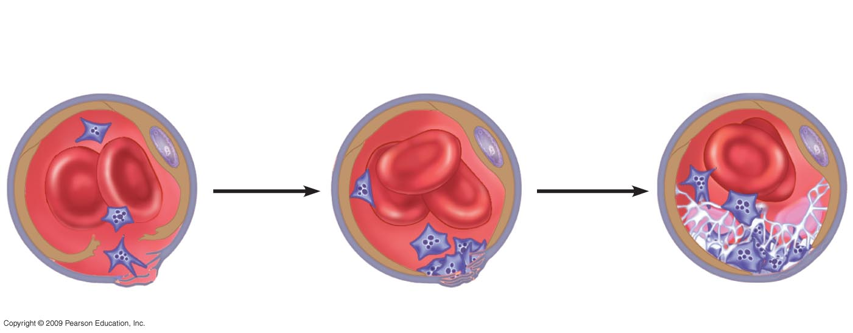
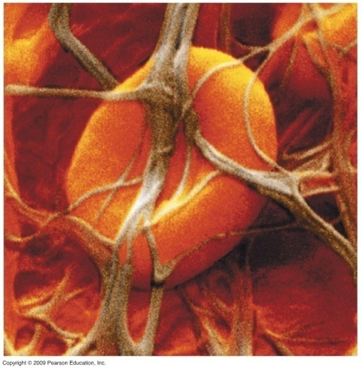
1
Platelets adhere
to exposed
connective tissue
2
Platelet plug
Forms
3
Fibrin clot
traps
blood cells
Epithelium
Connective
Tissue
Platelet plug
Platelet
A fibrin clot
The blood-clotting process
43

Slide 44
تبادل الغازات Gas Exchange
المصطلـــــــــــــــــــــــــــــــــح | تعريف المصطلــــــــــح
Mechanisms Of Gas Exchange | آليات تبادل الغازات
Three Phases Of Gas Exchange | مراحل تبادل الغازات
Breathing | التنفس
Transport Of Oxygen And Carbon Dioxide In Blood | قل الاكسجين و ثاني اكسد الكربون في الدم
Body Tissues Take Up Oxygen And Release Carbon Dioxide | امتصاص انسجة الجسم للأكسجين و التخلص من ثاني اكسد الكربون
Cellular Respiration | التنفس الخلوي
Requires A Continuous Supply Of Oxygen And The Disposal Of Carbon Dioxide | تزويد مستمر بالأكسجين والتخلص من ثاني اكسد الكربون
Respiratory Surfaces Must Be Thin And Moist For Diffusion Of O₂ And CO₂ | ينبغي للسطوح التنفسية ان تكون رقيقة ورطبة لانتشار الاكسجين وثاني اكسيد الكربون عبرها
Earthworms | ديدان الارض
Most Animals Have Specialized Body Parts That Promote Gas Exchange | تمتلك معظم الحيوانات اجزاء متخصصة بالجسم تقوم بعملية تبادل الغازات
Gills | لخياشيم
Tracheal Systems In Arthropods | اجهزة القصبات الهوائية في مفصليات الارجل
Tetrapods | رباعيات الارجل

Slide 45
تبادل الغازات Gas Exchange
المصطلـــــــــــــــــــــــــــــــــح | تعريف المصطلــــــــــح
Amphibians | البرمائيات
Reptiles | الزواحف
Mammals | الثديات
Extensions Of The Body | تمددات لسطح الجسم
Increase Surface To Volume Ratio | تزيد من نسبة السطح الى الحجم
Gas Exchange | تبادل الغازات
Ventilation | تهوية
Countercurrent Flow | التيار المعاكس
Advantages | فوائد
Higher Concentrations | تركيزات اكبر
Respiratory Surfaces | سطوح اجسامها التنفسية
Insect Tracheal Systems | الاجهزة القصبية للحشرات
Tiny Branching Tubes | انابيب دقيقة متفرعة
Air Is Piped Directly To Cells | يضخ الهواء مباشرة الى الخلايا
Evolved In Shallow Water | بدأت حياتها في المياه الضحلة
Diverged | تفرعت
Three Major Lineages | ثلاثة افرع رئيسية
Nonbird Reptiles | الزواحف غير الطائرة
Lower Metabolic Rates | ايضية منخفضة

Slide 46
تبادل الغازات Gas Exchange
المصطلـــــــــــــــــــــــــــــــــح | تعريف المصطلــــــــــح
Inhaled Through | , يستنشق الهواء
Nasal Cavity | التجويف الانفي
Filtered By Hairs And Mucus Surfaces | يرشح الهواء (من العوالق) عن طريق الشعر و الاسطح المخاطية
Air Is Warmed And Moisturized | تم تدفئة وترطيب الهواء
Air Is Sampled For Odors | يتم فرز الهواء من اجل تمييز الروائح
Nasal Cavity | التجويف الانفي،
Pharynx | البلعوم
Then Larynx, Past The Vocal Cords | الحنجرة مار بالا حبال الصوتية
Trachea | الى القصبات الهوائية
Cartilage Rings | مفتوحة بحلقات غضروفية
Paired Bronchi | الشعب الهوائية
Bronchioles | الشعيبات الهوائية
Alveoli, | الحويصلات الهوائية
Grapelike Clusters Of Air Sacs | عنقود من الاكياس الهوائية
High Surface Area Of Capillaries | مساحة السطح العالية للشعيرات الدموية
High Surface Area Of Alveoli | مساحة السطح العالية للحويصلات الهوائية
O₂ Diffuses Into The Blood | ينتشر الاكسجين الى الدم
CO₂ Diffuses Out Of The Blood | يطرد ثاني اكسيد الكربون خارج الدم

Slide 47
تبادل الغازات Gas Exchange
المصطلـــــــــــــــــــــــــــــــــح | تعريف المصطلــــــــــح
Mucus And Cilia | المخاط والأهداب
Protect The Lungs | تحمي الرئتين
Damaged By Smoking | ان تتلف بالتدخين
Lung Cancer | سرطان الرئة
Heart Disease | امراض القلب
Emphysema | ضيق التنفس
Risk Of Heart Attacks And Strokes | يزيد نوبات القلب والجلطات
Raises Blood Pressure | يرفع من ضغط الدم
Increases Harmful Types Of Cholesterol | يزيد من التعرض لأنواع الكلسترول الضارةالكلسترول الضارة
Accidents, Alcohol, Drug Abuse, HIV, And Murders Combined | يفوق الموت من الحوادث , تعاطي الكحول والإدمان على المخدرات و الايدز و الاغتيالات
Breathing | التنفس
Alternate Inhalation And Exhalation Of Air (Ventilation) | تعاقب شهيق وزفير الهواء (التهوية)
Inhalation | الشهيق
Rib Cage Expands | يتمدد (يتسع) القفص الصدري
Diaphragm Moves Downward | ينخفض الحجاب الحاجز
Pressure Around Lungs Decreases | ينخفض الضغط حول الرئة
5

Slide 48
تبادل الغازات Gas Exchange
المصطلـــــــــــــــــــــــــــــــــح | تعريف المصطلــــــــــح
Air Is Drawn Into The Respiratory Tract | يسحب الهواء الى الممرات التنفسية
Exhalation | الزفير
Rib Cage Contracts | ينقبض (يضيق ) القفص الصدري
Diaphragm Moves Upward | يرتفع الحجاب الحاجز الى اعلى
Pressure Around The Lungs Increases | يزداد الضغط حول الرئتين
Air Is Forced Out Of The Respiratory Tract | ويطرد الهواء خارج الممرات التنفسية
Automatic Control | التحكم الاوتوماتيكي
Breathing Control Centers | مراكز التحكم بالتنفس
Respond To CO₂ Levels | تستجيب لمستويات ثاني اكسيد الكربون في الدم
Drop In Blood Ph Increases | انخفاض الاس الهيدروجيني في الدم يزيد
Rate And Depth Of Breathing | معدل وعمق التنفس
Transport Of Gases In The Human Body | نقل الغازات في جسم الانسان
Heart Pumps Blood To Two Regions | يضخ القلب الدم الى منطقتين
Right Side Pumps Oxygen-Poor Blood To The Lungs | يضخ الجانب الايمن الدم الفقير الى الاكسجين الى الرئتين
Left Side Pumps Oxygen-Rich Blood To The Body | ضخ الجانب الايسر الدم الغني بالأكسجين الى بقية اجزاء الجسم
6

Slide 49
تبادل الغازات Gas Exchange
المصطلـــــــــــــــــــــــــــــــــح | تعريف المصطلــــــــــح
In The Lungs, Blood Picks Up O₂ And Drops Off CO₂ | في الرئتين ، يأخذ الدم الاكسجين و يطرد ثاني اكسيد الكربون
In The Body Tissues, Blood Drops Off O₂ And Picks Up CO₂ | في انسجة الجسم , يترك الدم الاكسجين ويأخذ ثاني اكسيد الكربون
O₂ Moves From The Alveoli Of The Lungs Into The Blood | يتحرك الاكسجين من الحويصلات الهوائية للرئتين الى الدم
CO₂ Moves From The Blood Into The Alveoli Of The Lungs | يتحرك ثاني اكسيد الكربون من الدم الى الحويصلات الهوائية للرئتين
Tissues Have More CO2 And Less O2 Than In The Blood | بها ثاني اكسيد الكربون اكثر وأكسجين اقل مما هو في الدم
CO2 Moves From The Tissues Into The Blood | يتحرك ثاني اكسيد الكربون من الانسجة الى الدم
O2 Moves From The Blood Into The Tissues | يتحرك الاكسجين من الدم الى الانسجة
7

Slide 50
تبادل الغازات Gas Exchange
المصطلـــــــــــــــــــــــــــــــــح | تعريف المصطلــــــــــح
Animals Transport O₂ Bound To Proteins | معظم الحيوانات تنقل الاكسجين المرتبط ببروتينات
Respiratory Pigments | الصبغات التنفسية
Copper-Containing Pigment | الصبغات المحتوية على النحاس
Mollusca | لرخويات
Iron-Containing Hemoglobin | الهيموجلوبين المحتوي على الحديد
Vertebrates | معظم الفقاريات
Invertebrates | اللافقاريات
Buffers Blood | ويعادل الدم
Heme Group | مجموعة الهيم
CO₂ In The Blood Is Transported As | ينقل معظم ثاني اكسيد الكربون في الدم
Bicarbonate Ions In The Plasma | هيئة ايونات البيكربونات في البلازما
8

Slide 51
Circulation الدورة الدموية
المصطلـــــــــــــــــــــــــــــــــح | تعريف المصطلــــــــــح
Mechanisms Of Internal Transport | آليات النقل الداخلي
Nutrients | مواد غذائية
Gas Exchange | تبادل الغازات
Removal Of Wastes | التخلص من الفضلات
Diffusion | عملية الانتشار
Inadequate For Large And Complex Bodies | ليست كافية بالنسبة للأجسام الكبيرة والمعقدة
An Internal Transport System Assists Diffusion By Moving Materials Between | يساعد جهاز النقل الداخلي عملية الانتشار بنقل المواد وتحريكها بين
Surfaces Of The Body | سطح الجسم
Internal Tissues | الأنسجة الداخلية
Gastrovascular Cavity | التجويف المعدي الوعائي
Cnidarians And Flatworms | في شعبة سينيداريا والديدان
Digestion | في عملية الهضم
Distribution Of Substances | وتوزيع المواد
Circulatory System | يتكون الجهاز الدوري
9

Slide 52
Circulation الدورة الدموية
المصطلـــــــــــــــــــــــــــــــــح | تعريف المصطلــــــــــح
Blood Vessels | الأوعية الدموية
Open Circulatory Systems | الأجهزة الدورية المفتوحة
Arthropods | مفصليات الأرجل
Molluscs | الرخويات
Open-Ended Vessels | أوعية ذات نهايات مفتوحة
Cells Directly Bathed In Blood | نغمر الخلايا مباشرة في الدم
Closed Circulatory Systems | الأجهزة الدورية المغلقة
Vertebrates, Earthworms, Squids, Octopuses | الفقاريات, ديدان الأرض, أسماك الحبار, الإخطبوط
Confined To Vessels | ينحصر الدم في الأوعية
A Heart Pumps Blood Through Arteries To Capillaries | يضخ القلب الدم عبر الشرايين إلى الشعيرات
Veins Return Blood To Heart | تعيد الأوردة الدم إلى القلب
Two-Chambered Heart | قلب ذو غرفتين
Single Circuit | دائرة مفردة
Gill Capillaries | الشعيرات الخيشومية
10

Slide 53
Circulation الدورة الدموية
المصطلـــــــــــــــــــــــــــــــــح | تعريف المصطلــــــــــح
Systemic Capillaries | إلى شعيرات الجهاز الدوري
Double Circulation | دورة دموية مزدوجة
Separate Pulmonary & Systemic Circuits | دورتين منفصلتين وهما الرئوية والجهازيه
Three-Chambered Hearts | قلوب ذات ثلاث غرف
Amphibians, Turtles, Snakes, Lizards | البرمائيات, السلاحف, الثعابين, السحالي
Two Atria And One Undivided Ventricle | بطين واحد غير مُجزأ أُذينان
Permits Blood Diversion Away From Lungs When Diving | يسمح بانحراف الدم بعيداً عن الرئة أثناء الغوص
Some Blood From Body And Lungs Mixes In The Ventricle When Not Diving | بعض الدم من الجسم والرئتين يختلطا في البطين في حالة عدم الغوص
Four-Chambered Hearts | القلوب ذات الأربع غرف
Crocodilians, Birds, Mammals | التماسيح, الطيور, الثدييات
Two Circuits That Do Not Mix | دورتان لا تختلطان مع بعضهما البعض
Right Side Pumps Blood From Body To Lungs | يضخ الجانب الأيمن الدم من الجسم إلى الرئة
Higher Blood Pressure | ضغط الدم الأعلى
More Efficient Movement Of Blood | يدعم الحركة الأكثر كفاءة للدم
11

Slide 54
Circulation الدورة الدموية
المصطلـــــــــــــــــــــــــــــــــح | تعريف المصطلــــــــــح
Needed In Endothermic Animals | مطلوب في الحيوانات داخلية الحرارة
The Human Cardiovascular System | الجهاز القلبي الوعائي للإنسان
Blood Flow Through The Double Circulatory System Of Humans | يتدفق الدم عبر الجهاز الدوري المزدوج للإنسان
Mammalian Heart | قلب الثدييات
Two Thin-Walled Atria | أُذينان رفيعة الجُدر
Thick-Walled Ventricles | بطينين سميكة الجُدر
Cardiac Output | السعة القلبية
Amount Of Blood/Minute Pumped Into Systemic Circuit | كمية الدم التي يضخها القلب في الدورة الجهازيه في الدقيقة
Heart Rate | معدل دقات القلب
Heart Valves | صمامات القلب
Heart Murmur | لغط القلب
Pacemaker (SA Node) | عضلة تنظيم دقات القلب (العقدة الجيب اٌذينية)
Rate Of Heart Contractions | معدل انقباضات القلب
Generates Electrical Signals In Atria | تولد الإشارات الكهربائية في الأُذنين
AV Node | العقدة الأُذين بطينة
12

Slide 55
Circulation الدورة الدموية
المصطلـــــــــــــــــــــــــــــــــح | تعريف المصطلــــــــــح
Relays These Signals To The Ventricles | تنقل هذه الإشارات للبطينين
Heart Attack | النوبة القلبية
Damage To Cardiac Muscle | هي تلف عضلة القلب
Blocked Coronary Artery | شريان تاجي مسدود
Stroke Death Of Brain Tissue | موت نسيج المخ
Atherosclerosis | مرض تصلب الشرايين
Capillaries | الشعيرات الدموية
Thin Walls | جدران رفيعة
Narrow | ضيقة
Increase Surface Area For Gas And Fluid Exchange | يزيد من مساحة السطح لتبادل الغازات والسوائل
Arteries And Veins | لشرايين والأوردة
Single Layer Of Epithelial Cells | مبطنة بطبقة واحدة من الخلايا الطلائية
Elastic Fibers Permit Recoil After Stretching | تسمح الألياف المطاطة بالارتداد إلى الحالة الطبيعية بعد الشد
Veins Have One-Way Valves That Restrict Backward Flow | الأوردة لها صمامات ذات اتجاه واحد والتي تمنع ارتداد الدم
Blood Pressure | ضغط الدم
13

Slide 56
Circulation الدورة الدموية
المصطلـــــــــــــــــــــــــــــــــح | تعريف المصطلــــــــــح
Depends On Cardiac Output And Resistance Of Vessels | وتعتمد على السعة القلبية ومقاومة الأوعية
Systolic Pressure | الضغط الانقباضي
Caused By Ventricular Contraction | نتيجة لانقباض البطين
Diastolic Pressure | الضغط الانبساطي
Low Pressure Between Contractions | نتيجة للضغط المنخفض بين الانقباضات
Structure And Function Of Blood | تركيب ووظيفة الدم
Plasma | لبلازما
Various Inorganic Ions | أيونات غير عضوية متعددة
Proteins, Nutrients | بروتينات, مواد غذائية
Wastes, Gases | فضلات, غازات
Hormones | هرمونات
Red Blood Cells (Erythrocytes) | خلايا الدم الحمراء
White Blood Cells (Leukocytes) | خلايا الدم البيضاء
Anemia | الأنيميا ”فقر الدم“
Abnormally Low Amounts Of Hemoglobin Or Red Blood Cells | كميات منخفضة بصورة غير طبيعية من الهيموجلوبين أو خلايا الدم الحمراء
14

Slide 57
Circulation الدورة الدموية
المصطلـــــــــــــــــــــــــــــــــح | تعريف المصطلــــــــــح
Causes Fatigue Due To Lack Of Oxygen In Tissues | تسبب الإجهاد نتيجة لقلة الأكسجين في الأنسجة
Erythropoietin Hormone (EPO) Regulates Red Blood Cell Production | هرمون المولد لخلايا الدم الحمراء يقوم بتنظيم عملية انتاج كرات الدم الحمراء
Some Athletes Artificially Increase Red Blood Cell Production By Injecting Erythropoietin Which Can Lead To | يقوم بعض الرياضيين بزيادة انتاج خلايا الدم الحمراء بصورة صناعية وذلك بحقن الهرمون المولد لخلايا الدم الحمراء والذي يمكن أن يؤدي إلى:
Clotting | التجلط
Stroke | سكتة دماغية
Heart Failure | ذبحة صدرية
Death | الموت
When A Blood Vessel Is Damaged | عند تلف الوعاء الدموي
Platelets Help Trigger The Conversion Of Fibrinogen To Fibrin | تساعد الصفائح الدموية على استهلال تحول الفيبرينوجين ”مولد الألياف“ إلى فيبرين
Which Forms A Clot That Plugs The Leak | والذي يُكون جلطة تسد النزيف
Blood-Clotting Process | عملية تجلط الدم
Platelets Adhere To Exposed Connective Tissue | تلتصق الصفائح الدموية بنسيج ضام ظاهر
Platelets Form A Plug | تكون الصفائح الدموية سُدادة
Fibrin Clot Traps Blood Cells | الفيبرين تجتذب الخلايا الدموية
15

