Slide 1
Computer skills
Chapter 1- part 2

Slide 2
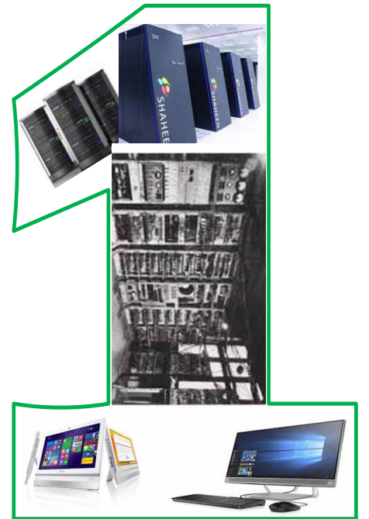

Slide 3
Lecture objectives
Distinguish between different types of computers.
Distinguish between different types of computing.
Know computer system components

Slide 4
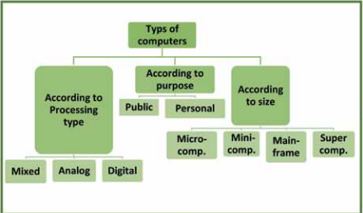
Types of computers

Slide 5
Types of computers based on their size

Slide 6
Types of computers based on their size
There are different types of computers based on their size:
Supercomputers
Mainframe computer
Minicomputers
Microcomputers

Slide 7
Types of computers based on their size
Supercomputers characteristics
It has hundreds of thousands of processors working together (up to more than 100,000 processors).
Super computers are measured with a scale called FLOPS and its multiples
It may speed more than 1000 trillion operations per second.
It consumes very large amounts of electricity.
It needs special cooling systems that result in huge temperatures.
The cost of operating and cooling the system is very large (the cost of operating one device may exceed $ 4 million annually).
Most modern supercomputers use the Linux operating system or modified versions of it specifically to suit the capabilities of the device.
Uses special and unconventional software technologies to exploit supercomputer speeds (running thousands of processors at the same time).
The supercomputer weighs hundreds of tons and occupies a very large space.
Pure gold or diamonds may go into the design of supercomputers

Slide 8
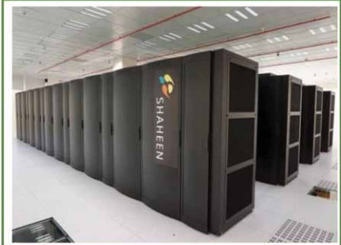
Types of computers based on their size
Supercomputers characteristics

Slide 9
Types of computers based on their size
Mainframe computer characteristics
It can run more than one operating system on the same device.
It can operate more than one virtual machine.
One large computer can substitute for hundreds of servers.
It is used in giant institutions such as banks, airlines and others.
It can serve thousands of users at the same time.
Has huge processing capabilities and high speeds.
Serves a wide range of computers (company branches - city - whole continent).

Slide 10
Types of computers based on their size
Mainframe computer characteristics

Slide 11
Types of computers based on their size
Minicomputers characteristics
Medium in size and smaller than the previous ones.
Usually used as a service provider (server) for networks and the Internet.
Designed to allow it to process multiple requests from different destinations.
Adopts the Central Memory Unit, which is the subscription of several clientcomputers in one central system unit.
Any user can access the database stored on the central unit.
It is used in major companies and government institutions to serve a large number of users.
Any user can use the various sharable resources associated with this central unit (such as a printer, scanner, etc.).

Slide 12
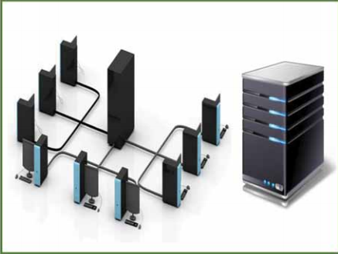
Types of computers based on their size
Minicomputers characteristics

Slide 13
Types of computers based on their size
Microcomputers characteristics
Small in size and light in weight.
Equipped with one or more microprocessors to increase its operating capacity.
It performs the same tasks as large computers, but slowly and with less information.
It is characterized by its ability to process various types of data quickly and sufficiently to perform the various functions related to the business of individuals or institutions.
Designed to perform various traditional computer functions such as writing, printing, browsing the Internet and designing images in addition to professional works such as montaging, writing programs, and others.
There are many forms, including desktop, laptop, personal assistant, tablet, smart phone devices, etc.

Slide 14
Types of computers based on their size
Microcomputers characteristics

Slide 15
Types of computers based on (processing method)

Slide 16
Types of computers based on (processing method)
There are different type of processing method
Digital Computer
Analog Computer
Hybrid Computer

Slide 17
Types of computers based on (processing method) :Digital Computer
They are the regular computers deployed in our daily life that perform operations by representing (converting) the data that they receive into a digital form.
They represent all the inputs they receive (whether numerical, literal, sounds, etc.) into a digital form and then process these data according to the orders of a specific program.

Slide 18
Types of computers based on (processing method) :Analog Computer
They are computers that operate with special values that can be received automatically as they depend on receiving analog data, which is a special type of non-digital data that can be measured as natural variables such as electrical voltage, current intensity or air pressure.
These measurements are processed inside the computer and the results are stored as standard or continuing analog quantities.
Examples of such computers include heart rate monitors such as those in hospitals and temperature and humidity measuring devices at meteorological stations

Slide 19
Types of computers based on (processing method) :Hybrid Computer
They are computers that combine the characteristics of the previous two types, analog and digital computers.
They can automatically receive data in the form of measurements, similar to analog computers.
They can also receive data in a separate entry form and run them in a numerical way, similar to digital computers.
These computers are used in advanced applications such as medicine and space

Slide 20
Types of computers according to the purpose

Slide 21
Types of computers according to the purpose
General Purpose Computers
Special Purpose Computers

Slide 22
Types of computers according to the purpose
General Purpose Computers
They are the most famous computers and are used by millions of users around the world that are used to run large and diverse groups of applications, whether industrial, scientific or commercial.
These computers are used to run general applications such as text editing, design or performing calculations.
Also, they can be used to run special applications such as students’ data logging, store contents, customer records at banks, etc.
The previously explained digital computers are general purpose computers.

Slide 23
Types of computers according to the purpose
Special Purpose Computers
It is designed to serve specific purposes where it can perform a range of
functions such as tracking and controlling missile and satellite tracks.
One of the most popular special purpose calculators is a gaming computer because it only contains game software.
Other areas in which special purpose computers are used :
1. Directing and piloting aircraft.
2. Monitoring air and maritime traffic.
3. Directing missiles and satellites.
4. Monitoring manufacturing processes.
5. Managing data communication networks.

Slide 24
Types of computers according to the method of implementing the instruction

Slide 25
Types of computers according to the method of implementing the instruction
computers with serial processing
computers with parallel processing
Normally, personal computers contain only one processor through which digital data is processed in a serial manner to solve different problems.
The problem can be divided into a separate series of instructions and the implementation of these instructions in succession, one after another, on the same processor; and not more than one instruction is executed at a time.
On computers with parallel processing, the matter is very different, as it depends on its design to use more than one processor to perform many tasks at the same time in a simultaneous way to solve a specific problem or implement specific instructions.
This is done by dividing some instructions between more than one processor and they are executed in parallel together and simultaneously.

Slide 26
Types of computers according to the method of implementing the instruction
Multicore Processors
Advantages of using parallel technology
recently, with the development of techniques for designing and manufacturing processors, it became possible for a single processor to perform many operations at the same time in parallel through the multiplicity of the processor cores (Multicore Processors).
High speed
Reliability or reliability
Decentralization

Slide 27
Types of computing

Slide 28
Types of computing
Distributed system
Grid computing
Cloud computing

Slide 29
Types of computing
Distributed system
Computing distributed from a group of computers that communicate with each other through a network connected to each other, where computers interact with one another in order to achieve a common goal.
Computer programs that run on distributed systems are called distributed programs. In distributed computing, the problem is divided into small problems and then distributed to different computers to solve this problem.

Slide 30
Types of computing
Distributed system
Distributed systems are characterized by many advantages, including:
1. There is no common clock between devices, as each device has its own pulse and is independent of other devices.
2. There is no shared memory, but information is exchanged by passing messages between different devices.
3. Ability to withstand failure, as there are many other devices to compensate and perform tasks.
4. Capacity for horizontal expansion of the system architecture (network size, number of devices increased).
5. Each device or node sees a small part of the system, and deals with a specific part of the problem.

Slide 31
Types of computing grid computing
Grid computing is the distribution of tasks (such as data storage) and the operations required to be implemented on a number of different computers located anywhere, depending on the need, via the Internet.
Network computing helps you through your personal computer, despite its modest specifications, to perform complex and advanced mathematical and scientific operations, such as areas of space research, financial and economic analyzes, earthquakes, and others.
It enables a personal computer or more to use the capabilities of high and advanced specifications (Supercomputer).
It is an application of the concept of distributed computing.

Slide 32
Types of computing
Cloud computing
Cloud computing is a package of computer hardware and software resources.
For example: space to store data, backup and self-sync, operating programs, applications, email and others.
It is available to customers through the use of the web browser without the need to be secreted and without attention to its physical location in order to facilitate the user.
There are many benefits to cloud computing, including:
1. Save costs for the user as there is no need to purchase and maintain the computer resources required.
2. Easy to access and deal with stored data anytime, anywhere.
3. Dealing with many of the applications and services available on the cloud easily whatever your computer capabilities.

Slide 33
Types of computing
Cloud computing
Examples of cloud service:
E-mail services such as: Gmail and Yahoo mail
Drop Box Cloud Storage services, such as Google Drive
Cloud Application, among which the most famous: Google Docs and Photoshop express
Cloud Operating Systems such as Windows Azure and Amazon Web Services
Google scholar.
Google Book Search.
Google Lab Search service.
Google Document service.

Slide 34
Types of computing
Cloud computing
Cloud computing requirements:
1. A personal computer.
2. Connect to the Internet.
3. Internet browser.
4. Subscribe to the cloud computing service.

Slide 35
Computer system components

Slide 36
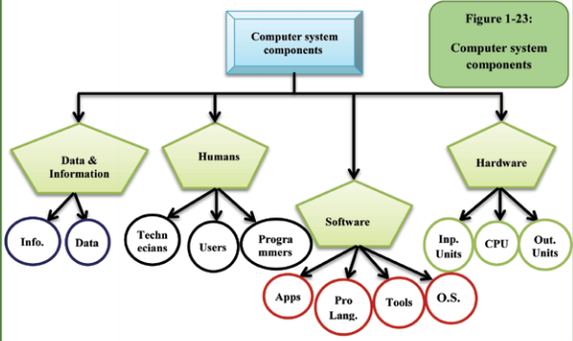
Computer system components
The computer system consists of a group of components or elements that work together in harmony and integration in order to achieve the optimal exploitation of the capabilities of the device and meet the needs of the user

Slide 37
Computer system components :Hardware
They are the physical devices that are connected to each other to form a computer as we know it, and are divided into:
Input units: used to enter data for the computer.
Output units: used to output data and information to the user.
System unit: The main component includes many internal components, the most important of which are the motherboard and central processing unit (processor), as well as memory units (RAM, ROM) and hard disk .. etc.

Slide 38
Computer system components :Software
It include all software that are run by the computer such as:
operating systems
programming languages
the various applications
the supporting tools that are used to protect and improve the work of the computer.

Slide 39
Computer system components :Humans
They are the people who perform computer related work (programming and development - data entry and use of various programs - maintenance - ..etc).
Also users: they are the people who deal with the computer and can be divided into three main sections:operating systems

Slide 40
Computer system components :Data and information
The data is the raw material that is processed inside the computer, which is often in the form of various inputs (text - numbers - symbols - pictures - sound..etc), for example student’s grades in different courses.
The information, it is the product of processing and running data that gives added value to the user such as the student’s total score or grade. It can be said that it is the output that the user wants to obtain. This will be covered in detail in the following chapters of the

Slide 41
The end of chapter 1

