Slide 1
Chapter(2)
Frequency Distributions
and Graphs
Lecturer : FATEN AL-HUSSAIN
Lecture (2)
Note: This PowerPoint is only a summary and your main source should be the book.

Slide 2
Introduction
2-1 Organizing Data
2-2 Histograms, Frequency Polygons, and Ogives
2-3 Other Types of Graphs
Note: This PowerPoint is only a summary and your main source should be the book.

Slide 3
2-1 Organizing Data
Data collected in original form is called raw data.
For example:
Score | f
8 | 3
7 | 2
6 | 3
5 | 4
4 | 1
2 | 5
Raw Data
2 | 5 | 8 | 7 | 2 | 2
6 | 8 | 5 | 2 | 5 | 7
4 | 5 | 6 | 2 | 8 | 6
Note: This PowerPoint is only a summary and your main source should be the book.

Slide 4
Each raw data value is placed into a quantitative or qualitative category called a class.
A class then is the number of data values contained in a specific class called frequency .
Note: This PowerPoint is only a summary and your main source should be the book.

Slide 5
A frequency distribution is the organization of raw data in table form, using classes and frequencies.
Two types of frequency distribution
Categorical Frequency Distributions
Grouped Frequency Distributions
Used for data that can be placed in specific
categories (nominal or ordinal level data).
When the range of the data is large data is grouped into classes that are more than one unit in width
Note: This PowerPoint is only a summary and your main source should be the book.

Slide 6
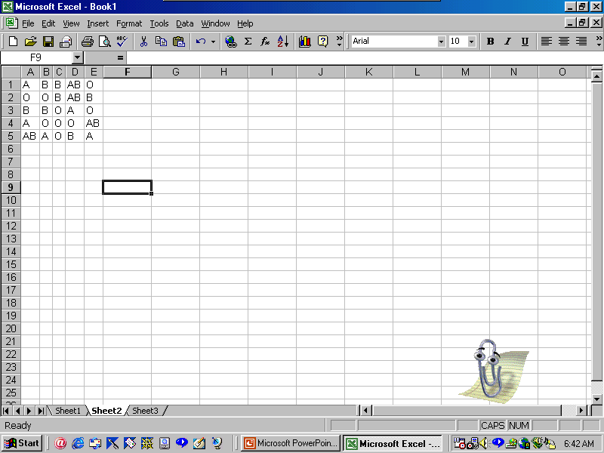
Categorical Frequency Distributions
For example:
Twenty-five army indicates were given a blood test to determine their blood type.
% = f/n*100
Class | Tally | Frequency (f) | Percent %
A B O AB Total
5/25*100=20
7/25*100=35
9/25*100=45
4/25*100=16
IIII
IIII II
IIII IIII
IIII
5
7
9
4
n=25
Note: This PowerPoint is only a summary and your main source should be the book.

Slide 7
Grouped Frequency Distributions
Class limits
Lower class limit
Upper class limit
Class boundaries
Upper class boundaries
Lower class boundaries
Lower class
Upper class
Class limits | Class boundaries | Tally | Frequency
24-30 | 23.5-30.5 | /// | 3
31-37 | 30.5-37.5 | / | 1
38-44 | 37.5-44.5 | //// | 5
45-51 | 44.5-51.5 | //// //// | 9
52-58 | 51.5-58.5 | //// / | 6
59-65 | 58.5-65.5 | / | 1
First class
second class
Note: This PowerPoint is only a summary and your main source should be the book.

Slide 8
  In this distribution, the values 24 and 30 of the first class are called “class limits”.
  24 is the “lower class limit” and 30 is the “upper class limit.”
  The numbers in the second column are called class boundaries.
  The class boundaries are used to separate the class so that there is no gap in frequency distribution.
  Lower boundary= lower limit - 0.5
  Upper boundary= upper limit + 0.5
Note: This PowerPoint is only a summary and your main source should be the book.

Slide 9
Class limits should have the same decimal place value as the data, but the class boundaries should have one additional place value and end in a 5.
For example:
Class limit 7.8-8.8
Class boundary 7.75-8.85
  Lower boundary= lower limit - 0.05
  =7.8- 0.05 =7.75
  Upper boundary= upper limit + 0.05
  =8.8+0.05=8.85
Note: This PowerPoint is only a summary and your main source should be the book.

Slide 10
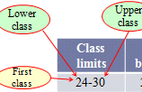
The lower class limit represents the smallest data value that can be included in the class.
The upper class limit represents the largest data value that can be included in the class.
Note: This PowerPoint is only a summary and your main source should be the book.

Slide 11
Questions ???
The numbers are used to separate the classes so that there are no gaps in the frequency distribution called class boundaries
Find the class boundaries for each class ?
2.15 – 3.93
49.005
Note: This PowerPoint is only a summary and your main source should be the book.

Slide 12
The class width is found by subtracting the lower (or upper) class limit of one class from the lower (or upper) class limit of the next class .
Class width=lower of second class limit-lower of first class limit
Class width=upper of first class boundary -lower of first class boundary
For example:
Class limits | Class boundaries
24-30 | 23.5-30.5
31-37 | 30.5-37.5
class width
class width
class width : 31-24 = 7
Note: This PowerPoint is only a summary and your main source should be the book.

Slide 13




The class midpoint X_{m} is found by adding the lower and upper class limit (or boundary) and dividing by 2 .
X_{m} =
Or
X_{m} =
For example :
Note: This PowerPoint is only a summary and your main source should be the book.

Slide 14
Rules for Classes in Grouped Frequency Distributions
There should be 5-20 classes.
The class width should be an odd number.
The classes must be mutually exclusive.
4. The classes must be continuous.
5. The classes must be exhaustive.
6. The classes must be equal in width
(except in open-ended distributions).
Age
10-20
20-30
30-40
40-50
50-60
Age
10-20
21-31
32-42
43-53
54-64
Better way to construct a frequency distribution
Note: This PowerPoint is only a summary and your main source should be the book.

Slide 15
Constructing a Grouped Frequency Distribution
1- The following data represent the record high temperatures for each of the 50 states. Construct a grouped frequency distribution for the data using 7 classes.
112 100 127 120 134 118 105 110 109 112
110 118 117 116 118 122 114 114 105 109
107 112 114 115 118 117 118 122 106 110
116 108 110 121 113 120 119 111 104 111
120 113 120 117 105 110 118 112 114 114
Note: This PowerPoint is only a summary and your main source should be the book.

Slide 16
STEP 1 Determine the classes.
Find the class width by dividing the range by the number of classes 7.
    Range = High – Low
        = 134 – 100 = 34
    Width = Range/7 = 34/7 ≈ 4.9=5
Round up
Note: This PowerPoint is only a summary and your main source should be the book.

Slide 17
Step 2 : Tally the data.
Step 3 : Find the frequencies.
Class Limits | Class Boundaries | Frequency | Cumulative Frequency
100 - 104 105 - 109 110 - 114 115 - 119 120 - 124 125 - 129 130 - 134
99.5 - 104.5
104.5 - 109.5
109.5 - 114.5
114.5 - 119.5
119.5 - 124.5
124.5 - 129.5
129.5 - 134.5
2
8
18
13
7
1
1
0
2
10
28
41
48
49
50
Note: This PowerPoint is only a summary and your main source should be the book.

Slide 18
2- The data shown here represent the number of miles per gallon that 30 selected four-wheel- drive sports utility vehicles obtained in city driving.
12 17 12 14 16 18
16 18 12 16 17 15
15 16 12 15 16 16
12 14 15 12 15 15
19 13 16 18 16 14
Note: This PowerPoint is only a summary and your main source should be the book.

Slide 19
    Range = High – Low
        = 19 – 12 = 7
    So the class consisting of the single data value can be used. They are 12,13,14,15,16,17,18,19.
    This type of distribution is called ungrouped frequency distribution
Note: This PowerPoint is only a summary and your main source should be the book.

Slide 20
Class Limits | Class Boundaries | Frequency | Cumulative Frequency
12 13 14 15 16 17 18 19 | 11.5-12.5 12.5-13.5 13.5-14.5 14.5-15.5 15.5-16.5 16.5-17.5 17.5-18.5 18.5-19.5 | 6 1 3 6 8 2 3 1 | 0 6 7 10 16 24 26 29 30
Note: This PowerPoint is only a summary and your main source should be the book.

Slide 21
Find the class boundary , midpoint of the last class and the class width?
Class | Frequency
4-9 | 2
10-15 | 4
16-21 | 3
22-27 | 8
28-33 | 5
Note: This PowerPoint is only a summary and your main source should be the book.

Slide 22

Solution
Class | Boundaries
4-9 | 3.5 – 9.5
10-15 | 9.5-15.5
16-21 | 15.5-21.5
22-27 | 21.5-27.5
28-33 | 27.5-33.5
X_{m} =
Class width= 10 - 4 = 6
Note: This PowerPoint is only a summary and your main source should be the book.

Slide 23
Histograms, Frequency Polygons, and Ogives
Note: This PowerPoint is only a summary and your main source should be the book.

Slide 24
For Continuous Data
The three most commonly used graphs in research
are as follows:
The histogram
2. The frequency polygon
3. The cumulative frequency graph, or Ogive
Note: This PowerPoint is only a summary and your main source should be the book.

Slide 25
Histogram
The histogram is a graph that displays the data by using contiguous vertical bars (unless the frequency of a class is 0) of various heights to represent the frequencies of the classes.
The class boundaries are represented on the horizontal axis
( On x-axis ,put class boundaries .On y-axis ,put frequency ).
Note: This PowerPoint is only a summary and your main source should be the book.

Slide 26
Example 2-4:
Construct a histogram to represent the data for the record high temperatures for each of the 50 states (see Example 2–2 for the data).
Class Limits | Class Boundaries | Frequency
100 - 104 105 - 109 110 - 114 115 - 119 120 - 124 125 - 129 130 - 134 | 99.5 - 104.5 104.5 - 109.5 109.5 - 114.5 114.5 - 119.5 119.5 - 124.5 124.5 - 129.5 129.5 - 134.5 | 2 8 18 13 7 1 1
Note: This PowerPoint is only a summary and your main source should be the book.

Slide 27
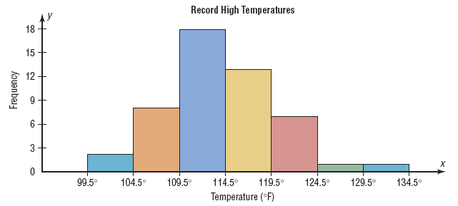
Histograms use class boundaries and frequencies of the classes.
Note: This PowerPoint is only a summary and your main source should be the book.

Slide 28
Frequency polygons
The frequency polygon is a graph that displays the data
by using lines that connect points plotted for the frequencies at the midpoints of the classes. The frequencies are represented by the heights of the points.
The class midpoints are represented on the horizontal axis.
( On x-axis ,put class midpoints .On y-axis ,put frequency ).
Note: This PowerPoint is only a summary and your main source should be the book.

Slide 29
Example 2-5:
Construct a frequency polygon to represent the data for the record high temperatures for each of the 50 states (see Example 2–2 for the data).
Class Limits | Class Midpoints | Frequency
100 - 104 105 - 109 110 - 114 115 - 119 120 - 124 125 - 129 130 - 134 | 102 107 112 117 122 127 132 | 2 8 18 13 7 1 1
Note: This PowerPoint is only a summary and your main source should be the book.

Slide 30
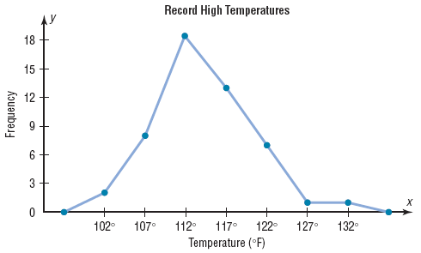
Frequency polygons use class midpoints and frequencies of the classes.
A frequency polygon
is anchored on the
x-axis before the first
class and after the
last class.
Note: This PowerPoint is only a summary and your main source should be the book.

Slide 31
Cumulative Frequency Graphs Or Ogives
The ogive is a graph that represents the cumulative frequencies for the classes in a frequency distribution
Cumulative frequency distribution is a distribution that
shows the number of data values less than or equal t a specific
value .
The upper class boundaries are represented on the horizontal axis
( On x-axis ,put upper class boundaries .On y-axis ,put cumulative frequency ).
Note: This PowerPoint is only a summary and your main source should be the book.

Slide 32
Example 2-6:
Construct an ogive to represent the data for the record high temperatures for each of the 50 states (see Example 2–2 for the data).
Class Limits | Class Boundaries | Frequency
100 - 104 105 - 109 110 - 114 115 - 119 120 - 124 125 - 129 130 - 134 | 99.5 - 104.5 104.5 - 109.5 109.5 - 114.5 114.5 - 119.5 119.5 - 124.5 124.5 - 129.5 129.5 - 134.5 | 2 8 18 13 7 1 1
Note: This PowerPoint is only a summary and your main source should be the book.

Slide 33
Class Limits | Class Boundaries | Frequency
100 - 104 105 - 109 110 - 114 115 - 119 120 - 124 125 - 129 130 - 134 | 99.5 - 104.5 104.5 - 109.5 109.5 - 114.5 114.5 - 119.5 119.5 - 124.5 124.5 - 129.5 129.5 - 134.5 | 2 8 18 13 7 1 1
Class Boundaries | Cumulative Frequency
Less than 99.5 Less than 104.5 Less than 109.5 Less than 114.5 Less than 119.5 Less than 124.5 Less than 129.5 Less than 134.5 | 0 2 10 28 41 48 49 50
Note: This PowerPoint is only a summary and your main source should be the book.

Slide 34
Cumulative frequency is the sum of the frequencies
accumulated up t the upper boundary of a class in
the distortion .

Slide 35
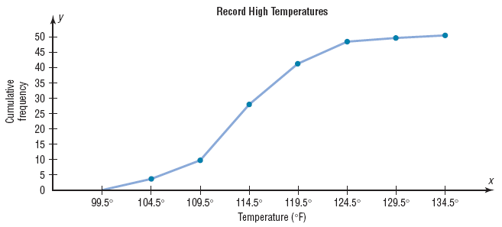
Ogives use upper class boundaries and cumulative frequencies of the classes.
Note: This PowerPoint is only a summary and your main source should be the book.

Slide 36
The Relative Frequency
The distribution using proportions instead f raw data as
frequencies called relative frequency .
Note: This PowerPoint is only a summary and your main source should be the book.

Slide 37
Example 2-7:
Construct a histogram, frequency polygon, and ogive using relative frequencies for the distribution (shown here) of the miles that 20 randomly selected runners ran during a given week.
Class Boundaries | Frequency
5.5 - 10.5 10.5 - 15.5 15.5 - 20.5 20.5 - 25.5 25.5 - 30.5 30.5 - 35.5 35.5 - 40.5 | 1 2 3 5 4 3 2
Note: This PowerPoint is only a summary and your main source should be the book.

Slide 38

Histograms
The following is a frequency distribution of miles run per week by 20 selected runners.
Class Boundaries | Frequency ( f ) | Relative Frequency
5.5 - 10.5 10.5 - 15.5 15.5 - 20.5 20.5 - 25.5 25.5 - 30.5 30.5 - 35.5 35.5 - 40.5 | 1 2 3 5 4 3 2
1/20 =
2/20 =
3/20 =
5/20 =
4/20 =
3/20 =
2/20 =
0.05
0.10
0.15
0.25
0.20
0.15
0.10
The sum of the relative frequencies will always be 1
Σf = 20
Σrf = 1.00
Note: This PowerPoint is only a summary and your main source should be the book.

Slide 39
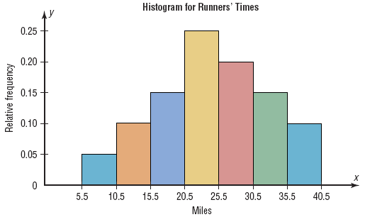
Use the class boundaries and the relative frequencies of the classes.
Note: This PowerPoint is only a summary and your main source should be the book.

Slide 40
Frequency Polygons
The following is a frequency distribution of miles run per week by 20 selected runners.
Class Boundaries | Class Midpoints | Relative Frequency
5.5 - 10.5 10.5 - 15.5 15.5 - 20.5 20.5 - 25.5 25.5 - 30.5 30.5 - 35.5 35.5 - 40.5 | 8 13 18 23 28 33 38 | 0.05 0.10 0.15 0.25 0.20 0.15 0.10
Note: This PowerPoint is only a summary and your main source should be the book.

Slide 41
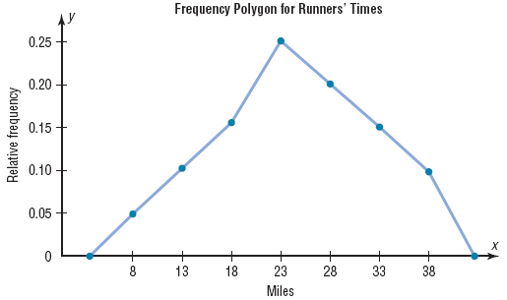
Use the class midpoints and the relative frequencies of the classes.
Note: This PowerPoint is only a summary and your main source should be the book.

Slide 42

Ogives
The following is a frequency distribution of miles run per week by 20 selected runners.
Class Boundaries | Frequency | Cumulative Frequency | Cum. Rel. Frequency
5.5 - 10.5 10.5 - 15.5 15.5 - 20.5 20.5 - 25.5 25.5 - 30.5 30.5 - 35.5 35.5 - 40.5 | 1 2 3 5 4 3 2 | 0 1 3 6 11 15 18 20
0
1/20 =
3/20 =
6/20 =
11/20 =
15/20 =
18/20 =
20/20 =
0
0.05
0.15
0.30
0.55
0.75
0.90
1.00
Σf = 20
Note: This PowerPoint is only a summary and your main source should be the book.

Slide 43
Ogives use upper class boundaries and cumulative frequencies of the classes.
Class Boundaries | Cum. Rel. Frequency
Less than 5.5
Less than 10.5
Less than 15.5
Less than 20.5
Less than 25.5
Less than 30.5
Less than 35.5
Less than 40.5
0
0.05
0.15
0.30
0.55
0.75
0.90
1.00
Note: This PowerPoint is only a summary and your main source should be the book.

Slide 44
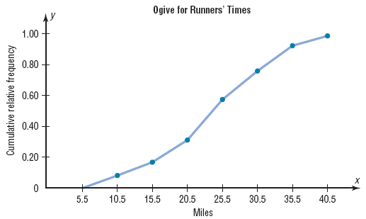
Use the upper class boundaries and the cumulative relative frequencies.
Note: This PowerPoint is only a summary and your main source should be the book.

Slide 45
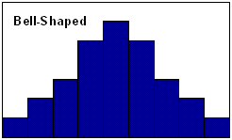
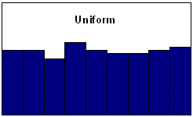
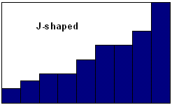
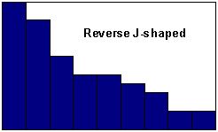
Shapes of Distributions
Flat
J shaped:few data values on left side and increases as one moves to right
Reverse J shaped: opposite of the j-shaped distribution
Note: This PowerPoint is only a summary and your main source should be the book.

Slide 46
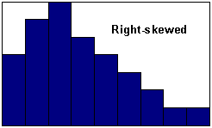
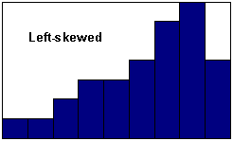
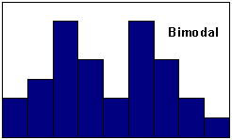
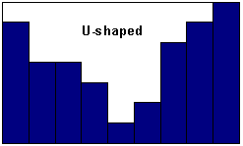
Positively skewed Negatively skewed
Note: This PowerPoint is only a summary and your main source should be the book.

Slide 47
Other Types of Graphs
Several other types of graphs are often used in statistics. We will discuss three other types of graphs as follows:
1. A bar graph
2. A Pareto chart
3. The Time series graph
4. The Pie graph
Note: This PowerPoint is only a summary and your main source should be the book.

Slide 48
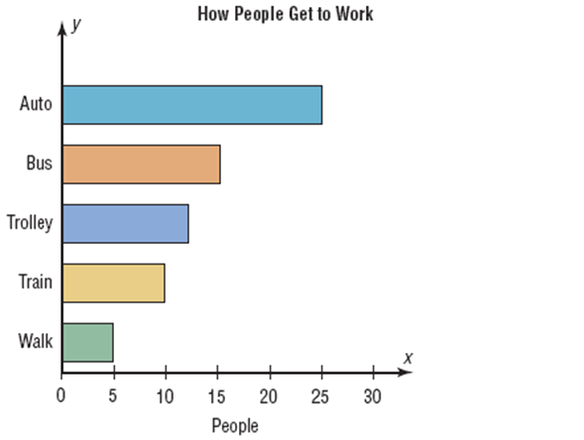
A bar graph represents the data by using vertical or horizontal bars whose heights or lengths represent the frequencies of the data .
When the data are
qualitative or
categorical
,bar graphs can be used.
Page (70)
Note: This PowerPoint is only a summary and your main source should be the book.

Slide 49
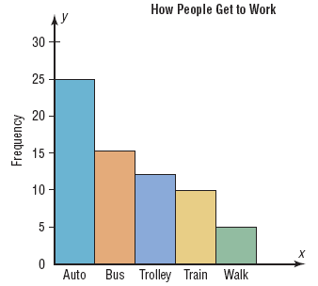
A Pareto chart is used to represent a frequency distribution for a categorical variable, and the frequencies are displayed by the heights of vertical bars, which are arranged in order from highest to lowest.
Pareto chart
When the variable
displayed on the
horizontal axis is
qualitative or
categorical, a
Pareto chart can be used
Note: This PowerPoint is only a summary and your main source should be the book.

Slide 50
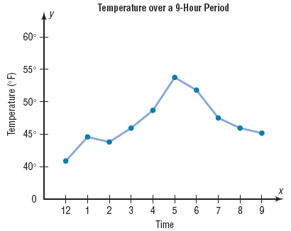
A time series graph represents data that occur
over a specific period of time.
When data are
collected over a
period of time,
they can be
represented by a
time series graph
(line chart)
Compound time series graph: when two data sets
are compared on the same graph.(Page 73)
Note: This PowerPoint is only a summary and your main source should be the book.

Slide 51
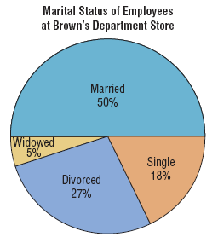


A pie graph is a circle that is divided into sections or
wedges according to the percentage of frequencies
in each category of the distribution.
The purpose of the pie graph is to show the relationship of the parts to the whole by visually comparing the sizes of the sections.
Percentages or proportions can be used.
The variable is nominal or categorical.
Note: This PowerPoint is only a summary and your main source should be the book.

Slide 52




Example 2-12:
Construct a pie graph showing the blood types of the army inductees described in example 2-1 .
Class | Frequency | percent
A | 5 | 20%
B | 7 | 28%
O | 9 | 36%
AB | 4 | 16%
Total | 25 | 100%
%
Shown in figure 2-15
Note: This PowerPoint is only a summary and your main source should be the book.

Slide 53
A stem and leaf plots is a data plot that uses part of a data value as the stem and part of the data value as the leaf to form groups or classes.
The stem and leaf plot is a method of organizing data and is a combination of sorting and graphing.
It has the advantage over a grouped frequency distribution of retaining the actual data while showing them in graphical form.
stem | leaves
2 | 4
3 | 5
- 24 is shown as
-35 is shown as
Note: This PowerPoint is only a summary and your main source should be the book.

Slide 54
Example 2-13:
At an outpatient testing center, the number of cardiograms performed each day for 20 days is shown. Construct a stem and leaf plot for the data.
25 31 20 32 13
14 43 02 57 23
36 32 33 32 44
32 52 44 51 45
Note: This PowerPoint is only a summary and your main source should be the book.

Slide 55
25 31 20 32 13
14 43 02 57 23
36 32 33 32 44
32 52 44 51 45
Unordered Stem Plot
Ordered Stem Plot
0
2
0 | 2
1 | 3 | 4
2 | 0 | 3 | 5
3 | 1 | 2 | 2 | 2 | 2 | 3 | 6
4 | 3 | 4 | 4 | 5
5 | 1 | 2 | 7
1
3
4
2
5
0
3
3
1
2
6
2
3
2
2
4
3
4
4
5
5
7
2
1
Note: This PowerPoint is only a summary and your main source should be the book.

Slide 56
Example 1 :
Data in ordered array:
21, 24, 24, 26, 27, 27, 41
stem | leaves
2 | 1 4 4 6 7 7
3
4 | 1
Example 2 :
Data in ordered array:
324 , 327 , 330 , 332 , 335 , 341 , 345
stem | leaves
32 | 4 7
33 | 0 2 5
34 | 1 5
Note: This PowerPoint is only a summary and your main source should be the book.

Slide 57
Quantitative | Qualitative or Categorical
Histograms | bar graph
Frequency Polygons | Pareto chart
Ogives | Pie graph
The Time series graph
stem and leaf plots
Note: This PowerPoint is only a summary and your main source should be the book.

Slide 58


