Slide 1
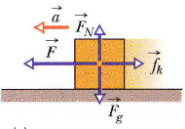
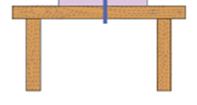
m
Friction

Slide 2
In this chapter we focus on the physics of: 1- Frictional force. 2- Centripetal force.

Slide 4
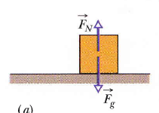
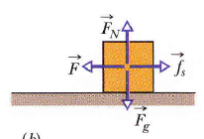
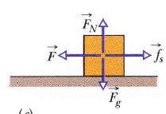
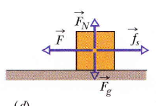
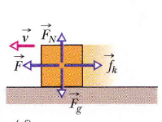
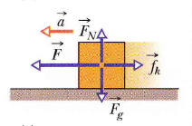
No motion, : is the static friction
Acceleration, : is the kinetic friction
Constant velocity

Slide 5
Frictional force
Static frictional force:
Kinetic frictional force:

Slide 7
Remember:
They are dimensionless.

Slide 8
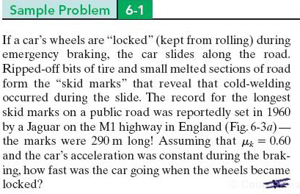

Slide 9
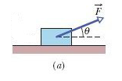
What is the acceleration of the block?

Slide 10
A particle is in uniform circular motion if it travels around a circle or circular arc at constant speed.
Centripetal acceleration
- magnitude
- direction: toward the center.
According to Newton’s second law: The cause of the centripetal acceleration is a Force called the centripetal Force
- direction: toward the center.

Slide 11
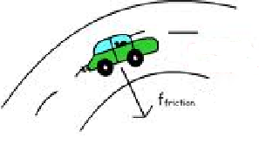
Friction Force is the centripetal force
T
Tension Force is the centripetal force
Fg
Gravity Force is the centripetal force

