Slide 1
Who are you _______________ invite to your party?
will
going to
go to
might

Slide 2
I am busy right now. I _______ breakfast.
am have
have
having
am having

Slide 3
_____ you waiting for a bus?
Do
Are
Does
Is

Slide 4
How _______ you _______ to drive?
was / learn
did / learn
did / learnt
are / learn

Slide 5
Kathy usually __________ in front of the window during the class.
sits
sitting
sit
is sit

Slide 6
It's so cold. I think it ______________ rain.
Is going to go might is

Slide 7
I ___________ sitting down at the moment.
am not
are not
is
don't

Slide 8
The children………… outside
Play
Plays

Slide 9
To join this table tennis academy, students _______ be 16 years old. are must has to

Slide 10
The police…………. find any clue about the criminal
do not
does not
Is not

Slide 11
You _______ do more exercise to stay fit.
must
are
shouldn't

Slide 12
Everybody ………… a good song.
enjoy
enjoys

Slide 13
A lady with 10 cats ……….in that big house
live
lives

Slide 14
He must ___________ the garage. It is full of rubbish.
cleaning
clean
cleans

Slide 15
One of the cookies ………missing
Is
are

Slide 16
His classmates ………. before a test.
Study
studies

Slide 17
Those ……….pretty shoes.
Is
Are
be

Slide 18
Ted and Mary …………..going to the movies
Is
are
have

Slide 19
Most of my teeth ________ clean.
Are
Is
was

Slide 20
It is important …….. health meals
to eating
to eat
eating

Slide 21
What _____ John ___________ at the moment?
does / do
is / do
are / doing
is / doing

Slide 22
We ________ enjoying our holiday here so much.
don't
are
is
doesn't

Slide 23
What _____________? It looks awful.
do you drinking
are you drink
are you drinking
does you drink

Slide 24
What does this word ________?
means
meaning
mean
is mean

Slide 25
It is necessary ……..to the manager
talking
talk
To talk
Is talking

Slide 26
You should not ……………. your work till tomorrow
delay
delaying

Slide 27
“Whose watch is this?” “It’s __________.”
your
mine
me
you

Slide 28
The book on the table is ……..
Him
His
It
her

Slide 29
This bag is …………..
Her
Hers
Him
your

Slide 30
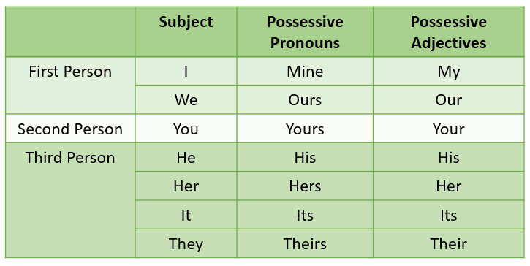

Slide 31
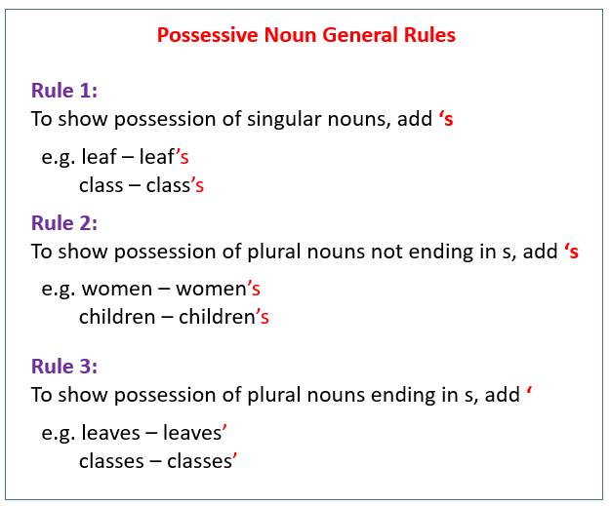

Slide 32
__________ bag is brown.
Sarah is
Sarah
Sarah’s
Sarah has

Slide 33
I found ………… toys in the living room
My brothers’
My brothers
My brother

Slide 34
…………… in this shop are amazing
Children’s bags
Childrens’ bag
Children bag

Slide 35
My uncle _______ English.
teached
was teach
did teach
taught

Slide 36
He ……….. do anything to help me.
don't do
isn't
not
doesn't

Slide 37
Tom is running towards the tree. He ______________ climb it.
is
will
doesn't
is going to

Slide 38
This booklet is really …………
Help
Helpful
helped

Slide 39
The movie I saw yesterday is ……………
amazed
amazing
amazful

Slide 40
She hates ………….at night
going out
Go out
Went out

Slide 41
My sister and I …………… play tennis
are not going to
am not going to
They are not going to

Slide 42
You should ……….. on time
Be
Being
are

Slide 43
He _______ his examination because he _______ very hard.
pass / study
past / was study
was past / studied
passed / studied

Slide 44
I prefer ………… the lunch over ……….. dishes
cook / do
cooking/ do
cook/ doing
cooking / doing

Slide 45
Beauty and Beast is ……….. movie
Wondered
Wonderful
wonder

Slide 46
……………… tennis is my favorite hobby
Play
Played
Plays
playing

Slide 47
Rice _______ in cold climates.
isn't grow
don't grow
aren't grow
doesn't grow

Slide 48
…………….is bad for your health
Smoked
Smoking
smoke

Slide 49
Sare and Nora are going ……. Some food
to cooking
cooks
to cook
cook

Slide 50
........... (he / drive) the car?
am he going to drive
Is he going to drive
are he going to drive

Slide 51
They .............. (not / walk) to the railway station.
is not going to walk
are not going to walk
are not going to walking

Slide 52
Where............ (you / play) tennis ?
is you going to play
am you going to play
are you going to play

Slide 53
I _______ anything last week.
did do
didn't do
wasn't do
don't do

Slide 54
I want a new TV ___ the one I have now is broken..
Because
So
but

Slide 55
The history test was difficult ___ the English one was easy
But
Because
so

Slide 56
We have a test on Monday ___ I'll have to study this weekend
But
So
because

Slide 57
I want ………….. Black shoes
to wear
wearing
to have wear

Slide 58
I need …………. My uncle because he is sick
Visiting
To visit
A visit

Slide 59
I was cold ___ I turned on the heater
Because
So
but

Slide 60
I had to work on Saturday ___ I couldn't go to John's party
But
Because
so

Slide 61
