Slide 1
3D Printing Techniques

Slide 2
3D Printing Techniques
Beam Deposition Processes
Printing Processes
Extrusion-Based Systems
Photopolymerization Processes
Sheet Lamination Processes
Direct Write Technologies
Powder Bed Fusion Processes

Slide 4
Photopolymerization techniques
Stereolithography
(SLA)
(Vector scan)
Digital light processing (DLP)
(Mask projection )
Two-photon Polymerization
(2PP)
2 photons
Digital projector
UV laser
(0.1-1 W)

Slide 5
Photopolymer resins
Acrylates
Epoxy
Notes:
The optimal properties of IPNs for specific applications can be obtained by selecting two appropriate components and adjusting their proportions [34]. For example, increas- ing the acrylate content increases the cure speed but decreases the adhesion characteristics, while increasing the epoxy content reduces the shrinkage of curing and improves the adhesion, but decreases the cure speed [36].
https://www.3dhubs.com/material-group/high-detail-resin

Slide 6
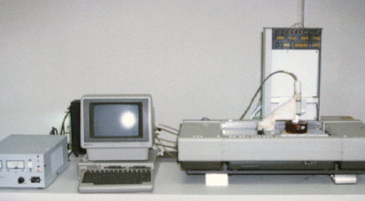
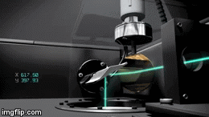
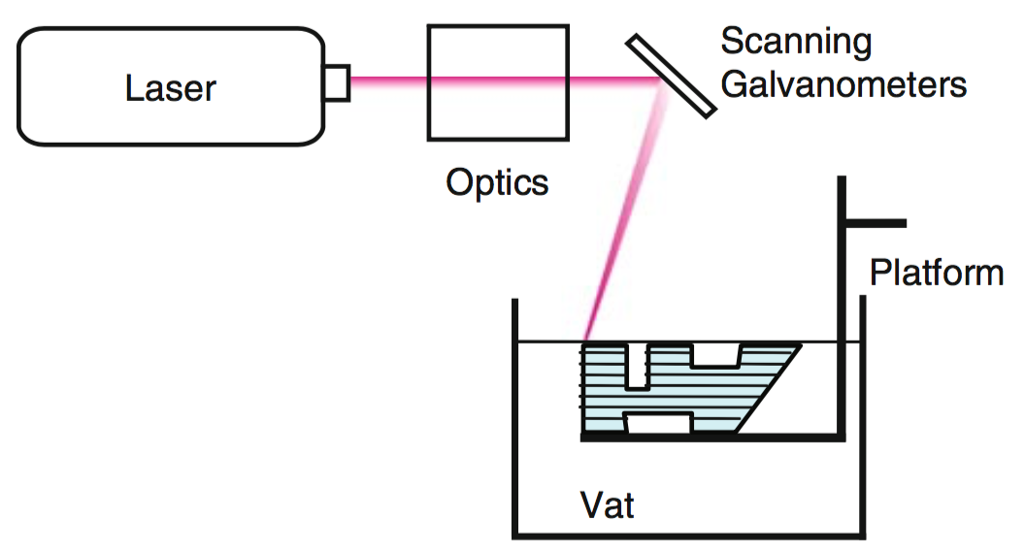
Stereolithography) SL or SLA(
Charles (Chuck) Hull invented the technology in 1986.
3D Systems adopted the technology and started to commercialize it.
SLA creates solid parts by selectively solidifying a liquid photopolymer resin using an UV laser.
It is a complex process, but simply:
The photopolymer resin is held in a vat with a movable platform inside.
A laser beam is directed in the X-Y axes across the surface of the resin according to the 3D data supplied to the machine (the .stl file).
The resin hardens precisely where the laser hits the surface.
Once the layer is completed, the platform within the vat drops down and the subsequent layer is traced out by the laser.
This continues until the entire object is completed and the platform can be raised out of the vat for removal.
First 3D Printer invented by Cuck Hull

Slide 8
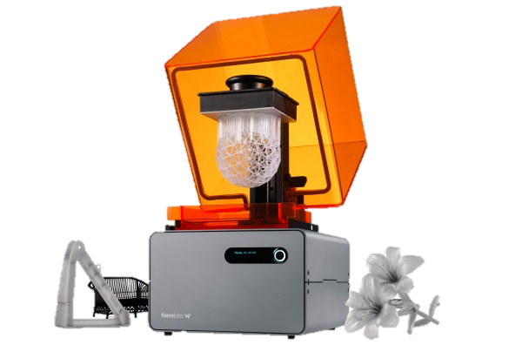
Stereolithography) SL or SLA(
Due to the nature of the SLA process, it requires support structures for some parts, specifically those with overhangs or undercuts.
These structures need to be manually removed.
During the post processing steps, many 3D printed objects need to be cleaned and cured.
FormLab,Form 1+
Advantages | Disadvantages
One of the most accurate 3D printing processes. | The required post-processing steps are not simple.
Excellent surface finish | Materials can become more brittle over time.
Nature of the raw material | Liquid (Resin)
Final Product | Plastic

Slide 9
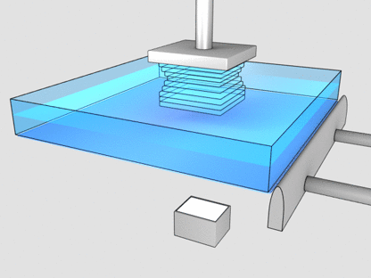
Digital Light Processing (DLP)
DLP is a similar process to SLA in using the photopolymers, but the major difference is the light source.
DLP uses a more conventional light source, such as an arc lamp, with a liquid crystal display panel or a deformable mirror device (DMD), which is applied to the entire surface of the vat of photopolymer resin in a single pass, generally making it faster than SL.

Slide 10
Digital Light Processing (DLP)
Also like SL, DLP produces highly accurate parts with excellent resolution, but its similarities also include the same requirements for support structures and post-curing.
One advantage of DLP over SL is that only a shallow vat of resin is required to facilitate the process, which generally results in less waste and lower running costs.
Advantages | Disadvantages
Faster than the SLA | The required post-processing steps are not simple.
Excellent surface finish | Resin is a highly cost material
Nature of the raw material | Liquid (Resin)
Final Product | Plastic

Slide 11
Continues Digital Light Processing (cDLP)

Slide 12
Two-Photon Polymerization (2PP)
(a) SEM image of 6×6 grid structure. (b) SEM image of “Tokyo Skytree”.
The two-photon polymerization (2PP) technique is based on the interaction of femtosecond laser radiation which induces a highly localised chemical reaction leading to polymerization of the photosensitive material with current resolution down to 100 nm.
Ref: High-aspect 3D two-photon polymerization structuring with widened objective working range (WOW-2PP)
Kotaro Obata, Ayman El-Tamer, Lothar Koch, Ulf Hinze and Boris N Chichkov

Slide 13
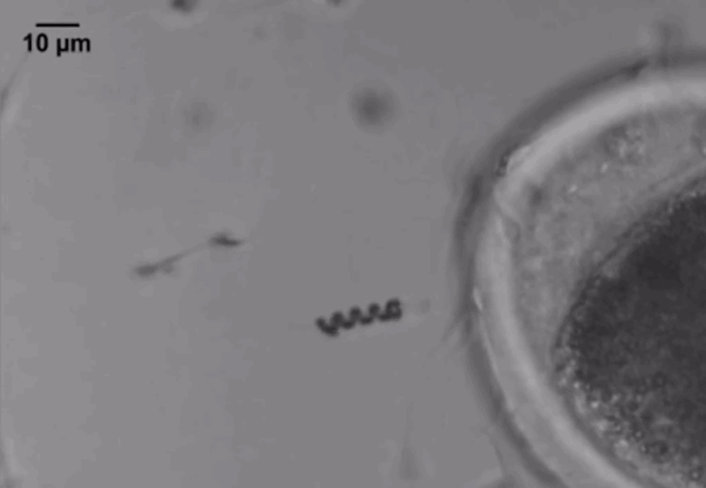
Two-Photon Polymerization (2PP)
Application of femtosecond pulses allows the introduction of laser energy with unprecedented precision in space and time.
By applying the light source that has the same timescale as molecular vibrations, one could observe and even control the outcome of chemical and biological reactions in a real time.
The application of the femtosecond lasers to probe molecular dynamics has been explored for more than two decades now and it was recognized by the award of the Chemistry Nobel Prize in 1999.
Advantages | Disadvantages
Getting to an accurate manufacturing scale (Micro and even Nano scale). | High cost of production
This technology has a bright future in the medical industry. | Has a limitation in regard to the produced material.
Nature of the raw material | Liquid (Resin)
Final Product | Plastic

