Slide 1
Unit 3 at home & abroad
Lesson 3
An adventurous life

Slide 2
A – 11 letters
adventurous

Slide 3
B – 6 letters
become

Slide 4
C – 5 letters
chief

Slide 5
i – 6 letters
insect

Slide 6
M – 7 letters
meeting

Slide 7
O – 8 letters
official ( adj. )

Slide 8
R – 6 letters
remote

Slide 9
S – 5 letters
scout ( n )

Slide 10
S – 8 letters
survival

Slide 11
V – 6 letters
viewer

Slide 12
New words
Adventurous
Become
Chief
Insect
Meeting
official ( adj. )
Remote
scout ( n )
Survival
viewer

Slide 13
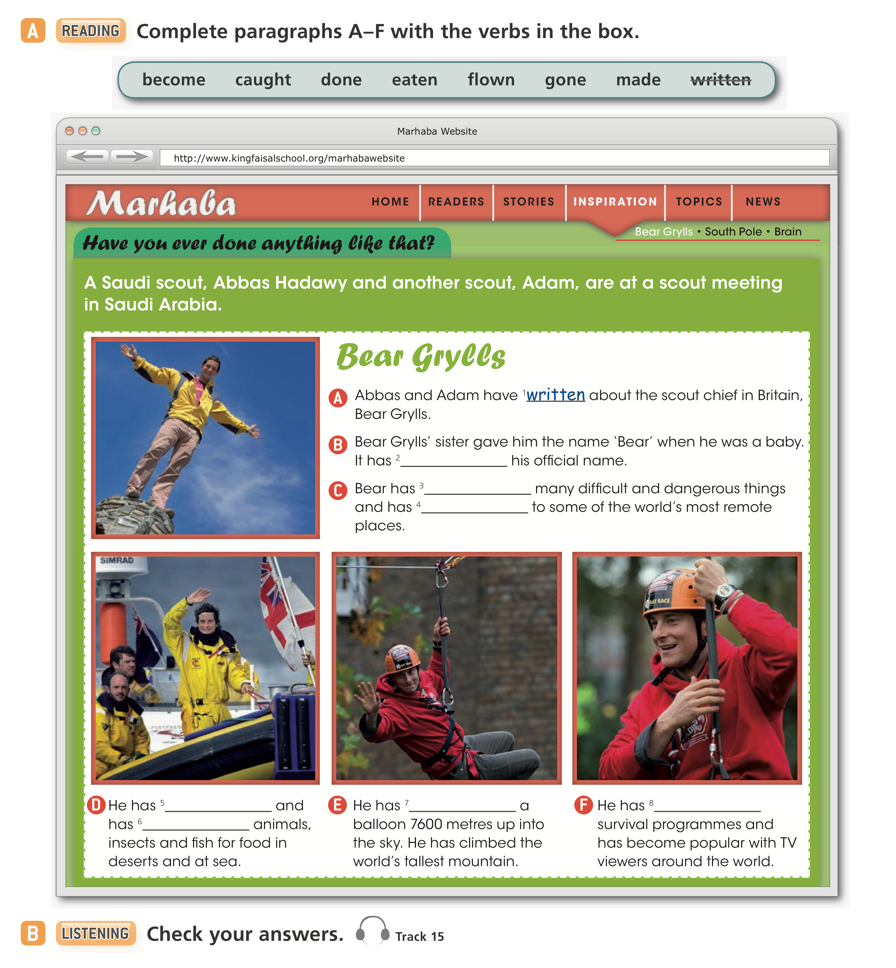
2 Become
3 Done
4 Gone
5 Caught
6 Eaten
7 Flown
8 made

Slide 14
