Slide 1
CHAPTER 12
GENETICS

Slide 2
CELL DIVISION
and
REPRODUCTION
2
Copyright © 2009 Pearson Education, Inc.
Notes:
2

Slide 3
Methods of Reproduction
0
  Living organisms reproduce by two methods
    1. Asexual reproduction
      Offsprings are identical to their parent cell (original cell or organism)
      Involves inheritance of all genes from one parent
      Prokaryotes reproduce asexually by binary fission.
      2. sexual reproduction
      - Involves inheritance of unique sets of genes from two parents
      - Offspring are similar to parents, but show variations in traits
3
Notes:
3

Slide 4
Prokaryotes reproduce by binary fission
0
  Binary fission means “dividing in half”
    Occurs in prokaryotic cells
    Two identical cells arise from one cell
    Steps in the process:
      A single circular chromosome duplicates, and the copies begin to separate from each other
      The cell elongates, and the chromosomal copies separate further
      The plasma membrane grows inward at the midpoint to divide the cells
4
Notes:
4

Slide 5
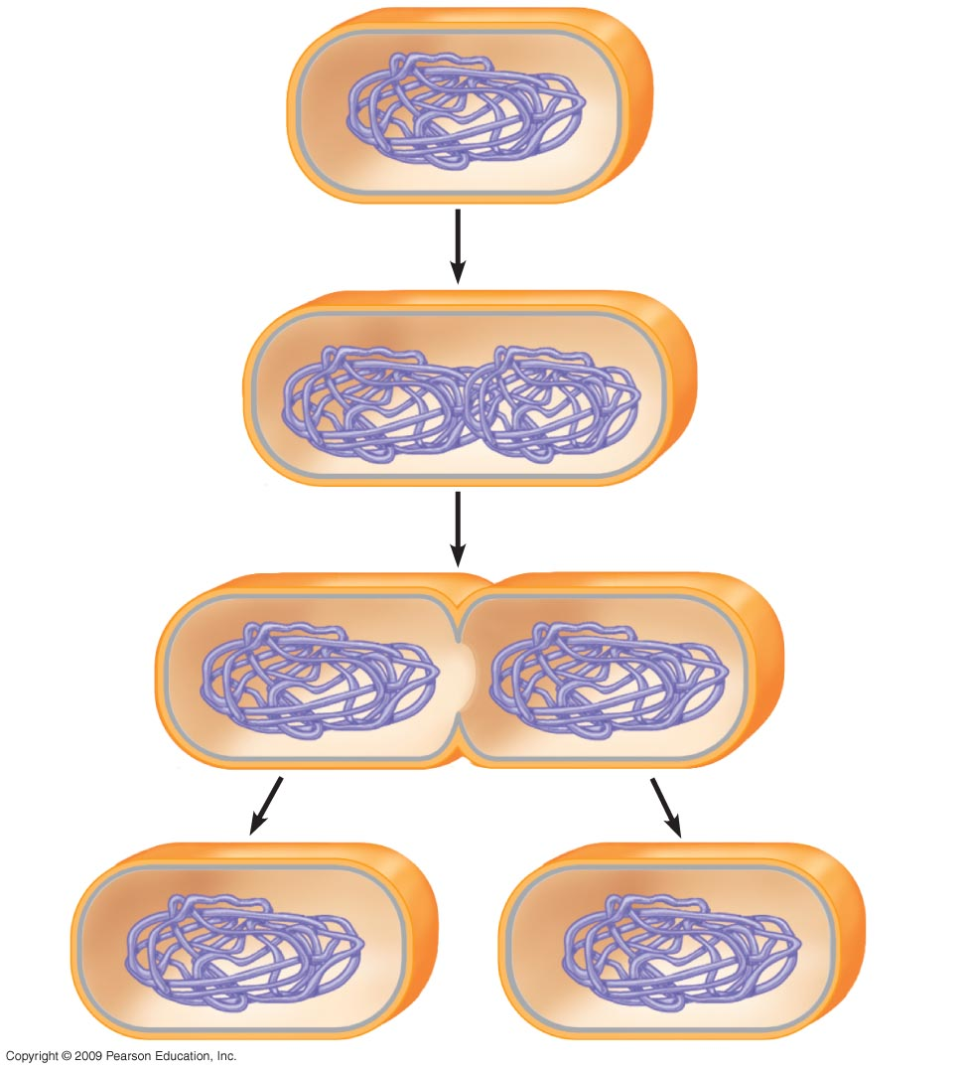
0
Prokaryotic chromosome
Plasma membrane
Cell wall
1
Duplication of chromosome
and separation of copies
Binary fission in
Prokaryotes
2
Continued elongation of the
cell and movement of copies
3
Division into two daughter cells
5
Notes:
5

Slide 6
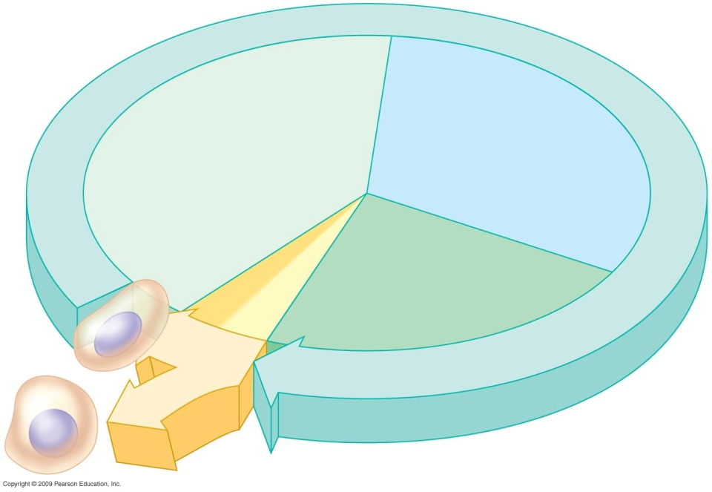
Eukaryotic Cell Division and Cell Cycle
0
  The cell cycle is an ordered sequence of events for cell division.
  Cells divide when they reach a certain size.
  The cell cycle consists of two stages
INTERPHASE
Interphase: Includes G1, S, and G2 phases during which cell contents are duplication .
G1: cell growth in size
S: DNA synthesis phase, duplication of chromosomes, each becomes two sister chromatids
G2: cell continue to growth and prepare for division
2. Mitotic (M) phase: involves mitosis and cytokinesis.
Mitosis: nuclear division
Cytokinesis: cytoplasmic division
- Duplicated chromosomes evenly distributed into two daughter nuclei
S
(DNA synthesis)
G₁
Cytokinesis
G₂
Mitosis
MITOTIC
PHASE (M)
The eukaryotic cell cycle
6
Copyright © 2009 Pearson Education, Inc.
Notes:
6

Slide 7
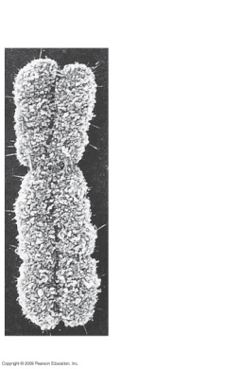
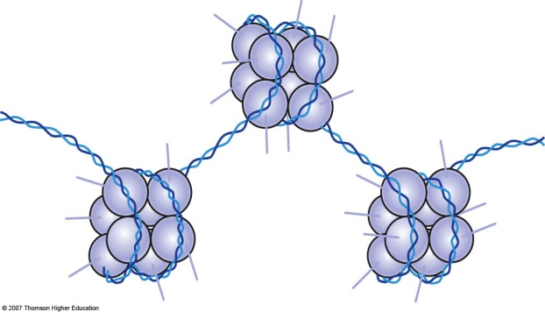
Eukaryotic chromosomes
The chromosomes carry the genetic information.
Eukaryotic chromosomes contain DNA and protein
The chromosomes are so named because they may be stained by certain dyes
When cells are not dividing, the genetic material is decondensed and is called chromatin
When cells are dividing, the genetic material is condensed and is called chromosome
condensed
Chromatin chromosome
decondensed
7

Slide 8
The large, complex chromosomes of eukaryotes duplicate with each cell division
0
  Early in the division process, chromosomes duplicate in S-phase.
  Each chromosome appears as two sister chromatids containing identical DNA molecules.
  Sister chromatids are joined at a narrow region called the centromere.
8
Notes:
8

Slide 9
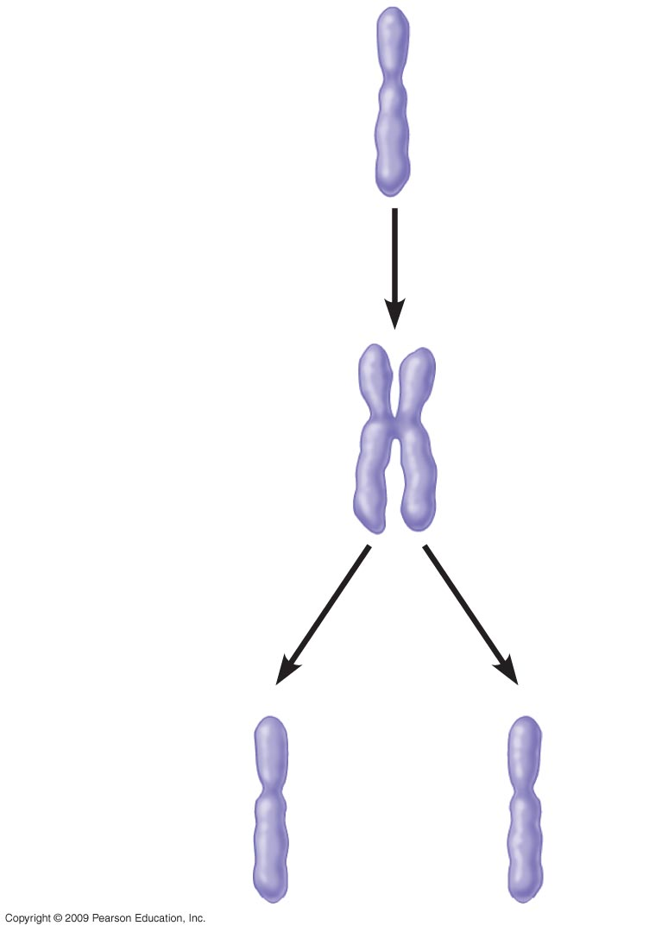

A Duplicated Chromosome
0
Sister chromatids
Chromosome duplication
Sister chromatids
Centromere
Chromosome
distribution
To daughter
cells
Chromosome duplication
and distribution
Electron micrograph
of a duplicated chromosome
9
Notes:
9

Slide 10
Mitosis
Identical chromosomes are distributed to each daughter cell
Mitosis preserves chromosome number in eukaryotic cell
10

Slide 11
Stages of Mitosis
0
  Mitosis: progresses through a series of stages:
  1.Prophase:Chromatin condenses into duplicated chromosomes (pair of sister chromatids) and chromosomes become visible.
  2.Prometaphase:Chromosomes begin to move toward cell’s midplane.
  3. Metaphase: Chromosomes align on cell’s midplane on top of each other.
4.Anaphase: Sister chromatids separate, move to opposite poles. Each former chromatid is now a chromosome.
5.Telophase: Chromosomes decondensed. Cytokinesis begins
Cytokinesis: Cytoplasmic division. Often overlaps telophase
11
Notes:
11

Slide 12
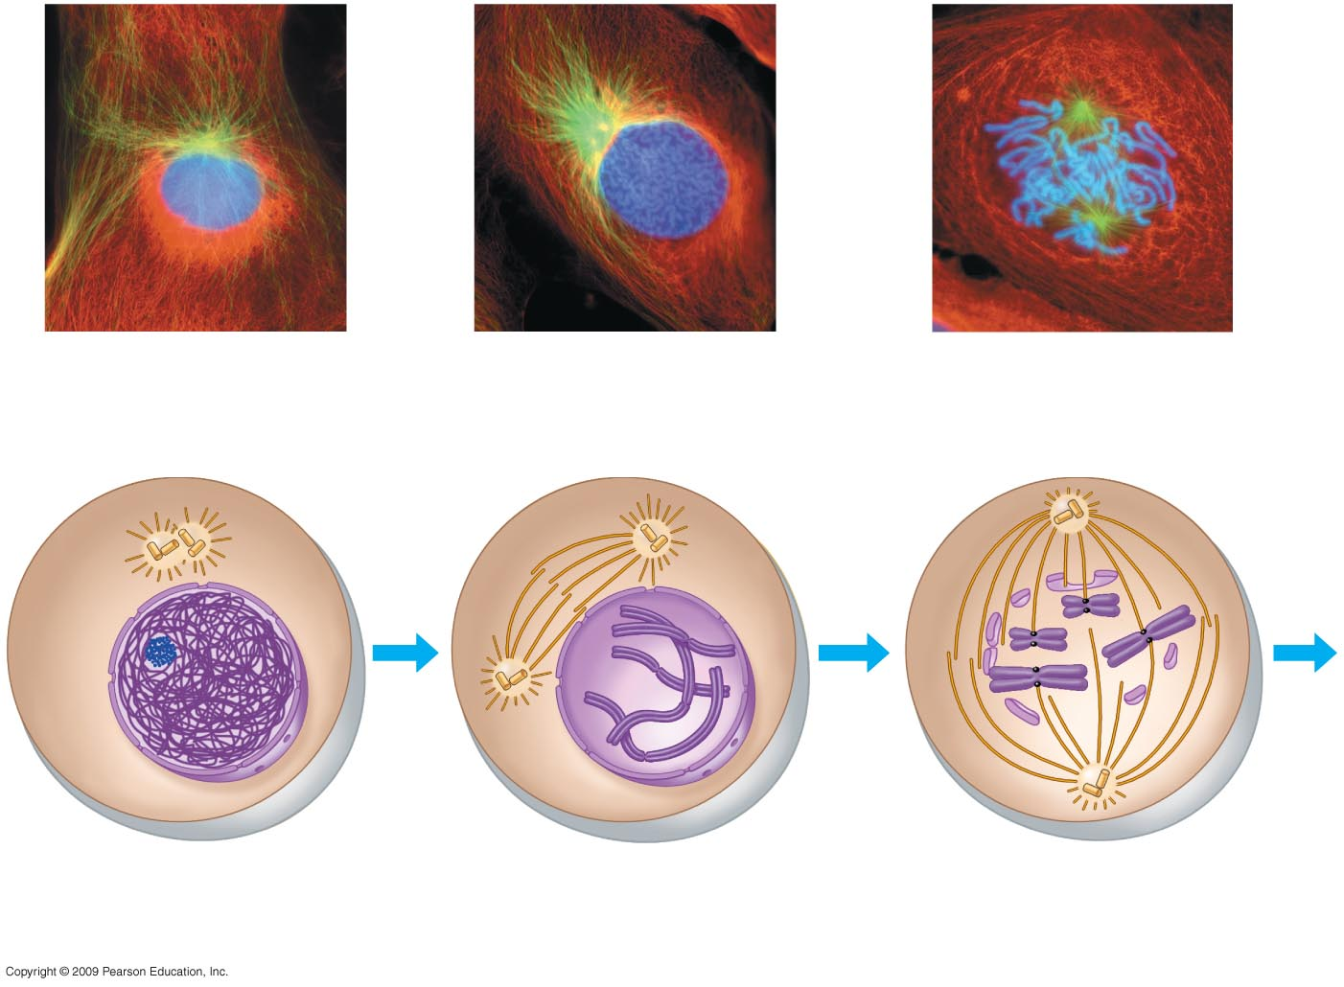
0
INTERPHASE
PROPHASE
PROMETAPHASE
Chromatin
Early mitotic spindle
Fragments of
Nuclear envelope
Kinetochore
Nuclear
Envelope
Plasma
Membrane
Centromere
Spindle
Microtubules
Nucleolus
Chromosome, consisting
of two sister chromatids
12
Notes:
12

Slide 13
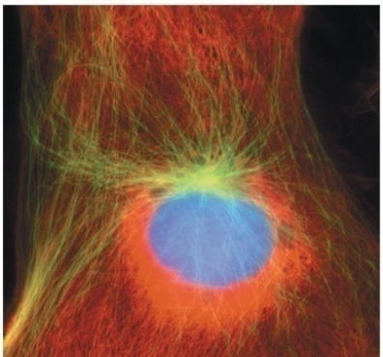
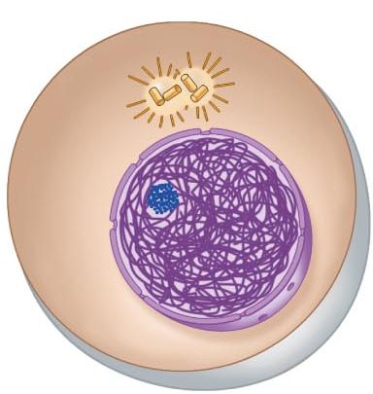
Cell division is a continuum of dynamic changes
0
  Interphase
    In the cytoplasm
      Cytoplasmic contents double
    In the nucleus
      Chromosomes duplicate during the S phase
13
Notes:
13

Slide 14
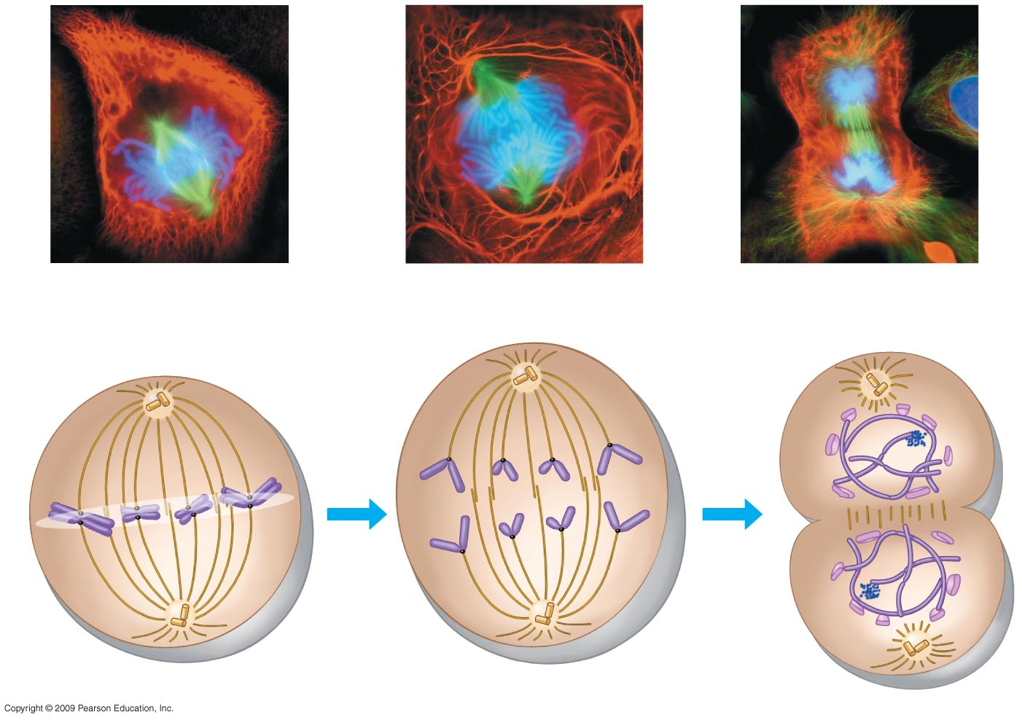
0
ANAPHASE
TELOPHASE AND CYTOKINESIS
METAPHASE
Metaphase plate
Cleavage furrow
Nucleolus
Forming
Nuclear envelope
Forming
Spindle
Daughter chromosomes
14
Notes:
14

Slide 15
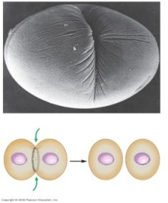
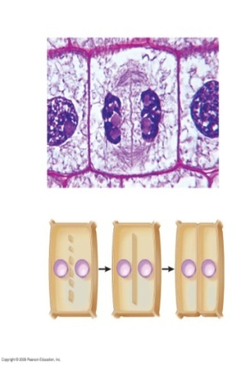
Cytokinesis differs for plant and animal cells
0
  Cytokinesis
    Cleavage in animal cells
      A cleavage furrow forms from a contracting ring of microfilaments, interacting with myosin
      The cleavage furrow deepens to separate the contents into two cells
    Cytokinesis in plant cells
      A cell plate forms in the middle from vesicles containing cell wall material
      The cell plate grows outward to reach the edges, dividing the contents into two cells
      Each cell has a plasma membrane and cell wall
15
Notes:
15

Slide 16
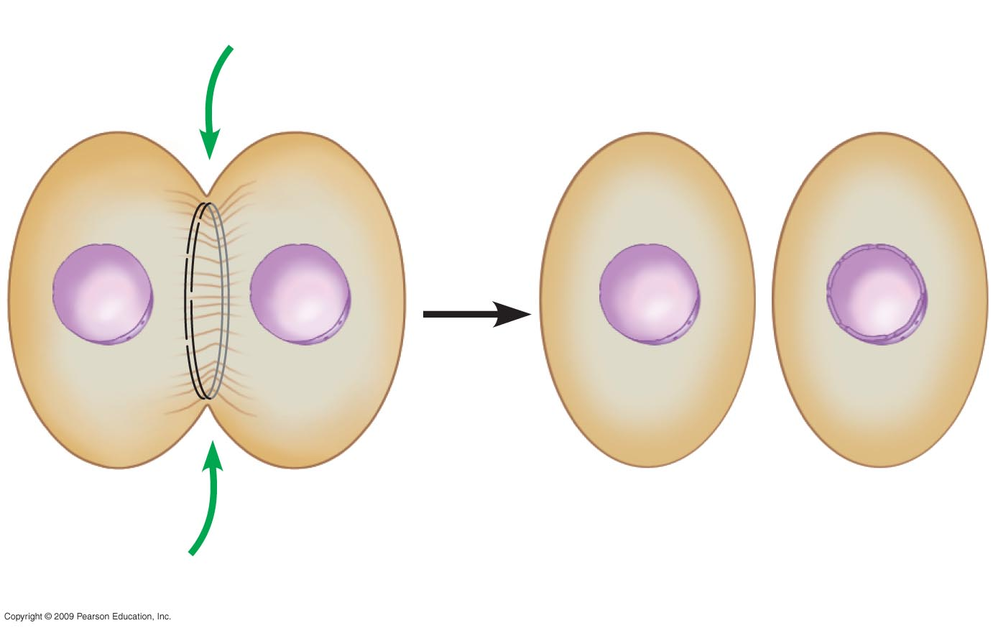
Cytokinesis in animal cells
Cleavage furrow
Contracting ring of
Microfilaments
Daughter cells
16
Notes:
16

Slide 17

Wall of parent cell
Cell plate forming
Daughter nucleus
0
Cytokinesis in
plant cells
Cell wall
New cell wall
Vesicles containing
cell wall material
Cell plate
Daughter cells
17
Notes:
17

Slide 18
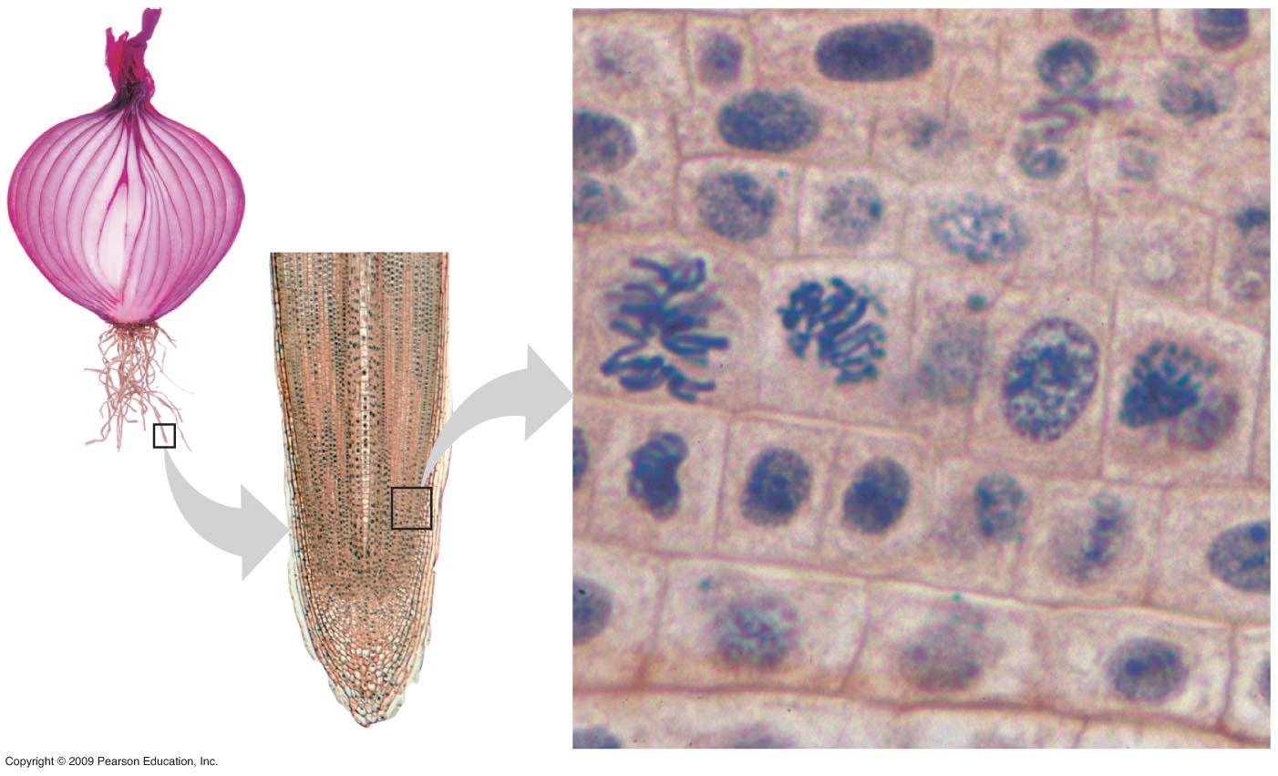
0
Growth (in an onion root)
18

Slide 19
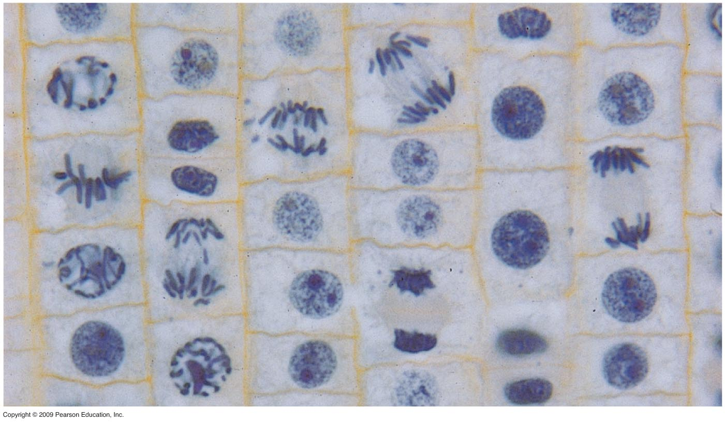
Mitosis
prophase
Telophase
Early Anaphase
Late Anaphase
Metaphase
Midi Anaphase
Telophase
19

Slide 20
MEIOSIS
20
Notes:
20

Slide 21
Chromosomes are matched in homologous pairs
0
  Somatic cells (all body cells except sex cells, sperm and ovum) have pairs of homologous chromosomes, receiving one member of each pair from the father and one from the mother
  Homologous chromosomes are matched in
    Length
    Centromere position
    Gene locations
      A locus (plural, loci) is the position of a gene
      Different versions of a gene may be found at the same locus on maternal (mother) and paternal (father) chromosomes
21
Copyright © 2009 Pearson Education, Inc.
Notes:
21

Slide 22
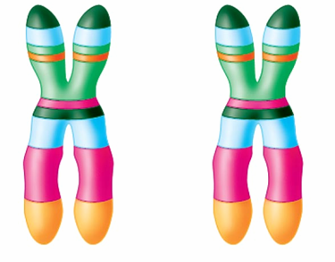
Chromosomes are matched in homologous pairs
0
Homologous pair of chromosomes
Centromere
  The human sex chromosomes X and Y differ in size and genetic composition
  Pairs of autosomes (all chromosomes other than sex chromosomes, X &Y) have the same size and genetic composition
Sister chromatids
One duplicated
chromosome
A homologous pair of chromosomes
22
Notes:
22

Slide 23
Gametes have a single set of chromosomes
0
  Meiosis is a process that converts diploid nuclei to haploid nuclei
    Diploid cells have two homologous sets of chromosomes (2n)
    Haploid cells have one set of chromosomes (1n)
    Meiosis occurs in the sex organs (testes and ovaries) producing gametes (sperm and eggs)
  Fertilization is the union of sperm and egg
    The zygote has a diploid chromosome number, one set from each parent
23
Notes:
23

Slide 24
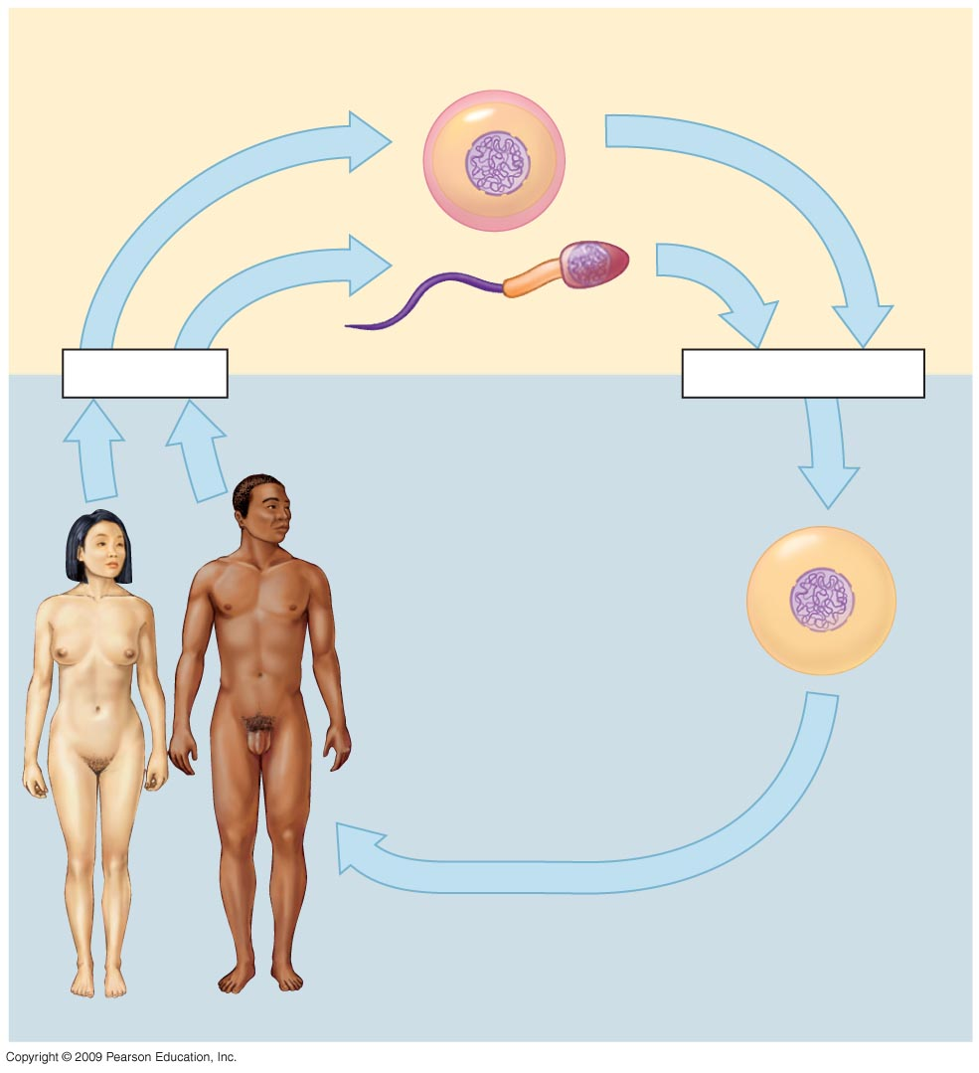
Haploid gametes (n = 23)
0
n
Egg cell
n
Sperm cell
Meiosis
Fertilization
Diploid zygote
(2n = 46)
2n
Multicultural diploid
Adults (2n = 46)
Mitosis and development
The human life cycle
24
Notes:
24

Slide 25
Meiosis reduces the chromosome number from diploid to haploid
0
  Like mitosis, meiosis is preceded by interphase
    Chromosomes duplicate during the S-phase
  Unlike mitosis, meiosis has two divisions
    During meiosis I, homologous chromosomes separate
      The chromosome number is reduced by half
      2n → 1n
    During meiosis II, sister chromatids separate
      The chromosome number remains the same 1n
25
Notes:
25

Slide 26
Meiosis reduces the chromosome number from diploid to haploid
0
  Events in the nucleus during meiosis I
    Prophase I
      Chromosomes coil and become compact
      Homologous chromosomes come together as pairs by synapsis
      Each pair, with four chromatids, is called a tetrad
      Nonsister chromatids exchange genetic materials by crossing over
    Metaphase I
      tetrads (duplicated homologous chromosomes) line up on metaphase plate side by side
    Anaphase I
  homologous chromosomes separate distributed to different nuclei
  Each nucleus contains haploid number of chromosomes
  Each chromosome has 2 chromatids
    Telophase I and cytokinesis
26
Notes:
26
Student Misconceptions and Concerns
1. Students might not immediately see the need for meiosis in sexual reproduction. Consider an example of what would happen over many generations if gametes were produced by mitosis. The resulting genetic doubling is prevented if each gamete has only half the genetic material of the adult cells.
2. How meiosis results in four haploid cells, yet mitosis yields two diploid cells, is often memorized but seldom understood. It can be explained like this. Consider a pair of chromosomes in a cell before any cell divisions. This pair of chromosomes duplicates such that two chromosomes become four (although each pair of sister chromatids are joined at their centromeres). Therefore, mitosis and meiosis each typically begin with four chromosomes. Mitosis divides once, producing two cells, each with two chromosomes. Meiosis divides twice, sorting the four chromosomes into four separate cells.
Teaching Tips
1. In meiosis I and meiosis II, the processes begin with duplicated pairs of chromosomes. This pair becomes two pairs. The two pairs include four items. Sort this group into two subgroups, and you are back to two pairs. Divide again, and you have separated four items into four groups of one. This can work with the shoe analogy if you wish to continue the reference. A pair of shoes is “reproduced” and becomes two pairs. Mitosis sorts them back into two pairs of shoes. However, meiosis keeps sorting, eventually isolating each shoe. Each solitary shoe would then represent a gamete, which would then be matched with another similar shoe (gamete) to make a new pair of shoes (organism).

Slide 27
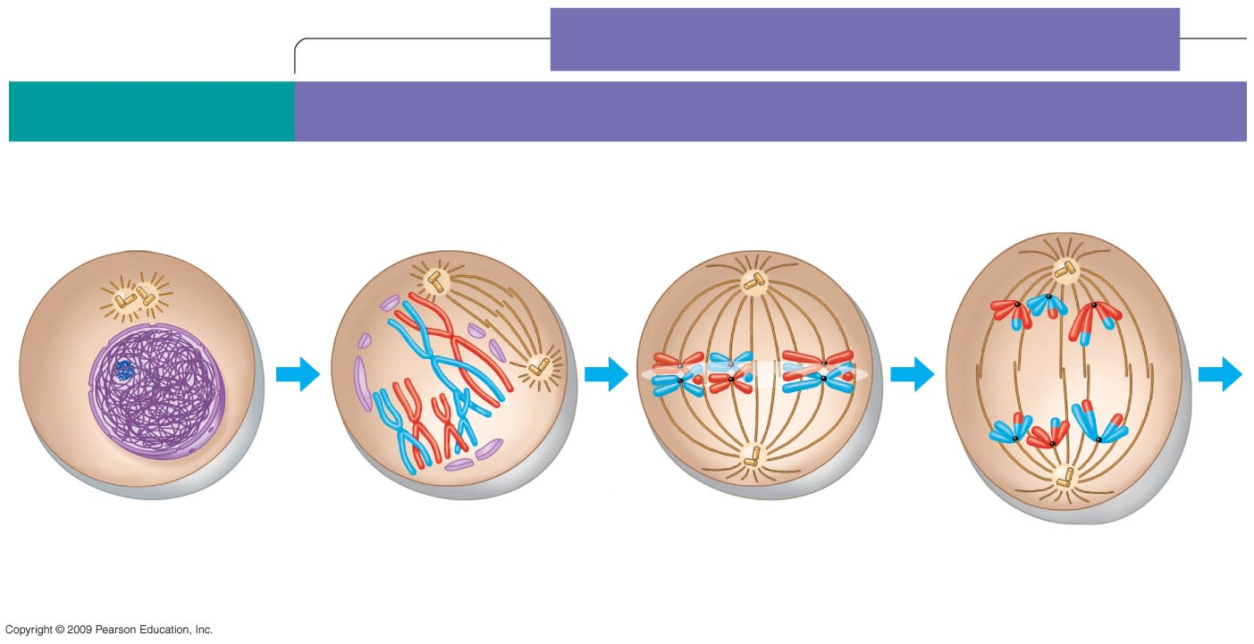
MEIOSIS I: Homologous chromosomes separate
0
INTERPHASE
PROPHASE I
METAPHASE I
ANAPHASE I
Centrosomes (with
Centriole pairs)
)
Sites of crossing over
Microtubules
attached to
Kinetochore
Metaphase
Plate
Sister chromatids
remain attached
Spindle
Nuclear
Envelope
Sister
Chromatids
Tetrad
Centromere
(with kinetochore)
Chromatin
Homologous
chromosomes separate
The stages of miosis I
27
Notes:
27

Slide 28
Meiosis II
Sister chromatids of each chromosome separate
  one distributed to each daughter cell
Each former chromatid is now called a chromosome
28

Slide 29
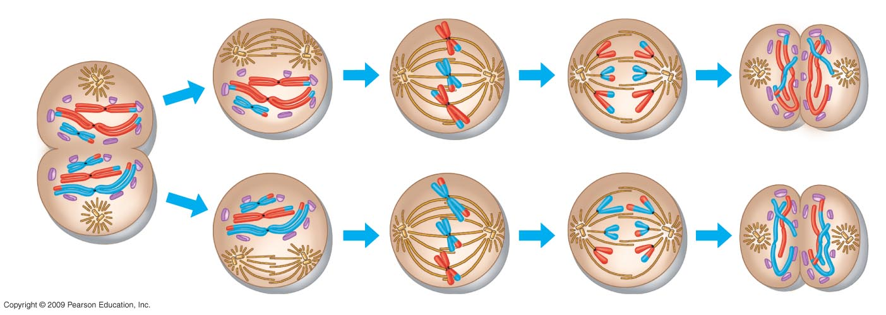
0
MEIOSIS II: Sister chromatids separate
TELOPHASE I
AND CYTOKINESIS
PROPHASE II
METAPHASE II
ANAPHASE II
TELOPHASE II
AND CYTOKINESIS
Cleavage furrow
Haploid daughter
cells forming
Sister chromatids
Separate
The stages of meiosis II
29
Notes:
29

Slide 30
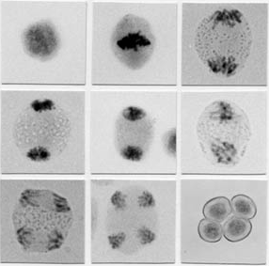
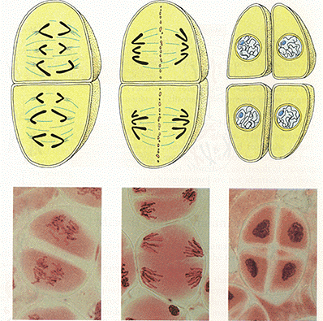
MEIOSIS
A
B
C
D
E
F
G
H
I
PROPHASE I
METAPHASE I
ANAPHASE I
TELOPHASE I
PROPHASE II
METAPHASE II
ANAPHASE II
TELOPHASE II
TETRAD
ANAPHASE II
TELOPHASE II
TETRAD
30

Slide 31
Patterns of Inheritance
31

Slide 32
The Basic Principles of Heredity
MENDEL’S LAWS
32
Notes:
32

Slide 33
Experimental genetics began in a garden
0
  Gregor Mendel discovered principles of genetics in experiments with the garden pea
    Mendel showed that parents pass heritable factors to offspring (heritable factors are now called genes)
    Advantages of using pea plants
      Controlled mating
      Self-fertilization or cross-fertilization
      Observable characteristics with two distinct forms
      True-breeding strains
33
Copyright © 2009 Pearson Education, Inc.

Slide 34
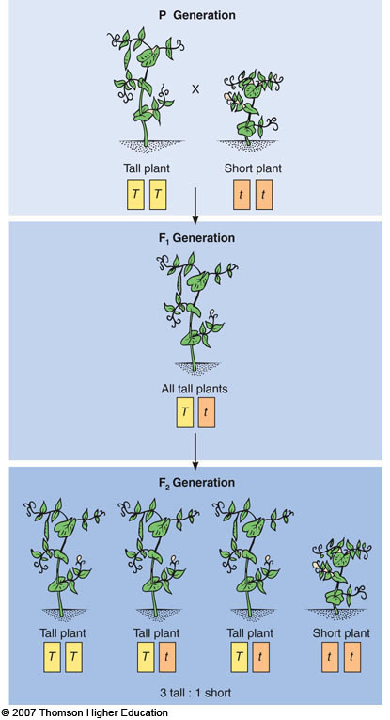
P generation
(true-breeding
parents)
One of Mendel’s pea crosses.
F₁ generation
Fertilization among
F₁ plants (F₁ ´ F₁)
F₂ generation
34

Slide 35
Mendel’s law of segregation describes the inheritance of a single character
0
  Example of a monohybrid cross
    Parental generation: Tall plant X Short plant
    F₁ generation: all plants were tall
    F₂ generation: Tall plants and short plants
  Mendel needed to explain
    Why one trait seemed to disappear in the F₁ generation
    Why that trait reappeared in one quarter of the F₂ offspring
35
Notes:
35
1

Slide 36
  Questions:
  Why one trait seemed to disappear in the F₁ generation?
  Why that trait reappeared in one quarter of the F₂ offspring?
  Answers: The questions were answered by Mendel’s Principle of Segregation (separation) which states that:
  Each trait is controlled by two factors (now known as alleles).
  During gametes formation (meiosis) the two alleles segregate (separate), so that each gamete (sperm or ovum) has one allele only.
36

Slide 37
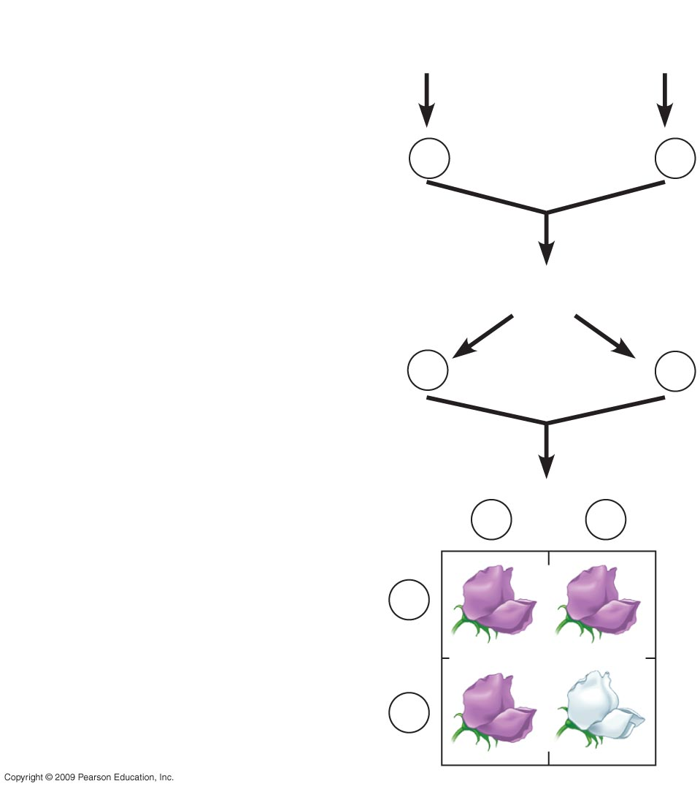




T
Genetic makeup (alleles)
t
P plants
tt
0
TT
T
t
T
All
All
t
Gametes
T
t
T
F₁ plants (hybrids)
AllTt
t
T
t
Gametes
1
–
2
T
1
–
2
t
T
Sperm
t
T
t
Phenotypic ratio
3 purple : 1 white
T
F₂ plants
T
TT
Tt
Eggs
Genotypic ratio
1 BB : 2 Bb : 1 bb
t
t
Tt
tt
Explanation of the crosses in previous figure
37

Slide 38
Learning Objective
Define the terms
phenotype, genotype
locus, allele
dominant allele, recessive allele
homozygous, and heterozygous
38

Slide 39
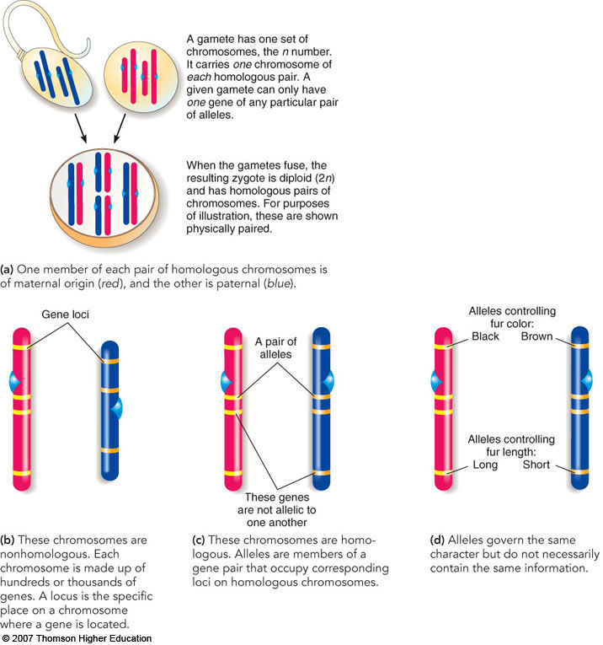
Genes: information units in chromosomes. There are two copies of each gene. One on the father chromosome and one on the mother chromosome. Each copy is called allele.
Locus: site of a gene on the chromosome.
Alleles: Copy of a gene (each gene has 2 copies, one on each of the homologous chromosomes), same loci on homologous chromosomes
39

Slide 40
Gene Pairs
Diploid individuals: Individual whose cells contain 2 sets of chromosome (23 from the mother egg+23 from the father sperm).
  Consequently, genes on these homologous chromosomes are in pairs. One from the father and one from the mother. Each copy is called alleles.
Homozygous
  Two identical alleles e.g. AA or aa.
Heterozygous
  Two different alleles e.g. Aa.
40

Slide 41
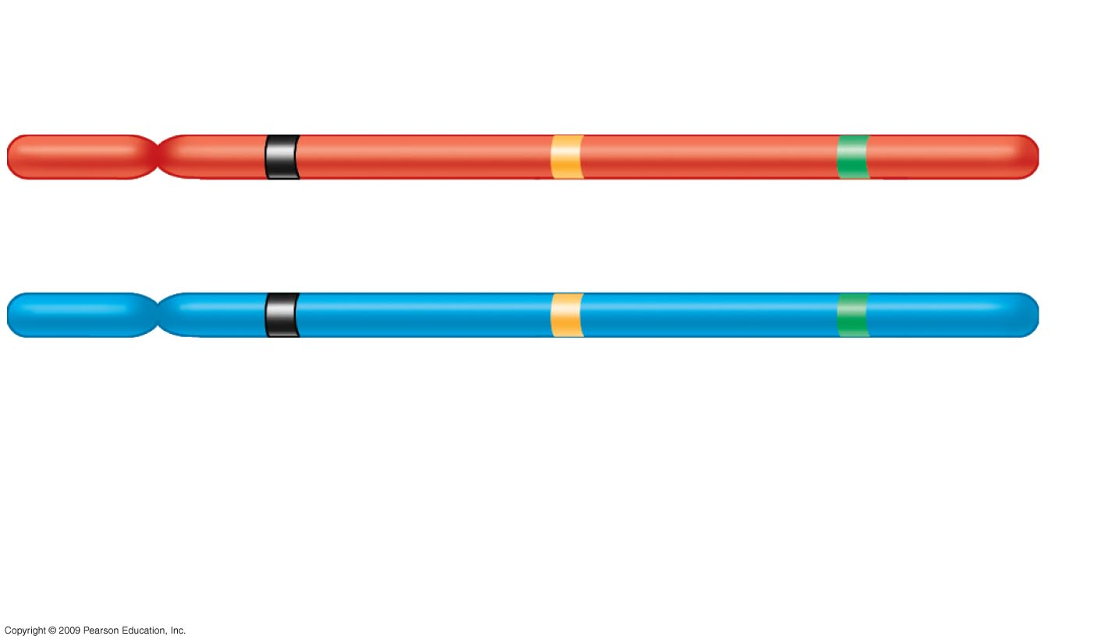
Gene loci
0
Dominant allele
P
a
B
P
a
b
Recessive allele
Genotype:
PP
aa
Bb
Homozygous
for the
dominant allele
Homozygous
for the
recessive allele
Heterozygous
Matching gene loci on homologous chromosomes
41
Notes:
41

Slide 42
Gene Expression
Dominant allele
  Alleles that is expressed in the heterozygous and it masks expression of a recessive allele
  Recessive allele
  Alleles that is not expressed in the heterozygous
  Phenotype
  appearance
  Genotype
  genetic constitution
42

Slide 43
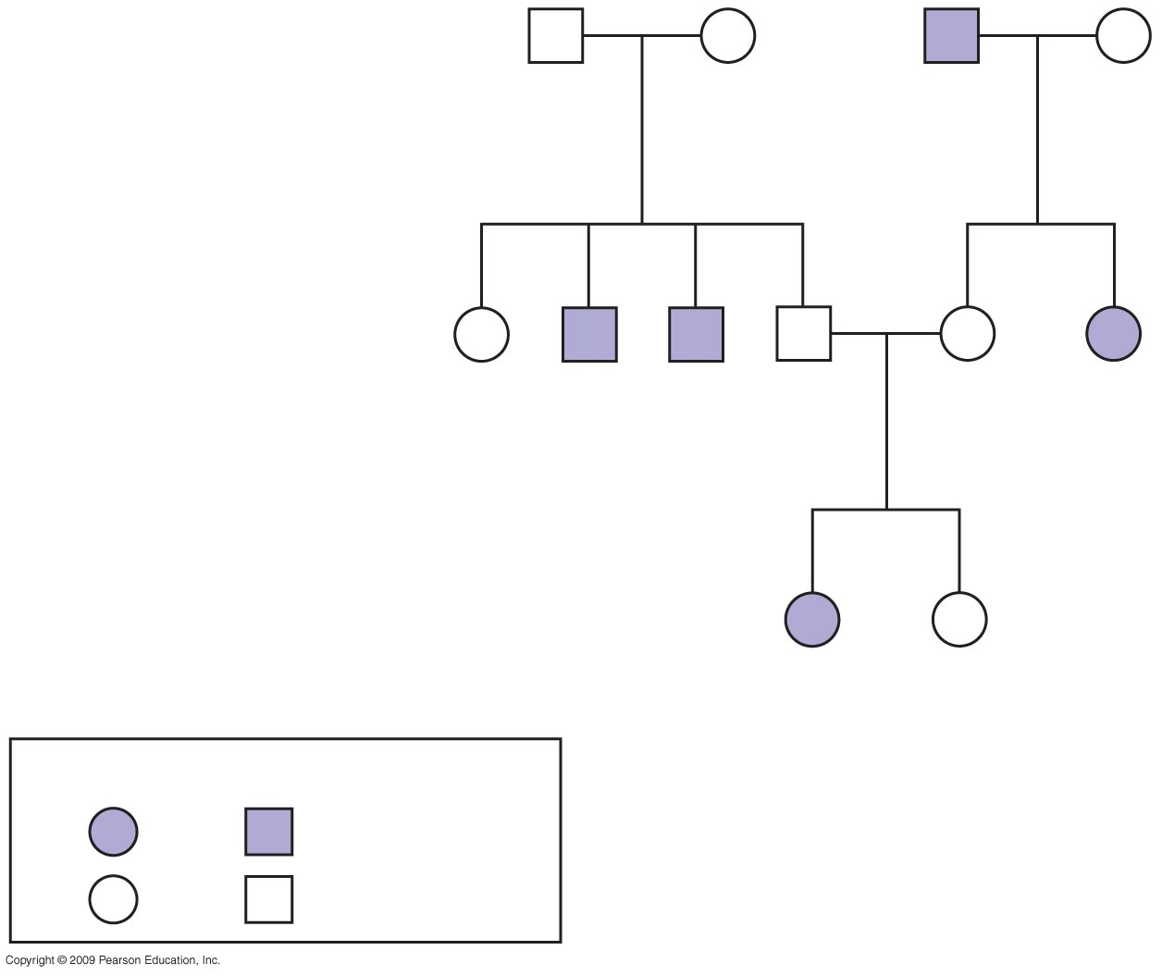
Genetic traits in humans can be tracked through family pedigrees
0
  A pedigree
    Shows the inheritance of a trait in a family through multiple generations
    Can also be used to deduce genotypes of family members.
    Important in genetic counseling.
Female
male
Symbols used in pedigree analysis
Affected
Normal
43
Copyright © 2009 Pearson Education, Inc.

Slide 44
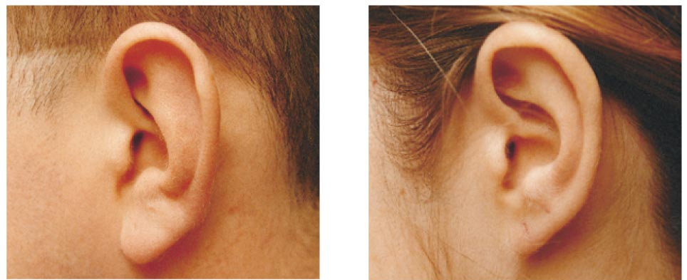
0
Examples of single-gene inherited traits in humans
Earlobe
Dominant Traits
Recessive Traits
Genotype
FF or Ff
ff
Phenotype
Free earlobe
Attached earlobe
44
Notes:
Figure 9.8A Examples of single-gene inherited traits in humans.

Slide 45
0
First generation
(grandparents)
Ff
Ff
ff
Ff
Second generation
(parents, aunts,
and uncles)
FF
ff
ff
Ff
Ff
ff
or
Ff
Third generation
(two sisters)
ff
FF
or
Ff
Female
Male
Affected
Unaffected
Pedigree showing inheritance of attached versus free earlobe
in a hypothetical family
45

Slide 46
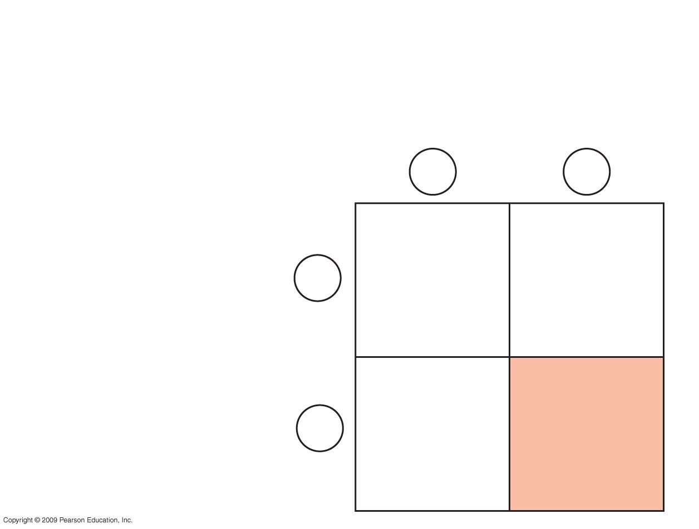
0
Parents
Normal
Dd
Normal
Dd
Sperm
D
d
Dd
Normal
(carrier)
DD
Normal
D
Offspring
Eggs
Dd
Normal
(carrier)
dd
Deaf
d
Offspring produced by parents who are both carriers
for Deafness which is a recessive diorder
46

Slide 47
Exceptions to Mendel’s laws
47
Notes:
47

Slide 48
Variations to Mendel’s Laws
Traits inheritance is not always dominant or recessive, or controlled by one gene.
Some of the exceptions to Mendel’s Laws are:
  1. Incomplete dominance: heterozygote has intermediate phenotype
  2. Co-dominance: heterozygote expresses phenotypes of both homozygotes.
3. Multiple alleles: Three or more alleles in a population for the same locus. Diploid individual has any two alleles.
4. Pleiotropy: the phenomenon of one gene mutation being responsible for or affecting more than one phenotypic characteristic.
5. Polygenes: Multiple independent pairs of genes may have similar and additive effects on the phenotype.
48

Slide 49
Incomplete dominance results in intermediate phenotypes
0
  Incomplete dominance
    Neither allele is dominant over the other
    Expression of both alleles is observed as an intermediate phenotype in the heterozygous individual
49
Notes:
49

Slide 50
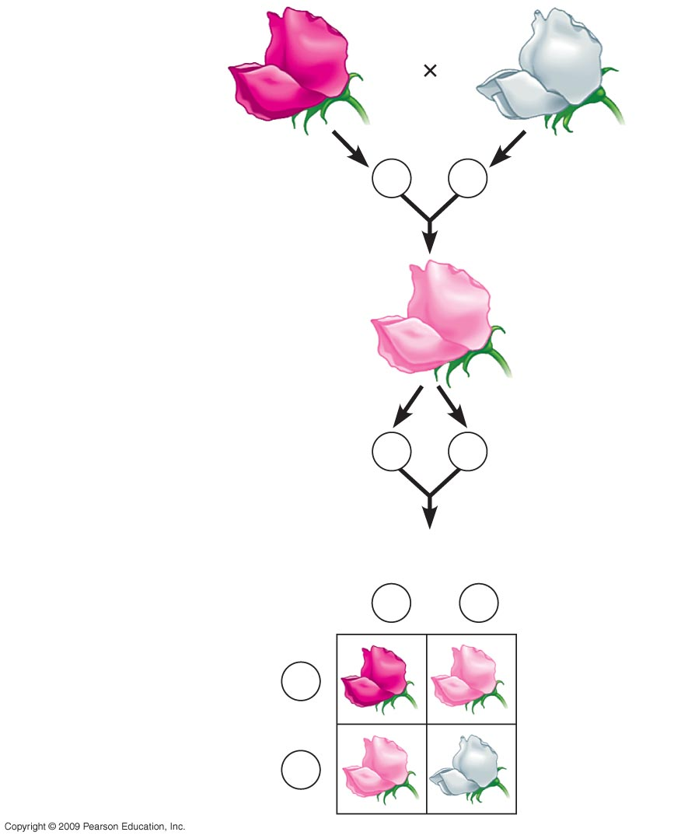
P generation
0
Red
RR
White
rr
Gametes
R
r
F₁ generation
Pink
Rr
Incomplete dominance in snapdragon color.
1
–
2
R
1
–
2
r
Gametes
Sperm
R
r
1
–
2
1
–
2
F₂ generation
1
–
2
R
RR
rR
Eggs
RR
1
–
2
r
Rr
rr
50
Notes:
50

Slide 51
Exceptions to Mendel Laws
When Mendel’s laws/results may not be observed
Genetic Occurrence | Definition | Examples
Polygenic inheritance | More than one gene can affect a single trait | 4 genes are involved in determining eye color. Human height
Pleiotropy | A single gene can affect more than one trait | A pleiotropic allele dominant for yellow fur in mice is recessive for lethal developmental defect. Sickle cell anemia
Multiple alleles for one gene | Genes may have more than two alleles | ABO blood types in humans
Dominance is not always complete | In incomplete dominance the heterozygote is intermediate. In co-dominance no single allele is dominant, and the heterozygote shows some aspect of both homozygotes. | Human blood groups
Environmental factors | Genes may be affected by the environment. | Siamese cats
51

Slide 52
Sex determination in different species
0
  X-Y system in mammals and fruit flies
    XX = female
    XY = male
  X-O system in grasshoppers and roaches
    XX = female
    XO = male
  Z-W system in birds, butterflies, and some fishes
    ZW = female
    ZZ = male
  Chromosome number in ants and bees
    Diploid = female
    haploid = male
52
Notes:
52

Slide 53
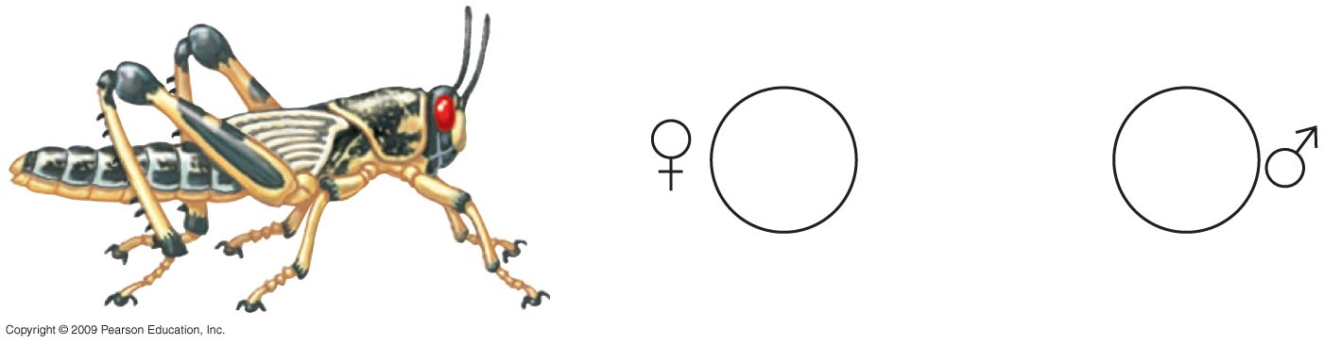
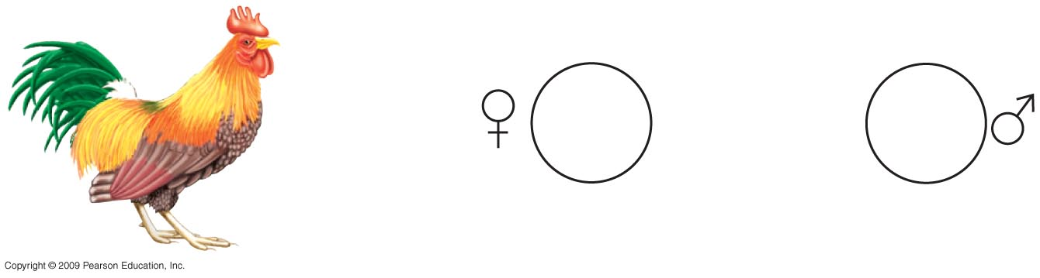
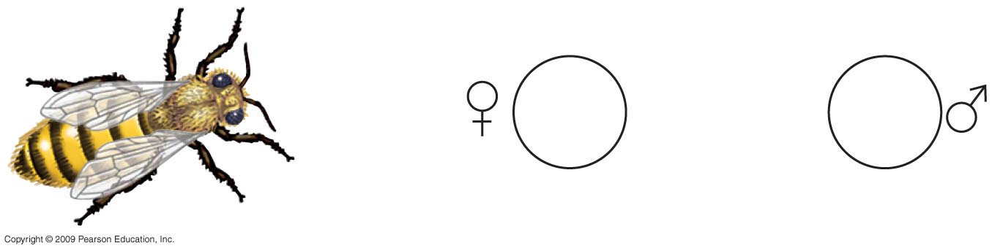
Female
0
male
22
+
XX
22
+
X
X-O system
X-O
76
+
ZW
76
+
ZZ
Z-W system
Z-W
32
16
Chromosome number system
53
Notes:
53

Slide 54
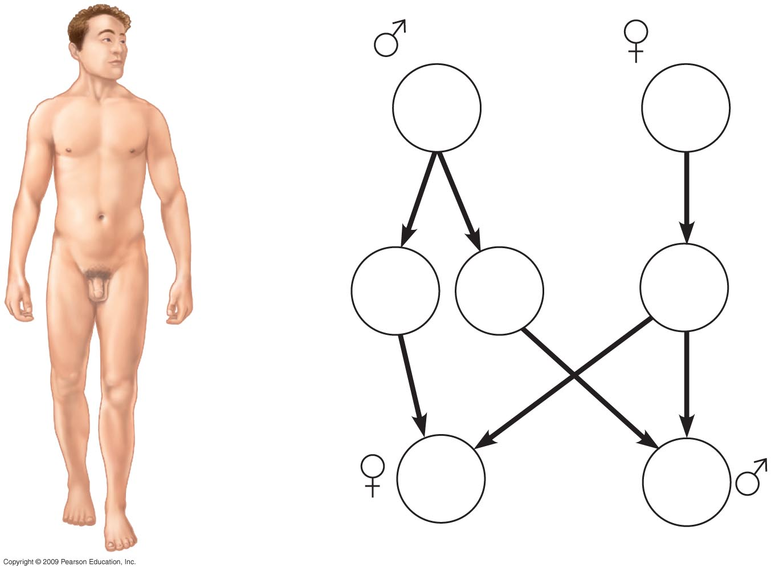
0
(male)
(female)
44
+
XY
Parents’
diploid cells
44
+
XX
22
+
X
22
+
Y
22
+
X
Sperm
Egg
X-Y system
44
+
XX
Offspring
(diploid)
44
+
XY
54
Notes:
54

Slide 55
Male not female (responsible) for getting either male or female babies
يقول  تبارك و تعالى فى كتابه الحكيم فى (سورة القيامة):
بسم الله الرحمن الرحيم
أَيَحْسَبُ الْإِنسَانُ أَن يُتْرَكَ سُدًى 36 أَلَمْ يَكُ نُطْفَةً مِّن مَّنِيٍّ يُمْنَى 37  ثُمَّ كَانَ عَلَقَةً فَخَلَقَ فَسَوَّى 38 فَجَعَلَ مِنْهُ الزَّوْجَيْنِ الذَّكَرَ وَالْأُنثَى  39
صدق الله العظيم
كانت إمرأة أبى حمزة الضبى شاعرة ، و قد هجرها زوجها حين ولدت بنتاً يوماً بخبائها ، فإذا هى تفول:
ما لأبى حمزة لا يأتينا يظل فى البيت الذى يــلينا
غضبـان ألا نلد الــبنينا تا الله ما ذلك فى ايـــــدينا
و إنما نأخذ ما أعطــينا و نحن كالأرض لزارعينا
تنبت ما قد زرعوه فينا
فرق لها و صالحها
55

