Slide 1
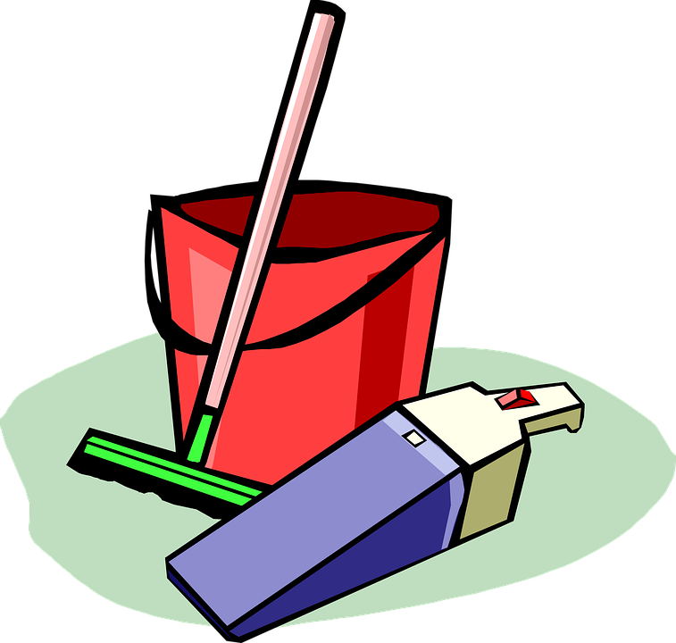
Family and Friends 2-Grade 2
Unit 8
Tidy up!
Lesson 3
Page 74

Slide 2
Objectives
1. Introduce new words.
2. Practice writing the new words.

Slide 3
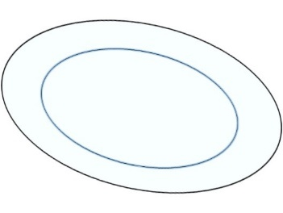
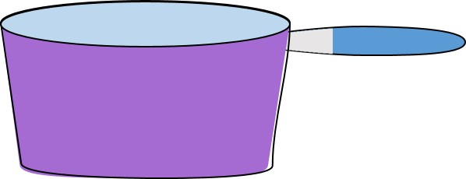
Listen, point and repeat
Plate
Spoon
Knife
Pan
Fork
Cup

Slide 4
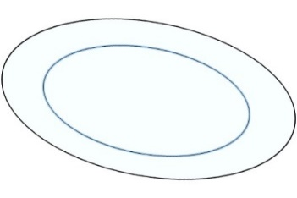
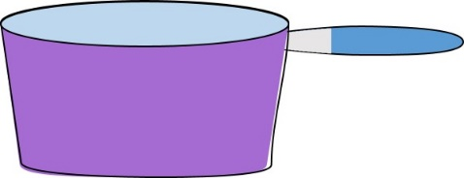
On your screen, match the words with the correct pictures using your finger!
Pan
Knife
Plate
Spoon
Fork
Cup

Slide 5
On your screen, match the words with the correct pictures using your finger!
Pan
Knife
Plate
Spoon
Fork
Cup

Slide 6
Read and tick the correct sentence.
The plate is white.
It’s a green and white spoon.
The fork is broken.
The pan is purple.
I have a yellow cup.
I don’t see a knife.

Slide 7
Read and tick the correct sentence.
The plate is white.
It’s a green and white spoon.
The fork is broken.
The pan is purple.
I have a yellow cup.
I don’t see a knife.

Slide 8
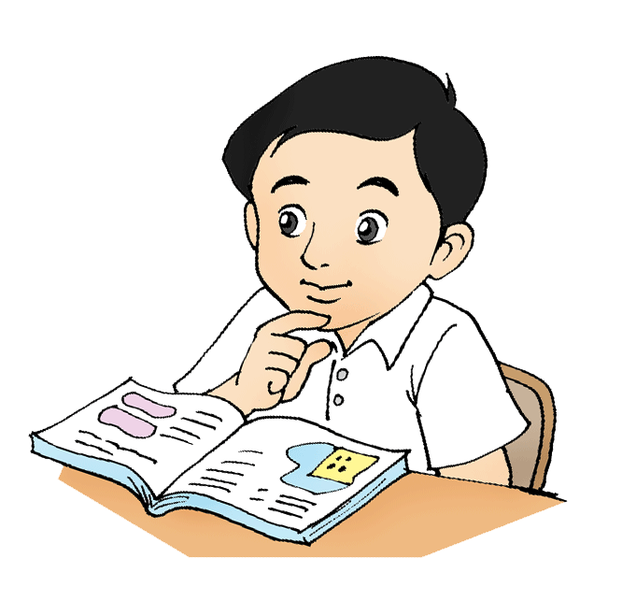
Open your class book P.74 and read.

Slide 9
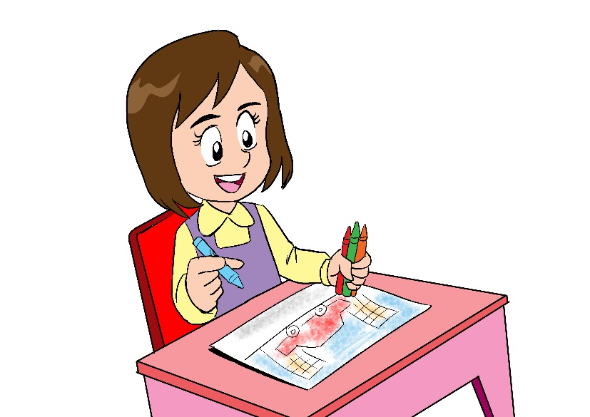
Open your workbook P.72 and answer the questions.

Slide 10
End of the lesson
Good job dear !

