Slide 1

Super Goal 5

Slide 2
UNIT 1

Slide 3
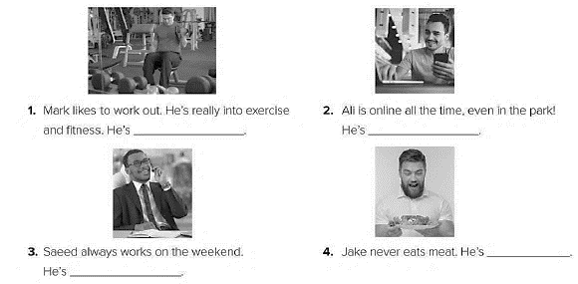
an exercise freak
an internet addict
a vegetarian
a devoted employee

Slide 4

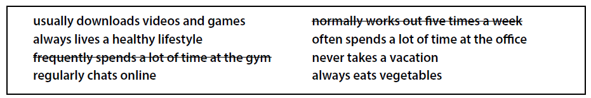
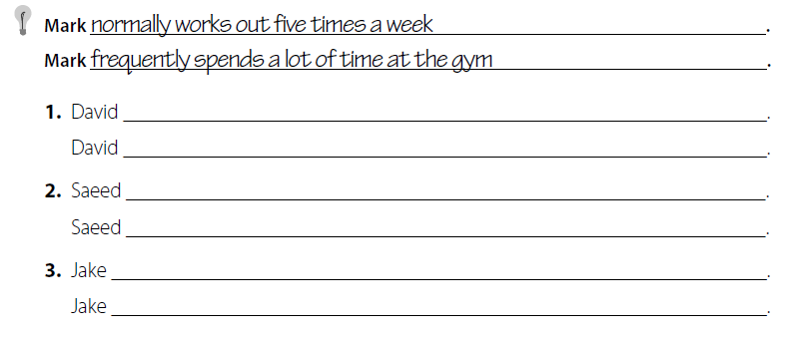
usually downloads videos and games .
regularly chats online .
often spends a lot of time at the office .
never takes a vacation .
always lives a healthy lifestyle .
always eats vegetables .

Slide 5
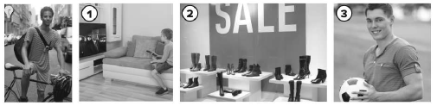
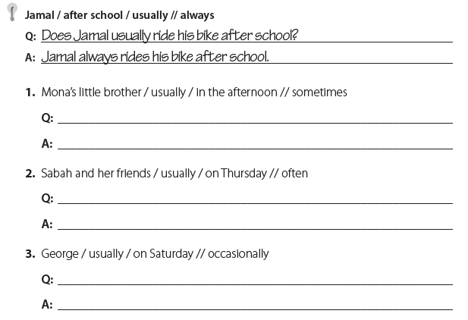
Does Mona’s little brother usually watch TV in the afternoon ?
Mona’s little brother sometimes watches TV in the afternoon .
Do Sabah and her friends usually go shopping on Thursday ?
Sabah and her friends often go shopping on Thursday .
Does George usually play football on Saturday ?
George occasionally plays football on Saturday .

Slide 6
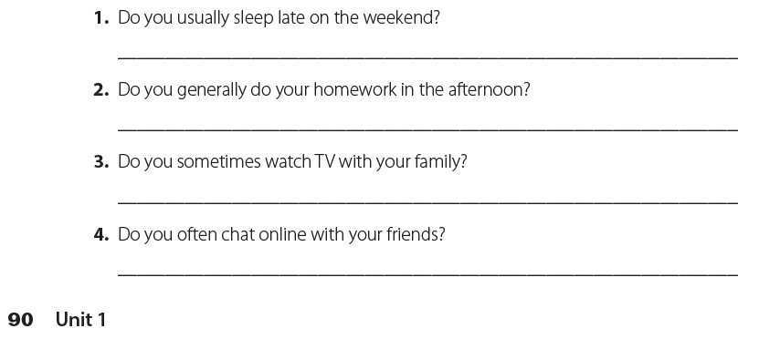
أجب عن نفسك مستعملا أحوال التكرار
I ………………. sleep late on the weekend .
I ………………. do my homework in the afternoon .
I ………………. watch TV with my family .
I ………………. chat online with my friends .

Slide 7
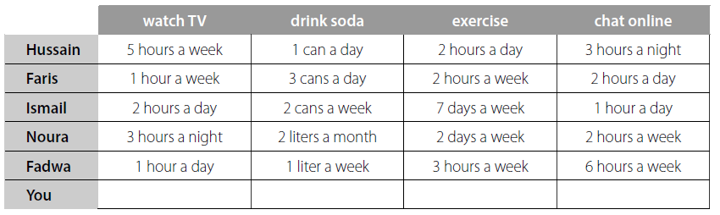
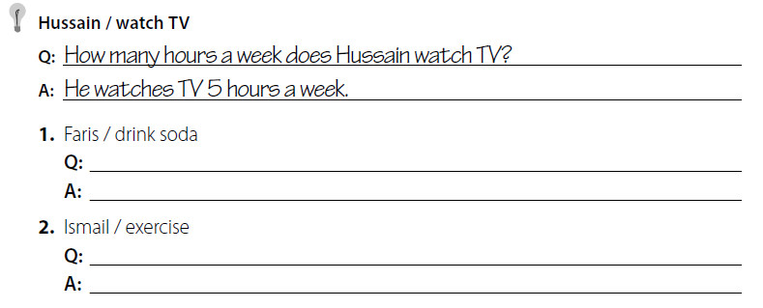
How many sodas does Faris drink ?
He drinks 3 cans of soda a day.
How many days does Ismail exercise per week ?
He exercises 7 days a week.

Slide 8
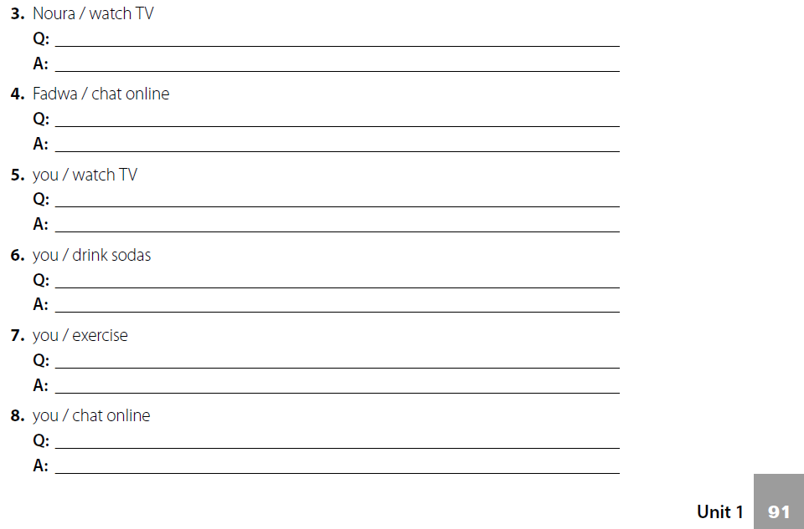
How many hours does Nura watch TV ?
She watches TV 3 hours a night .
How long does Fadwa chat online ?
She chats online 6 hours a week .
How many hours do you watch TV ?
I watch TV 2 hours a day .
How many sodas do you drink ?
I drink 4 cans of soda a day .
How much do you exercise ?
I exercise 1 hour a day .
How long do you chat online ?
I chat online 5 hours a day .

Slide 9

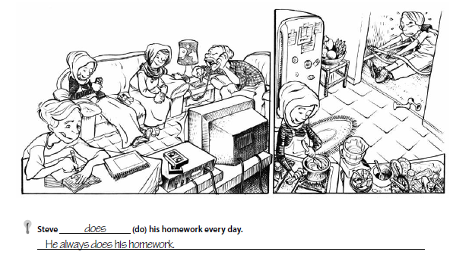

talks
He frequently talks to his boss on the phone .

Slide 10
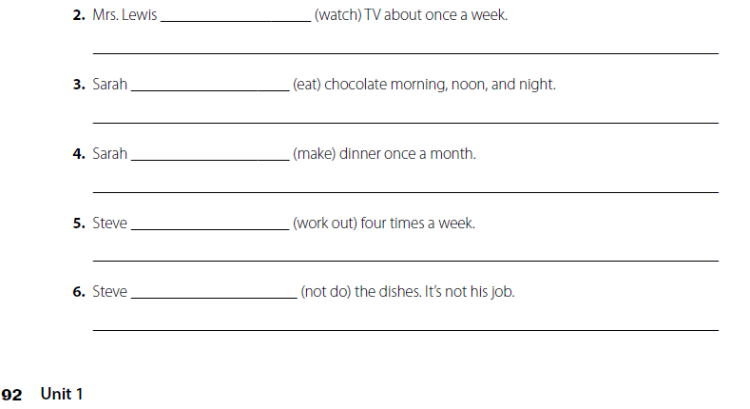
watches
Mrs. Lewis sometimes watches TV .
eats
She eats chocolate all the time .
makes
She rarely makes dinner
works out
He frequently works out .
does not
He never does the dishes .

Slide 11
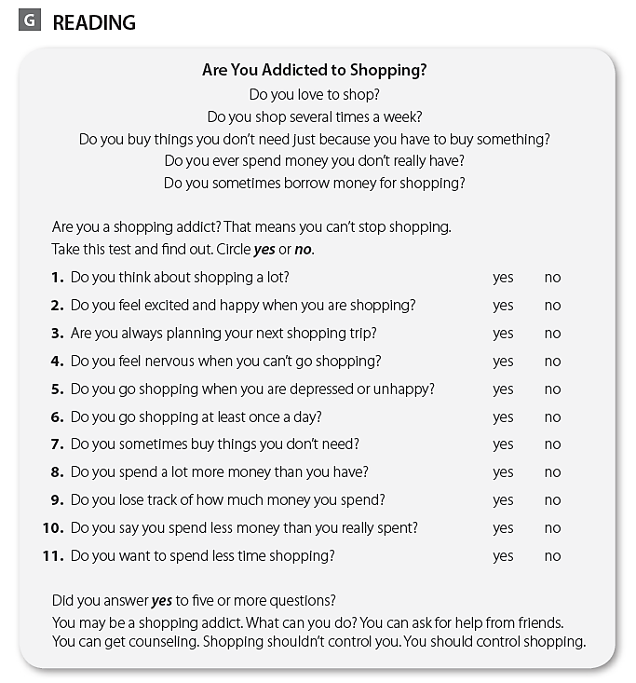
كل طالب يجيب عن نفسه

Slide 12
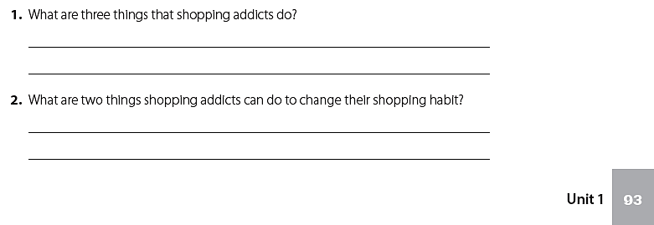
They go shopping when they’re depressed - They spend more money than they have - They feel nervous when they can’t go shopping .
They can ask friends for help .
They can get counseling .

Slide 13

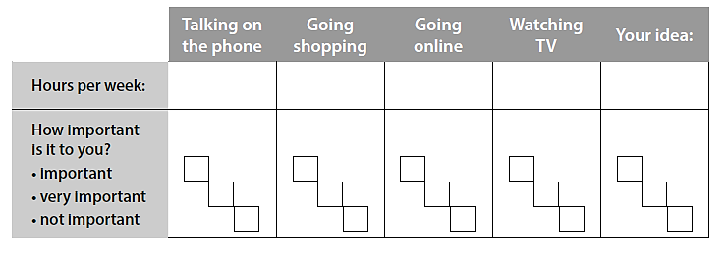
كل طالب يجيب عن نفسه

Slide 14
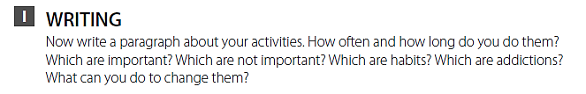
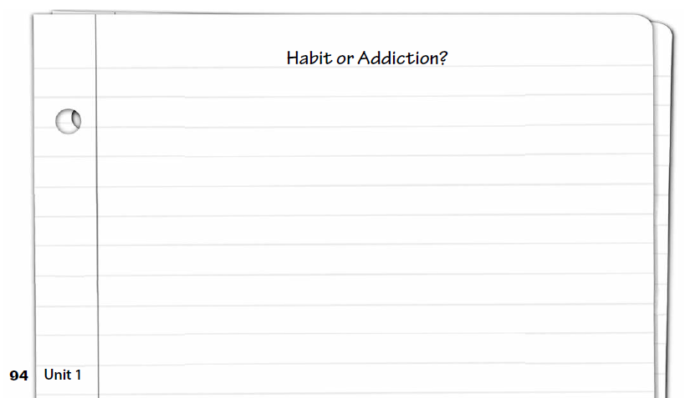
اكتب قطعة عن أنشطتك التي تمارسها

Slide 15
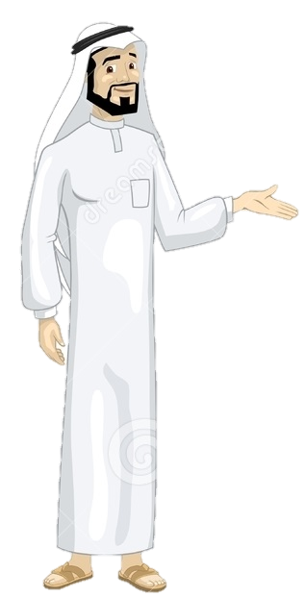
See you later
Take care
Teacher :
Badr Sayid Al-Shehri

