Slide 1
Instructors:
Dr. Hassan Fadag
Dr. Ahmad Basalah
DR. KHALID AL-HARBI
Dynamics
(8041102-3)
Second Semester
1439/1440H

Slide 2
Introduction
Lecture I

Slide 3
Talking Points
Course Syllabus
What is dynamics?
Historical background
Why do we need to study dynamics
Fundamental concepts
Units & Measurements
Notation
Subject Outline
Math Revision

Slide 4
Course syllabus
Course: Dynamics (804222)/(8041102)
Prerequisite: Static
Credit: 3 credit hours
Reference books: Russel C. Hibbeler, Engineering Mechanics: Dynamics.
Description: This course provides an introduction to dynamics and cover the fundamentals
of formulation off dynamics problems. Kinematics of a particle, linear
motion and trajectories of particles, plane motion (with cartesian, polar,
normal-tangential coordinates), work, kinetic and potential energy, impulse
and momentum, and rigid body kinematics & kinetics will be discussed in
the course.

Slide 5
Course syllabus (Cont.)
Grading:
Reading: The reading assignments for the course, (as well as the lecture topics), are
listed on the schedule page. First reading the lecture material at the text book
should be done prior to the corresponding lecture that related to the topic,
when possible. Second reading the text book / notes for the lecture material
should be completed after the corresponding lecture.
 | Assessment task | Week Due | Proportion of Total Assessment
1 | Class Activities | whole | 10%
2 | Periodic Exam. I | 7 (Wed) | 20%
3 | Periodic Exam. II | 14 (Wed) | 20%
4 | Final exam | - | 50%

Slide 6
Course syllabus (Cont.)
Attendance: Attendance will be taken and necessary. The student is responsible for all
additions, deletions and/or corrections syllabus as discussed during regularly
scheduled classroom periods. Instructor will not repeat the lecture or the class
information in his office room or by email, due to student absenting the class
lecture for any reason, whatsoever, whether the question related to homework,
class solved problems, handouts given in class. Student is responsible for finding
this information by his own from his classmates and /or make the copy of the
handout that are distributed in the class that he missed. However reasonable
questions related to the HW will be welcomed. No excuse will be entertained for
not taking exams or quizzes on specified/scheduled dates. The student must have
instructor’s prior approval for not taking those exams /quizzes, within a week of
the semester start day, for a very good reason that are unavoidable for him to
attend the class on those dates. It is the instructor’s decision whether to approve
it or not.
Academic Ethics: Any attempt to claim a credit for work that is not completely or partially done by
the student will lead to failing the course. This includes copying of files,
assignment and projects. NO CHEATING.
Class Activities: Optional project, oral quiz, extra activity and /or assignments: To be
announce by the lecturer later.

Slide 7
What is Dynamics?
Mechanics
Branch of physical sciences that
deals with the state of rest or motion
of bodies subjected to the action of
forces
Statics
Deals with the action of forces on
bodies at rest
Dynamics
Deals with the motion of bodies
under the action of forces

Slide 8
What is Dynamics? (Cont.)
Dynamics
Kinematics
Study the motion without reference to
the forces that cause it
Kinetics
Relates the action of forces on bodies
to their resulting motions
Position/Displacement/Distance
Velocity/ Speed
Acceleration/ Deceleration
Including
Time

Slide 9
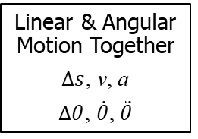
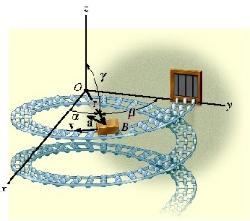
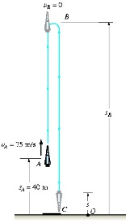
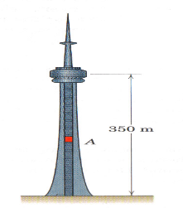
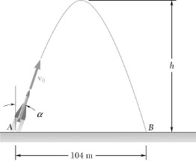
What is Dynamics? (Cont.)
Types of Motion
Rectilinear
Curvilinear
2-Dimensional Motion (Plane Motion)
3-Dimensional Motion
(Motion in Space)
1-Dimensional Motion
Linear Motion Only
Δs, v, a
3D- Vectors are used
2D- Vectors are used

Slide 10
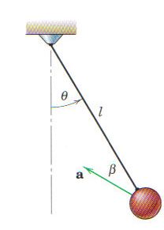
Historical Background
Galileo Galilei (1564-1642):
  Motion of the pendulum
  Bodies in free fall

Slide 11
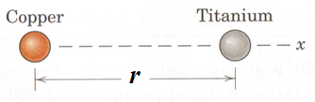
Historical Background (Cont.)
Newton (1642-1727)
  Three Laws of motion and law of universal gravitation
Euler, D’Alembert, Lagrange, Laplace, Coriolis, etc. (Advanced Dynamics)
  Law I: A body remains at rest or continues to move with uniform velocity if there is no unbalanced force acting on it.
  Law II: The acceleration of a body is proportional to the resultant force acting on it and is in the direction of this force (F = ma).
  Law III: The forces of action and reaction between interacting bodies are equal in magnitude, opposite in direction, and collinear.

Slide 12

Historical Background (Cont.)
Albert Einstein (1879-1955)
Came up with a new idea describing the gravity (General Relativity).

Slide 13
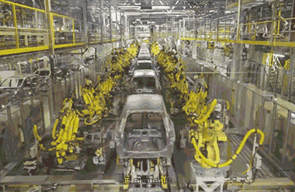
Why do we need to study dynamics
Dynamics principles are basic to the analysis and design of moving structures in:
Automotive industries
Aerospace industries
Automatic control systems
Turbines, pumps &machine tools.

Slide 14
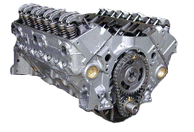
Why do we need to study dynamics (Cont.)
How do we decide how big to make the pistons?
Where should they be placed in the engine block?
How do we make the engine run smoothly?
Well, we could answer these questions by trial and error. But the 'errors' would be expensive exercises. Why not study the dynamics of engines and make some predictions instead!

Slide 15
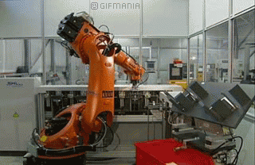
Why do we need to study dynamics (Cont.)
Or suppose we want to build a robot;
How do we decide how big to make the motors?
How fast can we expect it to move from one place to another?
How accurate will it be while it moves and stops?
How many joints should it have and where?

Slide 16
FUNDAMENTAL Concepts
Length (Space) : needed to locate position of a point in space, & describe size of the physical system
  Position in space is determined relative to some geometric reference system by means of linear and angular measurements.
  This reference system may be:
    Fixed in space: measurements are said to be absolute.
    Moving in space: measurements are made relative to fixed reference system.
Time (t): measure of succession of events.
Mass (m): The quantity of matter in a body as well as the property which gives rise to gravitational attraction. Weight is related to the mass by: mg.; where g is the gravitational acceleration.
Force: represents the action of one body on another characterized by its magnitude, direction of its action, and its point of application
Particle: A body of negligible dimensions (when its dimensions are irrelevant to the description of its motion or the action of the forces on it). Bodies of finite size, such as rockets, projectiles, or vehicles.
Rigid Body: A combination of large number of particles in which all particles remain at a fixed distance (practically) from one another before and after applying a load.

Slide 17
Units & Measurements
To be quantitative in physical sciences needs measurements
How tall are you? How about your weight?
  Height: 1.70 m
  Weight: 75 kg
Number + Unit
  “Height is 1.7.” has no physical meaning. Both numbers and units necessary for any meaningful physical quantities
Many quantities can be measured, such as, time, energy, temperature, distance, speed, force, moment, etc..
Some of these quantities are related to one another, such as, speed = distance/time, moment = force x distance, etc..

Slide 18
Units & Measurements (Cont.)
Fundamental quantities related to Dynamics and their SI Units
Prefixes for SI Units
  3,000 m = 3 x 1,000 m
= 3 x 10³ m = 3 km
  10 Mg = 10 x 10⁶ g
  = 10 x 10³ kg = 10 tons
  0.003 s = 3 x 0.001 s
= 3 x 10⁻³ s = 3 ms
Length | meter | m
Mass | kilogram | kg
Time | second | s
10^{x} | Prefix | Symbol
x=9 | giga | G
x=6 | mega | M
x=3 | kilo | k
x=-2 | centi | c
x=-3 | milli | m
x=-6 | micro | µ

Slide 19
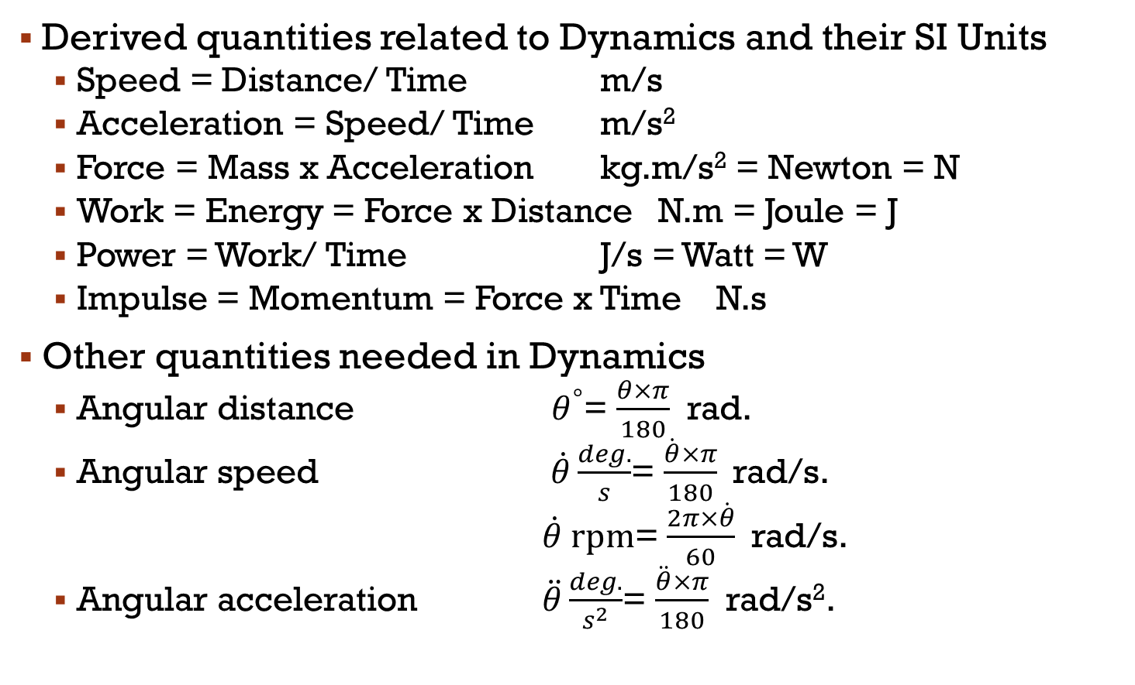
Units & Measurements (Cont.)

Slide 20
Units & Measurements (Cont.)
Other unit systems: U. S. customary system (foot, slug, second)
CGS system (cm, gram, second)
We will use SI units in this course, but it is useful to know conversions between systems.
  1 mile = 1609 m = 1.609 km 1 ft = 0.3048 m = 30.48 cm
  1 m = 39.37 in. = 3.281 ft 1 in. = 0.0254 m = 2.54 cm
  1 lb. = 0.465 kg 1 oz = 28.35 g
  1 slug = 14.59 kg
  1 hp = 746 W = 0.746 kW
  1 day = 24 hours = 24 * 60 minutes = 24 * 60 * 60 seconds
  72 km/h. = 72 (km/h.) x 1000 (m/1km) x (1h./3600 s) = 20 m/s
  Gravitational acceleration (g) = 9.81 m/s² = 32.2 ft/s²

Slide 21
Notation
Vector | Scalar
or or

Slide 22
Subject Outline
Dynamics
Kinematics
Kinetics
Particles
Rigid
Bodies
Particles
Rigid
Bodies
4
1
3
2
Rectilinear motion
Dependent or Constrained
motion
Curvilinear motion
  Rectangular cords.
  n-t cords.
  Polar cords.
Relative motion
Rigid body assumption
Same motions as in
particles + rotational motion
- Newton’s second law
- Work & Kinetic Energy
- Potential Energy
Impulse-Momentum

Slide 23
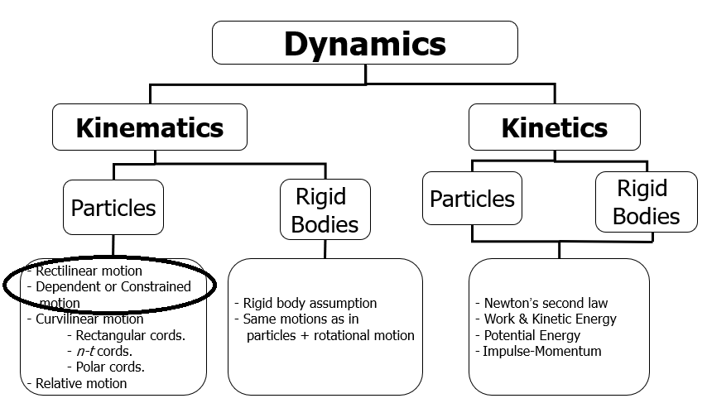

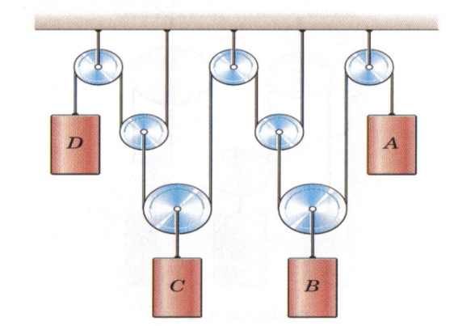
Kinematics of Particles
 |  | Rectilinear Motion
 |  | Dependent Motion

Slide 24
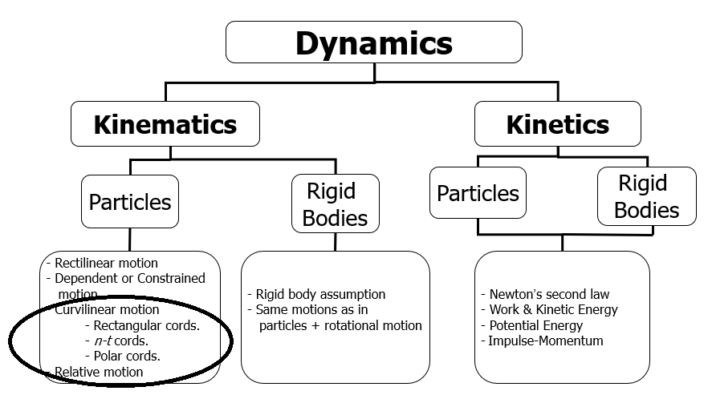
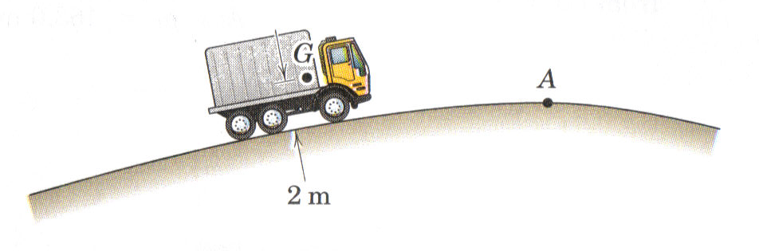
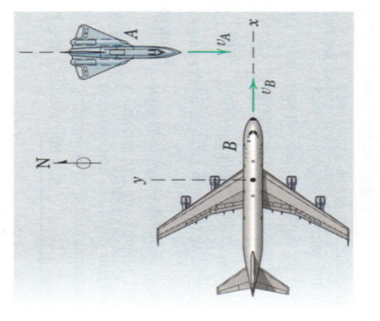
Kinematics of Particles
 |  | Curvilinear Motion
 |  | Relative Motion
v_{A}
v_{B}
v_{B/A}

Slide 25
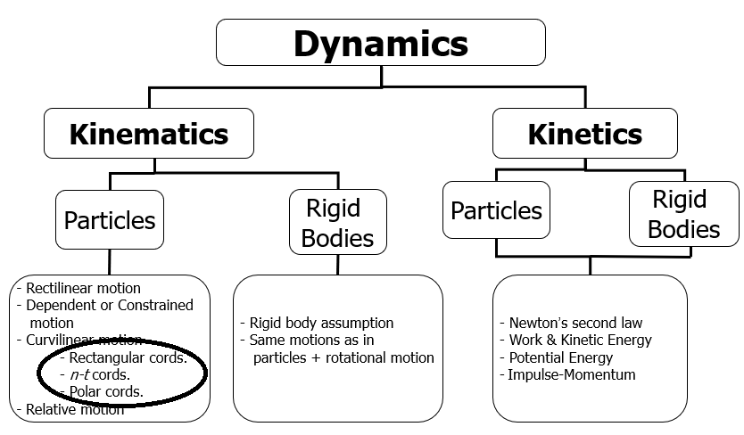
Coordinates Used for Curvilinear Motion
Rectangular coordinates
Normal-Tangential coordinates
Polar coordinates

Slide 26
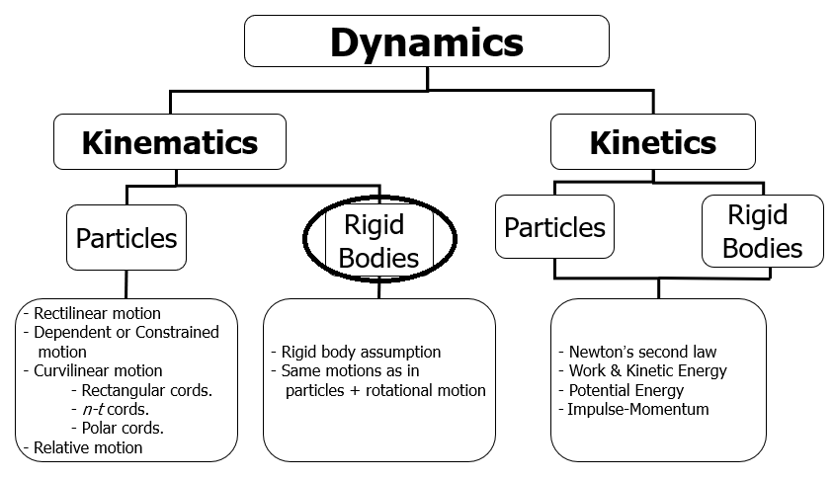
Kinematics of Rigid Bodies

Slide 27
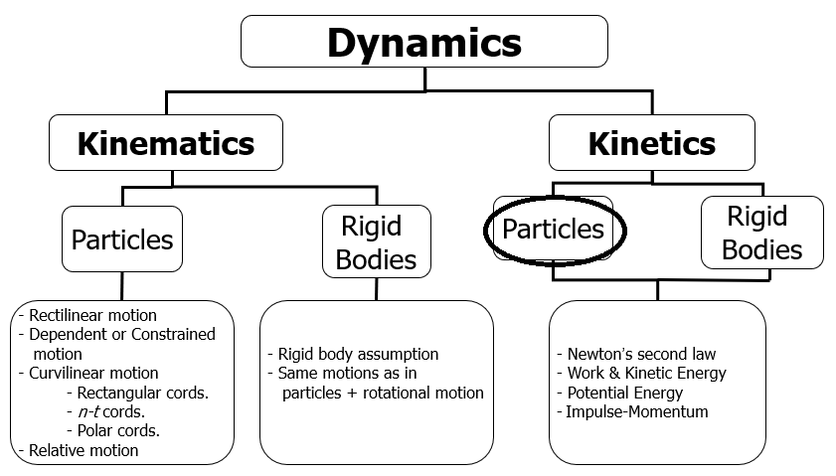
Kinetics of Particles
Free-Body Diagram

Slide 28
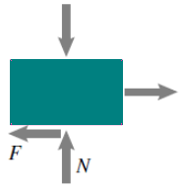
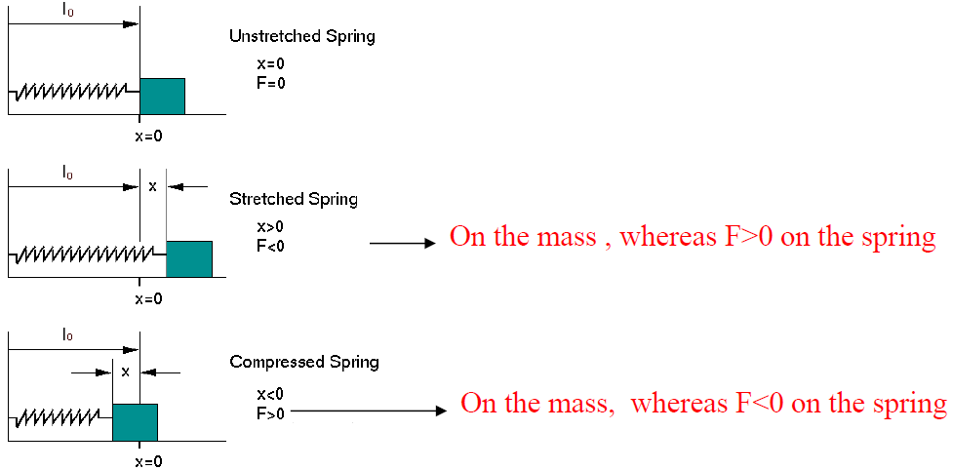
Important Forces that should be Included in Free-Body Diagram
Friction Force (F_{f})
Spring Force (F_{s})
Gravitational force (Weight or W) = mg
Normal force (N) = the force acting on the body surfaces by wall or floor
Friction force (F_{f}) = μ_{k} N; where μ_{k} = friction
coefficient, N = resultant normal force
It can be assumed that the spring doesn't have any mass for analyzing the particle motion.
The force of deformation can be F_{s} = kx, where k is spring stiffness and x is the distance that the spring is stretched or compressed from its relaxed length. The reaction force on the mass is F_{m} = -kx
W
Motion direction
f
Note:
When the body slides:
- smoothly
- in smooth surface
- without friction
- freely
NO
FRICTION

Slide 29

Math Revision

Slide 30


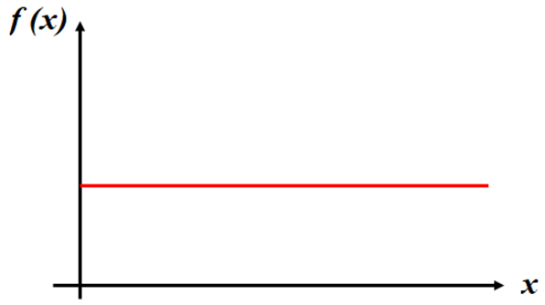
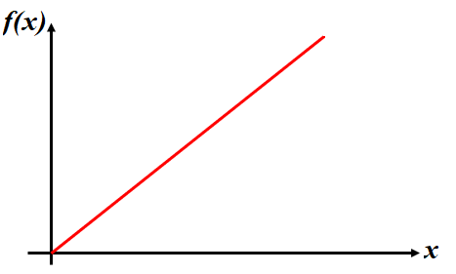
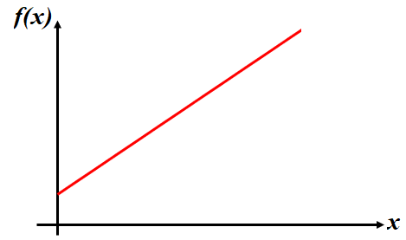



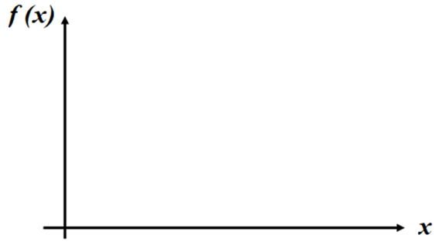

FUNCTIONS
f(x₂)
f(x₂)
c
f(x₁)
c
f(x₁)
x₁
x₂
x₁
x₂
Zero order function
Constant value
1st order function
Linearly Variable
2nd order function
Curvilinearly Variable

Slide 31
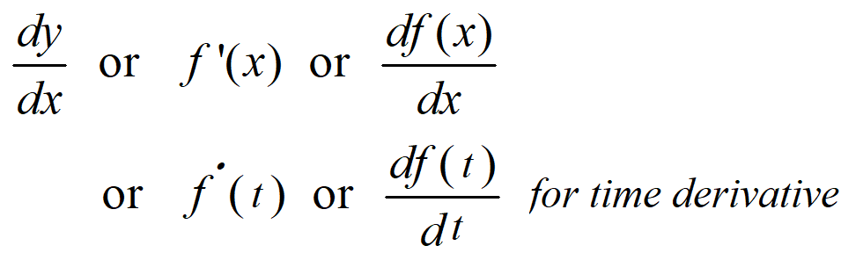
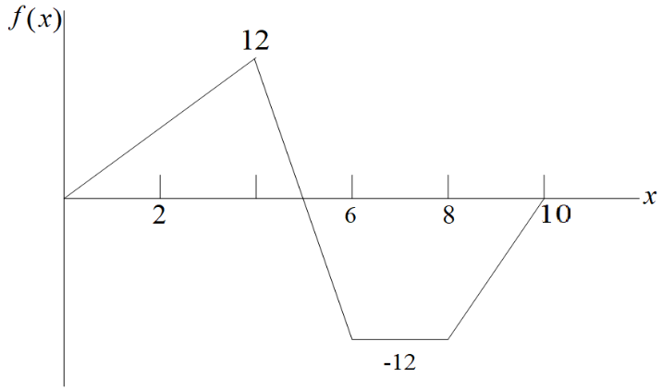
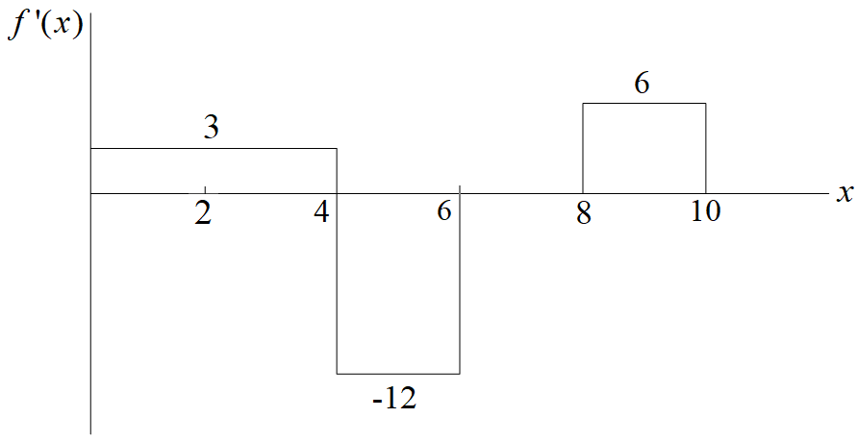
The derivative of a function is the slope at a given point.
Example: Plot the first derivative of the function shown below.
Differential Calculus

Slide 32
Chain Rule.
Derivatives Table:
Differential Calculus (Cont.)

Slide 33
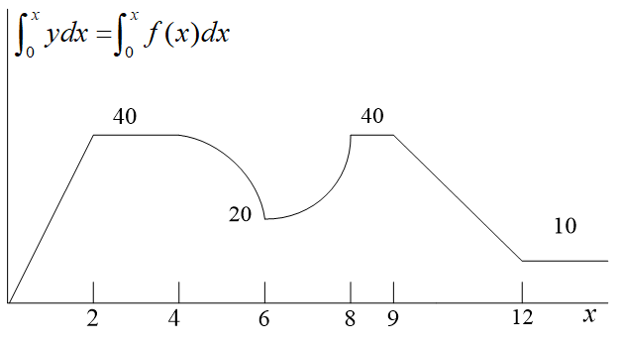
Indefinite and Definite Integrals.
Definite Integral as Area Under the Curve.
Example: Determine . Example: Determine .
INTEGRAL Calculus
Indefinite
Definite
Exact Area as Definite Integral

Slide 34
Integral Table:
INTEGRAL Calculus (Cont.)

Slide 35
Basic Vector Algebra
Scalars are quantities having only magnitude.
  Length or distance, speed, mass, time, work, energy, power, etc.
Vectors are quantities having both a magnitude and a direction.
  Position, displacement, velocity, acceleration, force, moment, impulse, momentum, etc.

Slide 36
Coordinate System
Rectangular or Cartesian Coordinate

Slide 37
Vectors in Cartesian Coordinate System
A = A₁i + A₂j + A₃k = (A₁, A₂, A₃)
i, j, and k are unit vectors pointing in the positive x, y, and z directions
A₁, A₂ and A₃ are called x, y, and z component of vector A

Slide 38
Vectors in Cartesian Coordinate System
Magnitude of A:
Direction of A:
It is a unit directional vector !
Equality: If A = B, it means A = B and also
Does the equality of two vectors necessarily imply that they are identical?

Slide 39
Addition of Vectors
Adding corresponding components
A = (A₁, A₂, A₃)
A + B = (A₁ + B₁, A₂ + B₂, A₃ + B₃)
B = (B₁, B₂, B₃)
Geometrical representation
(a) A pair of vectors A and B
(b) Added by the head-to-tail method
(c) Added by parallelogram law
(d) B is subtracted from A

Slide 40
Multiplication of a Vector by a Scalar
αA = (αA₁, αA₂, αA₃),
α is a real number
If α > 0,
multiply the length of the vector by α,
the direction unchanged
What happens if α < 0?
If α < 0,
multiply the length of the vector by α,
the direction changed by 180°

Slide 41
Basic Properties of Vector Algebra
1. Commutative law: A + B = B + A.
2. Associate law: (A + B) + C = A + (B + C).
3. Zero vector (0, 0, 0): A + (0, 0, 0) = A.
4. Negative vector: -A = (-A₁, -A₂, -A₃).
5. α(A + B) = αA +αB.
6. (αβ)A = α(βA)
7. (α + β)A = αA + βA.

Slide 42
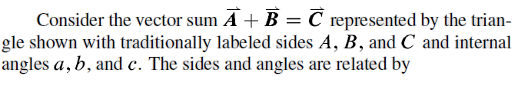
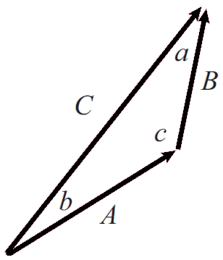
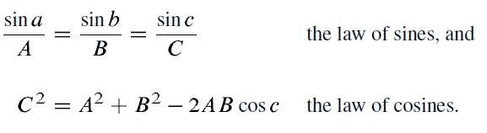
Vector triangles and the laws of sines and cosines

Slide 43
Dot Product
If A = A₁i + A₂j + A₃k and B = B₁i + B₂j + B₃k
It's Scalar, NOT Vector!
A . B = A₁B₁ + A₂B₂ + A₃B₃
Another name: scalar product.
Example: If A = (1, -3, 2) and B = (4, 5, -8), the dot product of A and B is -27.
Basic properties of the dot product:
A . B = B . A
(A + B) . C = A . C + B . C
A . (0, 0, 0) = (0, 0, 0)
A . A = |A|² = A²

Slide 44
Geometric Interpretation of Dot Product
A . B = |A||B|cosθ_{AB} = ABcosθ_{AB}
_{AB}
If two nonzero vectors
A . B = 0, then
?
cosθ_{ΑΒ} = 0
θ_{ΑΒ} = 90°
Perpendicular

Slide 45
Cross Product
If A = A₁i + A₂j + A₃k and B = B₁i + B₂j + B₃k
Vector Product!

Slide 46
Geometric Interpretation of Cross Product
_{AB}
If two nonzero vectors
A × B = 0, then
?
sinθ = 0
θ = 0°or 180°
_{AB}
_{AB}
Parallel

Slide 47
Example:
Let A = (1, -3, 2) and B = (4, 5, -8), then
Basic properties of cross product:
A × B = -B × A
(A + B) × C = A × C + B × C
A × (B × C) = (A . C)B – (A . B)C

Slide 48
Vector and Scalar Functions
A vector valued function A(t) is a rule that associates with each real number t a vector A(t).
A(t) = A₁(t)i + A₂(t)j + A₃(t)k
For example, f(t) = t³ – 2t + 4 is a scalar function of a single variable t, while A(t) = cos ti + sin tj + tk is a vector function of t.

Slide 49
Vector Differentiation
A vector function A(t) is differentiable at a point t if
exists, and A′(t) is called the derivative of A(t), written as
A′(t) = A₁′(t)i + A₂′(t)j + A₃′(t)k
Calculate the derivative of each component!
Example:
Let A(t) = cos ti + sin tj + tk. Find the derivative of A(t).
Solution:
A′(t) = -sin ti + cos tj + k

Slide 50
Rules of Vector Differentiation
if A = constant.

