Slide 1
Chapter 3
Vectors
Notes:
1

Slide 2
3-1 Vectors and Their Components
Learning Objectives
3.01 Add vectors by drawing them in head-to-tail arrangements, applying the commutative and associative laws.
3.02 Subtract a vector from a second one.
3.03 Calculate the components of a vector on a given coordinate system, showing them in a drawing.
3.04 Given the components of a vector, draw the vector and determine its magnitude and orientation.
3.05 Convert angle measures between degrees and radians.
Notes:
2

Slide 3
Scalars and Vectors

Slide 4
A Vector is something that has two and only two defining characteristics.
Magnitude : the meaning of magnitude is 'size' or 'quantity‘
Direction: the meaning of direction is quite self-explanatory. It simply means that the vector is directed from one place to another.

Slide 5
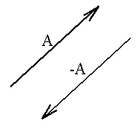
Properties of Vectors
1-Two vectors, A and B are equal if they have the same magnitude and direction, regardless of whether they have the same initial points
2-A vector having the same magnitude as A but in the opposite direction to A is denoted by –A .

Slide 7
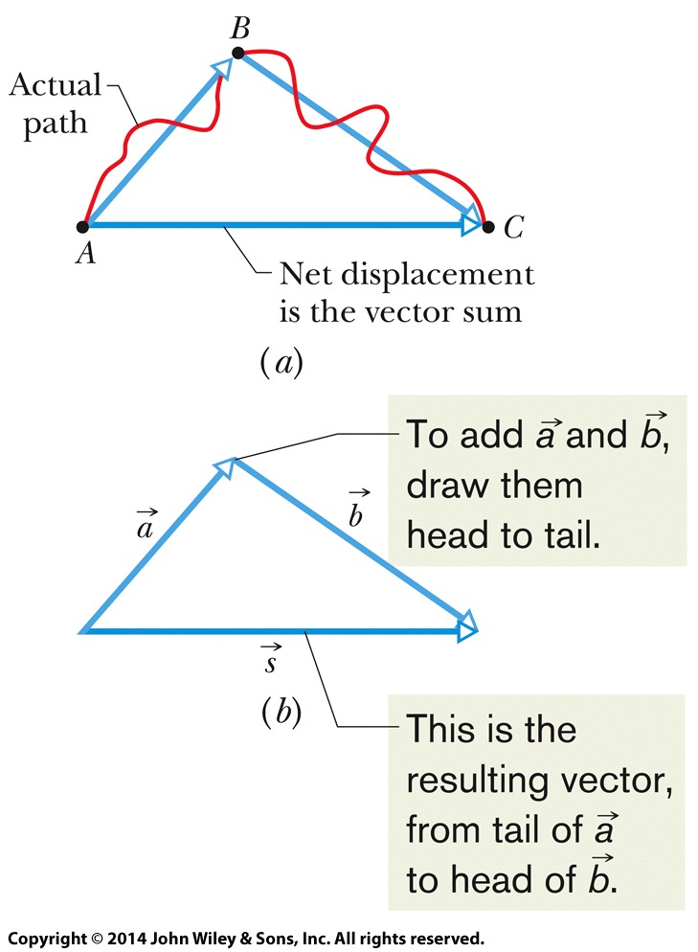
3-1 Vectors and Their Components
The vector sum, or resultant
Is the result of performing vector addition
Represents the net displacement of two or more displacement vectors
Can be added graphically as shown:
Eq. (3-1)
Figure 3-2
Notes:
7

Slide 8
3-1 Vectors and Their Components
Vector addition is commutative
We can add vectors in any order
Eq. (3-2)
Figure (3-3)
Notes:
8

Slide 9
3-1 Vectors and Their Components
Vector addition is associative
We can group vector addition however we like
Eq. (3-3)
Figure (3-4)
Notes:
9

Slide 10
3-1 Vectors and Their Components
These rules hold for all vectors, whether they represent displacement, velocity, etc.
Only vectors of the same kind can be added
(distance) + (distance) makes sense
(distance) + (velocity) does not
Answer:
(a) 3 m + 4 m = 7 m (b) 4 m - 3 m = 1 m
Notes:
10

Slide 11
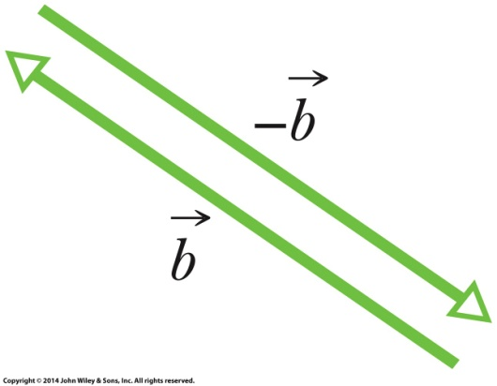
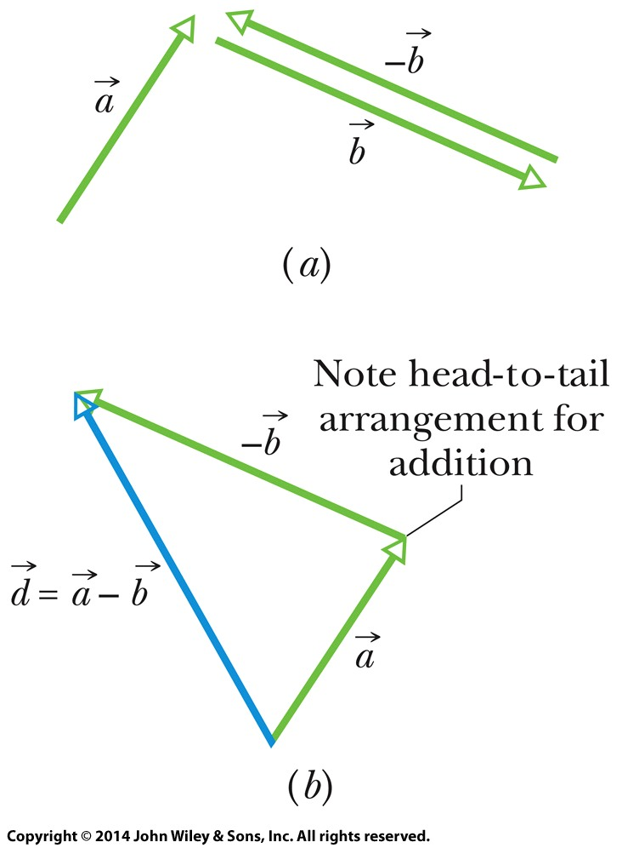
3-1 Vectors and Their Components
A negative sign reverses vector direction
We use this to define vector subtraction
Figure (3-5)
Eq. (3-4)
Figure (3-6)
Notes:
11

Slide 12
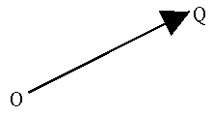
Graphically
Panel 1
a vector is represented by an arrow, defining the direction, and the length of the arrow defines the vector's magnitude. This is shown in Panel 1. . If we denote one end of the arrow by the origin O and the tip of the arrow by Q. Then the vector may be represented algebraically by OQ.
OQ = -QO.
The magnitude of a vector is denoted by absolute value signs around the vector symbol: magnitude of Q = |Q|.

Slide 13
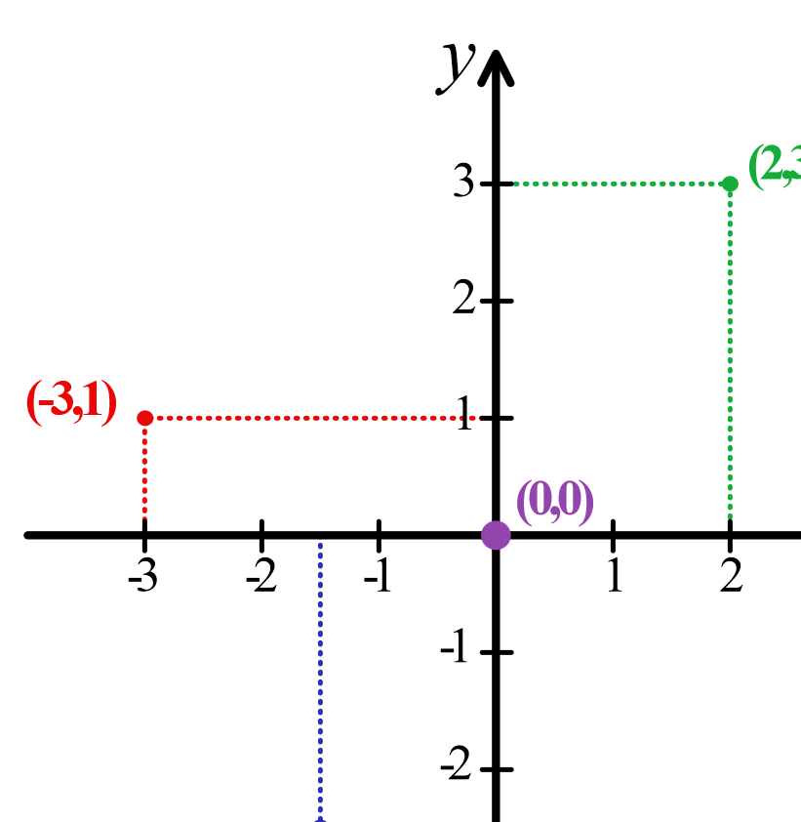
Cartesian coordinate system
in the plane, two perpendicular
lines are chosen and the coordinates
of a point are taken to be the signed
distances to the lines.

Slide 14
In three dimensions, three perpendicular planes are chosen and the three coordinates of a point are the signed distances to each of the planes

Slide 15
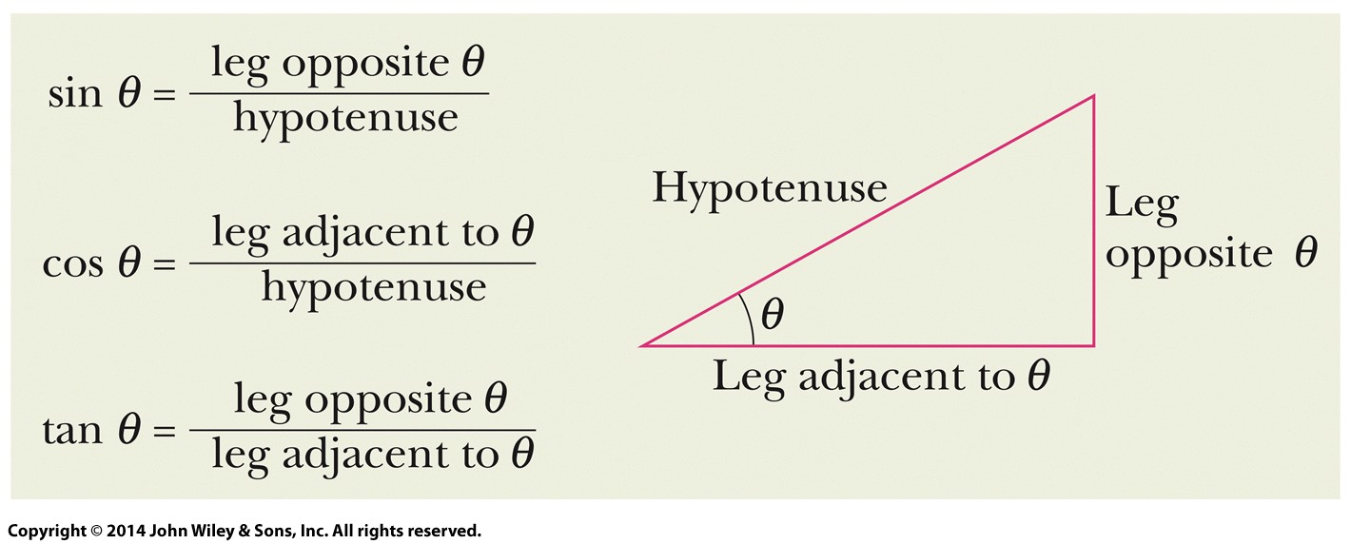
3-1 Vectors and Their Components
Angles may be measured in degrees or radians
Recall that a full circle is 360˚, or 2π rad
Know the three basic trigonometric functions
Figure (3-11)
Notes:
15

Slide 16
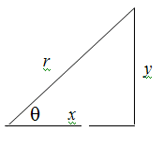
The polar coordinates
(1.3)
x = r cos Ɵ
And
y = r sin Ɵ
tan θ= y/x
Components in two dimensions can be found by:
Where θ is the angle the vector makes with the positive x axis, and a is the vector length
The length and angle can also be found if the components are known
Therefore, components fully define a vector
Eq. (3-5)
Eq. (3-6)

Slide 17
What is the magnitude and direction of the following vector? The direction of the vector is 55° North of East, and the vector's magnitude is 2.3.
Example

Slide 18
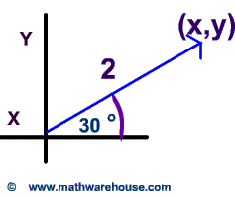
Example
Express the vectors coordinates below as ordered pairs in simplest radical form.
Answer
y coordinate = 2 ×sin(30°) = 1
x coordinate = 2 ×cos(30°) =

Slide 19
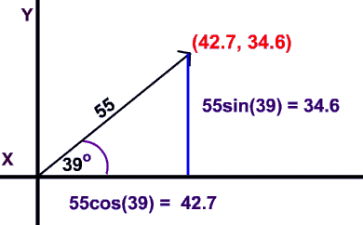
Example 2 Express the vectors coordinates below as ordered pairs in simplest radical form.
Answer

Slide 20
Example
Find the direction of the following vector
$$\frac{y}{x}$$

Slide 21
Example
$$\frac{y}{x}$$

Slide 23
The unit vector
Vectors can be related to the basic coordinate systems which we use by the introduction of what we call "unit vectors."
A unit vector : is one which has a magnitude of 1 and is often indicated by putting a hat (or circumflex) on top of the vector symbol, for example .

Slide 24
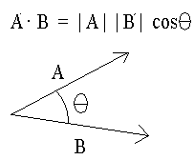
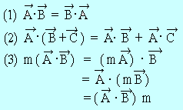
The multiplication of two vectors,
First, the scalar or dot product of two vectors
.
Note that the result of a dot product is a scalar, not a vector.
The rules for scalar products are given in the following list,
The scalar product of two vectors, A and B denoted by A·B, is defined as the product of the magnitudes of the vectors times the cosine of the angle between them,.

Slide 26
Example

Slide 27
Example

Slide 28
Exercise

Slide 29
Exercise

Slide 30
Solve the following Problems:
A) Problem (2) page 132
B) Problem (3) page 132
C) Problem (4) page 132
D) Problem (9) page 132
E) Problem (41) page 134

Slide 31
Vector has a magnitude of 88 km/h and is directed at 25° relative to the x axis. Which of the following choices indicates the horizontal and vertical components of vector ?
r_{x} r_{y}
a) +22 km/h +66 km/h
b) +39 km/h +79 km/h
c) +79 km/h +37 km/h
d) +66 km/h +22 km/h

Slide 32
which one of the following statements concerning unit vectors is true?
a) The magnitude of a unit vector is always equal to 1.
b) A unit vector always points in the direction of motion.
c) The magnitude of a unit vector sometimes equals zero.
d) A unit vector depends on the units of measurement used and is a method for tracking the units throughout a calculation.
e) Unit vectors are predominantly used in mathematics, but seldom used in physics

Slide 33
Sort these quantities into scaler and vectors:
Speed- velocity- acceleration- force- power- volume- displacement- pressure- mass-weight
scalers | Vectors

