Slide 1
Family and Friends 2-Grade 2
Unit 8
Tidy up!
Lesson 5
P 76

Slide 2
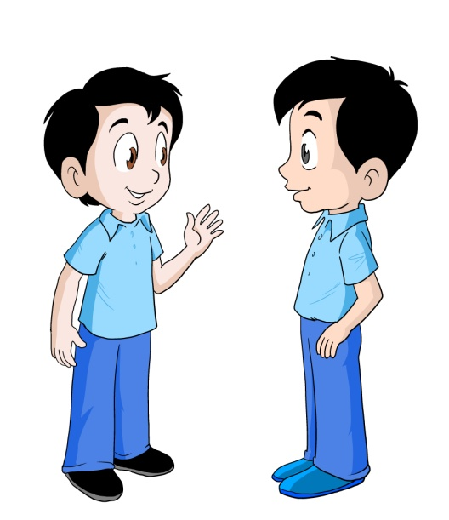
Objectives
1) Read the text.
2) Answer the questions.
_________________________________________________________________________________________________________________________________________________
Ministry of Education-2020

Slide 3
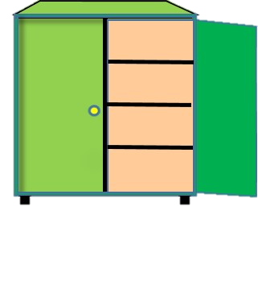
Look, listen then read
Dear kids magazine,
My name is Khalid. I’m from Bahrain.
This is a picture of my bedroom.
There’s a bed in my bedroom.
There are lots of stars on my blanket.
There are yellow stars on my rug too!
_________________________________________________________________________________________________________________________________________________
Ministry of Education-2020

Slide 4
Look, listen then read
There’s a green cupboard in my bedroom.
There’s a shelf.
I’ve got seven books on my shelf.
I like my bedroom.
Bye!
From Khalid (age 8)
_________________________________________________________________________________________________________________________________________________
Ministry of Education-2020

Slide 5
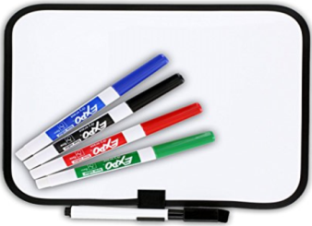
After reading, write T (true ) or F (false ) on your mini-board.
1- There are lots of footballs on the blanket. | F
2- There are stars on the rug.
3- Khalid has got seven books on his shelf.
4- Khalid doesn’t like his bedroom.
5- Khalid likes reading.
6- There’s a red cupboard in his bedroom.
_________________________________________________________________________________________________________________________________________________
Ministry of Education-2020

Slide 6
After reading, write T (true ) or F (false ) on your mini-board.
1- There are lots of footballs on the blanket. | F
2- There are stars on the rug. | T
3- Khalid has got seven books on his shelf. | T
4- Khalid doesn’t like his bedroom. | F
5- Khalid likes reading. | T
6- There’s a red cupboard in his bedroom. | F
_________________________________________________________________________________________________________________________________________________
Ministry of Education-2020

Slide 7
Read again and choose the correct answer.
1- There are lots of_________ on my blanket.
Stars
Footballs
_________________________________________________________________________________________________________________________________________________
Ministry of Education-2020

Slide 8
Read again and choose the correct answer.
2- Khalid has got _________ books on his shelf.
four
seven
_________________________________________________________________________________________________________________________________________________
Ministry of Education-2020

Slide 9
Read again and choose the correct answer.
3- There’s a _______ cupboard in my bedroom.
green
blue
_________________________________________________________________________________________________________________________________________________
Ministry of Education-2020

Slide 10
Read again and choose the correct answer.
4- There are _______ stars on my rug.
pink
yellow
_________________________________________________________________________________________________________________________________________________
Ministry of Education-2020

Slide 11
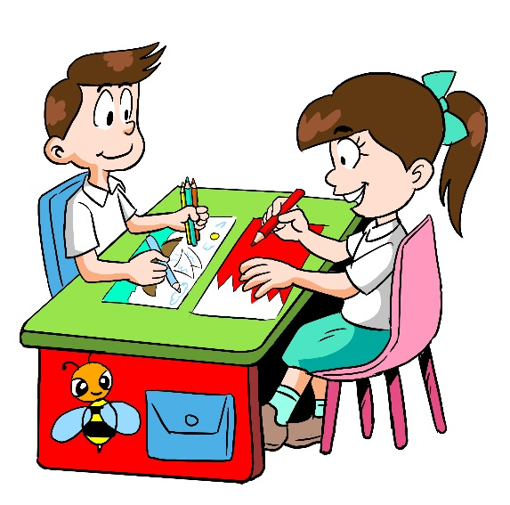
Open your workbook P. 74 and answer the questions.
_________________________________________________________________________________________________________________________________________________
Ministry of Education-2020

Slide 12
Well Done Kids !
End of lesson 5
_________________________________________________________________________________________________________________________________________________
Ministry of Education-2020

