Slide 1
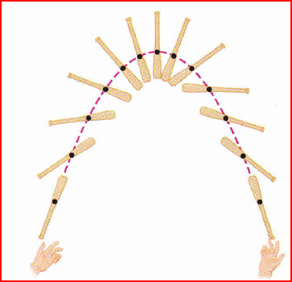
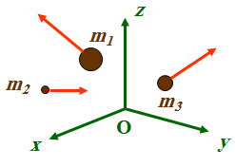

Slide 2
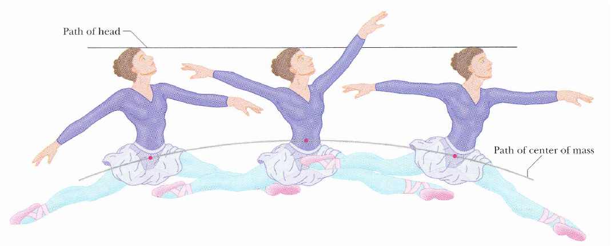

Slide 3
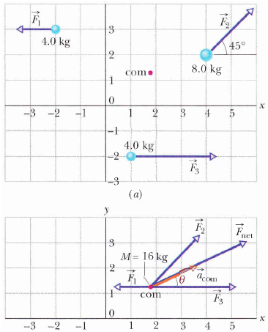
Q. What is the center of mass (COM)?

Slide 4
Q. Why do we study the center of mass (COM) of a system of particles?
A. We study the (COM) in order to predict the possible motion of the system.

Slide 5
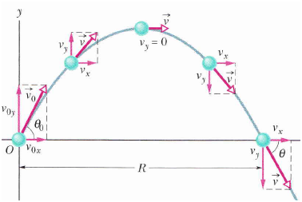
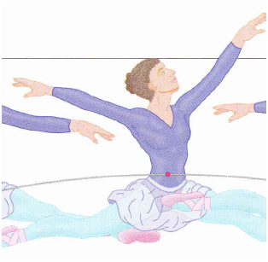
When we study the motion we usually consider two kinds of systems
System contains one particle such as : ball – box - bead
System contains more than one particle such as : ballerina – car – baseball bat
It’s motion is more complicated
Every part of the object moves differently
There are one point (COM) that moves in the simple parabolic path.
It’s motion is simple motion which we discussed before

Slide 6
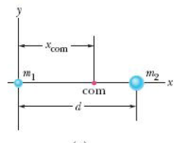
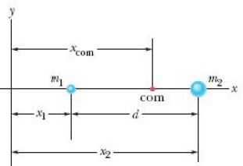
Q. How do we find the center of mass (COM)?
System of two particles on x-axis
or
Where
and x₁ , x₂ are the position of particles m₁ and m₂ respectively from the origin

Slide 7
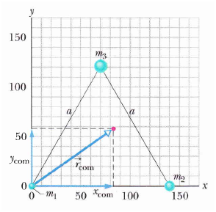
2. System of n particles along x- axis:
Rem: put x₁ , x₂ ....etc, with their signs
3. System of n particles distributed in 3D:

Slide 8
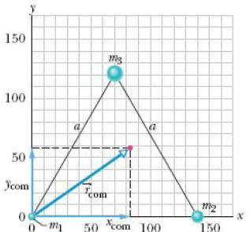
(9-4)

Slide 9
(9-5)

Slide 10
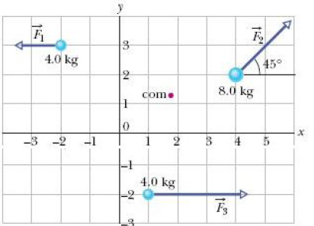
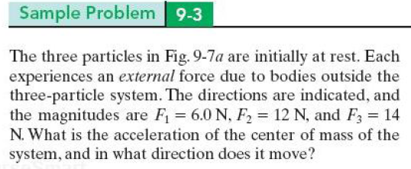

Slide 11
9-4 Linear Momentum of a single particle
9-5 Linear Momentum of a system of particles

Slide 12
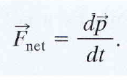
9-4 Linear Momentum of a single particle
is a vector quantity
SI unit is
Newton’s 2nd Law in terms of Momentum

Slide 13
9-5 Linear Momentum of a system of particles

Slide 14
The system is said to be
Isolated: When the net external forces acting on a system of particles is zero
Closed: When no particles leave or enter the system
then
0
= 0
then

Slide 15
or

Slide 16
Rem:
Rem: is a vector quantity and it has components, don’t forget signs when
you deal with it’s components.

Slide 17
