Slide 1
Computer Skills
Introduction to computer

Slide 2
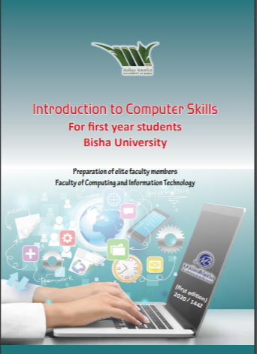
Course Book

Slide 3
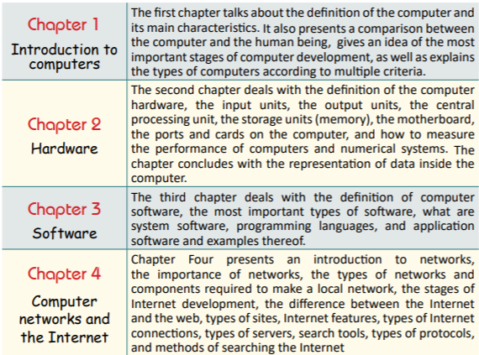
Book chapters

Slide 4
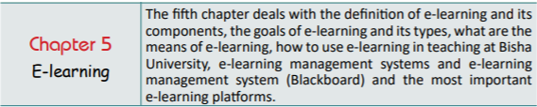
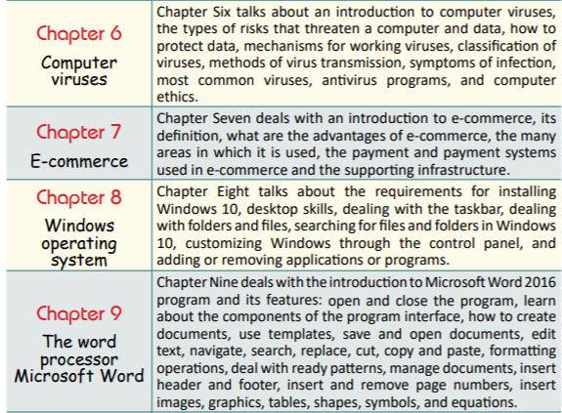
Book chapters

Slide 5
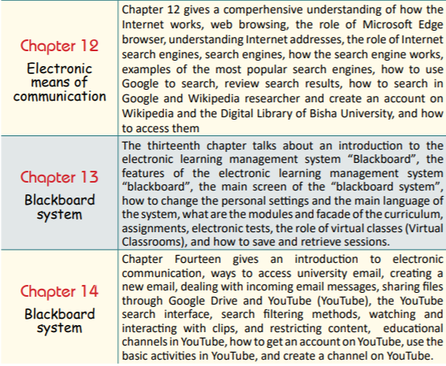
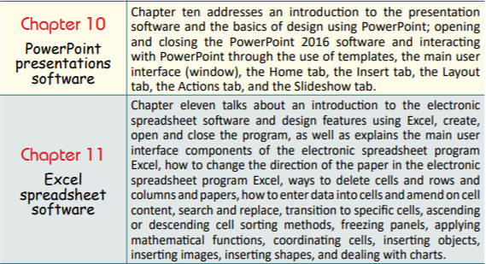
Book chapters

Slide 6
Evaluation and Assessment
marks | Evaluation method
10 marks | Assignments
10 marks | First mid-term
10 marks | Second mid-term
20 marks | Lab exam
50 marks | Final exam

Slide 7
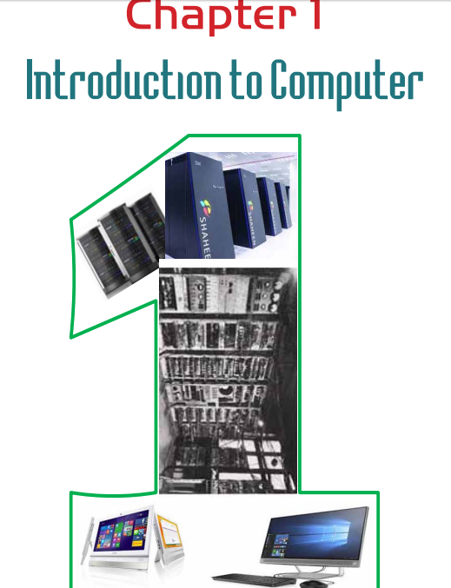

Slide 8
Lecture Objectives:
After studying this chapter, the student is expected to master the following
knowledge and skills:
1. To know what is the computer.
2. To distinguish different computer properties.
3. To list the computer›s features and capabilities.
4. To compare the computer›s capabilities to humans.
5. To learn about the different uses of the computer.
6. To distinguishes different stages and generations of computers.
7. To list the distinctive characteristics of each generation

Slide 9
Definition of computer
“An electronic device that receives data (inputs) and processes it by performing a set of operations (mathematical and logical) at high speed and infinitely accurate along with the ability to store huge amounts of data and information and retrieve them (outputs) when needed according to specific conditions. “

Slide 10
Computer Characteristics
• It consists of many parts connected to each other, which work as one unit.
• Depends on receiving inputs (data) through special devices (input units).
• It processes data using special instructions (computer software), which directs it to implement the required operations (mathematical and logical operations).
• Displays information resulting from processing operations using multiple methods and by special devices (output units).
• Stores massive amounts of data and information with high-capacity storage media (volumes).
• It can communicate with other devices to form a network of computers, which allows the sharing of data, programs, information and various resources (computer networks).

Slide 11
Comparison between computers and humans
computers | humans | Comparison Point
The computer can perform millions of mathematical operations, and solve complex equations with great accuracy and super speed measured in parts of a second | the human have limited capabilities in performing mathematical operations because of its errors, omissions or boredom. | Performing mathematical operations
The computer has high ability to store and process a huge amount of data in a way that made one almost completely dependent on it for storing important data and information | The human ability to store and process a data is limited | Data storage
the computer’s ability to retrieve information very quickly and under specific conditions that the user sets for the retrieval process. | the computer’s ability to retrieve information is very limited | Retrieve information

Slide 12
Comparison between computers and humans
computers | humans | Comparison Point
The computer have ability to perform certain operations repeatedly for hundreds and possibly millions of times without getting bored or error. | the human have limited capabilities to perform operations and they getting bored or error with repetition | . Accurate repetition
The computer do not have ability to to think freely | The human ability to think freely. | Thinking
the computer’s ability to Movement and flexibility is limited | The human have ability to Movement and flexibility | Movement
Computer do not have ability for self-learning | Human have ability for continuous self-learning | self-learning
Computer is worked based on human programming | the human being who invented and developed the computer continuously | Creativity and innovation
The computer is solve problems based on human programming | The human have ability to solve problems and judge events with experimental experience | Problem Solving

Slide 13
Comparison between computers and humans

Slide 14
Stages of computer development
The first stage: the early historical stage
The second stage: the emergence of mechanical and electromechanical computers
The third stage: modern computer generations
  First: the first generation (1945 - 1958) - vacuum tubes
  Second: the second generation (1959 - 1964) - the transistor
  Third: The third generation (1964 - 1970) - Integrated circuits
  Fourth: The fourth generation (1970 - 1995) – microprocessors
  Fifth: The fifth generation (1995-until now) - portable smart devices

Slide 15
Stages of computer development
The first stage: the early historical stage
develop machines that help in performing mathematical operations in an easier way
Abacus counter developed by the Chinese which used for easy counting and calculation

Slide 16
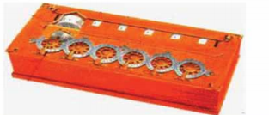
Stages of computer development
The emergence of mechanical and electromechanical computers
1643AD:The invention of a semi-automatic mechanical calculating machine by the French scientist Blaise Pascal to use for adding and subtracting numbers.
1693AD: Development of Pascal computing machine and making several improvements and additions by the scientist Libbies to be able to perform multiplication operations

Slide 17
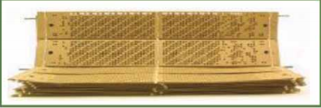
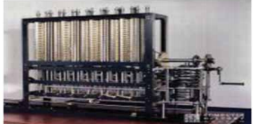
Stages of computer development
The emergence of mechanical and electromechanical computers
1805AD: The French scientist Joseph Marie Jacquard invented weaving machines programmed through a successive set of punched cards used as a program for automatic patterned silk weaving
1830AD:English scientist Charles Babbage invented a mechanical calculator that was able to perform mathematical operations and some other operation such as logarithms, and trigonometric percentages of angles

Slide 18
Stages of computer development
The emergence of mechanical and electromechanical computers
1887AD: American scientist Hermann Hollerith made a punching machine and tabulation machine, which was used to make a census of the population in the United States of America.
1890AD: A company was established to produce tabulation machines, and this company expanded and later joined with other companies, which led to the emergence of the famous (IBM) company.
1944AD: Aiken and Grace Hopper, with assistance and support from IBM, were able to develop and produce the first computer (an electromechanical calculator) calledMark-1

Slide 19
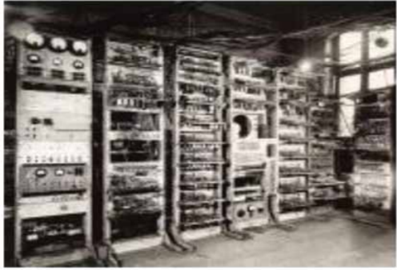
Stages of computer development
The emergence of mechanical and electromechanical computers

Slide 20
Stages of computer development
The third stage: modern computer generations
First: the first generation (1945 - 1958) - vacuum tubes
The use of vacuum tubestechnology in design and construction.
The size of these computers was very large and weighed heavily.
It consumes large quantities of electricity and generates large amount of heat.
It performs operations with a slow speed (1020- thousand operations per second).
It used machine language (based on binary system 0 and 1) in writing programs, and therefore the programs were very complex.
Magnetic cylinders were used as a means of entering data into the computer, and rudimentary printing machines to get results.

Slide 21
Stages of computer development
The third stage: modern computer generations
Second: the second generation (1959 - 1964) - the transistor
The use of transistor technology in design and construction.
The size of these computers is smaller than the first generation.
It executs operations at high speed (hundreds of thousands of operations per second).
Use of magnetic tapes and magnetic disks as a secondary memory.
The emergence of some high-level programming languages, such as Fortran and Cobol.

Slide 22
Stages of computer development
The third stage: modern computer generations
Third: The third generation (1964 - 1970) - Integrated circuits
The use of integrated circuit technology in design and construction.
It is much smaller than its predecessor and has a lower production cost.
It increased its speed a lot and became measured with nanoseconds.
Fast input and output devices as well as color screens appeared.
Increase the main memory capacity. It reached 8 million bytes on some devices.
The emergence of some high-level programming languages, such as "PL / 1", "Algol68" and "Lisp".

Slide 23
Stages of computer development
The third stage: modern computer generations
Fourth: The fourth generation (1970 - 1995) – microprocessors
The emergence of very small processor technology.
Computers were characterized by small size and low cost.
Significant increase in speed, reaching hundreds of millions of operations per second.
Read Only Memory (ROM)and Random Access Memory(RAM)appeared.
Operating systems have evolved a lot and personal computers have emerged.
Use floppy disks and hard disk to store data.
The beginning of the emergence of computer networks.
The emergence of many high-level programming languages, such as C, Pascal, C ++ and Prolog.

Slide 24
Stages of computer development
The third stage: modern computer generations
Fifth: The fifth generation (1995-until now) - portable smart devices
The emergence of multi-core processors, which led to a huge increase in speed.
Increased storage capacity, and the emergence of new storage media such as CDs and Flash memory.
The development of visual operating systems, such as the Windows operating system, and the emergence of visual programming languages that have facilitated the design and programming of applications such as Visual Basic and others.
The development in the field of networks and the emergence of the Internet.
The advent of artificial intelligence and the development of robotic technologies.

Slide 25
The End of Lecture 1

