Slide 1
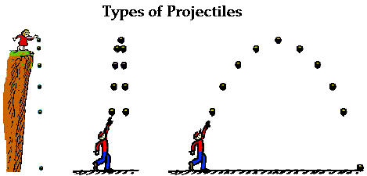
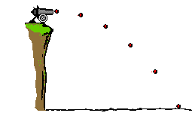

Slide 2
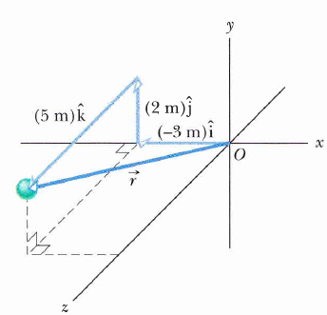
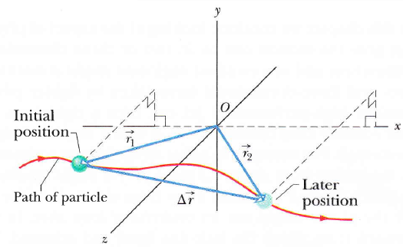
Position
Displacmen

Slide 3
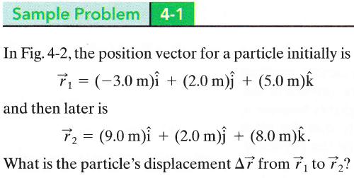

Slide 4
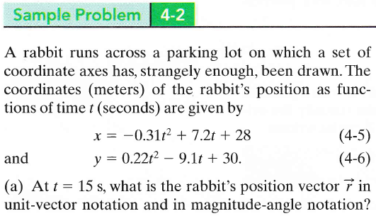
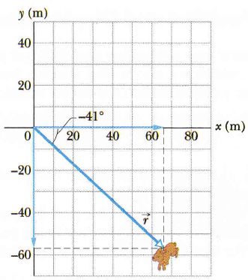

Slide 5
Average velocity
Instantaneous velocity
(Or velocity)
but
Example:

Slide 6
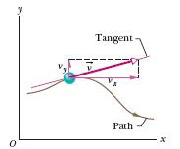
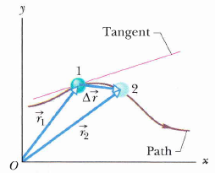
The direction of the Instantaneous velocity

Slide 7
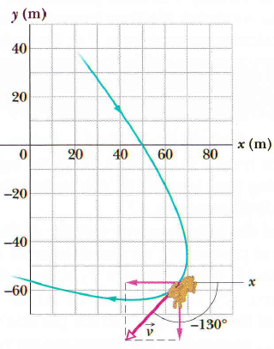

Slide 8
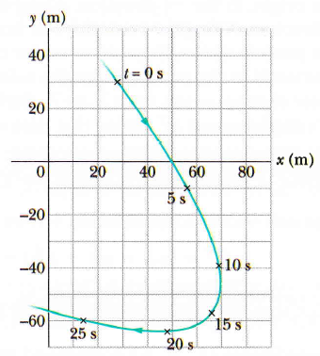

Slide 9
Average Acceleration
Instantaneous Acceleration
(Or acceleration)
but

Slide 10
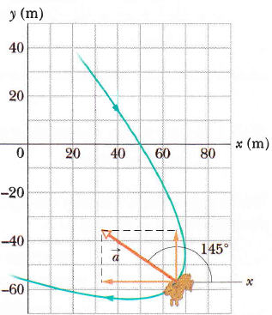

Slide 11
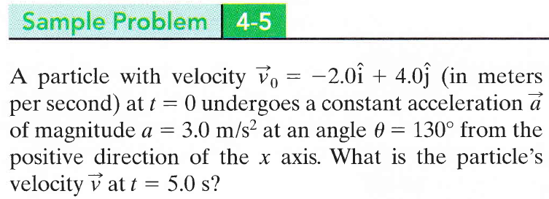

Slide 12
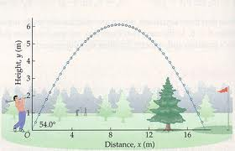
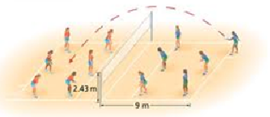

Slide 13
y
Max. height
Projectile
Projectile’s Path
θ₀
R
x
Launching point
Landing point
The range R

Slide 15
y
v_{0y}
θ₀
v_{0x}
x

Slide 16
y
y
y
y
x
x
x
x

Slide 17
y
v
v_{y}
v
v_{x}
v_{x}
v_{y}
v
v_{0y}
v₀
θ₀
v_{0x}
x
y

Slide 18
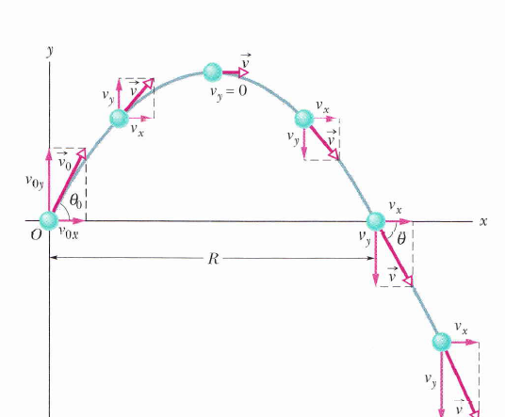

Slide 19
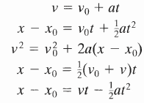
Projectile motion
Horizontal Motion
Vertical Motion

Slide 20
Projectile motion
Horizontal Motion
Vertical Motion
Max. height
v=
v_{x}
v_{y= 0}
v_{y}
v_{x}
v_{y}
v_{x}
v_{0y}
θ₀
v_{0x}
y
y
y
x
x
x

Slide 21
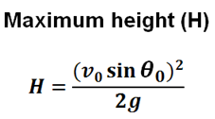
Max. height
H
x

Slide 24
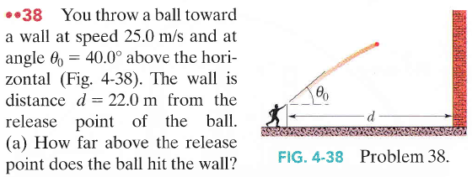

Slide 26
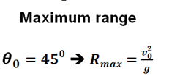
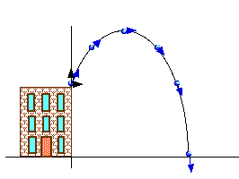
x
R
R

Slide 27
The equation of the projectile path (TRAJECTORY)
This is the equation of a parabola, so the projectile path is parabolic

Slide 28
x
R
R

Slide 29
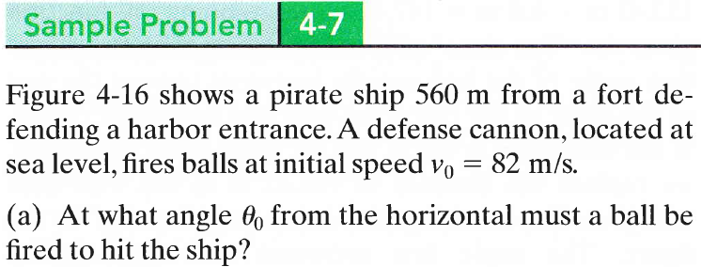
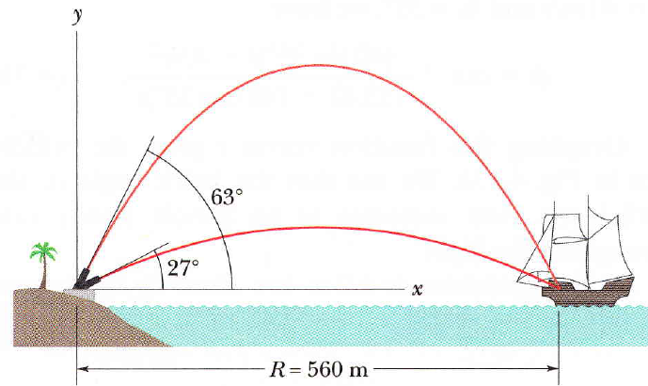

Slide 30
A particle is in uniform circular motion if it travels around a circle or circular arc at constant speed.
1-Velocity :
magnitude constant v.
direction :tangent to the circle in the
direction of motion.
2- Acceleration:
Why is the particle accelerating even though the speed does not vary?
- magnitude
- direction: toward the center.
- It is called Centripetal acceleration(meaning seeking center)

Slide 31
3- Period: is the time for a particle go around the circle once.
For one round ⇒ distance = circumference of the circle

Slide 32
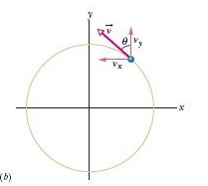

Slide 33
