Slide 1
Super Goal 5

Slide 2
UNIT 3

Slide 3
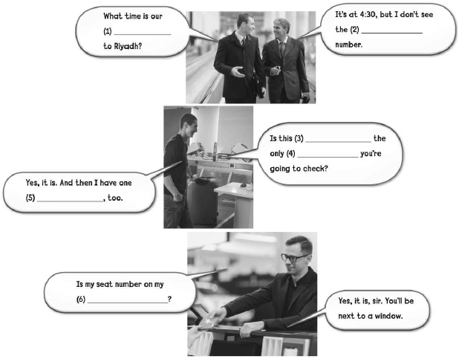
flight
gate
suitcase
baggage
carry-on
boarding pass

Slide 4
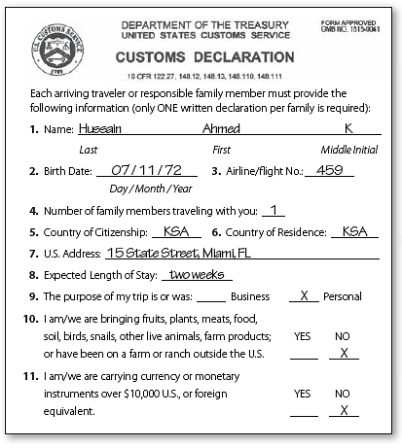
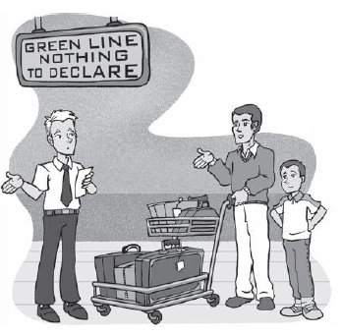

Slide 5
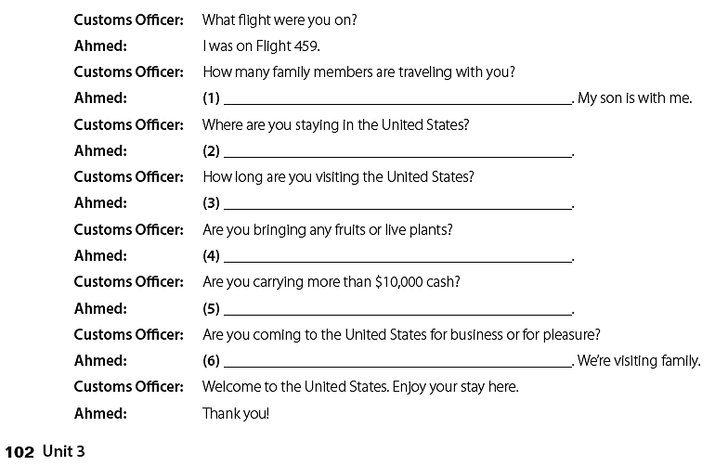
only one
We’re staying in Miami , Florida .
About two weeks .
No , I’m not .
No , I’m not .
We’re coming for pleasure

Slide 6
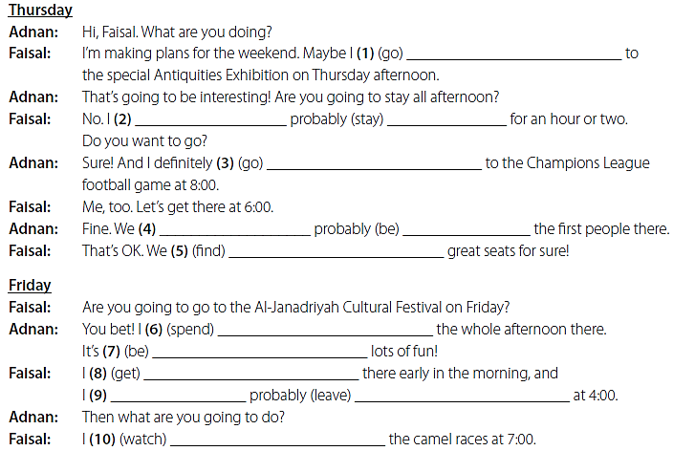
will go
will
stay
am going to go
will
be
are going to find
am going to spend
going to be
am going to get
will
leave
am going to watch

Slide 7
What are you doing on Friday ?
I’ll probably ride in the bicycle race .
What time is the race going to start ?
It’s going to start at 10:30 a.m.
What are doing on Friday afternoon ?
I’ll probably go to Yahiya's barbecue .

Slide 8
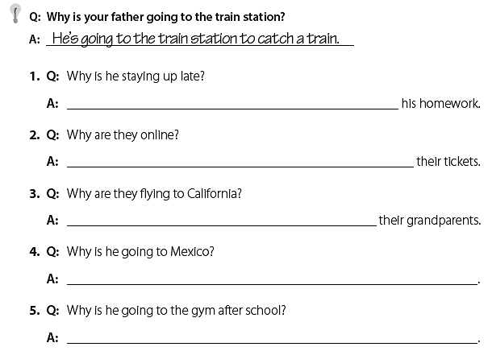
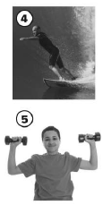
He’s staying up late to finish
They are online to check on
They are flying to visit
He’s going to Mexico to go surfing .
He’s going to the gym to work out .

Slide 9
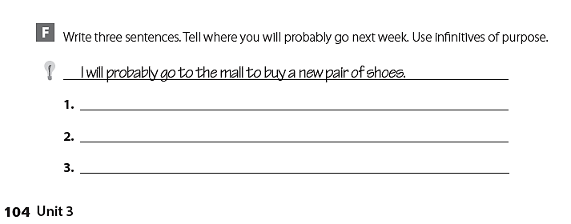
I will probably go to the park to play football .
I will probably go to my friend’s house to play video games .
I will probably go to the mall to hang out with my friends .

Slide 10
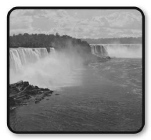
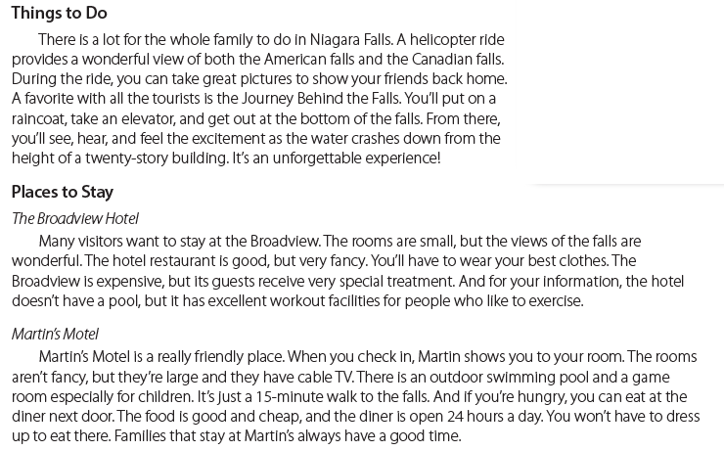

Slide 11
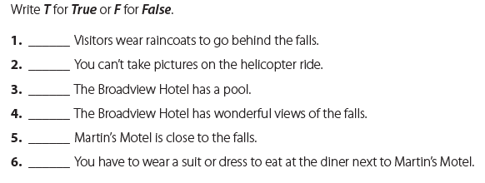
T
F
F
T
T
F
I probably will stay at the Broadview Hotel.
I want to see the falls from my room .
I probably will take the helicopter ride.
I want to get some good photos of the falls .

Slide 12
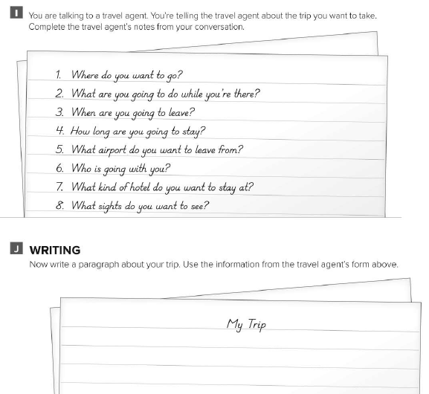
تصور بأنك تتحدث إلى وكيل سفر وتريد أن تخطط للسفر إلى مكان ما قم بإكمال الأسئلة التالية
قم الان بكتابة القطعة مستعملا المعلومات التي قمت بالإجابة عليها في الأسئلة السابقة

Slide 13
EXPANSION 1-3

Slide 14
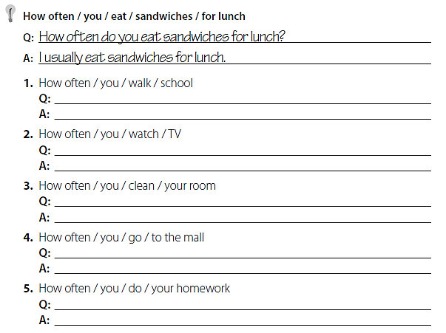
How often do you walk to school ?
I usually walk to school .
How often do you watch TV ?
I rarely watch TV .
How often do you clean your room ?
I sometimes clean my room .
How often do you go to the mall ?
I seldom go to the mall .
How often do you do your homework ?
I always do my homework .

Slide 15
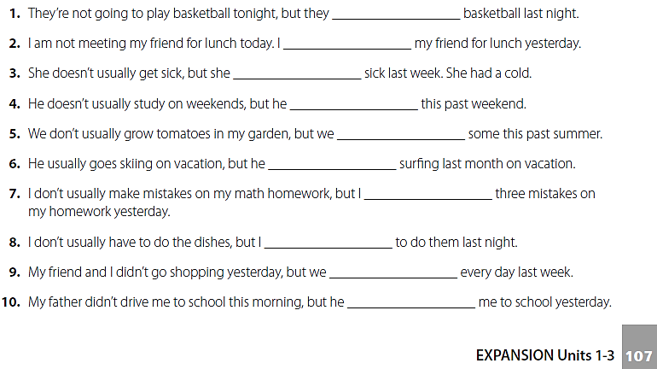
played
met
got
studied
grew
went
made
had
went
drove

Slide 16
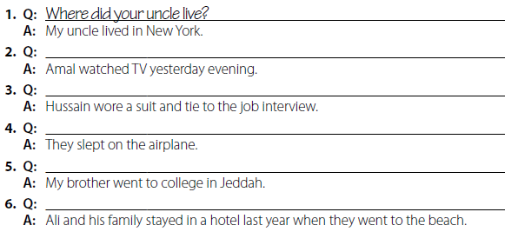
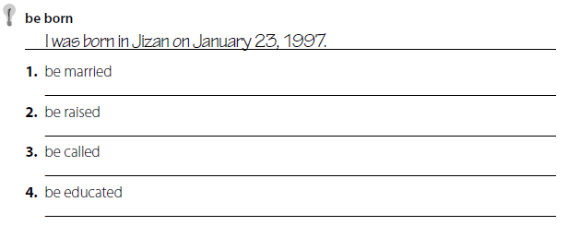
What did Amal do yesterday evening ?
What did Hussain wear to the job interview ?
What did they do on the airplane ?
Where did your brother go to college ?
Where did Ali and his family stay last year when they went to the beach ?
My parents were married in Abha .
I was raised in Jeddah .
I was called little Ali .
My father was educated in Riyadh .

Slide 17
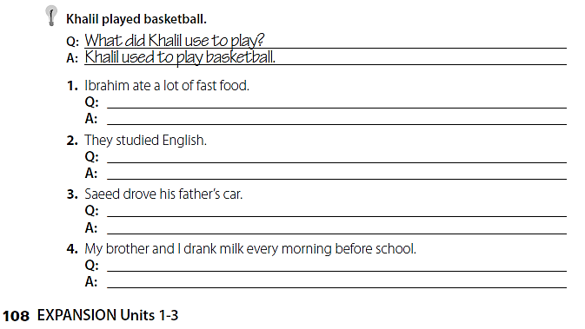
What did Ibrahim use to eat ?
He used to eat a lot of fast food
What did they use to study ?
They used to study English.
What did Saeed use to drive ?
Saeed used to drive his father’s car.
What did you and your brother use to drink every morning ?
We used to drink milk every morning before school .

Slide 18
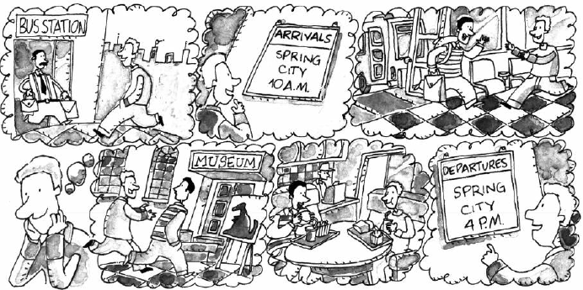
The bus is arriving at 10 A.M .
Robert is meeting his friend at the bus station today .
Robert and his friend are going to the museum later .
Robert and his friend are eating at a fast food restaurant .
Robert is going to the bus station at 4 p.m. .

Slide 19
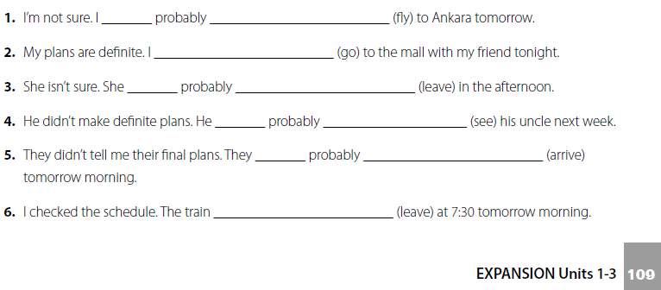
will
fly
am going to go
will
leave
will
see
will
arrive
is going to leave

Slide 20
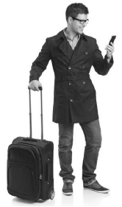
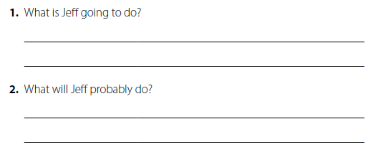
He is going to take a trip .
He is going to talk on his cell phone .
He will probably fly on a plane .
He will probably visit his friends .

Slide 21
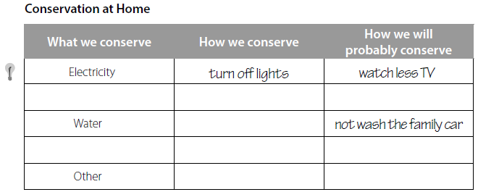

Slide 22
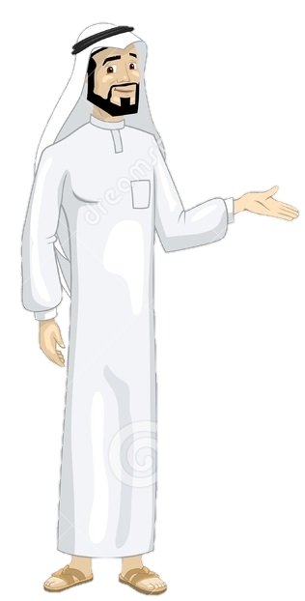
See you later
Take care
Teacher :
Badr Sayid Al-Shehri

