Slide 1
Zoo 103
Lab 7

Slide 2
Sponges
Kindom:Animalia
Sub kingdom :Parazoa
Phylum : Porifera
Genus: Sponges
Features:
Sponges are sessile with porous bodies and choenocytes
The germ layers of sponges are not really tissues because the cells are relatively unspecialized.
Sponges lack nerves or muscles.
Most sponges are marine and some live in fresh water.

Slide 3
Features
The body of a sponge consists of two cell layers separated by a gelatinous region, the mesohyl.
Most sponges are hermaphrodites , with each individual producing both sperm and eggs.
The body of a simple sponge resembles a sac perforated with holes .
Nearly all sponges are suspension feeders, collecting food particles from water.

Slide 4
Three types of sponges are known:
The ascon, sycon and leucon types, according to the structural complexity of the body, the first being the simplest.

Slide 5
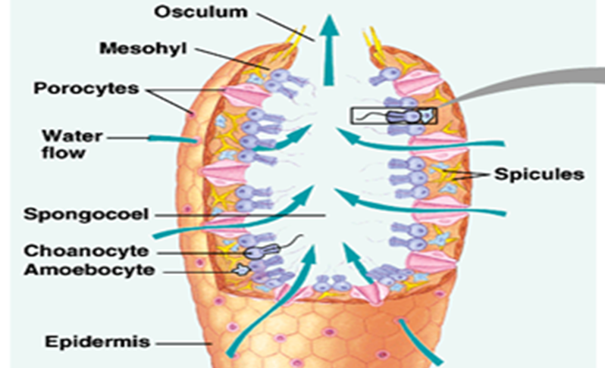

Slide 7
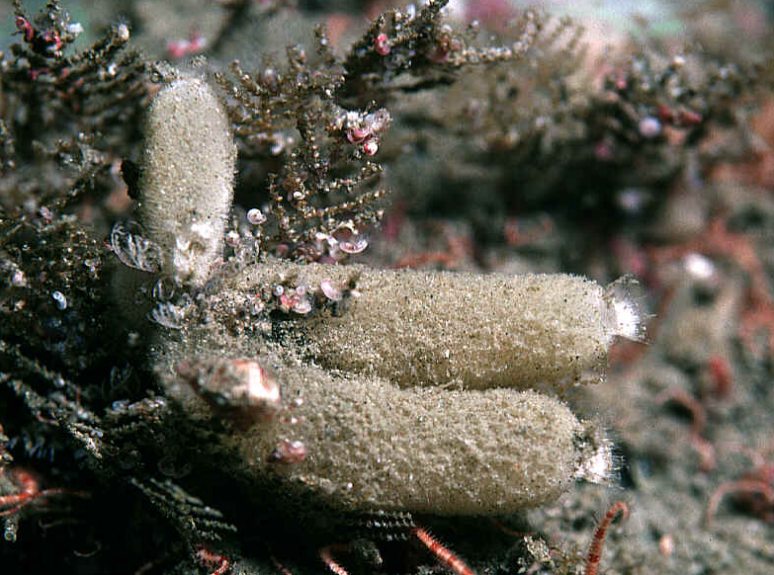
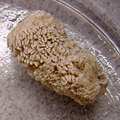
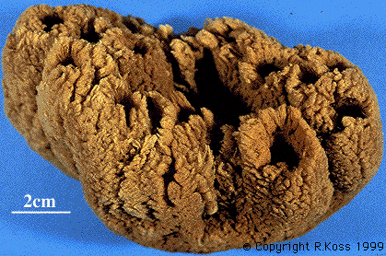
Sycon
Leucosolenia
Euspongia

Slide 8
Hydra
Subkingdom: Metazoa
Phylum: Coelenterata
Class: Hydrozoa
Genus: Hydra
They are radial symmetrical animals, mostly marine, solitary فردية or colonial and sedentary مستقرة or free-swim. They are also diplobiastic, that is, their body is built up of two cellular layers only, an outer ectoderm and an inner endoderm.

Slide 9
External Features:
They have a relatively simple body plan.
The basic body plan is a sac with a central digestive compartment, the gastrovascular cavity.
Hydra exist only in the polyp form جالسة .
When environmental conditions are favorable, a hydra reproduces asexually by budding.
When condition deteriorate الظروف الغير ملائمة hydra can reproduce sexually by forming resistant zygote.
Hydra has testes at upper part and ovary at the lower part of the body.

Slide 10
Hydra reproduction

Slide 12
Fasciola
Kingdom :Animalia
Sub kingdom: Eumetazoa
Division: Triploblastica,
Sub division: Acoelomates
Phylum: Platyhelminthes
Class :Trematoda
Genus: Fasciola
Species: Fasciola gigantica

Slide 13
They are called liver-flukes because they live in the bile ducts of cattle and other mammals leaf-like shape.
They usually have two suckers, an anterior or oral sucker which encloses the mouth, and a posterior or ventral sucker.
The alimentary canal begins with the mouth opening. This leads into a short muscular pharynx.
That is followed by the intestine which divides into 2, right and left, branches.

Slide 14
The excretory system consists of a great number of small canals which collect into a main excretory canal and opens to the outside by the excretory pore.

Slide 15
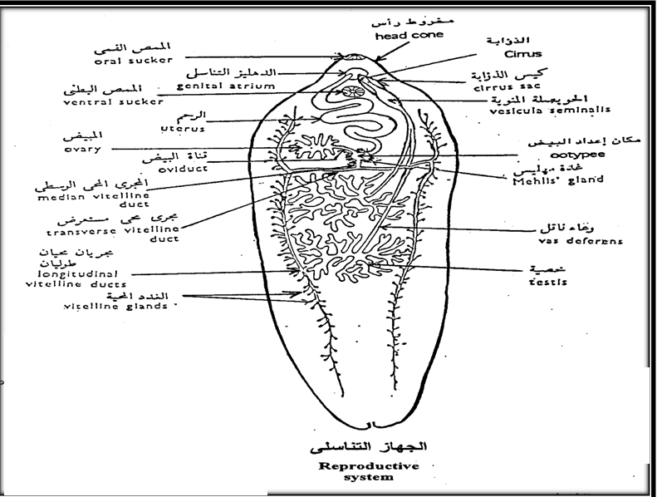
The male genital system consists of two testes lying approximately in the centre of the body branched and each gives off a vas deferens.
The female genital system consists of a single branched ovary.

Slide 16
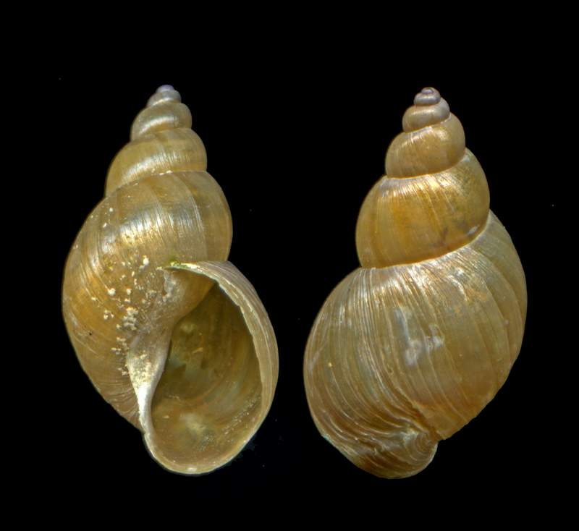
Limnaea cailliaudi, the intermediate host of fasciola
Limnaea snails

Slide 17
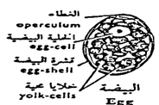
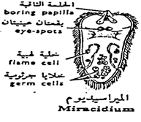
Stages in The Life ­history:-
1-Eggs and note the chitinous eggshell with its operculumغطاء .
2-The miracidium is a minute free-living larva with an elongated conical bodyجسم مخروطي entirely covered by cilia penet.

Slide 18
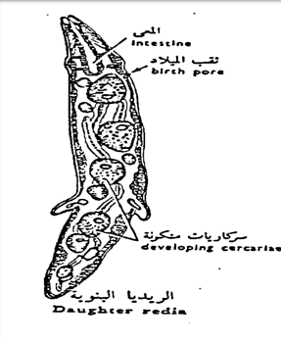
3-The sporocyst is sac­like, covered by epidermis and thin cuticle.
4-The redia has an elongated body with an anterior projecting.

Slide 19
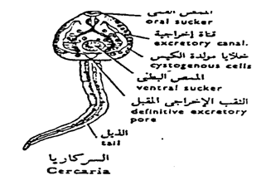
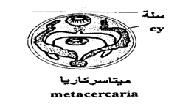
5-The cercaria has a heart-shaped body, a long unforked tail, and rudiments بدائي of most of the adult organs (two suckers, a pharynx).
6-The metacercaria or (encysted cercaria) has lost the tail and is enclosed in a thick cyst secreted by the cystogenous cells.

Slide 20
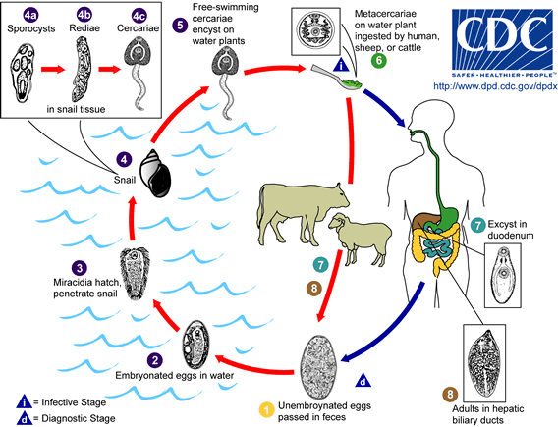
The Life cycle of Fasciola

Slide 22
Under The Microscope

Slide 23
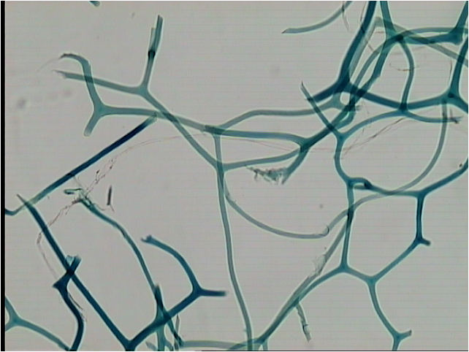
1-Spongia fibers from bath sponge.

Slide 24
3
2
1
Hydra - Male
1-Testes.
2-Oral cone.
3-Tentacles.
Notes:
24

Slide 25
3
2
1
Hydra - Female
1-Ovary.
2-Oral cone.
3-Tentacles.
Notes:
25

Slide 26
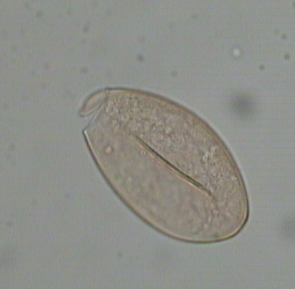
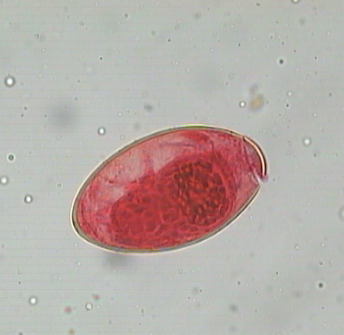
1
2
3
Fasciola egg
1-Operculum.
2-Developing miracidium.
3-Egg shell.

Slide 27
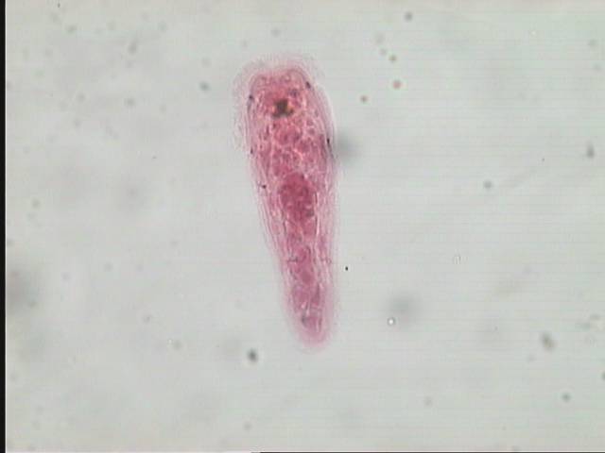
1
3
2
4
Miracidium of Fasciola
1-Boring papilla.
2-Cilia.
3-Eye Spots.
4-Germ celis.

Slide 28
1
2
Daughter radia of Fasciola
1- Developing radiae.
2- Sporocyst.

Slide 29
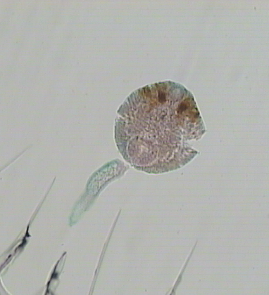
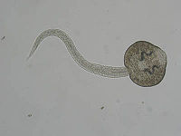
1
3
2
Cercaria of Fasciola
1- Head.
2-Tail.
3-Eye spot.

Slide 30
Thank you

