Slide 1
Unit 2 in the news
Lesson 2
Favorite and pet hates

Slide 2
A – 7 letters
address

Slide 3
C – 5 letters
chess

Slide 4
F – 7 letters
feeling

Slide 5
F – 10 letters
frightened

Slide 6
H – 4 letters
hate ( n and v )

Slide 7
P – 7 letters
podcast

Slide 8
R – 5 letters
reply ( n )

Slide 9
S – 7 letters
smoking

Slide 10
New words
Address
Chess
Feeling
Frightened
hate ( n and v )
Podcast
reply ( n )
smoking

Slide 11
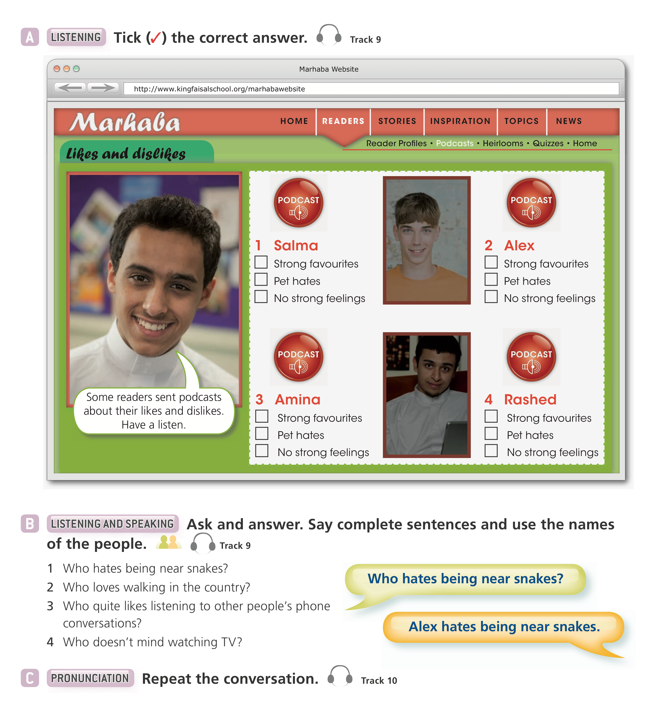
☑️
☑️
☑️
☑️

Slide 12
2 Amina
3 Rashed
4 Salma

Slide 14
D
B
A

Slide 16
‘d like to
like
would
like
like
‘d like to

