Slide 1
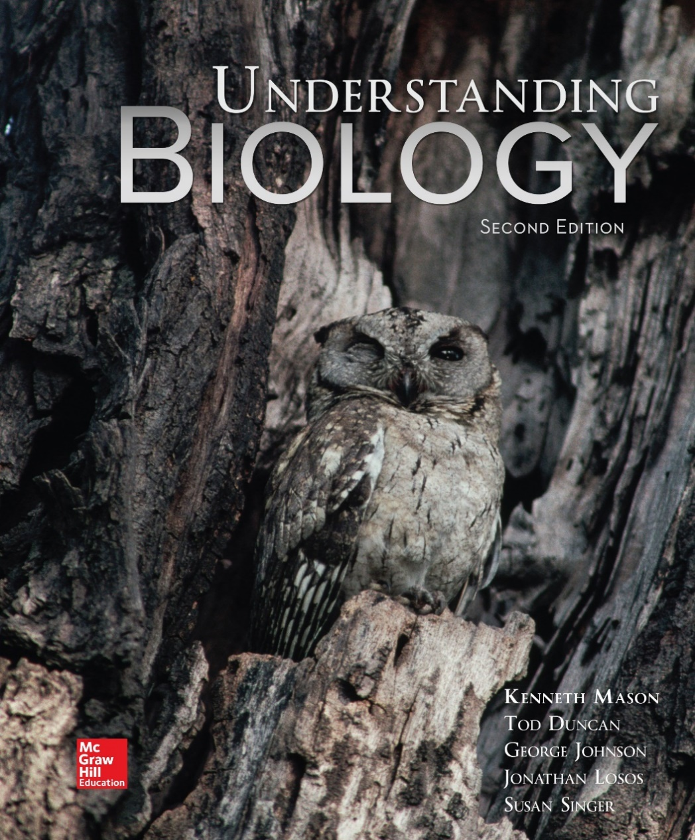
Chapter 04
Cell Structure
Copyright © McGraw-Hill Education. Permission required for reproduction or display.

Slide 2
Cells
Cells were discovered in 1665 by Robert Hooke
Early studies of cells were conducted by
Mathias Schleiden (1838)
Theodor Schwann (1839)
Schleiden and Schwann proposed the Cell Theory

Slide 3
Cell Theory
All organisms are composed of cells
Cells are the smallest living things
Cells arise only from pre-existing cells
All cells today represent a continuous line of descent from the first living cells
Not many cells are visible to the naked eye

Slide 4
Two types of microscopes
Microscopes
Light microscopes
Use magnifying lenses with visible light
Resolve structures that are 200 nm apart
Limit to resolution using light
Electron microscopes
Use beam of electrons
Resolve structures that are 0.2 nm apart

Slide 5
Two types of electron microscopes
Electron microscopes
Transmission electron microscopes transmit electrons through the material.
Scanning electron microscopes beam electrons onto the specimen surface.

Slide 6
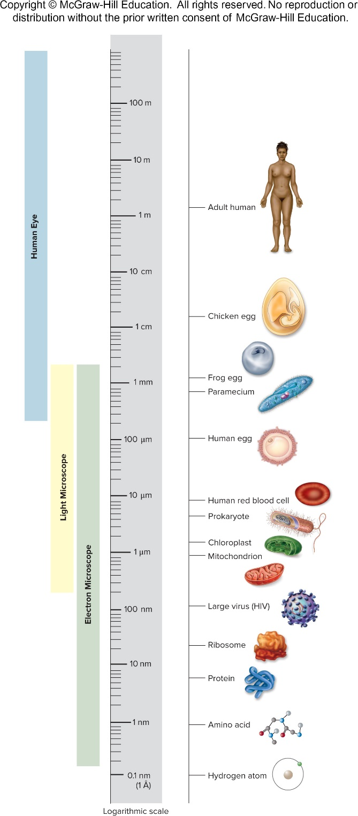
Figure 4.2
The size of cells
Except for vertebrate eggs, which can typically be seen with the unaided eye, most cells are microscopic in size. Prokaryotic cells are generally 1 to 10 μm across.

Slide 7
Basic structural similarities
All cells resemble one another in three fundamental ways
Centrally located genetic material
Cytoplasm
Semifluid matrix of organelles and cytosol
Plasma membrane
Phospholipid bilayer

Slide 8
Prokaryotic Cells
Simplest organisms
Lack a membrane-bound nucleus
DNA is present in the nucleoid
Cell wall outside of plasma membrane
Contain ribosomes
No membrane-bound organelles
Two domains of prokaryotes
Archaea
Bacteria

Slide 9
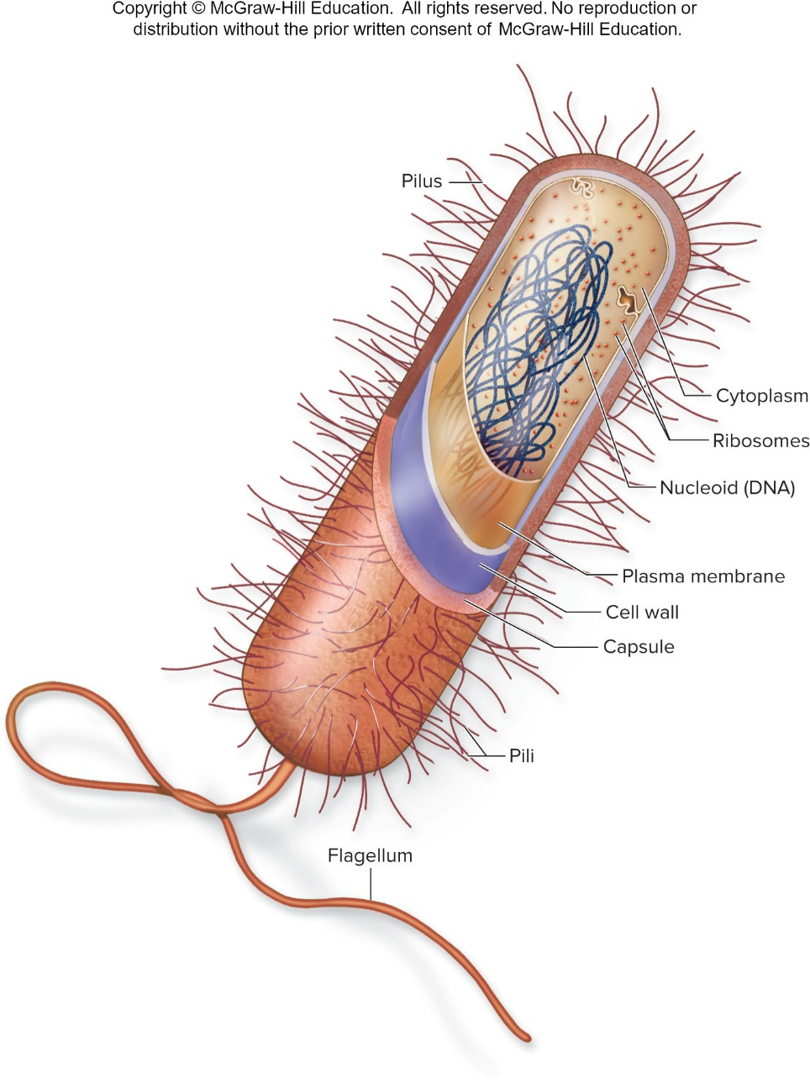
Figure 3.1

Slide 10
Bacterial cell walls
Most bacterial cells are encased by a strong cell wall
composed of peptidoglycan
Cell walls of plants, fungi, and most protists different
Protect the cell, maintain its shape, and prevent excessive uptake or loss of water
Susceptibility of bacteria to antibiotics often depends on the structure of their cell walls
Some secrete a jelly-like protective capsule

Slide 11
Archaea
Do not have peptidoglycan cell walls
Composed of polysaccharides and proteins
Membrane lipids are distinctly different from lipids in bacteria
DNA replication and protein synthesis similar to eukaryotes

Slide 12
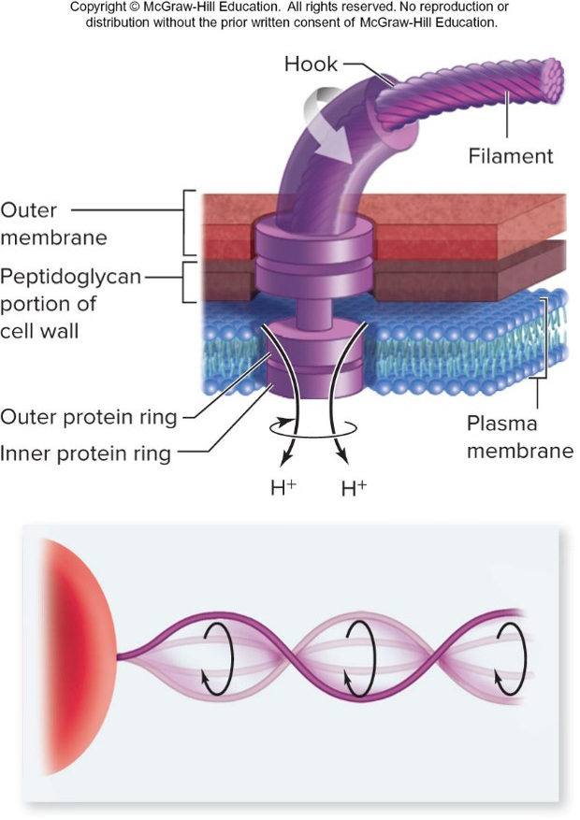
Figure 4.5
Flagella
Present in some prokaryotic cells
May be one or more or none
Used for locomotion
Rotary motion propels the cell
Rotary motor uses energy stored a proton gradient

Slide 13
Eukaryotic Cells
Possess a membrane-bound nucleus
More complex than prokaryotic cells
Hallmark is compartmentalization
Achieved through use of membrane-bound organelles and endomembrane system
Possess a cytoskeleton for support and to maintain cellular structure

Slide 14
Eukaryotic Cell Features
Plasma membrane
Cytoplasm
Organelles
Cytoskeleton
Nucleus

Slide 15
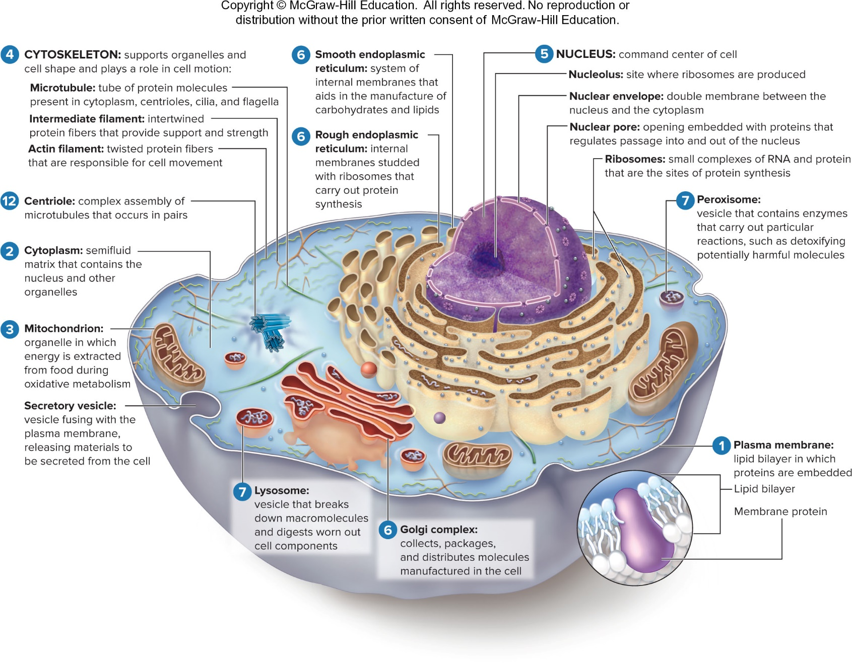
Figure 4.6

Slide 16
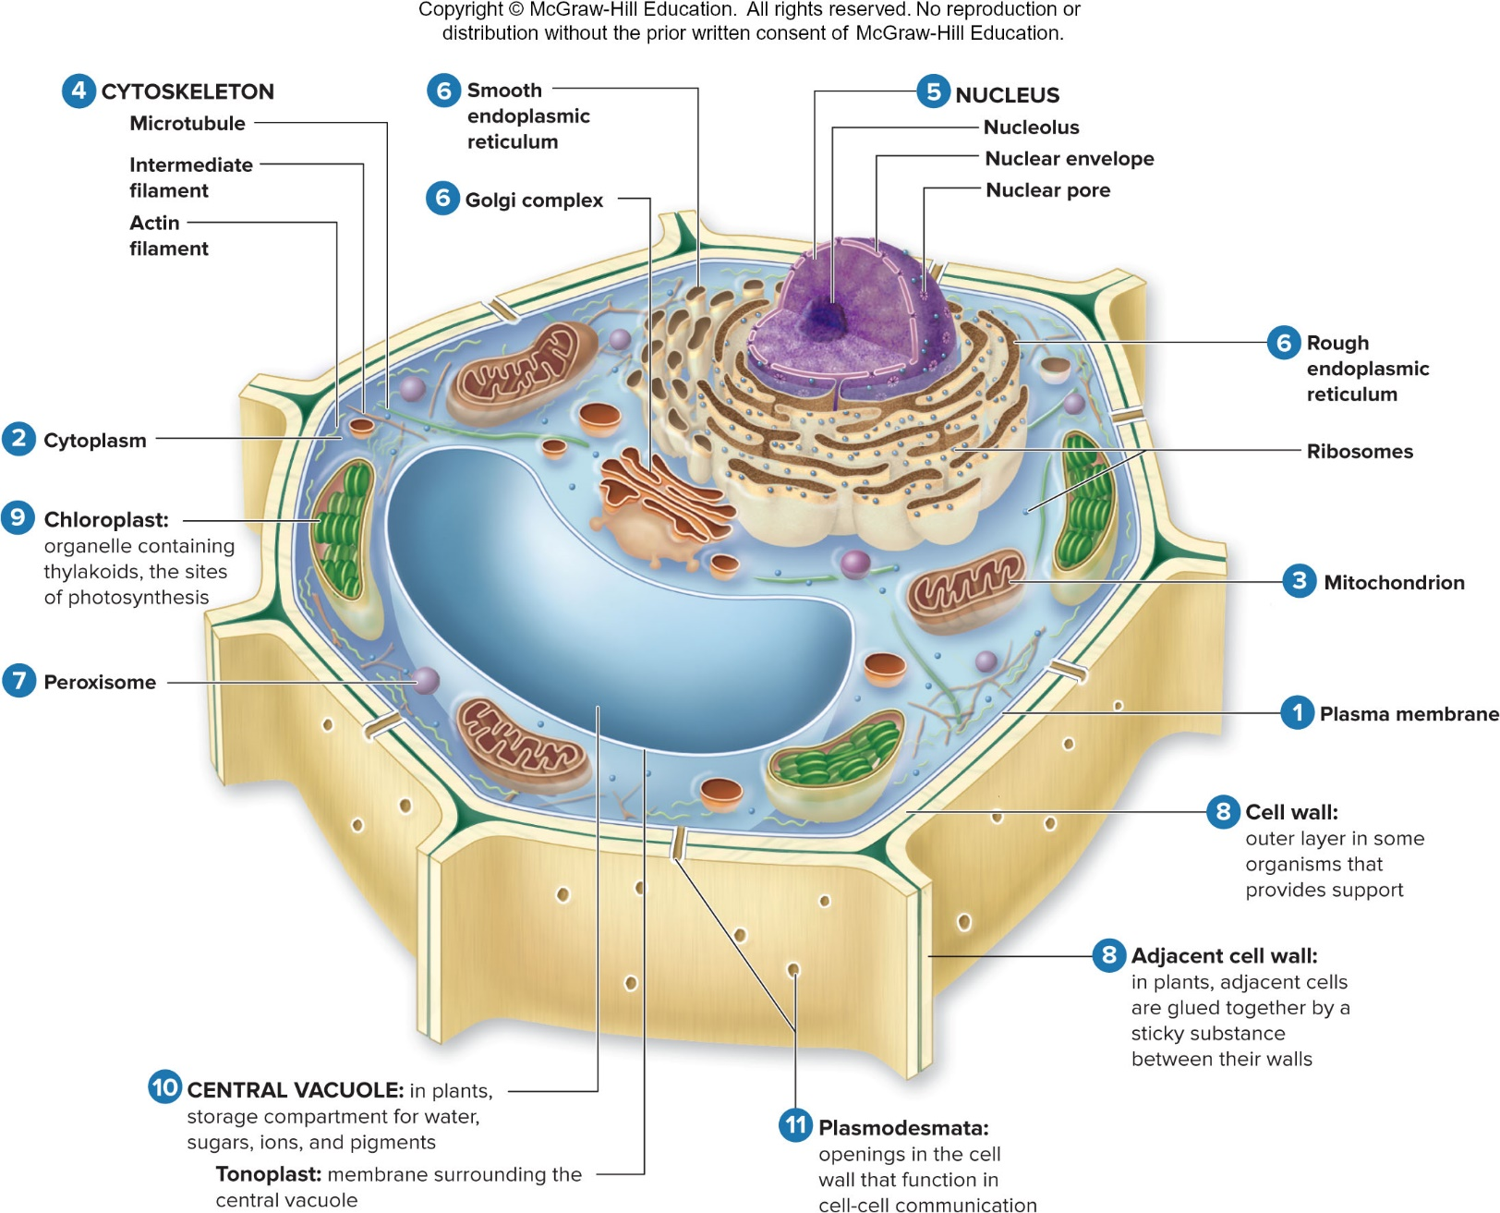
Figure 4.7

Slide 17
Nucleus
Repository of the genetic information
Most eukaryotic cells possess a single nucleus
Nucleolus – region where ribosomal RNA synthesis takes place
Nuclear envelope
2 phospholipid bilayers
Nuclear pores – control passage in and out
In eukaryotes, the DNA is divided into multiple linear chromosomes
Chromatin is chromosomes plus protein

Slide 18
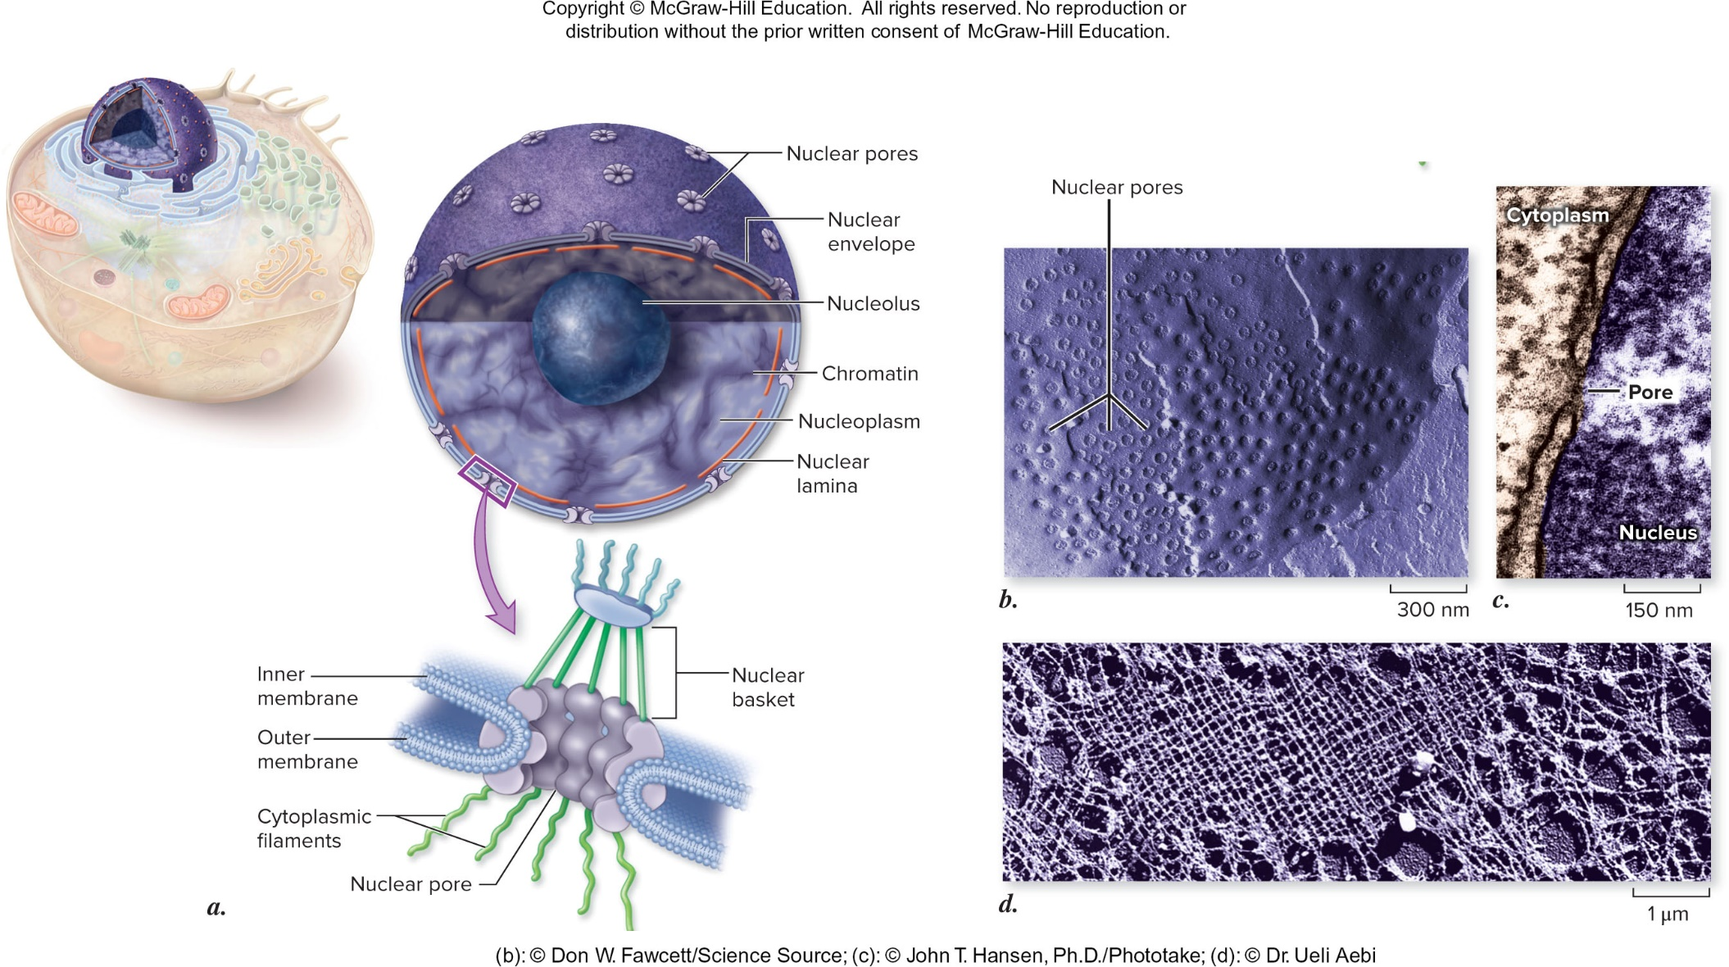
Figure 4.8
(b): © Don W. Fawcett/Science Source; (c): © John T. Hansen, Ph.D./Phototake; (d): © Dr. Ueli Aebi

Slide 19
Ribosomes
Cell’s protein synthesis machinery
Found in all cell types in all 3 domains
Ribosomal RNA (rRNA)-protein complex
Protein synthesis also requires messenger RNA (mRNA) and transfer RNA (tRNA)
Ribosomes may be free in cytoplasm or associated with internal membranes

Slide 20
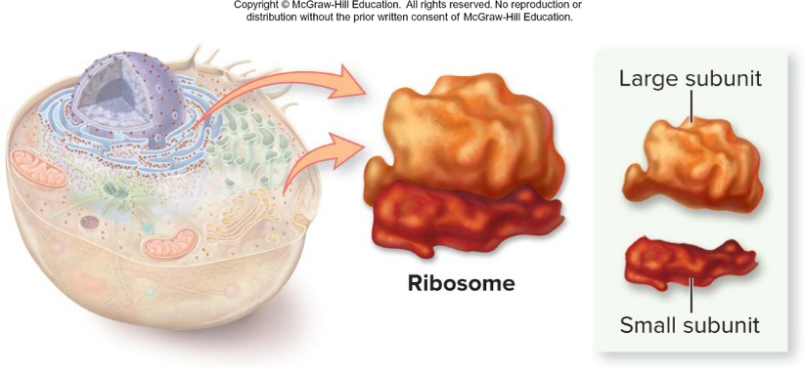
Figure 4.9

Slide 21
Endoplasmic reticulum
Rough endoplasmic reticulum (RER)
Attachment of ribosomes to the membrane gives a rough appearance
Synthesis of proteins to be secreted, sent to lysosomes or plasma membrane
Smooth endoplasmic reticulum (SER)
Relatively few bound ribosomes
Variety of functions – synthesis, store ${Ca}^{2+}$, detoxification
Ratio of RER to SER depends on cell’s function

Slide 22
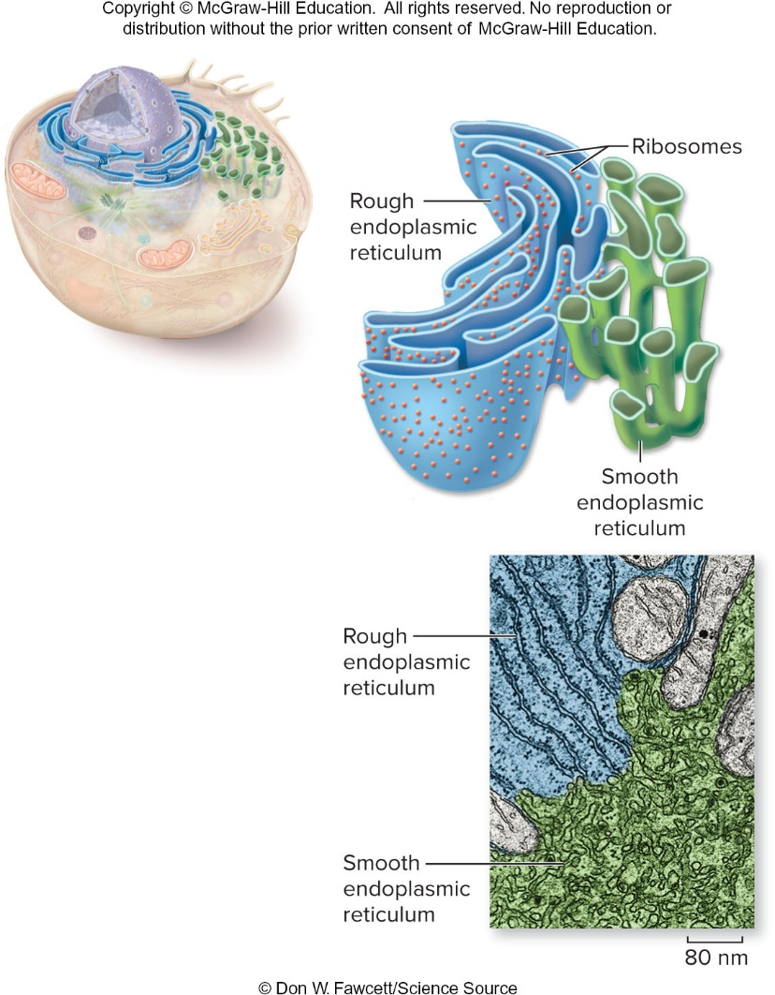
Figure 4.10
© Don W. Fawcett/Science Source

Slide 23
Golgi apparatus
Flattened stacks of interconnected membranes (Golgi bodies)
Functions in packaging and distribution of molecules synthesized at one location and used at another within the cell or even outside of it
Has cis and trans faces
Vesicles transport molecules to destination

Slide 24
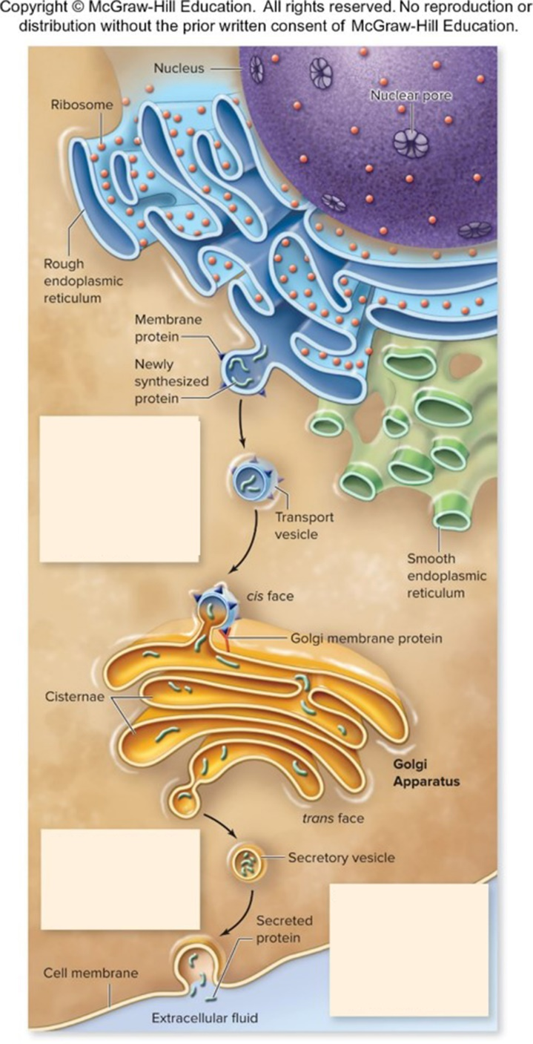
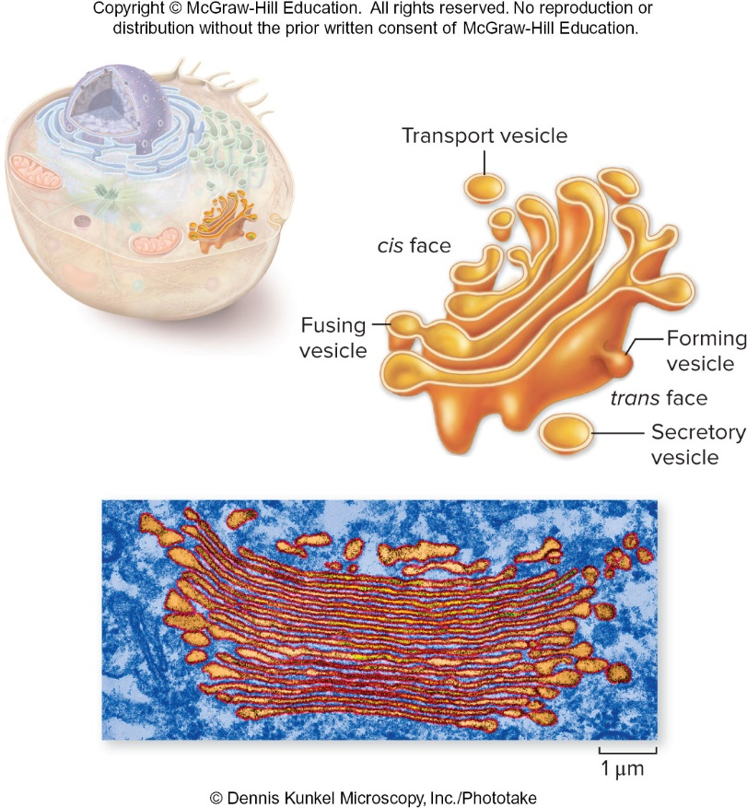
Figure 4.12
Figure 4.11
Vesicle containing proteins buds from the rough endo-plasmic reticulum, diffuses through the cell, and fuses to the cis face of the Golgi apparatus.
The proteins are modified and packaged into vesicles for transport.
The vesicle may travel to the plasma membrane, releasing its contents to the extracellular environment.

Slide 25
Lysosomes
Membrane-bounded digestive vesicles
Arise from Golgi apparatus
Enzymes catalyze breakdown of macromolecules
Destroy cells or foreign matter that the cell has engulfed by phagocytosis

Slide 26
Microbodies
Variety of enzyme-bearing, membrane-enclosed vesicles
Peroxisomes
Contain enzymes involved in the oxidation of fatty acids
Hydrogen peroxide produced as by-product – rendered harmless by catalase

Slide 27
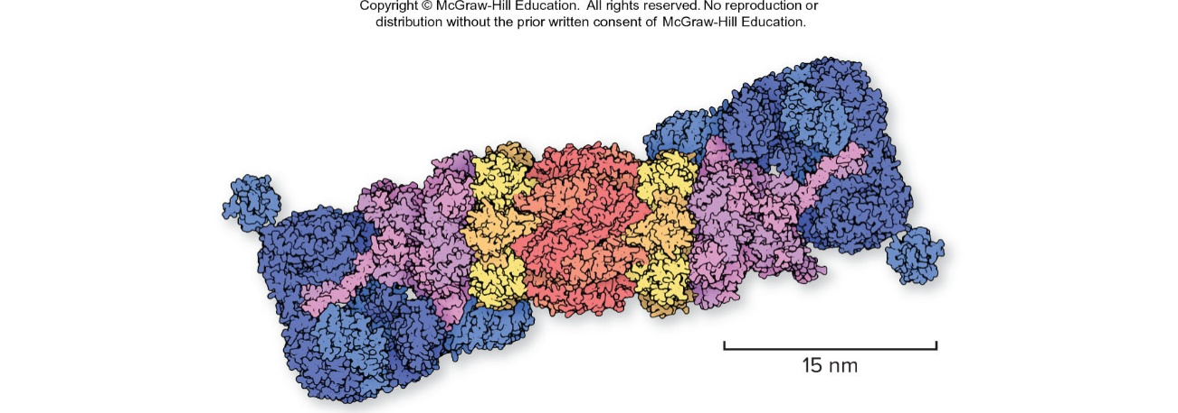
Proteosomes
Large cylindrical complexes
Proteolytic activity
Misfolded, damaged, or no longer needed proteins
Drosophila proteasome.
Image of PDB ID 4B4T (Unverdorben, P., et al., ”Deep classification of a large cryo-EM dataset defines the conformational landscape of the 26S proteasome,” PNAS (2014) 111:5444-5549). © 2015 David Goodsell & RCSB Protein Data Bank (www.rcsb.org). Molecule of the Month DOI 10.2210/rcsb_pdb/mom_2013_10

Slide 28
Vacuoles
Membrane-bounded structures in plants
Various functions depending on the cell type
There are different types of vacuoles:
Central vacuole in plant cells
Contractile vacuole of some fungi and protists
Storage vacuoles

Slide 29
Mitochondria
Found in all types of eukaryotic cells
Bound by membranes
Outer membrane
Intermembrane space
Inner membrane has cristae
Matrix
On the surface of the inner membrane, and also embedded within it, are proteins that carry out oxidative metabolism
Have their own DNA

Slide 30
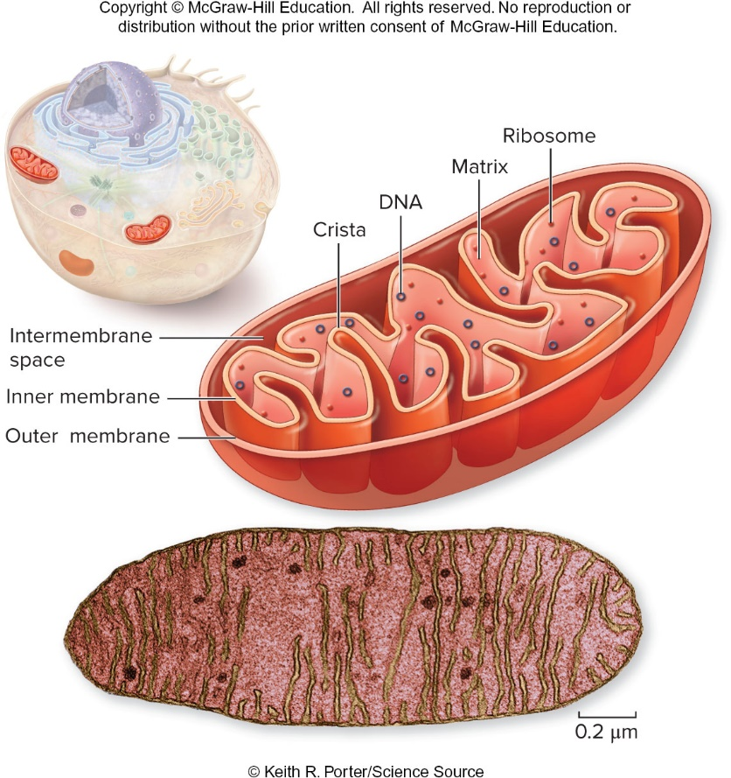
Figure 4.16
© Keith R. Porter/Science Source

Slide 31
Chloroplasts
Organelles present in cells of plants and some other eukaryotes
Contain chlorophyll for photosynthesis
Surrounded by 2 membranes
Thylakoids are membranous sacs within the inner membrane
Grana are stacks of thylakoids
Have their own DNA

Slide 32
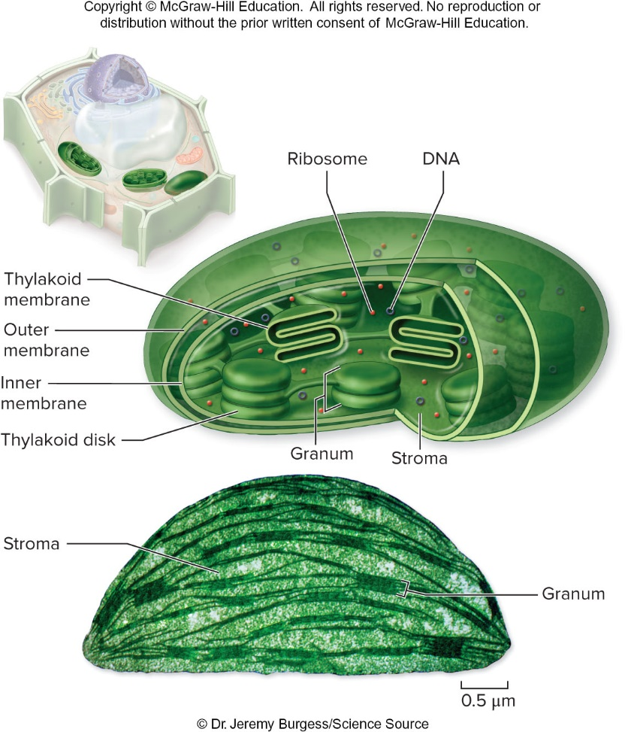
Figure 4.17
© Dr. Jeremy Burgess/Science Source

Slide 33
Endosymbiosis
Proposes that some of today’s eukaryotic organelles evolved by a symbiosis arising between two cells that were each free-living
One cell, a prokaryote, was engulfed by and became part of another cell, which was the precursor of modern eukaryotes
Mitochondria and chloroplasts

Slide 34
Cytoskeleton (1)
Network of protein fibers found in all eukaryotic cells
Supports the shape of the cell
Keeps organelles in fixed locations
Dynamic system – constantly forming and disassembling

Slide 35
Three types of fibers
Actin filaments (Microfilaments)
Two protein chains loosely twined together
Movements like contraction, crawling, “pinching”
Microtubules
Largest of the cytoskeletal elements
Dimers of α- and β-tubulin subunits
Facilitate movement of cell and materials within cell
Intermediate filaments
Between the size of actin filaments and microtubules
Very stable – usually not broken down

Slide 36
Centrosomes
Region surrounding centrioles in almost all animal cells
Microtubule-organizing center
Can nucleate the assembly of microtubules
Animal cells and most protists have centrioles – pair of organelles
Plants and fungi usually lack centrioles

Slide 37
Cell Movement
Essentially all cell motion is tied to the movement of actin filaments, microtubules, or both
Some cells crawl using actin microfilaments
Flagella and cilia have 9 + 2 arrangement of microtubules
Not like prokaryotic flagella
Cilia are shorter and more numerous

Slide 38
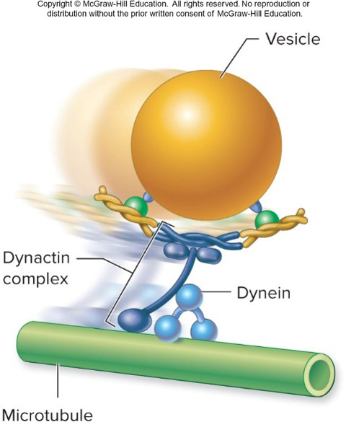
Molecular motors
Vesicles can be transported along microtubules using motor proteins that use ATP to generate force.
The vesicles are attached to motor proteins by connector molecules
The motor protein dynein moves the connected vesicle along microtubules.

Slide 39
Flagella and cilia
Many protists use flagella and cilia to swim
Pairs of microtubules move past each other using arms composed of the motor protein dynein
The motor protein dynein moves the connected vesicle along microtubules

Slide 40
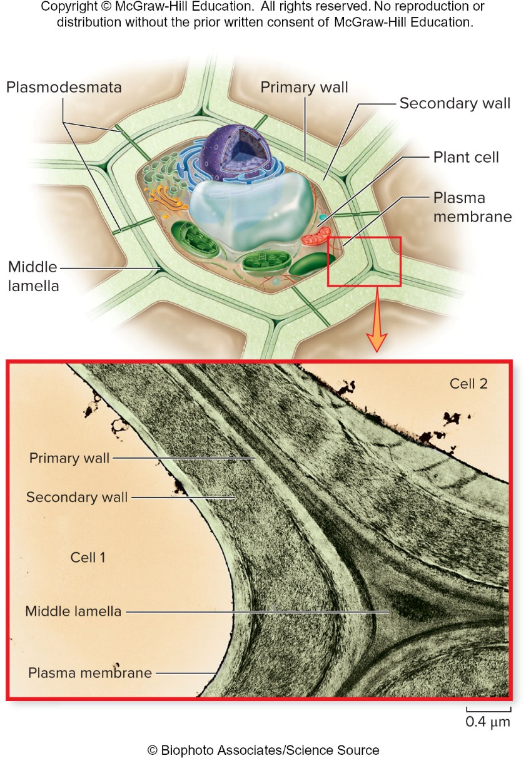
Figure 4.23
Eukaryotic cell walls
Plants, fungi, and many protists
Different from prokaryote
Plants and protists – cellulose
Fungi – chitin
Plants – primary and secondary cell walls
© Biophoto Associates/Science Source

Slide 41
Extracellular matrix (ECM)
Animal cells lack cell walls
Secrete an elaborate mixture of glycoproteins into the space around them
Collagen may be abundant
Form a protective layer over the cell surface
Integrins link ECM to cell’s cytoskeleton
Influence cell behavior

Slide 42
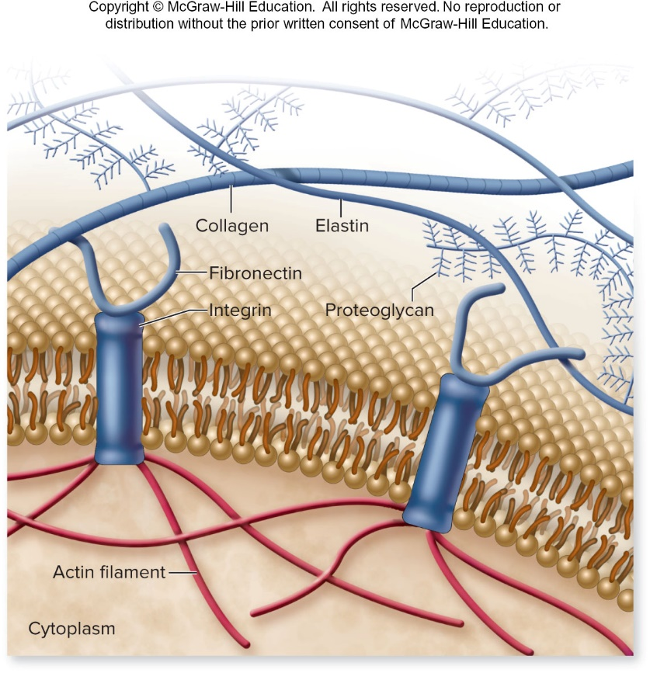
Figure 4.24

Slide 43
Cell-to-cell connections
Surface proteins give cells identity
Cells make contact, “read” each other, and react
Glycolipids – most tissue-specific cell surface markers
MHC proteins – recognition of “self” and “non-self” cells by the immune system

Slide 44
Table 4.2
TABLE 4.2 Cell-to-Cell Connections and Cell Identity
Type of Connection | Structure | Function | Example
Surface markers | Variable, integral proteins or glycolipids in plasma membrane | Identify the cell | MHC complexes, blood groups, antibodies
Septate junctions Tight junctions | Tightly bound, leakproof, fibrous claudin protein seal that surrounds cell | Hold cells together such that materials pass through but not between the cells | Junctions between epithelial cells in the gut
Adhesive junctions (desmosomes) | Variant cadherins, desmocollins, bind to intermediate filaments | Create strong, flexible connections between cells; found in vertebrates | Epithelium
Adhesive junctions (adherens junctions) | Classical cadherins, bind to microfilaments of cytoskeleton | Connect cells together; oldest form of cell junction, found in all multicellular organisms | Tissues with high mechanical stress, such as the skin
Adhesive junctions (hemidesmosomes, focal adhesions) | Integrin proteins bind cell to extracellular matrix | Provide attachment to substrate | Involved in cell movement and important during development
Communicating junctions (gap junctions) | Six transmembrane connexon/ pannexin proteins create a pore | Allow passage of small molecules from cell to cell in a tissue | Excitable tissues such as heart muscle
Communicating junctions (plasmodesmata) | Cytoplasmic connections between gaps in adjoining plant cell walls | Communicating junctions between plant cells | Plant tissues

Slide 45
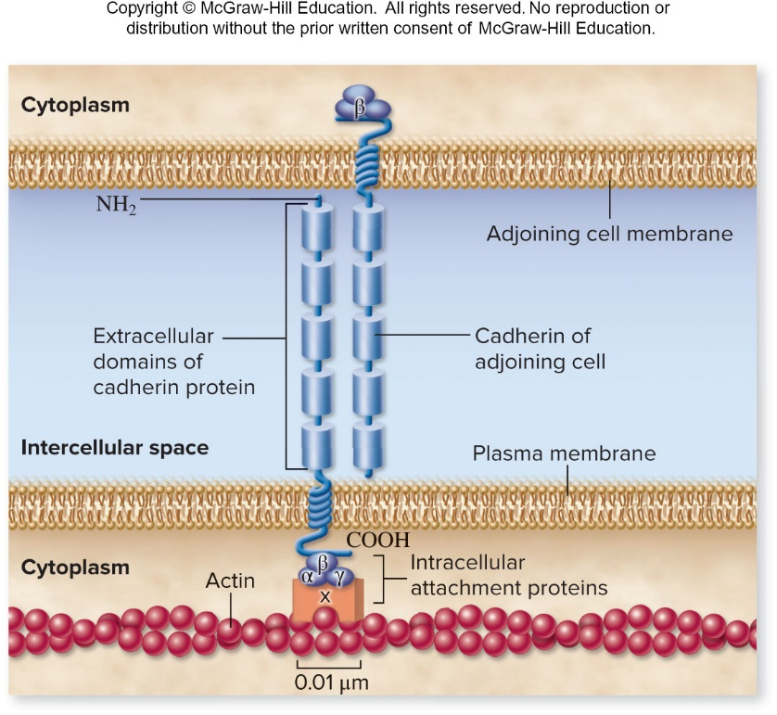
Cell connections (1)
3 Categories of cell connections
Adhesive junctions
Mechanically attaches cytoskeletons of neighboring cells
Adherens junctions
Desmosomes
Hemidesmosomes
Cadherin-mediated junction.

Slide 46
Cell connections (2)
Septate or tight junctions
Connect the plasma membranes of adjacent cells in a sheet – no leakage and form sheets of cells
Communicating junctions
Chemical or electrical signal passes directly from one cell to an adjacent one
Gap junction
Plasmodesmata

Slide 47
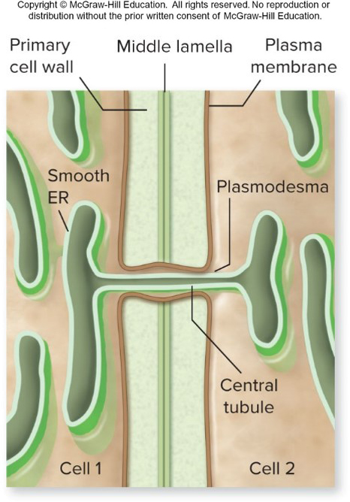
Plasmodesmata
Plant cells
Plasmodesmata
Specialized openings in their cell walls
Cytoplasm of adjoining cells are connected
Function similar to gap junctions in animal cells

