Slide 1

General Chemistry
CHEM 101
(3+1+0)
Dr. Mohamed El-Newehy
http://fac.ksu.edu.sa/melnewehy

Slide 2
Chapter 4
Reactions in Aqueous Solutions

Slide 3
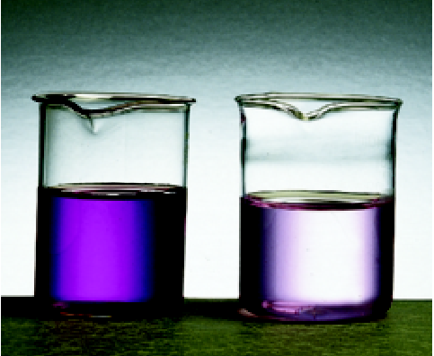
A solution is a homogenous mixture of 2 or more substances
The solute is(are) the substance(s) present in the smaller amount(s)
The solvent is the substance present in the larger amount
Solution
Solvent
Solute
Soft drink (l)
H₂O
Sugar, CO₂
Air (g)
N₂
O₂, Ar, CH₄
aqueous solutions of KMnO₄

Slide 4
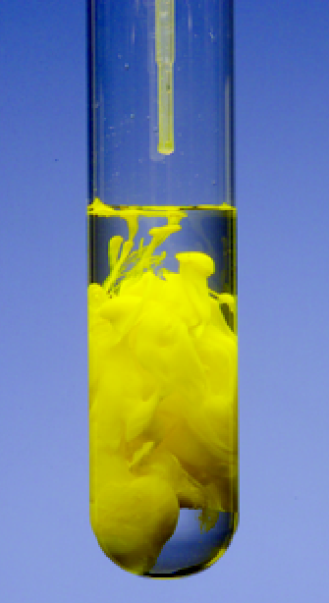
Precipitation Reactions
precipitate
Pb(NO₃)₂ (aq) + 2NaI (aq) PbI₂ (s) + 2NaNO₃ (aq)
molecular equation
Pb²⁺ + 2NO₃⁻ + 2Na⁺ + 2I⁻ PbI₂ (s) + 2Na⁺ + 2NO₃⁻
ionic equation
PbI₂
Pb²⁺ + 2I⁻ PbI₂ (s)
net ionic equation
Neutralization Reaction
acid + base salt + water
HCl (aq) + NaOH (aq) NaCl (aq) + H₂O

Slide 5
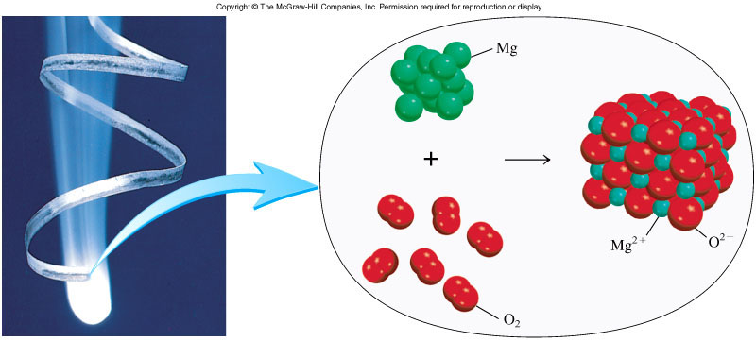
Oxidation-Reduction Reactions
(electron transfer reactions)
2Mg 2Mg²⁺ + 4e⁻
Oxidation half-reaction (lose e⁻)
O₂ + 4e⁻ 2O²⁻
Reduction half-reaction (gain e⁻)
2Mg + O₂ + 4e⁻ 2Mg²⁺ + 2O²⁻ + 4e⁻
2Mg + O₂ 2MgO

Slide 6
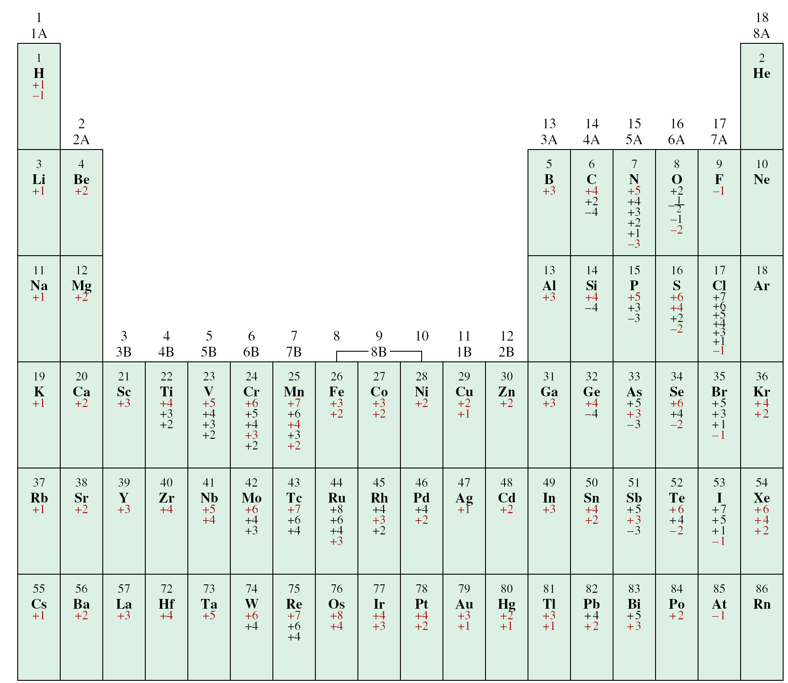
The Oxidation Numbers of Elements in their Compounds

Slide 7
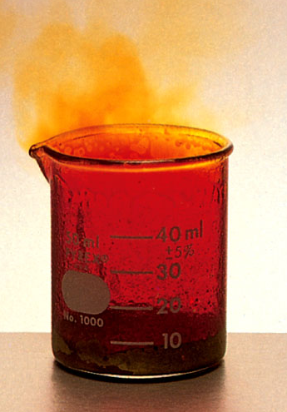
Types of Oxidation-Reduction Reactions
1. Combination Reactions
A combination reaction is a reaction in which two or more substances combine to form a single product.
A + B C
0
0
+3
-1
2Al + 3Br₂ 2AlBr₃

Slide 8
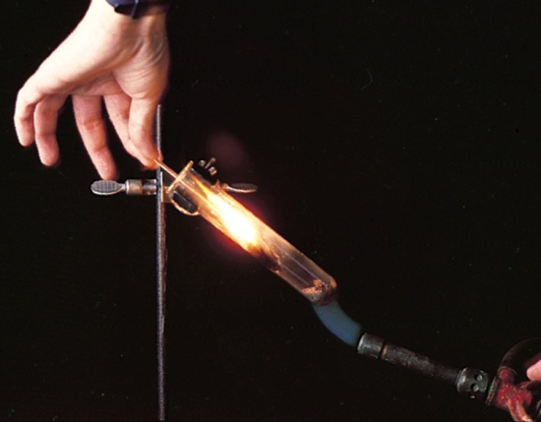
Types of Oxidation-Reduction Reactions
2. Decomposition Reactions
Decomposition reactions are the opposite of combination reactions.
A decomposition reaction is the breakdown of a compound into two or more components.
C A + B
+1
+5
-2
+1
-1
0
2KClO₃ 2KCl + 3O₂

Slide 9
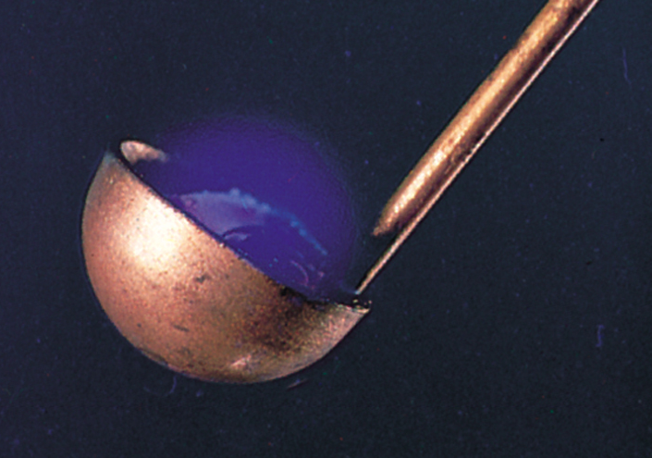
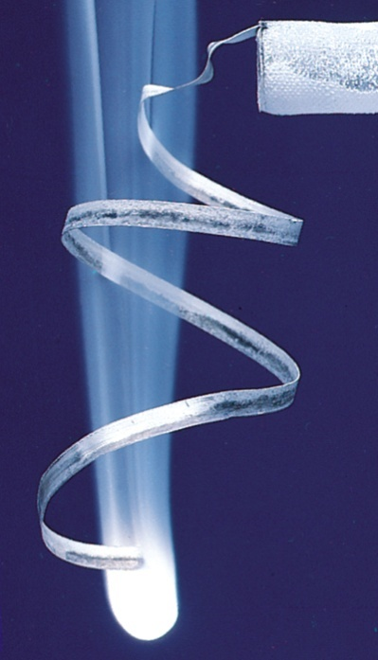
Types of Oxidation-Reduction Reactions
3. Combustion Reactions
A combustion reaction is a reaction in which a substance reacts with oxygen, usually with the release of heat and light to produce a flame
A + O₂ B
0
0
+4
-2
S + O₂ SO₂
0
0
+2
-2
2Mg + O₂ 2MgO

Slide 10
Concentration of solution
The concentration of a solution is the amount of solute present in a given quantity of solvent or solution.
Molarity (M), or molar concentration, which is the number of moles of solute per liter of solution.
moles of solute
M = molarity =
liters of solution
n
M =
v
where n denotes the number of moles of solute.
V is the volume of the solution in liters.

Slide 11
Concentration of solution
What mass of KI is required to make 500. mL of a 2.80 M KI solution?
M KI
M KI
volume of KI solution
moles KI
grams KI
1 L
2.80 mol KI
166 g KI
500. mL
x
x
x
= 232 g KI
1000 mL
1 L soln
1 mol KI

Slide 12
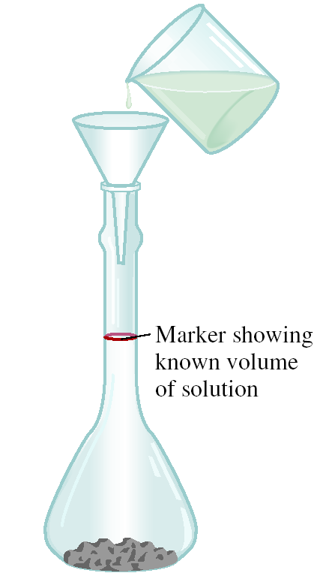
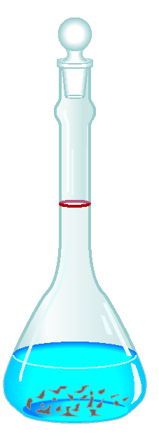
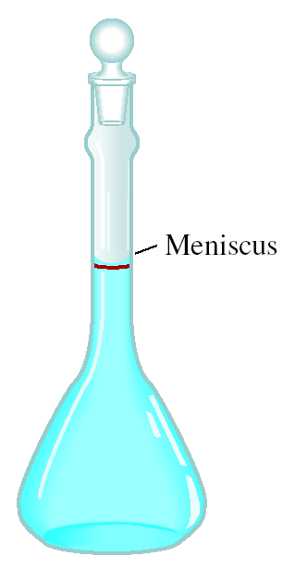
Concentration of solution
Preparing a Solution of Known Concentration
The solute is accurately weighed and transferred to a volumetric flask through a funnel.
Water is added to the flask, which is carefully swirled to dissolve the solid.
After all the solid has dissolved, more water is added slowly to bring the level of solution exactly to the volume mark.

Slide 13
Concentration of solution

Slide 14
Concentration of solution

