Slide 1
Unit 3 at home & abroad
Lesson 1
What’s wrong

Slide 2
B – 9 letters
break down ( v )

Slide 3
B – 9 letters
dirty

Slide 4
B – 9 letters
fall over

Slide 5
B – 9 letters
give ( someone ) a lift

Slide 6
B – 9 letters
steal ( stolen )

Slide 7
New words
break down ( v )
Dirty
fall over
give ( someone ) a lift
steal ( stolen )

Slide 8
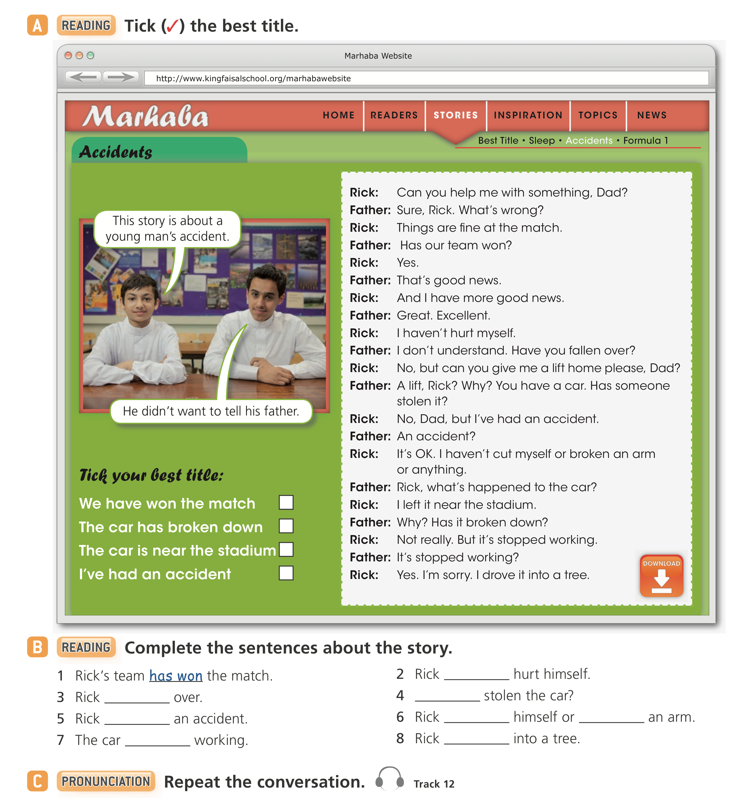
☑️

Slide 9
hasn’t
hasn’t fallen
Has someone
has had
broken
hasn’t bruised
has stopped
drove the car

Slide 11
has bruised
(He)’s hurt
Has (he) cut
has not finished
hasn’t closed
Has (school) started?

Slide 12
2
3
4
1

