Slide 1
Speaking Practice
Book 2 (Unit 5-8)

Slide 2
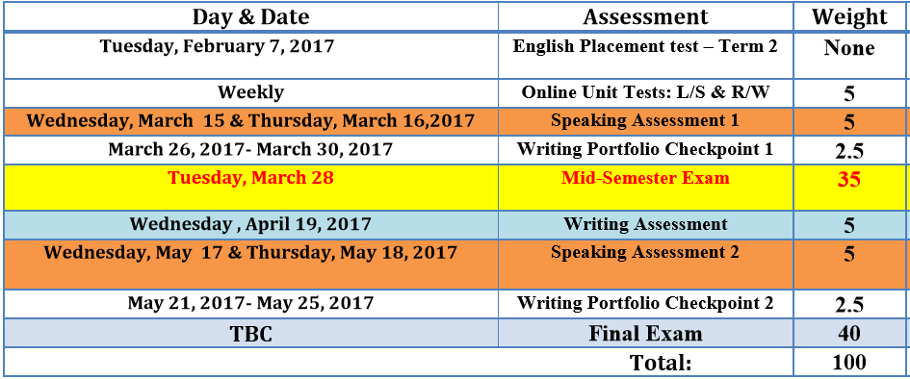

Slide 3
Unit 5

Slide 4
Task 1

Slide 5
What does it mean to be part of a family?
What is your definition of a family?
Which members of the family influence your life?
Which do you think has more influence on your personality: characteristics you inherit or people and events in your life? Why?
What are some coincidences of the people you know??

Slide 6
Task 2

Slide 7
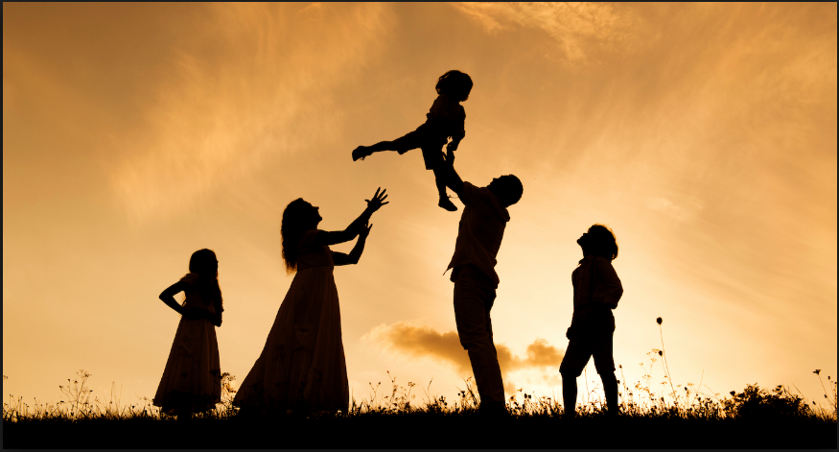

Slide 8
Task 3

Slide 9
You are having a group discussion and want to express your opinion? How will you do that?

Slide 10
Task 1

Slide 11
Is it important to learn about your family history? Why or why not?
Do you want to do a DNA analysis to learn more about your ancestors ? Why or why not?
Imagine that you can meet one of your ancestors from 100 years ago or more, What questions would you ask this person ? What would you like to know about his or her life?

Slide 12
Task 2

Slide 13
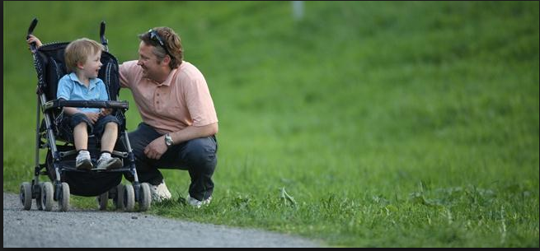

Slide 14
Task 3

Slide 15
You are having a group discussion and want to express your opinion? How will you do that?

Slide 16
Task 1

Slide 17
Which of these people is more part of your family: a cousin you never met or a friend? Why?
How do you define the word home?
“A gram of blood is worth more than a kilogram of friendship”. What does it mean?

Slide 18
Task 2

Slide 19
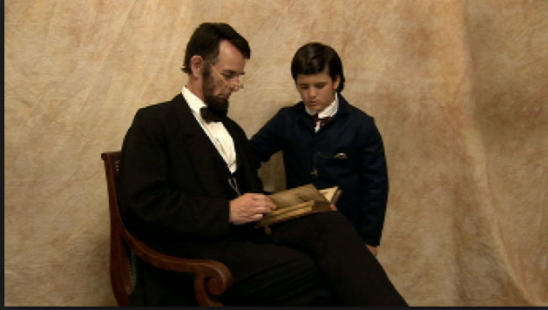

Slide 20
Task 3

Slide 21
You are having a group discussion and want to express your opinion? How will you do that?

Slide 22
Unit 6

Slide 23
Task 1

Slide 24
Why do things yourself?
What do you think of when you hear the expression “Do-It-Yourself” (DIY)?
Do people of different ages have different opinions of DIY projects?
What DIY skills do you have? Could you learn more?

Slide 25
Task 2

Slide 26
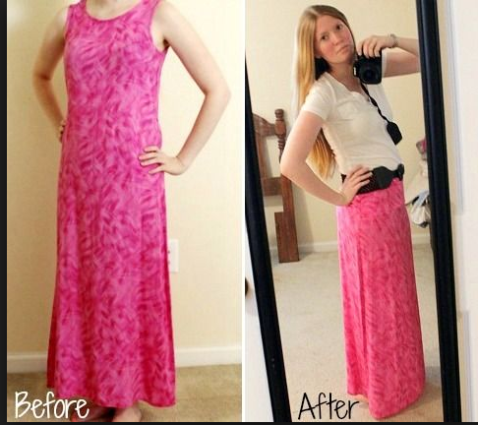

Slide 27
Task 3

Slide 28
You are listening to a lecture and don’t understand anything? How do you ask for clarification?

Slide 29
Task 1

Slide 30
Think of a time when someone you know tried to sell something, either online or in person. Describe the experience. What problems were there? Was it a success? Why or why not?
How does selling online affect regular stores and other businesses? Will bookstores go out of business? Will people still go to craft fairs and read ‘print” books?

Slide 31
Task 2

Slide 32
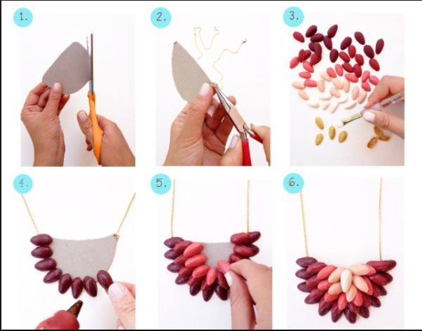

Slide 33
Task 3

Slide 34
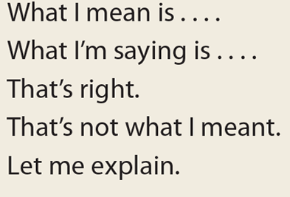
You are giving a presentation and someone asks you questions about what you said? How will you give clarification?

Slide 35
Task 1

Slide 36
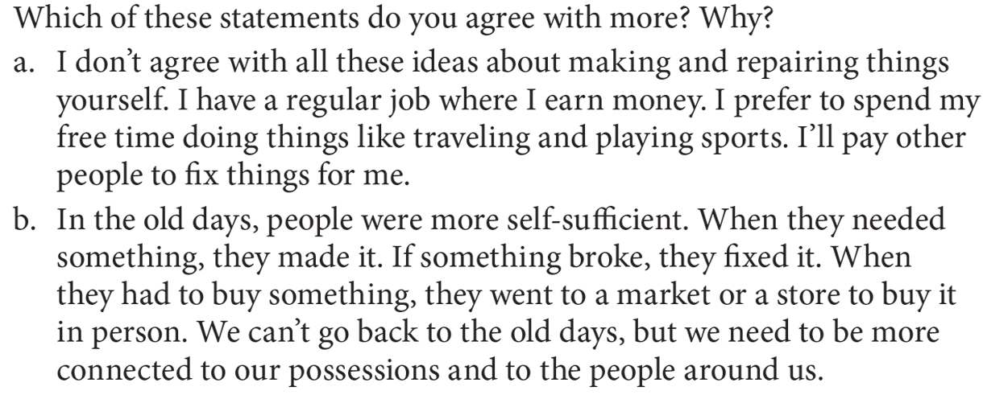
Do you ever buy things at auctions, either online or at a “real” auction? If yes, describe your experience. If no, would you like to? Why or why not?
What is something you would not buy online oe at an auction? Why not?

Slide 37
Task 2

Slide 38
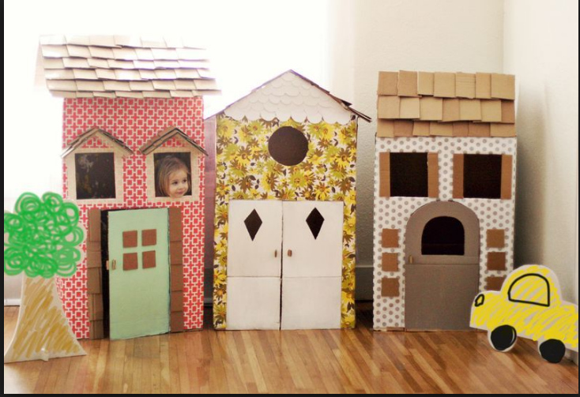

Slide 39
Task 3

Slide 40
You are listening to a lecture and don’t understand anything? How do you ask for clarification?

Slide 41
Task 1

Slide 42
What are some advantages and disadvantages of buying or selling things online?

Slide 43
Task 2

Slide 45
Task 3

Slide 46
You are giving a presentation and someone asks you questions about what you said? How will you give clarification?

Slide 49
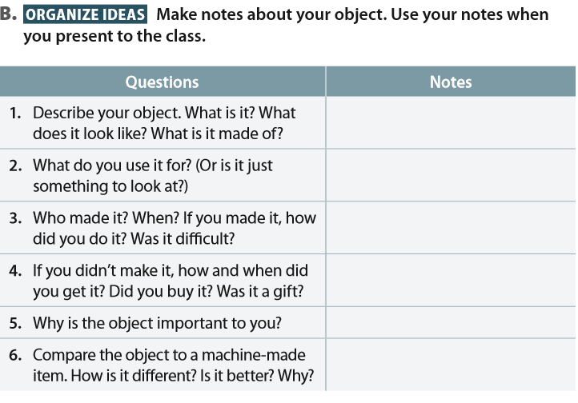

Slide 51
Unit 7

Slide 52
Task 1

Slide 53
What happens to our trash?
Do you think you throw too much trash ? Explain.
What does your city or town do with the trash it collects?
What happens to our trash?

Slide 54
Task 2

Slide 55
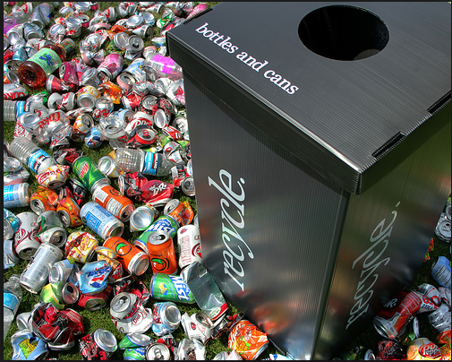

Slide 56
Task 3

Slide 57
You listened to a lecture and your friend wants you to tell him about the lecture. How would you tell him the main points?

Slide 58
Task 1

Slide 60
Task 2

Slide 61
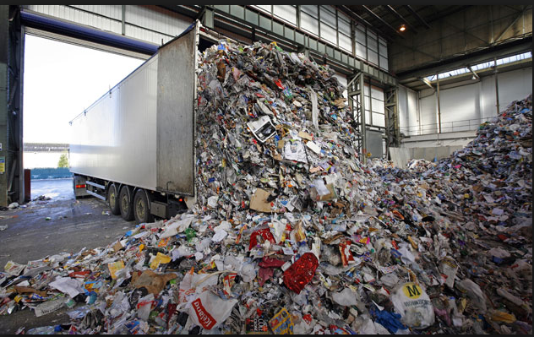

Slide 62
Task 3

Slide 63
You listened to a lecture and your friend wants you to tell him about the lecture. How would you tell him the main points?

Slide 64
Task 1

Slide 66
Task 2

Slide 68
Task 3

Slide 69
You listened to a lecture and your friend wants you to tell him about the lecture. How would you tell him the main points?

Slide 70
Unit 8

Slide 71
Task 1

Slide 72
Do you think you use a lot of water everyday ? Explain.
How important is cleanliness?
What did your parents tell you about cleanliness?
Why can disease spread in crowded cities?

Slide 73
Task 2

Slide 75
Task 3

Slide 76
You are having a group conversation and someone is trying to speak in your group. What should you do?

Slide 77
Task 1

Slide 78
What effect does the climate change have on the water supply?
How does the increase in population affect the water supply?

Slide 79
Task 2

Slide 80
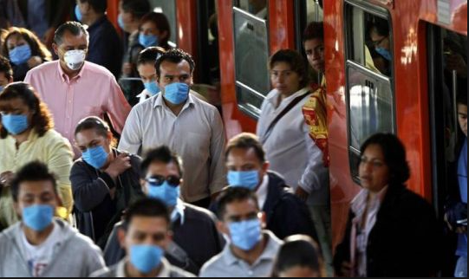

Slide 81
Task 3

Slide 82
What should you not do in a group conversation?

Slide 83
Task 1

Slide 85
Task 2

Slide 86
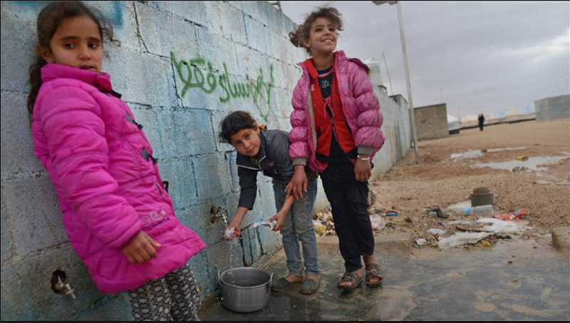

Slide 87
Task 3

Slide 88
How can you make other people hear you in a group conversation?

