Slide 1
Medical Chemistry
Solutions & Colloids
CHAPTER 5
LECTURE 10
*
‹#›

Slide 2
Solubility
Solubility: the maximum amount of a solute that dissolves in a given amount of solvent at a given temperature.
Solubility is a physical constant.
When one substance (solute) dissolves in another (solvent) it is said to be soluble (e.g., table salt or table sugar in water).
When one substance does not dissolve in another it is said to be insoluble (e.g., sand in H₂O).
If both the solvent and solute are liquids the terms miscible/immiscible are used.
‹#›

Slide 3
Factors Affecting Solubility 1. Nature of solute/solvent
The rule is “like dissolves like”.
Polar compounds dissolve in polar compounds (e.g., C₂H₅OH or C₁₂H₂₂O₁₁ in H₂O).
Nonpolar compounds dissolve in nonpolar compounds (e.g., C₆H₆ in CCl₄).
Most ionic compounds (e.g., NaCl) dissolve in water by dissociation into their ions.
Small covalent compounds that can hydrogen bond dissolve in water (e.g., NH₃ in H₂O).
‹#›

Slide 4
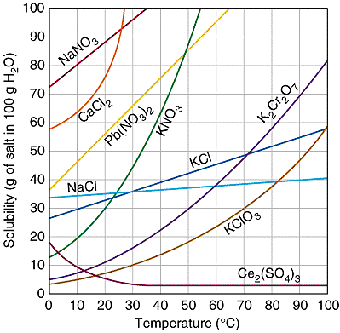
2. Temperature
Solids or liquids in liquids:
Solubility increases with increasing temperature.
MOST salts have greater solubility in hot water.
A FEW salts become less soluble with increasing temperature.
‹#›

Slide 5
2. Temperature
Example:
A solution containing 71.3 g of NH₄Cl in 100 g of water at 90 °C will be saturated.
If the temperature drops to 20 °C, the saturation level of NH₄Cl drops to 37.2 g.
Therefore, 24.1 g of NH₄Cl will precipitate.
Crystallization: to purify a solid, chemists often make a saturated soln of it at high temperature; when it cools, the precipitated solid will have much less impurity than before.
‹#›

Slide 6
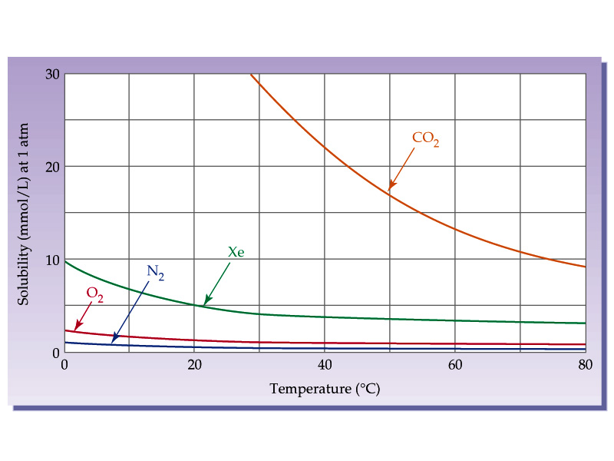
2. Temperature
b. Gases in liquids:
Solubility decreases with increasing temperature.
‹#›

Slide 7
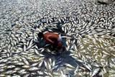
Thermal Pollution:
When the temperature of water increases, because of output from, e.g., a power plant, O₂ solubility decreases and may become so low that fish die.
‹#›

Slide 8
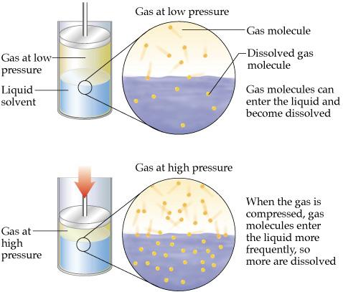
3. Pressure
Liquids and solids
Pressure has little effect on the solubility of liquids and solids.
Gases
Henry’s Law:
The solubility (S_{g}) of a gas in a liquid is directly proportional to the pressure (P_{g});
S_{g} = kP_{g},
k: constant.
‹#›

Slide 9
Colloids
Are homogeneous mixtures containing particles ranging from 1 to 1000 nm.
Characteristics of colloidal systems:
They scatter light and therefore appear turbid, cloudy, or milky.
They form stable dispersions; i.e., they do not form separate phases that settle out.
When the size of colloidal particles is > ̴ 1000 nm, the system is unstable and separates into phases which called suspension.
‹#›

Slide 10
Tyndall Effect & Brownian Motion
Tyndall Effect: light passing through and scattered by a colloid viewed at a right angle.
When a shine light through a colloid and look at the system from a 90º angle, the light pathway is seen without seeing the individual particles.
Brownian Motion:
is the random motion of any particle suspended in colloidal solutions.
(a) (b)
Colloid Solution
‹#›

Slide 11
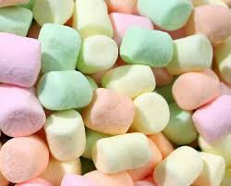
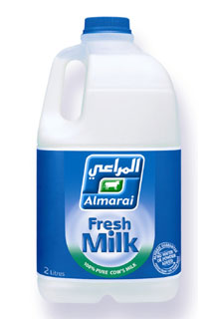
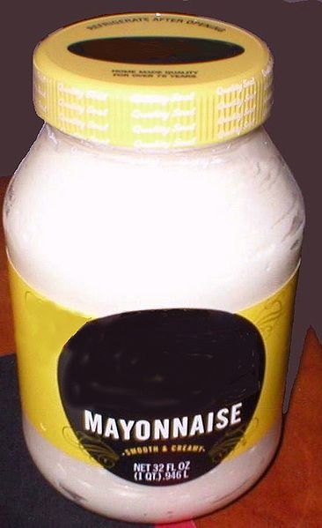
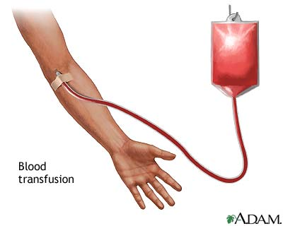
Types of Colloidal Systems
Type | Example
Gas in liquid | Whipped cream
Gas in solid | Marshmallows
Liquid in gas | Cloud, fog
Liquid in liquid | Milk, mayonnaise
Liquid in solid | Cheese, butter
Solid in gas | Smoke
Solid in liquid | Jelly
Solid in solid | Dried paint
‹#›

Slide 12
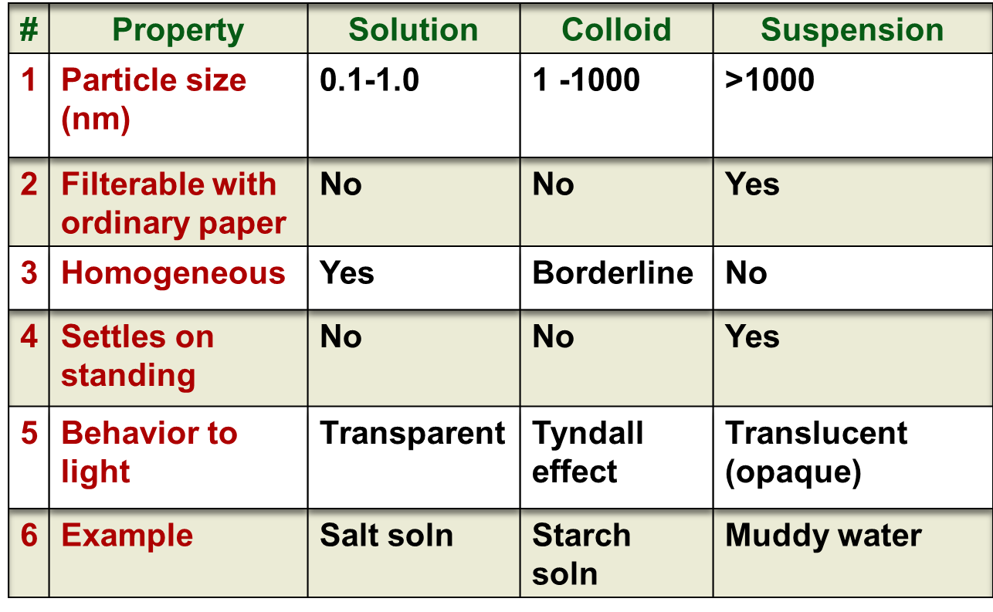
Comparison Between Solutions, Colloids, and Suspensions
‹#›

Slide 13
End of Lecture
‹#›

