Slide 1
Super Goal 5

Slide 2
UNIT 2

Slide 3
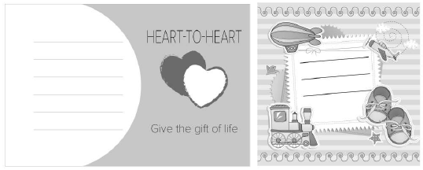
clinic
blood
donation
donor
parents
twins
newborns
infant

Slide 4
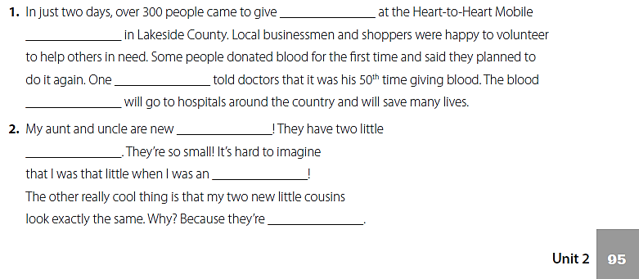
blood
clinic
donor
donation
parents
newborns
infant
twins

Slide 5
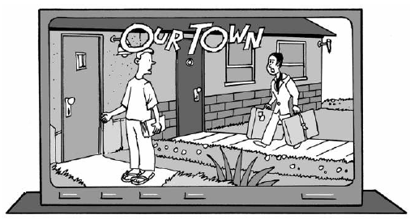
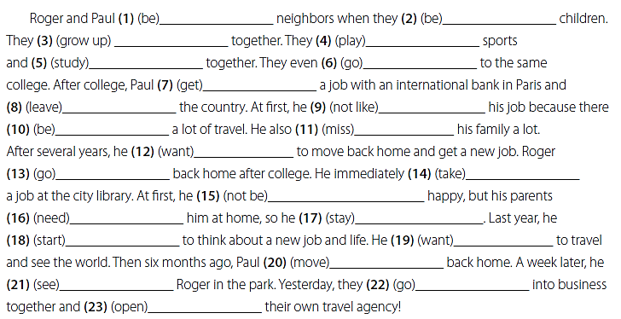
were
were
grew up
played
studied
went
got
left
didn’t like
was
missed
wanted
went
took
wasn’t
needed
stayed
started
wanted
moved
saw
went
opened

Slide 6
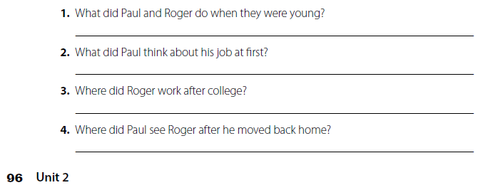
They played sports and studied together .
He didn’t like his job at first .
He worked at the city library .
He saw Roger in the park.

Slide 7
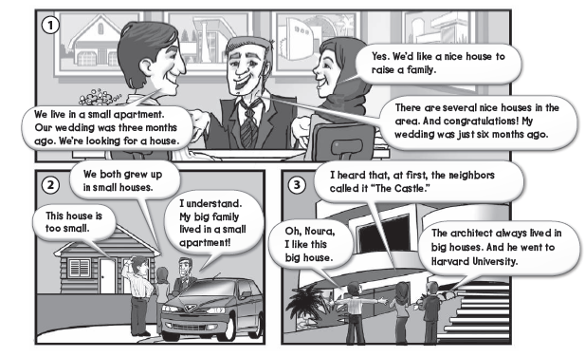

Slide 8
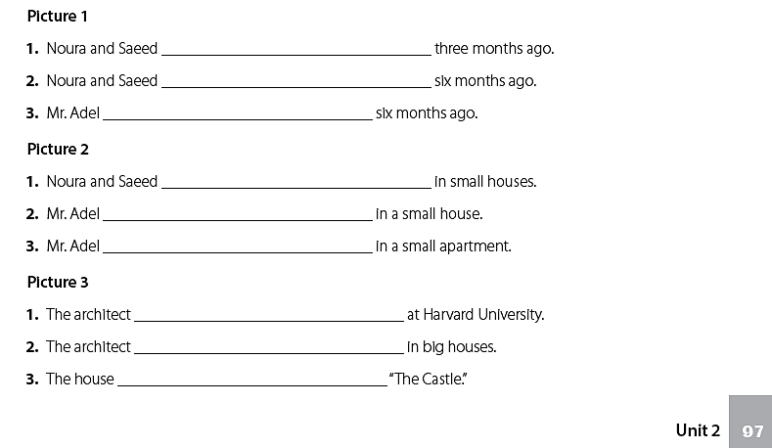
got married
weren’t married
was married
were raised
wasn’t raised
was raised
was educated
was raised
was called

Slide 9
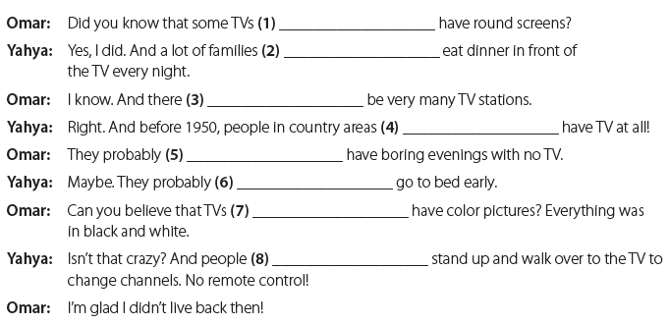
used to
used to
didn’t use to
didn’t use to
used to
used to
didn’t use to
used to

Slide 10
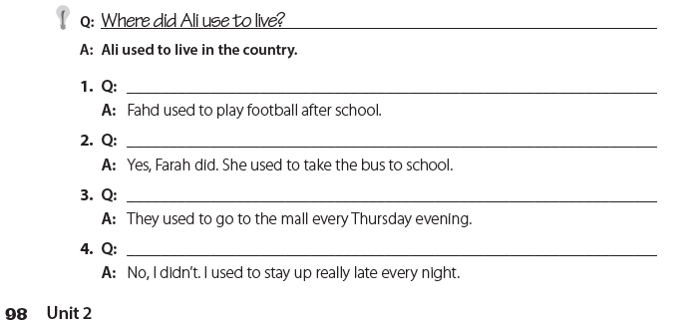
What did Fahad use to do ?
Did Farah use to take the bus to school ?
Where did they use to go every Thursday evening ?
Did you use to go to bed early every night ?

Slide 11
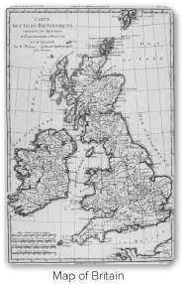
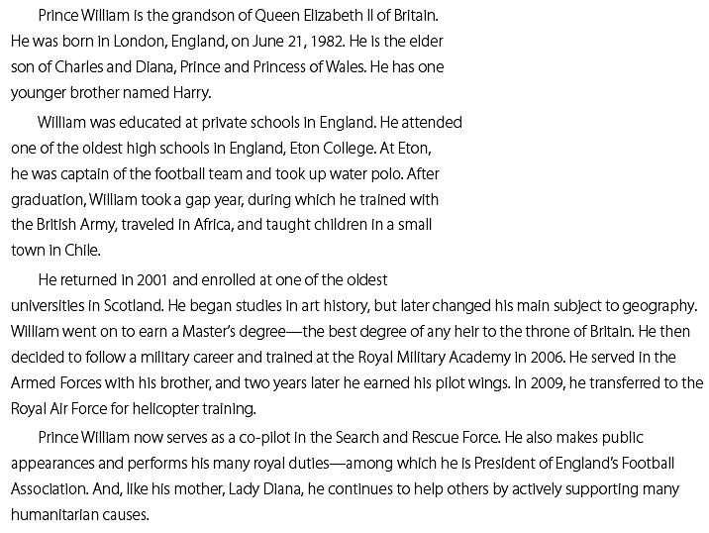

Slide 12
3
2
6
1
5
7
4

Slide 13
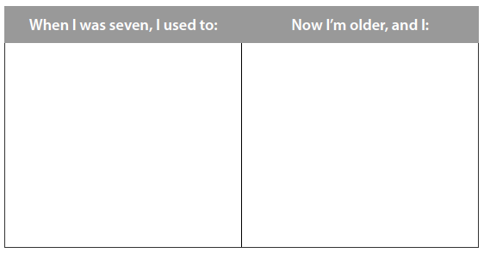
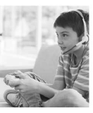
عندما كان عمري 7 سنوات كنت أقوم بفعل :
-
-
-
الان عندما كبرت أصبحت أقوم بفعل :
-
-
-
قم بكتابة نص عن حياتك سابقا وحياتك الان
قم بذكر ماكنت معتادا على فعله وما تفعله الان

Slide 14
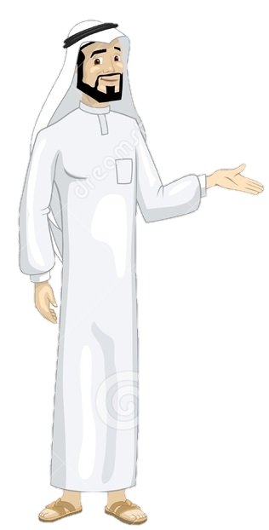
See you later
Take care
Teacher :
Badr Sayid Al-Shehri

