Slide 1
Unit 4
Planet Earth

Slide 2
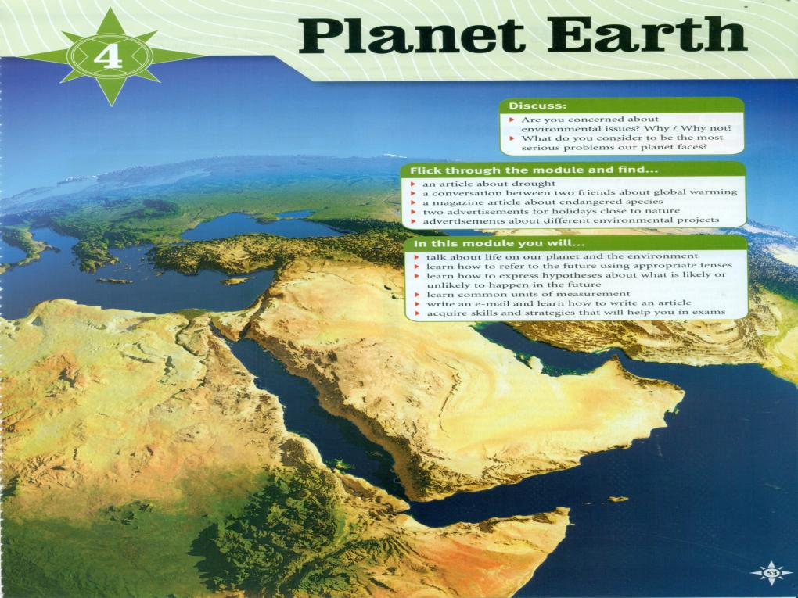

Slide 3
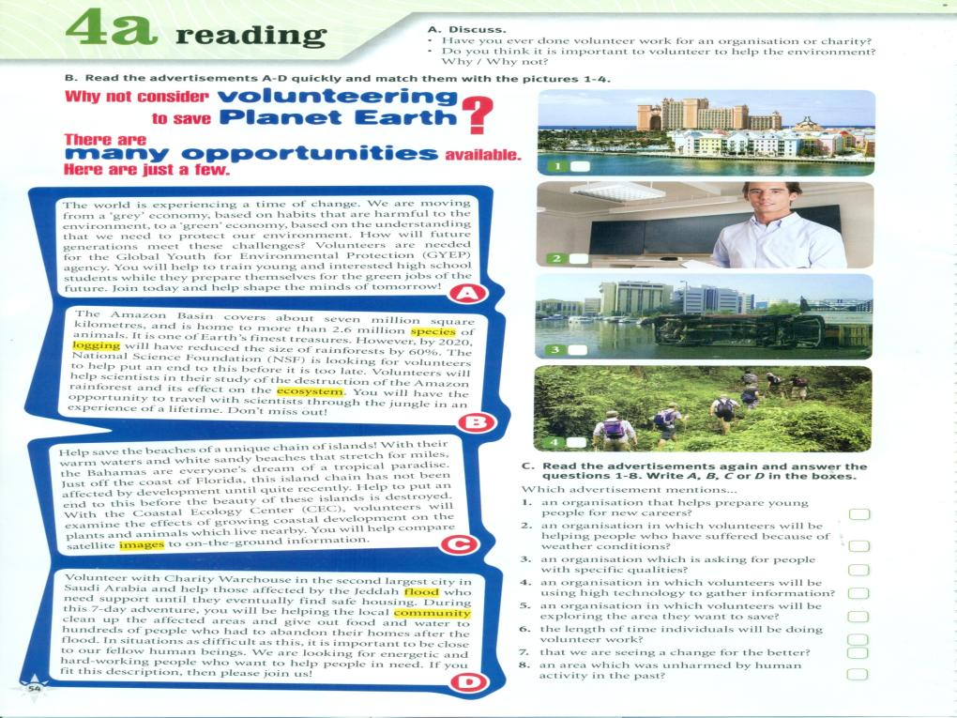

Slide 4
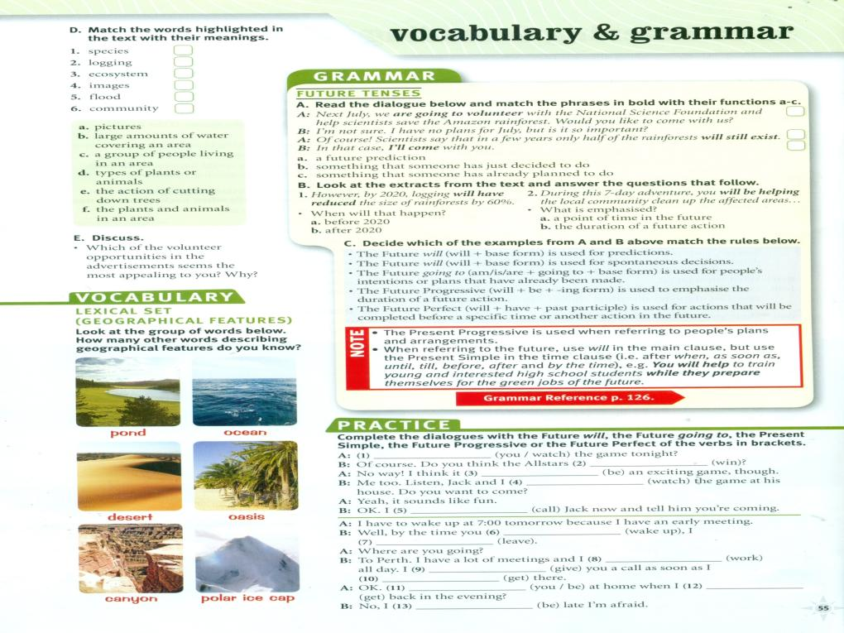
d
e
f
a
b
c
Are you going to watch
Will win
Will be
Are going to watch
‘ll call
Wake up
Will have left
Will be working
‘ll give
get
get
Will you be
Am going to be

Slide 5
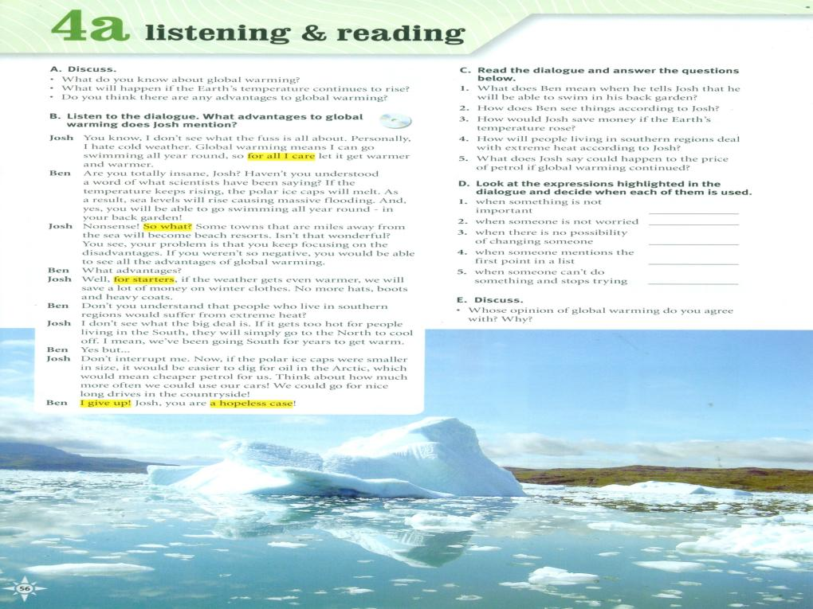
So what?
For all I care
A hopeless case
For starters
I give up

Slide 7
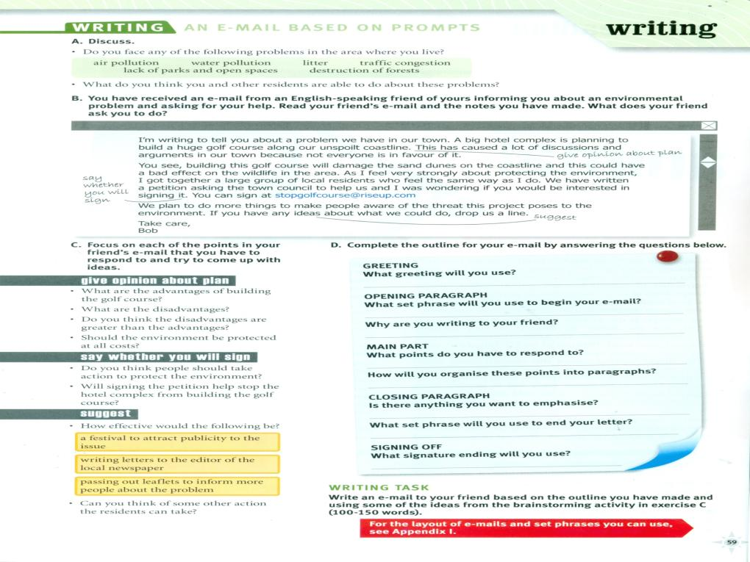

Slide 8
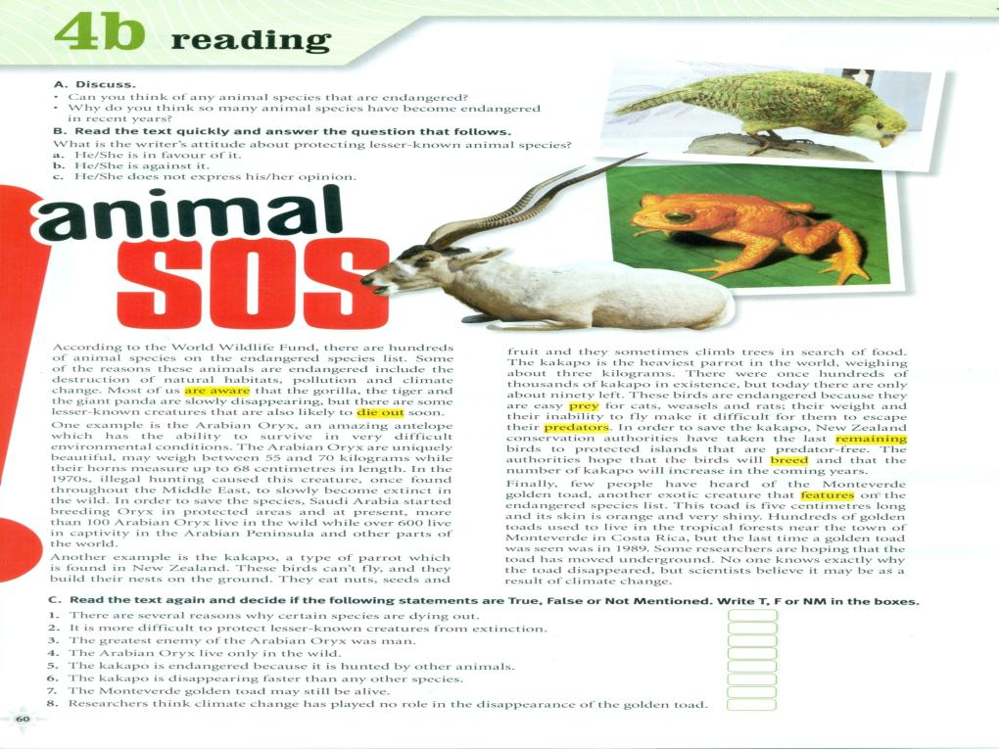

Slide 9
e
d
g
f
a
c
b

Slide 10
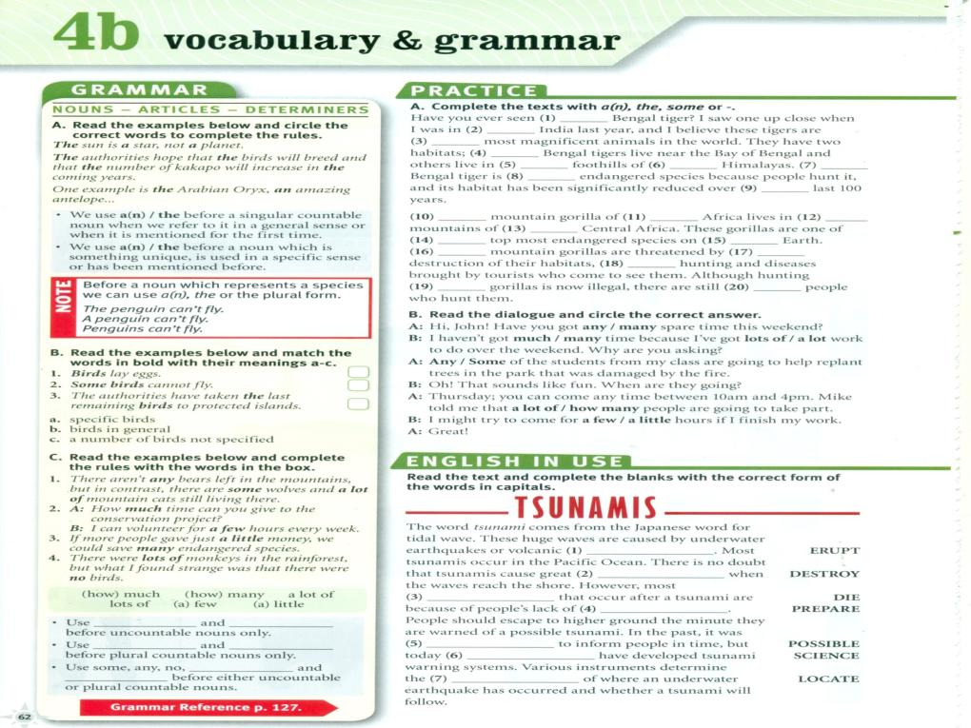
-
a
the
some
the
the
the
an
the
The
-
the
-
-
the
-
the
-
-
some
eruptions
destruction
deaths
preparation
possible
scientist
location

Slide 12
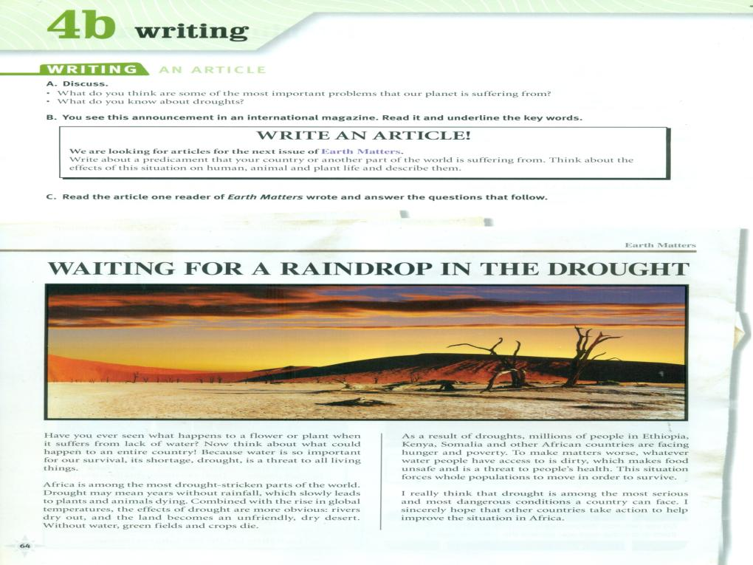

Slide 15
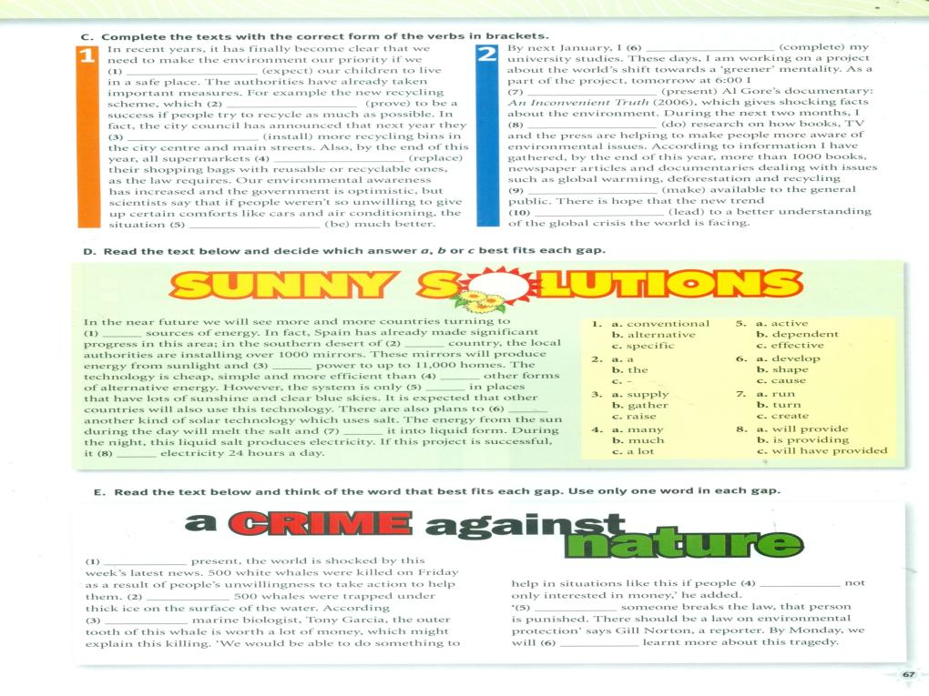
Will have completed
expect
Will prove
Will be presenting
Will install
Will be doing
Will have placed
Were made
Would be
Will lead

