Slide 1
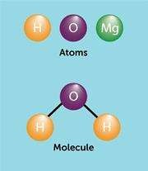
Chapter 2 Chemical basis of life

Slide 2
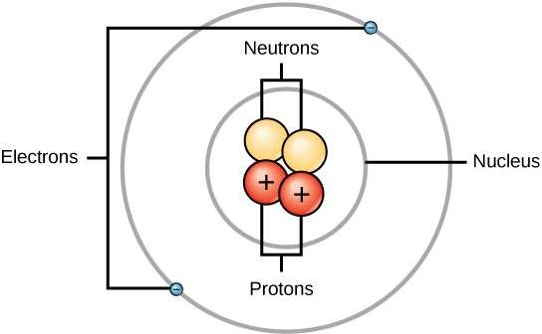
Atom
An atom is the smallest unit of any element.
An atom consists of: protons, neutrons and electrons.
At the center of an atom is the nucleus.
The nucleus contains both protons and neutrons.
Electrons orbit around the nucleus in pathways called orbitals (or shells).
Protons are positively charged (+), electrons are
negatively charged (-), and neutrons have no charge.

Slide 3
Although | the earth’s crust contains | 92 | naturally
occurring | chemical elements, only | 11 | of these
elements are common in living organisms and 20
are found as trace amounts.
Just 4 elements (carbon, nitrogen, oxygen and hydrogen) make up 96% of the total weight of the human body. Also, they make up practically all the chemical compounds in living organisms.
Most of the remaining (4%) consists of calcium, phosphorus, potassium and sulfur.
Trace elements are those required by an organism in small quantities.

Slide 4
Ions
An atom interacts with other atoms by the electrons.
An atoms that lose electron(s) will be positively charged and is called Cation (the + protons outnumber the – electrons) e.g. Na⁺.
An atom that gain electron(s) will be negatively charged and is called anion (the – electrons outnumber the + protons) e.g. Cl⁻.
An atom in which the number of electrons does not equal the number of protons (Anion or Cation) is generally called an Ion.

Slide 5
Molecules
Molecules consist of group of atoms linked together.
Water (H₂O) is the most common molecule in the body of living organisms.
Carbon is the most common element in the body of living organisms.
There are 2 types of biological molecules:
Organic molecules: contain carbon.
Inorganic molecules: do not contain carbon.

Slide 6
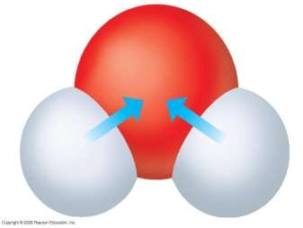
Water
The molecule that supports all forms of life
The body of living organisms consist of 70- 95% water.
All living organisms need water more than any other substance.
Living organisms are present on Earth due to the presence of water.
(–)
O
Water molecule
H
H
(+)
(+)

Slide 7
Properties of water
Polarity
Cohesion and adhesion
Water has high heat capacity
Liquid water is more dense than ice

Slide 8
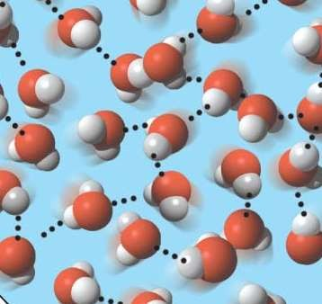
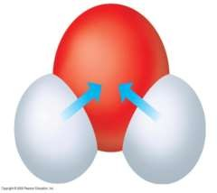
1- Polarity of water
Water molecule consists of hydrogen cations (H⁺) and hydroxide anions (OH⁻).
Water molecules are linked together by hydrogen bonds.
Thus water is a polar molecule which is able to dissolve other polar substances.
Water is considered as the main solvent in all biological systems.
(–)
Hydrogen bond
O
H
H
(+)
(+)

Slide 9
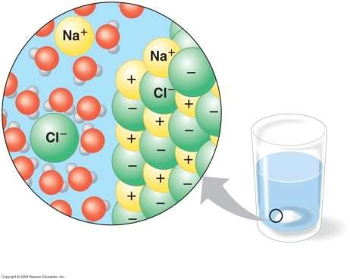
Hydrophilic substances are able to dissolve in water. Example: NaCl salt.
Hydrophobic substances are not able to dissolve in water. Example: Oil.
Dissolved salt
Salt crystal
A crystal of salt (NaCl) dissolving in water

Slide 10
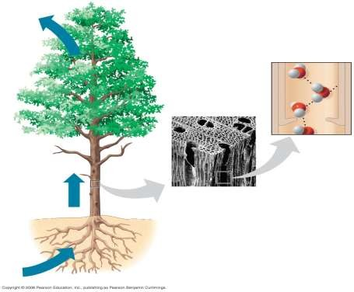
2- Cohesion and adhesion of water
Cohesion is the ability of water molecules to stick together due to the presence of hydrogen bonds.
Adhesion is the attraction between water and other polar substances (e.g. between water and plant cell wall).
Cohesion and adhesion are essential for transport of water
in plants against gravity.
Direction of water transport
Transport of water in plants

Slide 11
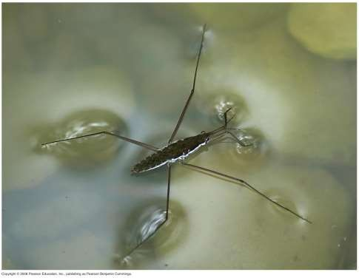
Cohesion
Cohesion causes water molecules at the surface to stick together and this is called surface tension.
Surface tension is related to cohesion.
Surface tension

Slide 12
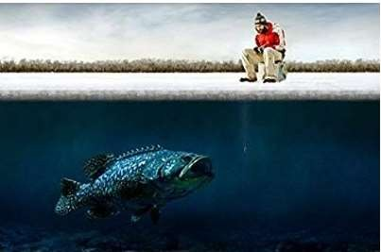
3- Water has high heat capacity
Hydrogen bonds allow water to absorb large amount of heat energy with only a slight change in its own temperature, thus water has high heat capacity.
Water has high heat of vaporization.
4- Liquid water is more dense than ice
Thus ice floats on water.
This provides aquatic organisms with a medium to live in it during winter.

Slide 13
Carbon: The basic element of life
There are 2 types of biological molecules:
Organic molecules: contain carbon.
Inorganic molecules: do not contain carbon.
Most molecules in the body of living organisms contain carbon, thus they are organic molecules.
Organic molecules are large and complex.
Some organic molecules are made of monomers (small units) that can combine to form polymers (large units).
There are 4 types of organic molecules:
Carbohydrates
Lipids
Proteins
Nucleic acids (DNA – RNA)

Slide 14
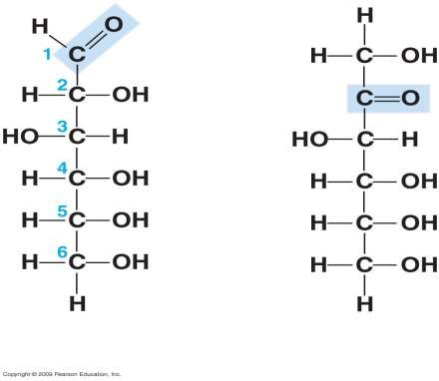
1. Carbohydrates
Carbohydrates are organic molecules.
Carbohydrates consist of carbon, hydrogen and oxygen.
Carbohydrates are the main source of energy for all living organisms.
Glucose
Fructose

Slide 15
There are 3 types of carbohydrates:
Monosaccharides: e.g. Glucose – Fructose.
Disaccharides: e.g. Sucrose – Maltose – Lactose.
Polysaccharides: e.g. Starch – Glycogen.
Monosaccharides are the simplest type of carbohydrates.
Monosaccharides are the carbohydrate monomers.
When two monosaccharides link together by glycosidic bond they form a disaccharide.
When more than two monosaccharides link together by glycosidic bonds they form a polysaccharide.
Polysaccharides are the most complex carbohydrates.
Polysaccharides are the carbohydrate polymers.
type of

Slide 16
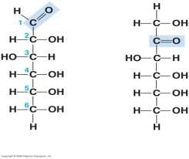
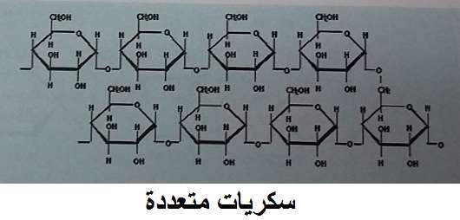
تارديهوبركلا -1 Carbohydrates
Monomer = Monosaccharide Polymer = Polysaccharide
Glucose
Fructose

Slide 17
2. Lipids
Lipids are organic molecules that consist of carbon, hydrogen and oxygen.
Lipids do not dissolve in water (hydrophobic or water-insoluble) but dissolve in alcohols.
Lipids are important in energy storage and contain twice the amount of energy present in carbohydrates.
Examples of lipids: Fat – oil – wax.

Slide 18
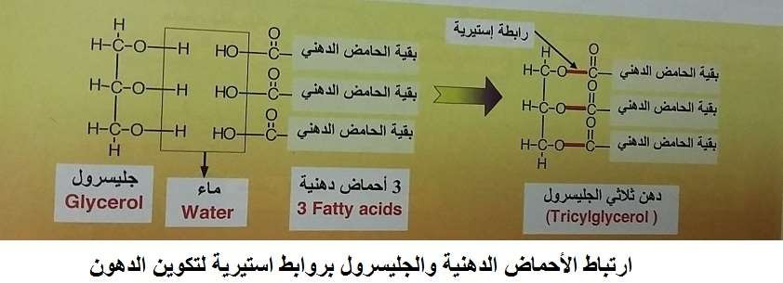
Lipids (polymer) consist of glycerol and fatty acids (monomers) attached together by ester bonds.
Monomer = glycerol and fatty acids Polymer = Lipid

Slide 19
3. Proteins
Proteins are organic molecules.
Proteins consist of carbon, hydrogen, oxygen and nitrogen.
Proteins are the main biological molecules that support structure and functions in the body of living organisms.
Proteins are the second most common biological molecules after water.
Proteins are the most complicated organic molecules in living organisms.

Slide 20
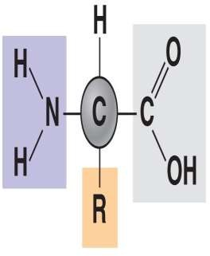
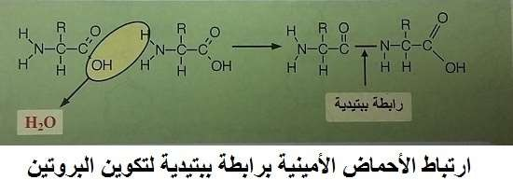
An amino acid consists of amino group and carboxyl group attached to the same carbon atom.
Structure of an amino acid
Amino
Group
Carboxyl group
When amino acids (monomers) link together by peptide bonds they form a protein (polymer).

Slide 21
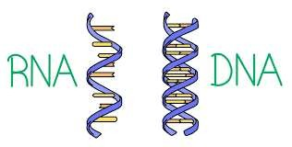
4. Nucleic acids
Nucleic acids are organic molecules that store and transmit genetic (hereditary) information.
Examples: DNA – RNA
DNA is a double strand.
RNA is a single strand.
A nucleic acid (polymer) consist of nucleotides (monomers).

Slide 22
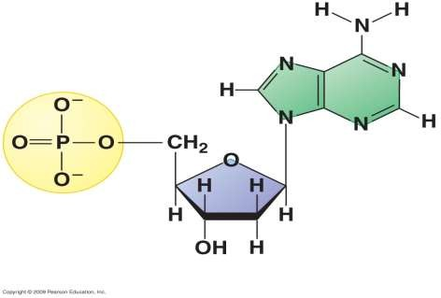
Nucleotides consist of 3 parts:
A five-carbon sugar called ribose (in RNA) or deoxyribose (in DNA)
Phosphate group
Nitrogenous base
Nucleotide structure
Nitrogenous
Base
ةينيجورتين ةدعاق
Phosphate Group تافسوف ةعومجم
Sugar
ركس

Slide 23
Nitrogenous bases of nucleic acids
DNA nitrogenous bases are | RNA nitrogenous bases are
adenine (A) | adenine (A)
cytosine (C) | cytosine (C)
guanine (G) | guanine (G)
thymine (T) | uracil (U)

