Slide 1
Unit 8
Culture
Next
Main Page
Previous

Slide 2
8 Culture
Reading
Vocabulary & Grammar
Listening
Vocabulary & Grammar
Speaking
Examination practice
Writing
Next
Main Page
Previous

Slide 3
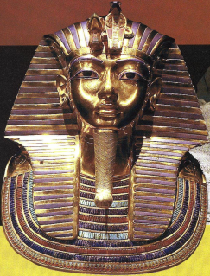
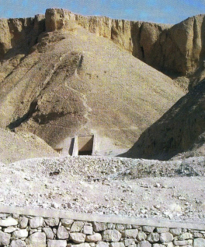
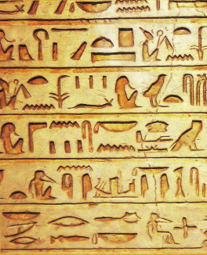
8 Culture
Reading
Next
Main Page
Previous

Slide 4
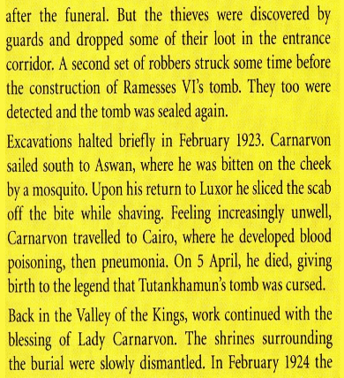
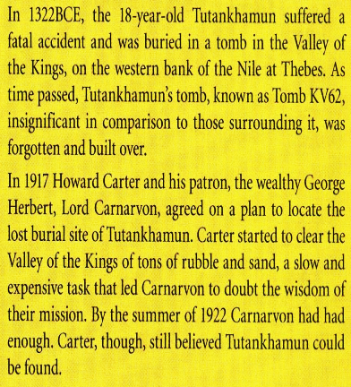
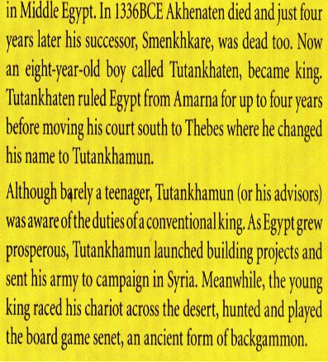
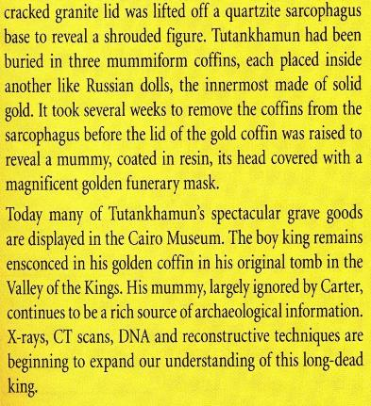
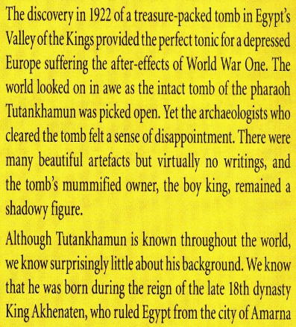
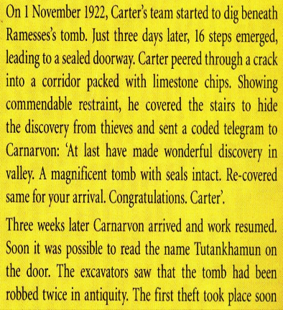
8 Culture
Reading
Next
Main Page
Previous

Slide 5
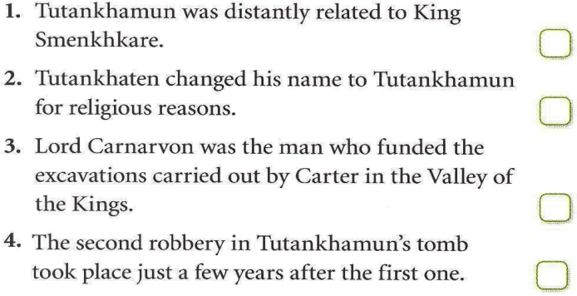
8 Culture
Reading
Next
Main Page
Previous

Slide 6
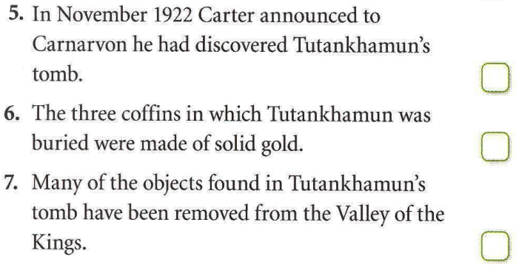
8 Culture
Reading
Next
Main Page
Previous

Slide 7
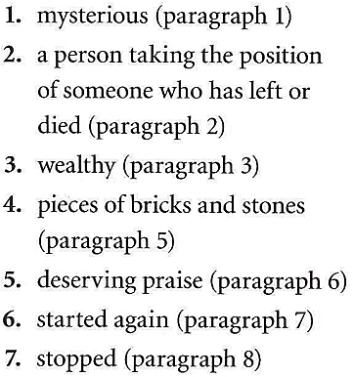
8 Culture
Reading
Next
Main Page
Previous

Slide 8
8 Culture
Reading
Next
Main Page
Previous

Slide 9
8 Culture
Vocabulary & grammar
Vocabulary
Next
Main Page
Previous

Slide 10
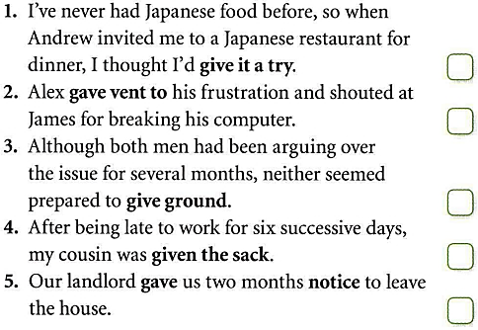
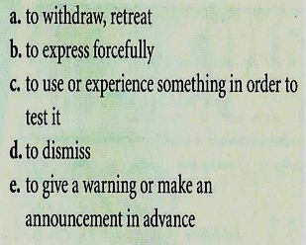
8 Culture
Vocabulary & grammar
Vocabulary
Next
Main Page
Previous

Slide 11
8 Culture
Vocabulary & grammar
Vocabulary
Next
Main Page
Previous

Slide 12
8 Culture
Vocabulary & grammar
Vocabulary
Next
Main Page
Previous

Slide 13
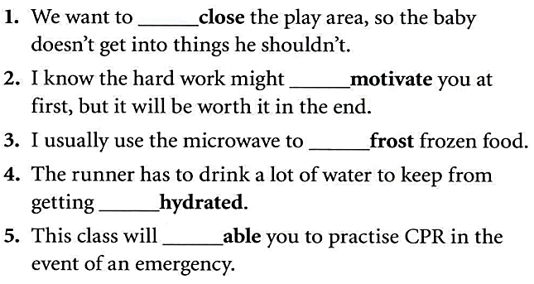
8 Culture
Vocabulary & grammar
Vocabulary
Next
Main Page
Previous

Slide 14
8 Culture
Vocabulary & grammar
Vocabulary
Next
Main Page
Previous

Slide 15
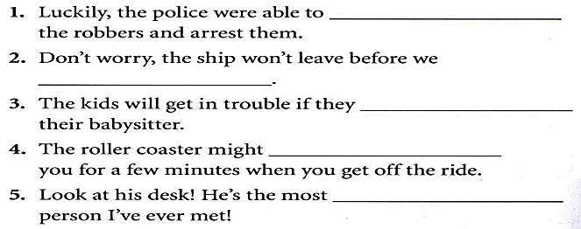
8 Culture
Vocabulary & grammar
Vocabulary
Next
Main Page
Previous

Slide 16
8 Culture
Vocabulary & grammar
Grammar
Next
Main Page
Previous

Slide 17
8 Culture
Vocabulary & grammar
Grammar
Next
Main Page
Previous

Slide 18
8 Culture
Vocabulary & grammar
Grammar
Next
Main Page
Previous

Slide 19
8 Culture
Vocabulary & grammar
Grammar
Next
Main Page
Previous

Slide 20
8 Culture
Vocabulary & grammar
Grammar
Next
Main Page
Previous

Slide 21
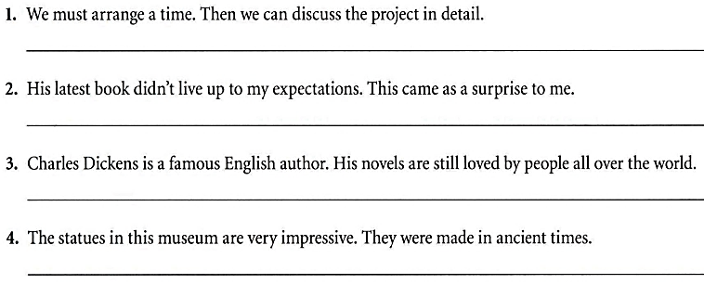
8 Culture
Vocabulary & grammar
Grammar
Next
Main Page
Previous

Slide 22
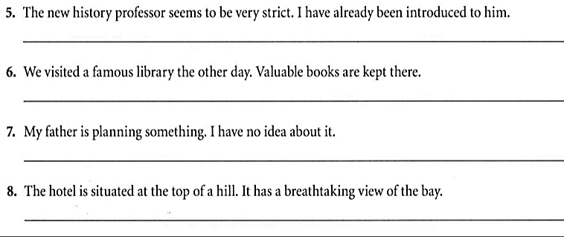
8 Culture
Vocabulary & grammar
Grammar
Next
Main Page
Previous

Slide 23
8 Culture
Listening
Next
Main Page
Previous

Slide 24
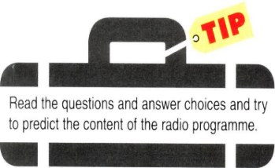
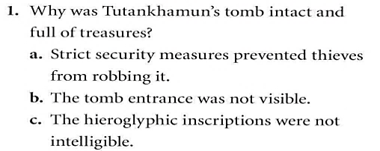
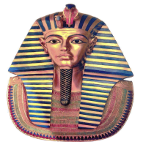
8 Culture
Listening
Next
Main Page
Previous

Slide 25
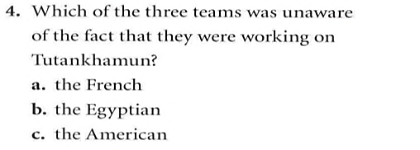
8 Culture
Listening
Next
Main Page
Previous

Slide 26
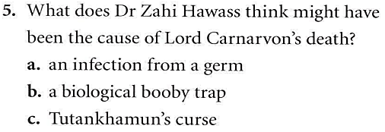
8 Culture
Listening
Next
Main Page
Previous

Slide 27
8 Culture
Listening
Next
Main Page
Previous

Slide 28
8 Culture
Vocabulary
Next
Main Page
Previous

Slide 29
8 Culture
Vocabulary
Next
Main Page
Previous

Slide 30
8 Culture
Vocabulary
Next
Main Page
Previous

Slide 31
8 Culture
Vocabulary
Next
Main Page
Previous

Slide 32
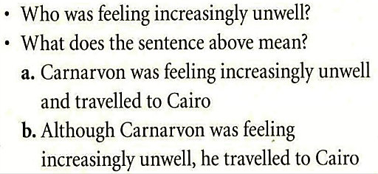
8 Culture
Grammar
Next
Main Page
Previous

Slide 33
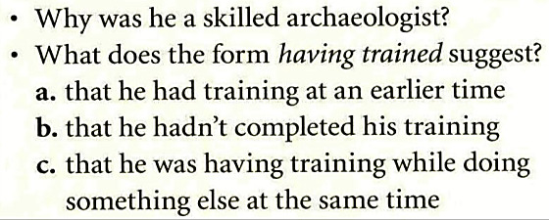
8 Culture
Grammar
Next
Main Page
Previous

Slide 34
8 Culture
Grammar
Next
Main Page
Previous

Slide 35
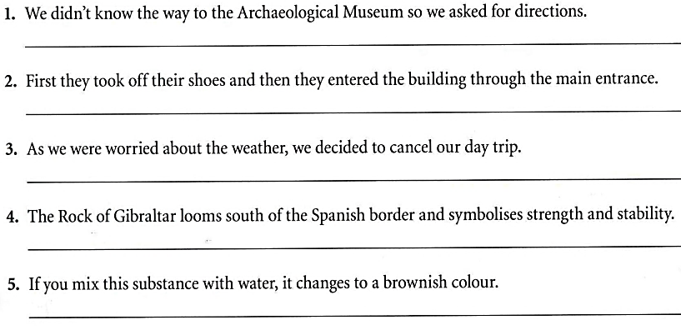
8 Culture
Grammar
Next
Main Page
Previous

Slide 36
8 Culture
Speaking
Next
Main Page
Previous

Slide 37
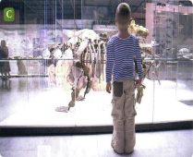
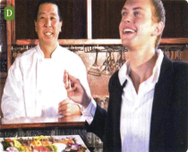
8 Culture
Speaking
Next
Main Page
Previous

Slide 38
8 Culture
Speaking
Next
Main Page
Previous

Slide 39
8 Culture
Examination practice
Next
Main Page
Previous

Slide 40
8 Culture
Speaking
Next
Main Page
Previous

Slide 41
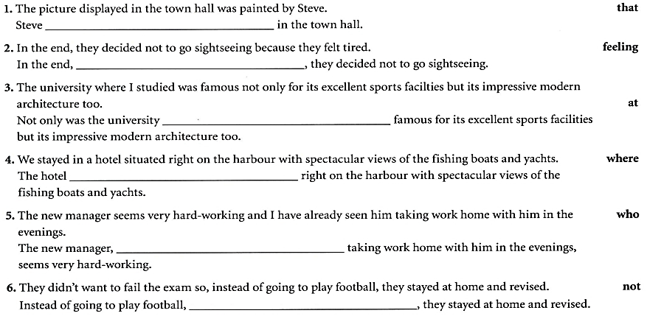
8 Culture
Speaking
Next
Main Page
Previous

Slide 42
8 Culture
Writing
Next
Main Page
Previous

Slide 43
8 Culture
Writing
Next
Main Page
Previous

Slide 44
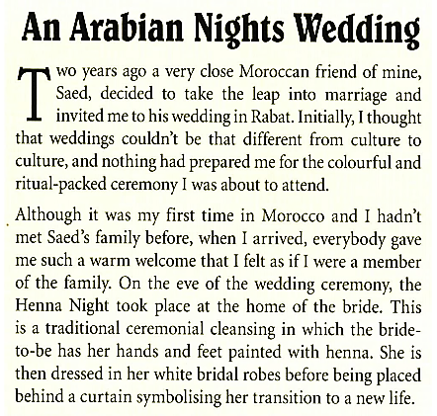
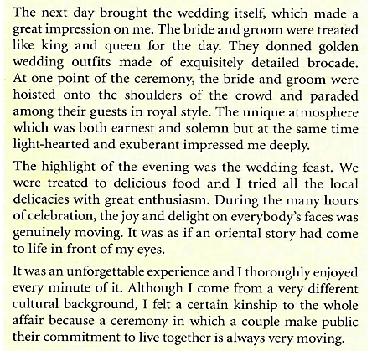
8 Culture
Writing
Next
Main Page
Previous

Slide 45
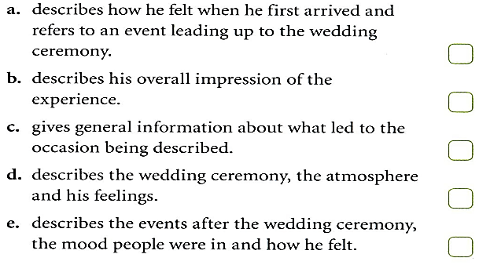
8 Culture
Writing
Next
Main Page
Previous

Slide 46
8 Culture
Writing
Next
Main Page
Previous

Slide 47
8 Culture
Writing
Next
Main Page
Previous

Slide 48
8 Culture
Writing
Next
Main Page
Previous

Slide 49
8 Culture
Writing
Next
Main Page
Previous

Slide 50
8 Culture
Writing
Next
Main Page
Previous

Slide 51
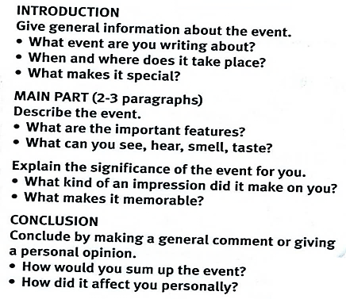
8 Culture
Writing
Next
Main Page
Previous

Slide 52
8 Culture
Writing
Next
Main Page
Previous

