Slide 1
Chapter 5
Force and Motion–I
Notes:
1

Slide 2
5-1 Newton's First and Second Laws
Learning Objectives
5.01 Identify that a force is a vector quantity and thus has both magnitude and direction and also components.
5.02 Given two or more forces acting on the same particle, add the forces as vectors to get the net force.
5.03 Identify Newton's first and second laws of motion.
5.04 Identify inertial reference frames.
.
5.06 Apply the relationship between net force on an object, its mass, and the produced acceleration.
5.07 Identify that only external forces on an object can cause the object to accelerate.
5.8 Identify Newton’s third law of motion
Notes:
2

Slide 3
5-1 Newton's First and Second Laws
A force:
Is a “push or pull” acting on an object
Causes acceleration
Characteristics of forces:
Unit: N, the newton; 1 N = 1 kg m/s²
Acceleration of a mass is proportional to the exerted force
Forces are vectors
Net force is the vector sum of all forces on an object
Principle of superposition for forces:
A net force has the same impact as a single force with identical magnitude and direction
Notes:
3

Slide 4
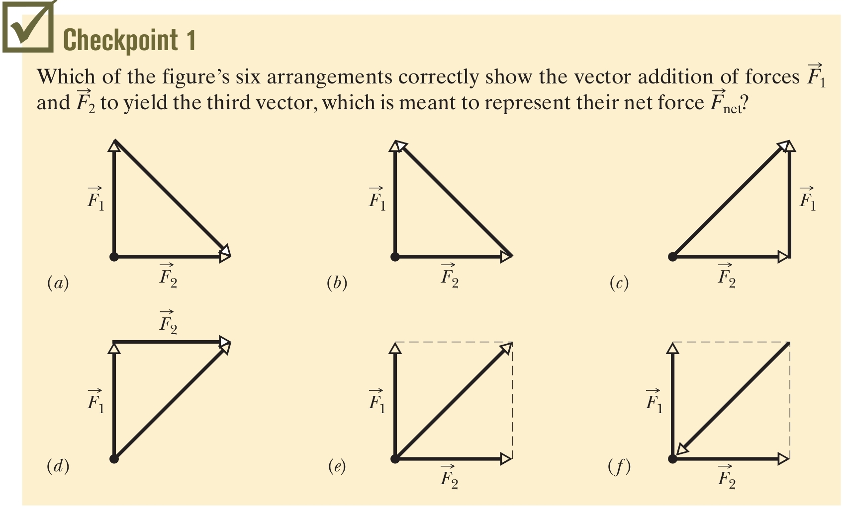
5-1 Newton's First and Second Laws
Generally, assume the ground is an inertial frame
Answer: (c), (d), (e)
Notes:
4

Slide 5
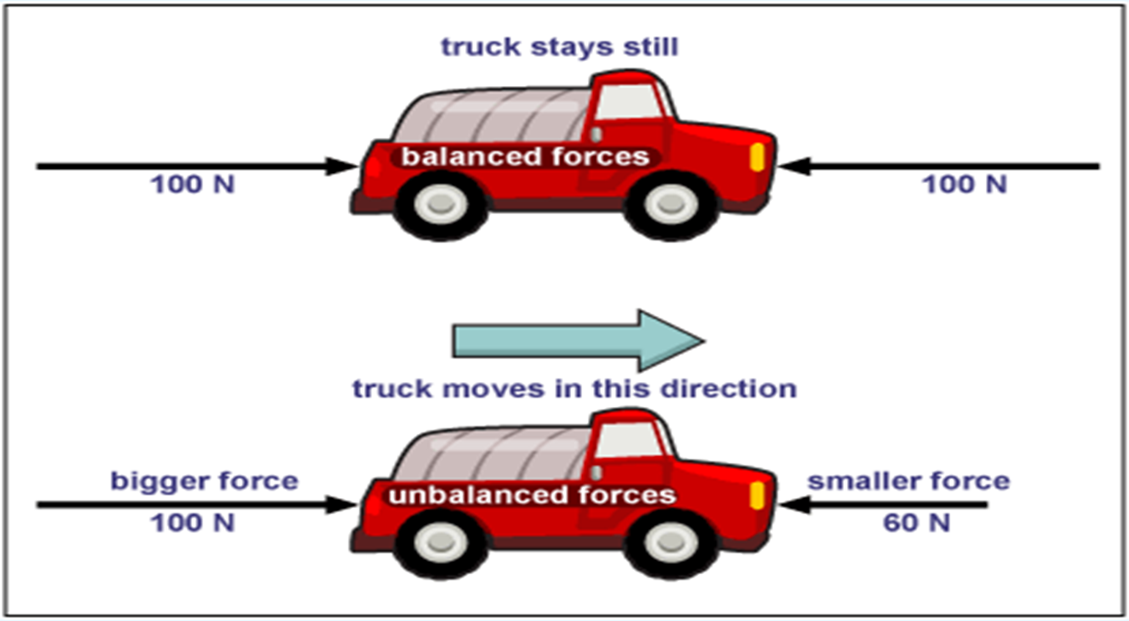
Equal forces in opposite
directions produce no motion
Unequal opposing forces
produce an unbalanced force causing motion

Slide 6
NEWTON'S LAWS OF MOTION
We will focus on Newton's three laws of motion:
Newtonian mechanics is valid for everyday situations
It is not valid for speeds which are an appreciable fraction of the speed of light
It is not valid for objects on the scale of atomic structure
Viewed as an approximation of general relativity

Slide 7
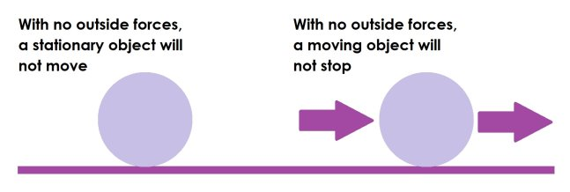
5-1 Newton's First and Second Laws
Newton’s First Law (law of inertia)
“An object at rest tends to stay at rest and an object in motion tends to stay in motion unless acted upon by an unbalanced force”
Notes:
7

Slide 8
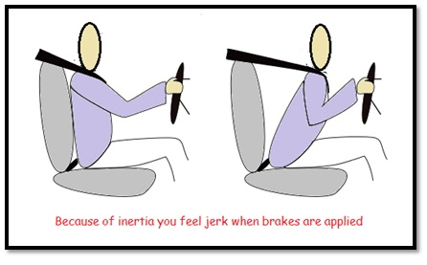
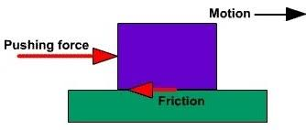
INERTIA is a property of an object that describes the tendency of the object to remain at rest or, if moving, to continue its motion.
more mass means more Inertia.
What is this unbalanced force that acts on an object in motion?
Frictional force or friction:

Slide 9
5-1 Newton's First and Second Laws
What is mass?
“the mass of a body is the characteristic that relates a force on the body to the resulting acceleration”
Mass is a measure of a body’s resistance to a change in motion (change in velocity)
It is not the same as weight, density, size etc.
Mass is inversely proportional to acceleration
Example Apply an 8.0 N force to various bodies:
Mass: 1kg → acceleration: 8 m/s²
Mass: 2kg → acceleration: 4 m/s²
Mass: 0.5kg → acceleration: 16 m/s²
Acceleration: 2 m/s² → mass: 4 kg
Notes:
9

Slide 10
5-1 Newton's First and Second Laws
Newton’s Second Law
“the law of acceleration, states that the acceleration of an object is directly proportional to the net force acting on it and inversely proportional to its mass.”
Eq. (5-1)
Notes:
10

Slide 11
5-2 Some Particular Forces
The gravitational force:
A pull that acts on a body, directed toward a second body
Generally we consider situations where the second body is Earth
In free fall (y direction, with no drag from the air):
This force still acts on a body at rest!
We can write it as a vector:
Eq. (5-8)
Eq. (5-9)
Notes:
11

Slide 12
5-2 Some Particular Forces
Weight :
The name given to the gravitational force that one body (like the Earth) exerts on an object
It is a force measured in newtons (N)
It is directed downward towards the center
Eq. (5-12)
Notes:
12

Slide 13
Mass vs Weight

Slide 14
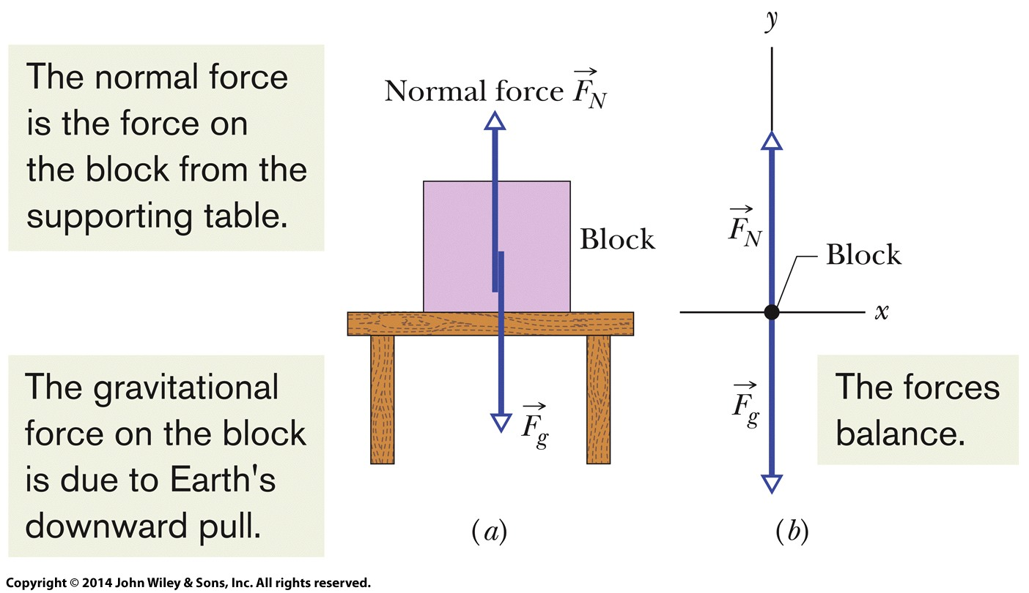
5-2 Some Particular Forces
The normal force:
If you are standing on a surface, the push back on you from the surface (due to deformation) is the normal force
Normal means perpendicular
Figure 5-7
Notes:
14

Slide 15
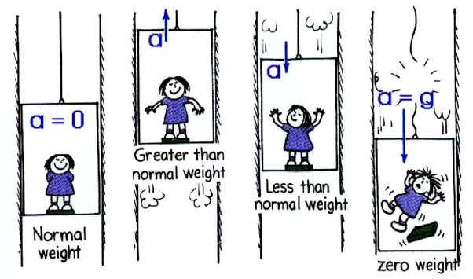
When the elevator moves to the top the acceleration to be a positive. But when moving the elevator to the bottom of the acceleration to be negative.

Slide 16
Example

Slide 17
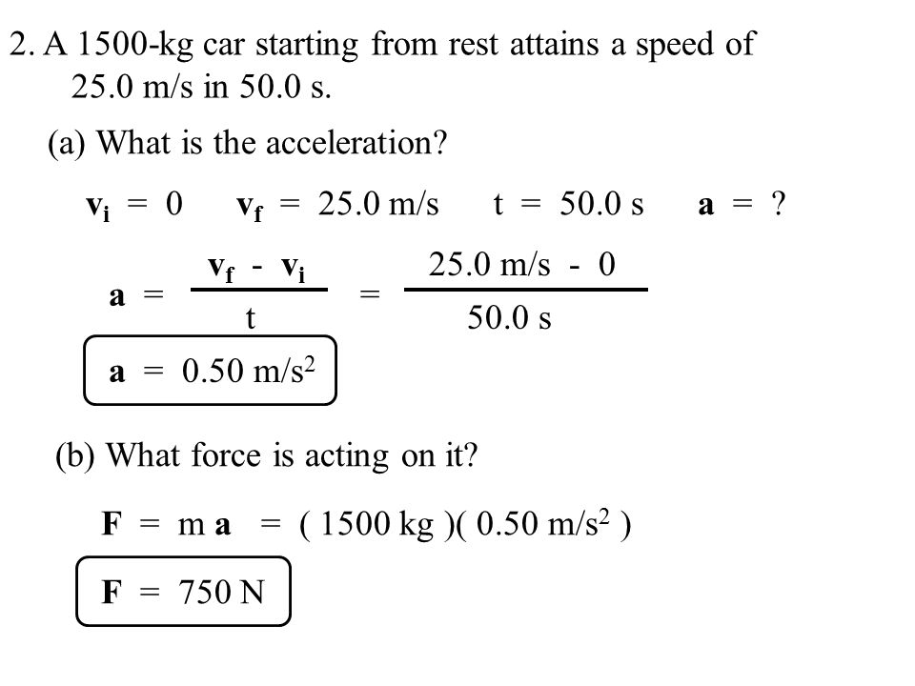
Example

Slide 18
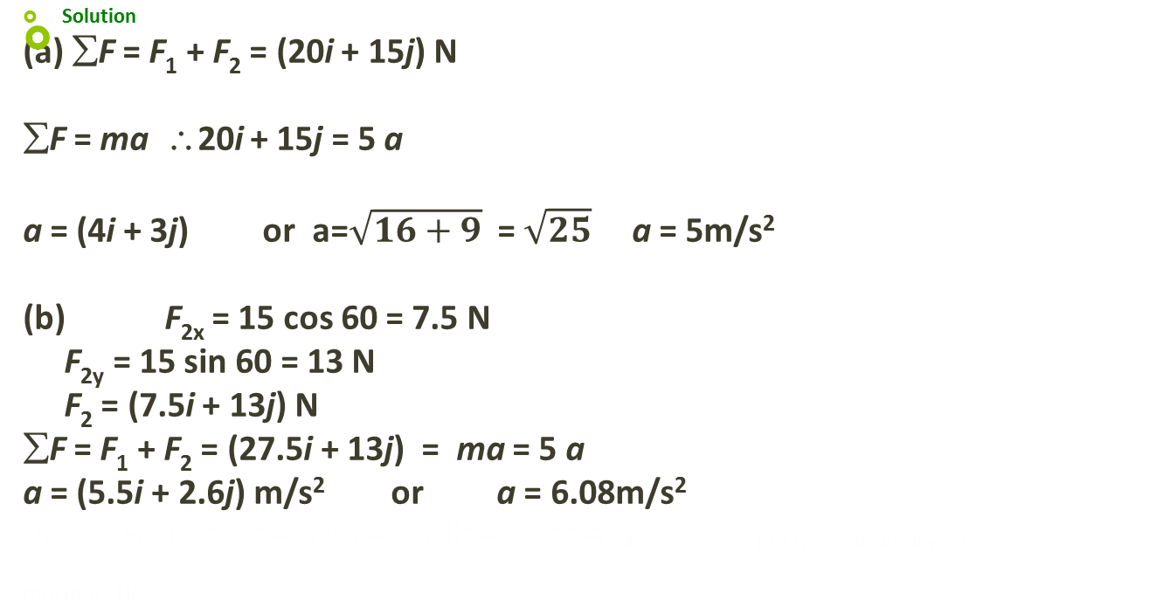
Example
Two forces, F₁ and F₂, act on a 5-kg mass. If F₁ =20 N and F₂ =15 N, find the acceleration in (a) and (b) of the Figure

Slide 19
Newton’s Third Law
“For every action there is an equal and opposite reaction”.

Slide 20
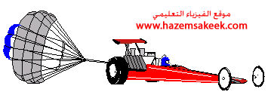
Example
The parachute on a race car of weight 8820N opens at the end of a quarter-mile run when the car is travelling at 55 m/s. What is the total retarding force required to stop the car in a distance of 1000 m in the event of a brake failure?
Solution
W = 8820 N, g = 9.8 m/s² , v_{o} = 55 m/s, v_{f} = 0, x_{f} - x_{o} = 1000 m
m = W/g = 900 kg
v_{f} ² = v_{o}² + 2a(x - x_{o}),
0 = 55² + 2a(1000), giving a = -1.51 m/s²
∑F = ma = (900 kg) (-1.51 m/s²) = -1.36 × 10³ N
The minus sign means that the force is a retarding force.

Slide 21
Example
A book rests on a table, exerting a downward force on the table. The reaction to this force is:
A) the force of the Earth on the book
B) the force of the table on the book
C) the force of the Earth on the table
D) the force of the book on the Earth
E) the inertia of the book
Ans: B

Slide 22
5 Summary
Newtonian Mechanics
Forces are pushes or pulls
Forces cause acceleration
Force
Vector quantities
1 N = 1 kg m/s²
Net force is the sum of all forces on a body
Newton's First Law
If there is no net force on a body, the body remains at rest if it is initially at rest, or moves in a straight line at constant speed if it is in motion.
Notes:
22

Slide 23
5 Summary
Mass
The characteristic that relates the body's acceleration to the net force
Scalar quantity
Newton's Second Law
Free-body diagram represents the forces on one object
Eq. (5-1)
Some Particular Forces
Weight:
Normal force from a surface
Friction along a surface
Newton's Third Law
Law of force-pairs
If there is a force by B on C, then there is a force by C on B:
Eq. (5-12)
Eq. (5-15)
Notes:
23

