Slide 1
Chapter(6)
The Normal Distribution

Slide 2
Introduction
6-1 Properties of the Normal Distribution
and the Standard Normal Distribution.
6-2 Applications of the Normal Distribution.
6-3 The Central Limit Theorem

Slide 3
The Normal Distribution

Slide 4
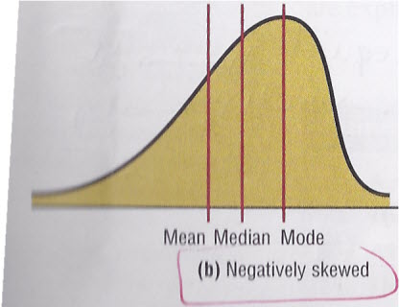
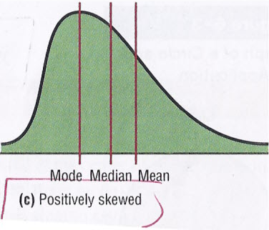
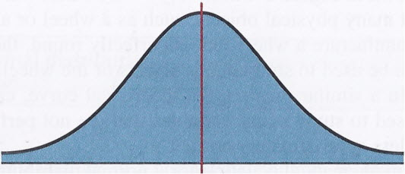
(b) Negatively skewed
(c) Positively skewed
(a) Normal

Slide 5
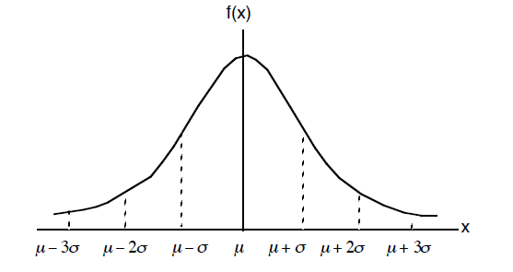
A normal distribution is a continuous ,symmetric ,bell shaped distribution of a variable.

Slide 6
The
mathematical
equation
for
the
normal
distribution:
where
e
≈
2
718
π
≈
3
14
µ
≈
population
mean
σ
≈
population
standard
deviation
A normal distribution curve depend on two parameters .
µ
Position parameter
σ
shape parameter

Slide 7
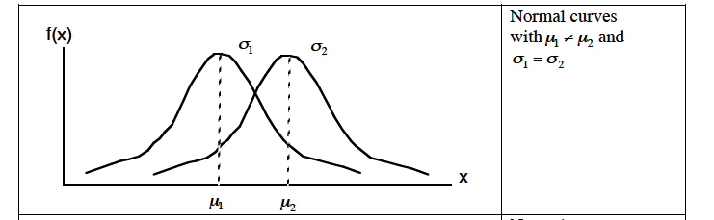
1
(1) Different means but same standard deviations.

Slide 8
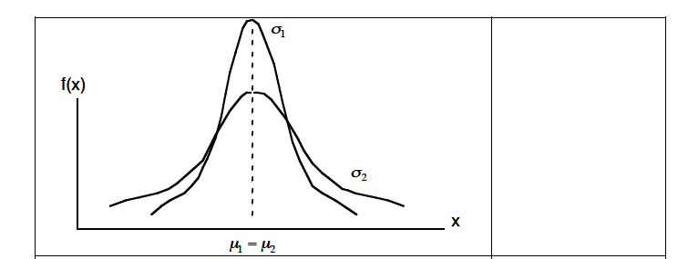
Normal curves
with μ1 = μ2 and
σ₁<σ₂
2
(2) Same means but different standard deviations .

Slide 9
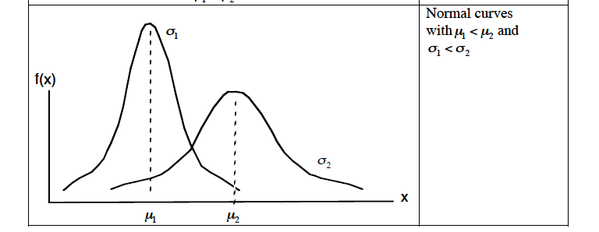
(3) Different means and different standard deviations .
3

Slide 10
Properties of the Normal Distribution
The normal distribution curve is bell-shaped.
The mean, median, and mode are equal and located at
the center of the distribution.
The normal distribution curve is unimodal (single mode).
The curve is symmetrical about the mean.
The curve is continuous.
The curve never touches the x-axis.
The total area under the normal distribution curve is
equal to 1 or 100%.

Slide 11
The area under the normal curve that lies within
  one standard deviation of the mean is approximately 0.68 (68%).
  two standard deviations of the mean is approximately 0.95 (95%).
  three standard deviations of the mean is approximately 0.997 (99.7%).

Slide 12
(Areas Under the Normal Curve)
Empirical Rule: Normal Distribution
68%
99.7%
95%
μ −3σ μ −2σ μ −1σ μ μ +1σ μ +2σ μ +3σ

Slide 13
The Standard Normal Distribution

Slide 14
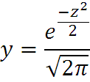
The standard normal distribution is a normal distribution with a mean of 0 and a standard deviation of 1.
The formula for the standard normal distribution is

Slide 15


All Normal Distribution can be transformed into standard Distribution.
or

Slide 16
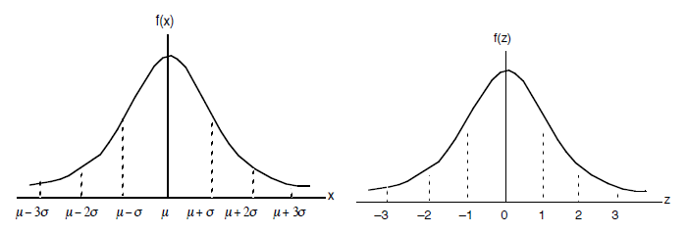
Empirical Rule: Standard Normal Distribution

Slide 17
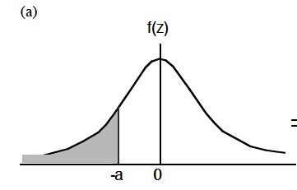
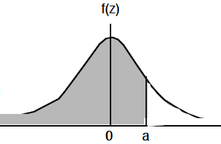
Finding Areas Under the Standard Normal Distribution Curve:
1. To the left of any Z value
P(z<-a) = P(z<a) = Q(a)

Slide 18
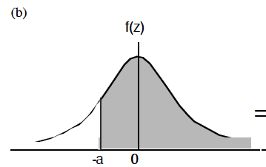
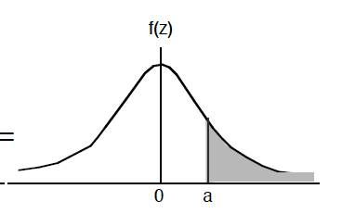
2.To the right of any Z value
P(z>-a) = P(z>a) = 1 - Q(a)

Slide 19
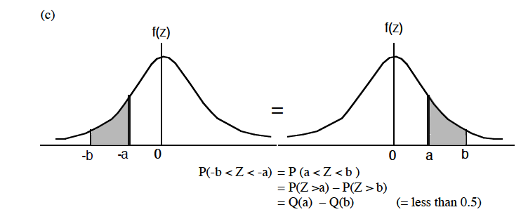
3.Between any two Z values
P(-b<z<-a) = P(a<z<b) = P(z>a) – P(z>b)
= Q(a) – Q(b)

Slide 20
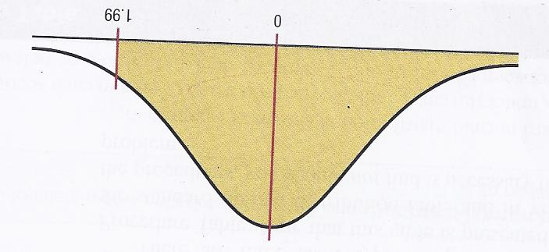
Example 6-1:
Find the area to the left of z=1.99
P(Z<1.99)=
0.9767

Slide 21
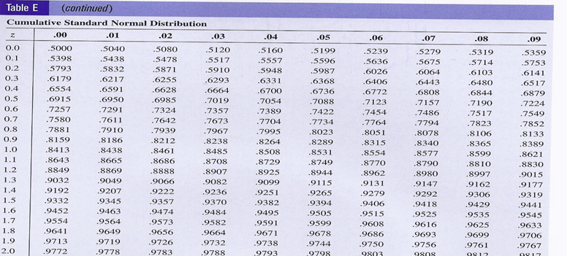
1.9 9
Column
row

Slide 22
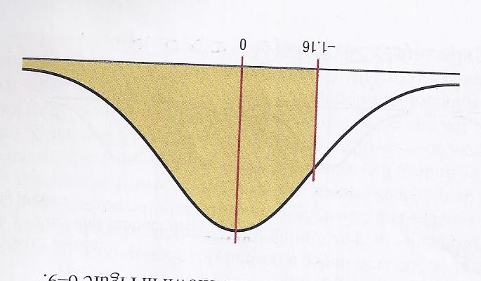
Example 6-2:
Find the area to the right of z=-1.16
P(Z>-1.16)=
1-P(Z<-1.16)
=1-0.1230
= 0.8770

Slide 23
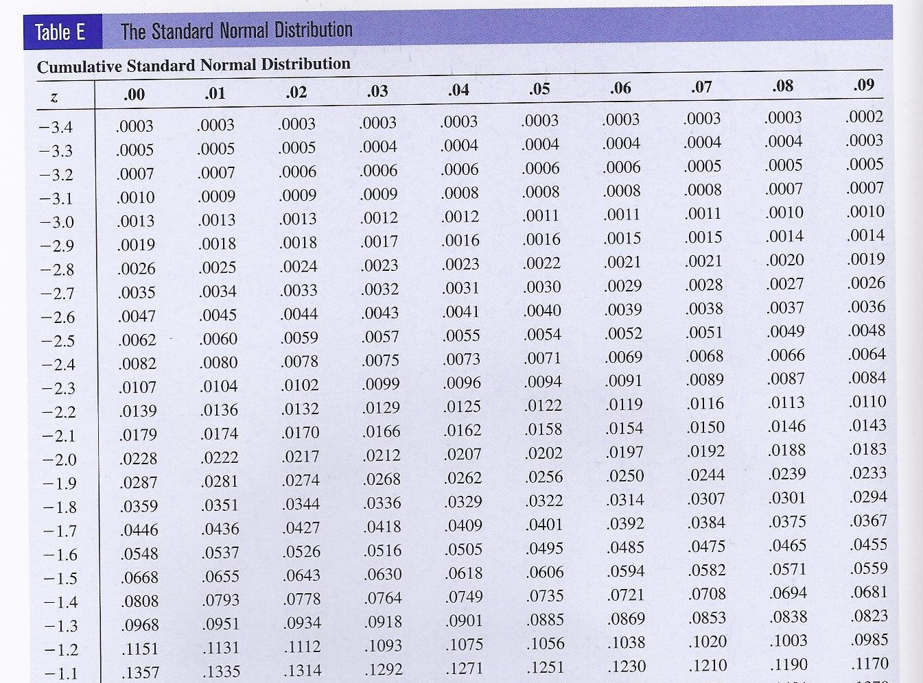

Slide 24
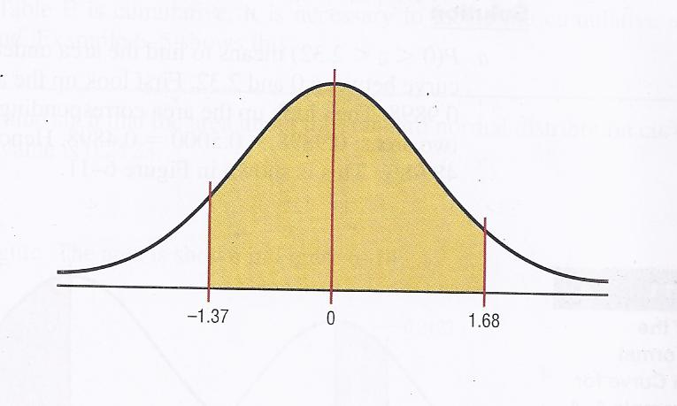
Example 6-3:
Find the area between z=1.68 and z=-1.37
P(-1.37<Z<1.68)=
P(Z<1.68)-P(Z<-1.37)
= 0.9535-0.0853
= 0.8682

Slide 25
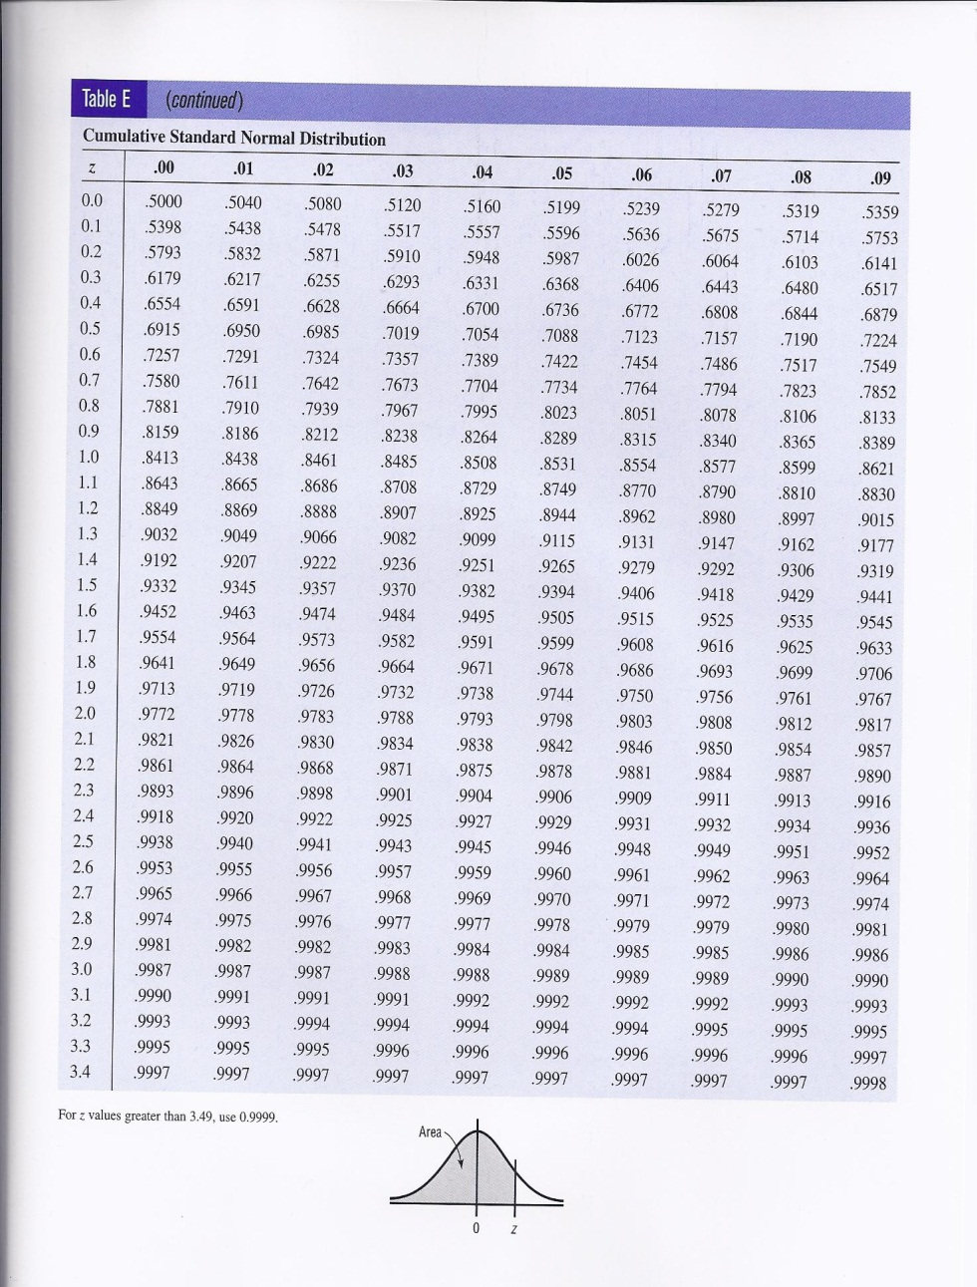

Slide 26
A Normal Distribution Curve as a Probability Distribution Curve:
The area under the standard normal distribution curve can also be thought of as a probability .

Slide 27
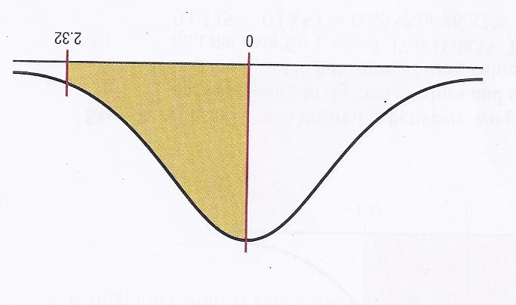
Example 6-4:
Find probability for each
a) P(0<z<2.23)
b) P(z<1.65)
c) P(z>1.91)
a) P(0<Z<2.23)=P(Z<2.23)-P(Z<0)
=0.9898-0.5000
=0.4898

Slide 28
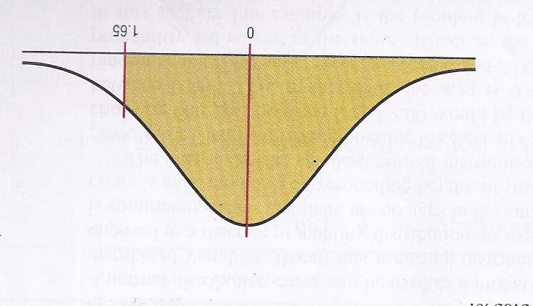
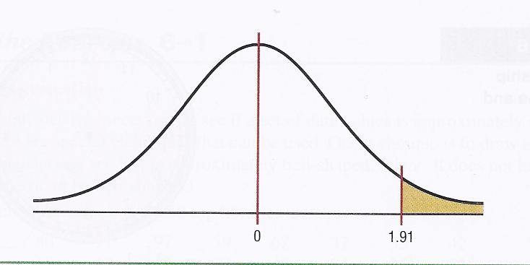
b) P(Z<1.65)=0.9505
c) P(Z>1.91)=1-P(Z<1.91)
=1-0.9719
=0.0281

Slide 29
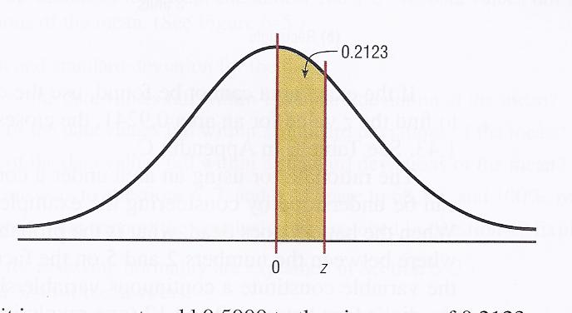
Example 6-5:
Find the z value such that the area under the standard normal distribution curve between 0 and the z value is 0.2123
0.2123+0.5000=0.7123
Z=0.56

Slide 30
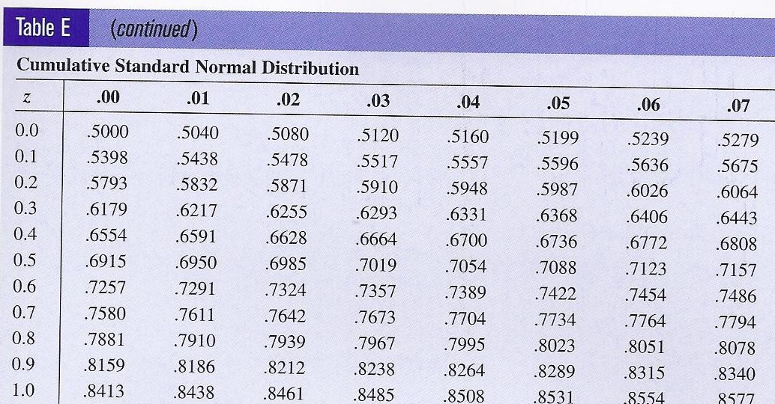

Slide 31
Applications of the Normal
Distribution

Slide 32
All normally distributed variables can be transformed into the standard normally distribution by using the formula for the standard score:
to solve the application problems in this section, we must use that three steps.
First Step: find the z , using the formula.
Second Step: draw the figure and Shading the area.
Third Step : find the areas under ,using table E.

Slide 33
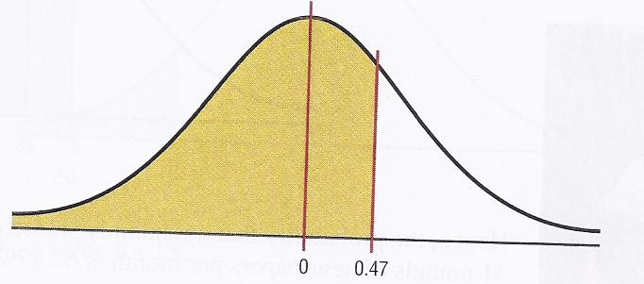
Example 6-6:
A survey by the National Retail Federation found that women spend on average $146.21 for the Christmas holidays. Assume the standard deviation is $29.44. Find the percentage of women who spend less than $160. Assume the variable is normally distributed.
Solution:
Step 1 : Find the z value .
Step 2 :Draw the figure
Step 3 :Find the area ,using table E.
P(Z<0.47)=
0.6808
68.08% of the women spend less than 160$ at Christmas time.

Slide 34
Example 6-7:
Each month, an American household generates an average of 28 pounds of newspaper for garbage or recycling. Assume the standard deviation is 2 pounds. If a household is selected at random, Find the probability of its generating.
a) Between 27 and 31 pounds per month
b) More than 30.2 pounds per month
Assume the variable is approximately normally distributed.
Solution (a) :
Step 1 : Find the two z value .

Slide 35
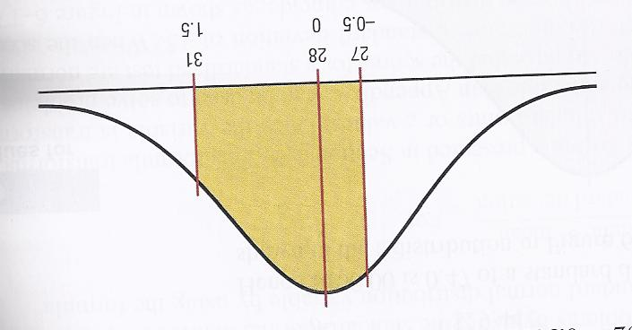
Step 2 :Draw the figure
Step 3 :Find the area ,using table E.
P(-0.5<Z<1.5)=
P(Z<1.5)-P(Z<-0.5) =
=0.9332-0.3085 =0.6247
The probability that household generates between 27 and 31 pounds of newspapers per month is 62.47%

Slide 36
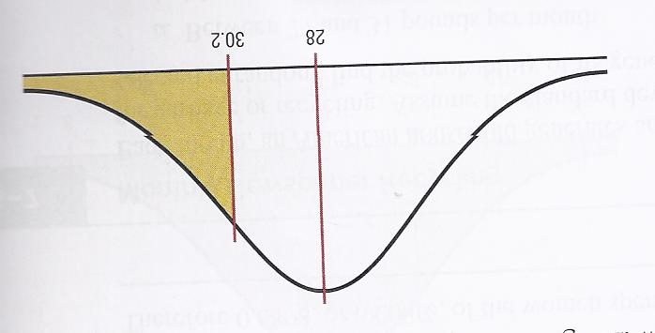
Solution (b) :
Step 1 : Find the z value .
Step 2 :Draw the figure
0
1.1
Step 3 :Find the area ,using table E.
P(Z>1.1)=
1-P(Z<1.1)
=1-0.8643
=0.1375
The probability that household generates more than 30.2 pounds of newspapers is 0.1375 or 31.75%

Slide 37
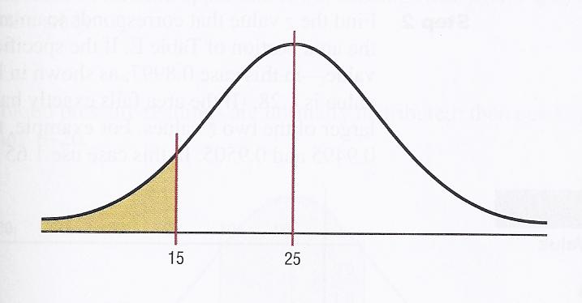
Example 6-8:
The American Automobile Association reports that the average time it takes to respond to an emergency call is 25 minutes. Assume the variable is approximately normally distributed and the standard deviation is 4.5 minutes. If 80 calls are randomly selected, approximately how many will be responded to in less than 15 minutes?
Solution:
Step 1 : Find the z value .
Step 2 :Draw the figure
Step 3 :Find the area ,using table E.
P(Z<-2.22)=
0.0132
Step 4 :to find how many calls .
-2.22
0
0.0132 × 80 = 1.056 ≈ 1

Slide 38
Finding Data Values Given Specific Probabilities
Formula for Finding X:
Area(left)
Z
X

Slide 39
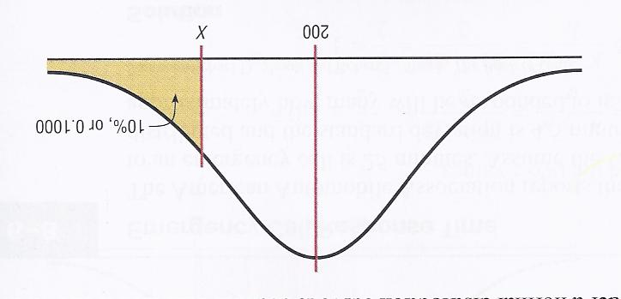
Example 6-9:
To qualify for a police academy, candidates must score in the top 10% on a general abilities test. The test has a mean of 200 and standard deviation of 20. Find the lowest possible score to qualify. Assume the test scores is normally distributed.
Solution:
Step 1 :Draw the figure
Step 2 : Find area (left) and
the z value .
1-0.10 = 0.9000
Z=1.28
Step 3 :Find the x.
Any body scoring 226 or higher qualify

Slide 41
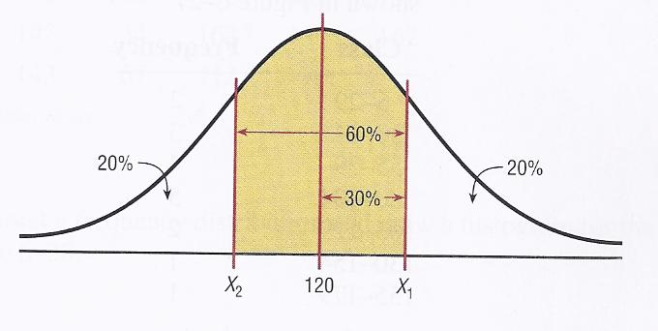
Example 6-10:
For a medical study, a researcher wishes to select people in the middle 60% of the population based on blood pressure. If the mean systolic blood pressure is 120 and the standard deviation is 8, find the upper and lower readings that would qualify people to participate in the study. Assume that blood pressure readings is normally distributed.
Solution:
Step 1 :Draw the figure

Slide 42
Step 2 : Find the two z values .
0.5000+0.3000=0.8000
0.5000-0.3000= 0.2000
Step 3 :Find the two x.
The middle 60% will have blood pressure reading of 113.28<X<126.72

Slide 43
CHAPTER 6
6-3The Central Limit Theorem

Slide 44
Distribution of Sample Means
A sampling distribution of sample means: is a distribution using the means computed from all possible random samples of a specific size taken from a population.
Sampling error: is the difference between the sample measure and corresponding population measure due to the fact that the sample is not a perfect representation of the population.

Slide 45
Distribution of Sample Means
Properties of the distribution of sample means:
1- The mean of the sample means will be the same as the population mean.
2- The standard deviation of the sample means will be smaller than the standard deviation of the population, and it will be equal to the population standard deviation divided by the square root of the sample size.

Slide 46
The Central Limit Theorem:
As the sample size n increase without limit, the shape of the distribution of the sample means taken with replacement from a population with mean and standard deviation will approach a normal distribution. This distribution will have a mean and a standard deviation
The formula for z values is:

Slide 47
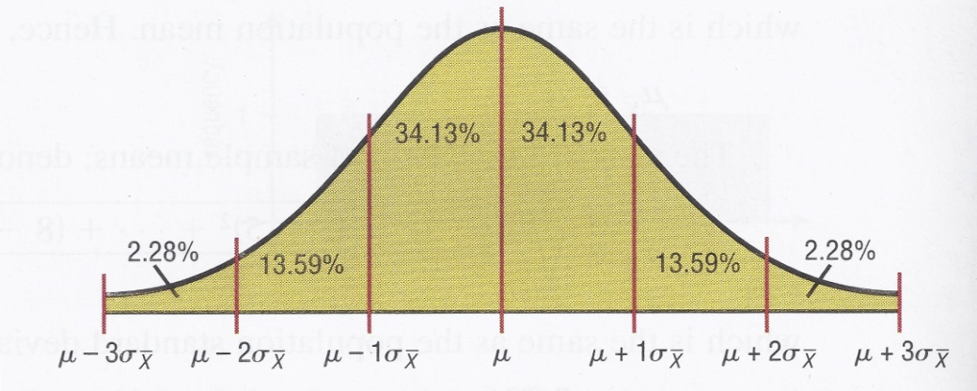
Two important things when we use Central limit theorem :
1- when the original variable is normally distributed , the distribution of the sample means will be normally distributed , for any sample size n.
2- when the original variable might not be normally distributed, a sample size must be 30 or more to approximate the distribution of sample means to normal distribution .

Slide 48
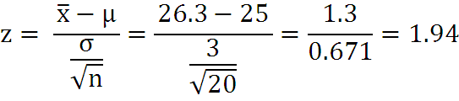
Example 6-13: Hours That Children Watch Television
A. C. Neilsen reported that children between the ages of 2 and 5 watch an average of 25 hours of television per week. Assume the variable is normally distributed and the standard deviation is 3 hours. If 20 children between the ages 2 and 5 are randomly selected, find the probability that the mean of the number of hours they watch television will be greater than 26.3 hours?
Solution:
Step 1 : Find the z value .

Slide 49
Step 2 :Draw the figure
0
1.94
Step 3 :Find the area ,using table E.
P(z > 1.94) = 1.000 – 0.9738 = 0.0262. That is, the probability of obtaining a sample mean greater than 26.3 is 0.0262 = 2.62%.

Slide 50
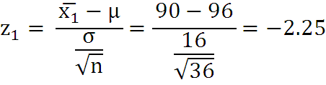
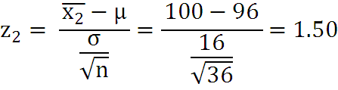
Example 6-14:
The average age of a vehicle registered in the United States is 8 years, or 96 months. Assume the standard deviation is 16 months. If a random sample of 36 vehicles is selected, find the probability that the mean of their age is between 90 and 100 months.
Solution:
Step 1 : Find the two z values .
Note: This PowerPoint is only a summary and your main source should be the book.

Slide 51
Step 2 :Draw the figure
-2.25
0
1.50
Step 3 :Find the area ,using table E.
P(-2.25<Z<1.50)=P(Z<1.50)-P(Z<-2.25) =0.9332-0.0122
=0.9210 or 92.1 %
The probability of obtaining a sample mean between 90 and 100 months is 92.1%; that is ,P(90 <X<100)= 92.1%
Note: This PowerPoint is only a summary and your main source should be the book.

Slide 52

Example 6-15: Meat Consumption
The average number of pounds of meat that a person consumes per year is 218.4 pounds. Assume that the standard deviation is 25 pounds and the distribution is approximately normal.
Find the probability that a person selected at random consumes less than 224 pounds per year.
If a sample of 40 individuals is selected, find the probability that the mean of the sample will be less than 224 pounds per year.
Solution(a):
Step 1 : Find the z value .
Note: This PowerPoint is only a summary and your main source should be the book.

Slide 53
Step 2 :Draw the figure
0.22
Step 3 :Find the area ,using table E.
P(Z<0.22) =
0.5871
Note: This PowerPoint is only a summary and your main source should be the book.

Slide 54
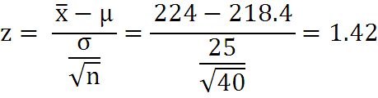
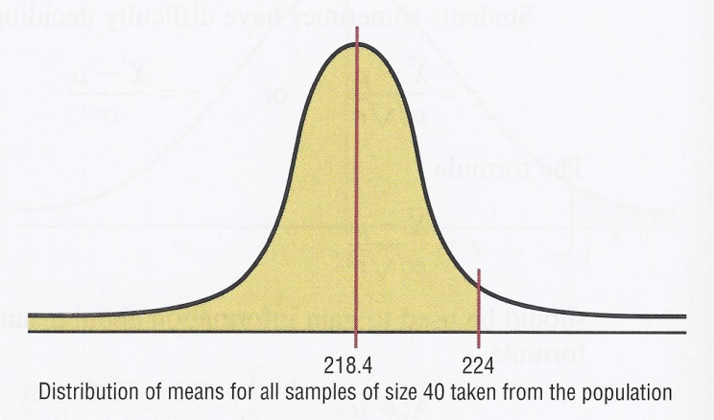
Solution(b):
Step 1 : Find the z value .
Step 2 :Draw the figure
0
1.42
Note: This PowerPoint is only a summary and your main source should be the book.

Slide 55
Step 3 :Find the area ,using table E.
P(z < 1.42) = 0.9222.
The probability that mean of a sample of 40 individuals is less than 224 pounds per year is 0.9222 or 92.22%.

Slide 56
THE END
مع تمنياتي لكن بالتوفيق
أ.هديل الرويثي

