Slide 1
Get Ready
2
Next
Main Page

Slide 2
English Language
Fourth Elementary Grade
Second Term
Next
Main Page
Previous

Slide 3
Contents
Welcome unit
The body
My face
Revision 1
Saudi Stars 1
Next
Main Page
Previous

Slide 4
Contents
My house
food
Revision 2
Saudi Stars 2
Progress check 1
Next
Main Page
Previous

Slide 5
Contents
In the street
Day and weather
Revision 3
Saudi Stars 3
Next
Main Page
Previous

Slide 6
Contents
My school
My country
Revision 4
Saudi Stars 4
Progress check 2
Next
Main Page
Previous

Slide 7
Welcome !
Next
Main Page
Previous

Slide 8
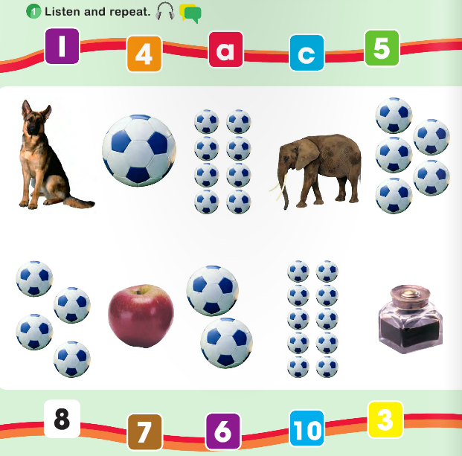
Welcome !
Next
Main Page
Previous

Slide 9
Unit 1
The body
Next
Main Page
Previous

Slide 10
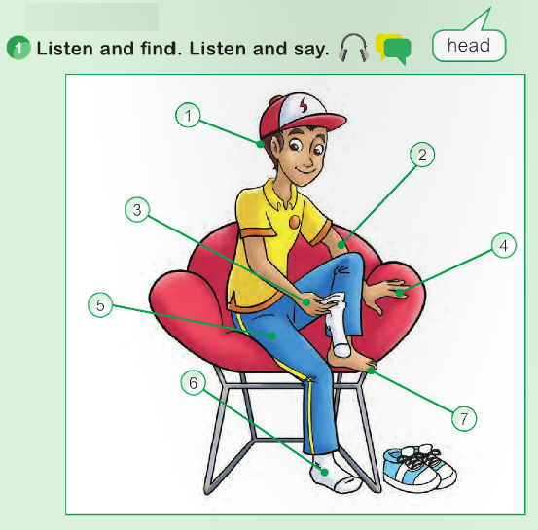
1 The body
Lesson 1
Next
Main Page
Previous

Slide 11
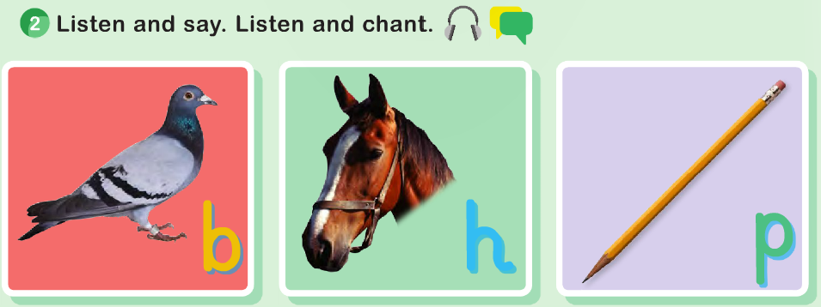
1 The body
Lesson 1
Next
Main Page
Previous

Slide 12
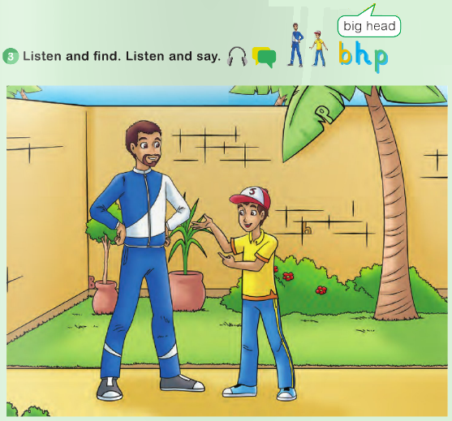
1 The body
Lesson 1
Next
Main Page
Previous

Slide 13
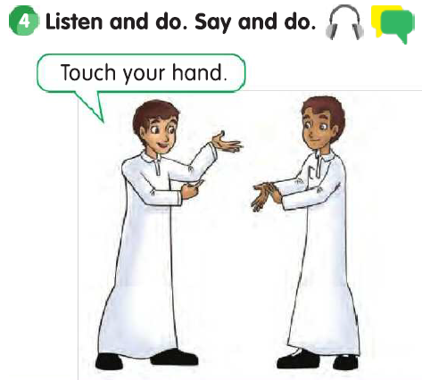
1 The body
Lesson 1
Next
Main Page
Previous

Slide 14
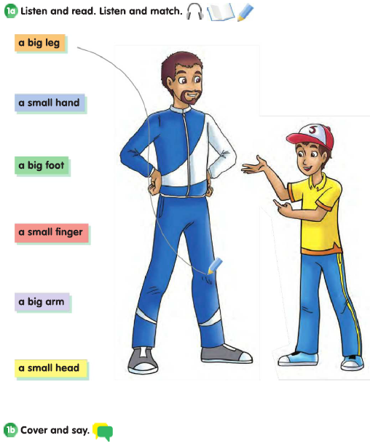
1 The body
Lesson 2
Next
Main Page
Previous

Slide 15
1 The body
Lesson 2
Next
Main Page
Previous

Slide 16
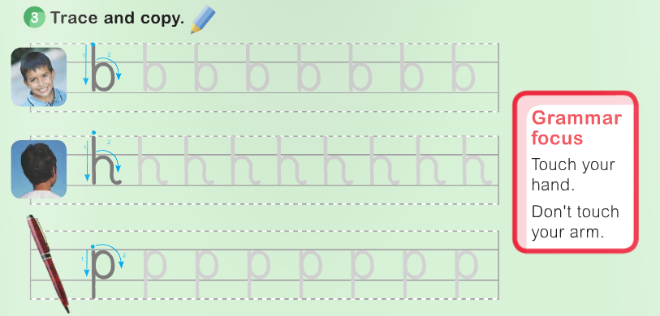
1 The body
Lesson 2
Next
Main Page
Previous

Slide 17
1 The body
Lesson 2
7
6
1
5
4
2
3
Next
Main Page
Previous

Slide 18
Unit 2
My face
Next
Main Page
Previous

Slide 19
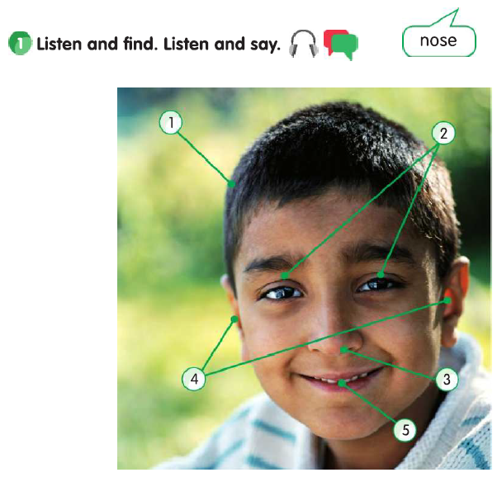
2 My face
Lesson 1
Next
Main Page
Previous

Slide 20
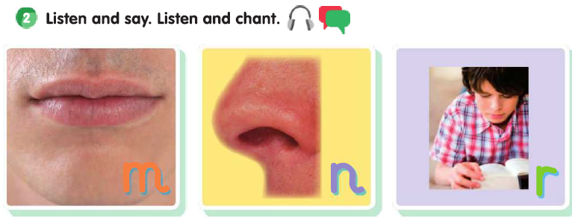
2 My face
Lesson 1
Next
Main Page
Previous

Slide 21
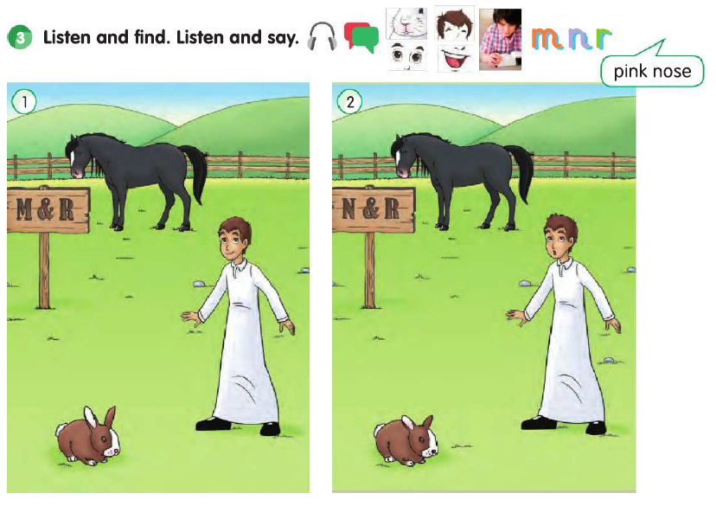
2 My face
Lesson 1
Next
Main Page
Previous

Slide 22
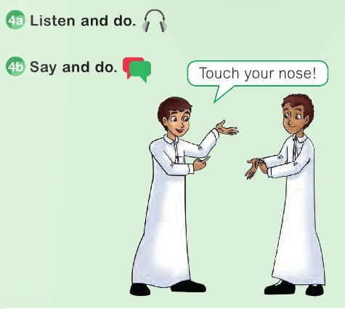
2 My face
Lesson 1
Next
Main Page
Previous

Slide 23
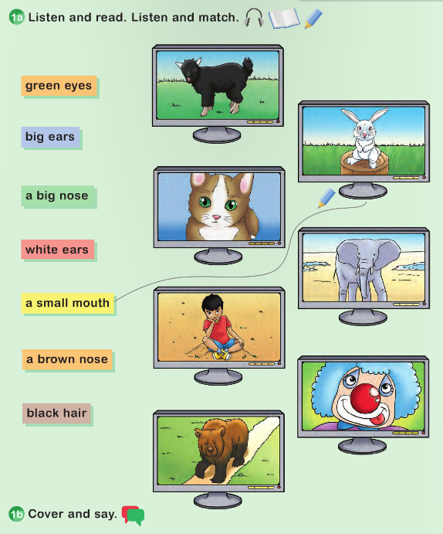
2 My face
Lesson 2
Next
Main Page
Previous

Slide 24
2 My face
Lesson 2
Next
Main Page
Previous

Slide 25
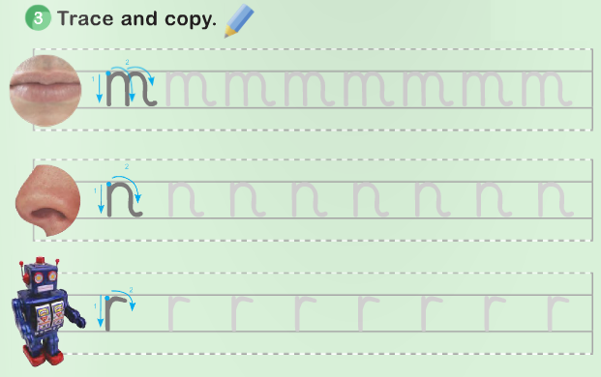
2 My face
Lesson 2
Next
Main Page
Previous

Slide 26
2 My face
Lesson 2
3
5
4
1
2
Next
Main Page
Previous

Slide 27
Revision 1
Next
Main Page
Previous

Slide 28
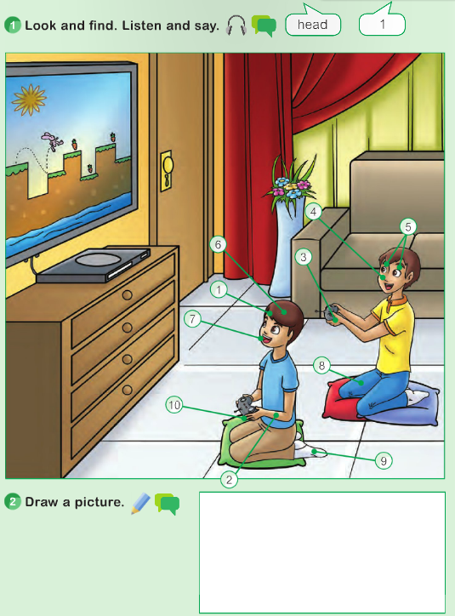
Revision 1
Next
Main Page
Previous

Slide 29
Revision 1
Next
Main Page
Previous

Slide 30
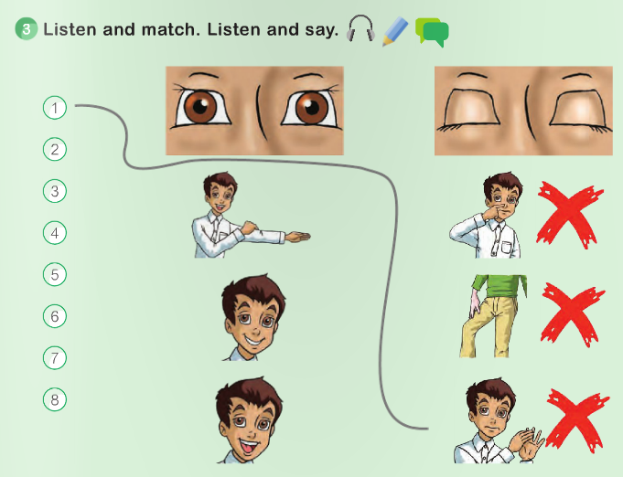
Revision 1
Next
Main Page
Previous

Slide 31
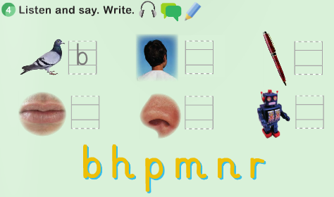
Revision 1
Next
Main Page
Previous

Slide 32
SAUDI
STARS 1
Next
Main Page
Previous

Slide 33
SAUDI STARS 1
Next
Main Page
Previous

Slide 34
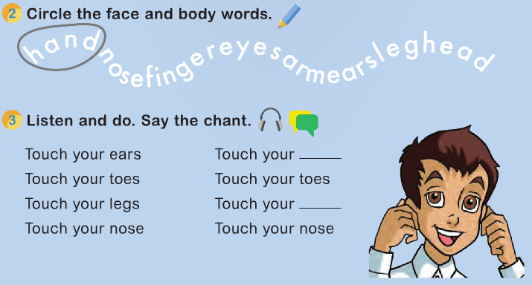
SAUDI STARS 1
Next
Main Page
Previous

Slide 35
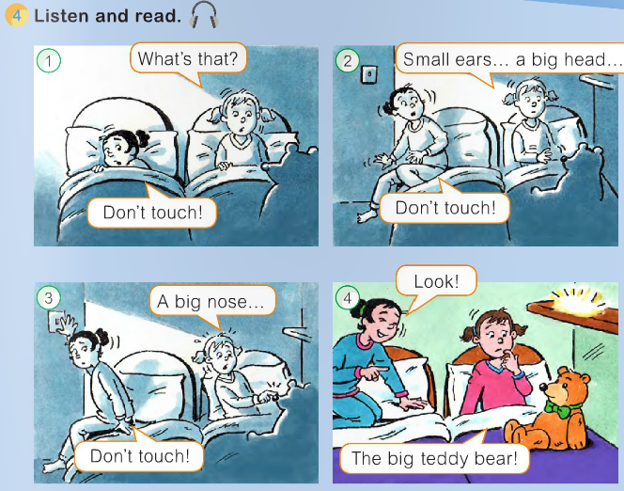
SAUDI STARS 1
Next
Main Page
Previous

Slide 36
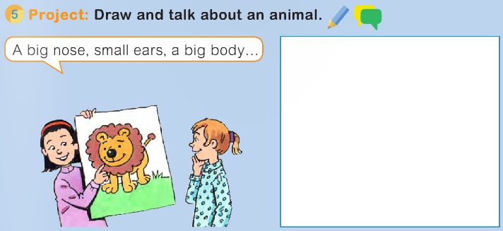
SAUDI STARS 1
Next
Main Page
Previous

Slide 37
Unit 3
My house
Next
Main Page
Previous

Slide 38
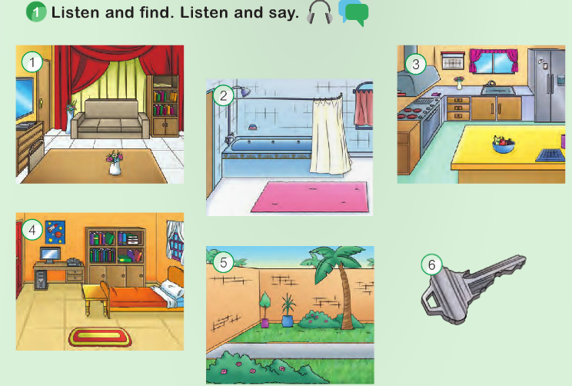
3 My house
Lesson 1
Next
Main Page
Previous

Slide 39
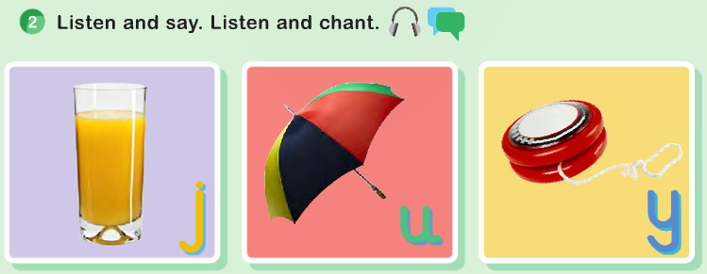
3 My house
Lesson 1
Next
Main Page
Previous

Slide 40
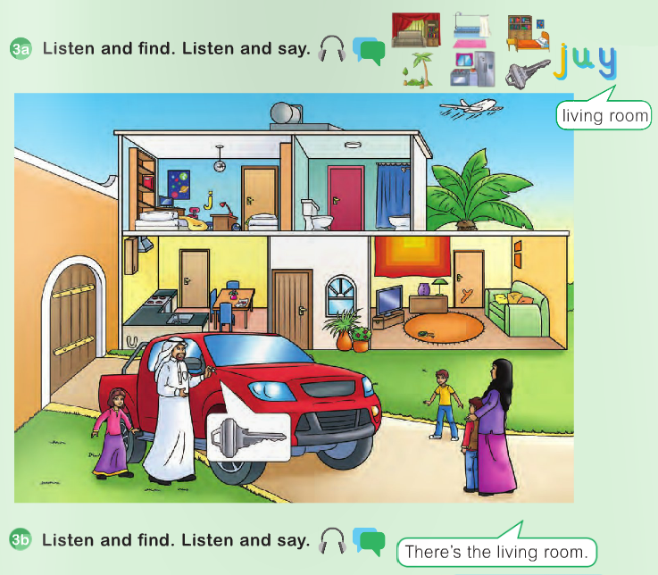
3 My house
Lesson 1
Next
Main Page
Previous

Slide 41
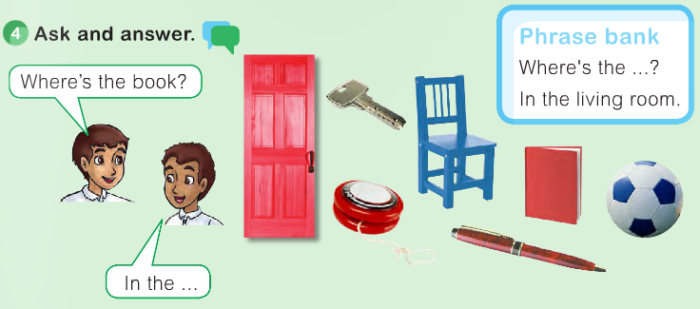
3 My house
Lesson 1
Next
Main Page
Previous

Slide 42
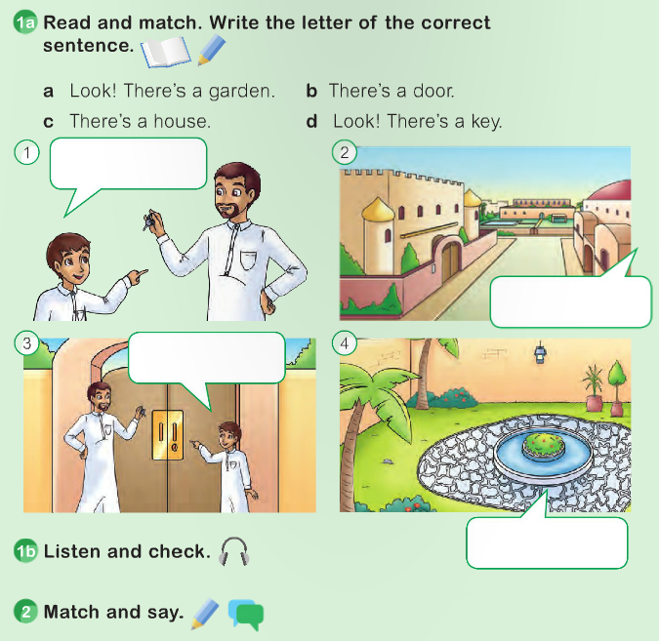
3 My house
Lesson 2
d
c
b
a
Next
Main Page
Previous

Slide 43
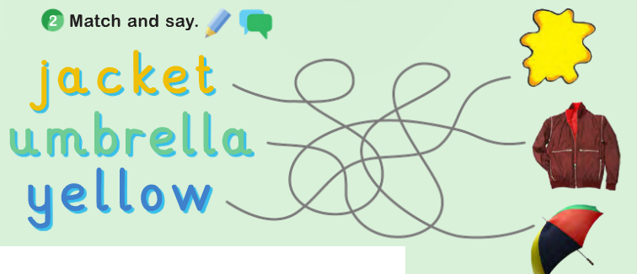
3 My house
Lesson 2
Next
Main Page
Previous

Slide 44
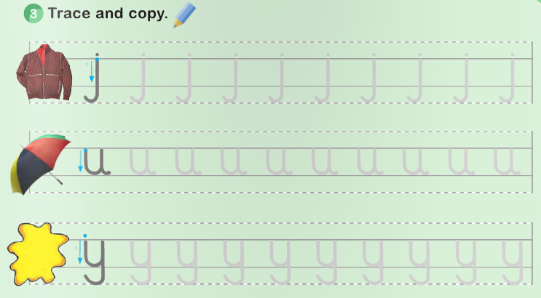
3 My house
Lesson 2
Next
Main Page
Previous

Slide 45
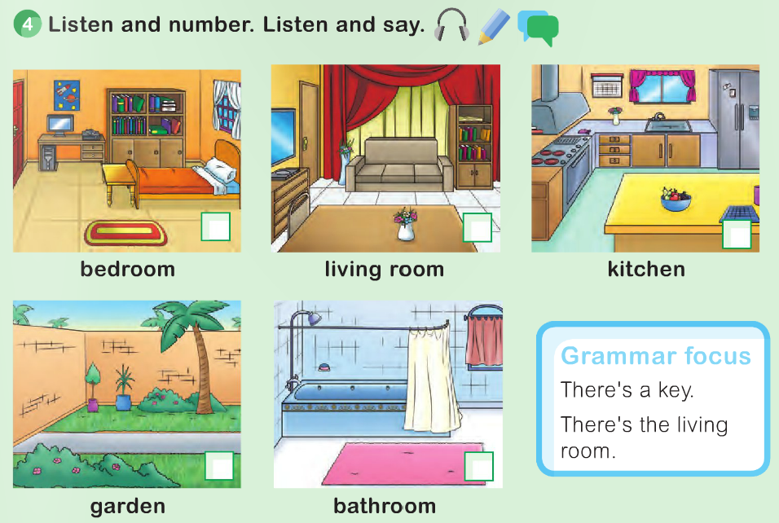
3 My house
Lesson 2
Next
Main Page
Previous

Slide 46
Unit 4
Food
Next
Main Page
Previous

Slide 47
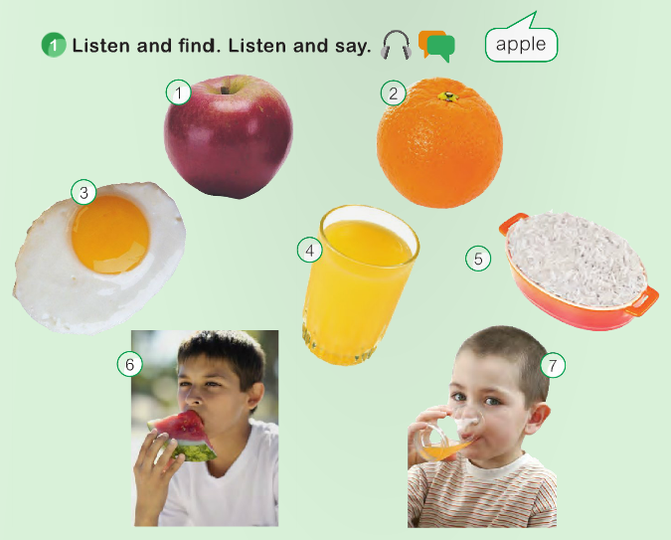
4 Food
Lesson 1
Next
Main Page
Previous

Slide 48
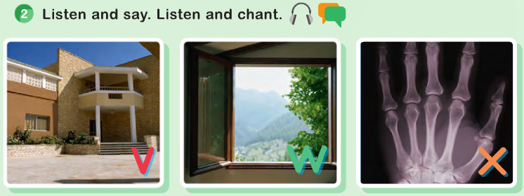
4 Food
Lesson 1
Next
Main Page
Previous

Slide 49
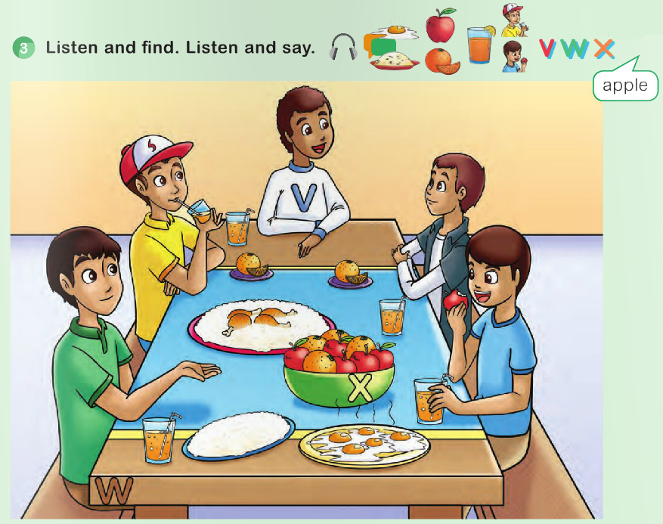
4 Food
Lesson 1
Next
Main Page
Previous

Slide 50
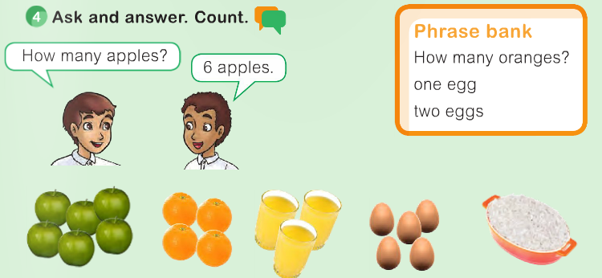
4 Food
Lesson 1
Next
Main Page
Previous

Slide 51
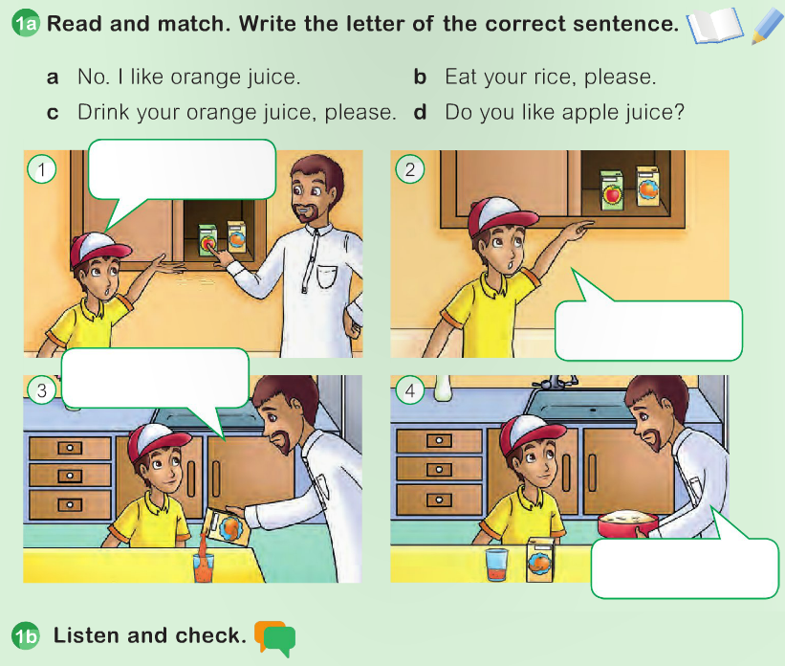
4 Food
Lesson 2
Next
Main Page
Previous

Slide 52
4 Food
Lesson 2
Next
Main Page
Previous

Slide 53
4 Food
Lesson 2
Next
Main Page
Previous

Slide 54
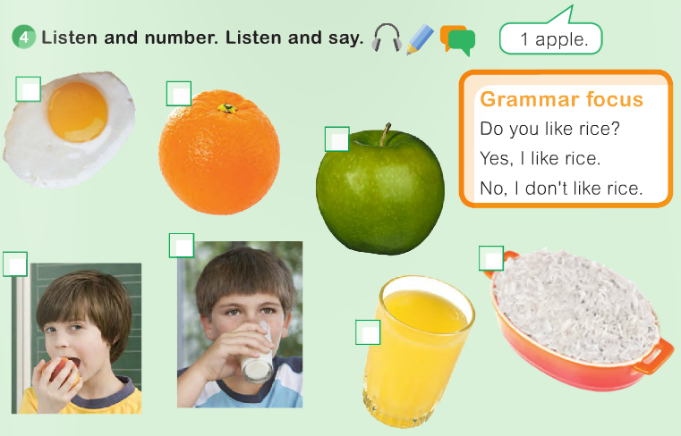
4 Food
Lesson 2
Next
Main Page
Previous

Slide 55
Revision 2
Next
Main Page
Previous

Slide 56
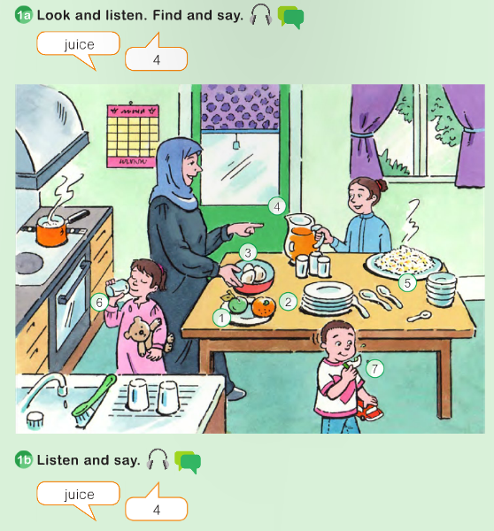
Revision 2
Next
Main Page
Previous

Slide 57
Revision 2
Next
Main Page
Previous

Slide 58
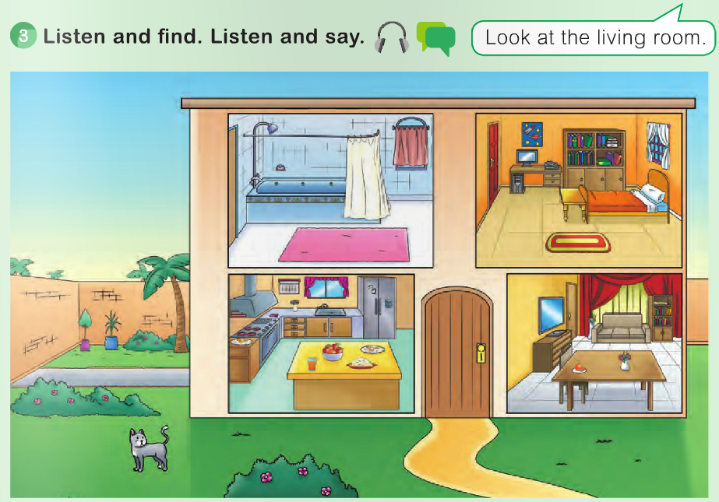
Revision 2
Next
Main Page
Previous

Slide 59
Revision 2
Next
Main Page
Previous

Slide 60
SAUDI
STARS 2
Next
Main Page
Previous

Slide 61
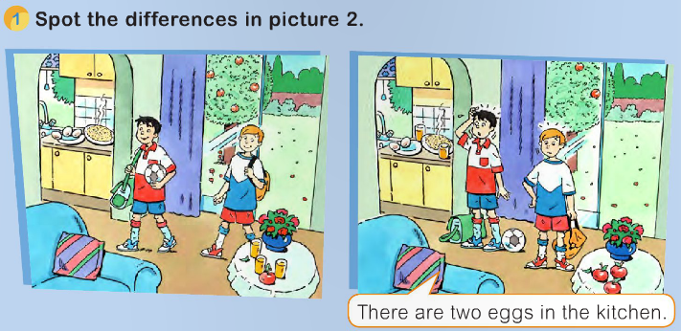
SAUDI STARS 2
Next
Main Page
Previous

Slide 62
SAUDI STARS 2
Next
Main Page
Previous

Slide 63
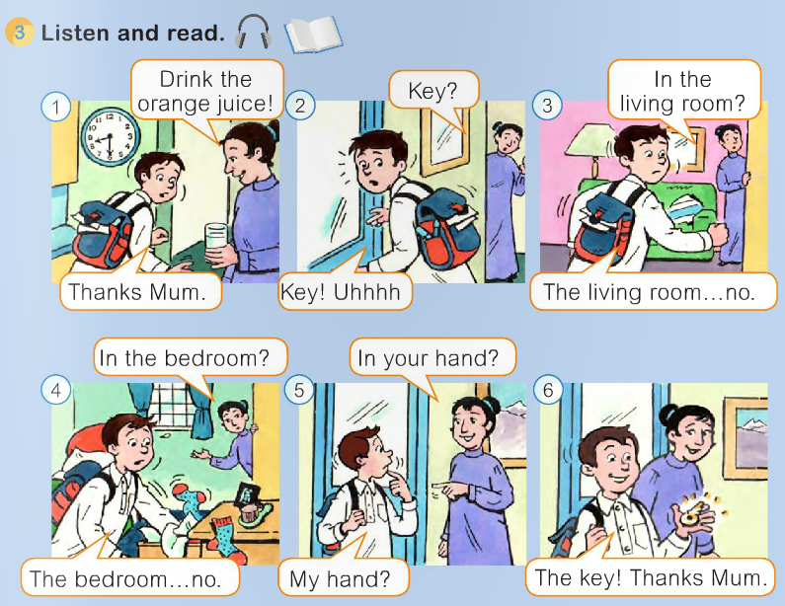
SAUDI STARS 2
Next
Main Page
Previous

Slide 64
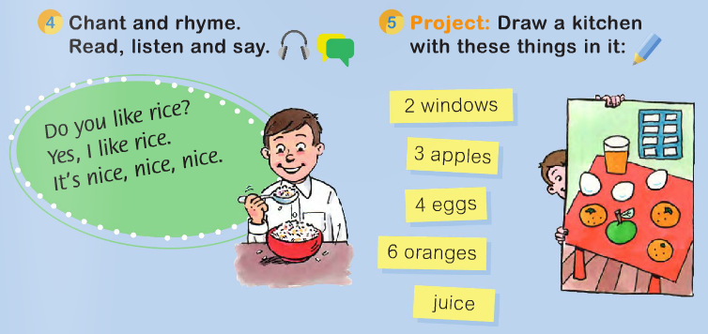
SAUDI STARS 2
Next
Main Page
Previous

Slide 65
Progress
Check 1
Next
Main Page
Previous

Slide 66
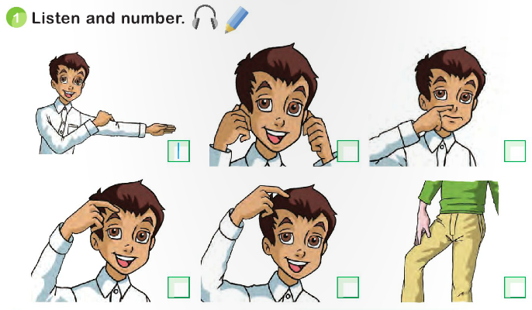
Progress check 1
Next
Main Page
Previous

Slide 67
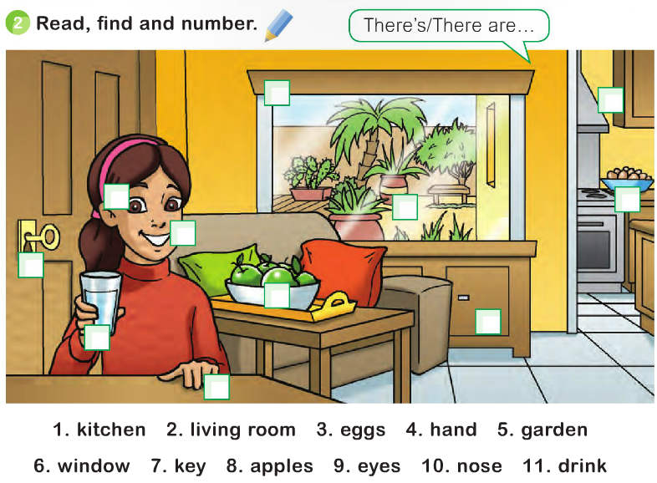
Progress check 1
Next
Main Page
Previous

Slide 68
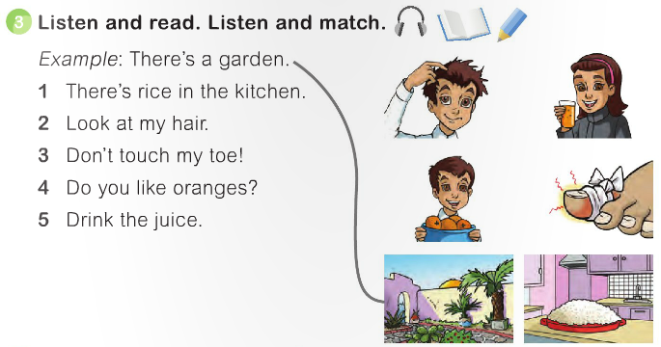
Progress check 1
Next
Main Page
Previous

Slide 69
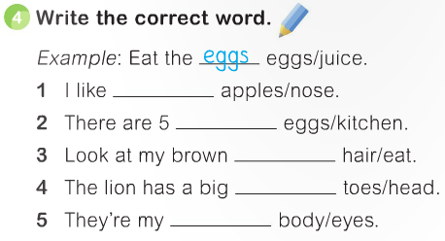
Progress check 1
Next
Main Page
Previous

Slide 70
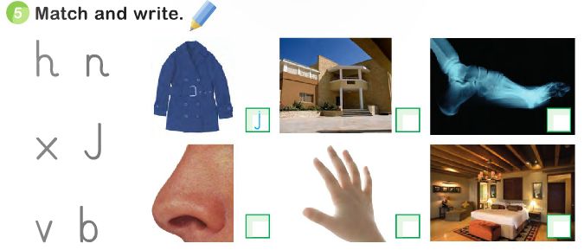
Progress check 1
Next
Main Page
Previous

Slide 71
Unit 5
In the street
Next
Main Page
Previous

Slide 72
5 In the street
Lesson 1
Next
Main Page
Previous

Slide 73
5 In the street
Lesson 1
Next
Main Page
Previous

Slide 74
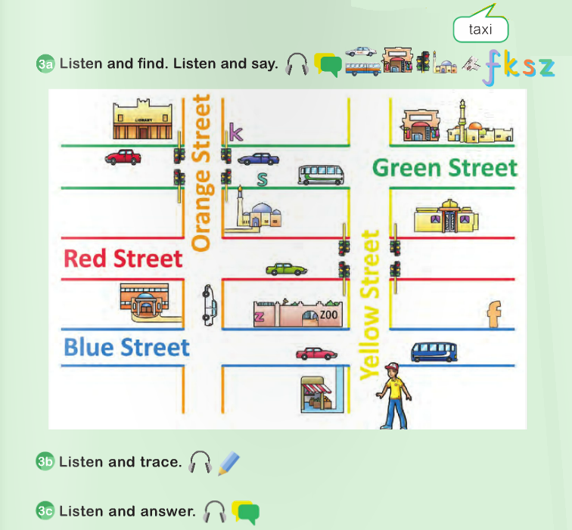
5 In the street
Lesson 1
Next
Main Page
Previous

Slide 75
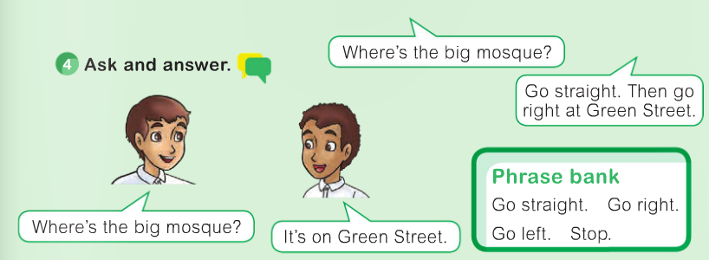
5 In the street
Lesson 1
Next
Main Page
Previous

Slide 76
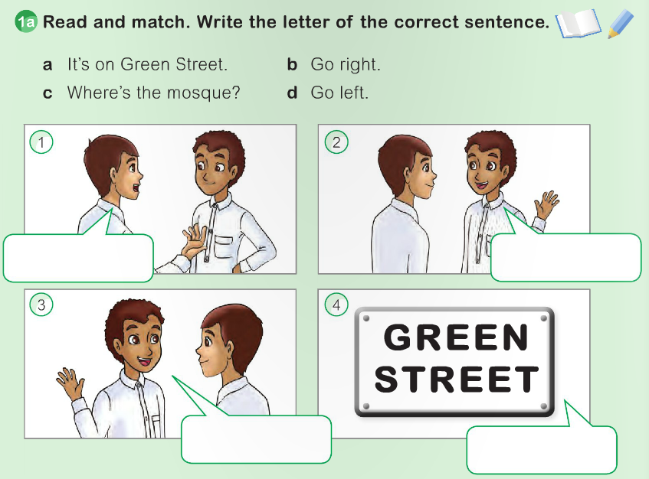
5 In the street
Lesson 2
Next
Main Page
Previous

Slide 77
5 In the street
Lesson 2
Next
Main Page
Previous

Slide 78
5 In the street
Lesson 2
Next
Main Page
Previous

Slide 79
5 In the street
Lesson 2
Next
Main Page
Previous

Slide 80
Day and
weather
Unit 6
Next
Main Page
Previous

Slide 81
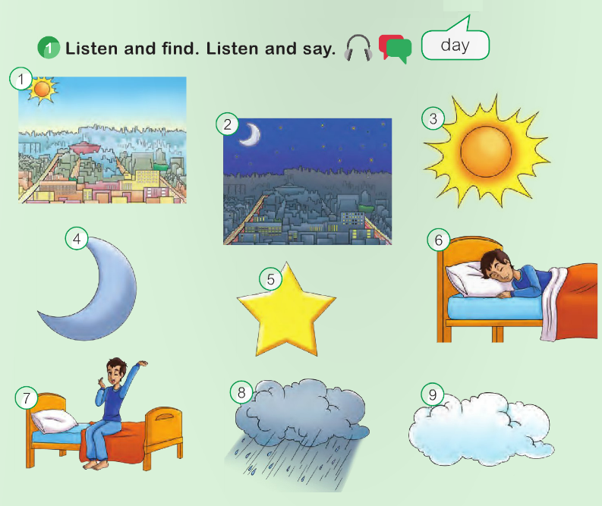
6 Day and weather
Lesson 1
Next
Main Page
Previous

Slide 82
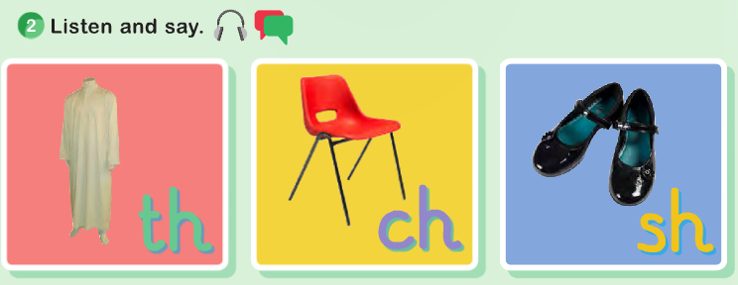
6 Day and weather
Lesson 1
Next
Main Page
Previous

Slide 83
6 Day and weather
Lesson 1
Next
Main Page
Previous

Slide 84
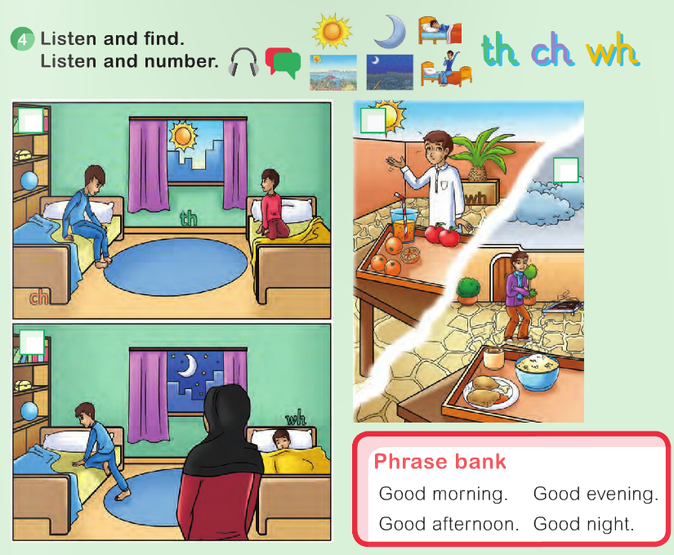
6 Day and weather
Lesson 1
Next
Main Page
Previous

Slide 85
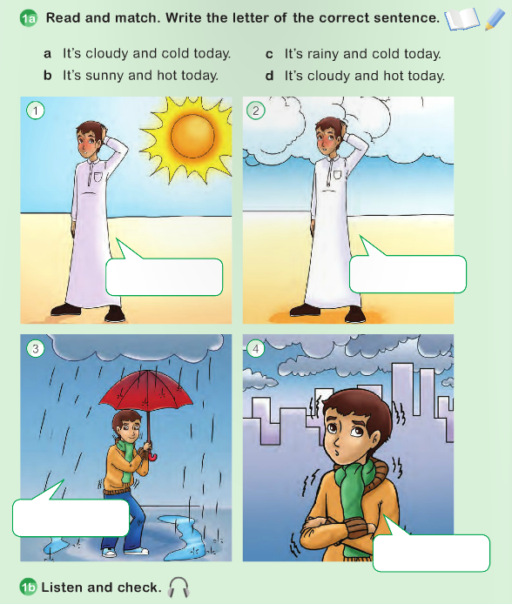
6 Day and weather
Lesson 2
Next
Main Page
Previous

Slide 86
6 Day and weather
Lesson 2
Next
Main Page
Previous

Slide 87
6 Day and weather
Lesson 2
Next
Main Page
Previous

Slide 88
6 Day and weather
Lesson 2
Next
Main Page
Previous

Slide 89
Revision 3
Next
Main Page
Previous

Slide 90
Revision 3
Next
Main Page
Previous

Slide 91
Revision 3
Next
Main Page
Previous

Slide 92
Revision 3
Next
Main Page
Previous

Slide 93
Revision 3
Next
Main Page
Previous

Slide 94
SAUDI
STARS 3
Next
Main Page
Previous

Slide 95
SAUDI STARS 3
Next
Main Page
Previous

Slide 96
SAUDI STARS 3
Next
Main Page
Previous

Slide 97
SAUDI STARS 3
Next
Main Page
Previous

Slide 98
SAUDI STARS 3
Next
Main Page
Previous

Slide 99
Unit 7
My school
Next
Main Page
Previous

Slide 100
7 My school
Lesson 1
Next
Main Page
Previous

Slide 101
7 My school
Lesson 1
Next
Main Page
Previous

Slide 102
7 My school
Lesson 1
Next
Main Page
Previous

Slide 103
7 My school
Lesson 1
Next
Main Page
Previous

Slide 104
7 My school
Lesson 2
Next
Main Page
Previous

Slide 105
7 My school
Lesson 2
Next
Main Page
Previous

Slide 106
7 My school
Lesson 2
Next
Main Page
Previous

Slide 107
7 My school
Lesson 2
Next
Main Page
Previous

Slide 108
Unit 8
My country
Next
Main Page
Previous

Slide 109
8 My country
Lesson 1
Next
Main Page
Previous

Slide 110
8 My country
Lesson 1
Next
Main Page
Previous

Slide 111
8 My country
Lesson 1
Next
Main Page
Previous

Slide 112
8 My country
Lesson 1
Next
Main Page
Previous

Slide 113
8 My country
Lesson 2
Next
Main Page
Previous

Slide 114
8 My country
Lesson 2
Next
Main Page
Previous

Slide 115
8 My country
Lesson 2
Next
Main Page
Previous

Slide 116
8 My country
Lesson 2
Next
Main Page
Previous

Slide 117
Revision 4
Next
Main Page
Previous

Slide 118
Revision 4
Next
Main Page
Previous

Slide 119
Revision 4
Next
Main Page
Previous

Slide 120
Revision 4
Next
Main Page
Previous

Slide 121
Revision 4
Next
Main Page
Previous

Slide 122
SAUDI
STARS 4
Next
Main Page
Previous

Slide 123
SAUDI STARS 4
Next
Main Page
Previous

Slide 124
SAUDI STARS 4
Next
Main Page
Previous

Slide 125
SAUDI STARS 4
Next
Main Page
Previous

Slide 126
SAUDI STARS 4
Next
Main Page
Previous

Slide 127
Progress
Check 2
Next
Main Page
Previous

Slide 128
Progress check 2
Next
Main Page
Previous

Slide 129
Progress check 2
Next
Main Page
Previous

Slide 130
Progress check 2
Next
Main Page
Previous

Slide 131
Progress check 2
Next
Main Page
Previous

Slide 132
THE END
with my pest wishes
Main Page
Previous

