Slide 1
Unit 1 the body
Lesson 1

Slide 3
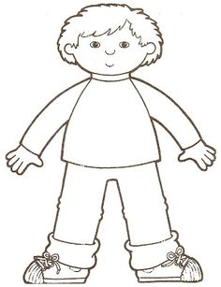
body

Slide 4
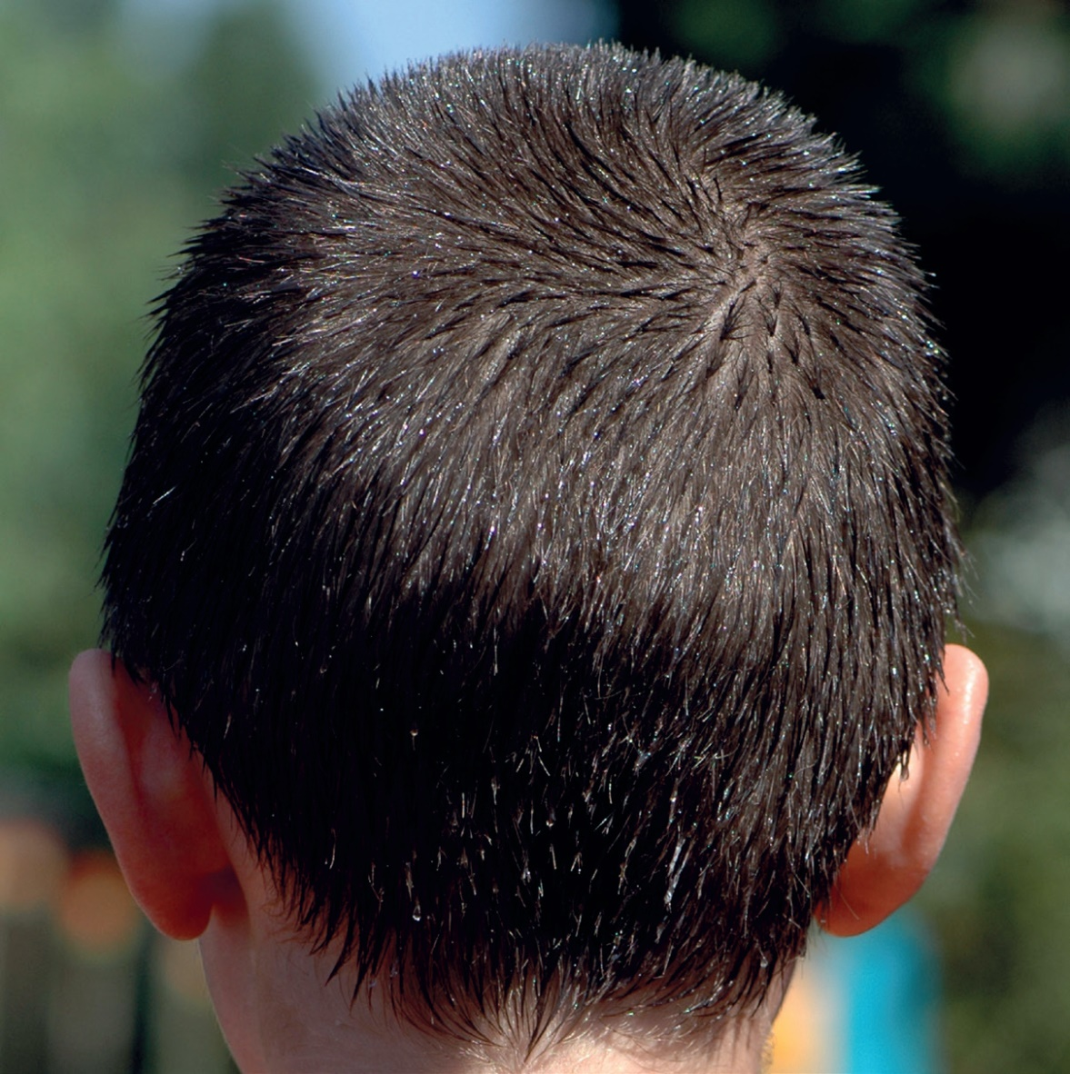
head

Slide 5
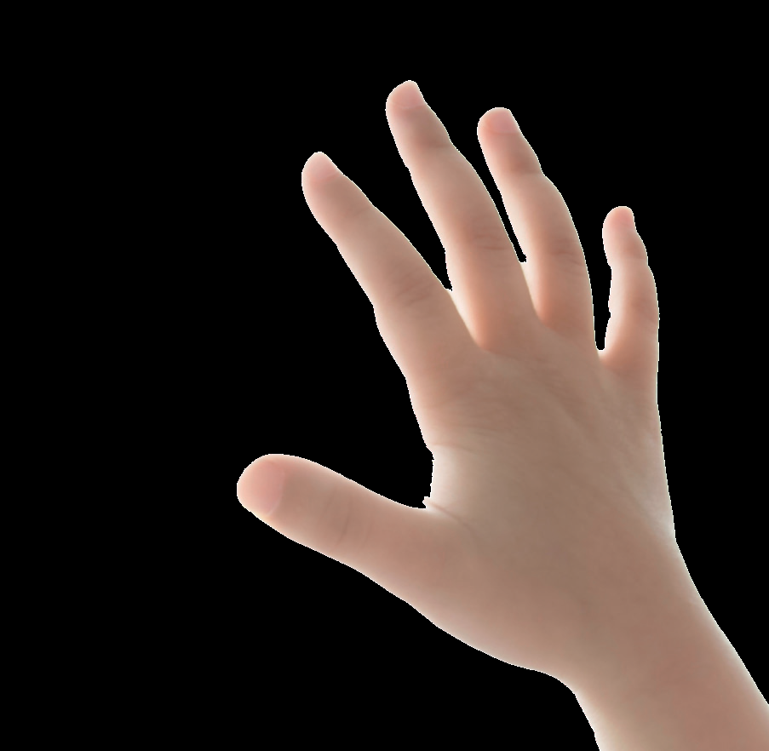
hand

Slide 6
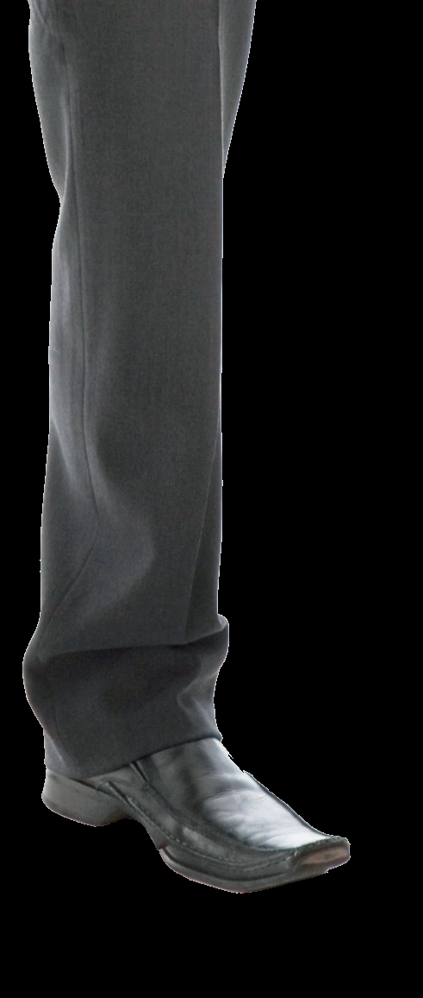
leg

Slide 7
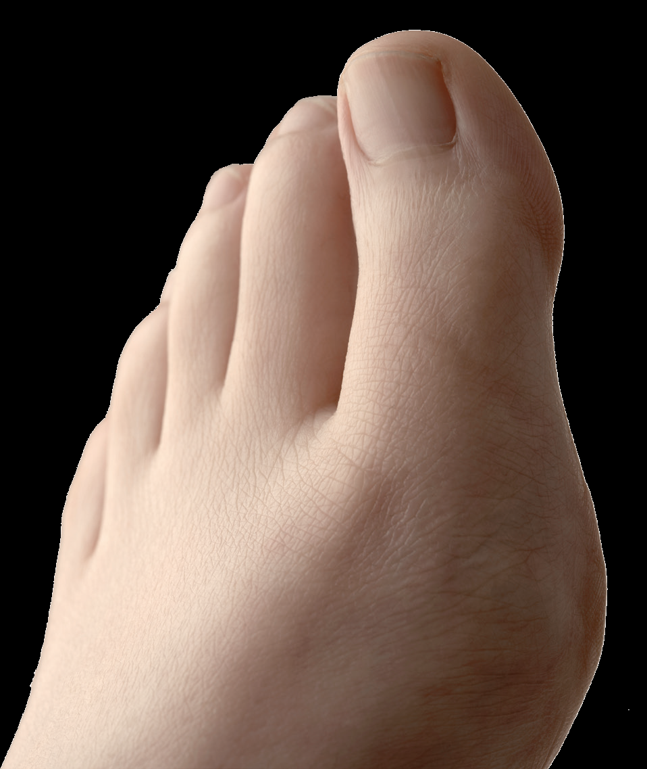
toe

Slide 8
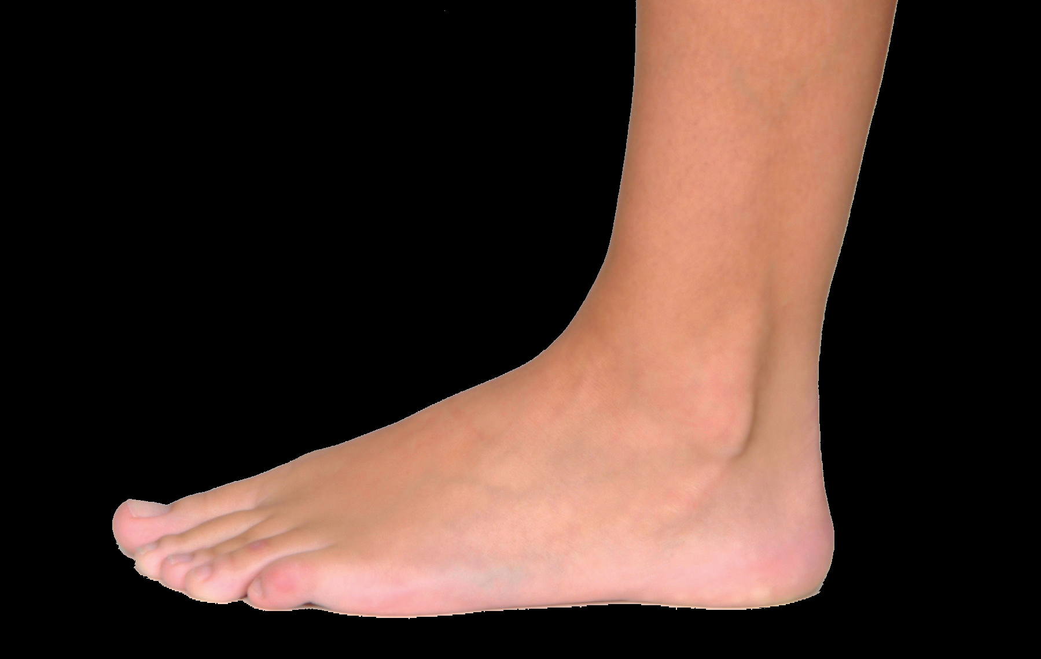
foot

Slide 9
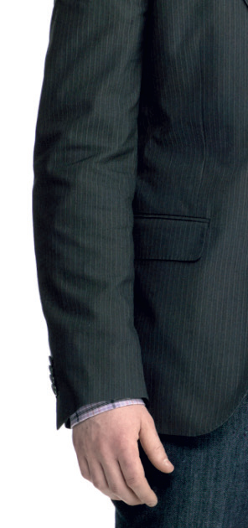
arm

Slide 10
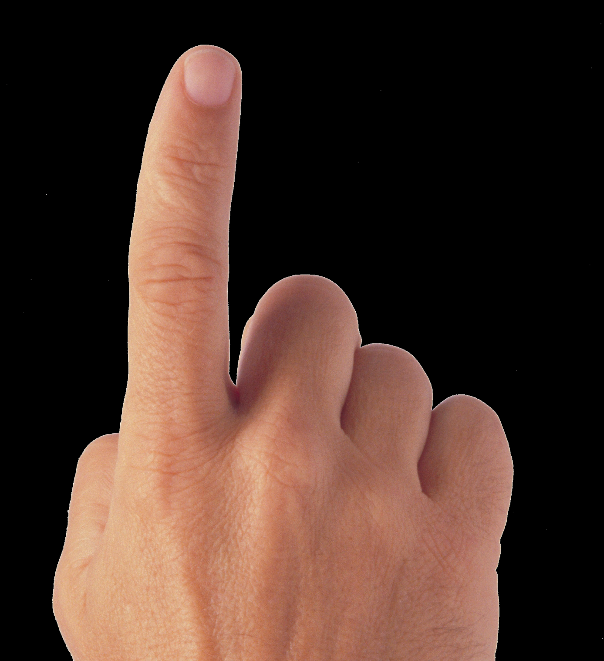
finger

Slide 11
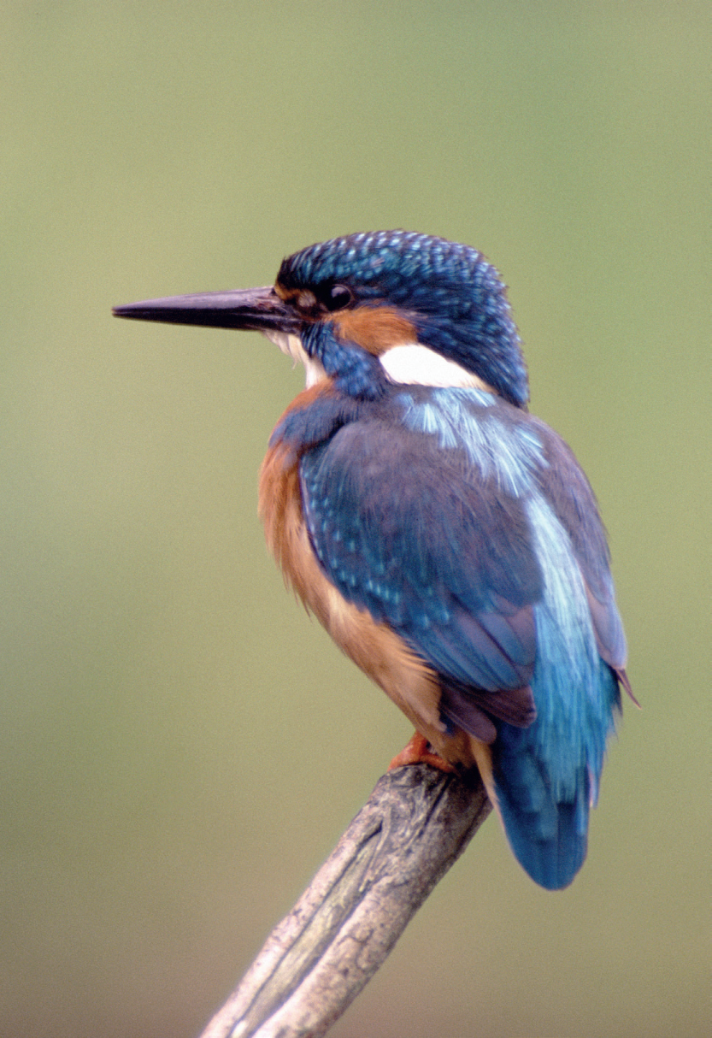
bird
B b

Slide 12
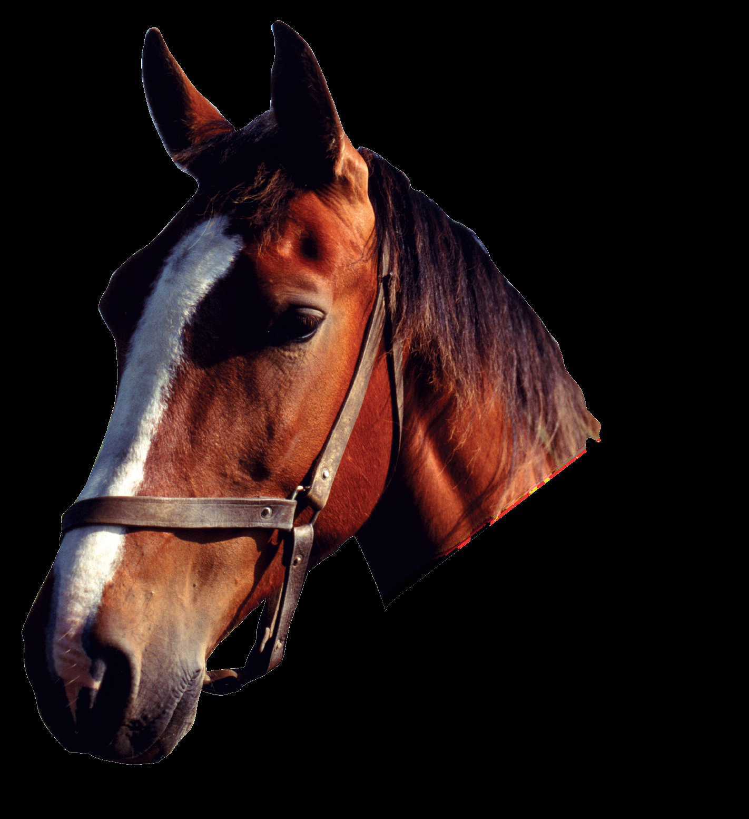
horse
H h

Slide 13
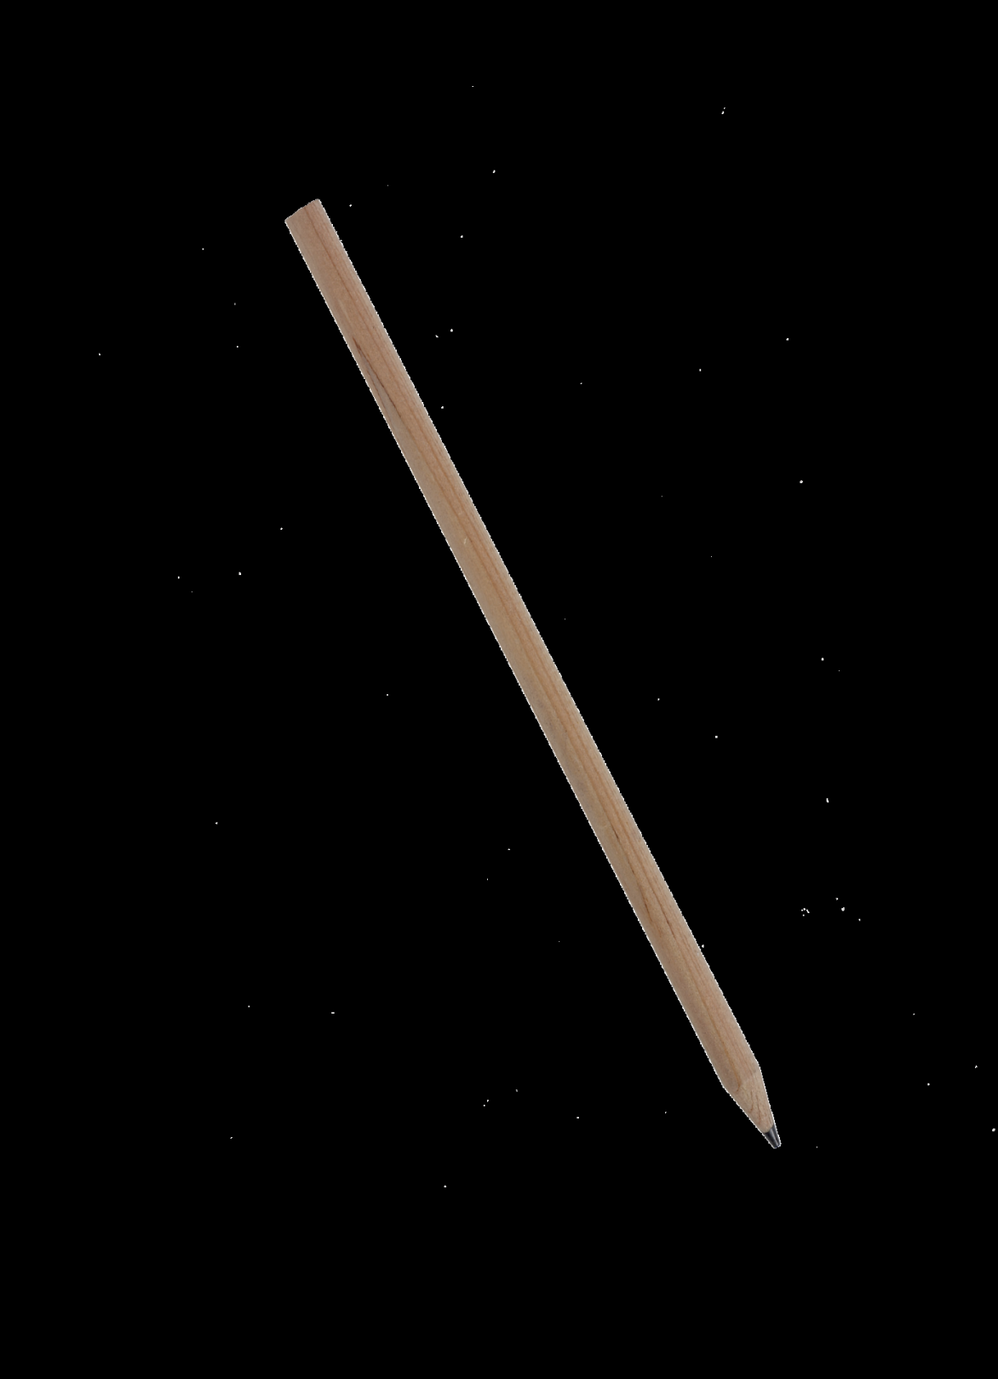
pencil
P p

Slide 14
Write the words & letters on the B.B
Body - head – hand – leg – arm – foot – toe – finger
B b – H h – P p

Slide 15
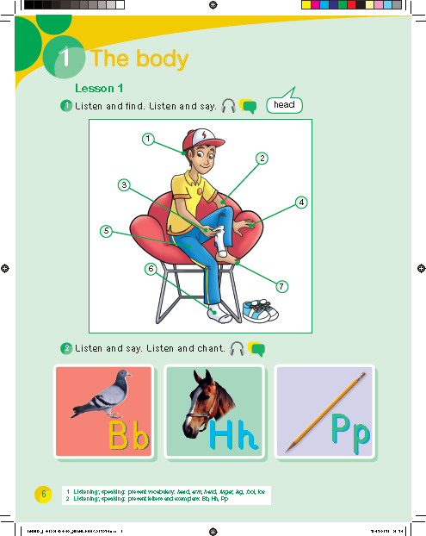

Slide 17
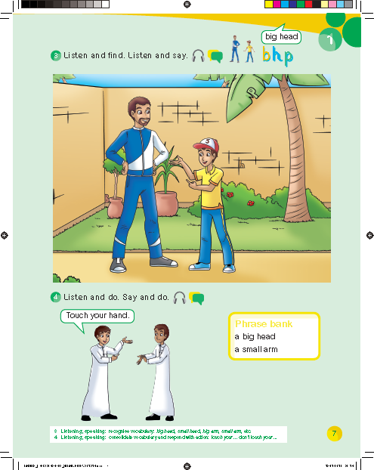

Slide 19
Workbook
p. 59

Slide 20
2
4
7
5
1
6
3

Slide 26
p
b
h

