Slide 1
Chapter 2 Frequency Distribution and Graph

Slide 2
Outline
2-1 Organizing Data
2-2 Histogram , Frequency Polygons, and Ogives
2-3 Other Types of Graphs Summary

Slide 3
2-1 Organizing Data
When data are collected in original form, they are called raw data.
For example : raw data
Score | f
8 | 3
7 | 2
6 | 3
5 | 4
4 | 1
2 | 5
2 | 5 | 8 | 7 | 2 | 2
6 | 8 | 5 | 2 | 5 | 7
4 | 5 | 6 | 2 | 8 | 6

Slide 4
raw data
data collected in original form
frequency distribution
the raw data is organized

Slide 5
frequency distribution
is the organizing of raw data in table form, using classes and frequencies.
Each raw data value is placed into a quantitative or qualitative category called a class.
A class then is the number of data values contained in a specific class called frequency .

Slide 6
Types of Frequency Distributions
Grouped Frequency Distributions
Categorical frequency distributions
Used for data that can be placed in specific categories, such as nominal- or ordinal-level data.
when the range of values in the data set is very large. The data must be grouped into classes that are more than one unit in width.

Slide 7
Example2-1: 25 Army inductees were given a blood test to determine their blood type. The data set is :
A B B AB O O O B AB B B B O A O A O O O AB AB A O B A
percent | frequency | Class
20% | 5 | A
28% | 7 | B
36% | 9 | O
16% | 4 | AB
100% | 25 | Total
Sample size = n

Slide 8
Grouped Frequency Distributions
Lower class
Upper class
Lower boundary
Upper boundary
Class limits | Class boundaries | Tally | Frequency
58-64 | 57.5-64.5 | / | 1
65-71 | 64.5-71.5 | / //// | 6
72-78 | 71.5-78.5 | ///// ///// | 10
79-85 | 78.5-85.5 | //// ///// //// | 14
86-92 | 85.5-92.5 | ///// ///// // | 12
93-99 | 92.5-99.5 | ///// | 5
100-106 | 99.5-106.5 | // | 2 ----------- Total 100
First class
second class

Slide 9
Terms Associated with a Grouped Frequency Distribution
Class limits: represent the smallest and largest data values that can be included in a class.
The lower class limit represents the smallest data value
The upper class limit represents the largest data value
Class limits should have the same decimal place value as the data,
In the blood glucose levels example, the values 58 and 64 of the first class are the class limits
The lower class limit is 58
The upper class limit is 64.
Class limits
58-64

Slide 10
The class boundaries
The class boundaries are used to separate the class so that there is no gap in frequency distribution.
Lower boundary= lower limit - 0.5
Upper boundary= upper limit + 0.5
Class boundaries
57.5-64.5
64.5-71.5
71.5-78.5
78.5-85.5
85.5-92.5
92.5-99.5

Slide 11
the class boundaries should have one additional place value and end in a 5.
For example: Class limit 7.8-8.8
Class boundary 7.75-8.85
Lower boundary= lower limit - 0.05
=7.8- 0.05 =7.75
Upper boundary= upper limit + 0.05
=8.8+0.05=8.85

Slide 12
Example:
Find the class boundaries for each class ?
2.15 – 3.93
49.005

Slide 13
The class width can be calculated by subtracting:
For example:
class width : 65-58= 7
Class width=lower of second class limit-lower of first class limit
Or
Class width=upper of second class limit-upper of first class limit
Class limits | Class boundaries
58-64 | 57.5-64.5
65-71 | 64.5-71.5
class width
class width

Slide 14
The class midpoint X_{m} is found by adding the lower and upper class limit (or boundary) and dividing by 2 .
The midpoint is the numeric location of the center
of the class
X_{m} =
Or
X_{m} =
For example :

Slide 15
Rules for Classes in Grouped Frequency Distributions
There should be 5-20 classes.
The class width should be an odd number.
The classes must be mutually exclusive.
4. The classes must be continuous.
5. The classes must be exhaustive.
6. The classes must be equal in width
(except in open-ended distributions).
Age
10-20
20-30
30-40
40-50
Age
10-20
21-31
32-42
43-53
Better way to construct a frequency distribution

Slide 16
Cumulative Frequency
Cumulative frequency :The sum of the frequencies accumulated up the upper boundary of a class in the distortion .
Cumulative frequency distribution is a distribution that shows the number of data values less than or equal t a specific value (usually an upper boundary)

Slide 17
Class Limits | Class Boundaries | Frequency
100 - 104 105 - 109 110 - 114 115 - 119 120 - 124 125 - 129 130 - 134 | 99.5 - 104.5 104.5 - 109.5 109.5 - 114.5 114.5 - 119.5 119.5 - 124.5 124.5 - 129.5 129.5 - 134.5 | 2 8 18 13 7 1 1
Class Boundaries | Cumulative Frequency
Less than 99.5 Less than 104.5 Less than 109.5 Less than 114.5 Less than 119.5 Less than 124.5 Less than 129.5 Less than 134.5 | 0 2 10 28 41 48 49 50

Slide 18
Constructing a Grouped Frequency Distribution
1- The following data represent the record high temperatures for each of the 50 states. Construct a grouped frequency distribution for the data using 7 classes.
112 100 127 120 134 118 105 110 109 112
110 118 117 116 118 122 114 114 105 109
107 112 114 115 118 117 118 122 106 110
116 108 110 121 113 120 119 111 104 111
120 113 120 117 105 110 118 112 114 114

Slide 19
STEP 1 Determine the classes.
Find the class width by dividing the range by the number of classes 7.
Range = High – Low
= 134 – 100 = 34
Width = Range/7 = 34/7 ≈ 4.9=5
Round up

Slide 20
Class Limits | Class Boundaries | Frequency | Cumulative Frequency
100 - 104 105 - 109 110 - 114 115 - 119 120 - 124 125 - 129 130 - 134
99.5 - 104.5
104.5 - 109.5
109.5 - 114.5
114.5 - 119.5
119.5 - 124.5
124.5 - 129.5
129.5 - 134.5
2
8
18
13
7
1
1
0
2
10
28
41
48
49
50

Slide 21
2- The data shown here represent the number of miles per gallon that 30 selected four-wheel- drive sports utility vehicles obtained in city driving.
12 17 12 14 16 18
16 18 12 16 17 15
15 16 12 15 16 16
12 14 15 12 15 15
19 13 16 18 16 14

Slide 22
Range = High – Low
= 19 – 12 = 7
So the class consisting of the single data value can be used. They are 12,13,14,15,16,17,18,19.
This type of distribution is called ungrouped frequency distribution

Slide 23
Class Limits | Class Boundaries | Frequency | Cumulative Frequency
12 13 14 15 16 17 18 19 | 11.5-12.5 12.5-13.5 13.5-14.5 14.5-15.5 15.5-16.5 16.5-17.5 17.5-18.5 18.5-19.5 | 6 1 3 6 8 2 3 1 | 0 6 7 10 16 24 26 29 30

Slide 24
Find the class boundary , midpoint of the last class and the class width?
Class | Frequency
4-9 | 2
10-15 | 4
16-21 | 3
22-27 | 8
28-33 | 5

Slide 25
Solution
Class | Boundaries
4-9 | 3.5 – 9.5
10-15 | 9.5-15.5
16-21 | 15.5-21.5
22-27 | 21.5-27.5
28-33 | 27.5-33.5
X_{m} =
Class width= 10 - 4 = 6
Note: This PowerPoint is only a summary and your main source should be the book.

Slide 26
Graphs
The three most commonly used graphs in research are:
The histogram
2. The frequency polygon
3. The cumulative frequency graph, or ogive

Slide 27
Graphical representation: why?
Purpose of graphs in statistics is to convey the data to the viewers in pictorial form
• Easier for most people to understand the meaning of data in form of graphs
• They can also be used to discover a trend or pattern in a situation over a period of time
• Useful in getting the audience’s attention in a publication or a speaking presentation

Slide 28
Histogram
The histogram is a graph that displays the data by using contiguous vertical bars (unless the frequency of a class is 0) of various heights to represent the frequencies of the classes.
The class boundaries are represented on the horizontal axis

Slide 29
Example 2-4: Construct a histogram to represent the data for the record high temperatures for each of the 50 states (see Example 2–2 for the data).
Class Limits | Class Boundaries | Frequency
100 - 104 105 - 109 110 - 114 115 - 119 120 - 124 125 - 129 130 - 134 | 99.5 - 104.5 104.5 - 109.5 109.5 - 114.5 114.5 - 119.5 119.5 - 124.5 124.5 - 129.5 129.5 - 134.5 | 2 8 18 13 7 1 1

Slide 30
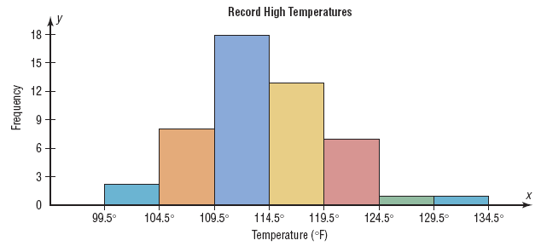
Histograms use class boundaries and
frequencies of the classes.

Slide 31
Frequency polygons
The frequency polygon is a graph that displays the data
by using lines that connect points plotted for the frequencies at the midpoints of the classes. The frequencies are represented by the heights of the points.
The class midpoints are represented on the horizontal axis.

Slide 32
Example 2-5:Construct a frequency polygon to represent the data for the record high temperatures for each of the 50 states (see Example 2–2 for the data).
Class Limits | Class Midpoints | Frequency
100 - 104 105 - 109 110 - 114 115 - 119 120 - 124 125 - 129 130 – 134 | 102 107 112 117 122 127 132 | 2 8 18 13 7 1 1

Slide 33
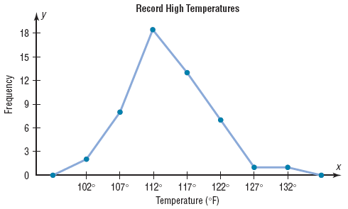
Frequency polygons use class midpoints and
frequencies of the classes.
A frequency polygon
is anchored on the
x-axis before the first
class and after the
last class.

Slide 34
Cumulative Frequency Graphs Or Ogives
The ogive is a graph that represents the cumulative frequencies for the classes in a frequency distribution
Cumulative frequency distribution is a distribution that shows the number of data values less than or equal t a specific value .
The upper class boundaries are represented on the horizontal axis

Slide 35
Example 2-6:Construct an ogive to represent the data for the record high temperatures for each of the 50 states (see Example 2–2 for the data).
Class Limits | Class Boundaries | Frequency
100 - 104 105 - 109 110 - 114 115 - 119 120 - 124 125 - 129 130 - 134 | 99.5 - 104.5 104.5 - 109.5 109.5 - 114.5 114.5 - 119.5 119.5 - 124.5 124.5 - 129.5 129.5 - 134.5 | 2 8 18 13 7 1 1

Slide 36
Class Limits | Class Boundaries | Frequency
100 - 104 105 - 109 110 - 114 115 - 119 120 - 124 125 - 129 130 - 134 | 99.5 - 104.5 104.5 - 109.5 109.5 - 114.5 114.5 - 119.5 119.5 - 124.5 124.5 - 129.5 129.5 - 134.5 | 2 8 18 13 7 1 1
Class Boundaries | Cumulative Frequency
Less than 99.5 Less than 104.5 Less than 109.5 Less than 114.5 Less than 119.5 Less than 124.5 Less than 129.5 Less than 134.5 | 0 2 10 28 41 48 49 50

Slide 37
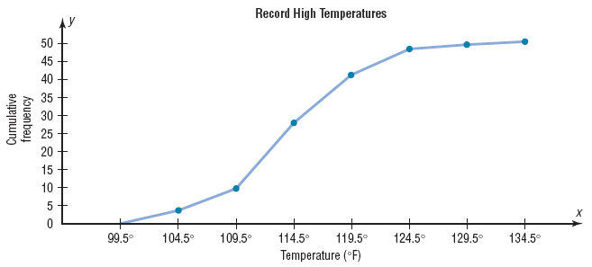
Ogives use upper class boundaries and cumulative frequencies of the classes.

Slide 38
Constructing Statistical Graphs
1: Draw and label the x and y axes.
2: Choose a suitable scale for the frequencies or cumulative frequencies, and label it on the y axis.
3: Represent the class boundaries for the histogram or ogive, or the midpoint for the frequency polygon, on the x axis.
4: Plot the points and then draw the bars or lines.

Slide 39
Relative Frequency Graphs
If proportions are used instead of frequencies, the graphs are called relative frequency graphs.
.

Slide 40
Example 2-7:Construct a histogram, frequency polygon, and ogive using relative frequencies for the distribution (shown here) of the miles that 20 randomly selected runners ran during a given week.
Class Boundaries | Frequency
5.5 - 10.5 10.5 - 15.5 15.5 - 20.5 20.5 - 25.5 25.5 - 30.5 30.5 - 35.5 35.5 - 40.5 | 1 2 3 5 4 3 2

Slide 41
Histograms
The following is a frequency distribution of miles run per week by 20 selected runners.
Class Boundaries | Frequency ( f ) | Relative Frequency
5.5 - 10.5 10.5 - 15.5 15.5 - 20.5 20.5 - 25.5 25.5 - 30.5 30.5 - 35.5 35.5 - 40.5 | 1 2 3 5 4 3 2
1/20 =
2/20 =
3/20 =
5/20 =
4/20 =
3/20 =
2/20 =
0.05
0.10
0.15
0.25
0.20
0.15
0.10
The sum of the relative frequencies will always be 1
Σf = 20
Σrf = 1.00

Slide 42
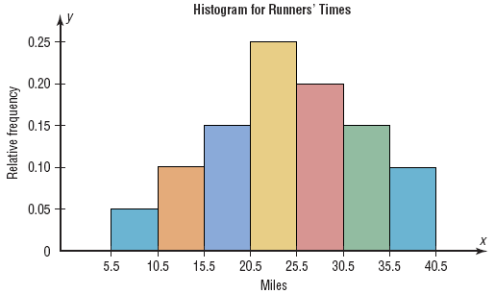
Use the class boundaries and the relative frequencies of the classes.

Slide 43
Frequency Polygons
The following is a frequency distribution of miles run per week by 20 selected runners.
Class Boundaries | Class Midpoints | Relative Frequency
5.5 - 10.5 10.5 - 15.5 15.5 - 20.5 20.5 - 25.5 25.5 - 30.5 30.5 - 35.5 35.5 - 40.5 | 8 13 18 23 28 33 38 | 0.05 0.10 0.15 0.25 0.20 0.15 0.10

Slide 44
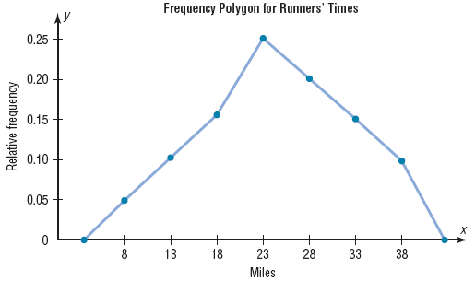
Use the class midpoints and the relative frequencies of the classes.

Slide 45
Ogives
The following is a frequency distribution of miles run per week by 20 selected runners.
Class Boundaries | Frequency | Cumulative Frequency | Cum. Rel. Frequency
5.5 - 10.5 10.5 - 15.5 15.5 - 20.5 20.5 - 25.5 25.5 - 30.5 30.5 - 35.5 35.5 - 40.5 | 1 2 3 5 4 3 2 | 0 1 3 6 11 15 18 20
0
1/20 =
3/20 =
6/20 =
11/20 =
15/20 =
18/20 =
20/20 =
0
0.05
0.15
0.30
0.55
0.75
0.90
1.00
the last class will always have a cum.Rel. frequency equal 1
Σf = 20

Slide 46
Ogives use upper class boundaries and cumulative relative frequencies of the classes.
Class Boundaries | Cum. Rel. Frequency
Less than 5.5
Less than 10.5
Less than 15.5
Less than 20.5
Less than 25.5
Less than 30.5
Less than 35.5
Less than 40.5
0
0.05
0.15
0.30
0.55
0.75
0.90
1.00

Slide 47
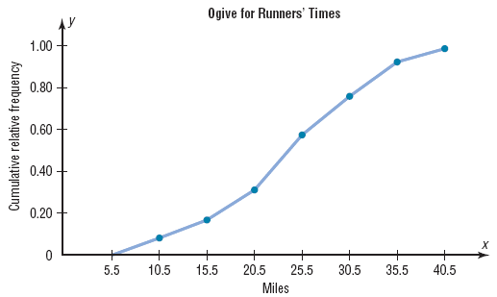
Use the upper class boundaries and the cumulative relative frequencies.

Slide 48
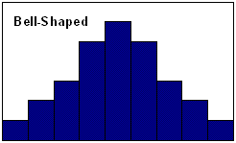
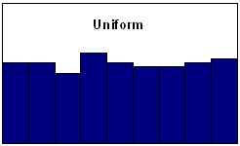
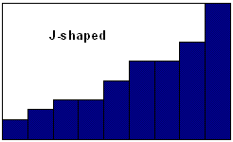
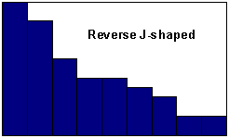
Shapes of Distributions
Flat
J shaped:few data values on left side and increases as one moves to right
Reverse J shaped: opposite of the j-shaped distribution

Slide 49
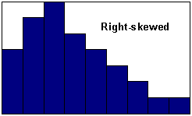
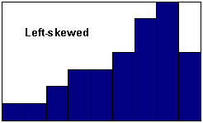
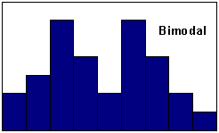
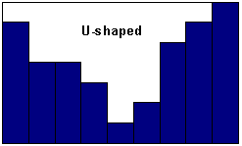
Positively skewed Negatively skewed

Slide 50
2.3 Other Types of Graphs
1. A bar graph
2. A Pareto chart
3. The Time series graph
4. The Pie graph

Slide 51
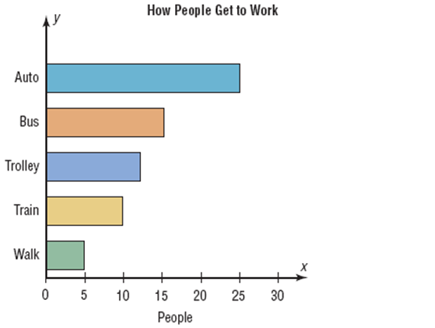
A bar graph represents the data by using vertical or horizontal bars whose heights or lengths represent the frequencies of the data .
When the data are
qualitative or
categorical
,bar graphs can be used.
Page (70)

Slide 52
*Example 2-8 P(69):College Spending for First-Year Students:
Class | Frequency
Electronic | 728$
Dorm decor | 344$
Clothing | 141$
Shoes | 72$

Slide 53
*Example 2-8 P(69):College Spending for First-Year Students:
Class | Frequency
Electronic | 728$
Dorm decor | 344$
Clothing | 141$
Shoes | 72$

Slide 54
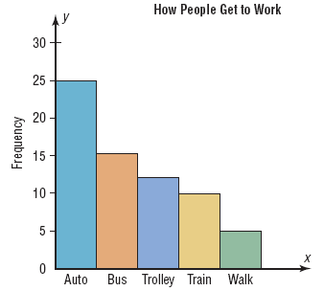
A Pareto chart is used to represent a frequency distribution for a categorical variable, and the frequencies are displayed by the heights of vertical bars, which are arranged in order from highest to lowest.
Pareto chart
When the variable
displayed on the
horizontal axis is
qualitative or
categorical, a
Pareto chart can be used

Slide 55
*Example 2-9 P(70): Turnpike costs:
Class (State) | Freq.
Indiana | 2.9
Oklahoma | 4.3
Florida | 6
Maine | 3.8
Pennsylvania | 5.8

Slide 56
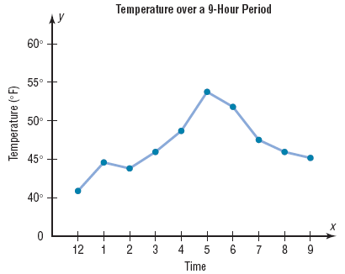
A time series graph represents data that occur
over a specific period of time.
When data are
collected over a
period of time,
they can be
represented by a
time series graph
(line chart)
Compound time series graph: when two data sets
are compared on the same graph.(Page 73)

Slide 57
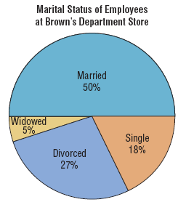
A pie graph is a circle that is divided into sections or
wedges according to the percentage of frequencies
in each category of the distribution.
The purpose of the pie graph is to show the relationship of the parts to the whole by visually comparing the sizes of the sections.
Percentages or proportions can be used.
The variable is nominal or categorical.

Slide 58
Example 2-12:
Construct a pie graph showing the blood types of the army inductees described in example 2-1 .
Class | Frequency | percent
A | 5 | 20%
B | 7 | 28%
O | 9 | 36%
AB | 4 | 16%
Total | 25 | 100%
ͦ
ͦ
%
Shown in figure 2-15

Slide 59
* Example 2-12 P(75): Blood Types for Army Inductees:
class | Freq. | Perc.
A | 5 | 20%
B | 7 | 28%
O | 9 | 36%
AB | 4 | 16%

Slide 60
Misleading graphs
Have a look to page no. 77
Note: This PowerPoint is only a summary and your main source should be the book.

Slide 61
A stem and leaf plots is a data plot that uses part of a data value as the stem and part of the data value as the leaf to form groups or classes.
The stem and leaf plot is a method of organizing data and is a combination of sorting and graphing.
It has the advantage over a grouped frequency distribution of retaining the actual data while showing them in graphical form.
Stem | leaves
2 | 4
4 | 1
- 24 is shown as
-41 is shown as

Slide 62
Example 2-13: At an outpatient testing center, the number of cardiograms performed each day for 20 days is shown. Construct a stem and leaf plot for the data.
25 31 20 32 13
14 43 02 57 23
36 32 33 32 44
32 52 44 51 45

Slide 63
25 31 20 32 13
14 43 02 57 23
36 32 33 32 44
32 52 44 51 45
Unordered Stem Plot
Ordered Stem Plot
0 | 2
1 | 3 | 4
2 | 0 | 3 | 5
3 | 1 | 2 | 2 | 2 | 2 | 3 | 6
4 | 3 | 4 | 4 | 5
5 | 1 | 2 | 7
0
2
1
3
4
2
5
0
3
3
1
2
6
2
3
2
2
4
3
4
4
5
5
7
2
1

Slide 64
Example 1 :
24, 26, 27, 30, 32, 41
27, 38 , 24, 21
Example 2 :
stem | leaves
32 | 4 7
33 | 0 2 5
34 | 1 5
Data in ordered array:
324,327,330,332,335,341,345

Slide 65
Quantitative | Qualitative or Categorical
Histograms | bar graph
Frequency Polygons | Pareto chart
Ogives | Pie graph
The Time series graph
stem and leaf plots

