Slide 1
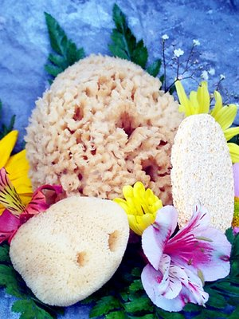
Sponges
Sponges are a diverse group of common types, with about 5000 species known across the world.
Sponges are primarily marine, but around 150 species live in fresh water.
Sponges have cellular-level organization, meaning that that their cells are specialized so that different cells perform different functions.
This is the simplest kind of cellular organization found among parazoans.

Slide 2
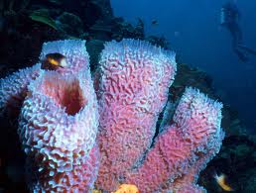
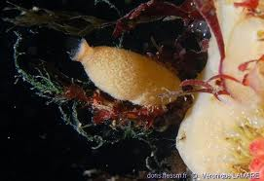
sponges include a system of pores (also called ostia) and canals, through which water passes.

Slide 3
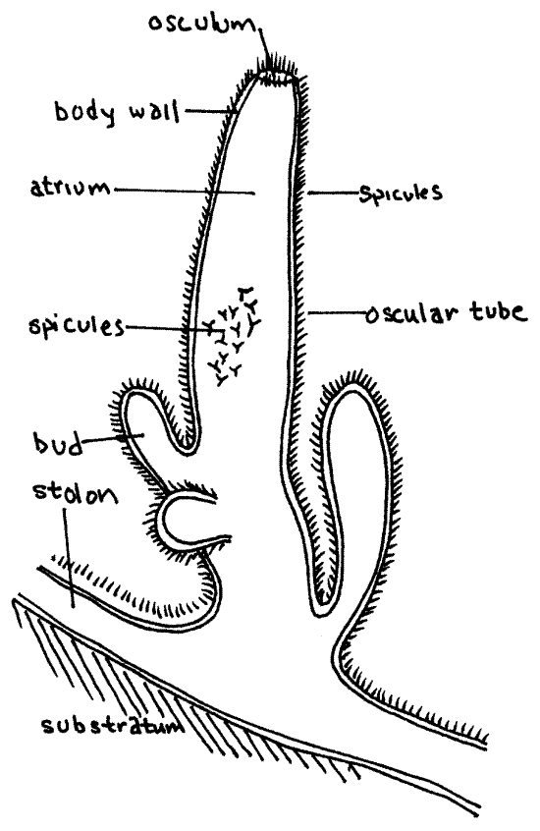
*Sponges have three different types of body plans
Asconoid
sponges are shaped like a simple tube perforated by pores.
The open internal part of the tube is called the spongocoel.
There is a single opening to the outside, the osculum.
Example: Leucosolenia
Classification
Phylum : Porifera
Class : Calcarea
Order : Homocoela
Genus : Leucosolenia

Slide 4
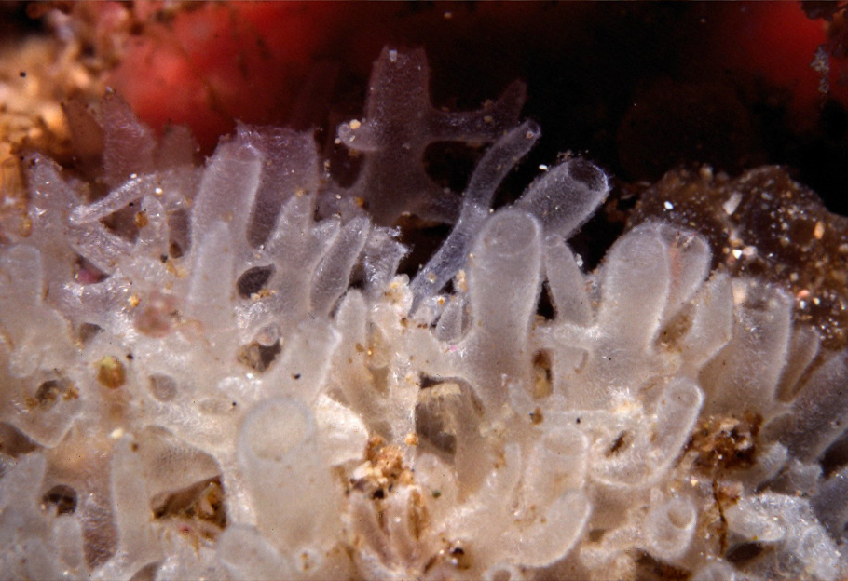
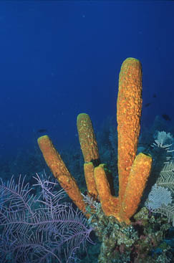

Slide 5
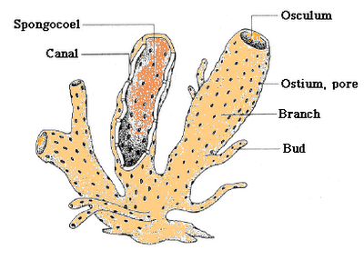
Syconoid
Synconoid sponges tend to be larger than Asconoids.
The Synconoid body wall is thicker.
Example: Sycon
Classification
Phylum: Porifera
Class : Calcarea
Order : Heterocoe
Genus : Sycon

Slide 6
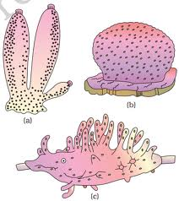
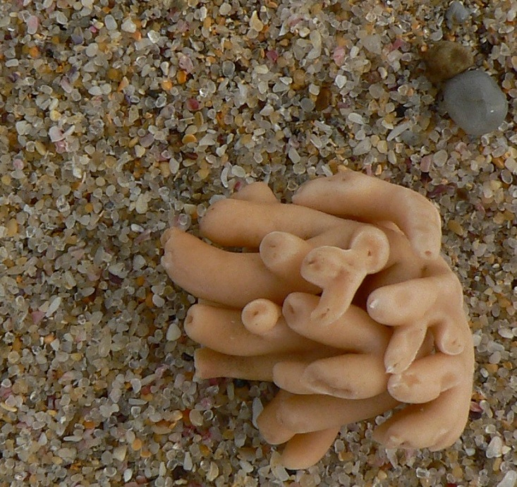

Slide 7
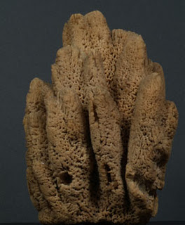
Leuconoid
These are the largest and most complex sponges.
Example: Euspongia
Classification
Phylum: Porifera
Class : Demosongia
Order : Keratosa
Genus : Euspongia
Euspongia is the common bath sponge.
It is a deep sea form and is found in the Mediterranean Sea.
It is like a cup and the skeleton is made of sponging fibres.

Slide 8
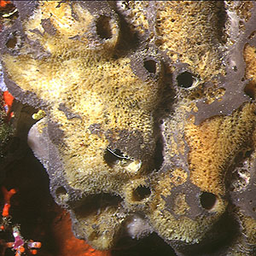

Slide 9
HYDRA
Classification:
Phylum: Coelentrata
Class : Hydrozoa
Order : Diploblastica
Genus : Hydra
Hydra can be white brown or green.
Hydra have a saclike body and a circle of tentacles at around the body opening.

Slide 10
This opening is used for both taking in food and eliminating wastes.
Hydra don't have eyes but they can sense light
They will also reproduce easily.
Hydra are carnivorous and will eat anything they can manage to catch including single celled animals, small crustaceans, worms, insects, and other tiny animals

Slide 11
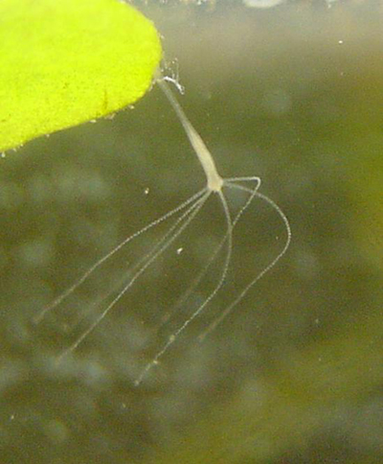
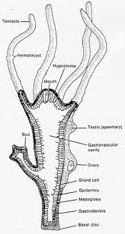
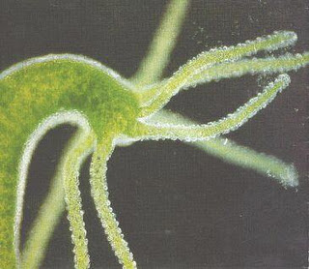
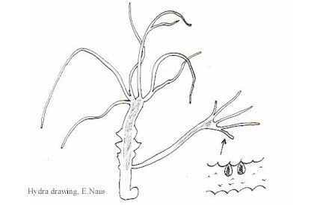

Slide 13
Fasciola

Slide 14
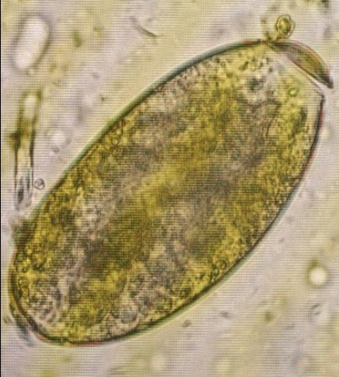
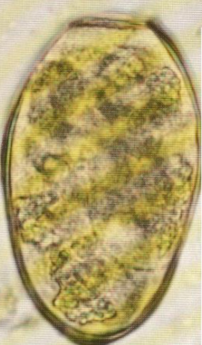
Fasciola eggs

Slide 15
Fasciola intermediate host
Lymnaea sp.

Slide 16
Cercaria of Fasciola

Slide 17
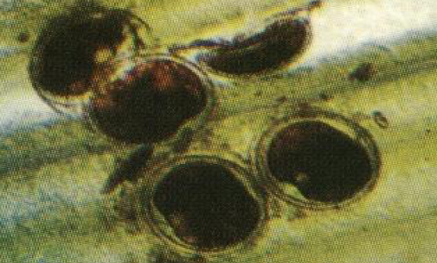
The infective stage of Fasciola
Encysted metacercaria

Slide 18
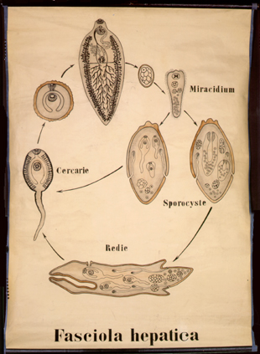
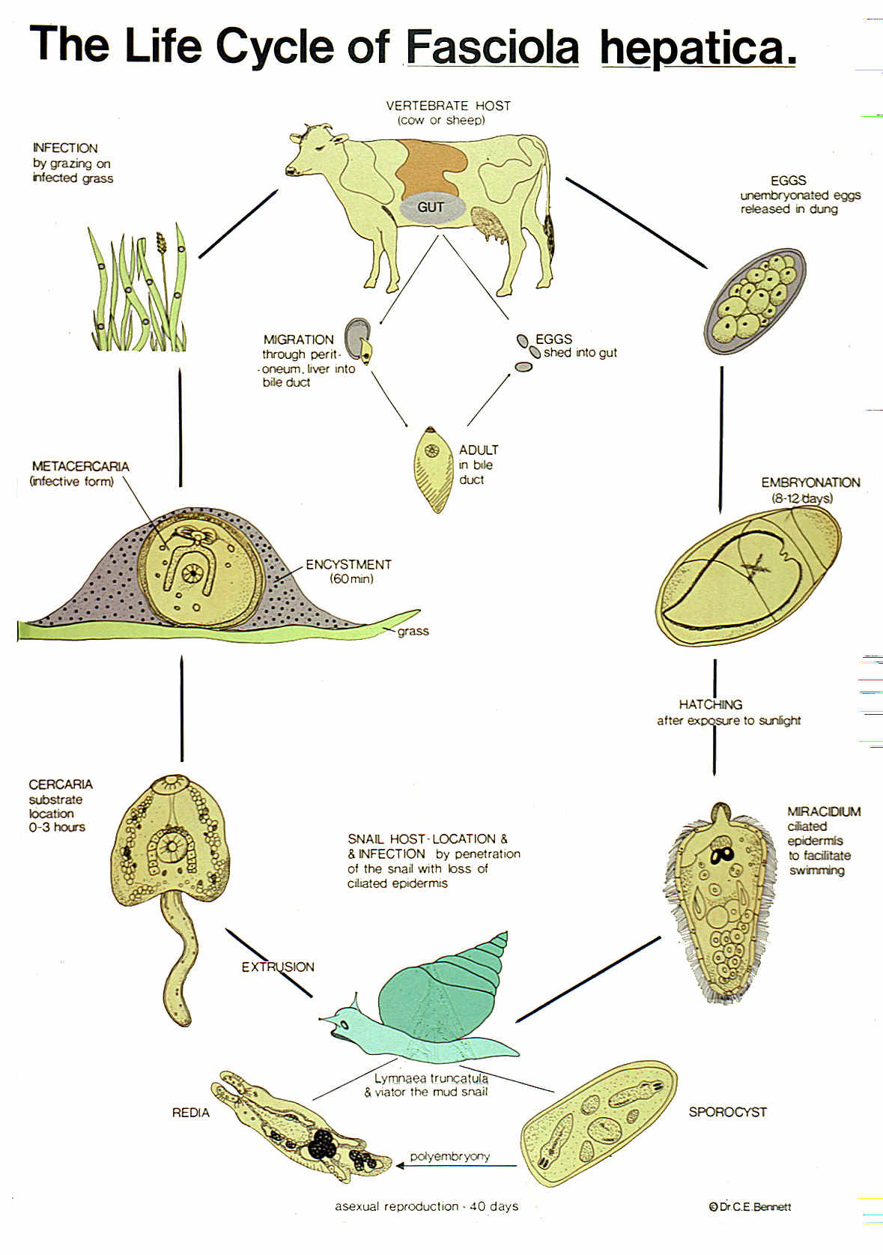
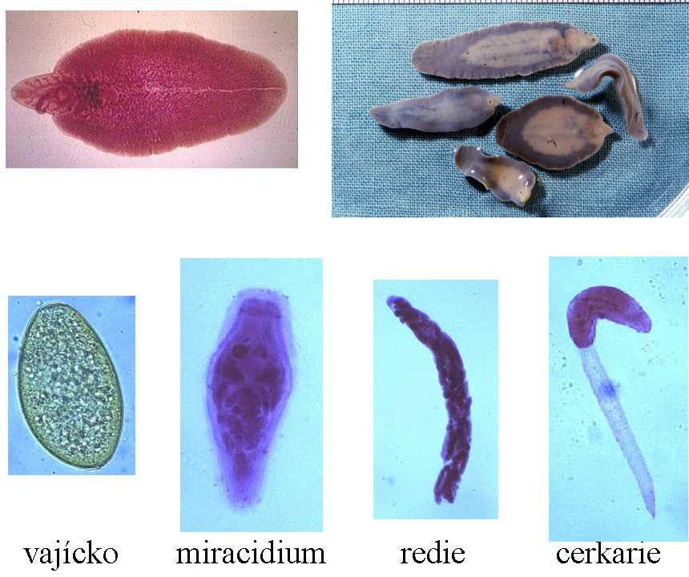
Fasciola

